Slide 1
Talk to Me, Baby!—
Early Language Support for Infants
Notes:
As training participants enter the room, have them complete and turn in the pre-assessment exercise. Scan the submitted assessments as they are turned in to provide yourself with an initial assessment of trainees’ starting knowledge and knowledge gaps, to assist you in anticipating potential upcoming questions and areas needing additional emphasis or examples.
Welcome to today’s training entitled “Talk to Me, Baby!” about Early Language Support for Infants.

Slide 2
Your Experience in the Infant Classroom
Notes:
Let’s get started today by talking about your experience in the infant classroom!
First let’s share with each other how long you’ve each been working in or with an infant classroom:
Ask each question, pausing after each question to give training participants time to answer–
For those of you who are Infant teachers,
How many of you are new to an infant classroom, working in one for less than a year?
How many of you have worked in an infant classroom for 1-3 years?
How many of you have worked in an infant classroom for 3-5 years?
How many of you have worked in an infant classroom for 5-10 years?
How many of you have worked in an infant classroom for more than 10 years?
[If there are any training participants who did not identify themselves in the first questions, please also ask the following questions:]
How many of you are Directors of a center with an Infant classroom?
And how many of you are floater teachers who may sometimes work in an Infant classroom?
Does anyone have any other role in Infant care?
And how many of you care for younger infants, who are primarily under 1 year old?
How many of you care for older infants, who are primarily between 12 and 18 months old?
Finally how many of you teach in a classroom with significant numbers of both younger and older infants?

Slide 3
Your Daily Routine in Your Infant Classroom
What words describe the infants in your classroom?
Notes:
Now let’s talk about your daily routine in your infant classroom—
Go to a flipchart or whiteboard—
Please share with me words that describe the infants in your classroom—their behavior, your care of them, and your classroom daily routine:
Capture the shared words on the flipchart/whiteboard. Make sure that everyone has the opportunity to share and that you have at least/approximately 20 words or phrases on the chart.
Now let’s make an acrostic poem out of your name and your experience providing care in an infant classroom—
You will use your first name as the inspiration for your acrostic, with a word or phrase stemming off each letter of your first name. That word or phrase for each letter of your name should start with that letter of you name and should describe what you enjoy about your work in the infant classroom.

Slide 4
A Sample Acrostic Poem:
Effie:
  E→ eager young minds
  F→ funny faces
  F→ family collaboration
  I→ interesting sounds
  E→ extraordinary love
Notes:
Prepare in advance an example of your own to share with the training participants and share it now—put it into this slide, in place of the example provided here—
For example, if your or a participant’s first name is “Effie,” the acrostic poem might look as follows:
E→ eager young minds
F→ funny faces
F→ family collaboration
I→ interesting sounds
E→ extraordinary love
Have 2-3 people share their names and their acrostic poem with the group.

Slide 5
Why This Learning Matters
Notes:
Let’s discuss first why early language is so very important in your care of infants—

Slide 6
Learning Objectives
  This training is designed to
  Review the Early Language Support dimension of the Infant CLASS® tool
  Identify what Early Language Support looks and sounds like at a high level in an Infant classroom
  Identify what materials can most effectively support Early Language in the Infant classroom
  Describe and apply practical strategies for implementing elements of teacher talk, communication support, and communication extension in the Infant classroom
  Introduce how these Early Language Support strategies in turn connect to Facilitated Exploration, Relational Climate, and Teacher Sensitivity in the Infant CLASS® tool
Notes:
This training is designed to
Review the Early Language Support dimension of the Infant CLASS® tool
Identify what Early Language Support looks and sounds like at a high level in an Infant classroom
Identify what materials can most effectively support Early Language in the Infant classroom
Describe and apply practical strategies for implementing elements of teacher talk, communication support, and
communication extension in the Infant classroom
Introduce how these Early Language Support strategies in turn connect to Facilitated Exploration, Relational
Climate, and Teacher Sensitivity in the Infant CLASS® tool
If relevant, point to/circle any words or phrases provided by the training participants that fairly obviously relate to the early language support concepts to be discussed in this training and note that this training will dig deeper into those experiences in their classrooms—

Slide 7
Why is language development so critical to our work in early childhood?
Language is the principal tool for establishing and maintaining relationships with adults and other children. (Epstein, 2007)
Teachers are very important in helping children develop a strong foundation in language. Teachers influence language development through the language they use, the way they set up the environment, and the types of experiences they provide. The opportunities children have for sociodramatic play and the level of that play affects children’s language development. Higher levels of play allow for increased language and more complex language structures. (Heisner, 2005)
Notes:
Why is language development so critical to our work in early childhood?
Language is the principal tool for establishing and maintaining relationships with adults and other children.
Teachers are very important in helping children develop a strong foundation in language. Teachers influence language development through the language they use, the way they set up the environment, and the types of experiences they provide. The opportunities children have for sociodramatic play and the level of that play affects children’s language development. Higher levels of play allow for increased language and more complex language structures.
How do you feel about these statements? Does any of this surprise or resonate with you?
Pause 2-3 minutes for group responses.

Slide 8
Why is language development so critical to our work in early childhood?
Early language skills form the basis for concept and literacy skills which in turn form the basis of lifelong learning in all areas.
Our language ability when entering school is a greater predictor of our overall long-term academic success than any other.
Our language ability is a predictor not only of our future academic success in that subject but across subject areas.
Language skills correlate to executive function skills as well.
Notes:
In addition,
Early language skills form the basis for concept and literacy skills which in turn form the basis of lifelong learning in all areas.
Our language ability when entering school is a greater predictor of our overall long-term academic success than any other.
Our language ability is a predictor not only of our future academic success in that subject but across subject areas.
Language skills correlate to executive function skills as well.
Executive function skills allow and enable us to plan, focus attention, remember instructions, and juggle multiple tasks successfully, and are critical for long-term life success.
***********************************************
References include the following:
Asano, Michiko, Mutsumi Imai, Sotaro Kita, Keiichi Kitajo, Hiroyuki Okada, & Guillaume Thierry (2015). Sound
symbolism scaffolds language development in preverbal infants. Cortex, 63: 196. Retrieved
from 10.1016/j.cortex.2014.08.025.
Barton, L.R., & H.E. Brophy-Herb (2006). Developmental Foundations for Language and Literacy from Birth to Three
Years. Learning to Read the World: Language and Literacy in the First Three Years, eds. S.E. Rosenkoetter & J.
Knapp-Philo, 15–60. Washington, DC: Zero to Three.
Perszyk, Danielle R. and Sandra R. Waxman (2016). Listening to the calls of the wild: The role of experience in
linking language and cognition in young infants. Cognition, 153: 175. Retrieved from
10.1016/j.cognition.2016.05.004.
Shonkoff, J.P. (2017). Breakthrough Impacts: What Science Tells Us About Supporting Early Childhood
Development. Young Children 72 (2): 8–16.
Sosa, Anna V. (2015). Association of the Type of Toy Used During Play With the Quantity and Quality of Parent-
Infant Communication. JAMA Pediatrics. Retrieved from 10.1001/jamapediatrics.2015.3753

Slide 9

Development of Neural Pathways
--Harvard University, Center on the Developing Child
Notes:
So we agree that supporting language development is very important in our work in early childhood…
But why is it equally, or even more important, to begin the work of early language support in our infant care specifically ?
90% of our brains develop by age 5. That development includes not only the size of our brains but also the architecture of our brains—the neural pathways, seen here in this image, that form the basis for how we connect and process information.
Our language development forms the foundation for our higher cognitive development.
Let’s take a look at another image representing brain development--

Slide 10
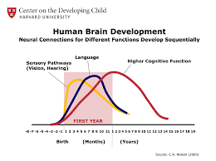
The Developing Brain
Notes:
Take a look at this diagram from Harvard University’s Center on the Developing Child. This diagram illustrates the development of those neural pathways we saw in the last slide.
The Language Development arc takes place in the middle of this diagram. At what age do you see that the development of those language neural connections peaks?
Pause for participants to review and answer—
Point out that, even though it continues after that and remains important after that, the peak takes place in the FIRST YEAR of life!
Too often in the past the most important component of infant care, in particular, has been viewed by many parents and other caregivers as rocking and “babysitting” to keep the infant safe from harm.
As we have just seen, however, language development begins at birth, and because many people do not realize this, many children do not receive the ongoing experiences that support the development of this critical foundation. We can change this together!!

Slide 11
Developmentally- Appropriate Language-Related Expectations for Infants
Notes:
So now that we know the importance of early language support for infants, let’s talk about developmentally-appropriate language-related expectations for infants.

Slide 12
Language Expectations for Infants
What are developmentally-appropriate language-related expectations
for infants (ages birth through 15 months)?
Notes:
At this point training participants will engage in a pair-and-share activity:
Please take a few minutes to reflect with a person next to you and share what you know to be developmentally-appropriate language expectations for infants—
Think of as many words, actions, and phrases that come to mind—
On the CLASS® tool, infants can be measured all the way up through 15 months, so remember that there could be a wide range of responses when you take into account a 6-week-old infant versus a 15-month-old infant.
Pause 2-3 minutes for training participants to reflect and talk together—prepare to use flip chart or whiteboard.
Now let’s share what words, actions, and phrases you came up with that are developmentally-appropriate language expectations for infants—
Take time to write down quickly all the answers called out by the pairs. Try to get at least 10 responses.
NOTE: This list is VERY important, as you will be referring back to it for most of the first half of the training.
We will refer back to this list as the we “check our knowledge” about two different tools we can use to ensure that our expectations are age-appropriate.

Slide 13
Developmentally-Appropriate Language Expectations for Infants
The Louisiana Birth to Five Early Learning & Development Standards (ELDS) state
“Children enter the world with the capacity to communicate. Before babies utter their first words, they are preparing to use language in many ways. As children grow and change, however, their communication needs change as well. Communicating with a preschooler is very different than communicating with a toddler or an infant. Infants and toddlers are learning the basics of communication and how important it is.”
Notes:
Poll participants to see who is familiar with the Louisiana Birth to Five Early Learning & Development Standards and to see who has completed training about the Standards.
Depending on the responses from the participants, you might say,
Remember that LouisianaBelieves.com is the website that centers and teachers can use to review the Louisiana Birth to Five Early Learning & Development Standards, also known as the Standards or ELDS, and access trainings as well as other information on Licensing regulations, Tier 1 curricula, CLASS®, and many other resources pertaining to early childhood and best practices.
The Louisiana Birth to Five Early Learning & Development Standards acknowledge that children enter the world with the capacity to communicate. That is seen when, for example, infants begin to cry when they are wet, hungry, etc., as a means to get their needs met. The Standards also acknowledge that as children grow and change, so do their communication needs.

Slide 14
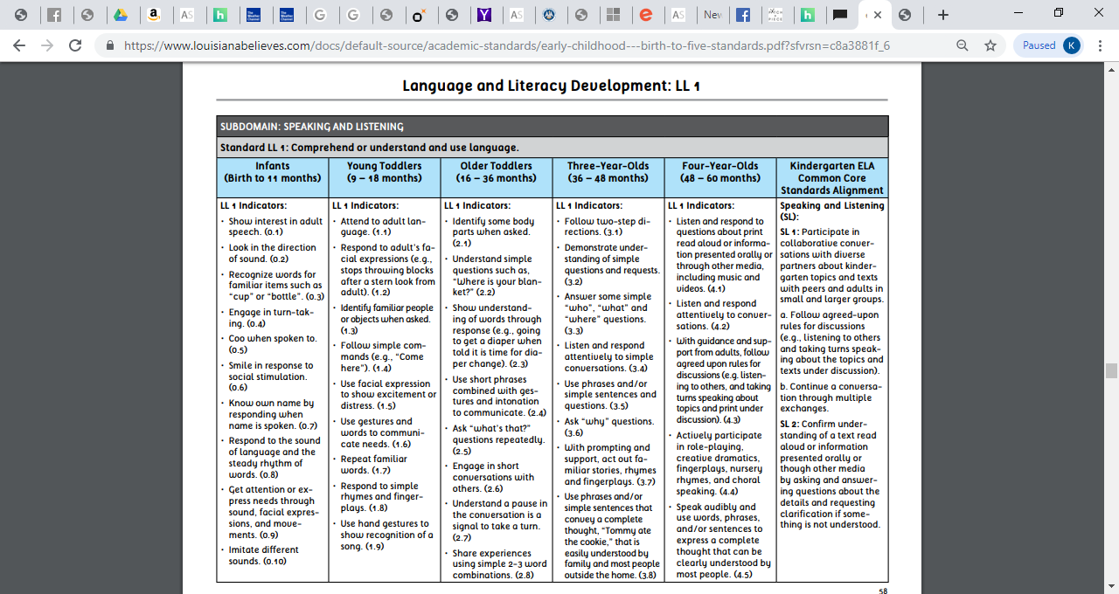
Louisiana’s Birth to Five Early Learning &
Development Standards (ELDS)
Notes:
Here is the overall standard across ages, but let’s zoom in on younger infants and older infants—

Slide 15
Louisiana’s Birth to Five Early Learning &
Development Standards (ELDS)
Infants (Birth to 11 months)
* Show interest in adult speech (0.1) * Respond to the sound of language and
* Look in the direction of sound (0.2) the steady rhythm of words (0.8)
* Recognize words for familiar items (0.3) * Get attention or express needs through
* Engage in turn-taking (0.4) sound, facial expressions, and
* Coo when spoken to (0.5) movements (0.9)
* Smile in response to social stimulation (0.6) * Imitate different sounds (0.10)
* Know own name by responding when name
is spoken (0.7)
Notes:
Depending on the responses listed from the participants’ pair-and-share activity about developmentally-appropriate expectations for infants, you might say,
Let’s look at how your responses match the ELDS “Language and Literacy Development Standard LL1—Comprehend or understand and use language”—found within the Subdomain “Speaking and Listening .”
Infants (Birth to 11 months)
Show interest in adult speech
Look in direction of sound
Recognize words for familiar items such as “cup” or “bottle”
Engage in turn-taking
Coo when spoken to
Smile in response to social stimulation
Know own name by responding when name is spoken
Respond to the sound of language and the steady rhythm of words
Get attention or express needs through sound, facial expressions, and movements
Imitate different sounds
Note how these may match responses from the pair-and-share activity. Consider marking the relevant participant responses with a symbol or color to show and highlight the younger infant expectations.
Next let’s look at expectations for older Infants, or “Young Toddlers”—
Notice some of the subtle differences between what the Standards classify as “infants” and “young toddlers” and how they overlap for a couple of months because infants progress at their own pace. Also notice how the expectations for older infants, classified in the Standards as “young toddlers,” build upon the developmental expectations of young infants.

Slide 16
Louisiana’s Birth to Five Early Learning &
Development Standards (ELDS)
Young Toddlers (9-18 months)
* Attend to adult language (1.1) * Repeat familiar words (1.7)
* Respond to adult’s facial expressions) (1.2) * Respond to simple rhymes and
* Identify familiar people or objects when fingerplays (1.8) asked (1.3) * Use hand gestures to show recognition
* Follow simple commands (1.4) of a song (1.9)
* Use facial expression to show excitement * Use 1-2 words to communicate so that or distress (1.5) communication is understood by
* Use gestures and words to communicate family and familiar adults most of
needs (1.6) the time (1.10)
Notes:
Young Toddlers (9-18 months)
Attend to adult language
Respond to adult’s facial expressions, such as stop throwing blocks after a stern look from an adult
Identify familiar people or objects when asked
Follow simple commands, such as “Come here”
Use facial expression to show excitement or distress
Use gestures to communicate needs
Repeat familiar words
Respond to simple rhymes and fingerplays
Use hand gestures to show recognition of song
Use one to two words to communicate, to ask questions or signal needs, so that the communication is understood by family and familiar adults most
of the time
Again note how these may match responses from the pair-and-share activity. Consider marking the relevant participant responses with a symbol or color to show and highlight the older infant expectations.
How do the expectations for older infants, classified in the Standards as “young toddlers,” build upon the developmental expectations of young infants?
Pause for responses. Responses may include the development of additional, more advanced facial expressions, gestures, and words; imitating words rather than just sounds; etc.

Slide 17
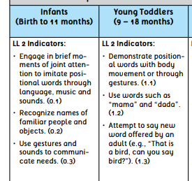
Louisiana’s Birth to Five Early Learning &
Development Standards (ELDS)
Language: Comprehend and use increasingly complex and varied vocabulary
Notes:
Again, depending on the responses charted from the participants pair-and-share activity, you might say,
Let’s look at how your responses match the ELDS “Language and Literacy Development Standard LL2: Comprehend and use increasingly complex and varied vocabulary.”
Infants (Birth to 11 months)
Engage in brief moments of joint attention to imitate positional words through language, music and sounds
Recognize names of familiar people and objects
Use gestures and sounds to communicate needs
Young Toddlers (9-18 months)
Demonstrate positional words with body movement or through gestures
Use words such as “mama” and “dada”
Attempt to say new word offered by an adult
Referring again to the charted responses submitted by the pair-and-share activity, you might say,
How have we done so far in matching up to the Louisiana Birth to Five Early Learning & Development Standards as they pertain to Language and Literacy for our infants? Depending on time, allow for a little discussion.
Depending on time, you may also poll participants on
Do you know of another tool used in centers that you could refer to for developmentally-appropriate language expectations for infants?

Slide 18
Teaching Strategies GOLD®
The TS GOLD® Language “Objectives for Development and Learning” are
Objective 8—Listens to and understands increasingly complex language
Objective 9—Uses language to express thoughts and needs
Objective 10—Uses appropriate conversational and other communication skills
Notes:
Another tool you could use to check developmentally-appropriate language expectations for infants are the Teaching Strategies GOLD® “Objectives for Development & Learning.”
Poll participants as to “Who is familiar with TS GOLD®?” “and “Who has actually completed observations on infants using this tool?”
Pause for responses.
Teaching Strategies GOLD®, or TS GOLD®, is an observation-based assessment tool used in Louisiana early childhood classrooms. It is a research-based tool that supports effective teaching through a process of “ongoing observational assessment for all areas of development and learning” and helping “teachers see children’s development and learning as a progression across the whole of the early childhood years.” The TS GOLD® tool is divided into areas of learning called “Objectives.”
TS GOLD® Language Objectives are:
8-Listens to and understands increasingly complex language
9-Uses language to express thoughts and needs
10-Uses appropriate conversational and other communication skills
Let’s take a look at each of these objectives to see how our list from the pair-and-share activity compares—

Slide 19
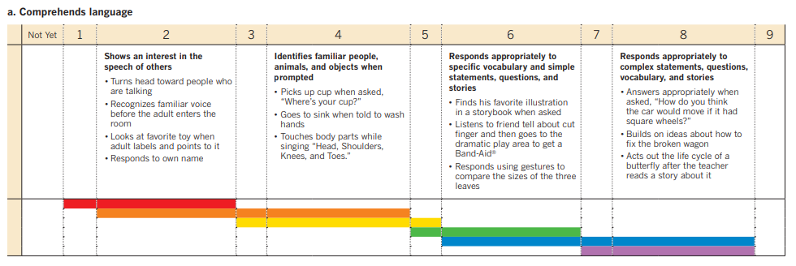
TS GOLD® Objective 8, Dimension a
Notes:
Depending on the responses by participants in the poll, you might say,
For those of you familiar with TS GOLD®, remember that the red color band you see here is for the infants under 1, and the orange color band is for 1-2 year olds, the yellow color band is for 2-3 year olds, and so on. See how the color bands for infants (red and some orange) overlap? This is because, as we know, children develop differently and at their own pace.
TS GOLD® Objectives 8, 9, and 10 deal with Language development.
Objective 8 is “Listens to and understands increasingly complex language.”
Let’s go through Dimension a of Objective 8, which is “Comprehends language,” to see how your charted responses match up for appropriate language expectations for infants.
Column 2, which shows the red and orange color bands, contains the Indicator “Shows an interest in the speech of others” and, more specifically,
Turns head toward people who are talking
Recognizes familiar voice before the adult enters the room
Looks at favorite toy when adult labels and points to it
Responds to own name
Does that match what we charted before for both younger and older infants?
Pause for some brief participant response, even if it is just head-nodding.
Column 4, which shows the orange and yellow color bands, contains the Indicator “Identifies familiar people, animals, and objects when prompted” and, more specifically
Picks up cup when asked, “Where’s your cup?”
Goes to sink when told to wash hands
Touches body parts while singing “Head, Shoulders, Knees, and Toes”
This column does not contain the red color band, so this would not be a developmentally-appropriate expectation for young infants, under age 1; rather, it shows that this would be a developmentally-appropriate expectation for some older infants and for toddlers, as the yellow color band represents ages 2-3.

Slide 20
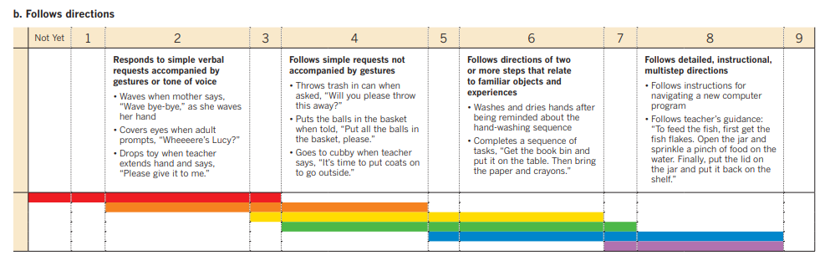
TS GOLD® Objective 8, Dimension b
Notes:
Next let’s go through Dimension b, “Follows directions,” of Objective 8, to see how your charted responses match up for appropriate language expectations for infants:
You see that the red band starts in the “Not Yet” column as it may not be developmentally-appropriate based on the infant’s age.
Column 2, which shows the red and orange color bands, contains the Indicator “Responds to simple verbal requests accompanied by gestures or tone of voice” and, more specifically, the examples
Waves when mother says, “Wave bye-bye,” as she waves her hand
Covers eyes when adult prompts, “Wheeeeere’s Lucy?”
Drops toy when teacher extends hand and says, “Please give it to me.”
Column 4, which shows the orange, yellow, and green color bands, contains the Indicator “Follows simple requests not accompanied by gestures” and, more specifically, the examples
Throws trash in can when asked, “Will you please throw this away?”
Puts the balls in the basket when told, “Put all the balls in the basket, please.”
Goes to cubby when teacher says, “It’s time to put coats on to go outside.”
This column does not contain the red color band, so this would not be a developmentally-appropriate expectation for young infants, under age 1; rather, it shows that this would be a developmentally-appropriate expectation for some older infants and for toddlers and some 3-year olds, as the yellow color band represents ages 2-3 and the green color band represents ages 3-4.

Slide 21
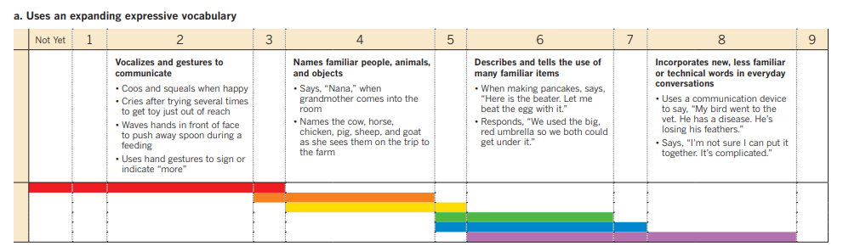
TS GOLD® Objective 9, Dimension a
Notes:
Objective 9 is “Uses language to express thoughts and needs.” Dimension a of Objective 9 is “Uses an expanding expressive vocabulary.”
Column 2, which shows the red color band, contains the Indicator “Vocalizes and gestures to communicate” and, more specifically, the examples of
Coos and squeals when happy
Cries after trying several times to get toy just out of reach
Waves hands in front of face to push away spoon during a feeding
Uses hand gestures to sign or indicate “more”
Point out how these expectations match the chart of developmentally-appropriate expectations, for younger infants—under age 1.
Because, as we have discussed, children develop at their own pace, sometimes children’s development does not fall within this color age bands—
For example, if an older infant, aged 12-15 months, is NOT showing that Indicator or those Behavioral Markers, that child is exhibiting a developmental delay and may need additional supports in and out of the classroom, in order to achieve that level of development.
Column 4, which shows the orange and yellow color bands, contains the Indicator “Names familiar people, animals, and objects” and, more specifically, the examples of
Says “Nana,” when grandmother comes into the room
Names the cow, horse, chicken, pig, sheep, and goat as she sees them on the trip to the farm
This column does not contain the red color band, so this would not be a developmentally-appropriate expectation for young infants, under age 1; rather, it shows that this would be a developmentally-appropriate expectation for some older infants and for toddlers, as the yellow color band represents ages 2-3.
At the same time, if a 9-11 month old infant said “Nana” when her grandmother entered the room, indicating that the infant is not merely babbling but recognizes her grandmother and that the infant knows who Nana is, that child would be developing, in that area of development, slightly ahead of the typical development for her peers.

Slide 22
Let’s Practice!
Now let’s practice matching
red color bands (for ages birth through 1) and
orange color bands (for ages 1 to 2 years old)
to the appropriate Indicators and examples of the
remaining TS GOLD® Language Objectives and their Dimensions—
Notes:
Now let’s practice matching
red color bands (for ages birth through 1) and
orange color bands (for ages 1 to 2 years old)
to the appropriate Indicators and examples of the
remaining TS GOLD® Language Objectives and their Dimensions—
Distribute the “TS GOLD® Objectives 9-10 Color Band” activity handout.
Ask participants to review 9b and its Indicators and examples. Then poll the group regarding which color band(s) are associated with the “Not Yet” column, column 2, and column 4. Then, after participants give their answer, pull up the next slide. If the group did not have the correct answer, explain why that color band is appropriate for that Indicator and examples.
Repeat for each successive Dimension. Use the Facilitator Notes for the remaining Objective and color band slides as you see fit—

Slide 23
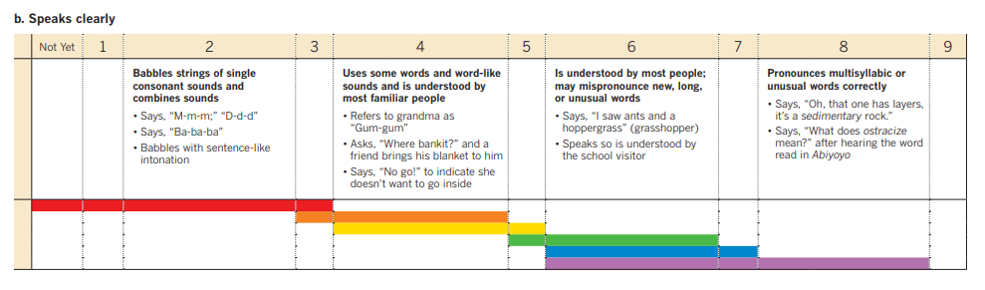
TS GOLD® Objective 9, Dimension b
Notes:
Dimension b of Objective 9 is “Speaks clearly.”
Again you see that the red color band starts in the “Not Yet” column, as it would not be developmentally-appropriate for our youngest infants to be expected to speak clearly.
Let’s see if any of these other Indicators match our list:
Column 2, which shows the red color band, contains the Indicator “Babbles strings of single consonant sounds and combines sounds” and, more specifically, the examples of
Says, “M-m-m,” “D-d-d”
Says, “Ba-ba-ba.”
Babbles with sentence-like intonation
Column 4, which shows the orange and yellow color bands, contains the Indicator “Uses some words and word-like sounds and is understood by most familiar people” and, more specifically, the examples of
Refers to grandma as “Gum-gum”
Asks, “Where bankit?” and a friend brings his blanket to him
Says, “No go!” to indicate she doesn’t want to go inside
As we have seen in the previous slides, this behavior in Column 4 is not developmentally-appropriate to expect of younger infants but might be expected of some older infants.

Slide 24
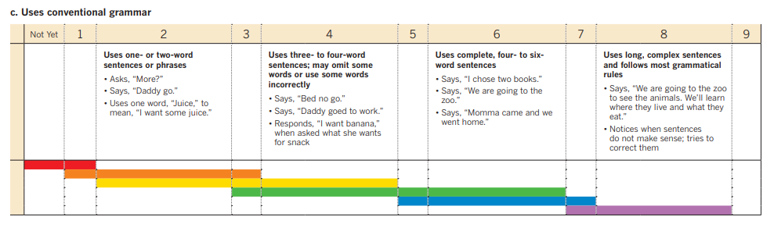
TS GOLD® Objective 9, Dimension c
Notes:
Dimension c of Objective 9 is “Uses conventional grammar.”
Again you see that the red color band not only starts but remains in the “Not Yet” column, as it would not be developmentally-appropriate for our youngest infants to be able to use conventional grammar. As you can see from the Behavioral Markers described in the column, this Objective is the starting point for sentence formation, so of course that is why young infants would fall under the “Not Yet” column.
Column 2, which shows the orange and yellow color bands, contains the Indicator “Uses one- or two- word sentences or phrases” and, more specifically, the examples of
Asks, “More?”
Says, “Daddy go.”
Uses one word, “Juice,” to mean, “I want some juice.”
Remember that the orange color band represents 1-2 year olds, which means that this behavior may be seen in some older infants, between ages 12-15 months; however, because Column 2 also shows the yellow color band, which represents 2-3 year olds, that means that it is developmentally-appropriate for children to develop this skill AFTER 15 months, when they are toddlers.

Slide 25
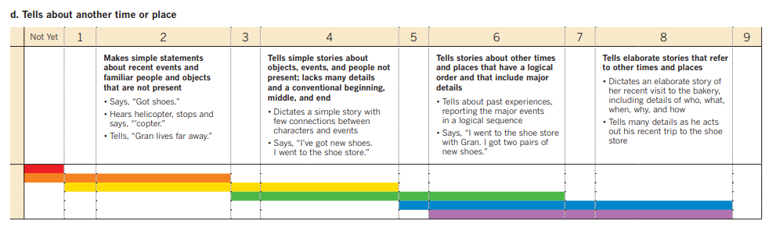
TS GOLD® Objective 9, Dimension d
Notes:
Dimension d of Objective 9 is “Tells about another time or place” and is very similar to Objective 9c, in that it describes simple statements that are not developmentally-appropriate to expect infants to do this and might not even be an objective that one year olds are able to accomplish yet either.
Column 2, with the Indicator, “Makes simple statements about recent events, and familiar people and objects that are not present,” is when a child, for example,
Says, “Got shoes.”
Hears helicopter stops and says, “copter.”
Tells, “Gran lives far away.”
Again, it may or may not be possible for older infants and children ages 1-2 years old to reach this milestone, as children develop differently and at their own pace.

Slide 26
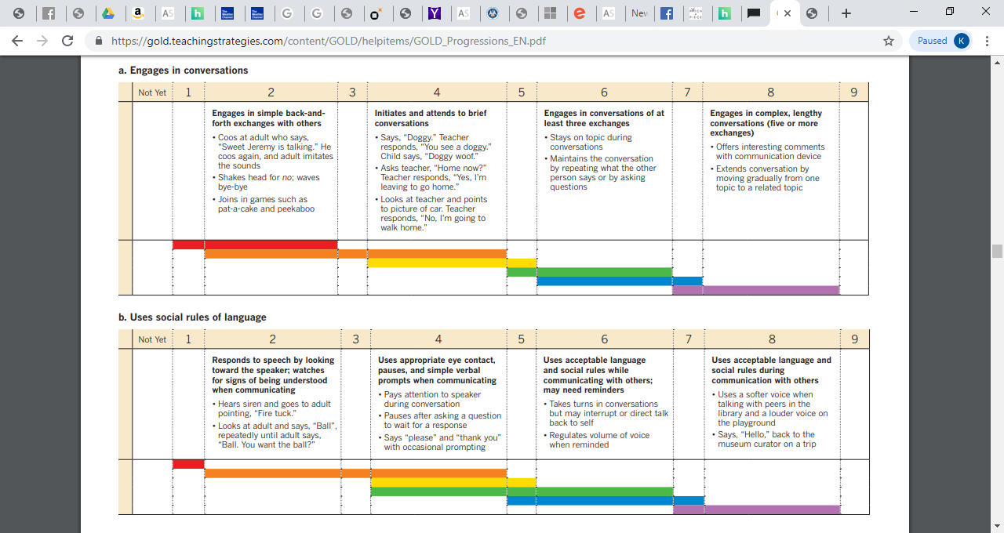
TS GOLD® Objective 10, Dimension a
Notes:
Our last TS GOLD® objective is 10, “Uses appropriate conversational and other communication skills.”
Dimension a of Objective 10 is “Engages in conversations.”
Column 2 has the Indicator, “Engages in simple back-and-forth exchanges with others” and, more specifically, the examples of
Coos at adult who says, “Sweet Jeremy is talking.” He coos again, and adult imitates the sounds.
Shakes head for no; waves bye-bye
Joins in games such as pat-a-cake and peekaboo
Column 4 has the Indicator, “Initiates and attends to brief conversations” and, more specifically, the examples of
Says, “Doggy.” Teacher responds, “You see a doggy.” Child says, “Doggy woof.”
Asks teacher, “Home now?” Teacher responds, “Yes, I’m leaving to go home.”
Looks at teacher and points to picture of car. Teacher responds, “No, I’m going to walk home.”
At what ages might we expect to see these behaviors, and how do you know?
Pause for training participants to explain about the red and orange color bands.

Slide 27
TS GOLD® Objective 10, Dimension b
Notes:
The final dimension we will review together today is 10b, “Uses social rules of language.”
Column 2 has the Indicator “Responds to speech by looking toward speaker; watches for signs of being understood when communicating” and, more specifically, the examples of
Hears siren and goes to adult pointing, “Fire truck.”
Looks at adult and says, “Ball”, repeatedly until adult says, “Ball. You want the ball?”
It has the orange color band, so it may be behavior that may be seen in some older infant/toddlers.

Slide 28
Check Your Knowledge
How do you think we did?
Did our list of developmentally-appropriate language expectations for infants match up well to the
Louisiana Birth to Five Early Learning & Development Standards (ELDS) and
Teaching Strategies GOLD® “Objectives for Development & Learning”?
Notes:
Poll the group with the following questions, allowing a little time for discussion if time permits:
Well, how did we do?
After going through the Louisiana Birth to Five Early Learning & Development Standards and Teaching Strategies GOLD® “Objectives for Development & Learning,” as they each pertain to developmentally-appropriate language expectations for infants, where were we on target?
Is there anything that surprised you?
Distribute the “TS GOLD® Objectives 8-10 Color Band” takeaway handout either now or at the conclusion of the training, so that participants have it for follow-up review after leaving the training.

Slide 29
Introduction to the Infant CLASS® Tool: Early Language Support
Notes:
Now that we have reviewed and established what are developmentally appropriate language-related expectations for infants, we are going to change gears a little and begin to talk about the Infant CLASS® tool, specifically the Early Language Support portion of that tool. This information will help you understand developmentally-appropriate ways to support the early language development of the infants in your care.

Slide 30
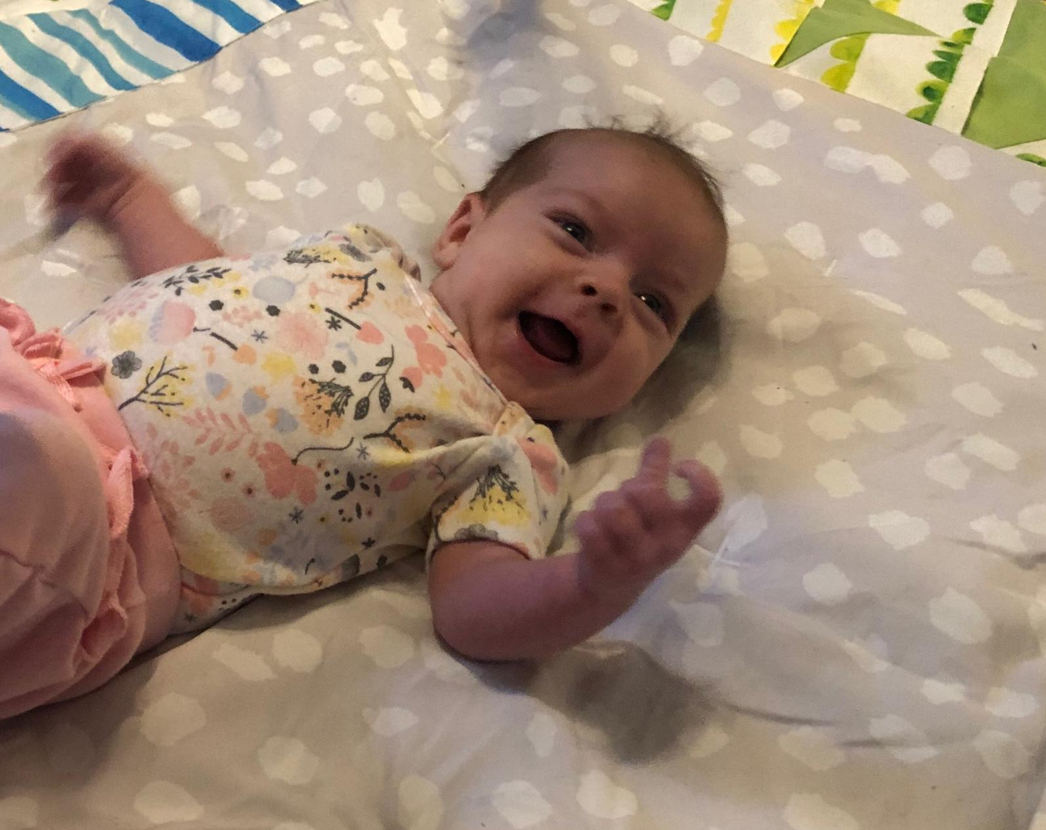
Infant CLASS® Tool
Domain: The Responsive Caregiver
Dimensions: Relational Climate
Teacher Sensitivity
Facilitated Exploration
Early Language Support
Notes:
Poll group: How many of you are familiar with Toddler or Pre-K CLASS®?
Infant CLASS® is similar, in that it is, like Toddler and Pre-K CLASS®, divided into levels called “Domains” and “Dimensions.” While Pre-K has 3 domains and Toddler has 2 domains, Infant CLASS® has just 1 domain, divided into 4 dimensions.
And, like the other CLASS® tools, many of these areas overlap.

Slide 31
Dimension: Early Language Support
Indicators:
  Teacher Talk
  Communication Support
  Communication Extension
Notes:
The Early Language Support Dimension “captures the amount and effectiveness of teachers’ use of language-stimulation and language-facilitation techniques to encourage infants’ early language development.”
The Early Language Support Dimension is divided further, into “Indicators”—these are “Teacher Talk,” “Communication Support,” and “Communication Extension.” When your interactions within your classroom are being observed, the observer is looking at the Dimension level, but then even more specifically at the Indicator level.
Under each Indicator is a series of “Behavioral Markers.” An observer looks for instances of these Behavioral Markers and the frequency of them when observing a classroom.
Let’s dive deeper into these 3 Infant Early Language Support Indicators, looking at the definitions for the Indicators, including the Behavioral Markers for each--

Slide 32
Early Language Support: Teacher Talk
Behavioral markers:
  Self-talk
  Describe classroom events
  Verbally label objects
  Use complete and varied sentences
Notes:
The Indicator “Teacher Talk” “reflects the consistency with which teachers provide language in the classroom.”
This means that in the infant classroom you should
“describe [your] own and infants’ actions during activities and routines [throughout the whole day]
comment on events happening in the classroom
[and use] language…[that] includes descriptive and variable words, spoken in complete sentences.”
Teacher talk is broken down into 4“Behavioral Markers”: self-talk, describe classroom events, verbally label objects, and use complete and varied sentences.
Self-talk means talking about yourself through the day, mapping all your actions during free play activities and during routines, and providing words for your actions. This should look the same for both younger and older infants.
Describing classroom events means describing all classroom events, such as people entering or leaving room, a child waking up from nap, a child talking or crying because he or she is hungry or he or she dropped a pacifier—again providing words for actions taking place in the room. This should look the same for both younger and older infants.
Verbally labeling objects means using descriptive and specific words to label all objects in the room or items infants are playing with. When working with older infants, add in labelling regarding colors, shapes, numbers, etc.
Using complete and varied sentences means talking to the children in complete sentences, asking them questions, carrying on conversations with them as part of your interactions. This should look the same for both younger and older infants—
Why shouldn’t we use “baby talk” with younger Infants…why should we use complete sentences even with younger infants?
Pause for responses—point out the importance of teaching consistent, proper language structure.

Slide 33

Early Language Support: Teacher Talk
Examples of “self-talk” and “labeling” opportunities:
Every time you
Go to change a child
Wipe a child’s nose
Pick up a child
Give a child a toy to play with
State what you are doing as you begin and while you are doing it.
Notes:
Examples of self-talk and labeling opportunities actually occur every time you go to do something—
For example, every time you go to change a child or wipe a child’s nose, you can describe what you are doing, such as saying, “Alright, Maggie, I am coming to get you for a diaper change” or “I need to wipe your nose, Will.”
As you move to pick up a child you can explain “I am picking you up to give you a bottle.”
When you give a child a toy to play with, you can label that toy, for example saying, “Here is a ball for you to play with.”
Note that you should state what you are doing as you begin and while you are doing it.
Also note that in those examples I just shared I used complete and varied sentences, to help children begin hearing and getting comfortable with the structure of language communication—
For example, instead of merely saying “wipe, wipe!” I said, “I need to wipe your nose, Will.”

Slide 34
Early Language Support: Teacher Talk
Examples of “describing classroom events” opportunities
(“parallel talk”):
There is a change in what is happening in the classroom environment
Someone enters the classroom, either in the morning at drop-off or mid-day
Someone wakes up from a nap
Someone is playing with a toy or making other sounds
Someone gets picked up in afternoon
Notes:
Another behavioral marker under Teacher Talk is “describing classroom events,” which is similar to parallel talk in Toddler and Pre-K CLASS®.
Here are some opportunities to embed describing classroom events throughout your day--
Whenever there is a change in what is happening in the classroom environment, such as by saying, “It is time to turn our lights out for nap.”
Whenever someone enters the classroom, either in the morning at drop-off or mid-day, such as by saying, “Look, Isaac is here today…hi, Isaac.”
Whenever someone wakes up from a nap, such as by saying, “Kennedy is waking up from nap; I see you Kennedy.”
Whenever someone is playing with a toy or making other sounds, such as by saying, “I hear Jamie shaking the rattle.”
Whenever someone gets picked up in the afternoon, such as by saying, “Here is Dominic’s mom; it is time for him to go home today.”

Slide 35
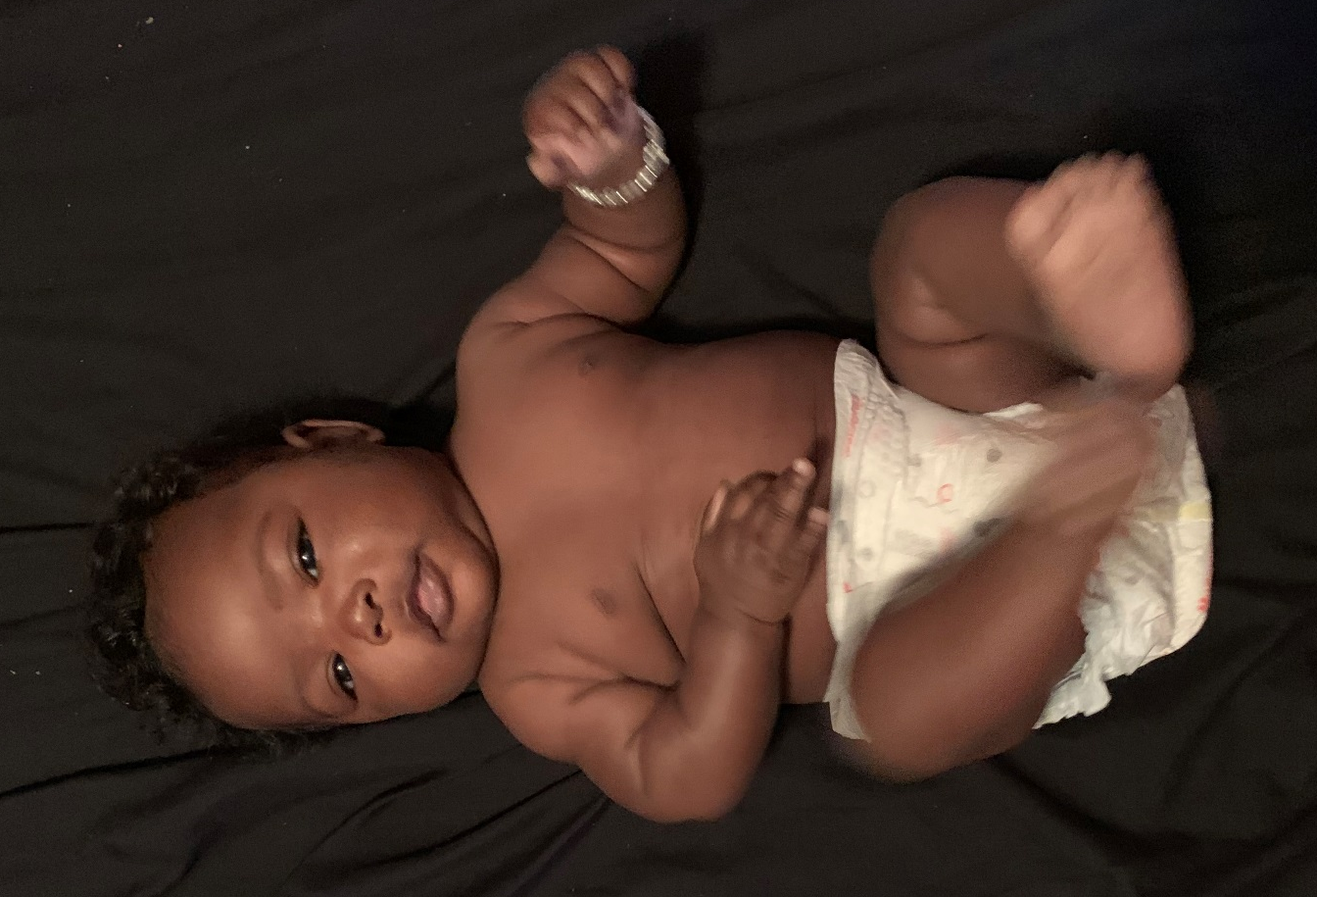
Let’s Practice!
Teacher talk while diapering/changing an infant
Remember that Teacher talk means
describing the teacher’s and infants’ actions
describing classroom events
verbally labeling objects and
using complete and varied sentences
First let’s practice Teacher talk while
diapering/changing an infant—
Notes:
Let’s practice how you can provide Early Language Support in routines such as diapering and feeding times—
One of the best times to practice and focus on Teacher talk is when you are changing a child.
Let’s give this a try with one of our baby props!
Remember that Teacher talk means self-talk (or describing your own and the infants’ actions), describing classroom events, verbally labeling objects, and using complete and varied sentences.
Activity options:
Depending on time and comfort level of training participants, this activity could be completed in whole group, in small groups, or could first be practiced in small groups and then shared out in whole group.
Have some training participants practice Teacher talk during diapering, with some participants practicing with an infant 6 weeks-9 months old and others practicing with an infant 9-15 months old. Have other training participants describe the effective examples they saw of self-talk, describing classroom events, verbally labeling objects, and using complete and varied sentences in the volunteers’ demonstrations.
If activity is done in small group:
As trainer you can walk around while participants work in small group and you can give feedback to small groups as they practice. Otherwise or in addition you can silently observe and note and then share with whole group best practices observed from the training participants. After, if time allows and if participants are comfortable, some could model their practice before the whole group.
If activity is done in whole group:
Is anyone willing to volunteer to come up here and model Teacher talk for us with diapering?
After the demonstration, have other training participants and yourself share other examples of how a teacher might exhibit Teacher talk during diapering.

Slide 36
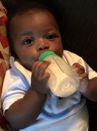
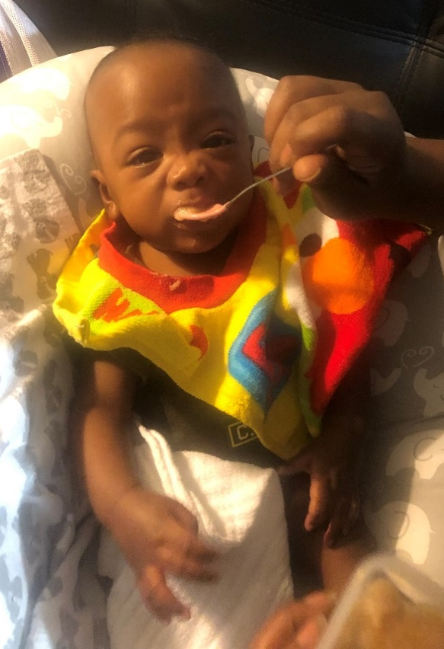
Let’s Practice!
Teacher talk while feeding an infant
Remember that Teacher talk means
describing the teacher’s and infants’ actions
describing classroom events
verbally labeling objects and
using complete and varied sentences
Next let’s practice Teacher talk while
feeding two infant age groups—
Notes:
Next let’s practice Teacher talk while feeding an infant.
Activity options:
Depending on time and comfort level of training participants, this activity could be completed in whole group, in small groups, or could first be practiced in small groups and then shared out in whole group.
Have some training participants practice Teacher talk during feeding, with some participants practicing with an infant 6 weeks-9 months old and others practicing with an infant 9-15 months old. Have other training participants describe the effective examples they saw of self-talk, describing classroom events, verbally labeling objects, and using complete and varied sentences in the volunteers’ demonstrations.
If activity is done in small group:
As trainer you can walk around while participants work in small group and you can give feedback to small groups as they practice. Otherwise or in addition you can silently observe and note and then share with whole group best practices observed from the training participants. After, if time allows and if participants are comfortable, some could model their practice before the whole group.
If activity is done in whole group:
Is anyone willing to volunteer to come up here and model Teacher talk for us with feeding?
After the demonstration, have other training participants and yourself share other examples of how a teacher might exhibit Teacher talk during feeding.

Slide 37
Early Language Support: Communication Support
Behavioral markers:
  Initiate sounds or words
  Imitate or repeat sounds
Notes:
We have practiced how we can provide Early Language Support through Teacher talk—
Now let’s learn about another Indicator under the Dimension “Early Language Support,” called “Communication Support.”
Communication support “captures teachers’ initiation and/or repetition of sounds in direct interactions with infants.” This means that in the infant classroom you should
“encourage infants to verbalize by initiating sounds and words with [the] infants
[and] imitate[e] sounds expressed by infants.”
Communication support is important because it encourages infants to talk—
This Indicator is measured by 2 Behavioral Markers: “initiate sounds or words” and “imitate or repeat sounds.”
This is where you make sounds, sound out words, and repeat sounds a baby says in back-and-forth exchanges.
From birth, babies begin to develop two sets of communication skills: receptive skills and expressive skills. Just like other ages, they learn by watching and listening to adults around them and then trying to imitate them.
Your Communication Support of your infants will help them develop both their receptive and their expressive skills.

Slide 38
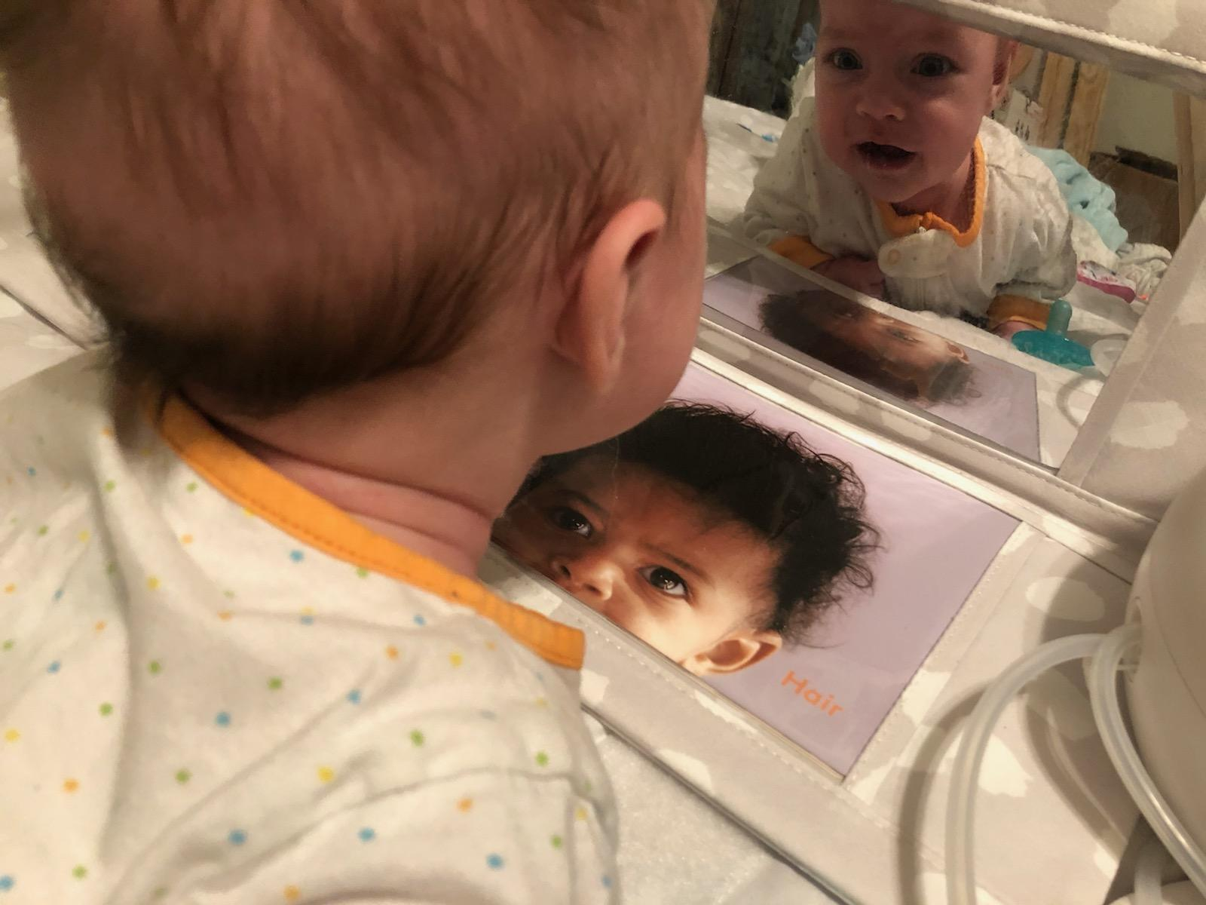
Early Language Support: Communication Support
Examples of opportunities to
“initiate sounds or words”:
  Making sounds
  Sounding out words
Notes:
Here are some examples of opportunities for initiating sounds or words—
A great way to do this is with mirrors. How many of you have mirrors in your classroom?
Presenter models with mirrors—shows mouth shape/formation.
For younger infants—make simpler sounds, such as
Ooooo
Bbbbbbbb
Older infants can make more complex sounds like
Tongue clicking/clacking
The sound of a motor, such as of a vehicle
By doing this initiating with your Infants, simple sounds can develop into words as a child progresses to the next stage.
For example, “bbb” can turn into “baby,” “bbb…bottle,” “bbb…ball,” “ddd…daddy,” “mmm…mama.”
You can also initiate sounds or words with infants in response to the infants’ vocalizations: for example, you can say “oooh!” after an infant squeals with excitement.
What else can you do or have seen done, to make sounds or initiate and sound out simple words?
Pause 2 minutes for training participants to share.

Slide 39
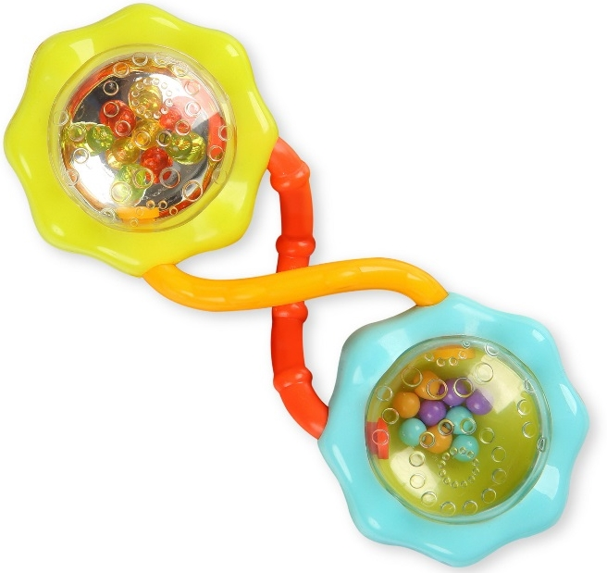
Early Language Support: Communication Support
Examples of opportunities to “imitate or repeat sounds”:
  Repeat sounds a baby says
  in back-and-forth exchanges
  Practice imitation and repetition of sounds with
  back-and-forth exchanges with a rattle
Notes:
Here are some examples of ways to imitate or repeat sounds during activities or routines:
You can repeat the sounds a baby is making by simply saying it: like “uh, uh, uh.”
You can also indicate to an infant that you are repeating the sounds he is making through a back-and-forth exchange.
A great way to work on imitation/repetition through back-and-forth exchange is with a rattle. You shake the rattle, and then you let the baby shake the rattle.
Presenter models using the rattle, shaking and pausing—creating rhythms.
Imitating and repeating those rattle sounds helps infants learning to imitate and repeat language sounds, too.
Furthermore, in addition to Communication Support, this activity also gives you the opportunity to “label” action, saying something like, “Shake it!”, thereby linking action with communication.

Slide 40
Early Language Support: Communication Extension
Behavioral markers:
  Provide words for infants’ communication
  Expand and extend on infants’ communication
  Model turn-taking
Notes:
The third and final Indicator under the Dimension Early Language Support is “Communication Extension.”
Communication extension “encompasses teachers’ efforts to extend communication attempts by adding words to actions and sounds and modeling turn-taking.” This means that in the infant classroom you should
“extend infants’ communication attempts by adding words to actions and sounds…
engage in back-and-forth verbal exchanges with infants….
[and] us[e] pauses and eye contact to encourage turn taking.”
This Indicator is divided into 3 Behavioral Markers: “Provide words for infant communication,” “expand and extend on infants’ communication,” and “model turn-taking.”
As you can see from those Behavioral Markers, “communication support” and “communication extension” especially overlap into each other.
Here are some examples of providing words for infants’ communication:
When an infant is making a noise when they see you warming up a bottle, you can acknowledge the infant’s communication by saying, “I see you are hungry; I am warming up your bottle.”
When an infant yawns after being wrapped in a blanket, you can say, “Does your blanket make you sleepy?”
When an infant sneezes, you can say, “Bless you! That was a big sneeze!”
Now, let’s take a deeper dive into expanding and extending on infants’ communication and modeling turn-taking—

Slide 41

Early Language Support: Communication Extension
Expanding and extending on communication
Notes:
“Expanding and extending on communication” is where teachers can begin to link babble or sounds like “ba ba” to words like “bottle” or “ball.”
For example: when a baby says “ba ba” and is looking towards their bottle, the teacher can say, “You want your bottle; are you hungry?” or “Yes, that is your bottle! Are you ready to drink your bottle?” thereby linking sounds to intention.
What are some other sounds or partial words that you can think of that babies typically make that you could expand or extend on, to advance their language development?
Pause 2-3 minutes for responses…some example might include the following:
Ma ma, da da, ball, drink, bye-bye, more, diaper

Slide 42
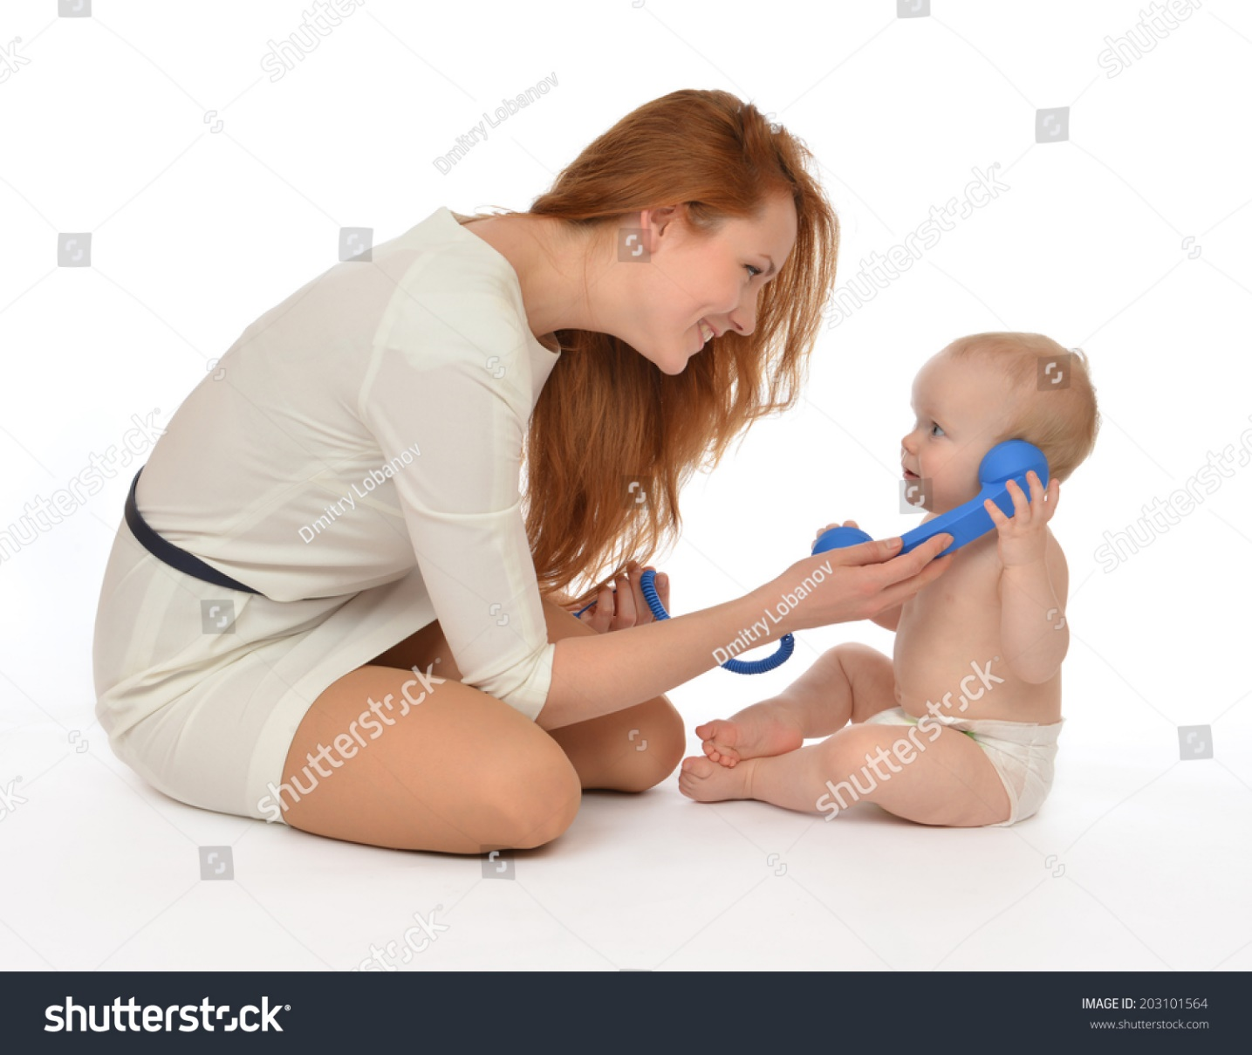
Early Language Support: Communication Extension
Modeling turn-taking
Notes:
[use Shutterstock 203101564]
Modeling turn-taking is when teachers engage in back-and-forth verbal exchanges with infants, using pauses and eye contact to encourage turn-taking.
A great way to model turn-taking is by using a play phone.
Hold the phone up to your ear and speak, and then hold the phone up to the baby and speak for the baby. Model a conversation with the baby, using the phone, moving it back-and-forth.
Can you think of any additional activities in which you can model turn-taking?
Pause for responses. Answers might include turn taking with looking in mirrors, holding play babies, rolling balls, stacking blocks, blowing bubbles, or more…including, of course, turn-taking with making noises or sounds.
What does turn-taking help babies learn and do?
Pause for responses.
Back-and-forth exchanges that are critical to conversational skills and future classroom learning skills.
Back-and-forth exchanges teach vital social skills as well—such as pausing, showing the courtesy of giving others a chance to talk, and listening to others.
Model simpler conversations with your youngest infants. Your older infants are likely to be able to respond with sounds or talk (babble) when you put the phone up to them as well as to respond with facial and other cues to your conversation.

Slide 43
Early Language Support: Communication Extension
Examples of opportunities to “model turn-taking”:
  Repeat sounds a baby says
  in back-and-forth exchanges
  Practice imitation and repetition of sounds with
  back-and-forth exchanges with a rattle
Notes:
You can also use a rattle for Teacher Talk and Communication Extension—
Playing with a rattle is also a good way to model turn-taking: you can hold and shake the rattle and then give the rattle to the baby and help the baby shake the rattle, moving the rattle back-and-forth.
Pauses in shaking, when the infant and teacher listen, can not only help model conversational “turn-taking” patterns but also develop an infant’s listening skills and concentration skills.
With younger infants, you may likely have to assist with the pauses and taking turns of the rattle-shaking, whereas older infants are more likely cognitively to be able to take their turn with verbal directions.
Playing with a rattle also gives you the opportunity to “label” action, saying something like, “Shake it!”, thereby linking action with communication.

Slide 44
What Early Language Support Looks and Sounds Like
Notes:
Let’s next take a look at some examples of opportunities for early language support and analyze them together--

Slide 45
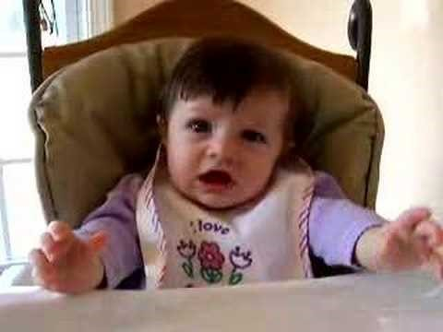
What does Early Language Support Look and Sound Like?
Notes:
[Video link found at https://youtu.be/kGwrxzwJdRA]
Let’s take a look together at an example of a baby’s early language efforts:
Watch video together.
Take a moment to write down what you have observed in the video—
Pause for 1-2 minutes.
Tell me some examples of what you early language efforts you see from the baby:
Answers might include the infant babbling, saying “na” and “da” sounds, looking at the camera and smiling and pausing. Point out examples that training participants don’t mention.
Is the caregiver providing Early Language Support?
Listen to participants’ answers—if they say yes, ask them what they see that you have been learning about. If participants do not make mention of it, note that the infant looks like she is waiting for someone to talk back to her, but no one responds, repeats, or encourages talking.
What could been done differently by the caregiver, to encourage Early Language Support?
Allow participants 3-5 minutes to share answers, and add in additional answers, depending on what the participants suggest. For example, the teacher/caregiver could
Repeat back, when the infant pauses, the sounds that the infant is saying--“na” and “ba"...”Na na na, ba ba ba”
Expand on “na” and “ba” by saying, “Oh, are you saying ‘bottle,’ do you want your bottle?”
Encourage the infant to make additional and different sounds—for example, “ma,” “da”—”can you say MaMa, or DaDa?”
Start to have a back-and-forth conversation with the infant. When the infant is pausing and smiling at the camera it would be a perfect opportunity for the teacher/caregiver to have that back-and-forth conversation with her.
For example, “Oh, are you saying ‘ba-ba’ because you are ready to eat, are you hungry?”
Then the caregiver could pause, and after the infant responds the caregiver could speak again, saying, “Yes, I know you are hungry; I have you in your highchair.”
Then the caregiver could pause, and after the infant responds the caregiver could speak again, saying, “I am fixing your lunch.”
Practice self-talk, talking to the infant about what the teacher/caregiver is doing, to keep the infant engaged and keeps “conversation” ongoing between the two.

Slide 46

What does Early Language Support Look and Sound Like?
Notes:
That last video was an example of a low level of Early Language Support from the caregiver.
We want to provide a high level of Early Language Support to the infants in our care.
Let’s take a look at another example of a caregiver with an infant and assess whether this is a higher level of Early Language Support--
[Video link found at https://www.youtube.com/watch?v=eZclOL7vIQQ and is 3:12 minutes, showing a 2 month old baby cooing, smiling, turn-taking, and eye contact.]
Watch video together.
Take a moment to write down what you have observed in the video—
Pause for 1-2 minutes.
Does this caregiver provide Early Language Support?
Listen to participants’ answers and ask them to explain how what they saw links back to what they have been learning about in this training--
Answers might include the following; add in additional answers, depending on what the participants suggest:
Examples of teacher talk are seen when the mom provides language to the infant when the infant is smiling, by saying, “Hi, Smiley!” and “Where’s my happy baby?” The caregiver is verbally describing the infant’s actions and using complete and varied sentences. Teacher talk is again seen when the baby seems to cough, and the mom responds back “Uh-oh.”
Examples of communication support are observed as the caregiver initiates sounds and encourages the infant to talk by asking and saying, “What is it?” “Talk to mama,” “Say uh-oh!”
The caregiver also imitates and repeats sounds expressed by the infant, such as when the baby says, “Ah-yah” and the caregiver repeats back that sound.
We also see communication extension in this video, specifically in the behavior indicators of the caregiver providing words for the infant's communication and expanding/extending on the infant's communication. We see this, for example, when the caregiver sees the infant smiling and responds by saying, “Hi, smiley” and “Where’s my happy baby?” Several times the caregiver also follows the infant’s gaze and asks, “What is it?” Again, towards the end of the video clip the baby is making a scowl of sorts, and the caregiver again asks, “What is it?
*(Remember that especially in non-verbal infants, facial expressions are a primary form of communication.)
Model turn-taking is seen throughout this video: each time the baby makes a sound the caregiver responds; moreover, frequently the caregiver says something and pauses, waiting for the infant to respond either verbally or by expression.

Slide 47

What does Early Language Support Look and Sound Like?
Notes:
Let’s take a look at another example of a caregiver with an infant and assess whether the level of Early Language Support--
[Video link found at https://www.youtube.com/watch?v=yQK15XlSUvg and is 1:40 minutes, showing turn-taking]
Watch video together.
Take a moment to write down what you have observed in the video—
Pause for 1-2 minutes.
This video is a great example of what as it pertains to Early Language Support?
Listen to participants’ answers and ask them to explain how what they saw links back to what they have been learning about in this training--
Answers might include the following; add in additional answers, depending on what the participants suggest:
Teacher talk: The caregiver engages in self-talk, verbally labeling whose turn and using complete and varied sentences.
Communication support: The caregiver initiates sounds, imitates and repeats sounds, and encourages talking.
This clip especially shows communication extension: The caregiver models turn-taking as the mom keeps going back-and-forth saying and pointing, “Mommy’s turn” and “your turn,” as they each take turns blowing raspberries.
*Remember at this stage it is natural for a baby to blow raspberries as they are developing muscles in their mouths that they will need for future language development. It is not spitting! It is actually an important, needed step to future language development.

Slide 48
Materials that Support Early Language Development
Notes:
Let’s talk next about the kinds of materials that you can use in your infant classroom to support the infants’ early language development!

Slide 49
Materials to Support Early Language Development
Mirrors Soft Blocks
Balls Rattles
Play Phones Books
Bubbles Music
Puppets Pictures
Notes:
The good news is that there are SO many materials that support early language development!
These include mirrors, soft blocks, balls, rattles, play phones, books, bubbles, music, puppets, and pictures.
Let’s look at how you can use each type of material to support specific learning concepts—

Slide 50
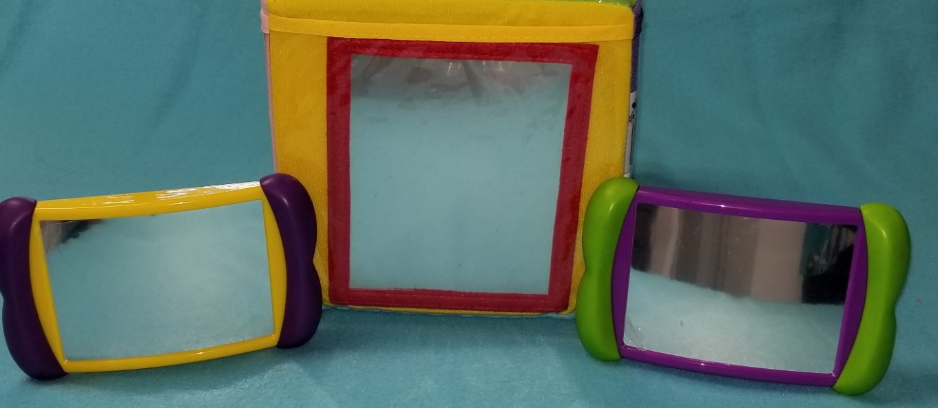

Materials to Support Early Language Development:
Mirrors
Support "Communication support" by initiating sounds and demonstrating sound formation with mirrors
Support "Teacher talk" by mapping words to actions, labeling objects, and using descriptive and specific words…use this chance to help develop infants’ vocabulary!
Support “Communication extension” by providing words for infants’ communication, expanding and extending on infants’ communication, and modeling turn-taking
Notes:
Let's start with mirrors—mirrors are a great way to help infants learn!
How many of you have mirrors in your classroom?
Pause to allow participants to respond verbally.
How do you engage with those mirrors, and facilitate the children in your care engaging with those mirrors?
Pause to allow participants to respond verbally.
You can support "Communication support" by initiating sounds and demontrating sound formation with mirrors.
Model with a mirror to demonstrate how to show infants mouth shape/formation.
For younger infants—make simpler sounds, such as, "Ooooo" and "Bbbbbbbb."
Older infants can make more complex sounds like tongue clicking or clacking and the sound of a motor of a vehicle.
Model the sound and model how a teacher would do this with a mirror with an infant.
By doing this initiation of sounds with your Infants, simple sounds can develop into words as a child progresses to the next stage.
For example, bbb can turn into baby…bbb, bottle…bbb, ball…ddd, daddy…, mmm, mama.
What else can you do or have seen done, to make sounds or initiate and sound out simple words?
Spend 2-3 minutes in class discussion.
You can also support "Teacher talk" by mapping words to actions, labeling objects, and using descriptive and specific words.
For example, talk about things that the infant sees when she or he looks in the mirror: "That is your face! How many ears do you see? You have two ears, and your ears help you to hear, like you hear me talk to you now. What else do we see in this mirror?"
You can support "Communication extension" by providing words for infants' communication, expanding and extending on infants' communication, and modeling turn-taking.
For example, you can model turn-taking by asking, "What do you see?" pausing and then saying, "That's right, you see a baby! Who is that baby?" pausing and then saying, "That's you!" You can provide words for infants' communication if an infant answers, "B, b, b...," responding, "that's a baby!" You can expand and extend on infants' communication by adding words to actions and sounds, such as adding, "That baby is smiling and talking!"
Mirrors also provide a great way to help infants explore!
As we have mentioned previously, the domain of Early Language Support frequently overlaps with the other Infant CLASS® domains. For example, you can provide what Infant CLASS® calls "Facilitated Exploration" with mirror play. The infant may even reach out to touch the "baby" in the mirror, and over time the infants will learn that they are seeing their own face and start to recognize their reflection.
[Please include Shutterstock https://www.shutterstock.com/image-photo/moscow-russia-june-06-2017-family-765907276]

Slide 51
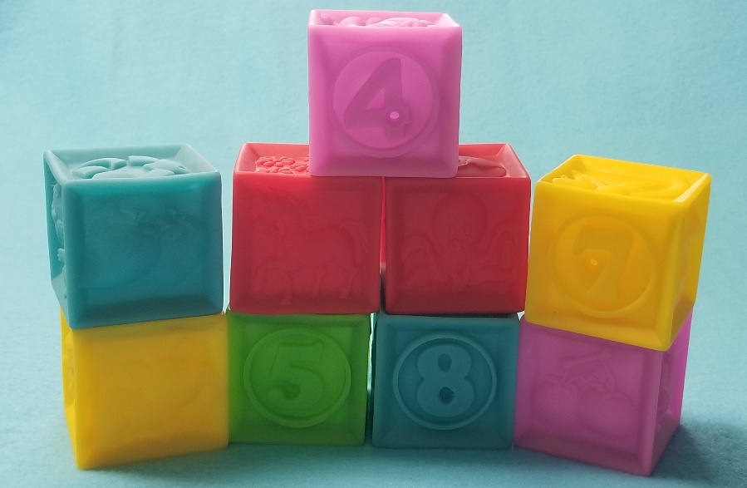
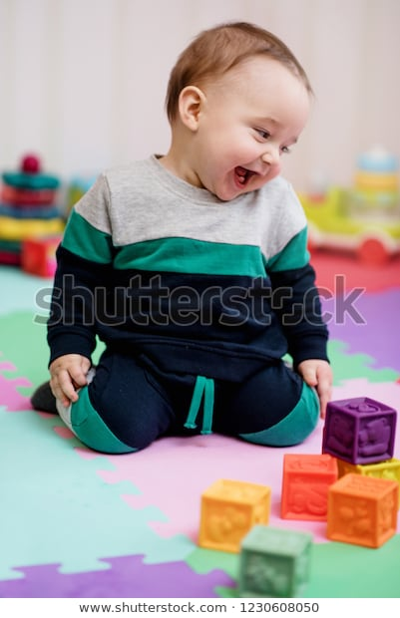
Materials to Support Early Language Development:
Soft Blocks
Soft blocks feature assorted colors, shapes, textures, and images…so with them you can support
Teacher talk because you can describe classroom events and label objects
Communication support because you can initiate sounds or words
Communication extension because you can provide words, extend communication, and model turn-taking
Notes:
Let's talk next about soft blocks--
Soft blocks feature many assorted colors, shapes, textures, and images.
Consequently, soft blocks, particularly those with pictures or textures on them, allow you opportunities for Teacher talk by “describing classroom events.” For example, you might support Early Language Development with soft block play by saying, “Oh, you’re stacking them; oh, they fell down.” Soft blocks that have pictures on them also provide you an opportunity, as the infant looks at or handles the block, to label objects. For example, you can label the image present on the block, "Look at the cow!" "That's a number—that's the number 1," "This block is blue, like your shirt."
Soft blocks also provide opportunities for Communication support because you can initiate sounds or words.
What sounds might you initiate with soft blocks like those pictured here?
Pause for responses. Sounds and words include b, b, b, block itself as well as the numbers or images on the blocks.
Soft blocks also provide opportunities for Communication extension, because you can provide words for infants' communication, expand and extend communication, and model turn-taking.
How might you add words to an infants' actions or sounds with a soft block?
Pause for responses. Responses might include, “Do you like the dog? I see you pointing at it!” or, when hearing an infant say, “d, d, da,” replying “dog” and pointing to the picture.
How might you model turn-taking with soft blocks?
Pause for responses. Responses might include taking turns pointing at blocks, grabbing or stacking blocks, or taking turns saying what is on the blocks.
[Please include Shutterstock https://www.shutterstock.com/image-photo/smiling-baby-girl-playing-blocks-lying-27090109]

Slide 52
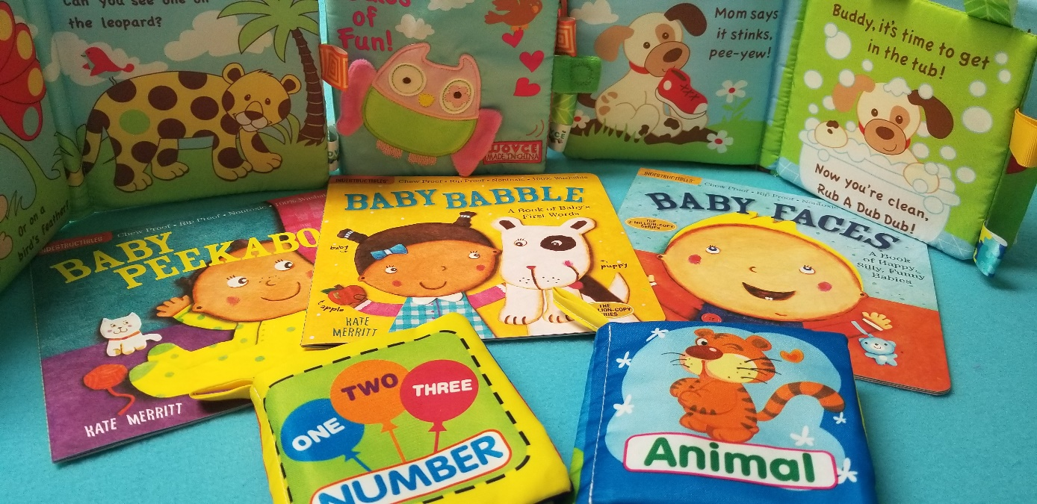
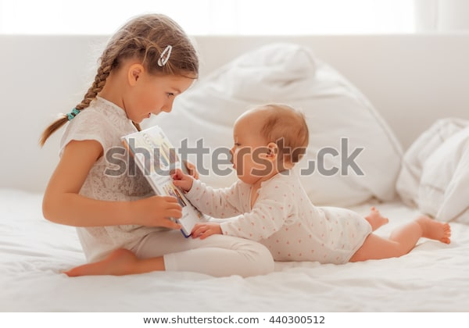
Materials to Support Early Language Development:
Books
Hearing words helps to build a rich network of words in an infant's brain--
Use books for
Verbally labeling objects Using complete and varied sentences
Initiating or imitating sounds and words Modeling turn-taking
Extending communication
Notes:
Of course books are a strong source of Early Language Support!
You can “verbally label objects” as you refer to pictures, and books with textures or things to touch also allow you to “describe classroom events” or “self-talk” as you as you model touching the book.
Reading a book allows you the opportunity to use complete and varied sentences with infants.
You can initiate sounds or words for the pictures in the book, or the texture of the book, you are reading together; books also provide you the opportunity to imitate or repeat the sounds the infant may make while looking at or touching the book with you.
And of course you can engage in back-and-forth verbal exchanges with infants as you read together, as you ask the infant questions about the story and about how it connects to their lives, using pauses and eye contact to encourage turn-taking.
Perhaps the most important reason to read aloud and gesture with books is that it makes a connection between the things an infant loves most—your voice and closeness to you—and books. Enjoying time spent with books can lay a strong foundation for later print literacy.
[Please add Shutterstock https://www.shutterstock.com/image-photo/sister-explaining-reading-baby-bed-book-440300512]

Slide 53

Materials to Support Early Language Development:
Bubbles
Use bubbles for
Verbally labeling objects
Describing classroom events
Initiating sounds and words
Extending communication
Notes:
Did you realize that bubbles are a great way to support early language development?
Playing with bubbles provides an opportunity for labeling, such as saying, “Oh, look at the bubbles!"
Play with bubbles provides an opportunity to describe events, such as saying, "Pop!”
You can initiate sounds or words and help children initiate or repeat sounds, by saying, “p, p, p, pop” or “b, b, b, bubbles.”
You can extend on communication by asking questions such as, “Where did it go? Did it pop?”
[Please include Shutterstock https://www.shutterstock.com/image-photo/childhood-babyhood-people-concept-happy-little-581026642]

Slide 54
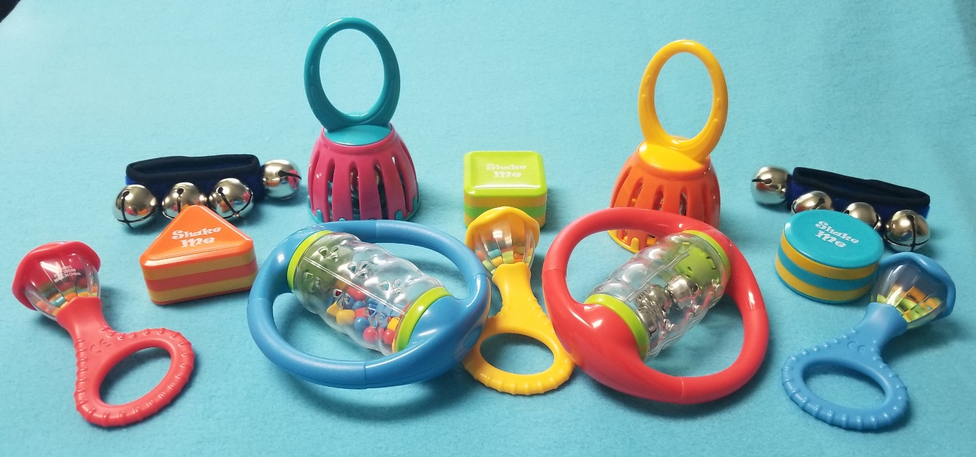
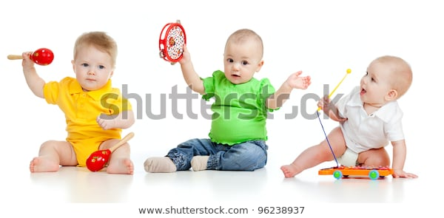
Materials to Support Early Language Development:
Music
Notes:
Music is beneficial for learning in many ways--
For example, playing music to an infant can activate the neural pathways responsible for many types of skill development.
Even as young as three months old we humans begin using music to help us remember things we have learned--
That also makes musical instruments and other forms of music a great medium to use to support early language development--
For example, when singing with children, you can encourage them to make sounds in the song, such as the animal sounds in “Old MacDonald” or the sounds in “Baby Shark.”
[Please add Shutterstock https://www.shutterstock.com/image-photo/children-playing-musical-toys-isolated-on-96238937]

Slide 55

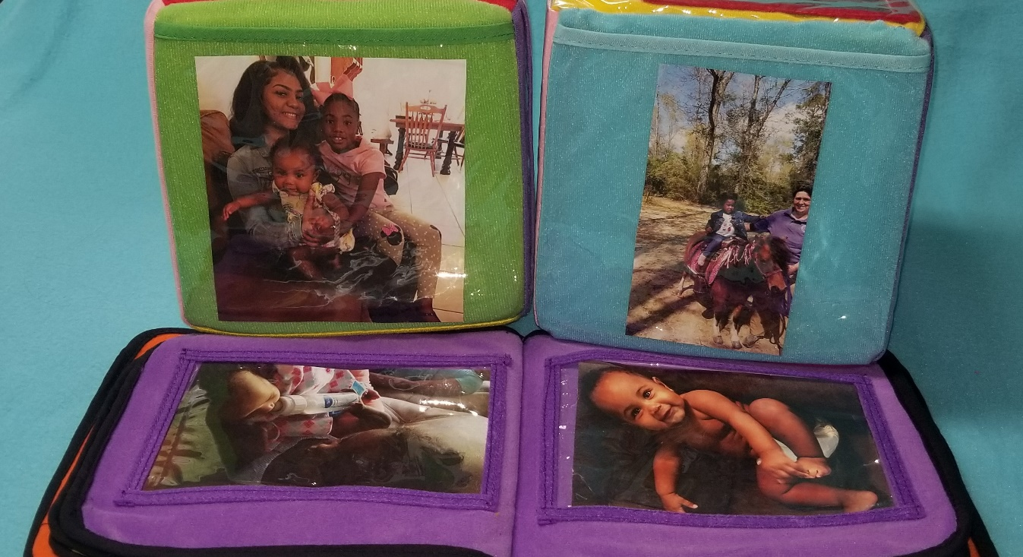
Materials to Support Early Language Development:
Pictures
Notes:
Pictures of infants’ families, especially, gives you the opportunity to label their Mama, Nana, Sister, etc. as well as to identify the infants themselves by their own names.
Place pictures along the bottom of classroom walls or on the floor, in real-life picture books or in picture cubes.
[Please include Shutterstock https://www.shutterstock.com/image-photo/cute-smiling-baby-girl-looking-photo-354923867]

Slide 56
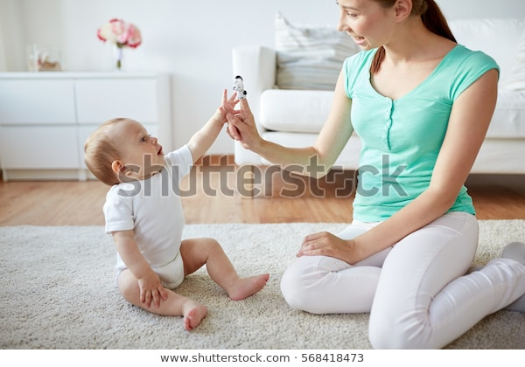
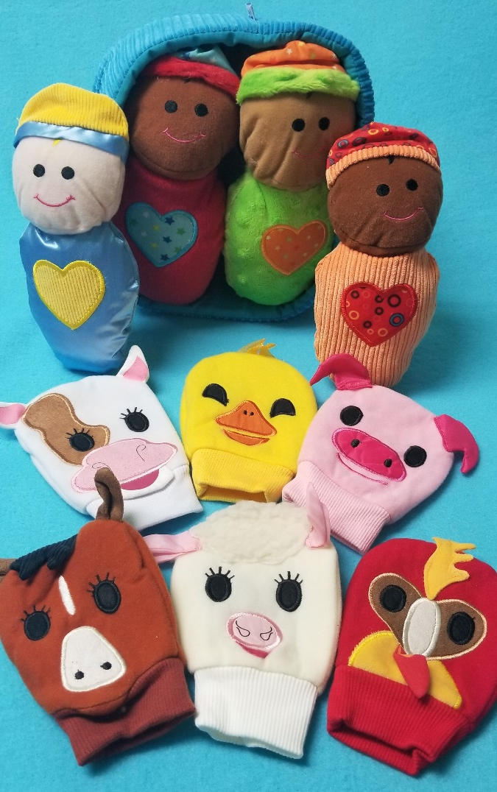
Materials to Support Early Language Development:
Puppets & Baby Dolls
Notes:
Play with puppets or baby dolls helps you model turn-taking, especially, as you take turns talking with the puppet or having the puppet talk to the infant. You can even use the puppets or doll to read or sing a song and to practice the words in the story or song.
[Please insert Shutterstock https://www.shutterstock.com/image-photo/family-children-parenthood-concept-happy-smiling-568418473]

Slide 57
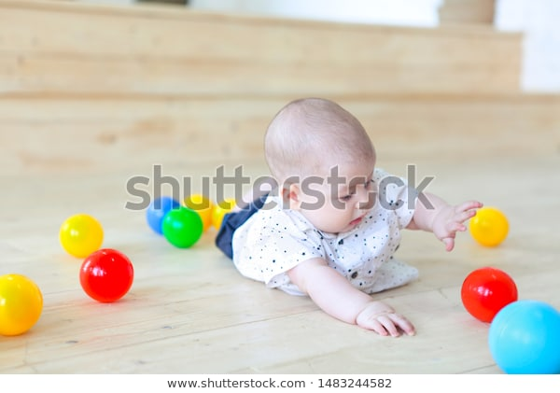
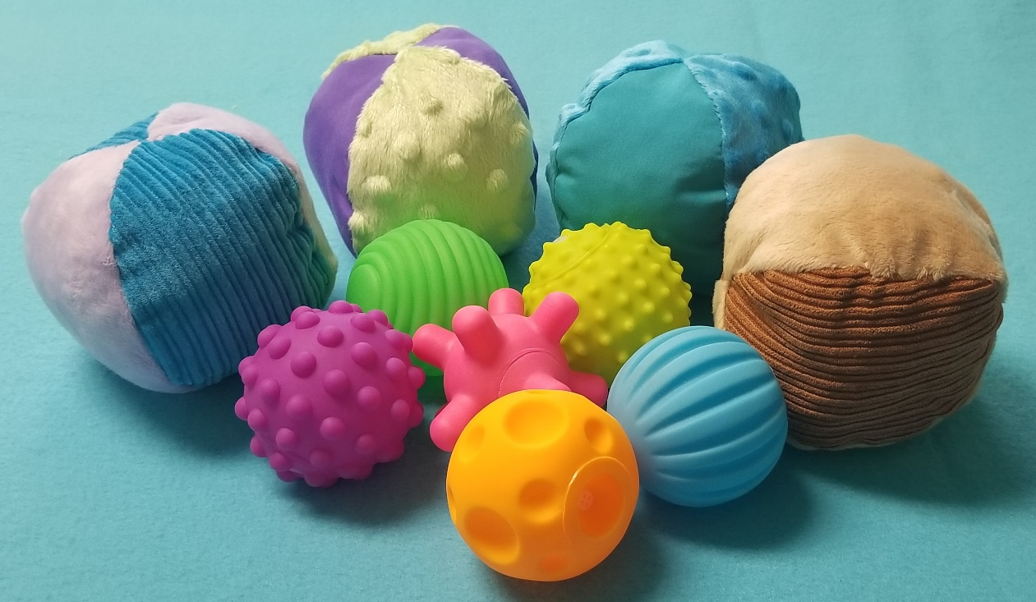
Materials to Support Early Language Development:
Balls
Notes:
With balls, you can practice rolling the balls back and forth with the infants—
[Please include Shutterstock https://www.shutterstock.com/image-photo/baby-boy-playing-balls-colorful-toys-1483244582]

Slide 58
Let's Practice!
Teacher talk, Communication support, & Communication extension
Practice using the material to support early language development assigned to your group:
Practice using the material for self-talk, to describe classroom events, to verbally label objects, and to use complete and varied sentences.
Practice using the item to initiate sounds or words.
Practice using the item to provide words for infants' communication, to expand and extend on infants' communication, and to model turn-taking.
Notes:
Now let’s practice what we’ve just been discussing!
Divide the training participants into pairs or small groups of 3-5 (depending on the size of the group). Give one group some musical instruments or song materials, one group picture materials, one group puppets or baby dolls, and one group balls. [All materials should be infant-appropriate.]
I have given each group an item that can be used to support early language development. Let’s take a few moments for each group to
Practice using the assigned material for self-talk, to describe classroom events, to verbally label objects, and to use complete and varied sentences
Practice using the item to initiate sounds or words and
Practice using the item to provide words for infants’ communication, to expand and extend on infants’ communication, and to model turn-taking
Give groups 5-7 minutes to practice.
Now let’s come back together and give each other some examples of how we could use these materials effectively to provide Early Language Support!
Which group wants to demonstrate using their material for self-talk, specifically?
Pick one volunteer group and allow them 1-2 minutes to demonstrate. Let other participants ask questions and/or provide additional examples of self-talk that might be done with that material.
Which group wants to demonstrate using their material to initiate sounds or words?
Pick one different volunteer group and allow them 1-2 minutes to demonstrate. Let other participants ask questions and/or provide additional examples of self-talk that might be done with that material.
And which group wants to demonstrate using their material to provide words for infants’ communication, to expand and extend on infants’ communication, and/or to model turn-taking?
Pick one volunteer group and allow them 1-2 minutes to demonstrate. Let other participants ask questions and/or provide additional examples of self-talk that might be done with that material.

Slide 59
How Early Language Support links to Other Infant CLASS® Dimensions
Notes:
As we mentioned earlier in this training session, effective Early Language Support will also support your success in the other three dimensions of the Infant CLASS® tool: those dimensions are called Relational Climate, Teacher Sensitivity, and Facilitated Exploration.

Slide 60
Relational Climate
Relational behaviors
Emotion expression
Respect for infants’ state
Lack of adult negativity
Notes:
Let’s take a look at the Relational Climate dimension of the Infant CLASS® tool—
Relational Climate is comprised of 4 Behavioral Markers:
Relational behaviors, which mean proximity (or physical closeness), eye contact (and being on the same eye level), joint (or sharing) attention, and providing affection and contact
Emotion expression, which means frequent smiling, laughing, and enthusiasm by both the teacher and returned by the infant
Respect for infants’ state, which means calm voice; gentle approach (and touch when moving or holding infants); consistent communication of intentions, transitions, or changes; and respectful language (including referring to infants using their names)
Lack of adult negativity, which means lack of irritation/frustration, lack of verbal harshness, lack of rough handling, and lack of negative comments
How does “Respect for infants’ state” connect with what we have learned about Early Language Support earlier?
Pause for responses.
When demonstrating “Respect for infants’ state” you communicate your intentions, transitions, and changes…which is also an example of what we have learned is Self-talk.

Slide 61
Teacher Sensitivity
Awareness and cue detection
Responsiveness
Infant comfort
Notes:
Let’s next take a look at the Teacher Sensitivity dimension of the Infant CLASS® tool—
Teacher Sensitivity is comprised of 3 Behavioral Markers:
Awareness and cue detection, which means that the teacher regularly visually scans the room; attends to the children physically by consistently physically orienting toward the majority of the infants; and consistently verbally and/or physically acknowledges the infants, whether or not they are making bids for attention, by talking to them or giving them a nod or smile
Responsiveness, which means the teacher consistently responds to the verbal and physical cues of infants to meet those infants’ emotions and needs and that teachers adjust actions and responses to meet the individual needs of infants
Infant comfort, which means that infants appear to be content in the classroom and comfortable with the teachers, that infants seek out the teacher and look to the teacher to acknowledge them when they do something new, and that infants look for teachers they they are upset and are calmed by the teacher’s presence or soothing efforts
How does what we have learned about self-talk and describing classroom events connect with “Teacher Sensitivity”?
Pause for responses.
When you are aware of and describe the cues you detect and your responses to those cues—those descriptions are self-talk and description of classroom events—then you are also demonstrating Teacher Sensitivity, through “awareness and cue detection” and “responsiveness.”

Slide 62
What we DON’T want to hear in infant classrooms—
Irritation
Frustration
Verbal harshness
Negative comments
  “spoiled”
  “crybaby”
  “you’ve been held too much”
  “quit blowing bubbles/spitting”
Notes:
We’ve talked a lot today about what we DO want to hear in an infant classroom, but just as important is what we DON’T EVER want to hear in an infant classroom, so let’s dig a little deeper into this topic—
What might irritation, frustration, and verbal harshness sound like in an infant classroom?
Pause for responses and discuss appropriate caregiver responses in those situations.
Let’s also talk about negative comments:
For example, sometimes infant caregivers may tell an infant that he or she is “spoiled,” a “crybaby,” or “has been held too much,” or an infant caregiver may tell an infant to “quit blowing bubbles” or “stop spitting.”
Why don’t we want to hear that? What do these things sound like?
Pause for responses.
Sometimes adults demonstrate negativity without even realizing it, because we may not understand what is actually developmentally-appropriate for an infant.
When an adult caregiver tells an infant that the infant is “spoiled” or a “crybaby” or “has been held too much,” what do you think the infant has done that probably led to those adult comments?
Pause for responses.
What have we learned today about how infants communicate and what they need—why are these not developmentally-appropriate comments to make to an infant…why don’t we ever want to hear these in an infant classroom?
Pause for responses and then link back to the relevant points of Relational Climate and Teacher Sensitivity—also remind participants about key infant development principles of attachment.
Babies communicate through their cries, coos, facial expressions, and body language long before they say their first words. When they cry or “fuss,” they are not trying to be irritating or frustrating, and they are not spoiled…they are just trying to communicate in the only way developmentally available to them at this time!
When an adult caregiver tells an infant to “quit blowing bubbles” or “stop spitting,” how does such a comment actually STOP early language development? What have we learned about an infant’s first attempts to communicate—why does an infant blow bubbles with her or his mouth or sometimes seem to be spitting or drooling?
Pause for responses and then link back to infants’ attempts to initiate and imitate sounds and how they have to learn how to do that.
Blowing bubbles or spitting or drooling are a natural consequence of early language attempts.

Slide 63
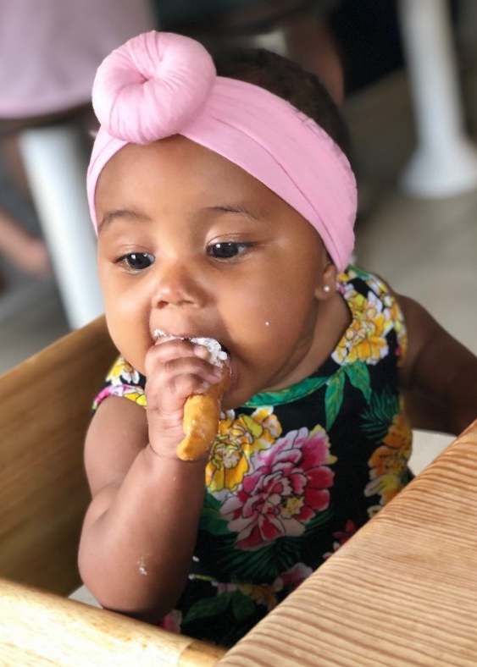
Facilitated Exploration
Involvement
Infant focused
Expansion of infants’ experience
Notes:
Finally, let’s take a look at the Facilitated Exploration dimension of the Infant CLASS® tool—
Facilitated Exploration is comprised of 3 Behavioral Markers:
Involvement, which means the teacher spends most of her time actively involved with the infants, consistently initiating, joining, or mirroring interactions and behavior with infants during play and within routines
Infant focused, which means the teacher consistently watches the infants to see what they are interested in and then follows the infants’ leads, in the teacher’s comments and/or in the activities the teacher selects, that the teacher allows the infants choice about activities, and that the teacher provides opportunities for the infants safely to explore options in their surroundings
Expansion of infants’ experience, which means the teacher regularly encourages the infants to persist in experiences through verbal and non-verbal encouragement and enthusiasm and that the teacher often adjusts the infants’ experience to support continued involvement or extend development—so, for example, the infant does not continue to play with the same materials in the same way
How does what we have learned about describing classroom events connect with “Facilitated Exploration”?
Pause for responses.
When you describe classroom events you are also demonstrating Facilitated Exploration, through “joining in experiences” and “expansion of infants’ experience” with further descriptions.

Slide 64
Key Knowledge Gained
Notes:
At this time, ask 3-5 participants to share the one most important thing she/he learned from the training and how it will help her/him better support the early language development of the children in her/his care, by also sharing one thing that they will change about the care they provide, based on this training.
Have all participants write down their learning on the “3-2-1 Action Plan.”
Then distribute and have participants complete the post-assessment evaluation and submit it to you.

