Slide 1
Louisiana Early Literacy Commission
October 14, 2019

Slide 2
Welcome
Introduce yourself to your shoulder partner. Be sure to share the following information:
Your name
The organization that you are representing
You favorite children’s book
We will each introduce our partner to the group.
Language & Literacy
Foundational Skills
Explicit teaching and practicing
of skills

Slide 3
Moving Towards Recommendations
September 9, 2019: Full commission meeting
October 14, 2019: Full commission meeting
November 20, 2019: Small workgroup meeting
December 16, 2019: Full commission meeting
January 15, 2020: Commission will submit a written report of its findings and recommendations
Notes:
We are here today because we are moving towards a set of recommendations in January. At our first meeting we discussed literacy in the early grades and how children learn to read. Today we will hear directly from teachers, literacy coaches, and administrators. They will tell us about their experiences and their students. They will let us know what supports are helping them do their work and what additional supports they may need.

Slide 4
Louisiana School System Planning Process
School systems review data and identify priorities for the coming year.
School systems budget formula funds and request competitive funds in alignment with priorities.
School systems implement approved plans with support from Network teams and vendor partners.
Notes:
As we are hearing from Louisiana teachers, I wanted to frame how the school system planning process works. This slide is an overview of the school system planning process. Each year Louisiana school systems follow this process to create plans, develop aligned budgets, and then implement their plans with support from LDOE.

Slide 5
Creating an Aligned System:
Providing Effective Evidence-Based Reading Instruction for Children from Birth through Third Grade
School systems review data, identify struggling groups, and identify priorities.
School systems identify and provide high quality instructional materials for foundational skills and knowledge building and administer high quality assessments.
School systems implement plans with support from Network teams and vendor partners.
Notes:
The recommendations from this commission will help guide the school system planning process and ensure that it includes a focus on early literacy. Recommendations will help school systems identify groups that need support, help school systems provide high quality instructional materials and assessments, and provide the support that is needed to successfully implement their plans.

Slide 6
Panelists
Notes:
Jose Guadarrama, Firstline, NOLA
Rebecca Stephenson, Point Coupee

Slide 7
Panel Discussion
Louisiana teachers and leaders have come today to tell us about early reading in their schools and school systems.
Each of our panelists will share their experiences with us. Afterwards, we will have time for questions and answers.
Language & Literacy
Read, understand, and express understanding of complex, grade eel
text
Foundational Skills
Explicit teaching and practicing
of skills
Notes:
5 people- 5 minutes each- 25 minutes- 10 minutes Q&A from Commission

Slide 8
Literacy Initiatives

Slide 9
Gallery Walk
Current Literacy Inititiatives
Curriculum Support/ Professional Development Vendor Guide
Content Leaders/ Mentor Teachers
CLASS/ Observation Tool
Starting at the initiative that has the same number as the sticky note on your table note, we will rotate through to learn more about each of these initiatives.
Language & Literacy
Read, understand, and express understanding of complex, grade eel
text
Foundational Skills
Explicit teaching and practicing
of skills

Slide 10
Reading: Data

Slide 11
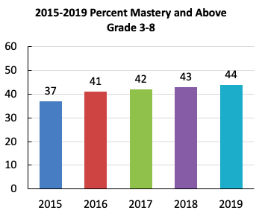
LEAP 2025
Louisiana students have steadily improved performance on LEAP 2025 assessments in ELA over time. The following data shows the percentage of students scoring Mastery and above.
ELA
Grade | 2018 | 2019 | Change
3 | 45 | 46 | +1
4 | 44 | 45 | +1
5 | 43 | 40 | -3
6 | 35 | 38 | +3
7 | 43 | 47 | +4
8 | 45 | 47 | +2
English I | 45 | 44 | -1
English II | 46 | 47 | +1
Notes:
Mastery = the performance level that we consider to be proficient...on track...on grade level. It is consistent with other states deem proficient.
ELA data has steadily improved since 2015
It is not improving fast enough
We must focus on our youngest students learning to read if we want to see significant gains over the next 5 years

Slide 12
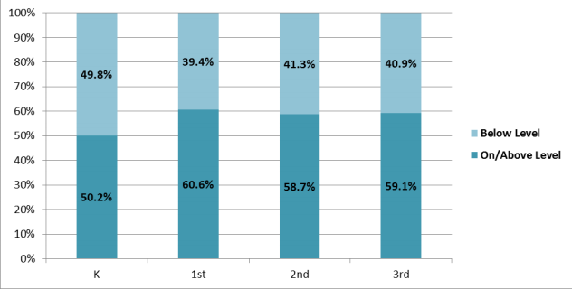
K-3rd Grade Data
Screening Results, Fall 2018
Fewer than 50% of students in kindergarten through third grade performed on or above level on literacy assessments in fall 2018.
Screeners
DIBELS Next
STEEP
STEP
*Note: Districts choose the screening instrument. About 90% use DIBELS Next.
Notes:
All students in grades K-3 are administered a literacy screener each fall.
Between 40-50% of students are entering the grade level without the foundational literacy skills measured by these screeners.
Over time, the majority of these students are not gaining the necessary literacy skills. In other words, students are not “catching up.”

Slide 13
Curriculum Implementation Observation Tool
The English Language Arts Foundational Skills, Grades K-2 Curriculum Implementation Observation Tool includes indicators for Foundations of Reading and Language and Literacy and is used to drive conversations between the observer and the teacher on methods to improve curriculum implementation in the classroom.
Fall observations have started in Grade 1 and Grade 2 classrooms.
A majority of teachers have high quality instructional materials.
Teachers and students are saying letters and sounds more often than they are writing them.
In some classrooms, students need more opportunities to read or write with the targeted letter sounds.
Students were often engaged in read-alouds and whole group discussion.
In some classrooms, students need more opportunities to engage in small group discussions or read texts with peers or independently.

Slide 14
Early Grade Teachers: Background
Recently the Tennessee Education Research Alliance produced research investigating the effectiveness of early vs. upper elementary teachers. Overall, their results revealed the following:
Low-performing upper elementary (3-5) teachers were more likely to be reassigned to lower grades the following years, though the numbers of reassigned teachers was small.
Notes:
As a result of these results, we looked at data on early grade teachers in Louisiana.

Slide 15
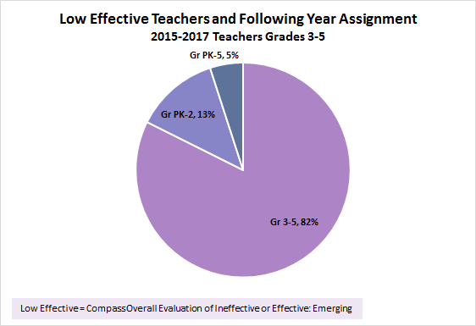
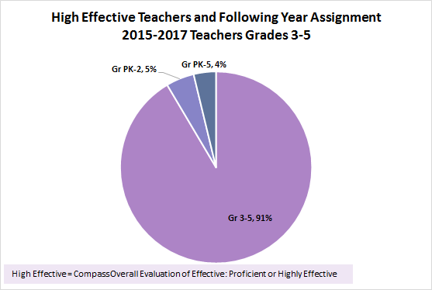
Reassignment of Upper Elementary Teachers
Upper elementary teachers with low effectiveness ratings are more likely (13%) than teachers with higher ratings (5%) to be transferred to PK-2 grades the following year.
Tennessee’s study showed 10% of the low effective teachers transferred to lower grades.
Note: This transfer represents an average of approximately 86 teachers with low effective ratings and 313 teachers with high effective ratings per year. Source or reason for grade change is unknown

Slide 16
Looking Ahead

Slide 17
Goal
Ideas for Draft Goals:
In groups of three, consider these options. Be prepared to share.

Slide 18
Working Towards the Goal
In November, we will have small virtual workgroup meetings to begin drafting the report. What workgroups do we need? (examples below)
Professional Development
Curriculum
Assessment/Accountability
Policy/Communication
Notes:
Let’s brainstorm our goal. We might shape it as Student’s will…
increasing the reading proficiency of third grade students and establish benchmarks for the intervening years

Slide 19
Next Steps
Pre-workgroup calls
November 20, 2019: Small workgroup meeting
December 16, 2019: Full commission meeting

