Slide 1
Focusing on Families: The Importance of Family Engagement in High-Quality Early Childhood Programs

Slide 2
Welcome, Session & Group Introductions

Slide 3
Learning Objectives

Slide 4
LEARNING OBJECTIVES
Explain why it is important to be accepting and supportive of all family types and individual family needs
Define early childhood family engagement and describe its importance in high-quality early childhood programs
Describe the role of families in their children’s development and learning
Identify the role of families in high-quality early childhood programs
List strategies for encouraging family engagement, communicating with families, facilitating family meetings, and supporting families as they actively facilitate the development and learning of their children at home

Slide 5
Introduction Activity
Write your definition of “family”
Bring your notecard and form a circle around the room
Be prepared to share your:
Name
Role
Definition of family

Slide 6
Defining Family

Slide 7
CURRENT DEFINITIONS OF FAMILY
Every family is different
Examples of family structures:
Nuclear
Cohabitating
Single-parent
Blended
Grandparent-led
Interracial
Multiracial
Transracial
Foster
Group-home
Kinship care
Commuter
Transnational
Mixtures of all the above

Slide 8
Reflection
Notes:
Stock photo ID:487054274

Slide 9
EVERY FAMILY IS UNIQUE
Relationships
Communication
Expectations
Beliefs
Notes:
Stock photo ID:497708556

Slide 10
Reflection
Notes:
Stock photo ID:1090454654

Slide 11
ACCEPTANCE
Early childhood professionals must accept all families in order to develop positive, respectful relationships.
This is accomplished through:
Equal partnerships
Mutual respect
Open communication
Shared trust
Collective decision-making
Notes:
Stock photo ID:497708556

Slide 12
Reflection
Notes:
Stock photo ID:483934360

Slide 13
ROLE
Families:
Are central to young children’s lives
Assume critical roles in their children’s development
Are children’s first and forever teachers

Slide 14
Reflection
Notes:
Stock photo ID:942881236

Slide 15
Exploring the Essential Elements of Family Engagement

Slide 16
Turn and Talk
Notes:
Stock photo ID:147661742

Slide 17
ELEMENTS
“How do early childhood education programs meet the challenge of engaging families in their child’s early learning and development?”
Participation
Communication
Engagement
Learning
Decision-making
Systems

Slide 18
Participation
Decision-making
Advocacy
Engagement
Assistance
Why
How

Slide 19
Communication
Multi-faceted
Responsive
Co-initiated
Continuous
Why
How

Slide 20
Engagement
Collaborate
Share
Engage
Inform
Why
How

Slide 21
Learning
Create
Sustain
Extend
Enhance
Why
How

Slide 22
Decision-Making
Value
Support
Collaborate
Plan
Why
How

Slide 23
Systems
Dedication
Training
Support
Leadership
Why
How

Slide 24
Identifying Family Engagement Strategies

Slide 25
Turn and Talk
Notes:
Stock photo ID:147661742

Slide 26
INVOLVEMENT OR ENGAGEMENT
Involvement
Engagement

Slide 27
Involvement or Engagement Activity

Slide 28
ACTIVITY INSTRUCTIONS
Sort the items on the worksheet from parent involvement on the left-hand side to family engagement on the right
Keep in mind that activities should increase in their ability to build relationships from lower levels of relationship building on the left to higher levels on the right

Slide 29
INVOLVEMENT OR ENGAGEMENT

Slide 30
STRATEGIES
“How do early childhood education programs meet the challenge of engaging families in their child’s early learning and development?”
Creating positive first impressions
Learning about one another
Communicating with families
Sharing children’s learning
Facilitating participation
Supporting learning at home

Slide 31
CREATING POSITIVE FIRST IMPRESSIONS
Family engagement begins with first impressions:
Websites
Social media
Email
Phone calls
Open-door policies
Center visits

Slide 32
LEARNING ABOUT ONE ANOTHER
Family engagement depends on knowledge:
Intake activities
Expectations
Feedback loops
Parent education opportunities

Slide 33
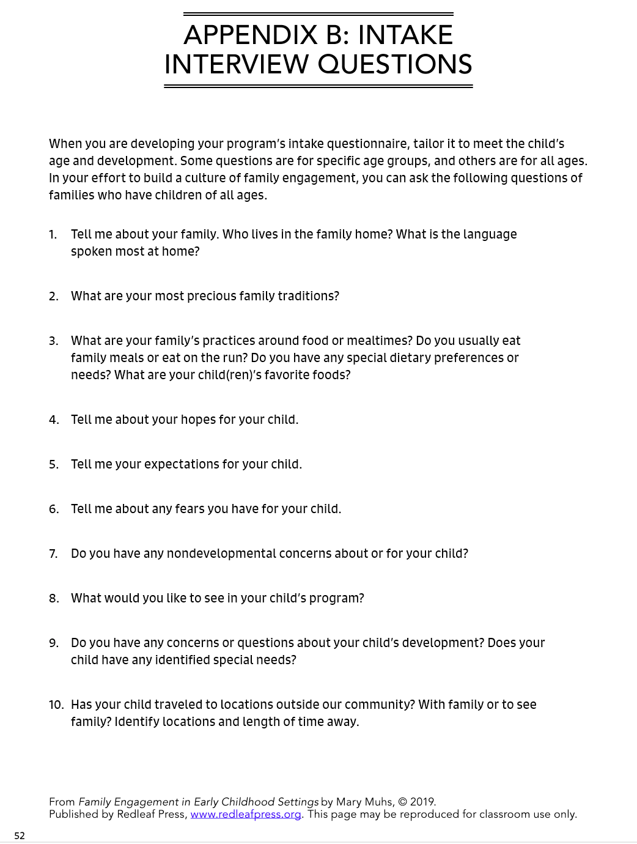
Example Intake Interview Questions

Slide 34
COMMUNICATING WITH FAMILIES
Communication is an essential element of family engagement:
Verbal
Newsletters
Technological

Slide 35
Example Newsletter

Slide 36
SHARING CHILDREN’S LEARNING
Sharing children’s learning helps families understand their children’s growth and development:
Documentation
Conferences and meetings
Engagement events

Slide 37
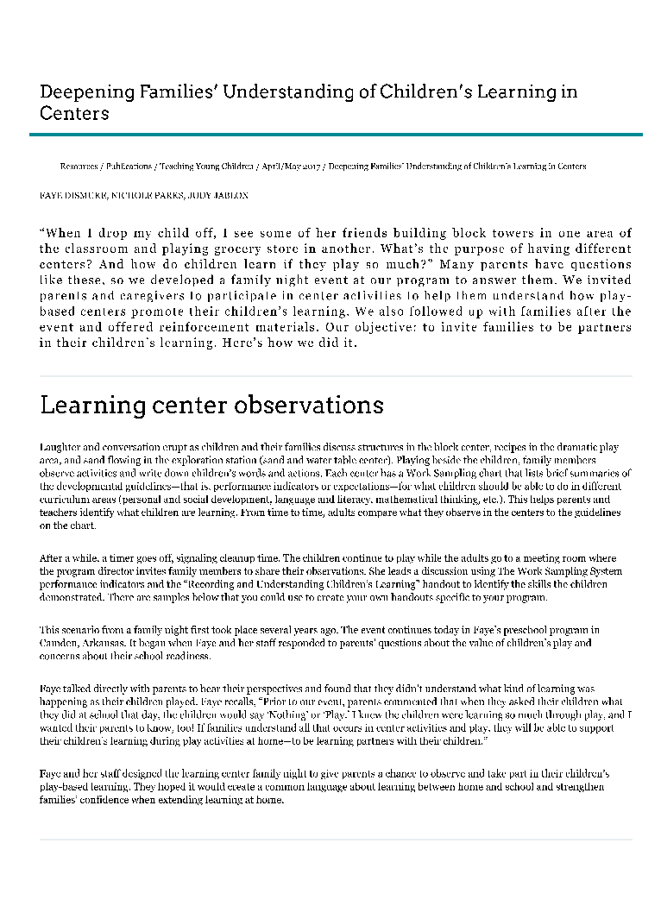
Example Engagement Event

Slide 38
FACILITATING PARTICIPATION
Meeting families where they are is a necessity:
In-person
Virtual
In-kind

Slide 39
SUPPORTING LEARNING AT HOME
Family engagement includes supporting learning at home:
Share activity plans
Create a resource library
Address parenting topics
Offer family workshops

Slide 40
Research-Based Resources
American Academy of Pediatrics (www.aap.org)
Parents as Teachers (www.parentsasteachers.org)
National Association for the Education of Young Children (www.naeyc.org)
Zero to Three (www.zerotothree.org)
Child Care Aware (www.childcareaware.org)

Slide 41
Family Engagement Activity
Notes:
Stock photo ID:947854280

Slide 42
ACTIVITY INSTRUCTIONS
Rate your engagement levels following the instructions provided
A: Always
S: Sometimes
N: Never
?: More information
Once you complete your ratings, complete the “Steps for Action” section by listing three areas for improvement, related strategies for completion, and anticipated completion dates

Slide 43
Session Review

Slide 44
REVIEW LEARNING OBJECTIVES
Explain why it is important to be accepting and supportive of all family types and individual family needs
Define early childhood family engagement and describe its importance in high-quality early childhood programs
Describe the role of families in their children’s development and learning
Identify the role of families in high-quality early childhood programs
List strategies for encouraging family engagement, communicating with families, facilitating family meetings, and supporting families as they actively facilitate the development and learning of their children at home

Slide 45
Reflections, Questions, & Comments

Slide 46
Please complete the Post-Assessment Evaluation. Thank you!

Slide 47
REFERENCES
Dismuke, F., Parks, N., & Jablon, J. (2017). Deepening families’ understanding of learning in centers. Teaching Young Children, 10. Retrieved from https://www.naeyc.org/resources/pubs/tyc/apr2017/deepening-families-understanding.
Donohue, C. (2017). Digital age family engagement: The role of media mentors. Exchange, March/April, 12-14.
Hare, J., & Gray L. A. (2008). All kinds of families: A guide for parents. Retrieved from http://www1.cyfernet.org/prog/fam.notradfam.html
Muhs,, M. (2019). Family engagement in early childhood settings. St. Paul, MN: Red Leaf Press.
National Association for the Education of Young Children. (nd). Principles of family engagement. Retrieved from https://www.naeyc.org/resources/topics/family-engagement/principles
National Center on Parent, Family, and Community Engagement, (n.d.). Parent involvement and family engagement: For early childhood professionals. Retrieved from https://eclkc.ohs.acf.hhs.gov/sites/default/files/pdf/parent-involvement-family-engagement-for-professionals.pdf
Washington, V. (Ed.). (2017). Essentials for working with young children (2nd ed.). Washington, DC: Council from Professional Recognition.
United States Census Bureau. (2019). Subject definitions: Family. Retrieved from https://www.census.gov/programs-surveys/cps/technical-documentation/subject-definitions.html#family

