Slide 1
Managing Effective Program Operations
The Early Learning Leadership Institute

Slide 2
Welcome, Session & Group Introductions

Slide 3
Learning Objectives

Slide 4
LEARNING OBJECTIVES
Understand that classroom planning, record keeping, and reporting rely on the use of well-constructed systems
Understand that listening and feedback are important communication tools
Understand the role of a coach
Know how to write a staff development plan
Know how to use systems, policies, and procedures effectively
Understand that systems only work when communicated and used
Improve staff interaction
Know the importance of staffing meetings and how to conduct them
Identify that teacher training necessitates planning and research

Slide 5
Communication

Slide 6
COMMUNICATION
The use of systems, policies, and procedures helps accomplish effective communication through:
Classroom management, planning, record keeping, and reporting
Leadership and coaching utilizing individualized staff development plans as an important component
Well-planned staff meetings held on a regular basis and designed to generate constructive employee interaction
Teacher training as a part of staff development necessitating planning and budget considerations

Slide 7
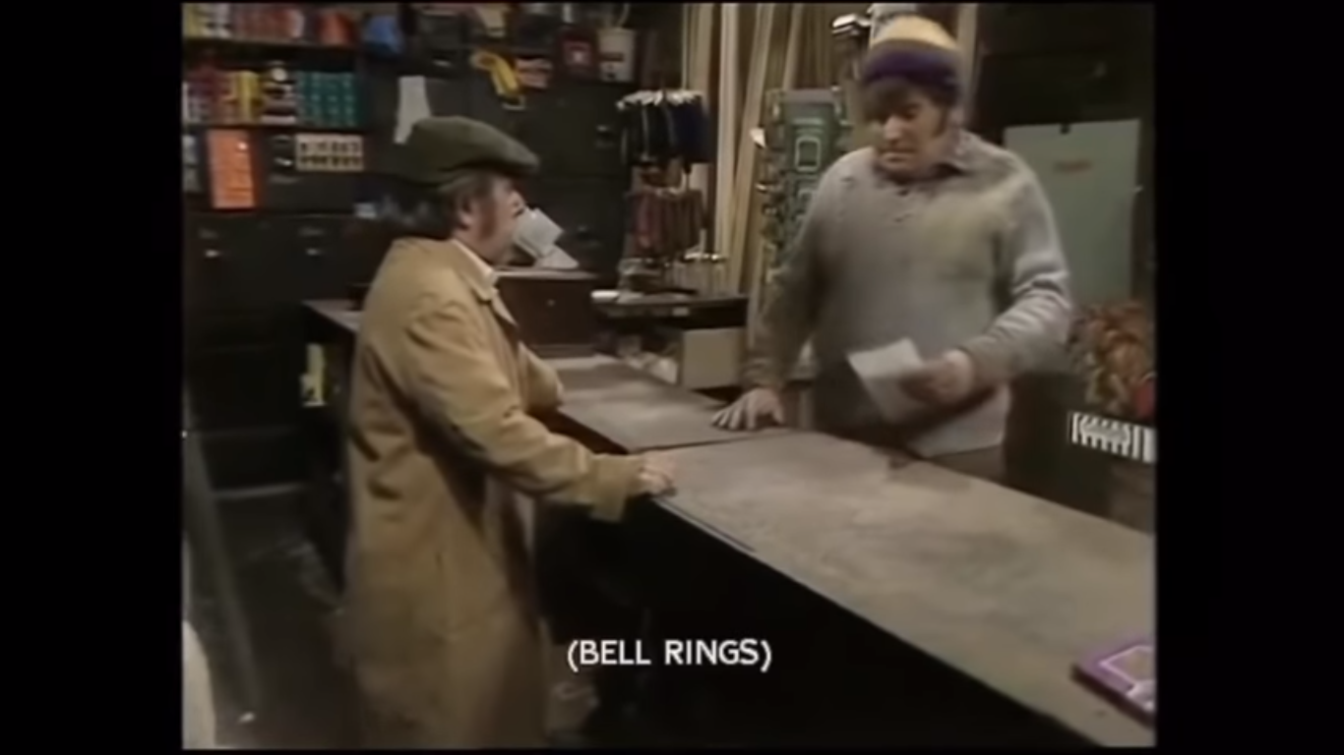
Difficulties of Communication Activity
The difficulties of communication:
Listen, think, and observe, but don’t give up.
Hold CTRL and click the picture to play video.
Notes:
https://youtu.be/dBT6u0FyKnc

Slide 8
Difficulties of Communication Reflection
Why didn’t the clerk understand the requests?
Why was the clerk frustrated with the customer?
How do you feel when you are asked to do something, and you don’t understand the directions?
How can you help employees understand what you want from them?

Slide 9
How to Communicate Effectively
How do you communicate effectively with employees?

Slide 10
HOW TO COMMUNICATE EFFECTIVELY
Create a receptive atmosphere
Be genuine
Be accurate
Be clear and concise
Use handouts and visual aids whenever possible
Listen – communication is a two-way street
Be aware of your body language – stand or sit straight, have eye contact, do not be afraid to smile
Be courteous
Be complete in presenting information
Be professional

Slide 11
Listening and Feedback
Is there a difference between hearing and listening?
Do you listen to hear, or do you listen to understand?
Do you listen to understand, or do you listen with the intent to reply?
Hold CTRL and click the picture to play video.
Notes:
https://youtu.be/-4EDhdAHrOg

Slide 12
Coaching

Slide 13
Coaching
What is your definition of a coach?
What are the qualities of a coach?

Slide 14
COACHING
A coach is one who focuses on program outcomes by building the skills and capabilities of their staff.
The coaching path should result in both programmatic and personal outcomes.
Some qualities of a coach are that they:
Understand that “it’s not about me”
Understand that mutual goals lead to success
Think before they comment and see the whole picture of what has been happening
Know how to build rapport for acceptance
Know how to provide examples of desired actions
Know how to build on the positive
Know how to support progress

Slide 15
Staff Development Planning

Slide 16
STAFF DEVELOPMENT PLANNING
Staff development plans guide both leadership and staff toward improvement and toward a high-quality early learning program. Each staff member should have an individualized staff development plan.
The goal of an individualized staff development plan is to have teachers understand their own needs to grow and develop in their job
How many of you have a staff development plan for each employee?
How do you or would you implement a staff development plan for each employee?
When should an individualized staff development plan be created?

Slide 17
STAFF DEVELOPMENT PLANNING
Keys to implementing an individualized model for staff development are:
Gathering data
Compiling a profile
Conducting a planning conference
Setting goals
Writing an action plan
Implementing the plan
Evaluating progress
Gathering data
Compiling a profile
Conducting a planning conference
Setting goals
Writing an action plan
Implementing the plan
Evaluating progress

Slide 18
Systems, Policies, and Procedures

Slide 19
Systems, Policies, and Procedures
Why are planning, record-keeping, and reporting important to the classroom?
What are systems?
What are policies?
What are procedures?

Slide 20
Systems
A system is an organized collection of parts related to a whole. So, there are subsystems that assist us in reaching the goals of the whole.
Can you give any examples of systems and subsystems?

Slide 21
SYSTEMS AND SUB-SYSTEMS
A successful restaurant has to have systems in place. The example given here demonstrates that everyone has a role. For example:
A person greets you when you walk in the door and takes you to a table and gives you a menu
Then someone comes and asks if you would like something to drink
Then someone comes and takes your order
To be able to serve what you have ordered, there has been behind the scenes work – a cook prepared your food, someone ordered the food into the restaurant, a food vendor had a delivery person, etc.

Slide 22
SYSTEMS FOR AN EARLY LEARNING CENTER
One system that an early learning center must have is how to schedule staff and when they should arrive at the center. For example:
There is the person who opens the center
There is a second person who comes in when the first child arrives
There is a schedule worked out for the arrival of additional teachers
There is a schedule for when staff leave for the day in an organized manner related to the number of children present and their ages

Slide 23
POLICIES
Policies are written statements of the organization’s principles and guidelines.
They allow management a way to communicate job expectations to employees
In early learning, policies relate to the organization’s principles, and procedures are used to manage workflow
Procedures flow from policies
For example: “It is the policy of this organization that cell phones may not be used in the classroom.”

Slide 24
PROCEDURES
Procedures are designed to help one carry out the policies of the organization.
They state specifically how a task will be done
For example: “In order to accomplish the cell phone policy of the organization, cell phones must be left in their cars or checked into the director’s office before work is begun.”

Slide 25
CLASSROOM SYSTEMS
Classroom systems are part of the many systems needed to make the center run smoothly and provide accountability.
For example: Morning attendance, daily playground checks, lunch and meal service, closing checklists, fire drill

Slide 26
PROCEDURES AND GOALS
Procedures cannot be developed if you do not know the “end goal” for each classroom.
What is the curriculum you use?
How much planning is needed to implement the curriculum?
How much time is allocated for the planning?
What are the end curriculum expectations?
What are parent expectations?
What are your program’s expectations?

Slide 27
POLICICES AND PROCEDURES FOR STAFF AND PARENTS
Parent registration forms
Parent handbook
Field trip forms
Late pick up
Sick children
Discipline and biting
Medications
Conferences
Immunization and records
Hours of operation and ages of children served
Toilet training
Excessively hot or cold weather
Weather emergencies
Accidents

Slide 28
COVID-19 IMPLICATIONS
Do you need new policies concerning payment/refunds when the center is closed due to health reasons?
Did you create and implement new systems regarding parents entering the building?
Did you create and implement new systems regarding children, staff, or parents wearing masks?
Did you find a way to continue pre-school via Zoom, or other methods? If you did, what are the tuition implications?
Did you create any new systems, policies, or procedures regarding lesson plans because of COVID-19 and using Zoom?

Slide 29
System Communication

Slide 30
Communicate with Thought and Intention
Hold CTRL and click the picture to play video.
Notes:
https://youtu.be/ixSUBl1WNxk

Slide 31
Communicate with Thought and Intention Reflection
How do you help employees understand what you want from them?
How do you support employees in asking for what they need?
Was there a system in place that the animals could have used or benefitted from?
Was the rabbit’s initial communication to the deer and coyote clear and precise and well-planned?
If they worked as a group, could there have been different outcomes for the deer and the coyote?

Slide 32
SYSTEM COMMUNICATION
Communication and implementing systems, policies, and procedures with staff requires:
Demonstration – show the steps in a process, let someone do it while you watch and provide scaffolding if needed
Written information – memos, email, policy manuals, social media, etc.
Supervision – check on the process regularly, check more frequently at the beginning, ask for questions, acknowledge progress
Documentation – keep a log, note on calendar, review at staff meeting, and keep minutes

Slide 33
System Communication
What are the best ways to establish and support planning, record keeping, and reporting center-wide?

Slide 34
SYSTEM COMMUNICATION
When communicating and monitoring classroom activities and procedures there are questions to be addressed.
Will plans be reviewed? If so, by whom and when?
What constitutes adequate planning?
Are adequate materials and supplies available?
What records should be kept and where?
Ex.: attendance, meals, daily records, accidents and incidences, fire drills, medication, lesson plans, etc.

Slide 35
The Effects of Leadership and Environment

Slide 36
LEADERSHIP, ENVIRONMENT, AND STAFF INTERACTION
Leadership and a respectful and supportive environment help create teamwork and involve various types of communication and positive social interactions with staff and between staff
Disengaged employees are lost opportunity
Just a smile can stimulate the brain and release endorphins that make us feel good

Slide 37
TEACHER WORKING CONDITIONS/ENVIRONMENT
Is the working environment of preschool teachers a paradox?
Are preschool teachers isolate or do they work in an autonomous setting?
Do preschool teachers need support and encouragement on a daily basis? If so, from where does this come? If not, why not?
Are there negatives in a teacher’s working environment? If so, what are they?
How do positive or negatives in the working environment impact staff, children, and the early learning program?
What is administration/management’s role in creating a positive working environment?

Slide 38
TEACHER WORKING ENVIRONMENT
Suggestions on how to improve the teaching environment:
Be available
Keep staff informed
Follow through on your promised actions in a timely manner
Have ongoing professional development
Develop activities that staff can do together
Develop teams regarding curriculum and preparation – collaborate
Understand the teacher’s need to have time with adults
Use staff meetings effectively

Slide 39
STAFF MEETINGS
Staff meeting should be well-run and well-planned and held on a regular basis:
Avoid impulsive staff meetings where the matter could be addressed later
Avoid creating the atmosphere that the meeting is to tell employees what they did wrong and are not constructive – you do not want a “what’s wrong now” attitude
Use meetings for staff development
Allow social time before or after the meeting – build camaraderie

Slide 40
STAFF MEETINGS
Staff meeting should:
Have an agenda
Have time limits for topics
Stay on topic
Have a setting that supports interaction
Have a setting that removes distractions
Come to resolution with the leader summarizing the meeting and ending with a plan and clear steps to take forward

Slide 41
Teacher Training

Slide 42
TEACHER TRAINING AND STAFF DEVELOPMENT
Teacher training is an essential part of staff development and early learning program improvement. This training cannot be done in a helter-skelter manner. Training needs to be individualized and planned ahead of time. The following needs to be taken into consideration as well:
State licensing requirements for staff
Availability of quality low-cost training opportunities
Advanced planning in the budget for conferences and trainings
Staff input about topics that interest them

Slide 43
Session Review

Slide 44
REVIEW LEARNING OBJECTIVES
Understand that classroom planning, record keeping, and reporting rely on the use of well-constructed systems
Understand that listening and feedback are important communication tools
Understand the role of a coach
Know how to write a staff development plan
Know how to use systems, policies, and procedures effectively
Understand that systems only work when communicated and used
Improve staff interaction
Know the importance of staffing meetings and how to conduct them
Identify that teacher training necessitates planning and research

Slide 45
Reflections, Questions, & Comments

Slide 46
Please complete the Post-Assessment Evaluation. Thank you!

