Slide 1
Teamwork
The Early Learning Leadership Institute

Slide 2
Welcome, Session & Group Introductions

Slide 3
Learning Objectives

Slide 4
LEARNING OBJECTIVES
Basic human needs
Impediments to teamwork
Ways to overcome the impediments to teamwork
Difference between empowerment and delegation
Importance of staff and teacher development
Importance for leadership to be conscious of the working environment
Importance for leadership to be cognizant of adult learning strategies

Slide 5
Human Needs and Teamwork

Slide 6
Basic Human Needs
Basic human needs are:
To feel welcome – friendliness
To feel comfortable
To be understood
To receive help and assistance
To be treated fairly
To be offered options and alternatives

Slide 7
What is Teamwork?

Slide 8
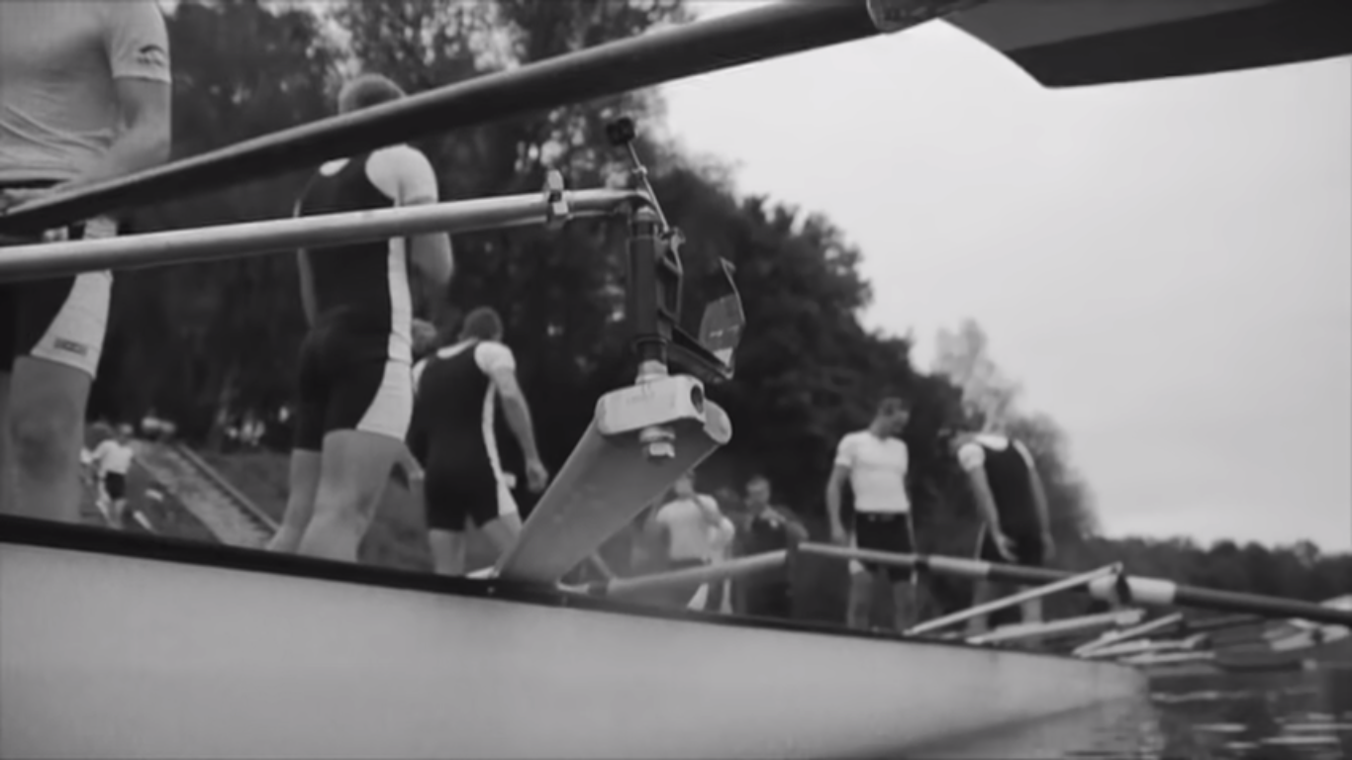
TEAMWORK AND ROWING
Hold CTRL and click the picture to play video.
Notes:
https://www.youtube.com/watch?v=y0FtXhSu0J0&feature=youtu.be

Slide 9
TEAMWORK
Teamwork – Everyone working toward a common goal and planning together to get the goal with objective direction. In the film, teamwork took:
Preparation
Synchronization
Unity
Engagement
A common goal
Focus
Dedication

Slide 10
Are There Impediments to Teamwork?

Slide 11
Impediments to Teamwork
Inattention
to
Results
Avoidance of
Accountability
Lack of
Commitment
Fear of
Conflict
Absence of
Trust

Slide 12
ABSENCE OF TRUST
Teams that have an absence of trust:
Team members are afraid to admit what they do not know and therefore are afraid to ask for help or guidance.
Team members are hesitant or afraid to go outside their classroom or area of responsibility and offer help or guidance.
Team members may jump to conclusions about the intentions of others.
Team members may hold grudges.

Slide 13
FEAR OF CONFLICT
Teams that fear conflict:
Meetings may be ineffective or rarely held to avoid conflict.
Meetings are boring.
Controversial topics are ignored.
Time is wasted as little is achieved.

Slide 14
LACK OF COMMITMENT
Teams that lack commitment:
Team members may not be clear about their goals and objectives.
There may not be “buy-in.”
There may be a fear of failure.
There may be second guessing.

Slide 15
AVOIDANCE OF ACCOUNTABILITY
Teams that avoid accountability:
See resentment among team members who have different standards of performance.
Tend to be mediocre.
Pay little attention to deadlines or ignore them altogether.
Are less creative.
Put undue pressure on the team leader.

Slide 16
INATTENTION TO RESULTS
Teams that do not pay attention to results:
Provide an inferior early learning program.
Lose good employees who do not like the work environment.
Tend to bicker, backbite, and gossip.
Are less creative.
Make accountability difficult.

Slide 17
Overcoming the Lack of Teamwork

Slide 18
Teamwork Activity
Divide into groups of 3-6
Each group is to receive a shuffled newspaper
Objective: put a newspaper in numerical or page order

Slide 19
ACTIVITY QUESTIONS
How does this activity relate to teamwork?
How did you deal with everyone’s ideas about the way to proceed?
Did anyone emerge as leader?
How did this person function?
How did you handle disagreements?
What implications does this have for you when at your job?

Slide 20
OVERCOMING LACK OF TEAMWORK
Leadership and environment help create teamwork and involve various types of communication and positive social interactions with staff and between staff.
Disengaged employees mean lost opportunity.
Just a smile can stimulate the brain and release endorphins that make us feel good.

Slide 21
Teamwork and Trust
What are the characteristics of teams that trust each other?

Slide 22
TEAMS WITH TRUST
Teams with trust:
Admit weaknesses and mistakes, take responsibility.
Ask for help.
Address controversial topics.
Accept questions and input from others.
Take risks in giving feedback and in offering assistance.
Share ideas.
Focus on appropriate tasks.
Are able and willing to apologize if necessary.
Look forward to opportunities to work as a group including at staff meetings and other events.

Slide 23
Teams That Do Not Fear Conflict
What are the characteristics of teams that do not fear conflict?

Slide 24
TEAMS THAT DO NOT FEAR CONFLICT
Teams that do not fear conflict:
Provide productive ideas, discussions, and solutions to problems.
Share ideas and opinions for moving ahead.
Convey that everyone’s ideas count and are wanted.
Make meetings lively and interesting.
Discuss topics that are important to operations and work with families and children.

Slide 25
Teams That Are Committed
What are the characteristics of teams that are committed?

Slide 26
TEAMS THAT ARE COMMITTED
Teams that are committed:
Are clear about their goals and priorities
Have “buy-in.”
Give consideration to everyone’s ideas. This helps create “buy-in” when consensus is met.
Learn from mistakes and willing to change direction when needed.
Understand the course of actions taken. This does not mean they totally agree, but have a framework about the reason for the action and helps eliminate grumbling.
Honor deadlines.
Acknowledge and celebrate results.

Slide 27
Teams That Are Accountable
What are the characteristics of teams that are accountable?

Slide 28
TEAMS THAT ARE ACCOUNTABLE
Teams that are accountable:
Regularly communicate with one another.
Hold everyone to high standards.
Are team-motivated and not striving for individual rewards.

Slide 29
Teams That Focus on Results
What are the characteristics of teams that focus on results?

Slide 30
TEAMS THAT FOCUS ON RESULTS
Teams that focus on results:
Keep good employees.
Provide quality early learning programs to parents and children.
Are focused on goals and priorities.
Leader is important in setting the tone and is focused on results.
Hold team members accountable.
Are not afraid to be constructively critiqued.
Are helpful to each other and generous in sharing expertise.

Slide 31
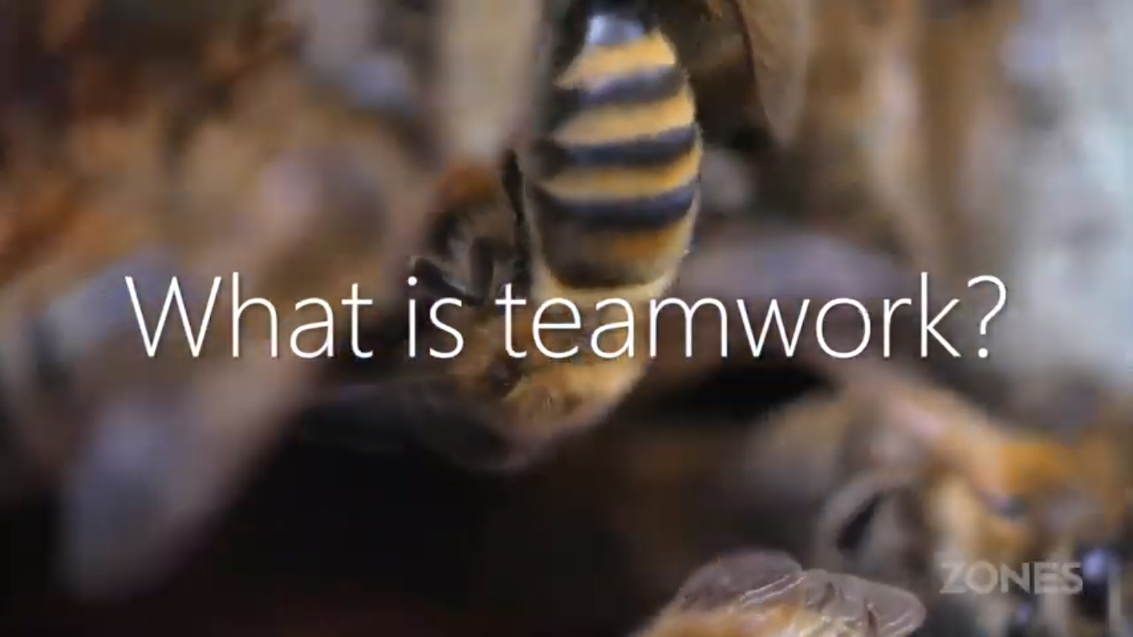
WHAT IS TEAMWORK
Hold CTRL and click the picture to play video.
Notes:
https://youtu.be/iFwVSLfQj1M

Slide 32
WHAT IS TEAMWORK
Key takeaways from the video:
Working as one
Standing strong
Pulling your own weight
Moving forward
Working in synchronicity
Having each other’s backs
Trusting your peers
Being able to deliver
Staying on track
Pulling together to achieve one goal

Slide 33
What Have We Learned?

Slide 34
Empowerment and Delegation

Slide 35
EMPOWERMENT
Empowerment is allowing your teachers to take action and make decisions within the sphere of their responsibilities. It means that there is trust and understanding that the actions and decisions of the teacher are in line with the mission of the organization.
When classroom teachers are empowered, there is a trust that they will perform their duties to the best of their ability on a daily basis and adhere to the policies and procedures of the organization.
Empowering employees improves job satisfaction and helps you to solve problems faster. Empowerment does not mean that there are no standards, nor does it mean that the organizational culture is “do your own thing.”

Slide 36
DELEGATION
Delegation is assigning responsibility to another to carry out specific activities. Below are reasons to delegate:
Your inbox is always full,
Your “to-do” list never gets done,
You regularly work extra hours on things “only you can do,” or
You never have a feeling of being caught up.

Slide 37
How to Delegate
Set clear expectations and timelines
Provide sufficient resources
Stay in touch, be available for questions and clarification
Provide constructive and specific feedback and not just a general “nice job”
Be willing to accept new ideas and input
Recognize and appreciate the effort of the employee

Slide 38
Staff/Teacher Development

Slide 39
STAFF/TEACHER DEVELOPMENT AND ENVIRONMENT
Environment may be understood in the following ways:
Working environment
The overall atmosphere created by leadership and staff working together or not working together to promote high-quality early learning programs. The focus here is the atmosphere created.
Educational environment for children
Creating indoor and outdoor spaces that promote creativity and learning.

Slide 40
Staff/Teacher Development
How do you support teachers so that they are effective in their job?

Slide 41
STAFF/TEACHER DEVELOPMENT
There is a leadership responsibility to support teachers which influences the development of the team.
It is important for teachers to understand the vision and mission of the organization that employs them.
This gives them their initial sense of direction that is further enumerated in the goals of the organization.
If leadership cannot enumerate this, the organization and its employees lack the guidance needed for success.

Slide 42
DID YOU KNOW?
If your leader/manager primarily ignores you, the chances of you being disengaged in your job is 40%.
If your leader/manager focuses on your weaknesses, the chances of you being disengaged in your job is 22%.
If your leader/manager focuses on your strengths, the chances of you being disengaged in your job is 1%.

Slide 43
STAFF/TEACHER NEEDS
Staff/Teachers also need:
To work in a safe environment.
To work in an atmosphere of trust and respect.
Team members enhance others’ skills by sharing their successes
Time to plan and collaborate.
Access to high quality professional development that addresses organizing skills, time management skills, communication skills, curriculum development and assessment skills, as well as other job-related needs.
To embrace necessary change.

Slide 44
Adult Learning Strategies

Slide 45
ADULT LEARNING STRATEGIES
Some general characteristics of adult learners:
The purpose of their learning/training needs to be explained.
They bring a variety of experiences which should be utilized in their learning.
They tend to be practical, dislike theory, want information that is applicable to what they are doing – relevance is important.
They are results oriented – may disengage in the learning process if they do not see where they will benefit.

Slide 46
ADULT LEARNING STRATEGIES
They process new information through discussion with others – like to work with others to learn collaboratively.
They use personal experiences as a resource – using similarities and differences between past experiences and present situations facilitates the transfer of learning.
They need to be both challenged and supported as they enhance their skills and acquire new strategies.
They do not like having their time wasted.

Slide 47
THE WISDOM OF GEESE
Hold CTRL and click the picture to play video.
Notes:
https://youtu.be/5rOg4WfNDfM

Slide 48
THE WISDOM OF GEESE
What are the instinctive capabilities of the geese?
They see the value of working together.
They encourage the other geese.
They protect the vulnerable.
They use all of their skills and share leadership as is necessary.

Slide 49
Session Review

Slide 50
REVIEW LEARNING OBJECTIVES
Basic human needs
Impediments to teamwork
Ways to overcome the impediments to teamwork
Difference between empowerment and delegation
Importance of staff and teacher development
Importance for leadership to be conscious of the working environment
Importance for leadership to be cognizant of adult learning strategies

Slide 51
Reflections, Questions, & Comments

Slide 52
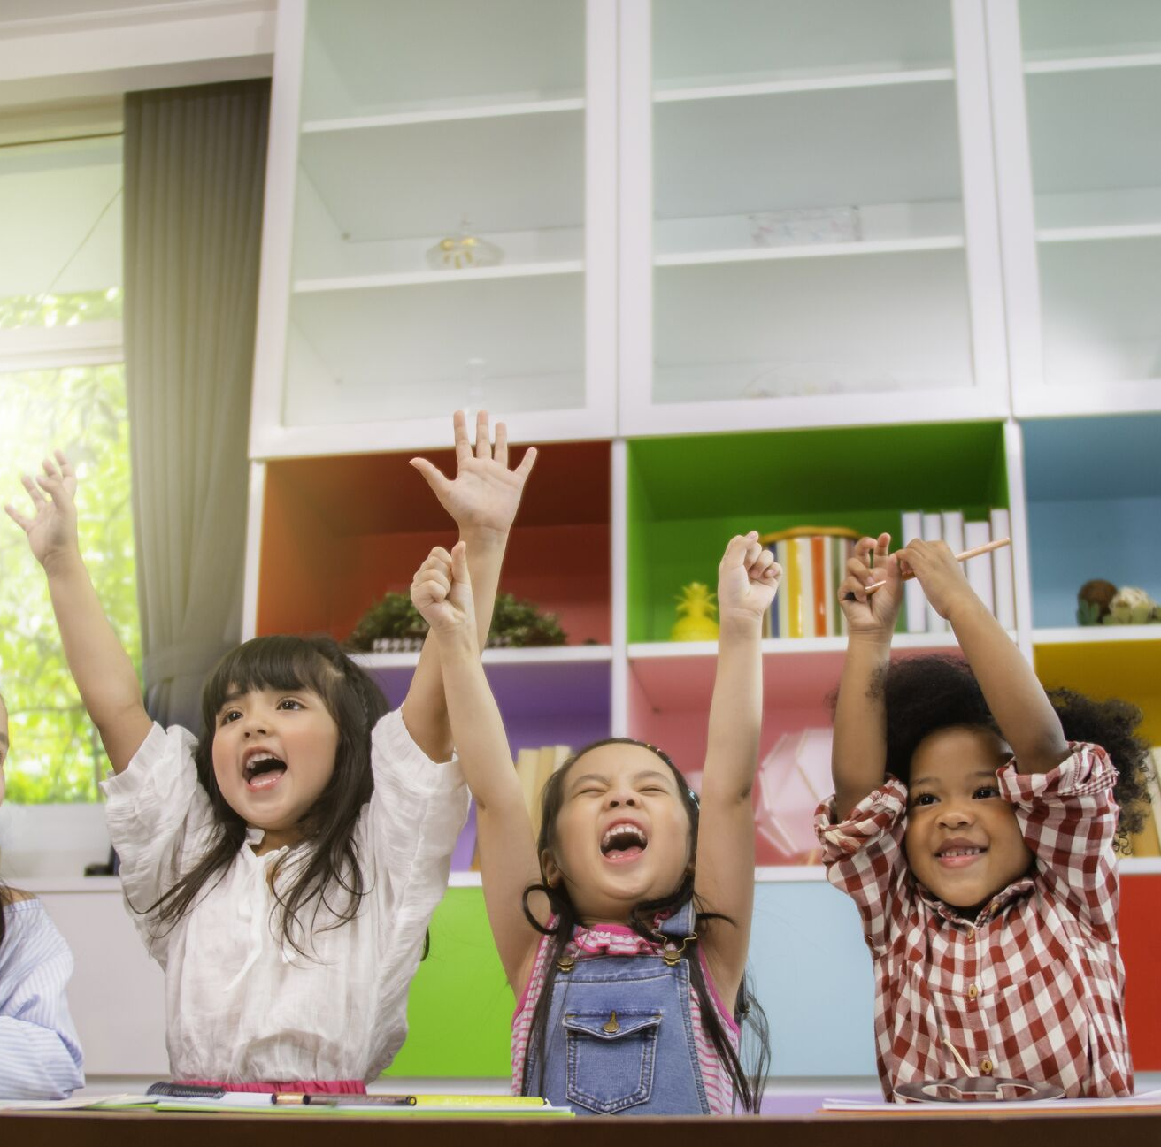
Please complete the Post-Assessment Evaluation. Thank you!

