Slide 1

Putting it All Together:
Standards, Curriculum, and Assessment

Slide 2
Welcome, Session & Group Introductions

Slide 3
Learning Objectives

Slide 4
LEARNING OBJECTIVES
Explain why standards are important and how they can be used to guide what one does in the classroom
Describe the difference between standards, curriculum, and assessment and how they are interconnected and work together for teaching effectiveness
Determine if an activity is relevant to the standards, follows the curriculum, and can be assessed and recorded

Slide 5
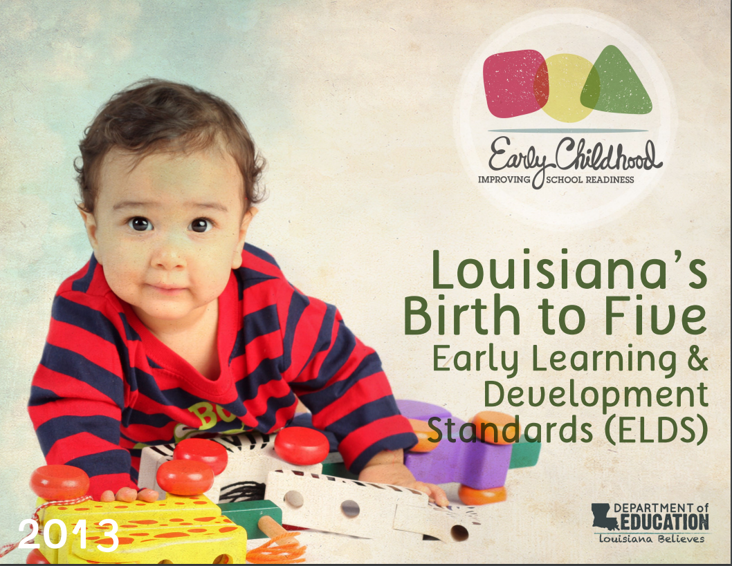
LOUISIANA’S EARLY
LEARNING & DEVELOPMENT STANDARDS
Louisiana’s Birth to Five Early Learning & Development Standards (ELDS)
Notes:
https://www.louisianabelieves.com/docs/default-source/academic-standards/early-childhood---birth-to-five-standards.pdf

Slide 6
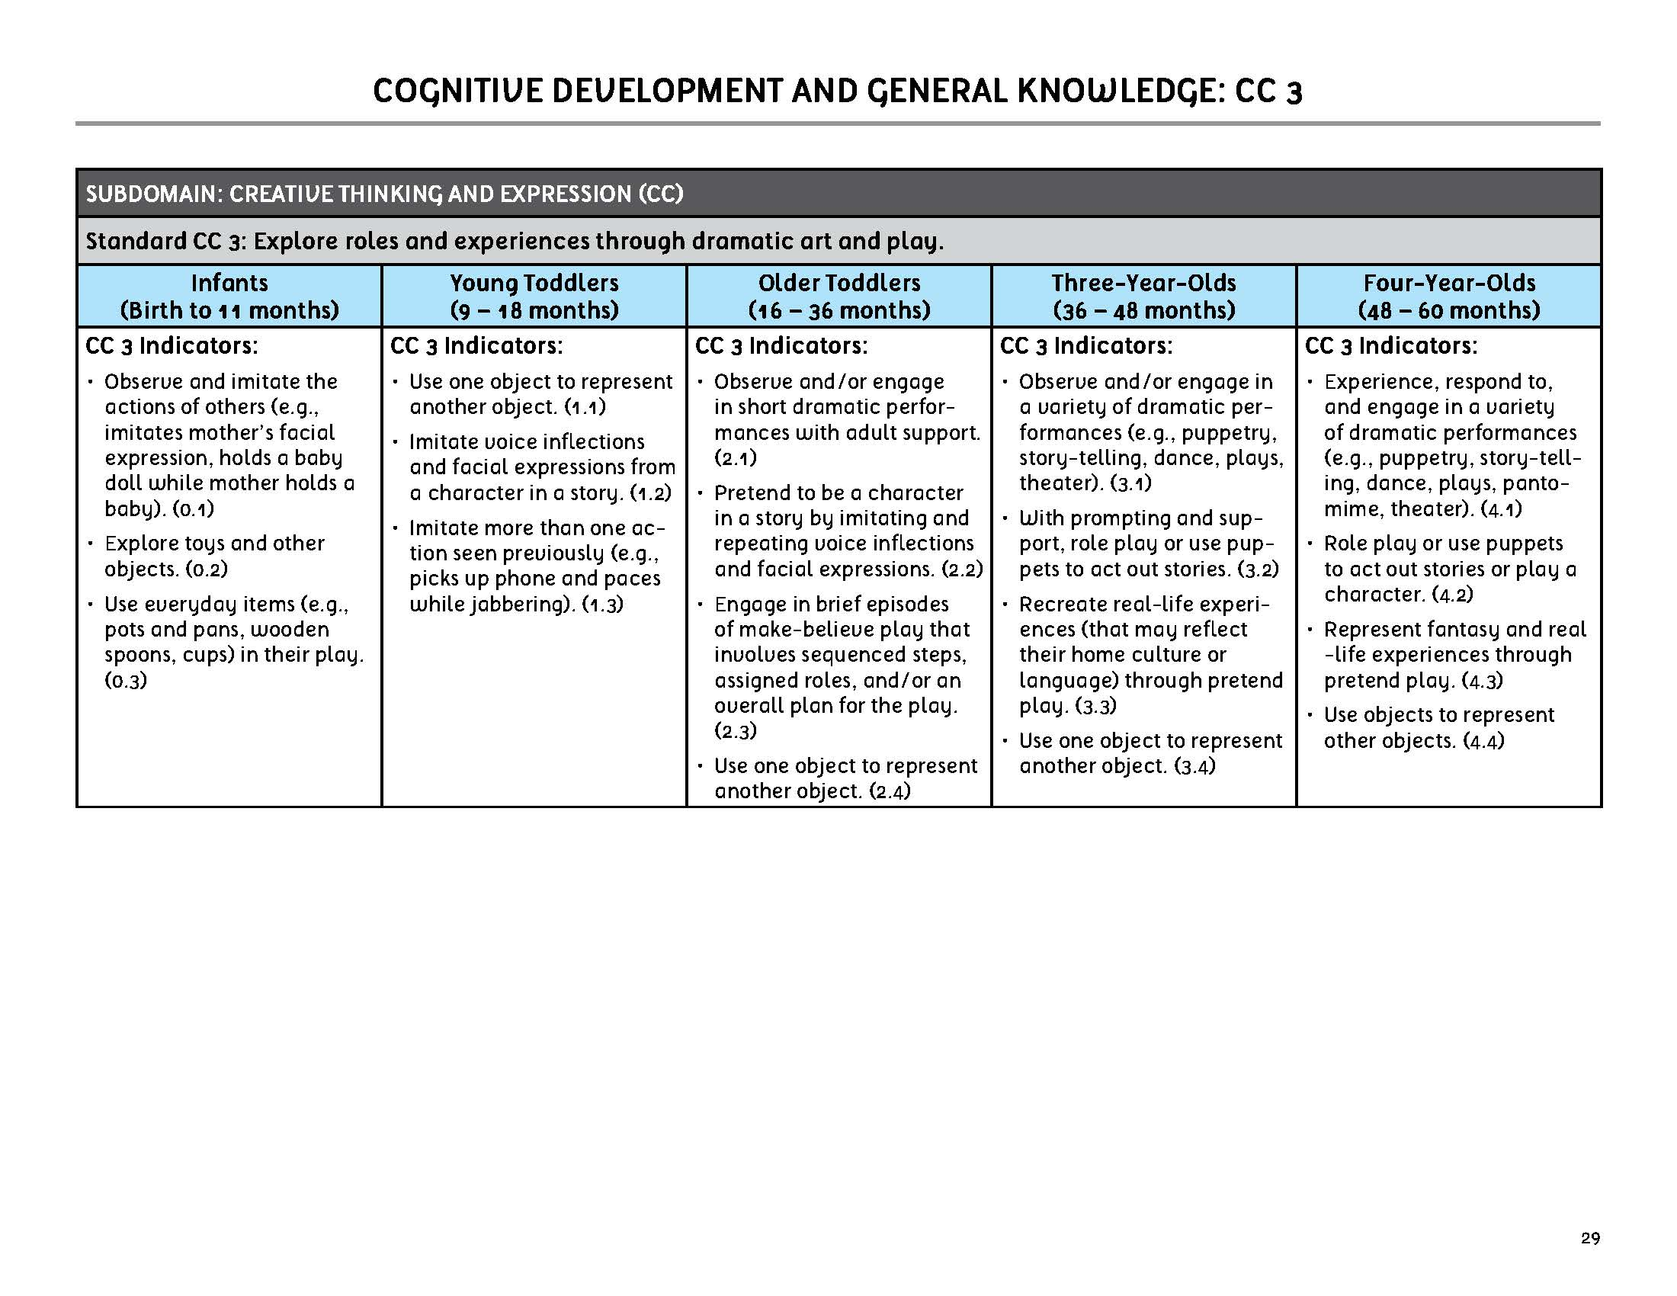

Slide 7
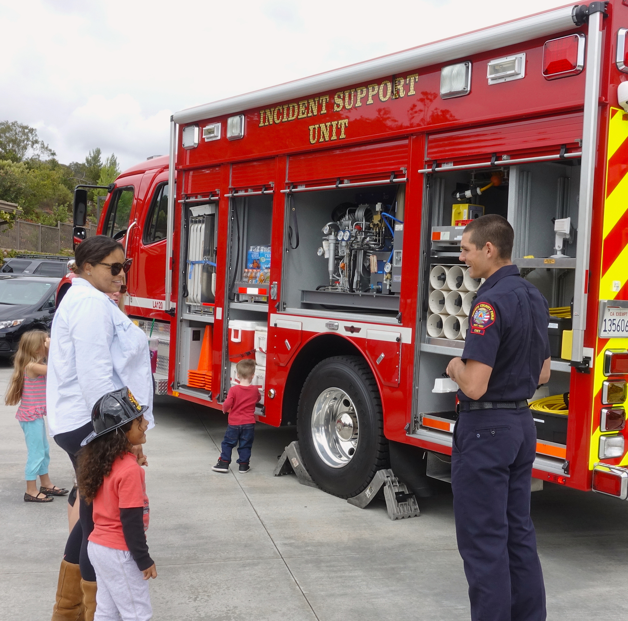
A Study of Community Helpers

Slide 8

A STUDY OF COMMUNITY HELPERS
A preschool teacher follows a curriculum based on themes, one of which is Community Helpers. While reviewing her class’s progress in meeting the Social Studies standards, the teacher noticed that children were discussing the various fire trucks that pass her center from a nearby station.

Slide 9
A STUDY OF COMMUNITY HELPERS
ELDS STANDARDS
GOALS AND SUGGESTED ACTIVITIES
RELEVANT BOOKS
TRIP TO THE FIRE STATION
STANDARDS RELATED TO SOCIAL SKILLS

Slide 10
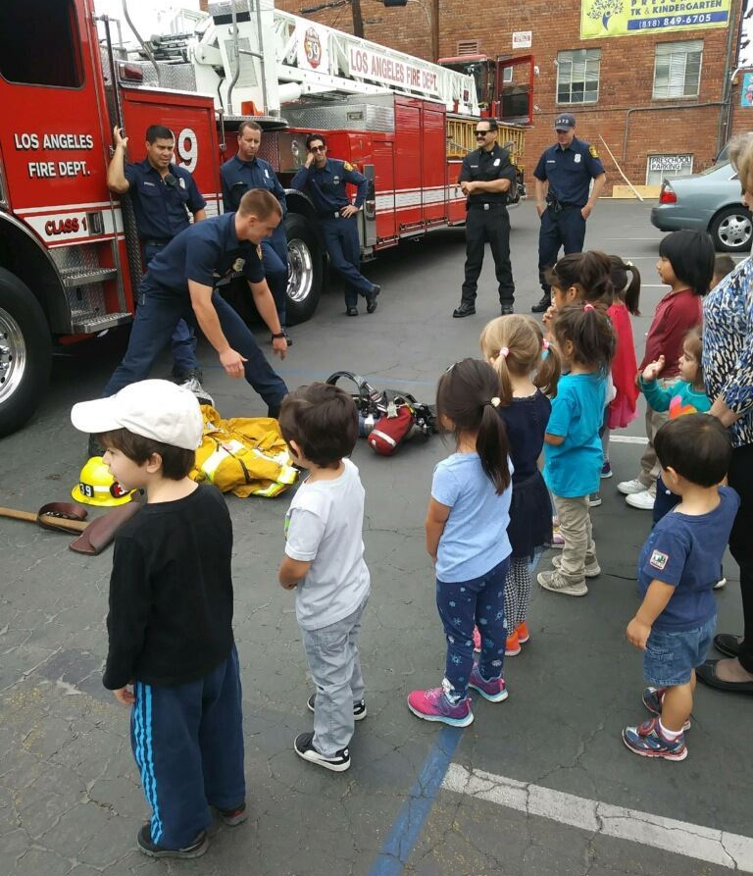
A STUDY OF COMMUNITY HELPERS
While at the station, the children learned:
  The purpose of the various trucks that firefighters use
  Firefighters’ jobs and how they work closely with the police to keep families safe
  Fire and weather safety and how to report emergencies, therefore addressing other safety standards.

Slide 11
A STUDY OF COMMUNITY HELPERS
In preparation for their return, the teacher had prepared relevant classroom materials for the children to play with:
  Toy fire trucks, fire chief and police cars, wooden firefighter and police figures, fire helmets, puzzles of various difficulties depicting firefighters and vehicles, and other related items
Once back in the classroom, the teacher watched and noted the children’s abilities to work the puzzles.

Slide 12
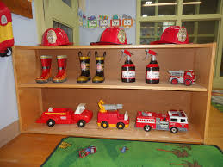
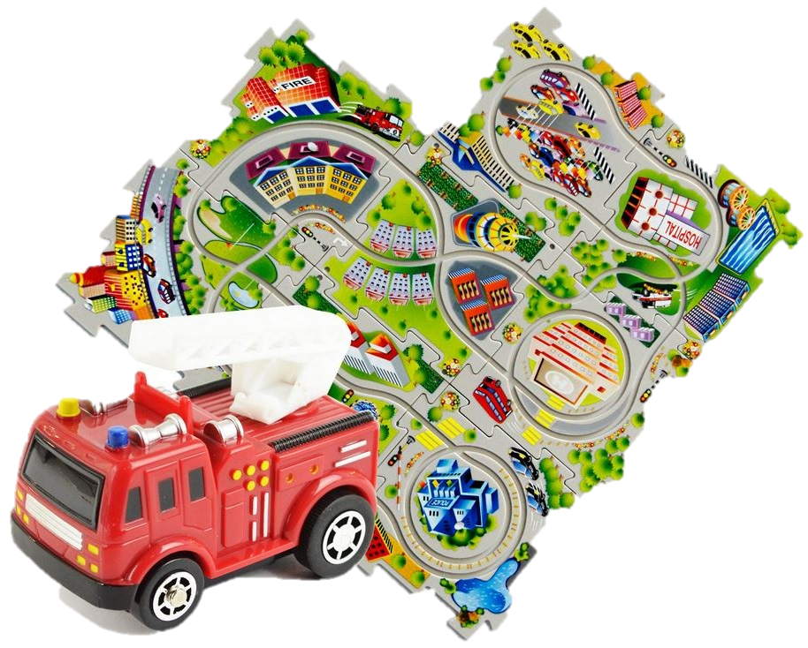
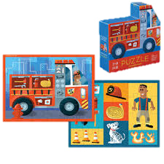

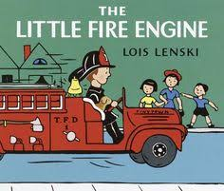
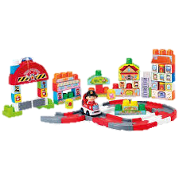
CLASSROOM MATERIALS

Slide 13

A STUDY OF COMMUNITY HELPERS
Instruction
Observation
Alignment
In what other ways can the teacher incorporate student interest within curricular activities? Other content areas she can incorporate?

Slide 14
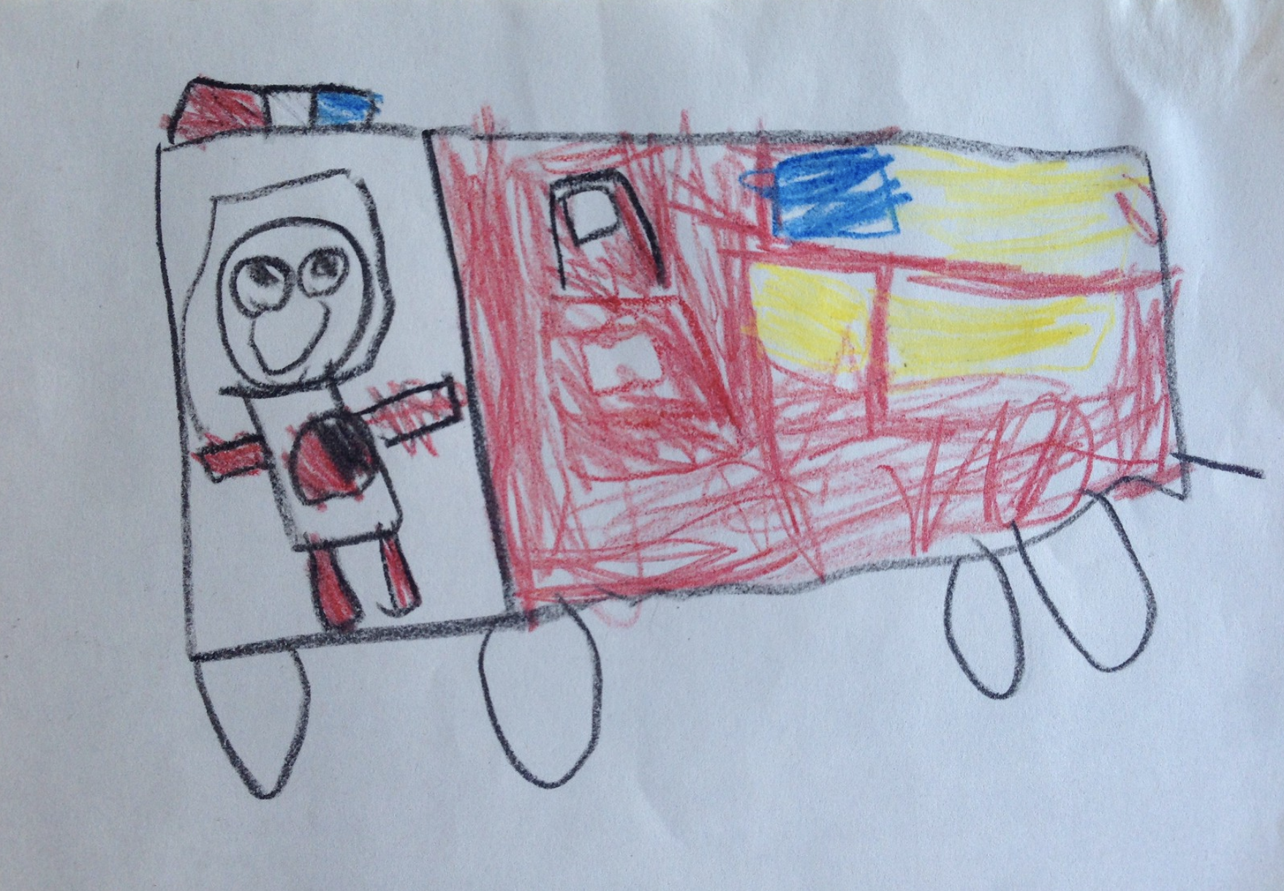
Firefighter Art
“We went to the fire station and saw the trucks. A fireman showed us pictures of her children. They have a big hose and they let me hold it.”

Slide 15
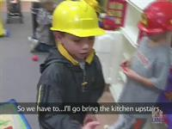
PRETEND PLAY FIREFIGHTER
This video illustrates how the children used some of the materials available in the dramatic play area.
It also demonstrates what the children learned as a result of the field trip and the other experiences the teacher planned.
Watch for examples of how children are recreating what they learned.
You will complete your Video Guide following the video.
Hold CTRL and click the picture to play video.
Notes:
https://vic.nsula.edu/hapi/v1/contents/permalinks/y9F8Jma3/view

Slide 16
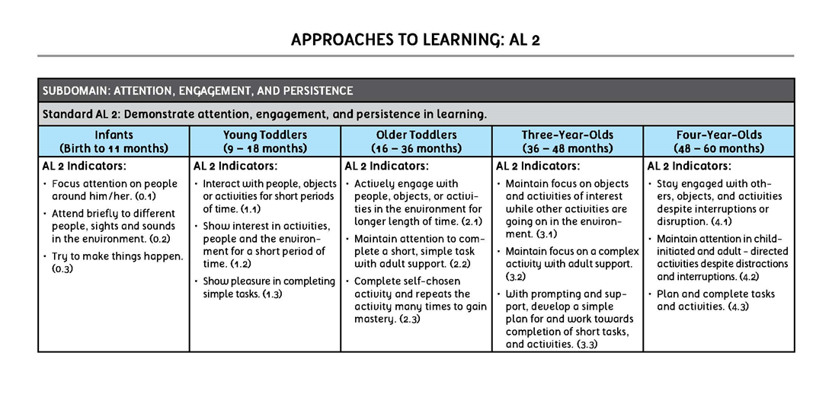

Slide 17
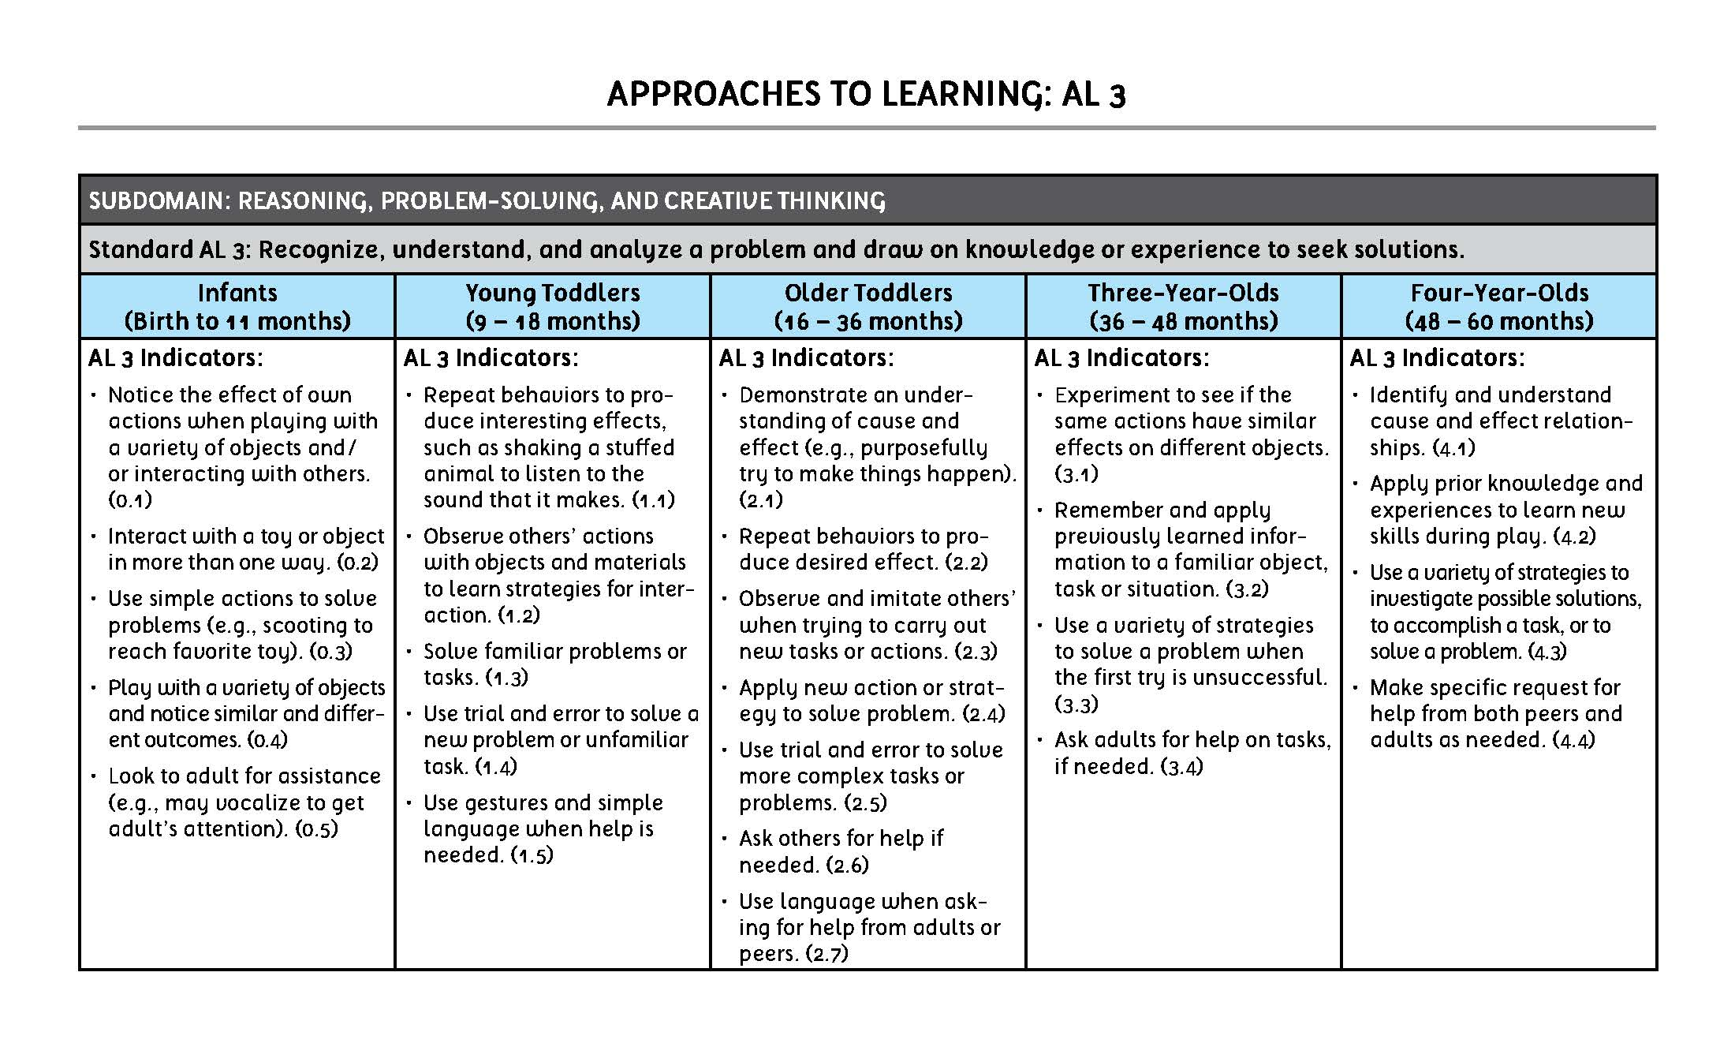

Slide 18
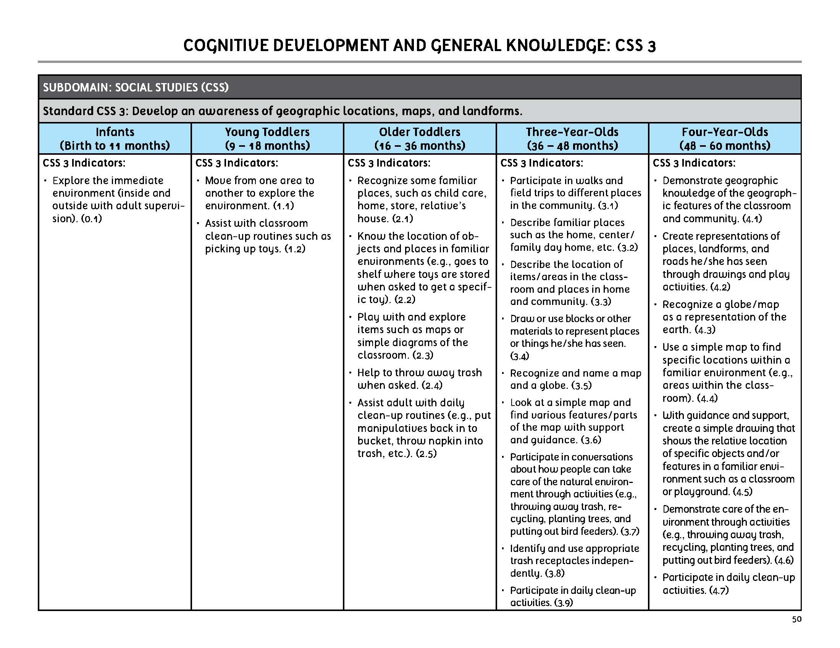

Slide 19
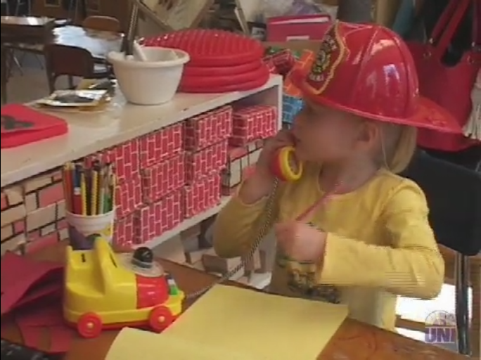
WHERE’S THE FIRE?
Hold CTRL and click the picture to play video.
Notes:
https://vic.nsula.edu/hapi/v1/contents/permalinks/Td79ZfMx/view

Slide 21
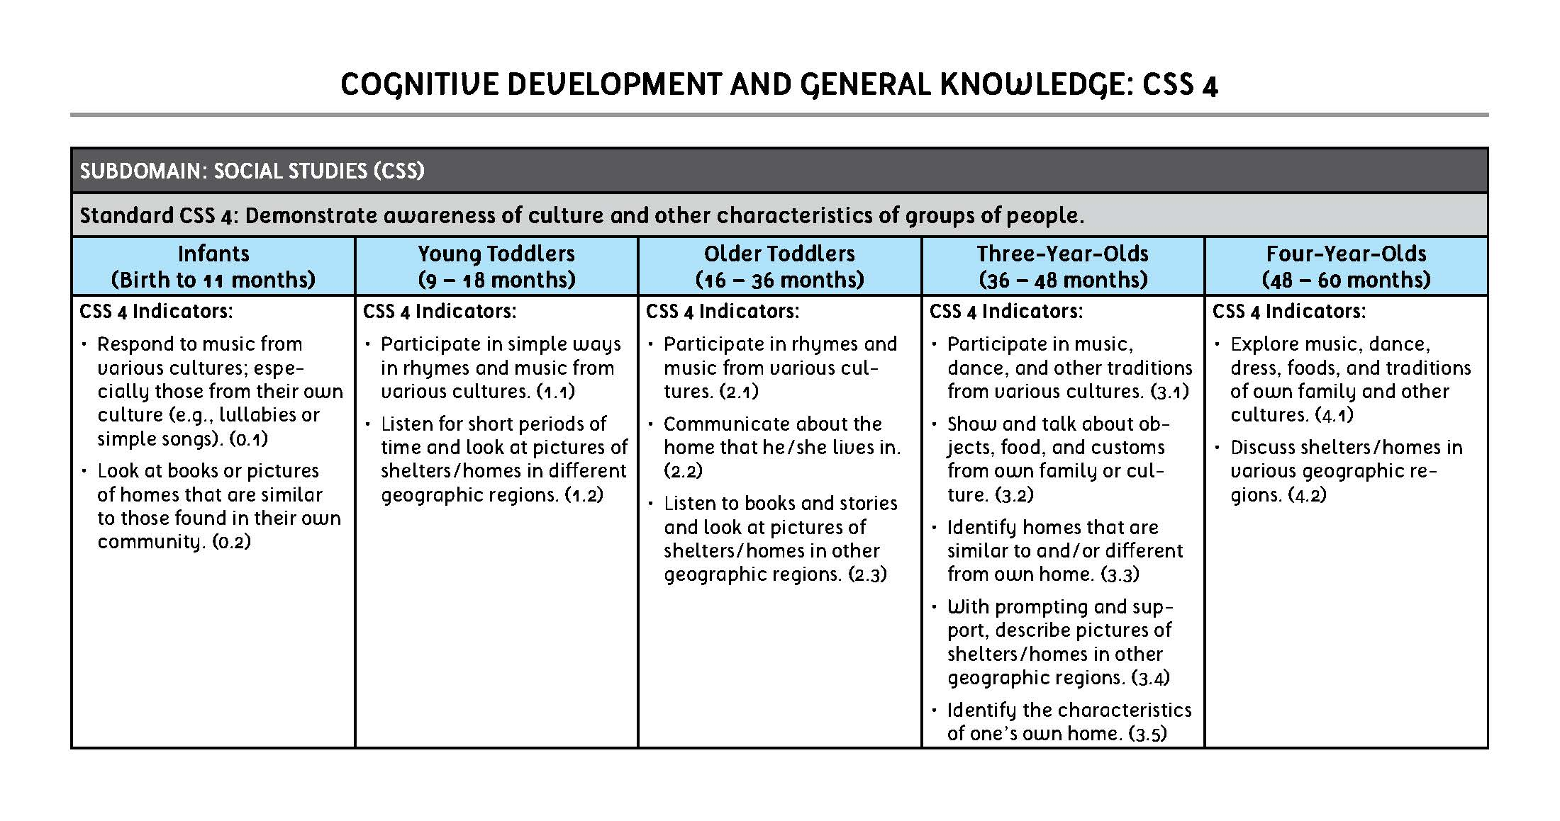

Slide 22
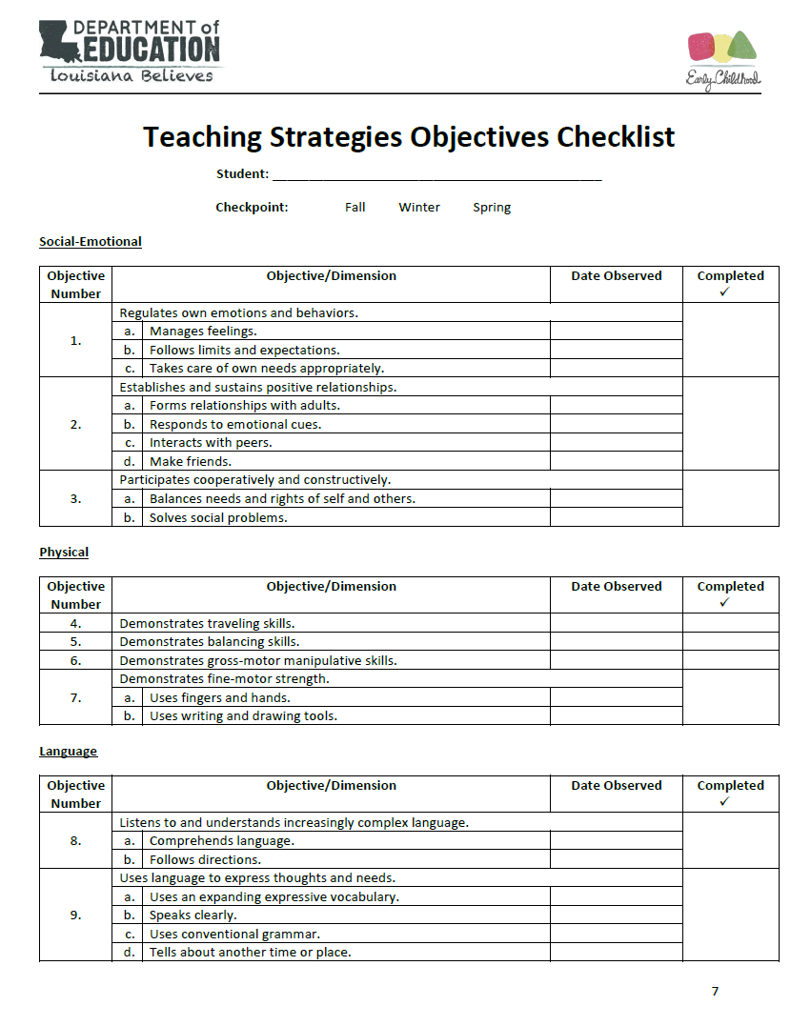
WHERE’S THE FIRE?
USING THE TEACHING STRATEGIES OBJECTIVES CHECKLIST
Work with your partner in this Recording Activity.
Use the Teaching Strategies Objectives Checklist and discuss what objectives you saw children demonstrate in the video.
Record the indicators that were demonstrated in the video on the checklist.

Slide 23
What Do I Do Now?

Slide 24
Session Review

Slide 25
REVIEW LEARNING OBJECTIVES
Explain why standards are important and how they can be used to guide what one does in the classroom
Describe the difference between standards, curriculum, and assessment and how they are interconnected and work together for teaching effectiveness
Determine if an activity is relevant to the standards, follows the curriculum, and can be assessed and recorded

Slide 26

Reflections,
Questions, & Comments

Slide 27

Please complete the Post-Assessment Evaluation.
Thank you!

