Slide 1
Do You See What I See?—
Using Assessments to Guide Children’s Learning and Development
Notes:
As training participants enter the room, have them complete and turn in the pre-assessment exercise. Scan the submitted assessments as they are turned in to provide yourself with an initial assessment of trainees’ starting knowledge and knowledge gaps, to assist you in anticipating potential upcoming questions and areas needing additional emphasis or examples.

Slide 2
Learning Objectives:
This training is designed to help you
Define observation-based assessment and understand its importance in promoting children’s development and learning;
Conduct effective observations and assess children throughout activities and routines within the daily schedule;
Gather useful assessment documentation in a way that is practical and easy;
Utilize documentation and assessment effectively to adjust curriculum, activities, and teaching strategies to promote children’s development and learning; and
Evaluate children’s progress with reliability.
Notes:
We are here today to learn how to use assessment to guide children’s learning and development.
This training is designed to help you understand
what observation-based assessment is and its importance in promoting children’s development and learning
how to conduct effective observations and assess children throughout activities and routines within the daily schedule
how to gather useful assessment documentation in a way that is practical and easy
how to utilize documentation and assessment effectively to adjust curriculum, activities, and teaching strategies to promote children’s development and learning
and how to evaluate children’s progress with reliability
Understanding how to conduct observation-based assessment of the children in your classroom is critically important, so that you can be as effective as possible at your job--supporting children’s positive growth and development.

Slide 3
Defining Observation-Based Assessment
Notes:
So first let’s define what “observation-based assessment” of children means--
How many of you have school-age children who have taken LEAP tests, or how many of you remember being in school and taking standardized tests?
Assessment in early childhood classroom is NOTHING like that.
Since “observation-based assessment” is not supposed to be like those tests or assessments, let’s talk about what it IS supposed to be like--

Slide 4
Observation-Based Assessment
How would you describe what “observation-based assessment” means?
Please take a few minutes to reflect on
as many words and phrases that come to mind!
Notes:
Please take a few minutes to reflect on how you would describe what “observation-based assessment” means--
Think of as many words and phrases that come to mind--
Pause for everyone to reflect--prepare to use flip chart or whiteboard--
Now let’s share what words and phrases you think are important in understanding what “observation-based assessment” means and that will help us each see what it means to this group.
Take time to write down quickly all the answers called out by the group. If many answers aren’t forthcoming, push them to share more/come up with more. Try to get at least 10 responses--
Then you might ask participants to point out which particular words and phrases stand out to them as helping to understand what observation-based assessment means. Have participants, who come closest to correct definitions, and/or participants who have shared words or phrases that might lead to interesting explanations, explain how they believe that the word(s) or phrase(s) relate to conducting and/or understanding observation-based assessment.

Slide 5
Observation-Based Assessment
Observation-based assessment can be defined as watching and listening to individual and groups of children, as children interact with their surroundings and other people, with the clear goal of looking for specific behaviors or ability, to understand better what a child knows and can do.
Observation-based assessments document the actions and words observed.
Observation-based assessments should be ongoing throughout the year.
Observation-based assessment documentation provides the basis for future planning of activities and supports for individuals and groups of children.
Notes:
Depending on the responses submitted by participants in the poll, you might say, Let’s look at how your responses match some standard definitions of observational assessment:
Observation-based assessment can be defined as watching and listening to individual and groups of children, as children interact with their surroundings and other people, with the clear goal of looking for specific behavior or ability, so as to understand better what a child knows and can do.
Observation-based assessments document the actions and words observed.
Observation-based assessments should be ongoing, throughout the year.
Based on those observations and documentation, observation-based assessment then leads to future planning of activities and supports for individual and groups of children.
Again, depending on the responses submitted by participants in the poll and timing, you might switch and/or simply refer back to the relevant keywords here that were also captured by the training participants.
As teachers, we should be continually conducting observation-based assessments of ALL children in our care, regardless of their age or whether they are considered “at risk.” Only through such observations and assessments can teachers implement curricula and plan lessons that support children where they are at and help them advance to their next levels.
Observation-based assessment is critical to your teaching: you cannot effectively teach without first knowing where children are in their development and what they are interested in doing.
A clearly defined approach to assessment helps teachers successfully collect information about EACH child, in ALL areas of development, in order to plan learning experiences and instruction that ensure the child’s growth in all areas.

Slide 6
Assessment of Typical versus Atypical Development
There are typical milestones of child development. However...
All children develop at different paces.
To support development, provide instruction at the level of each individual child, so that the instruction is at a level each child can understand.
Sometimes a child may need more support than other children need, and may even need additional support, from a specialist.
To ensure that all children succeed in social and educational setting, it is important to conduct observational assessments of the children in your care.
Notes:
While there are typical milestone periods at which most children develop certain skills, no child develops all skills at each typical milestone; rather, all children develop at different paces. For example, some are faster or slower to walk, or to talk. Observing what a child can and cannot do, and understanding typical developmental milestones, is necessary for you, both to provide instruction at the level that each individual child can understand and be able to learn from, and to help children advance their knowledge and abilities. Observation-based assessment will help you identify whether a child may need more support than other children need in learning a skill, and whether there is a need for additional, more intensive intervention from a specialist, in addition to the modifications and supports that you provide to the child in your classroom. Only developmentally-appropriate supports will help a child make further meaning about the world around them.
It is our responsibility (and our privilege) as children’s first classroom teachers to provide children with the positive supports that will prepare them socially and emotionally, cognitively, physically, and linguistically, to enter school excited and ready to keep learning.
Centers for Disease Control and Prevention, Child Development Basics, https://www.cdc.gov/ncbddd/childdevelopment/facts.html

Slide 7
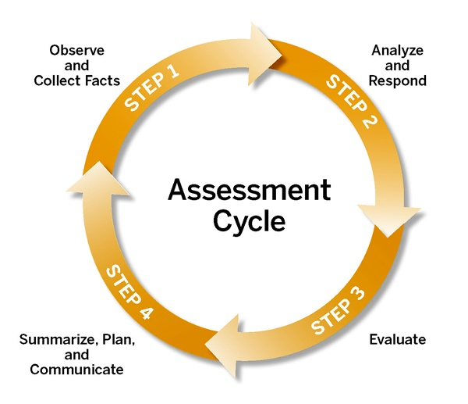
Teaching Strategies Assessment Cycle
Observational assessment is a
continuous cycle of
Learning
Measuring
Growing
Teaching Strategies, “The Importance of the Assessment Cycle”
Notes:
“In early childhood education, assessment is the process of gathering information about children in order to make decisions. Assessment is often equated with the notion of testing to judge a child’s abilities, but in actuality, it is a four-step cycle that helps teachers individualize learning for every child. Assessment has four primary purposes:
• to support learning
• to identify special needs
• to evaluate programs and monitor trends and
• to respond to program accountability requirements
[Source: The Importance of the Assessment Cycle in The Creative Curriculum® for Preschool https://teachingstrategies.com/wp-content/uploads/2017/03/Theory-Paper-Assessment-Creative-Curriculum-Preschool-10-2012.pdf]
Observational assessment is a continuous cycle of
Learning
Measuring and
Growing.
While this particular model comes from Teaching Strategies, this basic process is applicable to all observation-based assessment, regardless of whether you are using the Teaching Strategies GOLD observation tool or not.
Practicing this ongoing assessment cycle enables you to make informed decisions about how to individualize learning for each child. It is a critical component of a high-quality early childhood education program.

Slide 8
Teaching Strategies Assessment Cycle
Step 1:
Conduct daily, ongoing observations of children’s knowledge, skills, and behaviors-- with minimal or no intrusion to the children’s activity
Record clear observations
Learn what is unique and special about each child
Teaching Strategies, “The Importance of the Assessment Cycle”
Notes:
The first step of the observation-based assessment cycle involves collecting information--through daily and ongoing observation--of children’s knowledge, skills, and behaviors--in order to INDIVIDUALIZE children’s learning. The observations can be made with minimal or no intrusion to the children’s activity.
Teachers are often doing this without even realizing it! For example, if you teach three and four year olds, have you ever noticed that one of your little friends almost always chooses to build towers in the block area during free play? Making that observation was collecting information about the children in your care!
Through the process of observing and recording, you come to know the unique personalities and abilities of each individual child. The more you know about each child, the stronger your connection with that child...and we know from CLASS that strong connections with your children lead to gains in their learning.
As you understand how important observations are, you’ll want to to be proactive about having a plan for capturing and documenting the observations. It’s worth taking the time to set up your system for note-taking and for organizing your documentation on each child as you gather it. This will save you from having to sort through a mess of documentation at the same time later.
Later in this training we’ll cover specific methods and strategies for taking those observational notes and for collecting additional kinds of documentation. These other kinds of documentation might include photos, video clips, and samples of student work.

Slide 9
Teaching Strategies Assessment Cycle
Step 2:
Knowing what a child can and cannot do helps you decide how much support the child needs
Use information gathered to decide when what, and how to target instruction and provide support
Use information gathered to scaffold each child’s learning appropriately
Teaching Strategies, “The Importance of the Assessment Cycle”
Notes:
The next step in the cycle is to analyze the data you have collected and to respond. In other words, you should look through the notes and documentation you have gathered, and you should use that information to begin to plan how you can support the child’s learning.
Use your gathered information to decide when, what, and how to target instruction and provide support.
Remember, knowing what a child can and cannot do helps you decide how much support the child needs in order to meet to meet the learning objectives for that child and that child’s age. That support is called “scaffolding.”

Slide 10
Teaching Strategies Assessment Cycle
Step 3:
Decide which indicators of best describe the child’s knowledge, skills, and behaviors
Determine the child’s level of development in relation to each learning objective
Teaching Strategies, “The Importance of the Assessment Cycle”
Notes:
The next step of the cycle is to evaluate. By consistently analyzing your observation documentation, you are able to evaluate each child’s level of development and progression--based on what you have observed of the child’s knowledge, skills, and behaviors--in relation to the learning objectives in the Teaching Strategies GOLD Objectives for Development and Learning or in the Louisiana Early Learning and Development Standards. In evaluating each child’s level of development in relation to those standards, you can determine which indicators of learning most closely describe what the child demonstrates in terms of knowledge, skills, or behaviors.

Slide 11
Teaching Strategies Assessment Cycle
Step 4:
Summarize findings about each child
Intentionally develop plans for scaffolding, for individual children as well as the group
Communicate what you observed and strategies for supporting children’s growth to families and administrators
Teaching Strategies, “The Importance of the Assessment Cycle”
Notes:
The final step in the observation-based assessment cycle involves summarizing, planning, and communicating:
You should
Summarize what you now know about the child (and remember to date those notes, too!)
Intentionally develop your plans for the children (both as individuals and the group as a whole), to help them advance their skills
Communicate with families about their children’s strengths and ways they can assist their children’s further development
Why is it important to date your notes?
Pause for answers.
That’s right, so much happens in our classrooms, and we wear many hats, so we shouldn’t expect ourselves to remember everything. And time really flies. But when we have dated notes we can track whether a child has plateaued at the same skill level for several months and might need interventions.

Slide 12
TS GOLD Areas of Development and Learning
Areas of Learning of the TS GOLD Objectives:
Social-Emotional | Cognitive | Science & Technology
Physical | Literacy | Social Studies
Language | Mathematics | The Arts
Notes:
As many of you already know, Teaching Strategies GOLD is the observation-based assessment tool approved by the state of Louisiana for conducting observational assessments of children in your classrooms who are considered “at-risk.” (These include children in the Child Care Assistance Program, also known as CCAP, children in foster care, children for whom English is a second language, or children who have been diagnosed with a special need.)
Teaching Strategies, or TS, GOLD is a tool that helps you document children’s growth in up to 38 areas called “Objectives for Development & Learning.”
These Objectives are divided up into the following areas of learning:
Social-Emotional
Physical
Language
Cognitive
Literacy
Mathematics
Science and Technology
Social Studies
The Arts
In addition, TS GOLD contains Objectives for documenting English Language Acquisition.
While the tool has a total of 38 Objectives, Louisiana child care centers most commonly collect documentation for 22 of the Objectives.
--it is important to find out for which of the Objectives your center expects you to collect documentation.
It is not important to discuss, but, if asked, the Objectives regarding which some centers do not collect documentation are Science and Technology, Social Studies, The Arts, and English Language Acquisition. Just because one does not collect documentation in an online tool, however, does not mean that a teacher shouldn’t and couldn’t still make observations, and even collect documentation, under those Objectives.
Which of you have already used TS GOLD to some extent?
Pause and affirm.
The TS GOLD observation tool is “grounded in the most current research about how children develop and learn” and has been “tested by independent researchers.” The TS GOLD “objectives for development and learning are predictors of school success, based on school readiness standards.” And the TS GOLD tool is “inclusive of all children,” “provid[ing] specific strategies and resources for every type of learner, including…those with special needs.”

Slide 13
Objectives for Development and Learning:
Social-Emotional Domain
1. Regulates own emotions and behaviors
a. Manages feelings | c. Takes care of own needs appropriately
b. Follows limits and expectations
2. Establishes and sustains positive relationships
a. Forms relationships with adults | d. Makes friends
b. Responds to emotional cues | e. Participates cooperatively and constructively in group situations (etc.)
c. Interacts with peers
Notes:
At this point you will distribute a copy of the Teaching Strategies GOLD “Objectives for Development & Learning.”
I am handing out to you a copy of the Teaching Strategies GOLD “Objectives for Development & Learning.” As you can see, each area of development we just discussed is divided into Objectives, and some Objectives are further divided into dimensions.
Here are some examples of the TS GOLD Objectives and dimensions, from the Social-Emotional domain:
So, for example, the Objective of
Regulates own emotions and behaviors
is divided into the dimensions of
Manages feelings
Follows limits and expectations
Takes care of own needs appropriately
Not all objectives are appropriate for each age group you care for and teach. In the TS GOLD tool “developmental progressions are color coded by age level.” These “color bands” show teachers, administrators, and families which behaviors and skills are typical for children of a particular age and class range. These age ranges are divided into Birth - 12 months, 1 - 2 years, 2 - 3 years, 3 year old Preschool, PreK 4, and Kindergarten.
Although not all behaviors and skills are expected of each age group, it is important for early childhood educators to have a strong understanding of the whole range of development. The reality in the early childhood education world is that we move from room to room, if not during the course of a day, most likely during the course of our careers, so truly understanding the progression of young children’s development is essential to being successful at our jobs.
We also need to understand which skills children are likely to enter our classrooms with, and which skills we want to help them build before they move into their next classrooms.

Slide 14
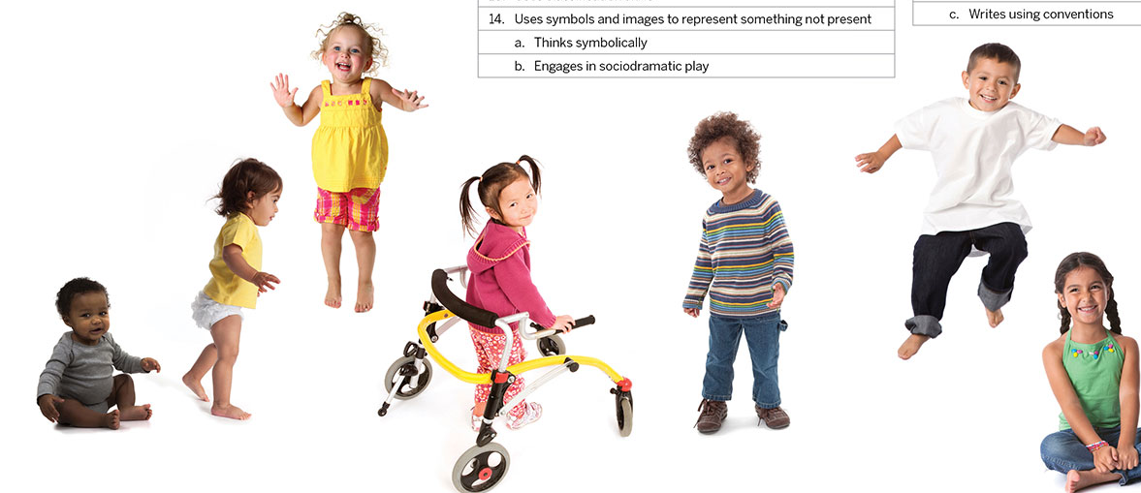
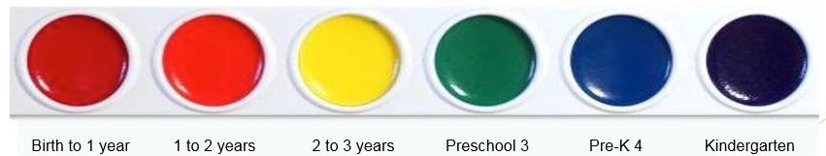
TS GOLD Color Bands
Notes:
As just mentioned, in TS GOLD age ranges are divided into these categories as well as colors:
Birth to 1 year is red
1 to 2 years is orange
2 to 3 years is yellow
Preschool 3 is green
Pre-K 4 is blue
and Kindergarten is purple
You’ll notice that it follows the spectrum of the rainbow, to help you remember which colors go with earlier and later ages.

Slide 15
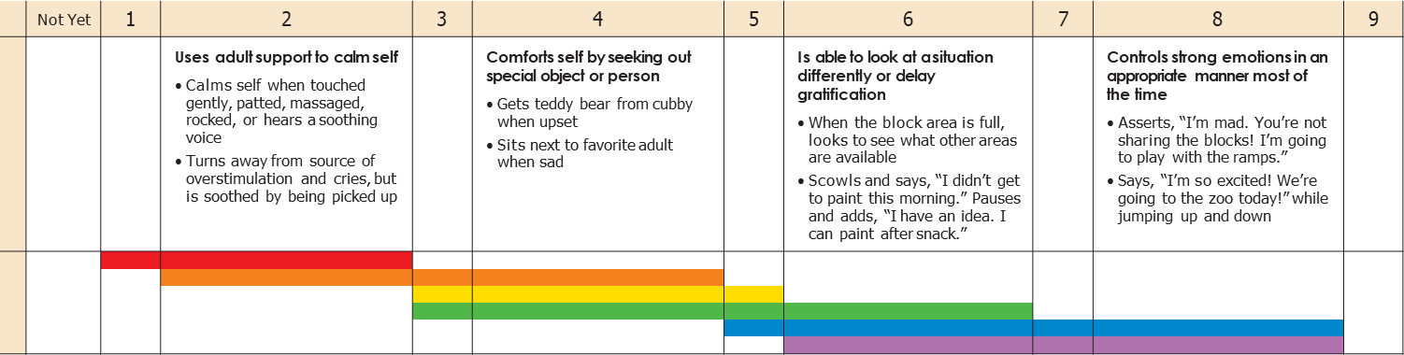
Practice applying the TS GOLD Color Bands:
Objective 1 Regulates own emotions and behaviors
a. Manages feelings
Notes:
Even if you do not have access to the TS GOLD software in your own classroom, you can download and print a copy of The “Objectives for Development and Learning,” including colorbands, to use in assessing the children in your care: https://gold.teachingstrategies.com/content/GOLD/helpitems/GOLD_Progressions_EN.pdf
Let’s go through an example to apply the color bands--
What this means is we will take an example of children’s behavior and categorize it according to its corresponding age of development.
Take a look at the handout (“TS Gold Objectives for Development & Learning”).
Find “Social & Emotional Objective 1: Regulates own emotions and behaviors.”
The first dimension is “Manages feelings.”
The way a 9-month old child “manages” her “feelings” is different than the way a four-year old “manages feelings”...and that’s because they are at different stages of development.
In TS GOLD these different ways of showing the objective (in this case, “regulates own emotions”) are called “Indicators.”
Point to/reference the slide.
An Indicator for “Manages feelings” is “Uses adult support to calm self.” [click to circle this Indicator]
Each bullet is an example of an Indicator.
When a baby stops crying after an adult rocks him, or when an upset toddler calms down after being picked up by a caregiver, he is using adult support to calm himself.
What color band do you think should be selected?
Pause for training participants to call out answers.
Because that is an expected way, according to all our knowledge of child development, that an infant or toddler would manage his feelings, it would be marked with the red and orange color bands. [click to circle these colorbands]
Point to/reference that Indicator above those color bands.

Slide 16
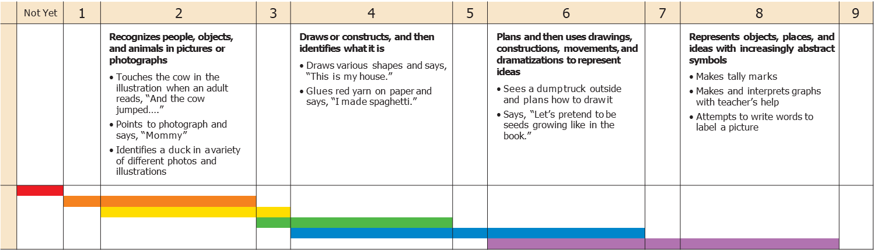
Practice applying the TS GOLD Color Bands:
Objective 14 Uses symbols and images to represent something not present
Thinks symbolically
Notes:
Let’s try another one, but we’ll do it a little differently.
Have you ever seen a child in the housekeeping area hold something up to her ear as though she’s talking on the telephone?
She’s using a real object as a prop and is imitating what she sees her parent doing.
She’s engaging in socio-dramatic play.
What objective does that fall under?
Pause for training participants to review their TS GOLD Objectives handout and call out answers.
[click for this Objective and dimension to appear]
That falls under Objective 14 under “Cognitive: Uses symbols and images to represent something not present.”
That behavior, of holding a prop, toy phone to the ear, is typical of what age?
Pause for training participants to call out answers.
(That’s right,) 1 - 3 years.
So what color bands would be used?
Pause for training participants to call out answers.
(That’s right,) orange and yellow.
[click to circle this colorband]

Slide 17
Ages & Stages of Development
Notes:
Now let’s dig deeper into some review and discussion of the typical Ages & Stages of Development--
You are encouraged to poll the group at this point to determine what ages are currently taught by participants, so that you are able to adjust your emphasis and examples accordingly as you present the training. Ask “Who teaches Infants? Who teaches Toddlers? Who teaches Preschoolers?”

Slide 18
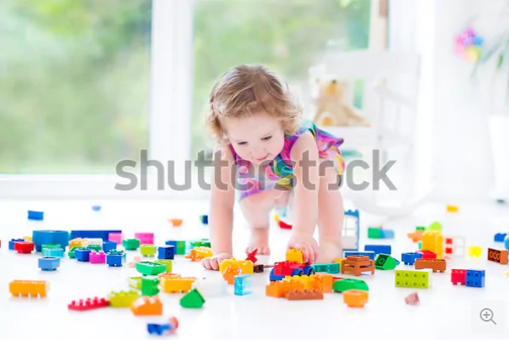
What does developmentally-appropriate mean?
[We want to use here Shutterstock picture 177145157]
Notes:
Has anyone heard of the term “DAP”? That acronym is used frequently among early childhood professionals. It refers to “Developmentally-Appropriate Practice.” That means that the goals and the learning experiences in our classrooms--in our practice--are fitting, or are “appropriate,” to the children’s age and development. Before we can set suitable goals and plan fitting lessons, we need to understand what developmentally-appropriate means.
As we noted earlier, each individual child develops at his or her own pace. That is because each individual child is unique. Years and years of research, however, show us that there are predictable neurotypical patterns of how most children grow and what they can do - socially, emotionally, cognitively, linguistically, and physically - at a particular stage of development. This knowledge, of what most children can do at what age, enables teachers (and other caregivers) to plan experiences and activities that will be in alignment with the children’s developmental abilities. This knowledge helps teachers to anticipate children’s behavior and have reasonable expectations about how children will respond to different activities or situations.
For example, we know that older toddlers actively explore their environment (GOLD Demonstrates positive approaches to learning–shows curiosity and motivation 14d, as well as ELDS Approaches to Learning 1); therefore, it is reasonable to expect that if a toddler finds a filled basket on the floor, she is going to dump it out. She is not being bad or misbehaving. She is acting in a way that is completely appropriate and expected for her development. A two year old learns by actively exploring her environment.

Slide 19
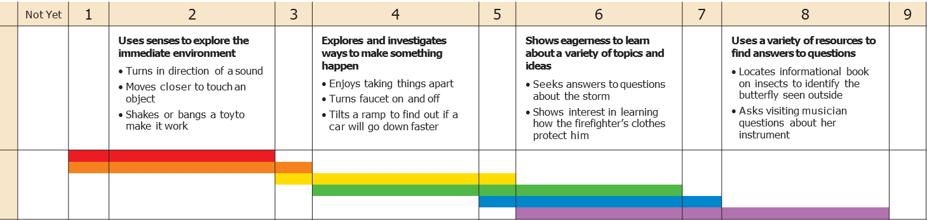
TS GOLD
Objective 11 Demonstrates positive approaches to learning
d. Shows curiosity and motivation
Notes:
We see this understanding of DAP throughout GOLD, including in the example I just mentioned—
An older toddler (2-3 years old), represented by colorband yellow [click for circle], first begins to “enjoy taking things apart” [click for circle], such as dumping out a filled basket, as a way of “exploring and investigating ways to make something happen.” That behavior is in fact an expectation of development and learning for children!
As teachers, we need to know what’s developmentally-appropriate at each stage so that our expectations align with the development of the children in our care.
We also need to know what’s developmentally-appropriate at each stage so that if a child hasn’t yet demonstrated certain behaviors or skills, you can pursue additional supports for the child, such as providing extra one-on-one guidance or instruction or referring a family for special services.

Slide 20
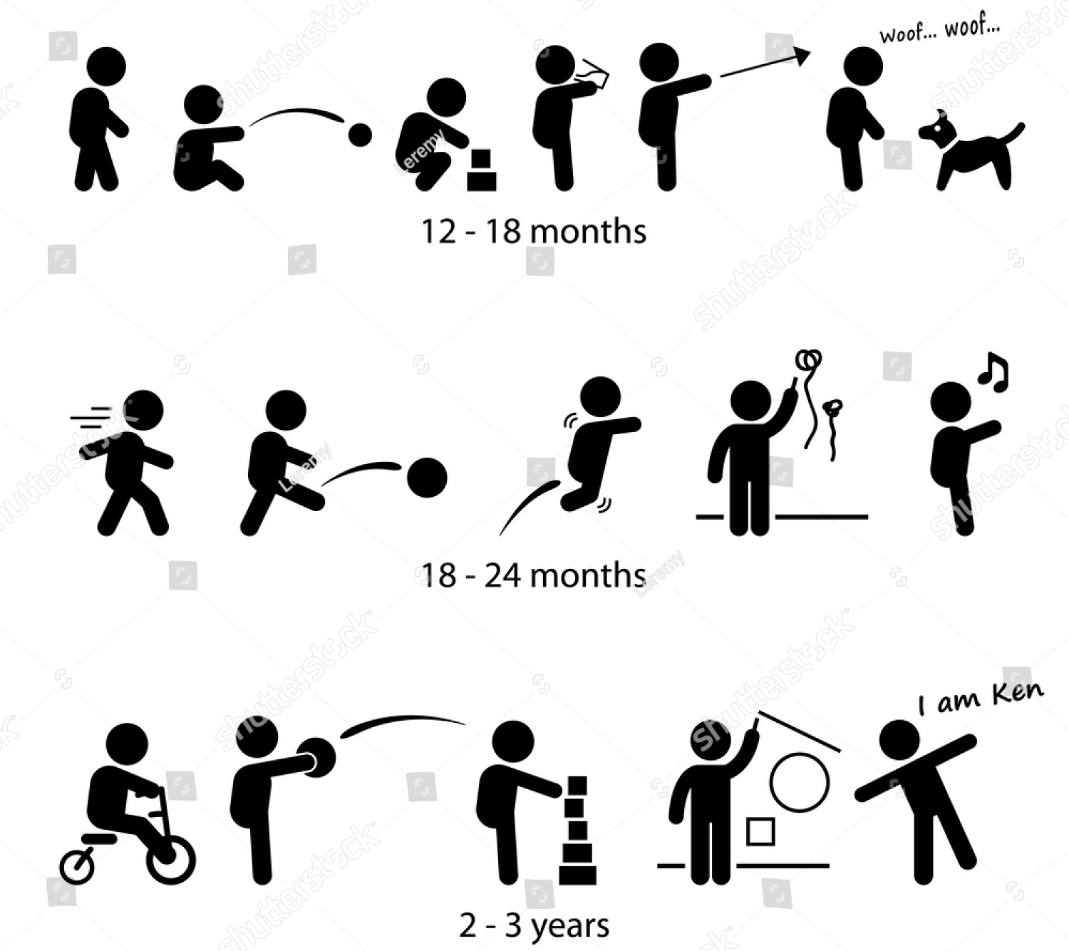
Let’s Practice: Appropriate developmental expectations
Answer choices:
Birth to 1 year
1 to 2 years
2 to 3 years
3 to 4 years
4 to 5 years
Notes:
[please insert Shutterstock photo 170353472]
Okay, let’s review some additional developmentally-appropriate expectations with a little quizzing of ourselves:
We know that all typical four year olds can walk, but when do children typically first begin to walk?
Pause for answers.
Yes, children typically begin walking around one year old.
Okay, I’m going to describe a behavior or skill, and I’d like you to determine at which age children typically first begin doing this skill.
We will use the age ranges of the Teaching Strategies GOLD tool--
Here are your possible answer choices to each question: “Birth to 1 year,” “1 to 2 years,” “2 to 3 years,” “3 to 4 years,” and “4 to 5 years.”
As we know, children don’t reach milestones on precise dates, they develop at different rates...so in terms of the walking example, even if you have a niece that started motoring around the house at eight months, we would say that behavior typically begins from age 1 to 2 years, not birth to 1 year.
So, just call out, as a group, what you think is the correct answer to each question—
(A training alternative is to provide participants with 5 different colored note cards, with each category designated by a different color such as Birth to 1 year = light blue and the participants hold up the cards rather than call out the answers.)

Slide 21
Appropriate developmental expectations:
In what age range is it appropriate first to expect children to:
Hold a rattle and shake it?
Birth to 1 year
Repeat simple phrases from familiar stories, such as “Chicka, Chicka, Boom! Boom!”
2 to 3 years
Point to pictures in a book?
1 to 2 years
Feed self with finger foods such as Cheerios?
Birth to 1 year
Notes:
Pause between clicks--
Click to allow the first question to show up onscreen.
In what age range is it appropriate to expect children to…
Hold a rattle and shake it?
PAUSE after asking EACH question aloud, for participants to answer aloud or hold up the appropriate answer card--
You may need to remind participants of the possible answer choices—
Click to let the first answer appear onscreen.
That’s right, a child age birth to 1 year is typically first able to hold a rattle and shake it.
Follow this procedure of clicking for the next question, pausing for answers, clicking for the answer, for each question on this slide and the next two slides.
Repeat simple phrases from familiar stories such as, “Chicka, Chicka, Boom! Boom!” (2 to 3 years)
Point to pictures in a book? (1 to 2 years)
Feed self with finger foods such as Cheerios? (Birth to 1 year)

Slide 22
Appropriate developmental expectations:
Sit and remain engaged during storytime, despite interruptions?
4 to 5 years
Recognize and respond to feelings of others, by saying things like, “She crying”?
2 to 3 years
With the guidance of a teacher, can wait for a turn with a toy?
3 to 4 years
Express preferences for food or favorite toys by making sounds and facial expressions?
Birth to 1 year
Notes:
Only let the first line up on the screen initially--
In what age range is it appropriate first to expect children to…
Click to allow the first question to show up onscreen.
Sit and stay engaged during storytime, even when there are interruptions (as opposed to getting up and moving somewhere else during an interruption) (4 to 5 years)
Recognize and respond to feelings of others, by saying things like, “She crying” (2 to 3 years)
With the guidance of a teacher, waiting for a turn with a toy? (3 to 4 years)
Express preferences for food or favorite toys by making sounds and facial expressions? (Birth to 1 year)

Slide 23
Appropriate developmental expectations:
Identify some of the letters in their names?
3 to 4 years
Name “how many” after counting up to three blocks?
2 to 3 years
Respond with facial expressions when someone calls her name?
Birth to 1 year
Roll balls and watch how they move?
1 to 2 years
Sit for a teacher-led group time up to 15 minutes?
4 to 5 years
Notes:
We’re going to shift our thinking now, from when children typically first start doing something to when is it developmentally-appropriate for us to expect children to do certain things.
Click for each individual question, pause for responses, click for answer, move on the next question and repeat.
If behind on time, this slide can be skipped.
In what age range is it appropriate to expect children to regularly be able to…
Identify some of the letters in their names? (3 to 4 years)
Tell “how many” after counting up to three blocks? (2 to 3 years)
Respond with facial expressions when someone calls her name? (Birth to 1 year)
Roll balls and watch how they move? (1 to 2 years)
Sit for a teacher-led group time up to fifteen minutes? (4 to 5 years)

Slide 24
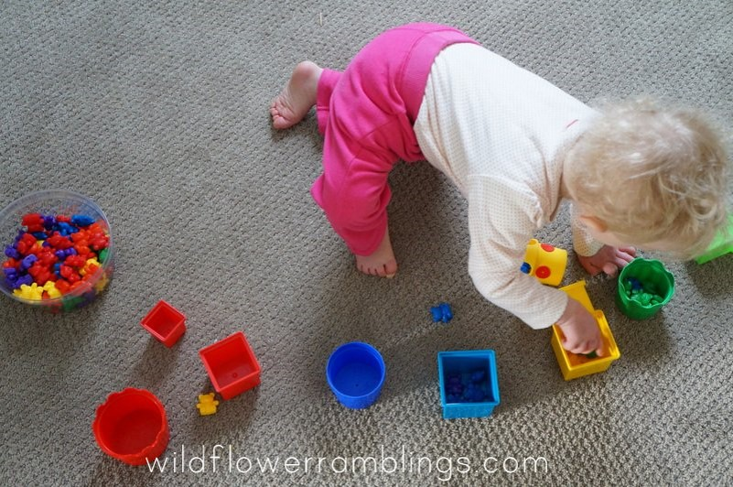
Practice assessing sample observation documentation:
taken from wildflowerramblings.com
Notes:
Next let’s practice making assessment of some observation documentation:
I am giving you a handout on which you can write your observations--
Give handout.
On the screen is an example of a piece of documentation--
What are the different things you can observe and evaluate based on this documentation? Note them on your handout--
Pause for participants to write down observations, individually or in pairs.
Possible answers include the following from the GOLD Objectives:
Mathematics—23—Demonstrates knowledge of patterns
Physical—7—Demonstrates fine motor strength and coordination—a. Uses fingers and hands
Cognitive—13—Uses classification skills
Cognitive—11—Demonstrates positive approaches to learning—a. Attends and engages; b. Persists; c. Solves problems; d. Shows curiosity and motivation
(If these examples were used in a training on the ELDS, possible answers would include the following:
Combining & separating groups by color or size--”Understand basic patterns, concepts, and operations” (Cognitive Development and General Knowledge--CM 2--Mathematics
Fine motor--”Develop small muscle control and coordination” (Physical Well-Being and Motor Development--PM 2--Motor Skills and Physical Fitness)
Cause-effect/trial & error--”Recognize, understand, and analyze a problem and draw on knowledge or experience to seek solutions” (Approaches to Learning--AL 3--Reasoning, Problem-Solving, and Creative Thinking)
Persistence--”Demonstrate attention, engagement and persistence in learning” (Approaches to Learning--AL 2--Attention, Engagement, and Persistence)
Curiosity & exploration--”Engage in play-based learning to explore, investigate and acquire knowledge about themselves and world” (Approaches to Learning--AL 1--Initiative and Curiosity

Slide 25
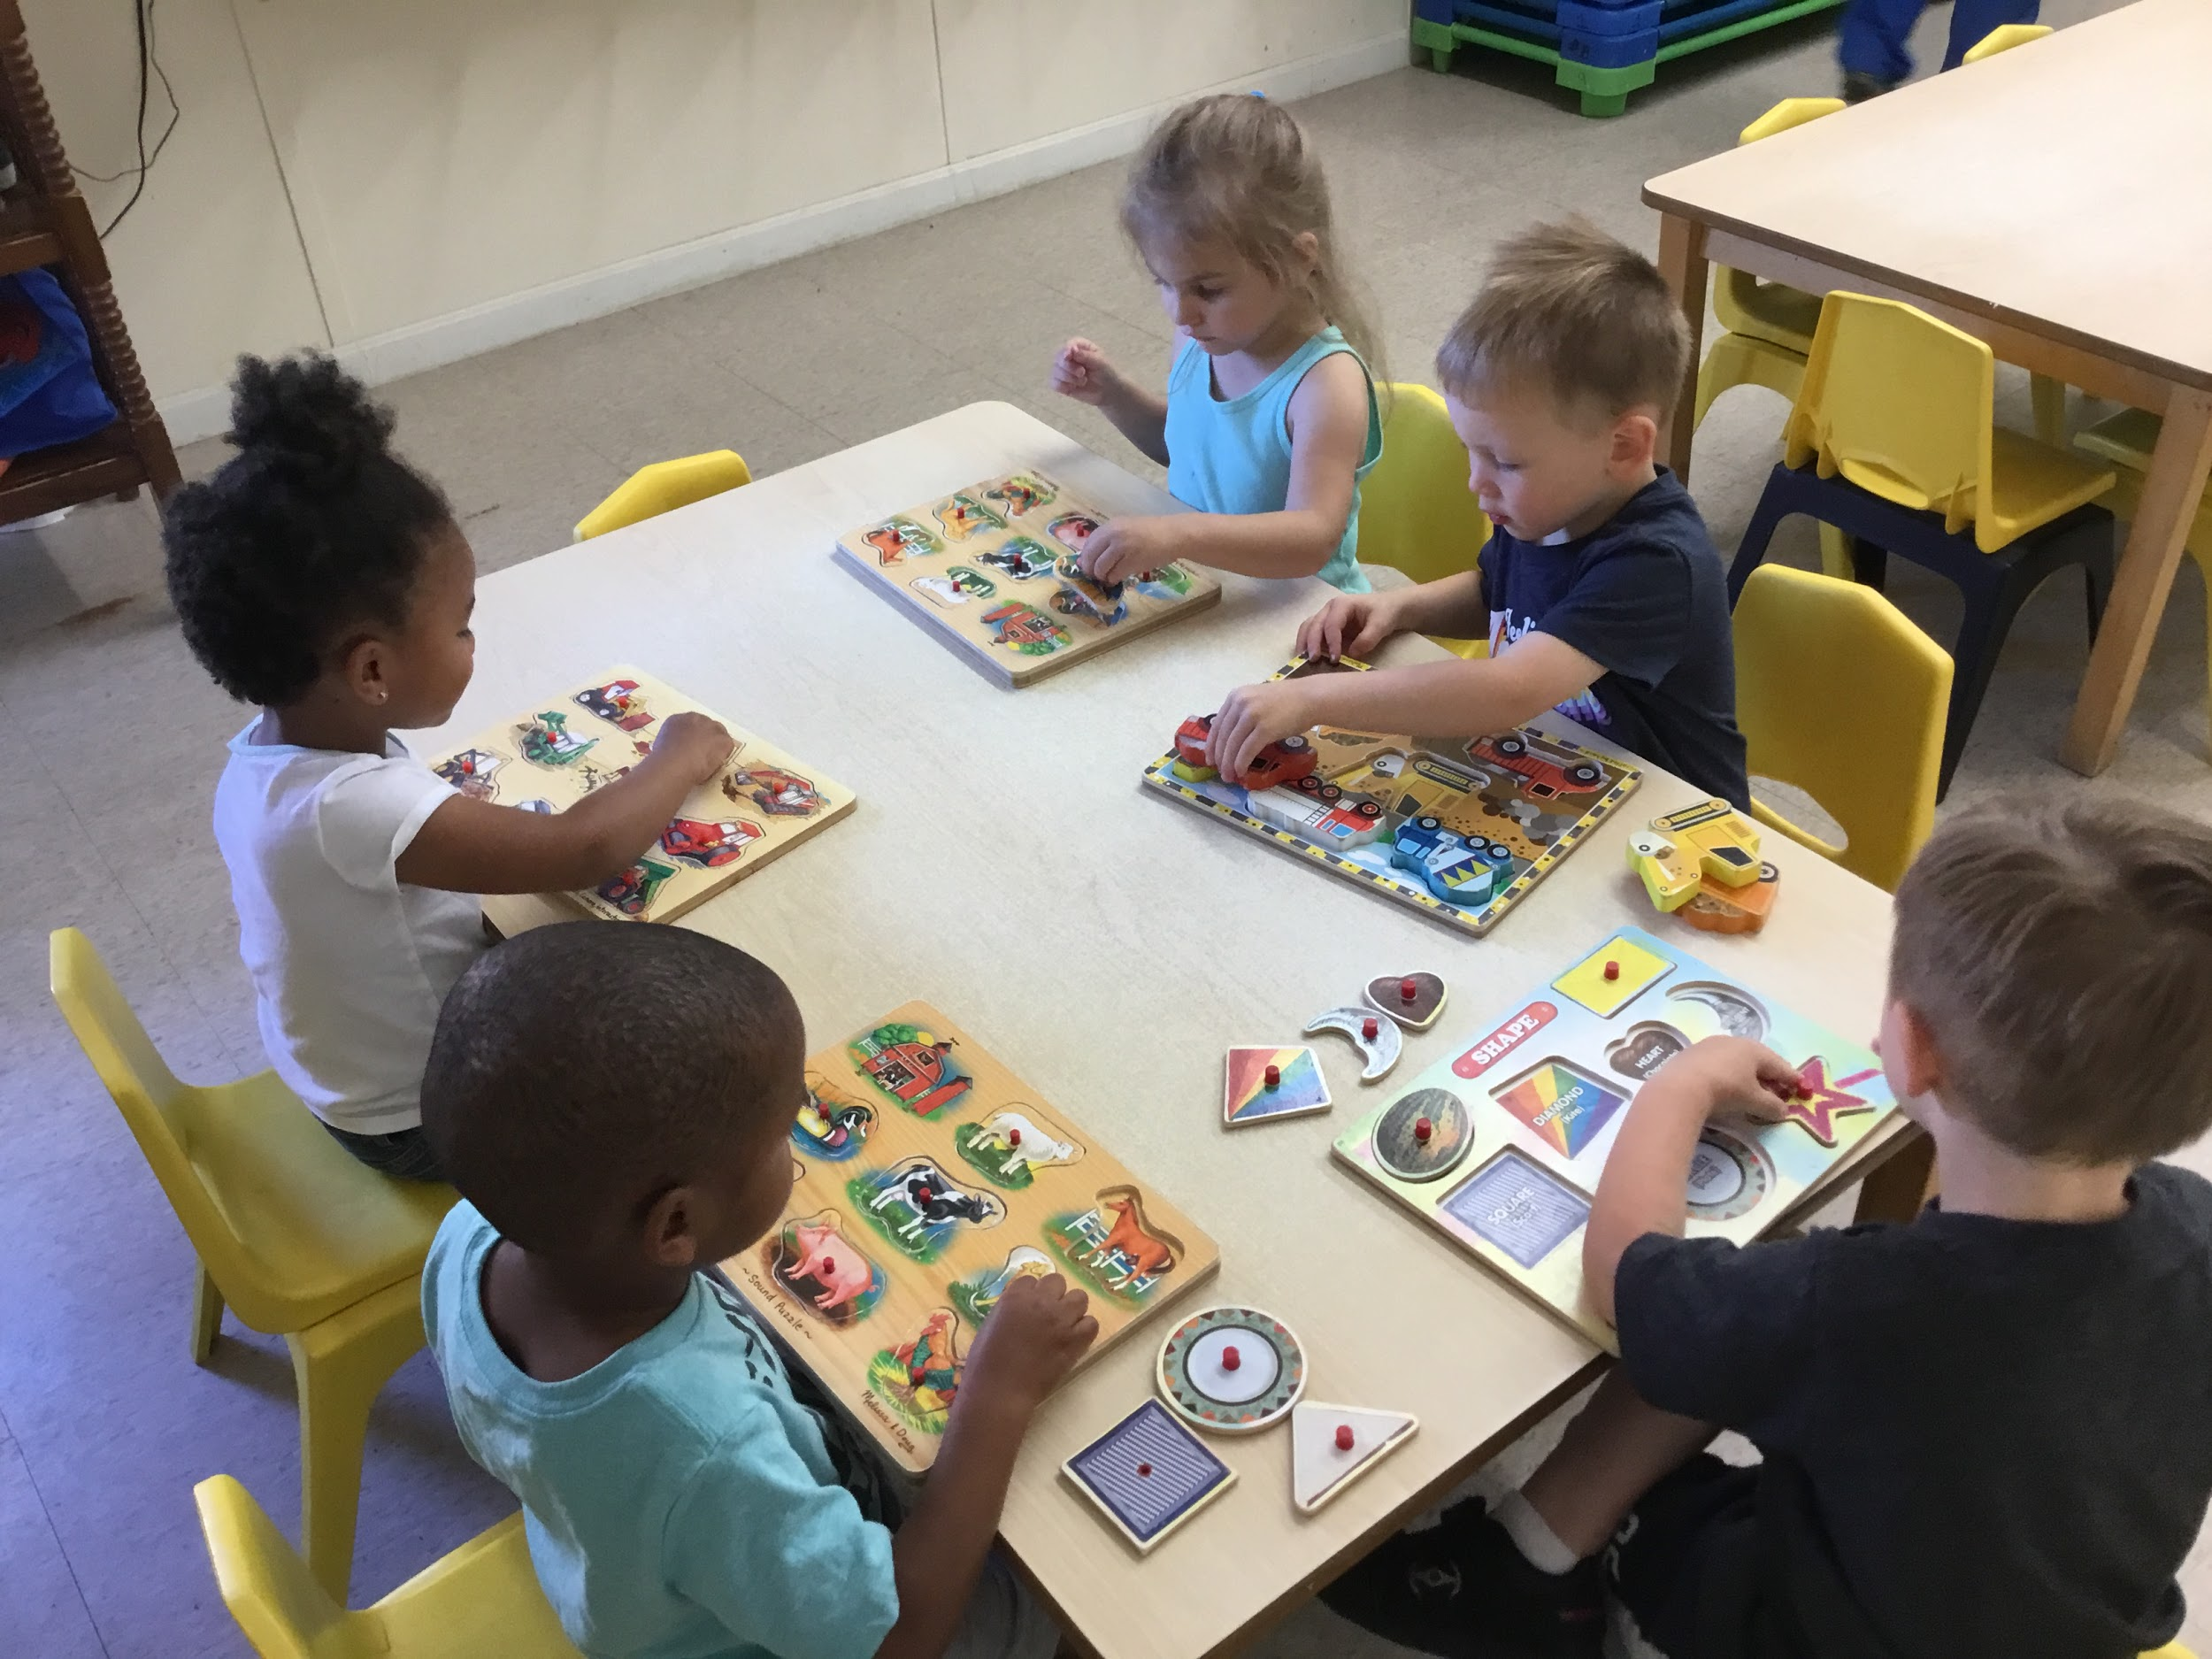
Practice assessing sample observation documentation:
Notes:
Let’s do another one...
What are the different things you could possibly observe and evaluate based on this photo documentation? Note your observations on your handout--
Pause for participants to write down observations, individually or in pairs.
When discussing together, at conclusion note that there are many indicators of development that can be observed, and for multiple children, from just this one picture.
Possible answers include the following from the GOLD Objectives:
Cognitive—11—Demonstrates positive approaches to learning—a. Attends and engages; b. Persists; c. Solves problems; d. Shows curiosity and motivation
Physical—7—Demonstrates fine motor strength and coordination—a. Uses fingers and hands
Mathematics—21—Explores and describes spatial relationships and shapes
Mathematics—23—Demonstrates knowledge of patterns
Social-Emotional—2—Establishes and sustains positive relationships
Science and Technology—25—Demonstrates knowledge of the characteristics of living things
(If these examples were used in a training on the ELDS, possible answers would include the following—
you might point out possible observations that the participants do not notice and what might be observed in conversation:
Independently complete a task--”Engage in play-based learning to explore, investigate, and acquire knowledge about themselves and their world” (Approaches to Learning--AL 1--Initiative and Curiosity)
Persistence, attention--”Demonstrate attention, engagement, and persistence in learning” (Approaches to Learning--AL 2--Attention, Engagement, and Persistence)
Problem-Solving--”Recognize, understand, and analyze a problem and draw on knowledge or experience to seek solutions” (Approaches to Learning--AL 3--Reasoning, Problem-Solving, and Creative Thinking)
Sorting
Fine Motor--”Develop small muscle control and coordination” (Physical Well-Being and Motor Development--PM 2--Motor Skills and Physical Fitness)
Shapes and properties--”Understand shapes, their properties, and how objects are related to one another in space” (Cognitive Development and General Knowledge--CM 4--Mathematics)
Identification of animals--”Acquire scientific knowledge related to life science” (Cognitive Development and General Knowledge--CS 3--Science)
Social skills--”Develop healthy relationships and interactions with peers and adults” (Social-Emotional Development--SE 1--Social Relationships)
Confidence--”Express feelings that he/she is capable of successfully making decisions, accomplishing tasks, and meeting goals” (Social-Emotional Development--SE 3--Self-Concept and Self-Efficacy)

Slide 26
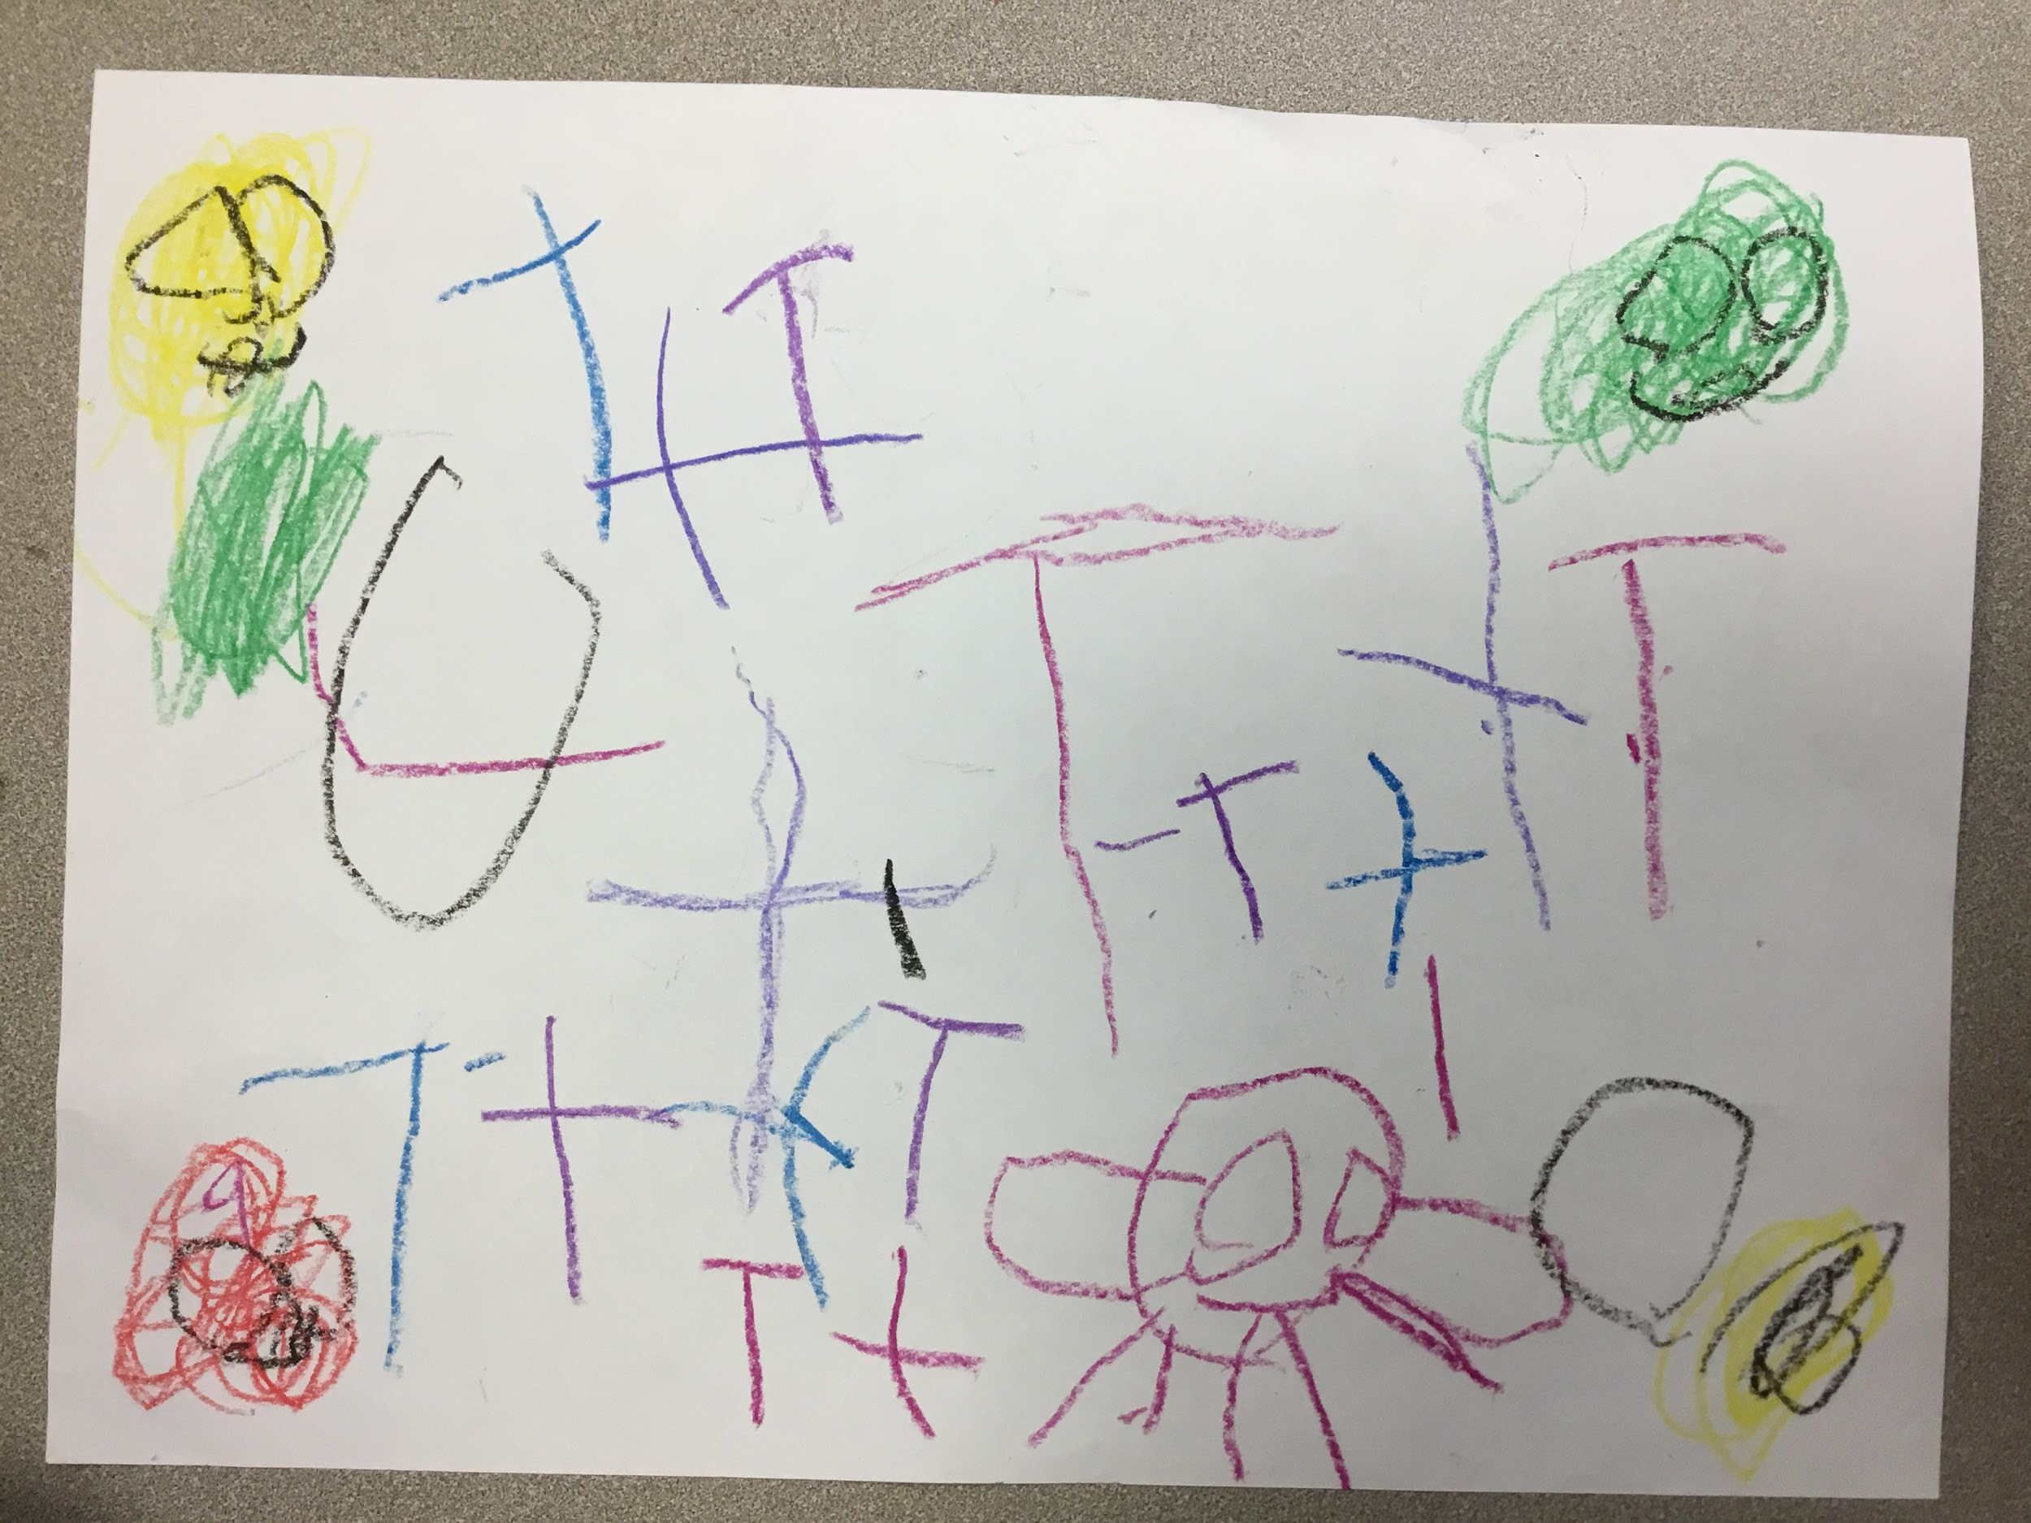
Practice assessing sample observation documentation:
Notes:
And one more--
What are the different things you could possibly evaluate from this student work? Note your observations on your handout--
Pause for participants to write down observations, individually or in pairs.
Possible answers include the following from the GOLD Objectives:
Physical—7—Demonstrates fine motor strength and coordination—a. Uses fingers and hands
Literacy—17—Demonstrates knowledge of print and its uses; 19—Demonstrates emergent writing skills
The Arts—33—Explore the visual arts
(If these examples were used in a training on the ELDS, possible answers would include the following—
fine motor--”Develop small muscle control and coordination” (Physical Well-Being and Motor Development--PM 2--Motor Skills and Physical Fitness)
identifying print features (maybe)--”Demonstrate understanding of the organization and basic features of print” (Language and Literacy Development--LL 5--Reading, Foundational Skills)
early stages of writing--”Develop familiarity with writing implements, conventions, and emerging skills to communicate through written representations, symbols, and letters” (Language and Literacy Development--LL 7--Writing)
creative thinking--”Demonstrate creative thinking when using materials, solving problems, and/or learning new information” (Approaches to Learning-- AL 4--Reasoning, Problem-Solving, and Creative Thinking)
artistic expression--”Develop an appreciation for visual arts from different culture and create various forms of visual arts” (Cognitive Development and General Knowledge--CC 2--Creative Thinking and Expression)

Slide 27

Louisiana’s Early Learning & Development Standards
Louisiana Believes website
(lousianabelieves.com):
Louisiana’s Birth to Five Early Learning & Development Standards (ELDS)
Notes:
Developmentally-appropriate expectations like those found in GOLD can also all be found in Louisiana’s Birth to Five Early Learning & Development Standards, sometimes referred to as ELDS or Standards. You can access the standards on Louisiana Believes website.
At this point trainer can poll participants on familiarity with this resource:
How many of you have seen this document?
How many of you have had a training in ELDS?
How many of you know where to access a copy of these Standards in your center?
Trainer should have (and hold-up) a printed copy of Louisiana’s Birth to Five Early Learning & Development Standards,

Slide 28
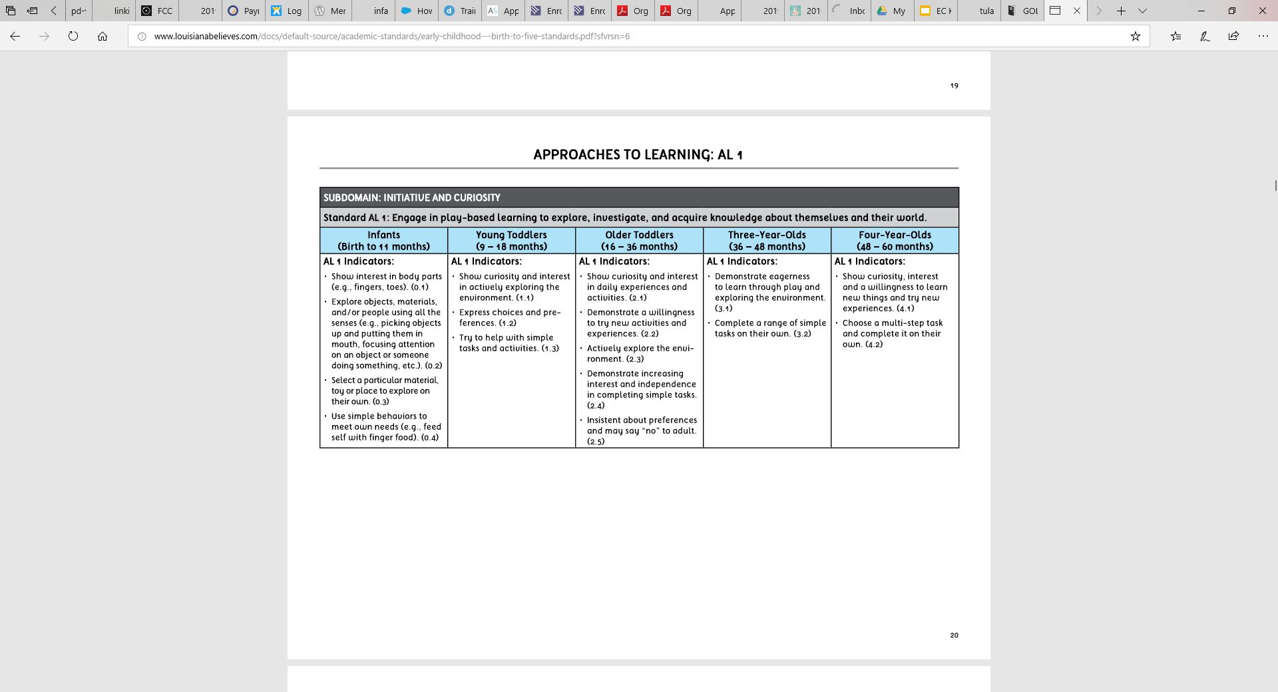
Louisiana’s Early Learning & Development Standards
Notes:
This page shows you how the Standards document looks inside--
It is divided by areas of development called “domains.”
This Domain in the Standards is called “Approaches to Learning.” [click to circle this domain]
This Domain is similar to one of the TS GOLD Objectives we reviewed a short time ago, “Objective 11—Demonstrates positive approaches to learning.”
As with TS GOLD, each Domain (and each Subdomain--in this case “Initiative and Curiosity” [click to circle this domain]) are broken up by age groups, to show what “indicators” (in other words, behaviors) you can expect to see at each age.
Remember the example we discussed a short time ago, of a child dumping out a filled basket she finds?
This shows you where the behaviors, in the example we just discussed, (that of a child actively exploring the environment) [click for circle] fall (first under “Older Toddlers”) [click for circle].
As you can see, both the ELDS and the GOLD Objectives align—that is because both are based on what a significant body of research tells us is true of child development.

Slide 29
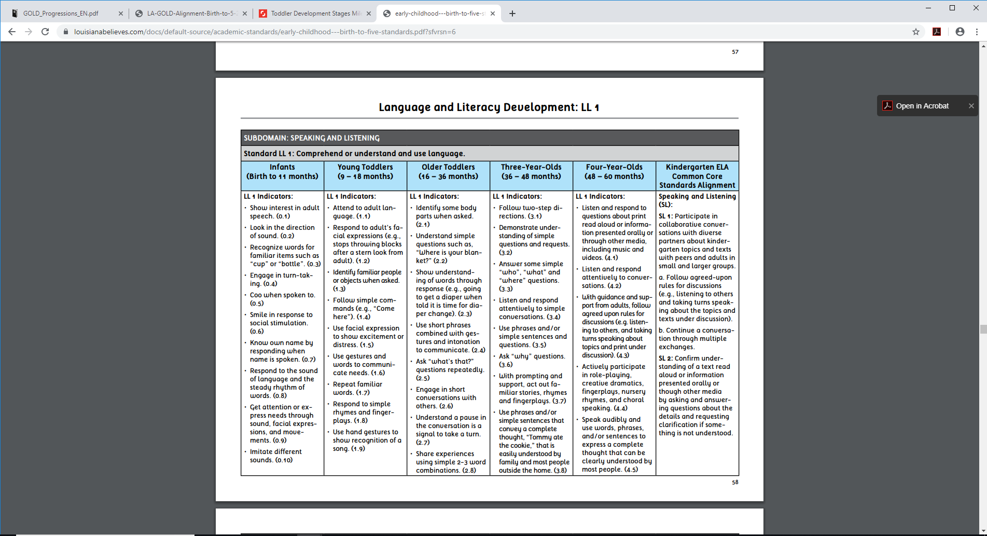
Louisiana’s Early Learning & Development Standards
Notes:
Let’s practice using the ELDS for an assessment of children’s Language development, and consider when a child in your care may need additional, specialized developmental supports—
When you go in the youngest rooms in your center, what kinds of sounds do you usually hear?
Pause for responses.
You probably hear a lot of “Ba-ba-ba” and “Mom-mom-mom” because we know young toddlers start to communicate with beginning sounds.
Here’s an example of when a child may need a referral to a specialist--
A little boy was approaching his second birthday and only making grunting-type sounds. His teacher talked to his parents about what was typical of children his age. He was their first child, so the parents didn’t realize it was a matter of concern. The parents talked to the pediatrician at his next check-up about the teacher’s observation, and the pediatrician referred the child for a speech evaluation. A speech therapist started going to the center each week to work with him, and he’s beginning to say some words now. If his teacher hadn’t been aware of what the developmentally-appropriate expectations for language development are, he might still not be talking.
If you look at ELDS Language and Literacy Development Standards 1 and 2 [click to circle this domain and click again to circle this Standard], we see that by 11 months infants are typically imitating different sounds [click to circle], and between 9-18 months they’re repeating familiar words [click to circle] and using words such as “mama” and “dada.” Since the child in our example was almost two years old and only making grunting sounds rather than imitating actual words, he needed referral to a specialist.

Slide 30
Available early childhood developmental supports:
Mental Health Consultation: Supports social and emotional development of young children https://medicine.tulane.edu/departments/clinical-sciences/psychiatry/research/tikes
Louisiana EarlySteps: Provides support for children birth to 36 months with a developmental delay or medical condition likely to result in developmental delay http://ldh.la.gov/index.cfm/page/139/n/139
Pupil Appraisal: Provides support for children age 3 and older with developmental delays, learning problems, behavioral challenges, or other special needs [contact your parish school system office]
Notes:
While most of the time YOU will be the person who can provide extra one-on-one guidance or instruction to an individual child to help him or her learn a challenging skill...as we just discussed sometimes a child needs a referral to a more intensive interventional support.
To conclude this section on Typical Ages & Stages of Development, here are some common early childhood developmental supports offered in every parish in Louisiana:
Mental Health Consultation is a service that includes on-site observations in child care center classrooms; interactive trainings with child care staff; and consultations with Directors, teachers, and families in regard to the social and emotional development of young children. Services are provided through the TIKES Tulane Early Childhood Mental Health Consultation Program.
EarlySteps is a program that provides services to families with infants and toddlers aged birth to 36 months, who have a developmental delay or who have a medical condition likely to result in a developmental delay. Children may have cognitive, motor, vision, hearing, communication, or social-emotional delays, for example. EarlySteps services are designed to improve a family’s capacity to enhance their child’s environment and are provided in the child’s natural environment, such as the child’s home or child care. Anyone can make an EarlySteps referral, so that EarlySteps can make an eligibility determination..
Similar to EarlySteps, Pupil Appraisal is a program that helps identify and intercede with children age 3 and older, who are at risk due to developmental delays, learning problems, behavioral challenges, or other special needs, by providing services to children, parents, and teachers. Pupil Appraisal services are offered by each parish school system.

Slide 31
Techniques for Conducting Observations
Notes:
Now that we understand even better the importance of conducting observation-based assessments, let’s talk, as promised earlier, about effective techniques for conducting observations--

Slide 32
Taking quality observational notes:
Be concise
Avoid descriptive language
Avoid emotional language
Write what you actually see
Notes:
Observational notes are one of the most useful ways to collect the FACTS you have observed, to help you analyze, evaluate, and plan future activities and instruction
...but to be useful, the notes have to be HIGH-QUALITY--
The first and MOST important is, be CLEAR—
You want to be sure that when you or someone else re-reads the note that it is fully understandable.
Second, Be CONCISE--
Avoid descriptive language
Avoid emotional language and
Write what you actually see
For example, instead of writing:
“When it was center time, Nadiya was sitting on the floor on some of the rainbow pillows acting like she was reading that big book of ocean animals”.
You want to write:
“Nadiya looked at a book during center time.”
Being concise is important for a few reasons: for one thing, it will help you take your note more quickly, because we all know how much you have to do in your classroom!! For another thing, it will help you be objective if you avoid an emotional response and if you write only what you SEE. Objectivity is critical for a quality assessment.

Slide 33
Taking quality observational notes:
Be FACTUAL—
Write only what you
SEE
and
HEAR—
AVOID “Why?”
Who? (child’s name)
When?
What happened?
Where?
Notes:
Third, Be FACTUAL, and write only what you SEE and HEAR--
For example, write Who? What? Where? and When?--WHO does WHAT WHERE and WHEN
You want to include the name of the child being observed, so that you don’t get the note mixed up with the note for another child--obviously you won’t be able to help your children if you’re basing your plan for one child on the needs of another child!
You want to include WHERE you observed the behavior--in the sandbox, at the art center, on the diaper-changing table?
You want to include WHEN you made the observation, by date--this will be helpful when reviewing observational notes over time and analyzing what growth the child has or has not demonstrated and over what length of time.
You want to include WHAT happened, specifically...WHAT did a child do, or WHAT did a child say? Clearly documenting what happened will help you when you go back to analyze and evaluate the child’s level, in order to plan for any needed scaffolding.
Why do you think you would need to “avoid why”?
At this point, wait for one or more participants to share a or some possible answers--recognize any answers that link to objectivity, and avoiding emotion.
When we try to explain WHY we are writing what we THINK, not what we see or hear, sometimes we make assumptions or let our feelings get involved in other ways.

Slide 34
Taking quality observational notes: an example
Date: 5/1/19
Location: writing center
Note: James and Doug write next to ea other. J said, “D, you have a lot of words that rhyme with you.—pan, man, can, ran. I’m writing them.”
J clear speech, J holds pencil w/3 fingers in middle
[TS GOLD Objectives 7b, 9b, 9c, 15a, 19b]
Notes:
Here is an example of a high-quality observational note that is clear and factual, listing when, where, who (by child’s name), and what happened:
Take a look at this--
First, it’s clear about who is doing what when and where
It’s factual, noting things like
“write next to each other”
“said” and quoted exactly what the child said
The note-taker is also concise by using abbreviations, like
ea, for each
J and D, for James and Doug, once the children have first been identifed
w/, for with
Then the note-taker was able to analyze what the documented behavior demonstrates--”clear speech,” “holds pencil w/3 fingers in middle” and at a later time evaluate which development and learning objectives this demonstrated behavior matches.

Slide 35
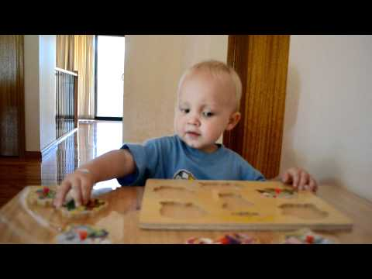
Taking quality observational notes: Video
https://www.youtube.com/watch?v=42AfHO9F9Eg
Notes:
Let’s practice taking a high-quality observational note--
As we watch the following video together, write one piece of HIGH-QUALITY documentation using your handouts and what you’ve learned in training so far today--
Remember that an observational note IS one form of documentation.
Do a quick oral review poll with participants:
Let’s review--
What should a quality observational note look like--what should it do?
Participants should call out elements of the previous slides, related to clear, concise, factual, etc.
Okay, you’re ready! Focus in on the younger boy in the video, and write a quality observational note about what you see:
[Anecdotal Record-Levi 18 months completing a puzzle: 2:21 min.] https://www.youtube.com/watch?v=42AfHO9F9Eg
Pause for participants to finish writing observational note(s). Then have at least two participants, depending on timing, share out some of the things they documented, and give constructive feedback based on the rules just discussed--clear, concise, and factual. “Is the note clear? Factual? Concise? If not, how could we edit it to make it stronger?”
Things that could be documented are:
· He is sitting in a chair at a table working on a puzzle.
· He removes all the puzzle pieces with his right hand and places them on the outside of the puzzle.
· He picks up the first piece with his right hand and tries it in 3 different spaces across the puzzle before placing it back on the table where he
got it.
· He picks up the second piece with his left hand and transfers to his right hand. He tries it in two spots before raising it and yelling “Ah, ah”
to the adult sitting across from him. The adult tells him, “It’s ok, try again,” and points to the spot on the puzzle. He holds the piece up towards the adult and says “Help” and hands her the puzzle. He watches as she turns it and lays it above the slot. He reaches with his left hand and slides the piece into place. The adult cheers and he reaches for another piece with his right hand.
· He continues trying to place another piece in the puzzle with the adult guiding him to try two different spots before finding it and
responding “Oh, there!”
· He grabs a fourth piece and tries a spot; when it doesn’t go in, he says “No”and “how.” The adult still encourages him, and he finds the
right spot.
· He picks up piece and looks at it and places it right in the puzzle. He begins pointing at the picture on the puzzle and saying “do do,” and an
older child comes over and says, “Yes, doggie, I have a doggie.”
· The younger boy reaches for another puzzle piece and starts to put it in when the older boy helps him and then puts the last piece in the
puzzle. The younger boy looks up.
Now let’s look at your “Teaching Strategies Objectives for Development & Learning” handout to see which objective your documentation could fit.
Give participants time to mark down objectives--
AFTER participants have named on their own some of the objectives met, fill in with others--and point out how just this one piece of documentation would help a teacher assess how a child is doing in 25 different categories of the TS GOLD tool--
Objectives could be: Social-Emotional 1. Regulates own emotions and behaviors
a. Manages feelings
b. Follows limits and expectations
c. Takes care of own needs appropriately
2. Establishes and sustains positive relationships
a. Forms relationships with adults
b. Responds to emotional cues
Physical 6. Demonstrates gross-motor manipulative skills
7. Demonstrates fine-motor strength and coordination
a.Uses fingers and hands
Language 8. Listens to and understands increasingly complex language
a.Comprehends language
b. Follow directions
9. Uses language to express thoughts and needs
a. Uses an expanding expressive vocabulary
b. Speaks clearly
c. Uses conventional grammar
10. Uses appropriate conversational and other communication skills
a.Engages in conversation
b. Uses social rules of language
Cognitive 11. Demonstrates positive approaches to learning
a.Attends and engages
b. Persists
c. Solves problems
d. Shows curiosity and motivation
e. Shows flexibility and inventiveness in thinking
12. Remembers and connects experiences
a.Recognizes and recalls
b. Makes connections
13. Uses classification skills
14. Uses symbols and images to represent something not present
a.Thinks symbolically
Math 21. Explores and describes spatial relationships and shapes
a.Understands spatial relationships
b. Understands shapes

Slide 36
Materials for documenting observations
Note pads
Sticky notes
File folders on walls
Clip boards
Dry-erase boards
Plastic folders
Photographs (of children independently or together meeting objectives, of child samples such as artwork)
Videos
Voice/Audio recordings
Notes:
Now that we’ve talked about and practiced writing quality observational notes, let’s talk about logistics for documenting children’s abilities and behaviors--
Some strategies for capturing those observational notes include using materials such as
note pads
sticky notes
file folders on walls
clipboards
dry-erase boards
and more.
You want to have these materials readily at hand so that you can record observations as you see them.
You might keep a small size notepad or sticky notes in your pocket; or you might hang a clipboard in the classroom and attach a pen to it--all of these strategies allow you to be prepared, with materials readily at hand, for taking a concise observational note.
You might keep file folders on the walls--you could have one for each child and place the notepad sheet, sticky note, or page from your clipboard in the appropriate child’s folder. You could also take one file folder and draw a grid on the inside of it, with a block drawn out and labelled for each child; then you could attach sticky notes with observations taken for different children under the appropriate block inside the folder.
You could also hang up a dry erase board, and scribble quick observational notes there. You can then capture those notes at the end of the day by taking a picture of them. The pictures of those observational notes on the dry erase board could be printed and added to children’s folders.
If you have an “at-risk” child in your classroom, you can take photographs of any of these materials used to take your observational note, through the TS GOLD app, and upload those photographic versions of the notes into the TS GOLD app. It is all about working smarter and not harder! It is usually faster to jot down an observational note than it is to type it into a device...and you also might not have an iPad or computer constantly at hand in your classroom.
Plastic folders for each child provide another way to collect the observational notes that you jot down on any of the materials mentioned above. Plastic folders or separate file folders for each individual child also provide a great place to save artwork or printed photographs that illustrate children’s abilities. You can then go back later and jot down observational notes about the artwork and photographs.
Finally, if you have an iPad or camera or videocamera in the classroom or readily available to you, photographs, videos, or voice recordings of children engaged in activities also provide excellent documentation of those children’s abilities. Videos can be especially useful, because you can go back and review them several times, to help you make as many observations about the children as possible. Take multiple pictures of a child or group of children as they play, because looking back on a sequence of pictures will reveal aspects that you may have missed in your initial observation. These photographic documents will help you understand the play as it unfolds; you can also ask the children to explain their play, to clarify their thinking and intentions (rather than making assumptions).

Slide 37
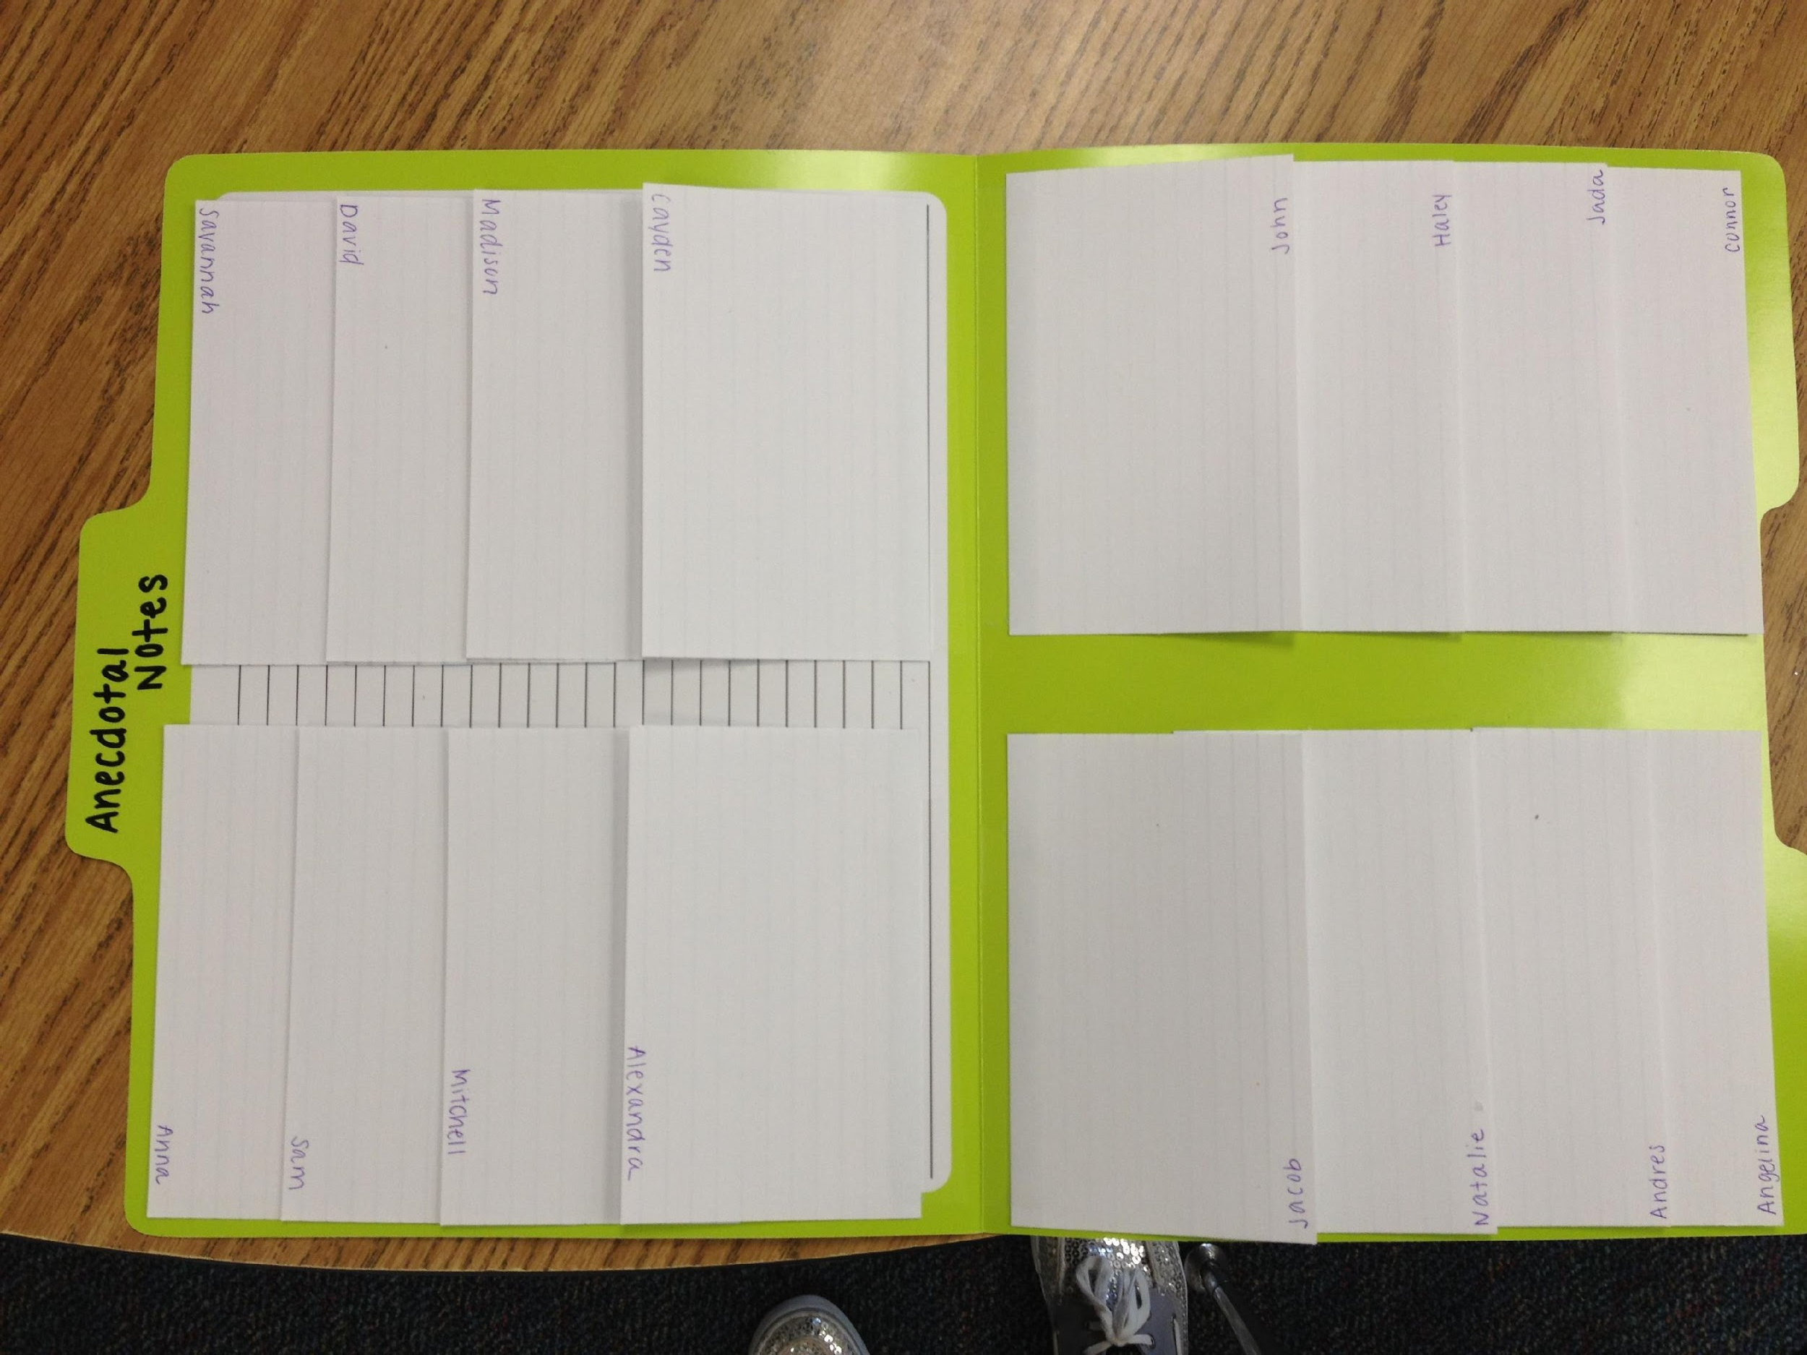
Sample Documentation Strategy
taken from Arielle Harvey
on pinterest.com
Notes:
Here is an example of a file folder divided into separate blocks with an index card for each child.

Slide 38
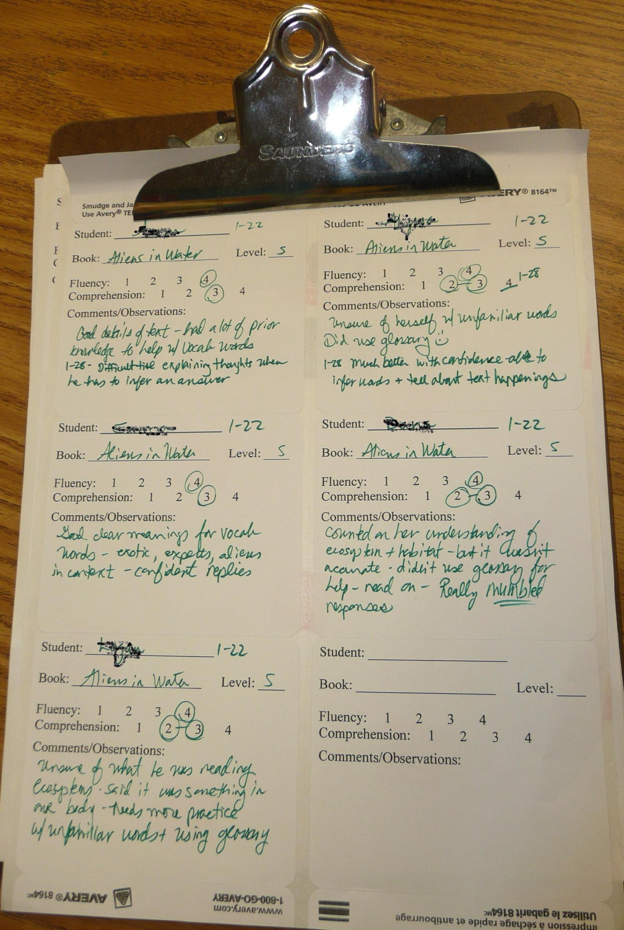
Sample Documentation Strategy
taken from scholastic.com
Beth Newingham’s Teacher Blog on “Assessment in My Reading Workshop
Notes:
Here is an example of a clipboard with paper divided into separate grids to take notes on individual children.

Slide 39
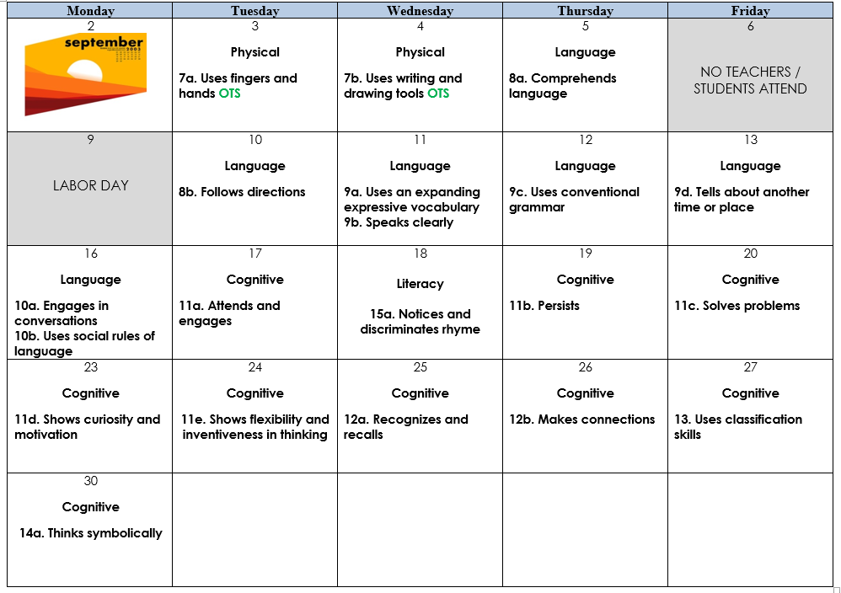
Making a plan for observation and documentation:
Notes:
To help ensure that you observe children’s ability level across developmental domains--in other words, that you are observing social-emotional AND physical AND language and literacy AND cognitive development--it can be helpful to create a calendar that breaks up and identifies what milestones or objectives you will observe for each week--
Here is an example of how you can make a plan to do just that, to observe all objectives for learning and development each quarter of the year--
As you can see in the example, the calendar provides you with a plan to observe each child for the listed objectives each day.
However, at the same time, remember not to LIMIT yourself to observing ONLY a particular objective at a time or observe only one child at a time--
Just because you are focusing on one objective in particular, your documentations can capture more objectives. Even when you are looking for a particular skill, the actions and behaviors you observe and document likely apply to more than one objective. Get the biggest bang for your buck by seeing how many other objectives this particular documentation can cover. You should note all objectives that apply to your observation.
Also remember that you can use group observations to cover more than one child at a time when applicable.
Finally, remember not to limit yourself to observing only what is on the calendar each day or week! Observe additional behaviors and indicators as they occur and stand out to you.
Using a calendar like this one is a great way to remember to focus on particular dimensions and ensure you get complete documentation on each child. It will just take practice to get into a natural groove!

Slide 40
Collecting documentation routinely:
In order to assess children ACCURATELY, it is very important to collect observational data ROUTINELY:
in different situations
throughout the day
over time
One observation might not be typical or representative of a child’s behavior or ability.
Ongoing observations help you to detect PATTERNS in a child’s behavior, which are more accurate indicators of a child’s behavior or ability.
Notes:
In order to assess your children accurately, it is very important to collect observational data ROUTINELY--
Taking observational notes in different situations--such as free play, or structured activities, throughout the day, over time, gives you a lot of information, or data, for reflection. One observation might not be typical or representative of a child’s behavior or ability. The documentation notes you have from ongoing observations help you to detect PATTERNS in a child’s behavior, which are more accurate indicators of a child’s behavior or ability.
This does NOT mean that you have to plan any EXTRA activities in order to collect observational data--
Early Learning and Development Standards and TS GOLD Objectives already correlate with everyday routines and instruction you should already have in place in your classroom, especially if your center has and you are using a curriculum recognized as high-quality by the state.

Slide 41
Collecting documentation throughout the day:
• What might be captured during mealtimes?
• What might be captured during transitions?
• What might be captured in center time?
• What might be captured in outdoor time?
• What might be captured in small group time?
What might be captured in whole group time?
Notes:
Let’s talk about WHAT observational data you might collect throughout the daily schedule:
•What might be captured during mealtimes? A lot happens during snacks and meal times, so we should be actively observing! During mealtimes, what are some of the skills or behaviors children are demonstrating?
Pause for response.
Possible answers include: child feeding self, ability to wait , preferences for certain foods, etc.
•What might be captured during transitions?
Possible answers include: following one and two-step directions (put toy in bucket and sit on carpet square), movement abilities (tiptoe to the door), etc.
•What might be captured in center time?
Possible answers include: if a child repeatedly chooses the same center or conversely, resists going to a certain center, how a child plays with the toys, how a child interacts with others at the center, etc.
•What might be captured in small group time?
Possible answers include: finger grip on crayons, ability to accurately touch and count objects, if a child speaks more freely than in whole group, etc.
•What might be captured in whole group time?
Possible answers include: being able to answer questions about a story; participating in fingerplay; keeping to personal space, etc.

Slide 42
Collecting observations safely:
Make sure there is never a break in the supervision of your children--to conduct observations safely use:
Sticky notes / a notepad / a clipboard near you → jot a quick note, while repeatedly looking up and scanning the play area; expand on the note later
Photos → document actions quickly in the moment, using the photo as a prompt for taking a note safely later
Naptime is a useful time to write or expand on notes and to analyze and evaluate observational notes….but remember you still must be able to see every child, gauge whether every child’s chest is rising and falling, and be able to respond immediately to the children!
Notes:
Let’s also talk about when and how to conduct observations safely--
Make sure there is never a break in the supervision of your children:
Keeping sticky notes or a notepad or a clipboard near you when doing small group instruction, center play, or outside play allows you to jot a quick note, while repeatedly looking up and scanning the play area. You can then expand on the note later, so as not to compromise your supervision.
Photos are another easy way to document actions quickly in the moment as both documentation or a reminder to you of what was happening, allowing you to take a note later, when you will not compromise your supervision.
Sometimes naptime can provide useful time to write or expand on notes and to analyze and evaluate observational notes taken during the day. As you well know, though, as a teacher you have to juggle multiple responsibilities simultaneously...so, while it is very important to practice observational-based assessment, you must also be sure not to do so in a way that could possibly compromise the safety of the children in your care:
During naptime teachers must be able to see every child and gauge whether every child’s chest is rising and falling and be able to respond immediately to the children. Licensing allows teachers to combine classrooms during naptime, as long as all the children are asleep and your center is within building ratio at the time. If any children are awake, however, room ratio is needed.
When working on observation-based assessment during naptime, be SURE that you do not become completely involved in that work--you must not at any point lose track of what is happening in the classroom...you must be able to respond immediately to the children.
We also all know that as teachers you often need to use naptime as a chance to work on cleaning toys and other lesson planning. Again, it will take practice to learn the way you are most comfortable juggling and alternating between these duties...but we promise that you can get it with practice!
If your center has them and can provide you with the assistance, floaters, afternoon staff, and naptime assistants are a great way to give Lead Teachers, who are responsible for documentation/observation, a little time to get things done. This especially helps during TS GOLD levelization times when you need a laptop or actual computer. Tablets work for documentation but don’t work for finalizing/leveling.

Slide 43

Collecting observations appropriately:
Notes:
Finally, it is also important to remember to keep CONFIDENTIALITY--
Don’t talk about the children in your care outside of your center. Don’t talk about the children in your classroom with parents who aren’t their own. Don’t leave notes about the children in plain site for visiting parents to see information about other children. And don’t keep photos, videos, or other recordings of children or their work on your personal phone or devices. Be sure you check your center’s policy, as many centers do not allow cell phones in the classroom and as many centers do not allow staff to record documentation of children on personal devices. It is best practice to capture photographs, videos, and audio recordings on center devices rather than personal ones...but we also know that sometimes centers do not have iPads, cameras, or other devices for staff.

Slide 44

Conducting observations:
Notes:
The key is to BE READY, with several different types of materials available, for documenting observations—
And to be READY to document important and telling moments: watch for moments when something starts to happen—
Often unplanned observations, such as in child-initiated play, tell you much more about what children know, understand, and can do

Slide 45
Using Curriculum & Supplemental Activities for Assessment and Differentiation
Notes:
Now that we have learned about what to observe, how to document observations, and when to observe, let’s talk about how you can use curriculum tools for assessment and for supplemental activities to help children achieve new skills, through differentiated instruction.

Slide 46
Why Tier 1 curriculum supports children’s development:
Each Tier 1 curriculum offers guidance and tools for assessing children’s growth and learning. You can use this assessment information to collect evidence of and monitor children’s progress. Each of the Tier 1 curriculum assessments are
consistent with the Louisiana Birth to Five Early Learning and Development Standards and with the TS GOLD Objectives for Development and Learning
conducted through a variety of methods such as anecdotal observations/notes, checklists, photographs, work samples, benchmark assessments, rubrics, etc.
embedded throughout activities and routines within the daily schedule (whole group, small group, center times, outdoor times, transitions, etc.)
Notes:
“Tier 1 curriculum” is a term that indicates that the curriculum has been reviewed by early childhood and curriculum experts in the Louisiana Department of Education and found to be of superior quality.
Each Tier 1 curriculum offers guidance and tools for assessing children’s growth and learning. You can use this assessment information to collect evidence of and monitor children’s progress. Even though the Tier 1 curricula are not specifically linked to the Louisiana ELDS or TS GOLD Objectives, each of the Tier 1 curriculum assessments are
consistent with the ELDS and with the TS GOLD Objectives for Development and Learning
conducted through a variety of methods such as anecdotal observations/notes, checklists, photographs, work samples, benchmark assessments, rubrics, etc.
embedded throughout activities and routines within the daily schedule (whole group, small group, center times, outdoor times, transitions, etc.)
This means that the observations tools each Tier 1 curriculum provides are also consistent with our state standards. This means that you can be confident that you are focusing your observations on important areas of learning.

Slide 47
How to use Tier 1 curriculum assessment:
Become familiar with the new curriculum assessments (for example, what skills are assessed and how often they are assessed)
Before teaching, review the skills covered in the daily and weekly lesson plans
Plan for when, where, which children and what sills or objectives will be assessed each day of the week
Use the activities and assessments included in the curriculum to collect information on children’s knowledge and skills
reflect on children’s progress and use assessment information to make adaptations or accommodations to support the learning of every child
Notes:
Each Tier 1 curriculum provides different supports for documenting and analyzing observations of children’s learning and play. Each curriculum provides, in some form, a checklist of age-appropriate skills in each developmental domain (i.e., cognitive, physical, language, social, emotional) and a method for annotating whether the child is beginning, developing, or has mastered that skill.
Each Tier 1 curriculum also provides suggested activities that utilize the desired skills. That allows you to assess the children “in action” rather than try to assess skills in isolation.
Furthermore, each Tier 1 curriculum provides suggestions for differentiation, so that as teachers you have ways to help individual children who are struggling with the skill, and ways to challenge an individual child who has mastered the skill earlier than her/his peers.
Here is how you can use Tier 1 curriculum assessment:
Become familiar with the new curriculum assessments (for example, what skills are assessed and how often they are assessed)
Before teaching, review the skills covered in the daily and weekly lesson plans
Plan for when, where, which children, and what skills or objectives will be assessed each day of the week
Use the activities and assessments included in the curriculum to collect information on children’s knowledge and skills
Reflect on children’s progress and use assessment information to make adaptations or accommodations to support the learning of every child
Let’s take a look at several examples of assessment tools, including those in several popular Tier 1 curricula--

Slide 48
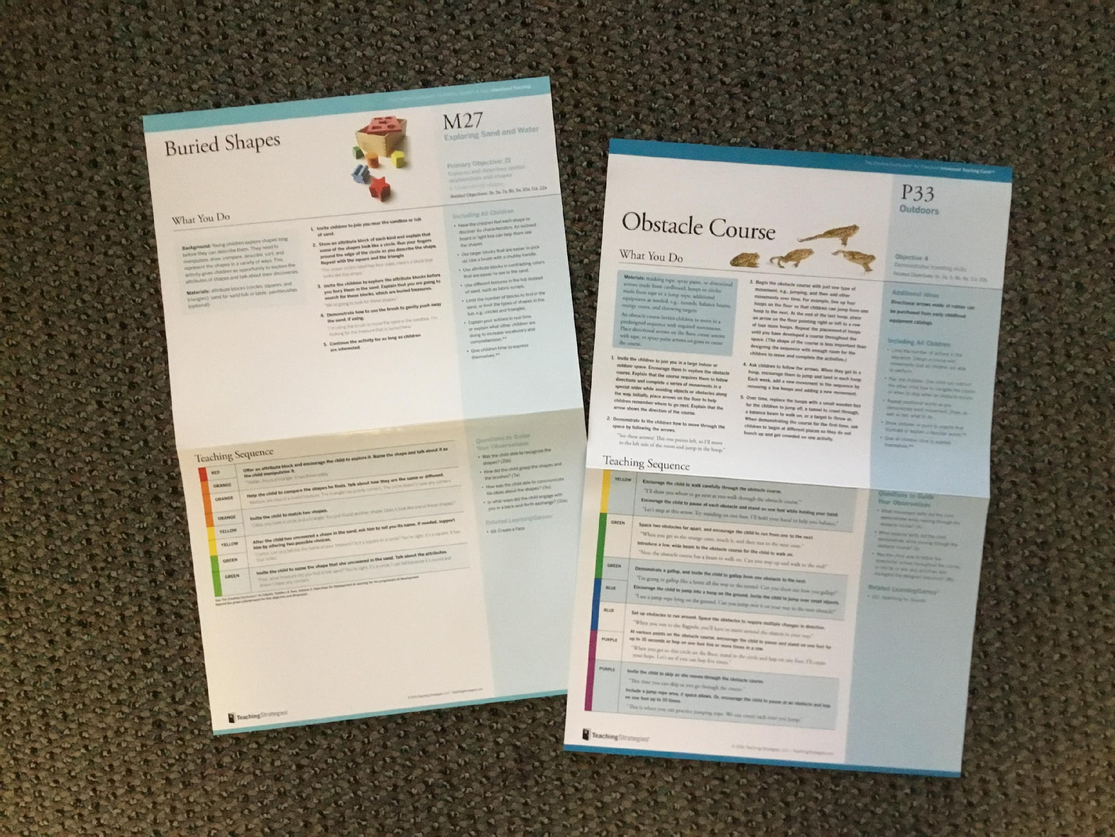
Additional Observation Tools/Methods:
Creative Curriculum
Notes:
Do any of your centers have Creative Curriculum?
Pause briefly for verbal or non-verbal response.
If so, you may already know that both the Infant/Toddler and the Preschool Creative Curriculum come with “Activity” cards categorized as Social/Emotional, Physical, Language/Literacy, and Math. These cards already list the different objectives from TS Gold that the particular activity on the cards meets. I encourage you to hang or place these cards where you plan to conduct the activity. The cards are laminated, so you can use them, while doing the activity, as dry erase, or you can place sticky notes on them with anecdotal notes about the children. (If you use TS GOLD you can also then reference these notes later, for entering into TS GOLD.) Mighty Minutes also have the objectives listed on them as well.

Slide 49
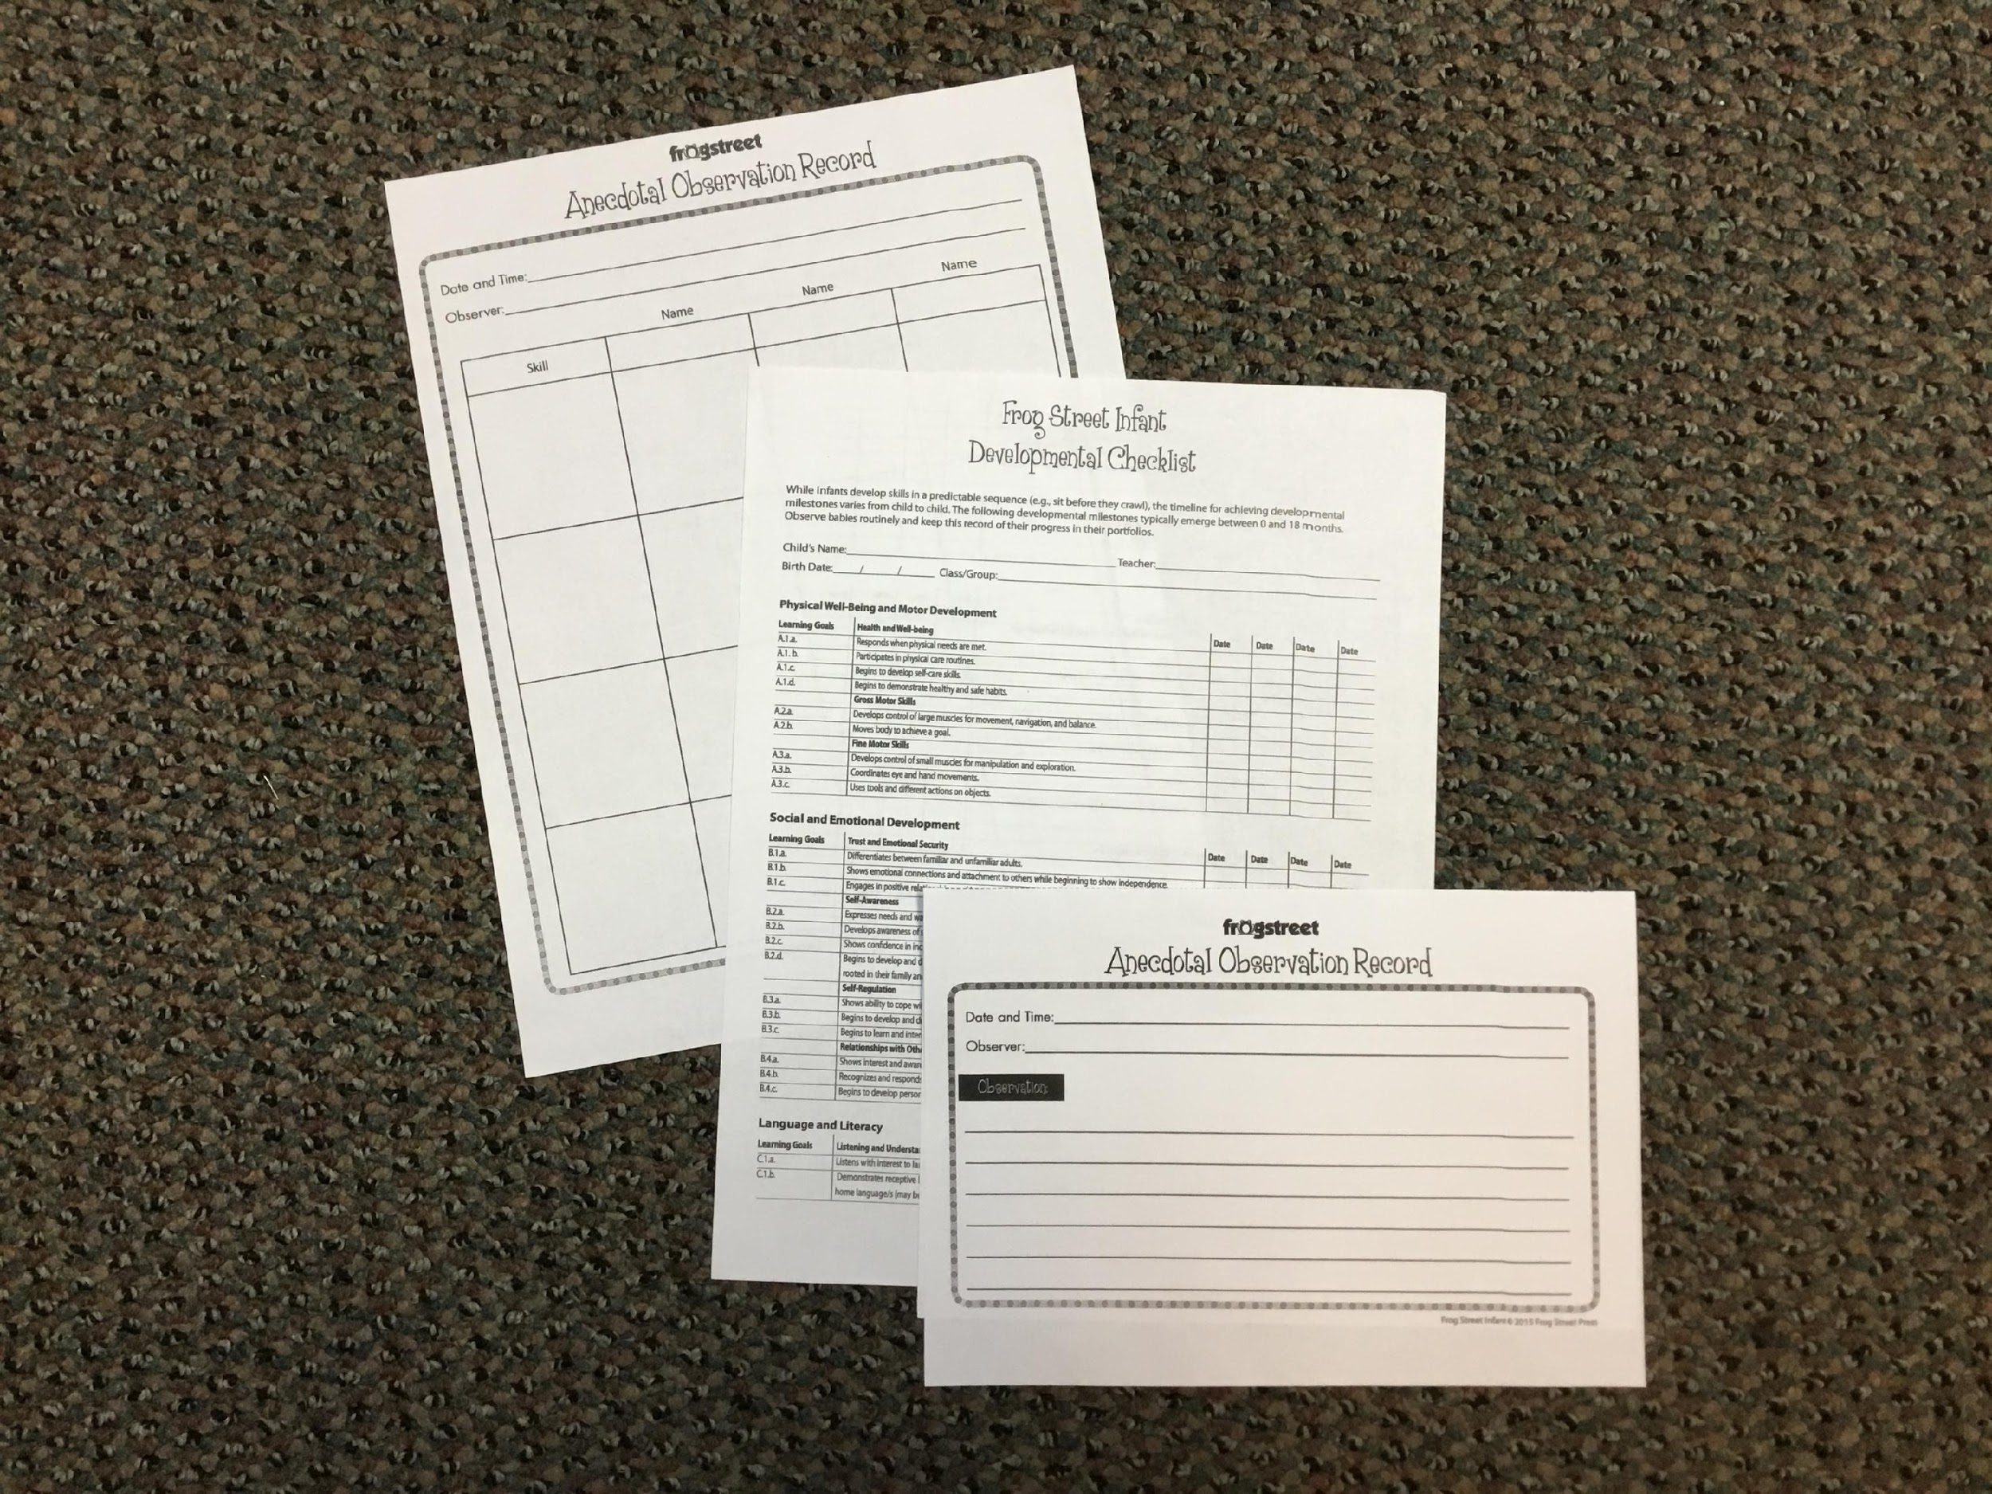
Additional Observation Tools/Methods:
Frog Street
Notes:
Do any of your centers have the Frog Street Curriculum?
Pause briefly for verbal or non-verbal response.
If so, you may know that each of the different age Frog Street Curricula comes with CDs for printing lesson plans and anecdotal note-taking options. One anecdotal note-taking option is a half-page; another is a page where you could list a few children next to the activity...this whole page tool gives you space to take notes for each child. Frog Street also has age-specific Developmental Checklists that you could make for each child and track throughout the year. Those of you whose centers have purchased the Frog Street Curriculum can also go online to get a printout of how Frog Street links up to TS GOLD objectives as well.
Remember, even if your center does not yet have a Tier 1 curricula, and even if you do not currently assess a child in TS GOLD, you can still practice observation-based assessment through the other strategies we discussed in this training.
Tier 1 curricula also provide you with strategies for differentiating activities to scaffold learning and development!

Slide 50
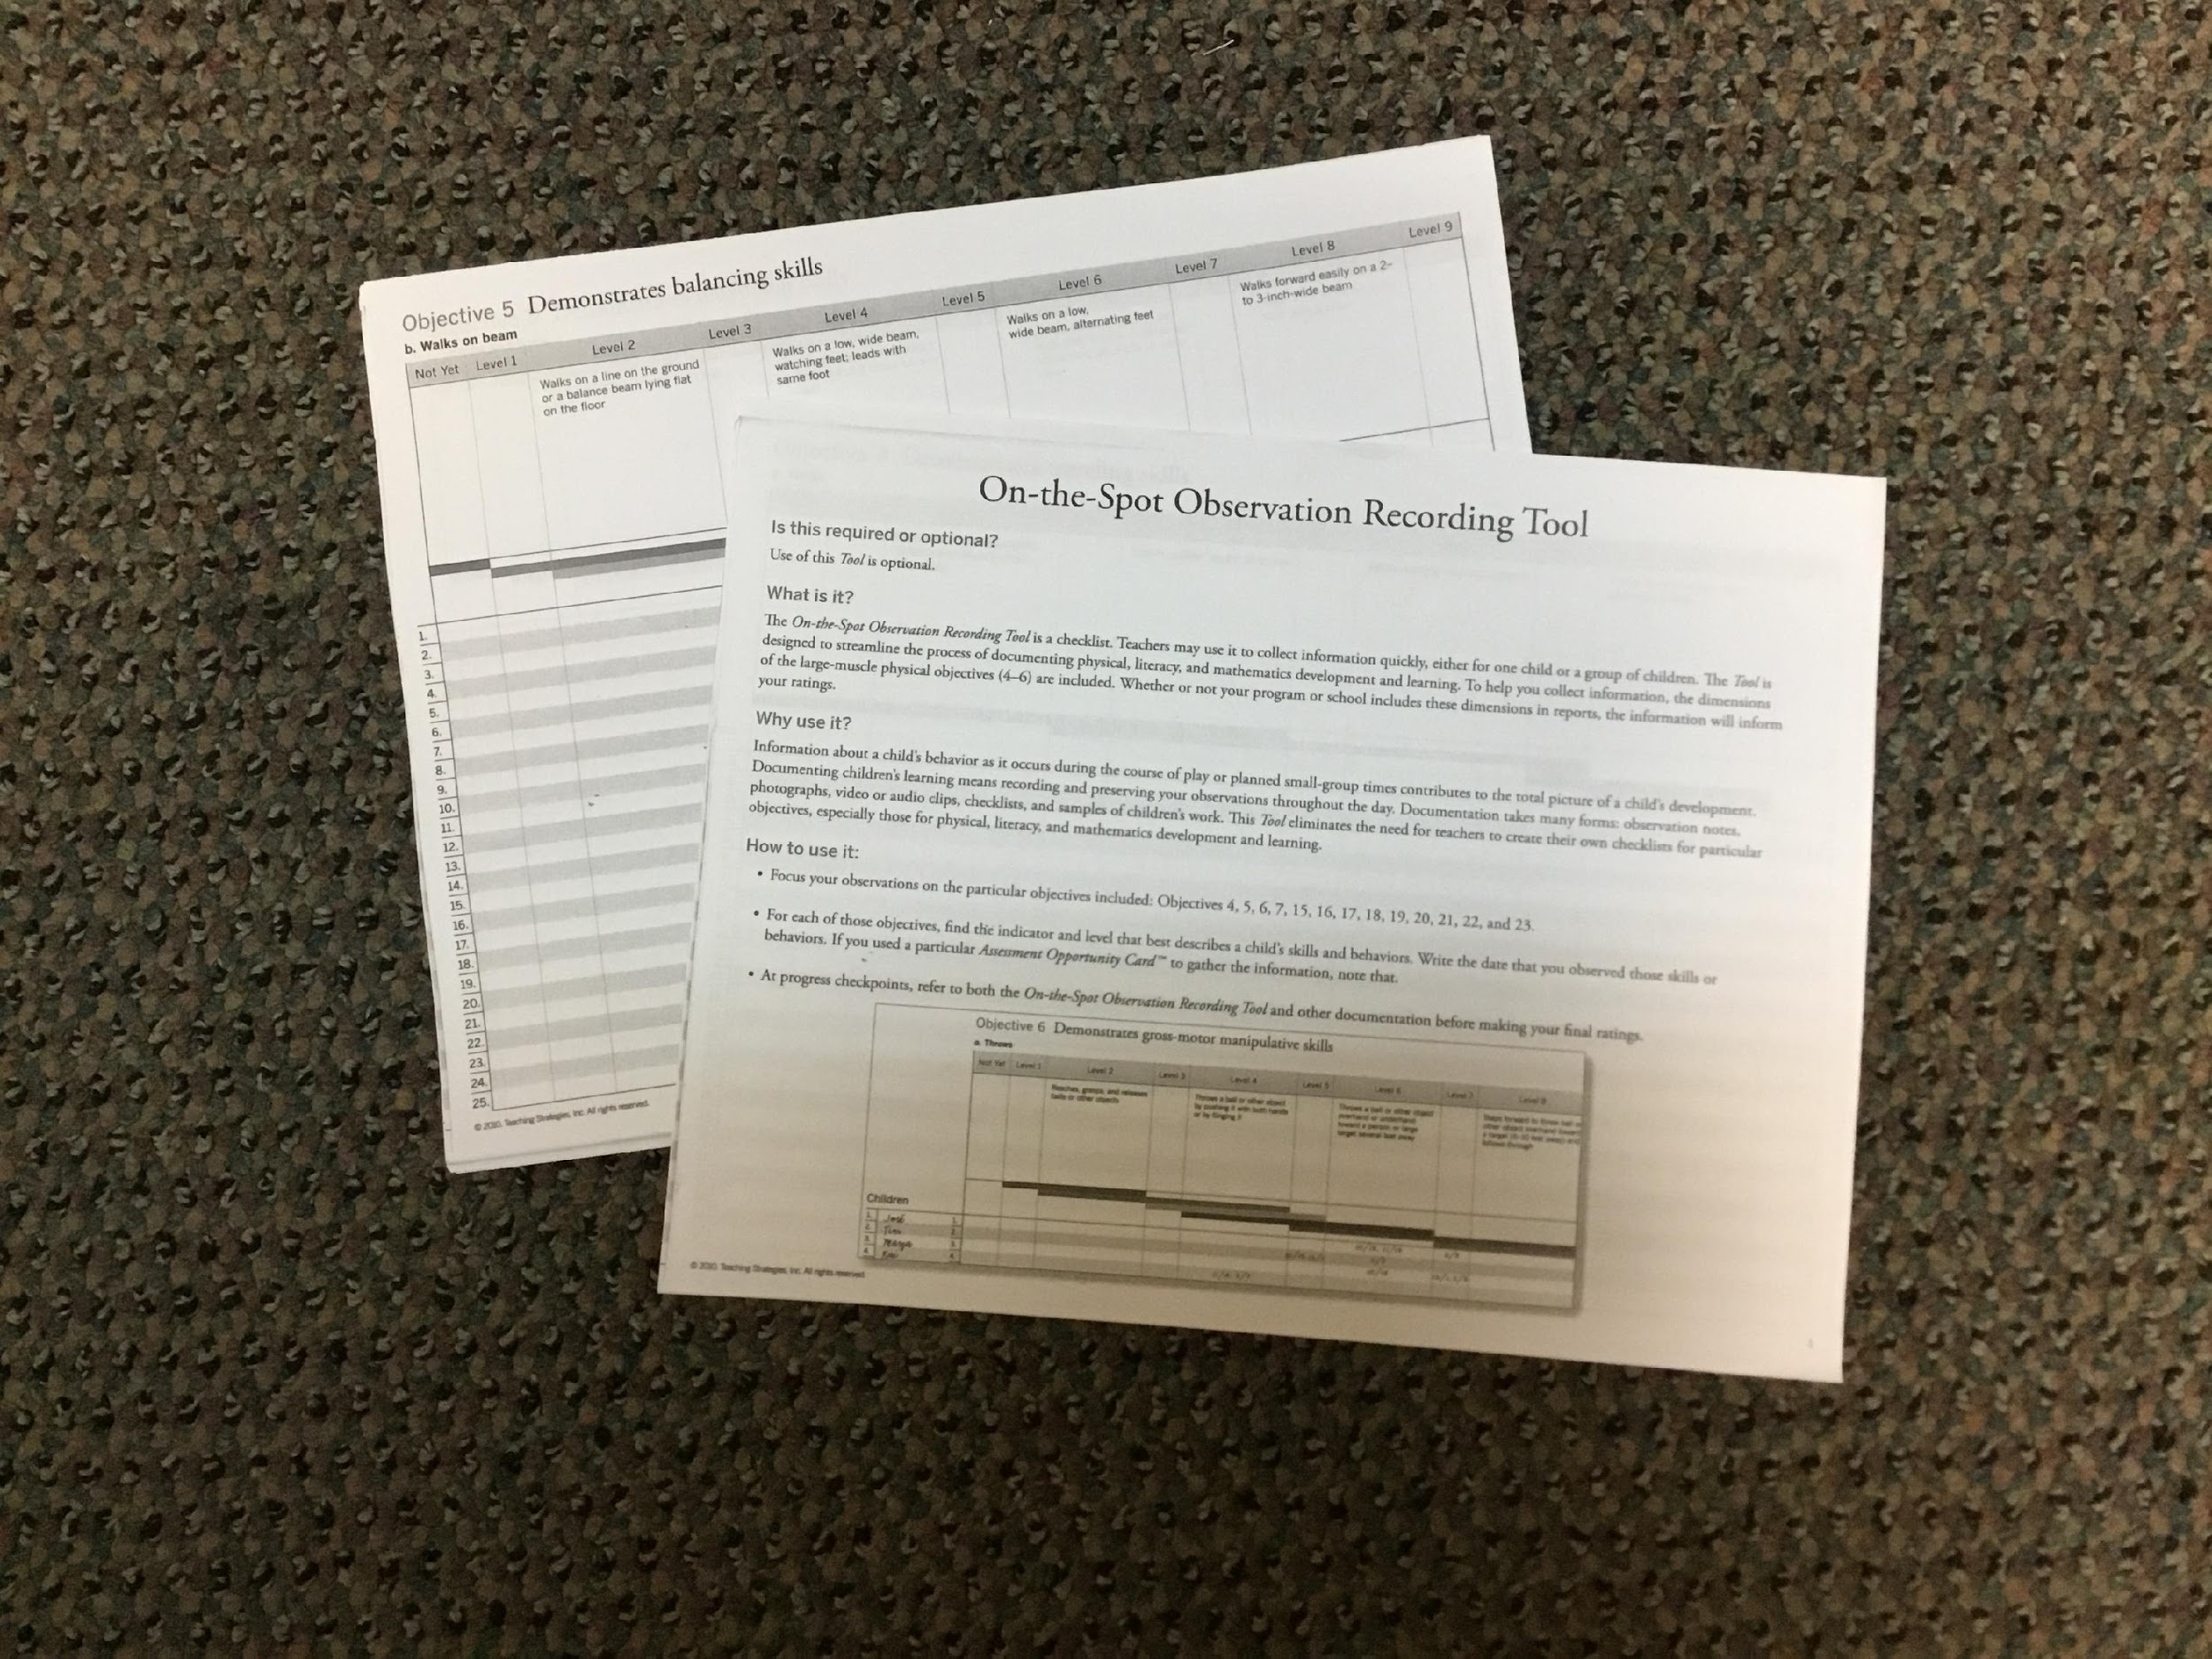
Additional Observation Tools/Methods:
TS GOLD “On the Spot”
Notes:
If running out of time, skip this slide—
Has anyone seen this observation tool before?
Pause briefly for verbal or non-verbal response.
It is a paper form of the TS Gold “On the Spot” objectives that could be documented as you see a child demonstrate a skill, like traveling skills. While this “On the Spot” documentation is not available free online through Teaching Strategies, it is available through their store; sometimes it can also be provided through your parish’s Early Childhood Community Network. You could keep a printout of this tool on a clipboard, record the children’s names down the left-hand side, and then put a date under where the child’s skill matches. Another option is again to use a sticky note to make an anecdotal note for each child. This tool would be easy to use on every child in every classroom, regardless of whether or not you have an at-risk child whose assessment you are entering into the TS GOLD online tool. This “On the Spot” paper-based tool is also recommended for use when having trouble with the TS Gold System itself or when teachers are not able to be connected outside or in their classrooms to document in the system.

Slide 51
Evaluating Development with Reliability
Notes:
We have covered a lot of material today! Our final topic is about evaluating development with reliability--

Slide 52
Objectivity vs. Subjectivity
Facts vs. Assumptions:
Facts are things that you see and hear.
Assumptions are your personal opinions.
When looking at behavior vs. interpretation of behavior, remember the difference between facts and assumptions:
Behavior is the way that someone acts in response to others and situations. (facts)
Interpretation of behavior is someone’s personal opinion of another’s behavior. (assumptions)
Notes:
We began talking about objectivity earlier in this training, and you were also given some pre-work prior to this training about “Facts v. Assumptions,” to help you begin thinking about the difference between the two--
When observing the children in your classroom, you want to be sure you practice OBJECTIVITY vs. SUBJECTIVITY--
Objectivity and subjectivity are related to facts and assumptions--
Facts are things that you see and hear.
Assumptions are your personal opinions.
When looking at behavior vs. INTERPRETATION of behavior, remember the difference between facts and assumptions:
Behavior is the way that someone acts in response to others and situations--that is the fact.
In contrast, the interpretation of behavior is someone’s personal opinion of another’s behavior...what you think--that is an assumption.

Slide 53
Objectivity vs. Subjectivity
Facts vs. Assumptions:
“Amelia did not share with Jacob when he asked to see her toy.”
vs.
“Amelia has difficulty sharing.”
Notes:
Which of these notes demonstrates objectivity and fact?
Which of these notes demonstrates subjectivity and assumption?
“Amelia did not share with Jacob when he asked to see her toy.”
vs.
“Amelia has difficulty sharing.”
Pause to give participants time to give their answer.
The first statement demonstrates objectivity and fact; the second statement demonstrates subjectivity and assumption.

Slide 54
Objectivity vs. Subjectivity
“Tyler was playing with the music blocks. When Carly and Josh ask to play, Tyler agreed by saying ‘yes’ and showing them how.”
vs.
“Tyler is a nice boy and gets along well with the other children.”
Notes:
Let’s practice one more time:
Which note is objective, and which is subjective?
“Tyler was playing with the music blocks. When Carly and Josh ask to play, Tyler agreed by saying ‘yes’ and showing them how.”
vs.
“Tyler is a nice boy and gets along well with the other children.”
Which note is objective, and which is subjective?
Pause to let participants respond. The first statement is objective, and the second statement is subjective.
And which type of note do we want to write, and why?
Pause to let participants respond, and ensure that they understand why we want to write objective notes--that they can articulate some of the reasons from the previous slides.

Slide 55
Additional Assessment Reliability Tool
Free, online TS GOLD Inter-Rater Reliability testing:
https://my.teachingstrategies.com/irr/status/
Free, online additional TS GOLD resources:
https://mypd.teachingstrategies.com/
Notes:
Whether or not you currently have the opportunity to use the TS GOLD tool to observe and assess the developmental progress of children in your classroom, you can still use another tool by TS GOLD to help you test your reliability in making developmentally-appropriate observations and assessments--
You can access free, online TS GOLD inter-rater reliability testing at https://my.teachingstrategies.com/irr/status/
You can access additional free, online TS GOLD resources at https://mypd.teachingstrategies.com

Slide 56
Last Thoughts
As an additional possible follow-up to this training, look for a training that helps you support the children in your care further by helping you to practice differentiating activities to scaffold learning and development!
Notes:
As an additional possible follow-up to this training, look for a training that helps you support the children in your care further by helping you to practice differentiating activities to scaffold learning and development!
And you might also dive deeper by looking at the “Alignment of Teaching Strategies GOLD Objectives for Development & Learning Birth through Kindergarten with Louisiana's Birth to Five Early Learning and Development Standards” (https://teachingstrategies.com/wp-content/uploads/2017/03/LA-GOLD-Alignment-Birth-to-5-2013.pdf).
Make sure you have laid out, or lay out the two handouts below.
After we finish in a few minutes, please be sure to pick up these two takeaway handouts I have for you:
One, a “Glossary of Important Terms and Phrases,” that will help you review key concepts from this training, and
Two, an article on scaffolding.

Slide 57
Key Knowledge Gained!
Notes:
At this time, ask 2-3 participants to share the one most important thing she/he learned from the training and how it will help her/him better support the children in her/his care.
Have all participants write it down on the “3-2-1 Action Plan.”
Then distribute and have participants complete the post-assessment evaluation and submit it to you.

Slide 58
Please complete the Post-Assessment Evaluation
Thank you!

