Slide 1
We Have a Curriculum, Now What Do We Do? Successfully Implementing an Early Childhood Curriculum
Amy Hook Poirier

Slide 2
Welcome, Session & Group Introductions

Slide 3
Learning Objectives

Slide 4
LEARNING OBJECTIVES
Recognize the elements needed for successful curriculum implementation
Identify their role as an early childhood professional (director, teacher, staff, etc.) in the implementation of high-quality early childhood curriculum
Develop individual role-specific strategies to successfully implement high-quality early childhood curriculum in their current role
Plan steps they can take immediately, within a month, within three months, and within six months to improve the implementation of a high-quality early childhood curricula within their classroom or center

Slide 5
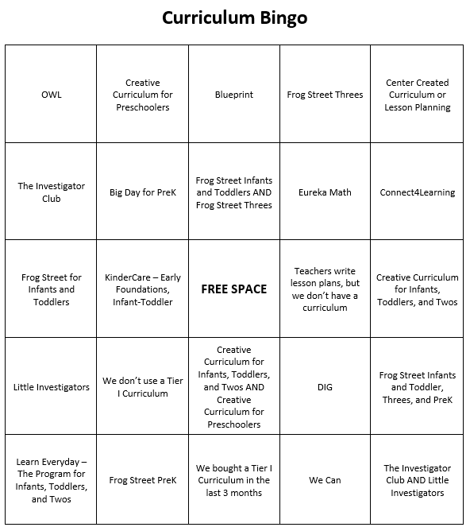
Introduction Activity

Slide 6
Elements of a Successful Curriculum Implementation

Slide 7
Elements
Schedules & Materials
Planning & Implementation
Observation & Assessment
Modifications & Adjustments

Slide 8
Turn and Talk
Notes:
Stock photo ID:179607697

Slide 9
Schedules

Slide 10
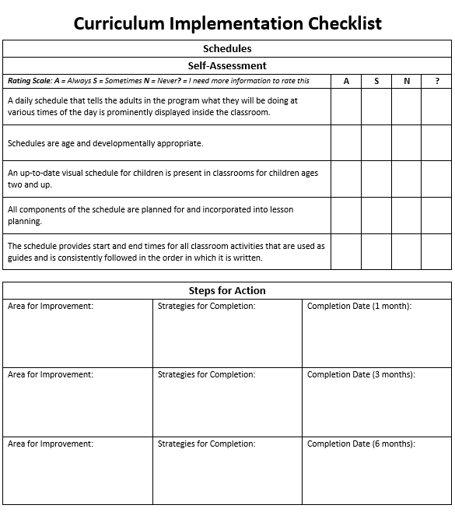
CHECKLIST
Teachers follow a current, detailed,
age-appropriate daily schedule
that is posted in the classroom.
Purpose
Importance
Elements

Slide 11
Purpose
Daily schedules are multipurpose
and provide:
Guidance
Framework
Visibility
Order

Slide 12
Importance
Consistent daily schedules provide:
Predictability
Security
Control

Slide 13
Elements
Quality daily schedules contain:
Routines
Transitions
Group times
Play times

Slide 14
INFANTS
Individualization
Key elements of infant daily schedules
Flexibility
Support

Slide 15
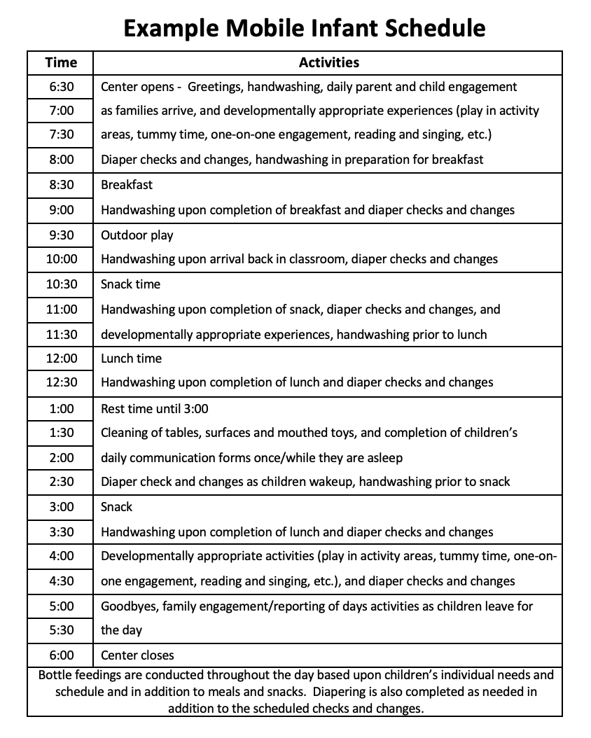
Example Mobile Infant Schedule

Slide 16
TODDLER
Transition time
Key elements of toddler daily schedules
Movement and engagement
One-on-one time

Slide 17
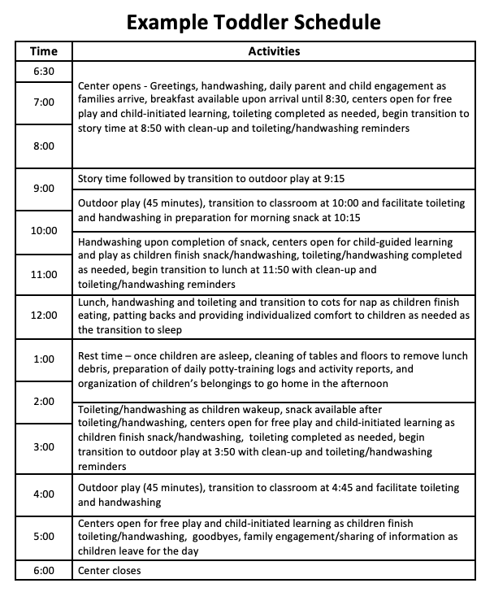
Example Toddler Schedule

Slide 18
PRESCHOOL
Consideration
Key elements of preschool daily schedules
Planning
Balance

Slide 19
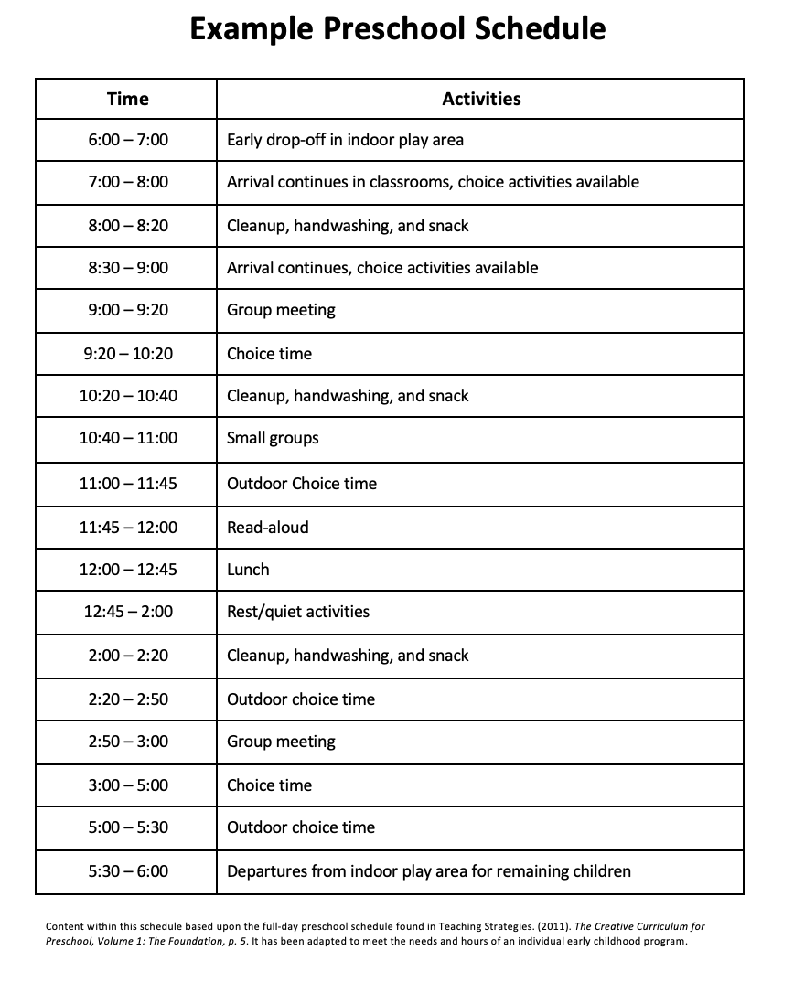
Example Preschool Schedule

Slide 20
How are you currently using schedules in your program?

Slide 21
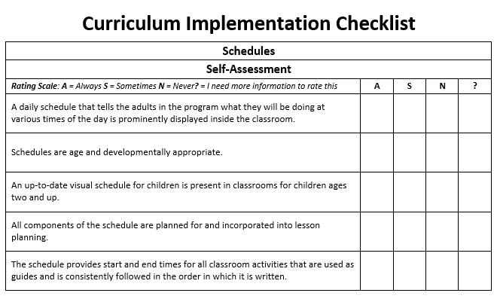
PART 1: SELF-ASSESSMENT
Use the “Schedules” section of the Curriculum Implementation Checklist

Slide 22
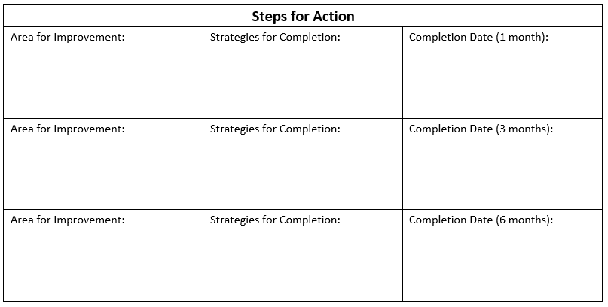
PART 2: STEPS FOR ACTION
Consider how you scored the self-assessment portion of the “Schedules” section, in addition to what you have learned in this training so far
Use this information to complete the “Part 2: Steps for Action” portion of the handout

Slide 23
Materials

Slide 24
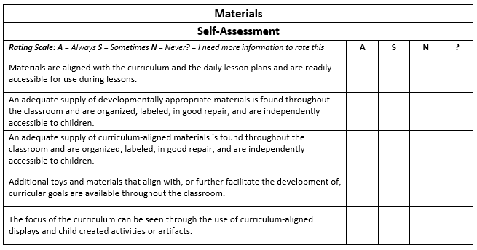
CHECKLIST
Teachers and children use curriculum-
aligned materials across activity types
throughout the day.
Everyday use
Accessibility
Implementation
Influence

Slide 25
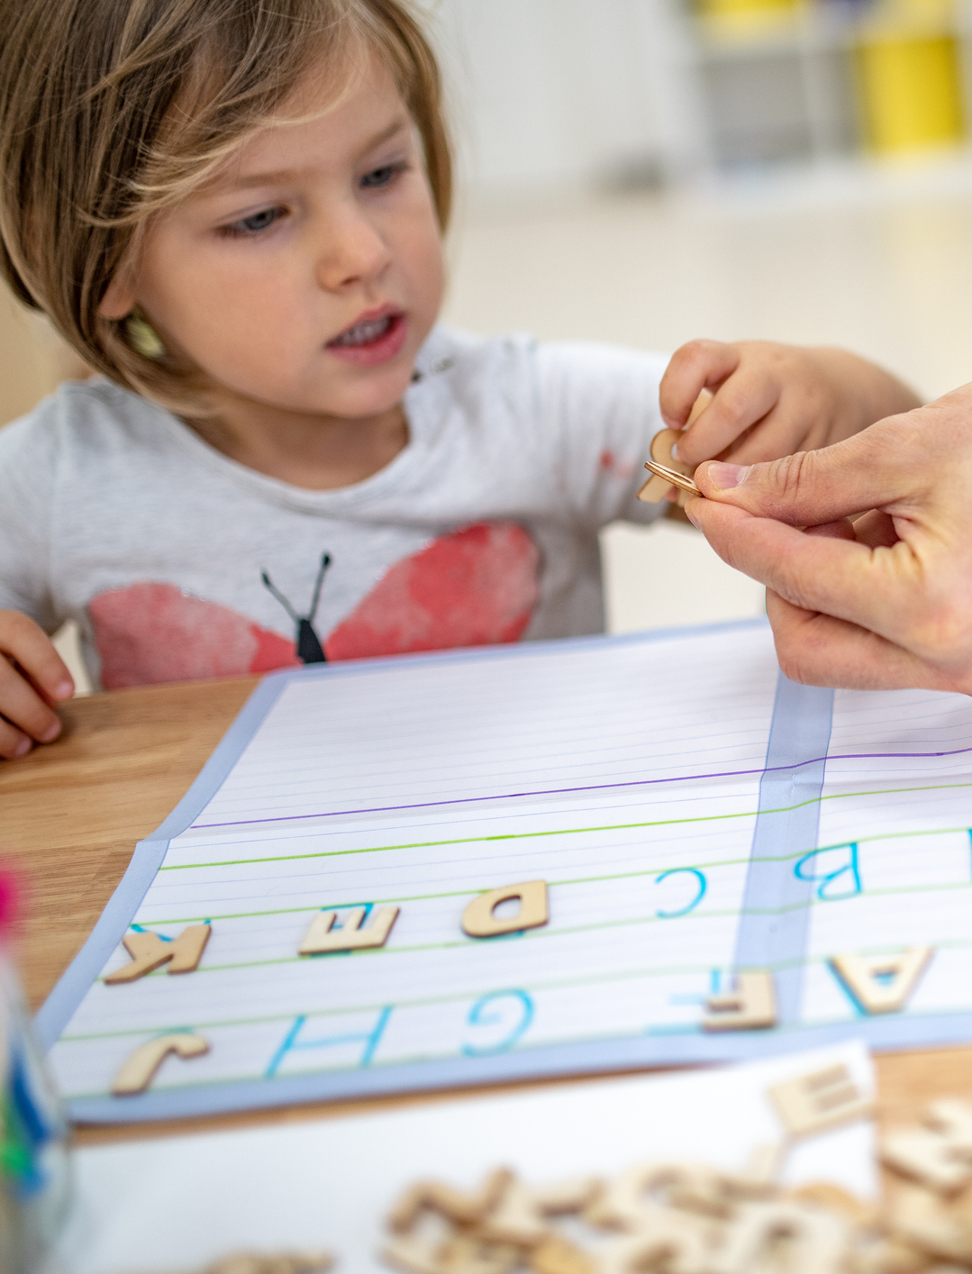
Everyday Use
Teachers and children use curriculum-aligned materials across activity types throughout the day:
Lessons
Classroom
Displays

Slide 26
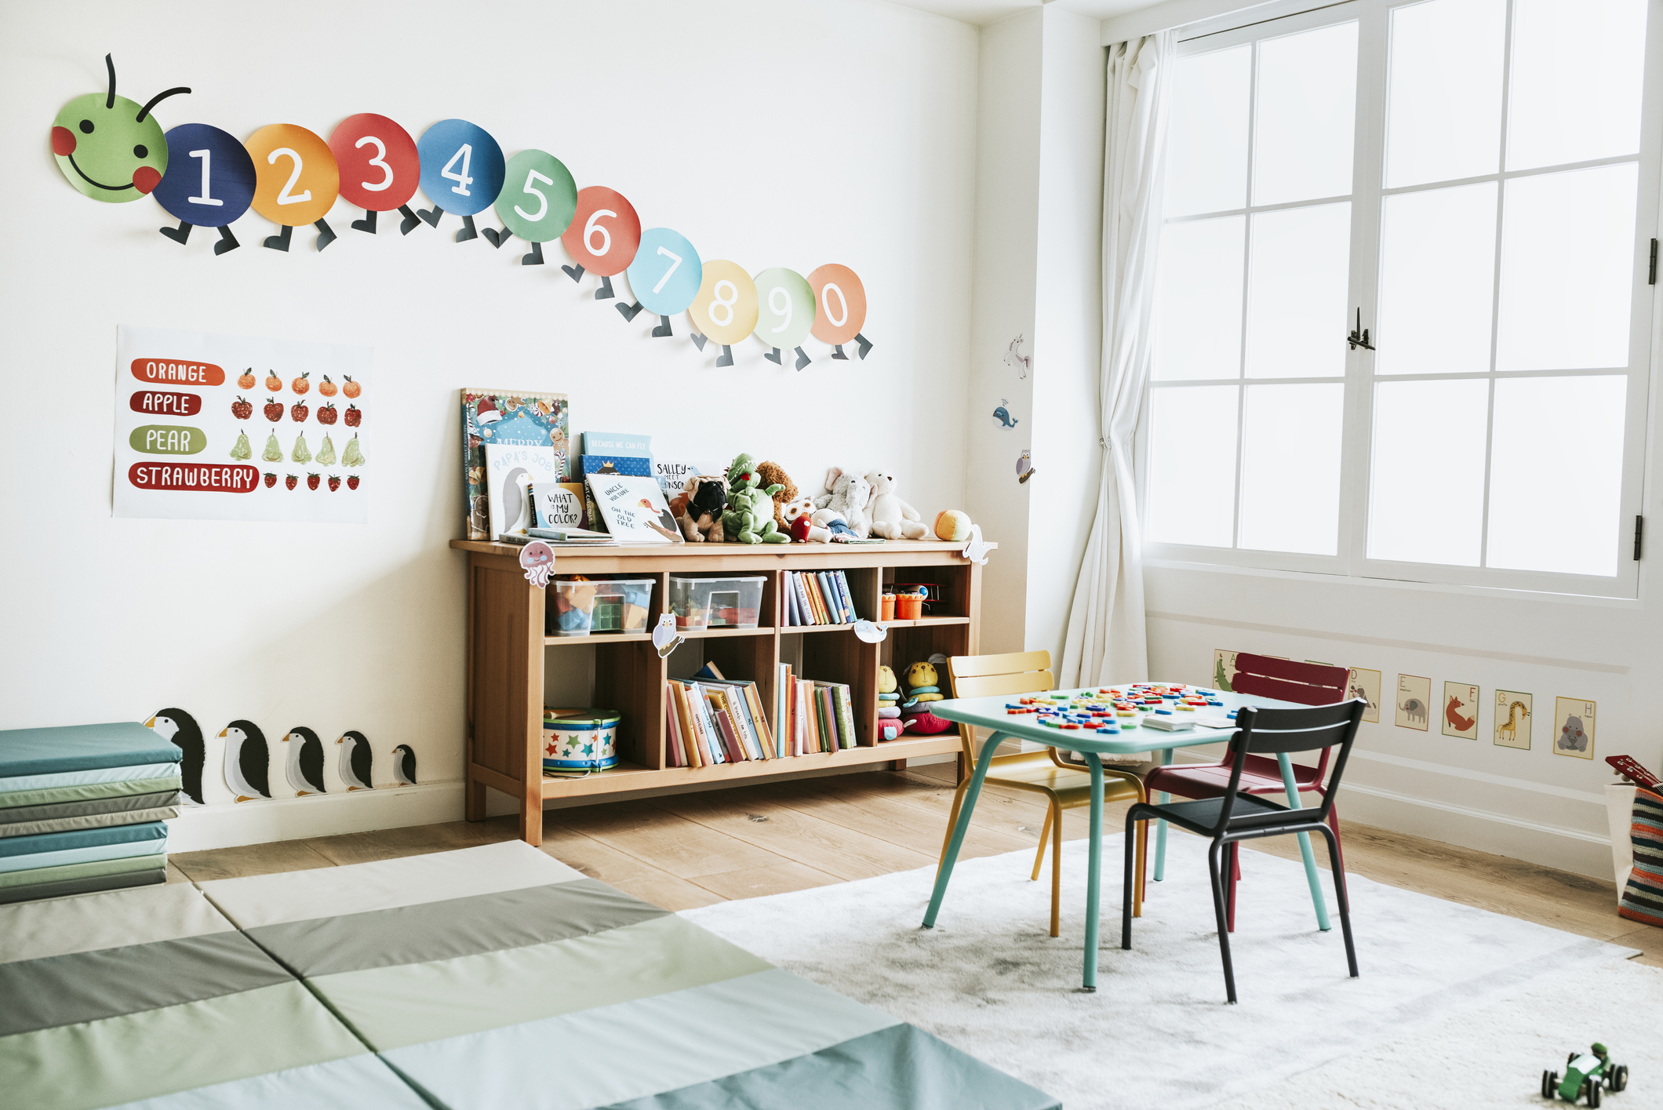
Accessibility
Developmentally appropriate materials must be easily accessible to children at all times:
Location
Labeling
Appropriateness
Amount and repair

Slide 27
Implementation
Appropriate materials are available for use when implementing curricular activities:
Alignment and accessibility
Shareability
Similarity

Slide 28
Influence
Not having the appropriate materials negatively affects:
Curriculum
Development and learning
Interest and curiosity

Slide 29
How are you currently using materials in your program?

Slide 30
PART 1: SELF-ASSESSMENT
Use the “Materials” section of the Curriculum Implementation Checklist

Slide 31
PART 2: STEPS FOR ACTION
Consider how you scored the self-assessment portion of the “Materials” section, in addition to what you have learned in this training so far
Use this information to complete the “Part 2: Steps for Action” portion of the handout

Slide 32
Planning & Implementation

Slide 33
CHECKLIST
The teacher follows the scope and sequence of the curriculum, engages in lesson planning, and implements the curriculum with fidelity.
Scope and sequence
Lesson planning
Evidence
Fidelity

Slide 34
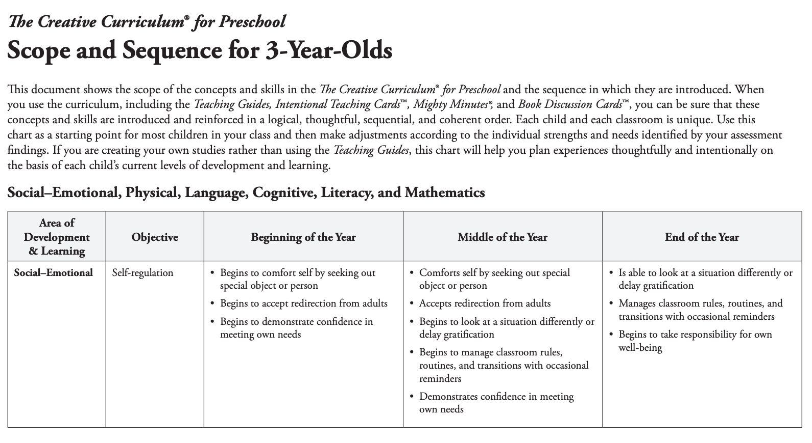
SCOPE AND SEQUENCE
The teacher follows the
scope and sequence of the
curriculum:
Scope
Sequence
Pacing

Slide 35
LESSON PLANNING
The teacher engages in purposeful planning and creates lesson plans that utilize the curriculum while considering the individual characteristics of children:
Developmental appropriateness
Individual characteristics
Inclusive of different planning types

Slide 36
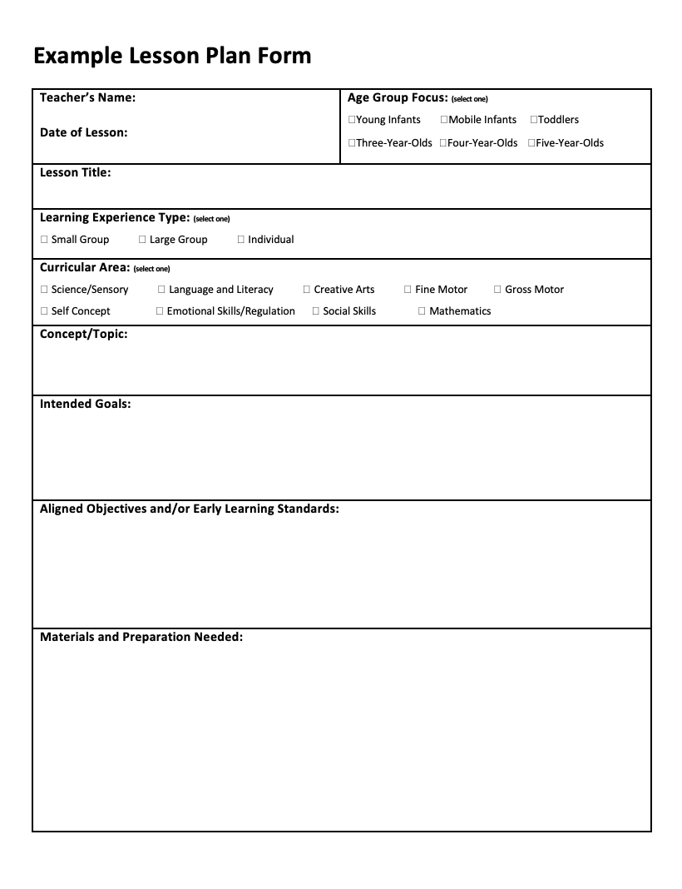
Whole Group Single Lesson Plan

Slide 37
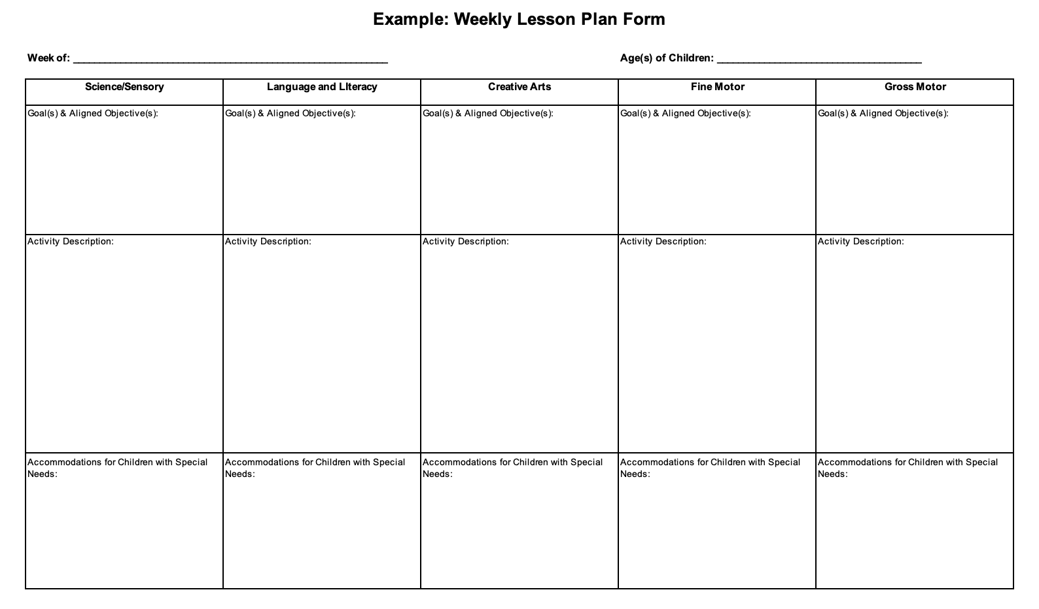
EXAMPLE WEEKLY LESSON PLAN FORM

Slide 38
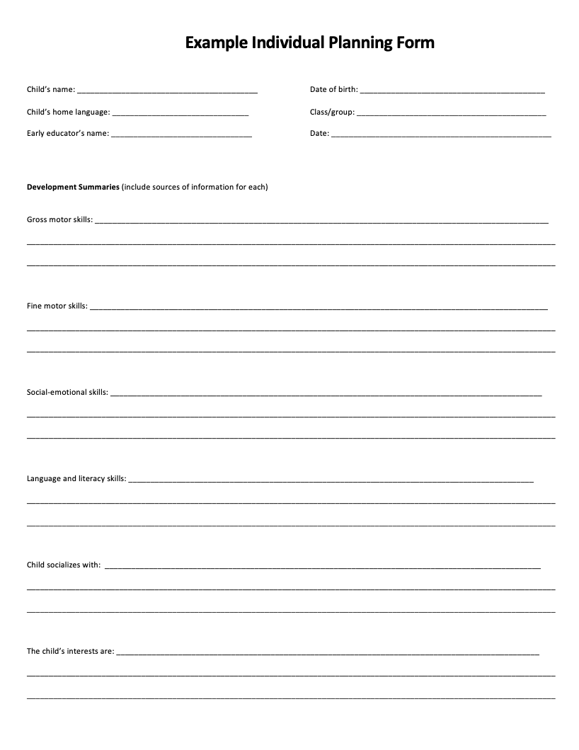
Individualized Lesson Plan

Slide 39
EVIDENCE
Evidence of curriculum implementation is found throughout the classroom and incorporated into communication with parents:
Activities and materials
Displays and artifacts
Parent communication

Slide 40
FIDELITY
“Implementing a curriculum with fidelity means that early educators consistently use a curriculum as its developers intended it to be used. This includes implementing the curriculum in ways that are responsive to children’s and families’ strengths, needs, interests, and cultural and linguistic backgrounds.”

Slide 41
How are you currently using planning and implementation in your program?

Slide 42
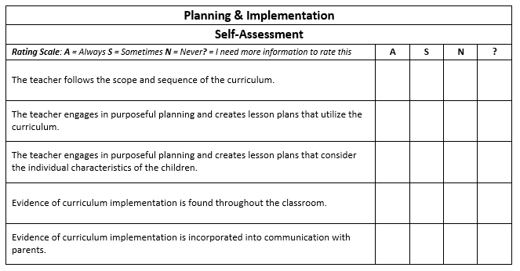
PART 1: SELF-ASSESSMENT
Use the “Planning & Implementation” section of the Curriculum Implementation Checklist

Slide 43
PART 2: STEPS FOR ACTION
Consider how you scored the self-assessment portion of the “Planning & Implementation” section, in addition to what you have learned in this training so far
Use this information to complete the “Part 2: Steps for Action” portion of the handout

Slide 44
Observation & Assessment

Slide 45
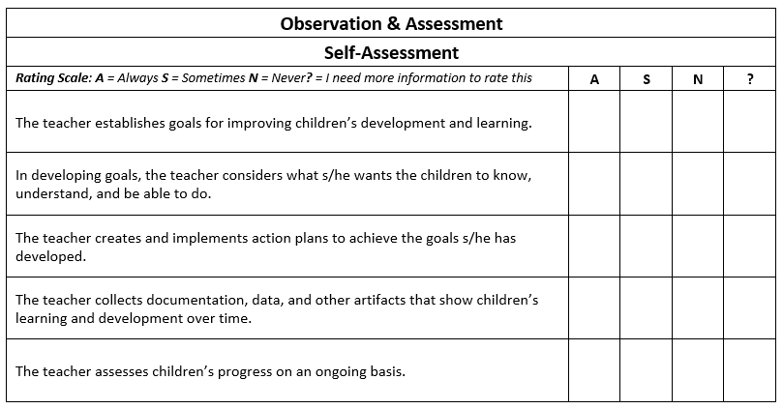
CHECKLIST
The teacher uses assessment tools
to follow children’s progress and
guide planning.
Goal setting
Action planning
Progress monitoring

Slide 46
Goal Setting
Establish goals for improving children’s:
Development across domains
Learning across content areas
Consider what you want children to:
Know
Understand
Be able to do

Slide 47
Action Planning
Create and implement action plans for achieving the goals you have developed:
Lesson planning
Children’s interests and progress
Family input

Slide 48
Progress Monitoring
Assess children’s progress on an ongoing basis:
Observe and document individual progress
Use information from multiple sources
Collect, examine, and use data

Slide 49
How are you currently using observation and assessment in your program?

Slide 50
PART 1: SELF-ASSESSMENT
Use the “Observation & Assessment” section of the Curriculum Implementation Checklist

Slide 51
PART 2: STEPS FOR ACTION
Consider how you scored the self-assessment portion of the “Observation & Assessment” section, in addition to what you have learned in this training so far
Use this information to complete the “Part 2: Steps for Action” portion of the handout

Slide 52
Modifications & Adjustments

Slide 53
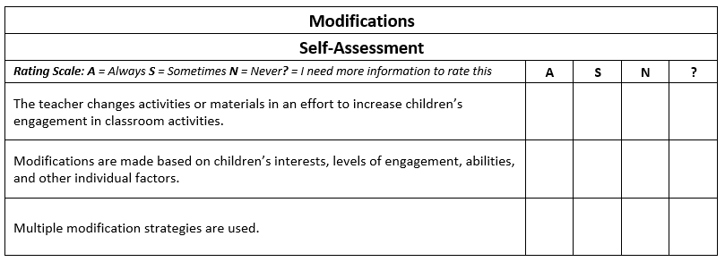
CHECKLIST
The teacher uses appropriate
modifications as indicated in the
curriculum to meet the individual
needs of children.
What
Why
Who
When
How

Slide 54
WHAT
A curriculum modification is when a
teacher changes an activity or
materials in an effort to facilitate or
increase children’s engagement in
classroom activities.
Participation
Interest
Development
Learning

Slide 55
WHY
ACCESS
PARTICIPATION
INCREASED LEARNING

Slide 56
WHO
Physical impairment
Communication barrier
Need for additional time
Lack of understanding
Lack of interest
Developmental need
Some children need modifications
to fully participate in classroom
activities.

Slide 57
WHEN
Modifications should be made when children are not fully participating in one or more classroom activities.
When all elements of high-quality teacher-child interactions are in place
When a child is interested, but not participating
Before moving onto one-on-one or more focus instruction

Slide 58
HOW
Modifications should be made so children can take full advantage of classroom activities.
Alter the environment
Adapt materials
Simplify the activity
Integrate child preferences
Use special equipment
Provide adult support
Utilize peer support
Facilitate invisible support

Slide 59
How are you currently modifying the curriculum to meet children’s needs?

Slide 60
PART 1: SELF-ASSESSMENT
Use the “Modifications” section of the Curriculum Implementation Checklist

Slide 61
PART 2: STEPS FOR ACTION
Consider how you scored the self-assessment portion of the “Modifications” section, in addition to what you have learned in this training so far
Use this information to complete the “Part 2: Steps for Action” portion of the handout

Slide 62
Session Review

Slide 63
REVIEW LEARNING OBJECTIVES
Recognize the elements needed for successful curriculum implementation
Identify their role as an early childhood professional (director, teacher, staff, etc.) in the implementation of high-quality early childhood curriculum
Develop individual role-specific strategies to successfully implement high-quality early childhood curriculum in their current role
Plan steps they can take immediately, within a month, within three months, and within six months to improve the implementation of a high-quality early childhood curricula within their classroom or center

Slide 64
Reflections, Questions, & Comments

Slide 65
Please complete the Post-Assessment Evaluation. Thank you!

