Slide 1
Lies, More Lies, and the Internet
04-32 Information Literacy and Research
Edited 7/27/2018

Slide 2
Do Now - 5 Minutes!
Edited 7/27/2018
Using complete sentences, write a few paragraphs to address the following:
  What do you use the internet for?
  Which websites are your favorite/most used?
  When you’re looking for the answer to a question on the internet, what do you do?
  How do you evaluate what information on the internet, tv, or from other sources is good?
Notes:
Have students spend 5 minutes writing on this topic.
Have a short discussion focusing primarily on the last two questions. Have a student scribe make notes of how students evaluate information on your board for reference to come back to later.
Hand out first page of 04-33 Effective Research Handout

Slide 3

DHMO and You
Edited 7/27/2018
Individually complete the page 1 of Information Literacy handout.
Read through the sites and gather your facts to be able to present a credible argument for or against banning DHMO
Did you know?
There are an average of 3,536 child deaths due to DHMO inhalation each year.
- CDC
Click to play interview with Professor Tam Way
Notes:
Give the students 10-15 minutes to complete page 1. Make sure to monitor their site usage and ask questions as they are going along about how the sites are affecting their position. If any students are already in on the hoax, ask them to Kindly play along.
After students have completed page 1 and you’ve had a short discussion take a vote on both sides of the issue.
Click at the bottom to play the short (4 minute) interview with Tom Way, professor and author of dhmo.org, it reveals that DHMO is water.

Slide 4
Don’t get DUPED
Edited 7/27/2018
One technique for not getting fooled by information on the internet is to follow these five tips, look carefully at:
  Date
  URL
  Pop-up Ads
  Evidence
  Design
Adapted from SOS Info Literacy Laramie/Lederle Collaboration Effort DHMO Lesson & John D. Brock Evaluation

Slide 5
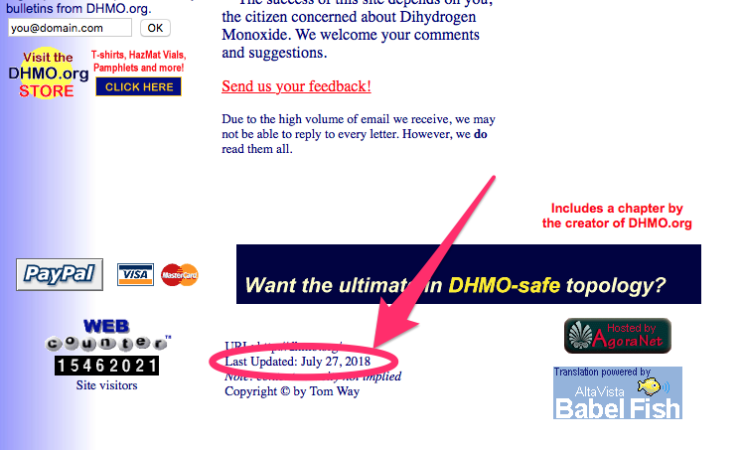
Date last updated
Edited 7/27/2018
Adapted from SOS Info Literacy Laramie/Lederle Collaboration Effort DHMO Lesson & John D. Brock Evaluation
Notes:
Ask the class, “Was there a clue in the last Updated date?”
No, it at least claims to be up-to-date

Slide 6
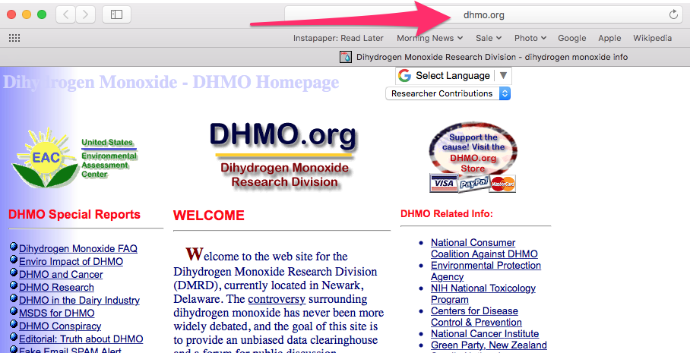
URL
Edited 7/27/2018
Adapted from SOS Info Literacy Laramie/Lederle Collaboration Effort DHMO Lesson & John D. Brock Evaluation
Notes:
What is a URL? Stands for Uniform Resource Locator. For the web it’s the address you see that represents where the information lives.
Ask the class, “Any clue in the URL that maybe this is suspect?”
No, it looks legit, like an organization that is sophisticated enough to have their own domain.

Slide 7
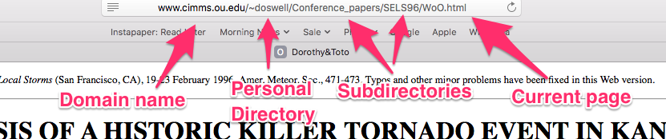
Reading a URL
Edited 7/27/2018
Domain name is usually what comes after the www, in this case cimms.ou.edu
The ~ before doswell is an indicator that it is a personal page and not an official page of ou.edu
What do the names of the directories tell us about whether this might be valid?
DHMO.org has a .org domain, does that mean anything important?
Adapted from SOS Info Literacy Laramie/Lederle Collaboration Effort DHMO Lesson & John D. Brock Evaluation
Notes:
Ask about why the domain might be an important thing to look at when evaluating the validity or trustworthiness of sources. Is it familiar? Is it a source they have found to be reliable before?
In this case what might indicate this might be a trustworthy source? (That it’s a .edu)

Slide 8
Reading a URL
Edited 7/27/2018
Domain extensions might help us evaluate a source.
.edu | Educational organization (most US universities) |  | .com | Company (usually .co in the UK)
.k12 | US school site (not all US schools use this) |  | .org | Any organization
.ac | Academic institution (outside of US) |  | .net | Network (sometimes used by internet service providers)
.sch | School site (some schools outside of the US use this) |  | .uk | United Kingdom
.gov | US government agency |  | .ca | Canada
.mil | US military institution
Which of these are available to anyone? Which are reserved?
Adapted from SOS Info Literacy Laramie/Lederle Collaboration Effort DHMO Lesson & John D. Brock Evaluation
Notes:
Everything on the left are reserved, everything on the right is available to anyone.
Why would that matter?

Slide 9

Pop-Up and other Intrusive Ads
Edited 7/27/2018
Advertising is a common way for sites to make money to stay in business
Why would lots of intrusive ads or ads for sketchy products be a bad sign?
Adapted from SOS Info Literacy Laramie/Lederle Collaboration Effort DHMO Lesson & John D. Brock Evaluation
Notes:
Ads are a fact of life on the internet, but sketchy ads or overly intrusive ads are usually a sign that the site’s primary purpose is to generate clickbait to drive ad revenue, not to provide reliable information.

Slide 10
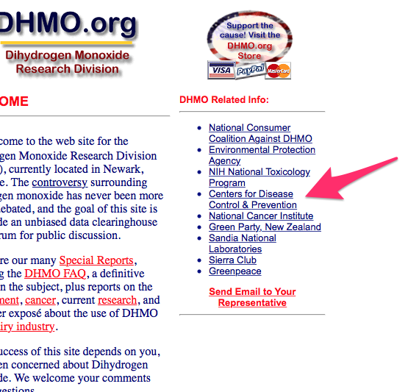
Evidence
Edited 7/27/2018
Visit the sources a webpage cites as sources or evidence to back up claims.
  Are they reputable sources?
  Do they say what the page claims they say?
Adapted from SOS Info Literacy Laramie/Lederle Collaboration Effort DHMO Lesson & John D. Brock Evaluation
Notes:
Many sites will link to sources they used as evidence to make their claims. Check! A lot of time we find that what they claim the sources say isn’t what they really say.

Slide 11
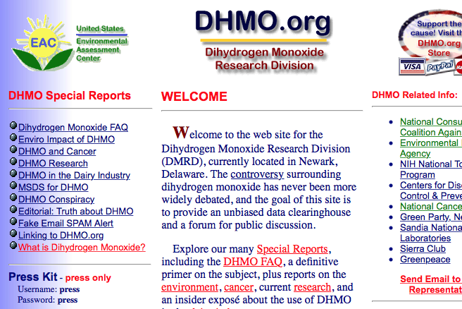
Design
Edited 7/27/2018
While it’s not the most important part, a site that has poor or really outdated design might be that way because either it’s not actually updated or has been hastily put together.
  What does DHMO.org's design tell us?
Adapted from SOS Info Literacy Laramie/Lederle Collaboration Effort DHMO Lesson & John D. Brock Evaluation
Notes:
Many sites will link to sources they used as evidence to make their claims. Check! A lot of time we find that what they claim the sources say isn’t what they really say.

Slide 12
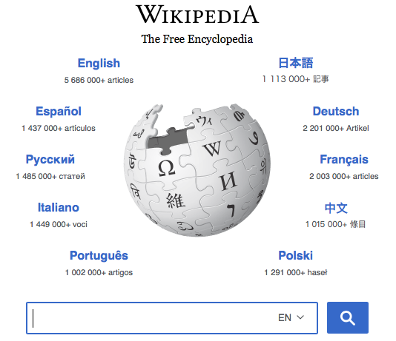
Wikipedia
Edited 7/27/2018
Is Wikipedia a good source?
  Who can add articles?
  Who can edit articles?
How can Wikipedia be a useful source?
  As an introduction to a topic
  Bibliography!
Adapted from SOS Info Literacy Laramie/Lederle Collaboration Effort DHMO Lesson & John D. Brock Evaluation
Notes:
Discuss with students whether they think Wikipedia is a reliable source. Truthfully, it very often can be, however the amount of vandalism on popular articles and the lack of reliable editors on a lot of less popular articles means students need to be extra cautious.
Recommend students use it as a place to get an overview, but more importantly, to use as a great table of contents for sources for their own research. The hyperlinked bibliography at the end of every article usually leads to more reliable sources, but remember even then students need to avoid getting DUPED.

Slide 13
Don’t get DUPED
Edited 7/27/2018
One technique for not getting fooled by information on the internet is to follow these five tips, look carefully at:
  Date
  URL
  Pop-up Ads
  Evidence
  Design
Adapted from SOS Info Literacy Laramie/Lederle Collaboration Effort DHMO Lesson & John D. Brock Evaluation

