Slide 1
Identifying Attendance Barriers & Addressing them Through School-level Student Support Systems

Slide 2
Welcome!
Gwen Murray, PhD
Louisiana State University
Social Research & Evaluation Center
© 2023 LSU, Social Research & Evaluation Center; G. Murray, PhD

Slide 3
David is a 7th grade student. Coming back from winter break, he missed 4 days of schools in 2 weeks. What do you do?
© 2023 LSU, Social Research & Evaluation Center; G. Murray, PhD

Slide 4
Objectives
Participants will be able to:
describe root causes of chronic absenteeism
assess Tier 2 attendance intervention plans that identify student and family needs
develop systems to create and monitor Attendance Success Plans
© 2023 LSU, Social Research & Evaluation Center; G. Murray, PhD

Slide 5
Thinking About Absenteeism
BARRIERS | AVERSION | DISENGAGEMENT
Students CANNOT attend school for these reasons | Students WILL NOT attend schools as an avoidance strategy | Students DO NOT attend school due to disinterest, lack of connection, or parent mindset
Illness / Chronic Disease physical behavioral Family Responsibilities childcare/caring for siblings or other family members difficulty supporting learning) Parent incarcerated Unmet Basic Needs (Maslow’s) housing instability poor transportation no safe path to school natural disasters/ property loss Involvement with Juvenile Justice System | Academic Struggles avoidance of challenging work (**student may be academically behind) Social Struggles Avoidance of embarrassment Fear of stigma or being teased Language barriers Mental Health Struggles PTSD Acute anxiety Depressive or manic episode Trauma School Climate Avoidance of bullying Avoidance of unsafe conditions Parent Concerns Fear of COVID Parents’ poor experiences with school | Lack in Cultural Competence (Academic) Irrelevant curriculum Unengaging curriculum Poor Relationships and Climate No trusted adults Lack a sense of safety, belonging, and support in school Poor peer relationships Discipline Patterns School discipline rates Frequent discipline referrals Personal experience with suspension Questioning Value of Attending School No perceived consequences for skipping Peer pressure to skip Interest in entering workforce/trade Student is Overage
(Adapted from Attendance Works, 2014)
© 2023 LSU, Social Research & Evaluation Center; G. Murray, PhD

Slide 6
Knowing Your Community
Pick your top five factors that impact your students’ attendance.
family responsibilities
mental health issues
other health issues
housing instability
lack of basic needs (food, uniform, etc.)
involvement with judicial system or DCFS
concerns about school safety
school refusal
parent disengagement
frequent discipline issues
poor relationships: peers
poor relationships: teachers
Is there one set of factors that needs more attention than others at your school or in your district?
Barriers
Aversions
Disengagement
© 2023 LSU, Social Research & Evaluation Center; G. Murray, PhD

Slide 7
Working with Students & Families: When
Tier 2 Intervention: Implement as early intervention (5-9 days)
Includes excused, unexcused absences
Sets individual attendance goals
Precedes punitive measures, referrals to court, etc.
If student does not respond to Tier 1 Interventions
Advisory / Morning Meeting Structure
​Check-ins Following Absence
​Attendance Incentives
If student does not respond to Tier 2 Strategies
Assess & Support Student Academic Needs​
Develop Catch-Up Plan
https://tinyurl.com/LATier2Attendance
© 2023 LSU, Social Research & Evaluation Center; G. Murray, PhD

Slide 8
David’s family might not have a working phone number. How do you connect with them to determine their needs?
© 2023 LSU, Social Research & Evaluation Center; G. Murray, PhD

Slide 9
Working with Students & Families: How
For student specific planning, seek to answer:
Why is the student chronically absent (barriers; aversion; disengagement)?​
Cannot work to solve the problem until it is fully understood
Who does this student trust? ​
Trusted adults at school are critical for student reengagement, and for accountability with students and their families/caregivers
Where does this family/caregiver feel most supported? Why?
Families/caregivers are critical stakeholders in student attendance; empowering their participation is important to improve absenteeism
Who | What
 | Early Childhood | Elementary | Upper Grades
Student | Attend meeting | Identify patterns, needs Set goals | Set goals
Parent/Caregiver | Set goals | Set goals Attend meeting | Attend meeting
Teacher / School | Facilitate meeting Set goals | Set goals Attend meeting | Hold meeting
https://tinyurl.com/LATier2Attendance
© 2023 LSU, Social Research & Evaluation Center; G. Murray, PhD

Slide 10
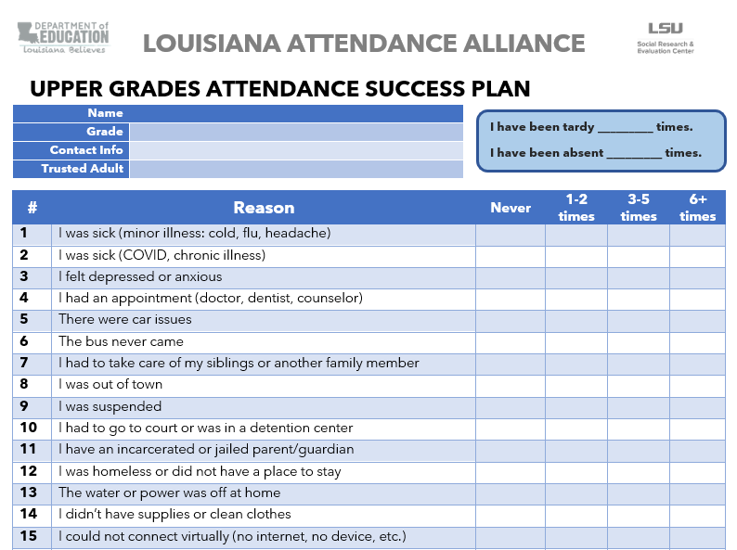
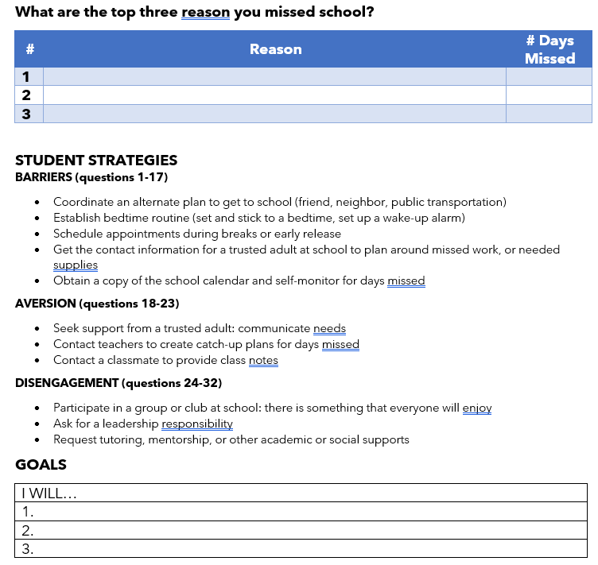
Sample Attendance Success Plans
© 2023 LSU, Social Research & Evaluation Center; G. Murray, PhD
https://tinyurl.com/LATier2Attendance

Slide 11
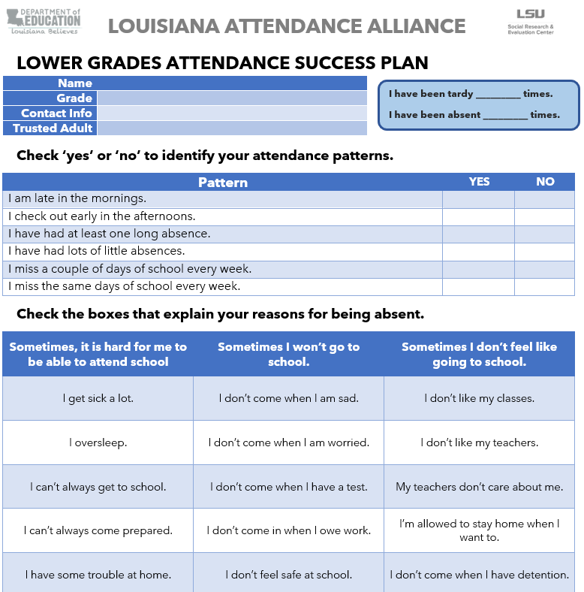
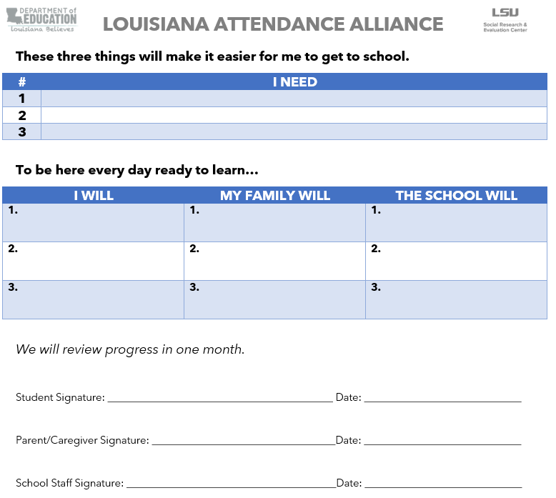
Sample Attendance Success Plans
© 2023 LSU, Social Research & Evaluation Center; G. Murray, PhD
https://tinyurl.com/LATier2Attendance

Slide 12
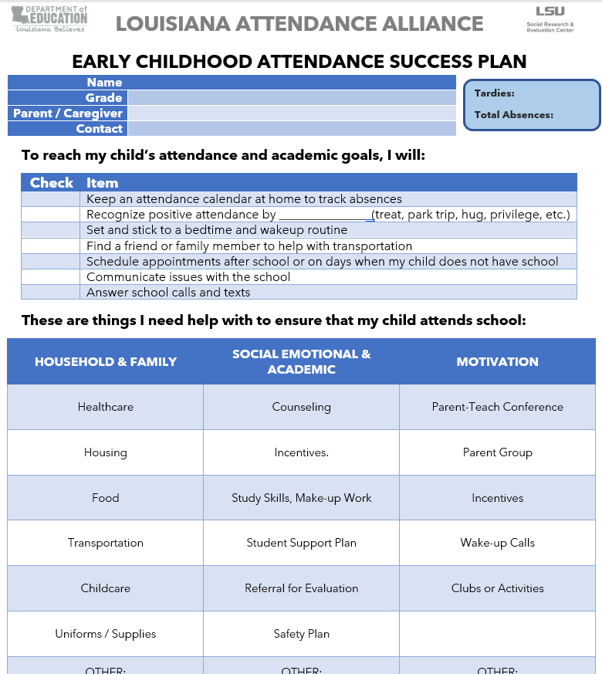
Sample Attendance Success Plans
https://tinyurl.com/LATier2Attendance
© 2023 LSU, Social Research & Evaluation Center; G. Murray, PhD

Slide 13
Based on his and his family’s needs, David is a good candidate for a Tier 2 Attendance Success Plan. How will you implement and monitor?
© 2023 LSU, Social Research & Evaluation Center; G. Murray, PhD

Slide 14
Building Systems
How do we make this happen?
Integrate into existing teaming structure.
© 2023 LSU, Social Research & Evaluation Center; G. Murray, PhD

Slide 15
Student Assistance Team (SAT)
The Student Assistance Team (SAT):
is a school-based team that convenes routinely to review student attendance, behavior, and coursework data;
the team should include (recommendation): 2 administrators, 2 teachers, other support personnel
can happen during first 10 of PLCs/teaming time, during leadership or SBLC mtgs
creates and executes targeted, Tier II intervention plans for students who do not currently have an IEP or a 504 plan; (though it can include them, as needed);
monitors the impact of these interventions over time.
© 2023 LSU, Social Research & Evaluation Center; G. Murray, PhD

Slide 16
Student Assistance Team (SAT)
Who are the members of the team? 2 administrators 2 teachers 1-2 additional support personnel
When will the team meet? (day of week, time of day)
How long will the meeting last? (meeting duration; or designated time embedded into existing development structure—leadership team; PLCs/teaming/collaboration time)
How will students be referred to SAT? (Is there a form? Who oversees collecting and reviewing referrals?)
Where will the data come from? With what frequency? Who will pull?
WHO
WHEN
HOW
© 2023 LSU, Social Research & Evaluation Center; G. Murray, PhD

Slide 17
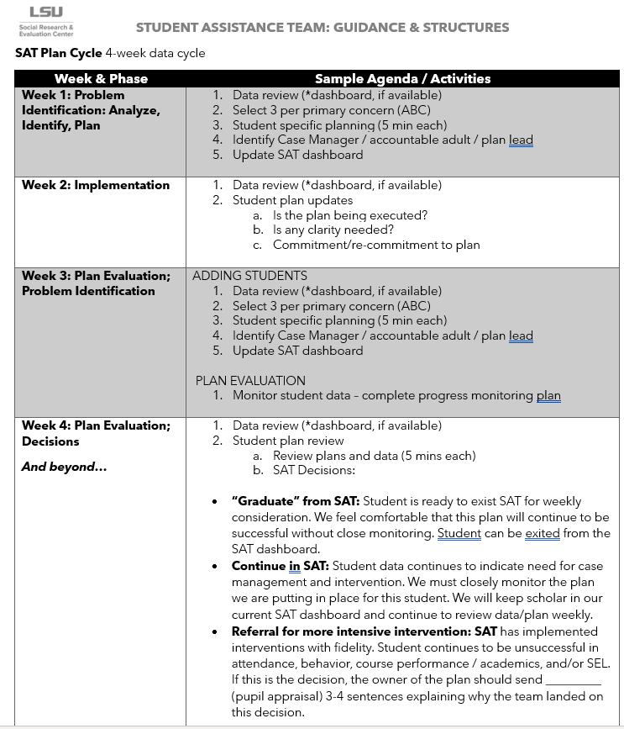
Student Assistance Team: Process
Suggested agendas
Scalability
Manageability
© 2023 LSU, Social Research & Evaluation Center; G. Murray, PhD

Slide 18
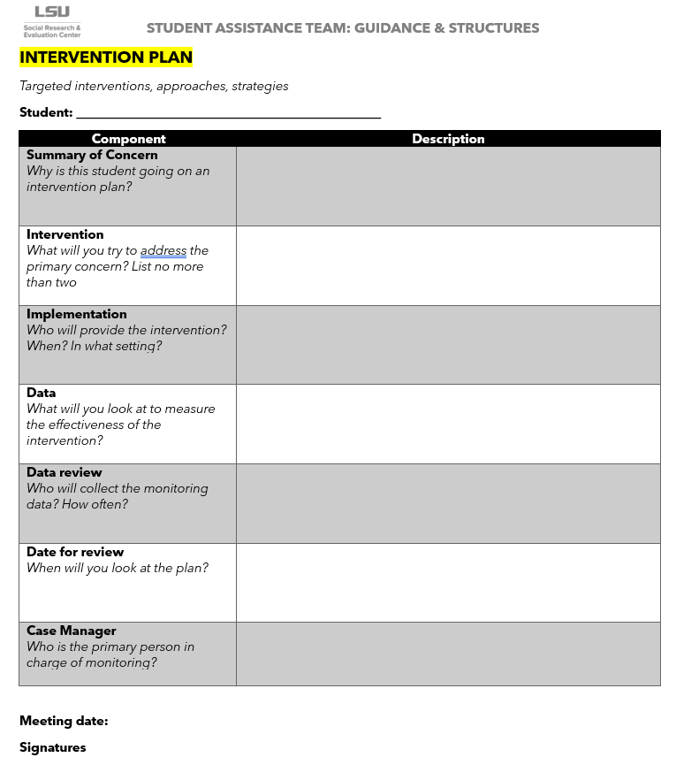
Student Assistance Team: Intervention
Templates for pre-work
Template for intervention plan
Template for progress report
© 2023 LSU, Social Research & Evaluation Center; G. Murray, PhD

Slide 19
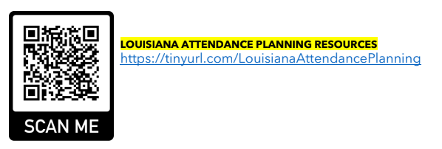
Student Assistance Team: Monitoring
© 2023 LSU, Social Research & Evaluation Center; G. Murray, PhD

Slide 20
Contact Information
Gwen Murray, PhD
gmurray1@lsu.edu
© 2023 LSU, Social Research & Evaluation Center; G. Murray, PhD

