Slide 1
U.S. Army Specialty Training, Opportunities and Educational Support
Lafayette Army Recruiting Leadership
CPT/P Kevin Finerty
1LT Shane McCarthy
1SG Calethia Thompson

Slide 2
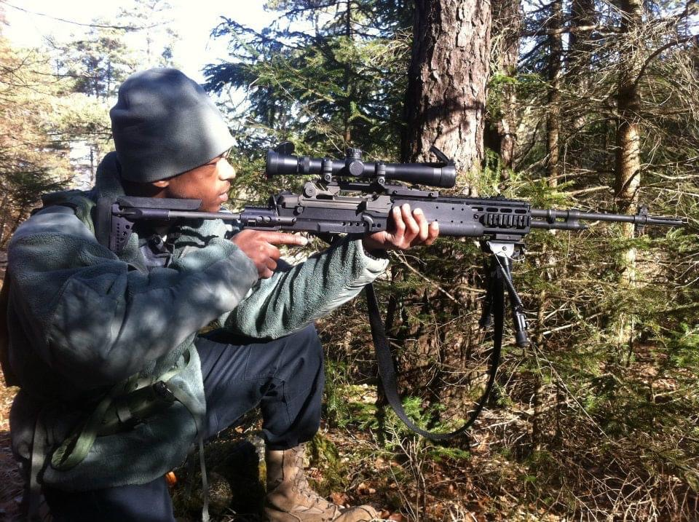
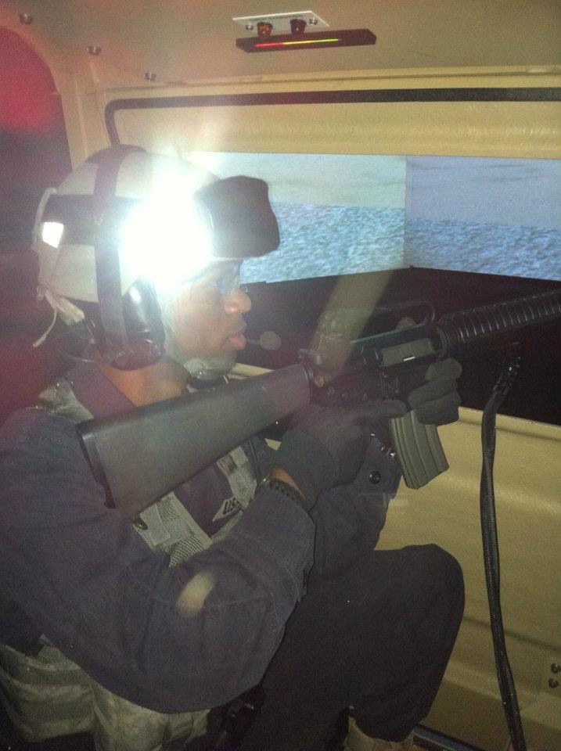
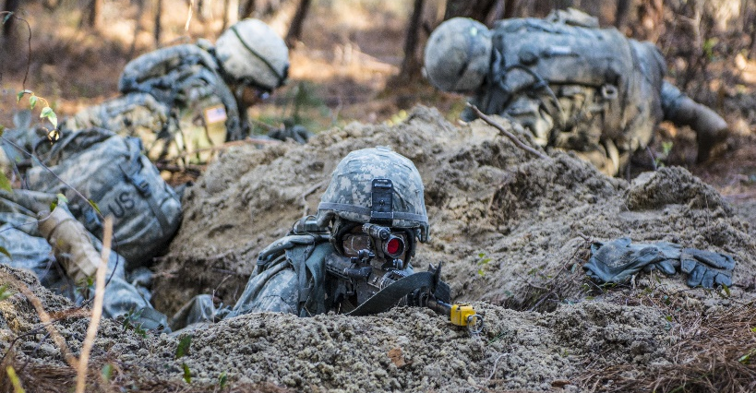
Leadership Development and Educational Support

Slide 3
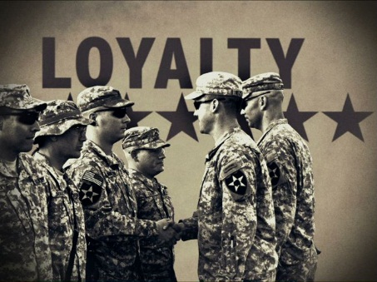
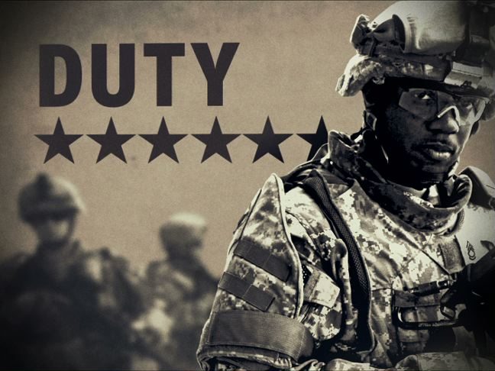
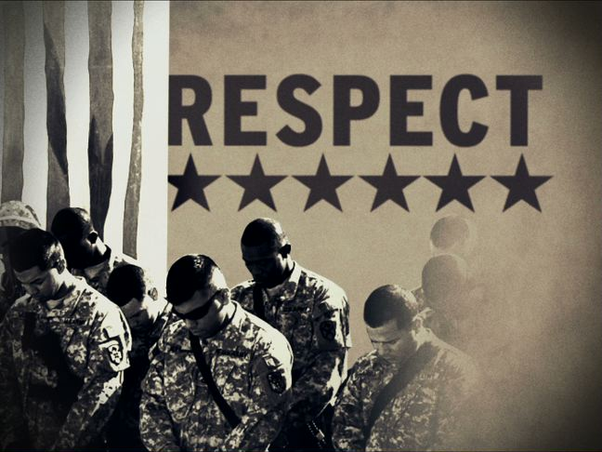
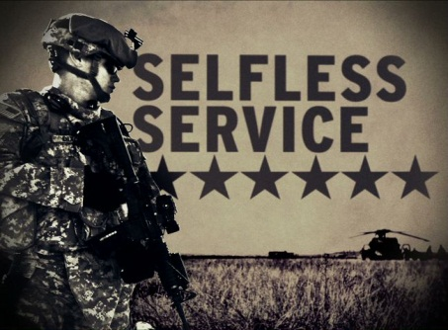
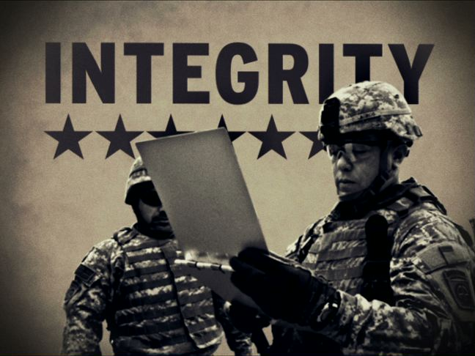
ARMY VALUES
LOYALTY: Bear true faith and allegiance to the U.S. Constitution, the Army, your unit and other soldiers
DUTY: Fulfill your obligations
RESPECT: Treat people as they should be treated
SELFLESS SERVICE: Put the welfare of the Nation, the Army and your subordinates before your own
HONOR: Live up to the Army values
INTEGRITY: Do what’s right, legally and morally
PERSONAL COURAGE: Face fear, danger or adversity (physical or moral)

Slide 4
Post-9/11 GI Bill
Montgomery GI Bill
The Post- 9/11 GI Bill is an education benefit program for individuals who served on active duty after September 10, 2001.
Assistance may be used for college degree and certificate programs, technical or vocational courses, flight training, apprenticeships or on-the-job training, high-tech training, licensing and certification tests, entrepreneurship training, certain entrance examinations, and correspondence courses.
Requirements:
Honorable Discharge
Graduated from HS
In July of 2008 the Post-9/11 GI Bill was signed into law, creating a new robust education benefits program rivaling the WWII Era GI Bill of Rights.
Can pay your full tuition & fees at school
Provide you with a monthly housing allowance while you are going to school
Give you up to $1,000 a year to use for books and supplies.
If you live in the middle of nowhere the Post-9/11 GI Bill will even provide you with a one-time relocation allowance to move to where your school is located.
Another new provision of the Post-9/11 GI Bill allows eligible servicemembers to transfer their unused benefits to family members. You can use your Post-9/11 GI Bill for college and many other types of training.
Full time $1,994.00
¾ time $1,495.00
½ time $997.00
less than ½ time more than ¼ time $997.00 **
¼ time or less $498.50 **

Slide 5
USAR Minuteman Scholarship Benefits
Full College Tuition (Varies based on school): insert tuition cost
US Army Reserve Pay (based on E5 pay grade, 2018 rates):
1st Year:
Monthly Training: ($311.05/weekend) x (12 weekends)= $3732.60
• Annual Training: ($77.76/day) x (14 days) = $1088.64
2nd Year:
Monthly Training: ($311.05/weekend) x (12 weekends) = $3732.60
• Annual Training: ($77.76/day) x (14 days) = $1088.64
3rd Year:
Monthly Training: ($331.98/weekend) x (12 weekends) = $3983.76
• Annual Training: ($83.00/day) x (14 days) = $1162.00
ROTC Cadet Summer Training (Advanced) = $927.13
4th Year:
Monthly Training: ($364.42/weekend) x (12 weekends) = $4373.04
• Annual Training: ($91.10/day) x (14 days) = $1275.40
Total (4-year) Reserve Pay: $21,363.81 (not including yearly pay increases)
ROTC Stipend
Freshman: ($300/month) x (10 months) = $3000/yr
Sophomore: ($350/month) x (10 months) = $3500/yr
Junior: ($450/month) x (10 months) = $4500/yr
Senior: ($500/month) x (10 months)= $5000/yr
Total (4-year) ROTC Stipend: $16,000.00
Book Stipend ($1200/yr) x (4 yrs) = $4800.00
Total USAR Minuteman Scholarship Value and Compensation:
$42163.81 + tuition cost = final value
- A D D I T I O N A L B E N E F I T S F O R -
MIN U T E MA N S M P C A D E T S
Higher starting pay as an Officer - USAR 2LTs who participated in the Simultaneous Membership Program (SMP) can earn up to $107.03 more per weekend than their peers (2018 figures) of the same rank, due to having 4 years in service upon commissioning. Those who switch to Active Duty after their USAR commitment will earn much more.
Branch of Choice and Advanced Officer Training - GRFD (Minuteman) SMP Cadets can request their Branch of choice (based on USAR availability), and train with the unit they will join, building rapport with their future supervisor and other leaders within the unit.
Earned retirement years - SMP time counts toward retirement - they will have up to 4 fewer years to serve after commissioning for a USAR retirement (for standard 4-year SMP cadets, this means serving 16 years after commissioning, as opposed to 20 for non-SMP Officers).
Health Care - SMP Cadets and their families are eligible for Tricare Reserve Select health insurance.
Access to Military shopping and facilities - SMP Cadets are authorized to use on-post facilities (if available), many of which are tax-free, such as the Commissary/PX, Gyms, and outdoor recreation rentals; they are also authorized to reserve Space-Available (Space-A) airline flights.
Continuing Education - Minuteman recipients can use Tuition Assistance after completing IET to help pay for their graduate degree (conditions apply).

Slide 6
Enlisted, Warrant and Officer Opportunities

Slide 7
Army Job Specialties
(Over 150 Jobs, only 11 are combat centric)
Administrative Support
Features support jobs dealing with Army personnel, administration, finance, legal, information and religious services. Roles and responsibilities include clerical to supervisory positions. Army human resources jobs can also be found here. Jobs include administrative specialists (e.g. unit supply, finance) and religious support
Mechanics
Tasked with keeping the Army's vehicles and machines in proper running order. MOSs range from heating and cooling mechanics to vehicle mechanics who service aircraft, wheeled and tracked vehicles, heavy equipment and watercraft.
Intelligence & Combat Support
Supports U.S. Army personnel involved directly in combat. They work behind-the-scenes to support and provide intelligence to Soldiers on the field. Jobs include food services, watercraft operators, intelligence analysts, translators, interpreters and topography specialists.
Computers & Technology
Includes technical and informational support for a variety of areas. Positions available in computers, communications, environmental health, intelligence, explosives and unmanned vehicle operations.
ARTS & MEDIA
Covers the administration, communication and supervision of Army affairs for both military and civilian audiences. Jobs include broadcast technicians, graphic designers, translators, journalists and musicians.
Medical & Emergency
Addresses jobs in the medical, dental and veterinary fields. These MOSs cover a variety of responsibilities throughout the military health care field, from clinical settings to point of injury.
Legal & Law Enforcement
Focuses on keeping the people and property of the Army safe. MOSs include firefighters, military police, criminal investigators, security and emergency specialists
Construction & Engineering
Consists of jobs in every aspect of construction, including electrical, carpentry, masonry and plumbing, as well as heavy equipment operation and supervising construction engineering.
Combat
Involves Army reconnaissance, security and other aspects of both offensive and defensive combat situations. Jobs include artillery specialists, infantry, special operations and tank crew. Many combat MOSs are open to women.
Transportation & Aviation
Involves the coordination and supervision of personnel, equipment and procedures for proper transportation and use of Army materials throughout the world. Jobs include air traffic controllers, railway equipment repairers, parachute riggers and truck maintainers.

Slide 8
“High School to Flight School” Qualifications
Be older than 18, but not more than 32 years at the time of board selection
Have less than 8 active federal service years
Complete Class I flight physical (Scheduled with U.S. Army Recruiters)
Be a U.S. Citizen
110 GT or higher (Score comes from ASVAB)
SIFT (Army Flight Instrument Test) Score of 40 or higher
High School Diploma or higher level of education
Able to obtain a security clearance
If prior service, must not be on Active Duty (Active Duty Service members must compete through the In-Service Board)
https://recruiting.army.mil/ISO/AWOR/
AR 601‐210 para. 9‐16. Members of the DEP or DTP may not process for OCS or WOFT

Slide 9
Other Specialty Programs
“Slacker to Hacker” similar to High School to Flight School with emphasis on cyber defense jobs in the Army
Soldier admissions to the United States Military Academy at West Point (Enlisted Soldiers can apply to all service academies, acceptance will supersede enlistment contract)
Officer Candidate School (OCS): Interested persons with a completed Bachelors degree can apply to attend OCS outright, and upon successful graduation, commission as an Officer in the U.S. Army
Specialized medical recruiting, for those students already in or completed advanced medical degrees can qualify for direct commissions and other options
Army Civilian Acquired Skills Program (ACASP): Interested persons who have already completed civilian certification for trade skills, medical jobs (commonly EMT-B and/or Paramedic) can enlist at a higher rank and qualify to skip certain portions of Army Initial Entry Training
Funded Legal Education Program (FLEP): Pairs above listed educational benefits for already serving Soldiers to get paid to attend Law School, commission as an Officer upon graduation and serve in the Army Judge Advocate General (JAG) Corps
U.S. Army Ranger Selection and Special Forces Assessment and Selection options

Slide 10
Closing Remarks
We invite and encourage any student or individual who has considered service to our Nation, who may need help paying for continued education or would like to get trained or qualified in a new skill set to talk to any of our recruiters
We view ourselves as Army career advisors and the best way we can reach the largest number of people, is with everyone’s help sharing our message
Our goal is to get the most accurate information out to help each person make their best and informed decision to support their future
We have experienced recruiters all over the state and the Nation
In the relative area we have a recruiting offices in
Lafayette
New Iberia
Opelousas
Lake Charles
DeRidder
CPT Finerty: 504-813-5364

