Slide 1
JumpStart Convention
Building a Foundation for Attendance Systems
January 23, 2024

Slide 2

So happy to be here with you!
Emily Orngard: Director of Professional Learning and District Partnerships at EveryDay Labs
Darvell Edwards - Executive Director of Special Programs
Erin Valls - PBIS Coordinator
Notes:
Emily & Cindy
Hi everyone! Happy to see you all again, if you missed last week’s session, the recording is available and was sent to you yesterday through OMS, so feel free to go back there and check it out for more detailed information on who we are and who EveryDay Labs is.

Slide 3

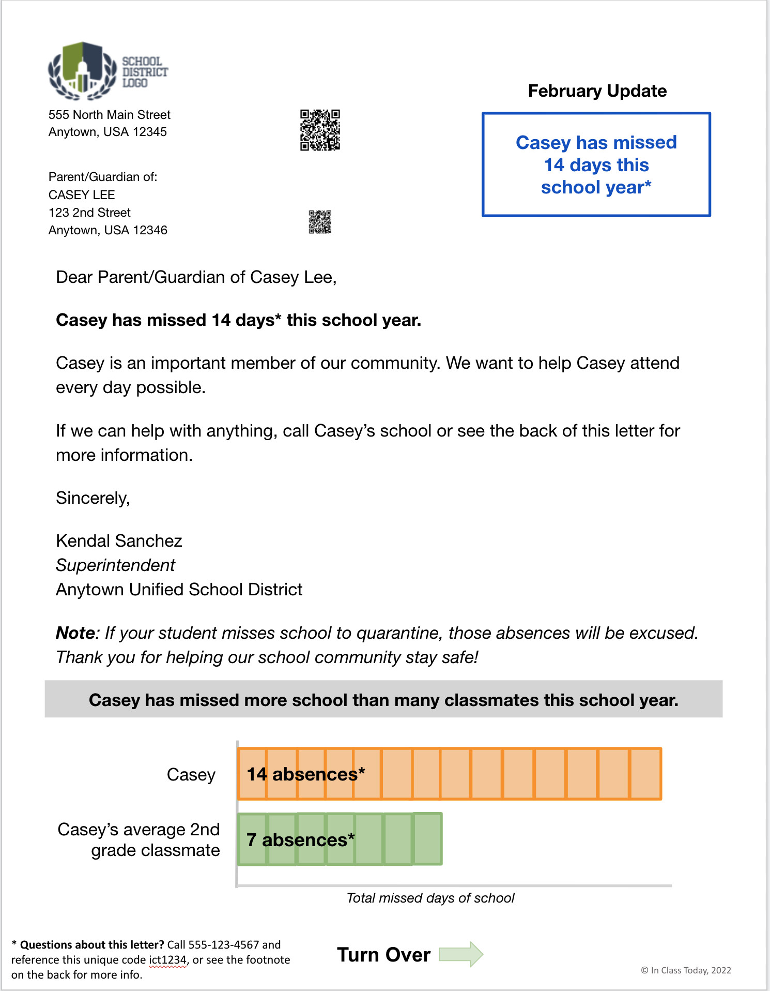
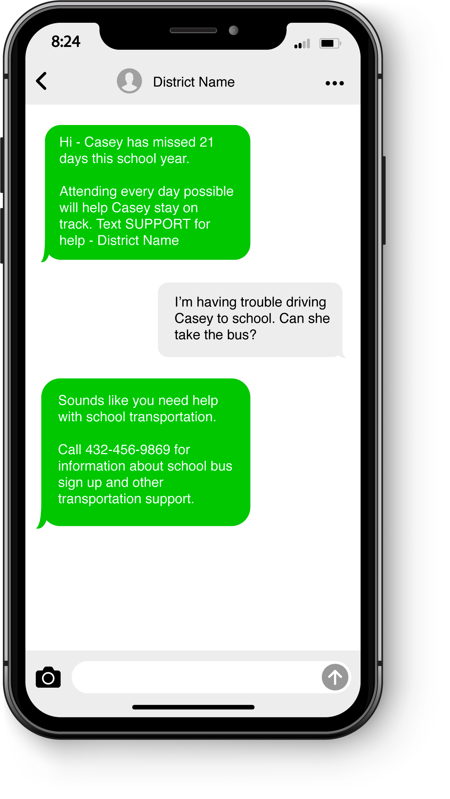
EveryDay Labs: Behavioral science is at our core
Family Communication
Attendance
Notes:
A bit about EveryDay Labs before we jump into everything today, We are an organization that was born out of the Harvard Kennedy Research Lab. Our founder, Dr. Todd Rogers is a professor of behavioral science at Harvard and is continually researching how to use behavioral science to motivate action & change people’s behavior. He became very interested in applying behavioral insights to education, and seeing if he could improve family communication, attendance and reduce chronic absenteeism. Thus, our intervention was born!
We partner with districts all across the country to provide this Tier I Universal Intervention. We send mail nudges and text nudges designed to motivate families to help their students come to school more often. We also provide access to a data platform that helps districts analyze data to find emerging attendance trends & patterns and we offer professional learning as well!

Slide 4
Today’s Focus
Chronic Absenteeism: What is it and why do we care?
Setting school-level expectations
  Taking a systemic approach to attendance
  Creating effective attendance teams
Notes:
In this series, we’re going to be diving deep into aligning your attendance systems with an MTSS approach. We’ll spend time digging into Tier I, Tier II and Tier III systems, but before we can do that, we have to first set a clear foundation in order to have space for that tiered approach.
Today, in order to build that foundation First, we’ll dive into chronic absenteeism and get really specific about what it is, and why we care so much about it.
Next we’ll shift into thinking about how we can ensure we have clarity on our attendance policies for all of our school community
We’ll end today focused on how to set school level expectations around attendance - what does a systemic approach look like, and what are some best practices around creating effective attendance teams.

Slide 5
Supports for Students
Social Emotional Supports
Community Resources
Accelerated Learning
On Time Graduation
HealthCare Solutions
Teacher Effectiveness
Safe Environments
ATTENDANCE
Notes:
Cindy
Strong attendance improves all other outcomes
Very challenging to address your achievement gap if not addressing your attendance gap
We are all making incredible investments in academic recovery and improvement– by investing in attendance, you drastically increase your ROI for academic achievement work
Essr ending - Hold onto the things that have the highest academic ROI - attendance is one of those critical investments – its the foundation to build on

Slide 6


A Systemic Approach
Notes:
Cindy

Slide 7
Three Attendance Metrics
Average Daily Attendance
Truancy
Chronic Absenteeism
Notes:
Cindy
It’s been interesting to watch over the last decade or so as more and more research has surfaced around the academic consequences of chronic absenteeism
chronic absenteeism has over time become a critical piece of data that we need to focus on because of how much we know it can impact a child’s learning

Slide 8
Average Daily Attendance (ADA):
Tracking ADA allows you to
      monitor overall health of school/district attendance
      set school-wide goals
      reward staff/students for improvement
Notes:
Cindy
Let’s dive into Average Daily Attendance a little more.
This metric is really helpful to track because it allows you to monitor the overall health of your school’s attendance, set school-wide goals, and reward staff/students for improvement, or for reaching those goals. It’s a great metric for getting a quick snapshot into how your school is doing overall.
One of the critical pieces of a system is making sure that everyone is on the same page when it comes to thinking about ADA.
Do you track ADA right now? How important is it for your schools that you’re serving? Do your school sites know their ADA rates? Or how to find it?

Slide 9
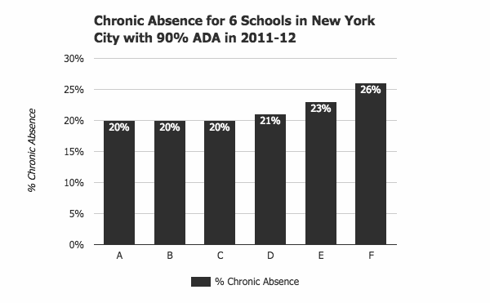
ADA Can Mask a High Chronic Absence Rate
Notes:
Cindy
While ADA is really helpful, because it tells you on average the number of students that show up on any given day, we want to make sure it’s not the only metric we are grounding ourselves in.
One reason for this, is that ADA rates can actually mask a high chronic absence rate.
Here, you’re looking at a graph of 6 schools in New York, all with a 90% ADA rate. As you can see, while their ADA rate is the same, their chronic absenteeism rate varies significantly between the 6 schools. Some are lower at 20%, some go all the way up to 26%. This is why it’s important to ensure that you have a system in place for tracking both measurements.
ADA rates support school wide data, and Chronic Absenteeism is a a bit more of an individual metric. If I have a school of 200 students with 10 missing every day, their ADA rate would be 95%.
When we consider chronic absenteeism, the question becomes: who are those 10 students that are consistently missing school? - and what can we do to help them attend more regularly?

Slide 10

Truancy
Counts only unexcused absences
Emphasizes compliance
Relies on legal & administrative solutions
Chronic Absence
Counts all absences: excused, unexcused, & suspensions
Emphasizes academic impact of missed days
Uses community-based, positive strategies
Chronic Absenteeism = Missing 10% of Enrolled Days
Notes:
Cindy
Now let’s take a closer look at chronic absenteeism and how it differs from truancy.
Again, Truancy only counts unexcused absences. When discussing truancy with families, these conversations tend to be more formal and have historically been a bit more punitive with a focus on compliance and legal solutions.
Over the last 10 years, however, many school districts have shifted their focus from truancy and more punitive attendance practices to an emphasis on monitoring and addressing chronic absenteeism. Regardless of whether a student’s absences are excused or unexcused, we know that if a student is missing more than 10% of school days, they are likely to fall behind their peers with strong attendance. As a result, when districts prioritize addressing chronic absenteeism, they are focused on using community-based and positive strategies to support students in improving their attendance, whether their absences were excused or unexcused.

Slide 11
Academic Consequences of Chronic Absenteeism
In Elementary School:
Weaker development of social skills
Less likely to read well by 3rd grade
More likely to be retained
In Middle School
Lower grades and test scores
A warning sign that students will eventually drop out
In High School
Lower grades and test scores
Lower graduation rates
Lower rates of college enrollment & completion
Notes:
Cindy
It’s been interesting to watch over the last decade or so as more and more research has surfaced around the academic consequences of chronic absenteeism
chronic absenteeism has over time become a critical piece of data that we need to focus on because of how much we know it can impact a child’s learning

Slide 12
The Impact on Student & School Success
Attendance Band | Avg. Percentile Reading | Avg. Percentile Math
95%+ (N=16,273) | 50.3 | 44.2
90-94.9% (N=2,530) | 38.8 | 32.0
85-89.9% (N=966) | 36.0 | 30.3
80-84.9% (N=486) | 33.0 | 29.7
<80% (N=580) | 31.1 | 24.9
2021 data from a large urban district & current partner
Notes:
Cindy
We examined the relationship between chronic absenteeism and achievement on MAP Tests in Grades 1–2 in a large urban district we currently partner with.
The district serves over 150,000 students that is largely made up of emergent bilingual students and students of color.
The analysis showed that even missing 1–2 additional days of school across the attendance bands had a dramatic correlation on both reading and math achievement.
What implications does this have for reading on level by third grade?
This data really brings into focus the way chronic absence snowballs, impacting achievement, and ultimately becomes the strongest predictor of a student’s risk for dropping out.
Units are percentiles of normed RIT scores
Averages are regression-adjusted means

Slide 13
The Impact on Student & School Success
Attendance Band | Avg. Percentile Reading | Avg. Percentile Math
95%+ (N=16,273) | 50.3 | 44.2
90-94.9% (N=2,530) | 38.8 | 32.0
85-89.9% (N=966) | 36.0 | 30.3
80-84.9% (N=486) | 33.0 | 29.7
<80% (N=580) | 31.1 | 24.9
2021 data from a large urban district & current partner
Notes:
Cindy
We examined the relationship between chronic absenteeism and achievement on MAP Tests in Grades 1–2 in a large urban district we currently partner with.
The district serves over 150,000 students that is largely made up of emergent bilingual students and students of color.
The analysis showed that even missing 1–2 additional days of school across the attendance bands had a dramatic correlation on both reading and math achievement.
What implications does this have for reading on level by third grade?
This data really brings into focus the way chronic absence snowballs, impacting achievement, and ultimately becomes the strongest predictor of a student’s risk for dropping out.
Units are percentiles of normed RIT scores
Averages are regression-adjusted means

Slide 14
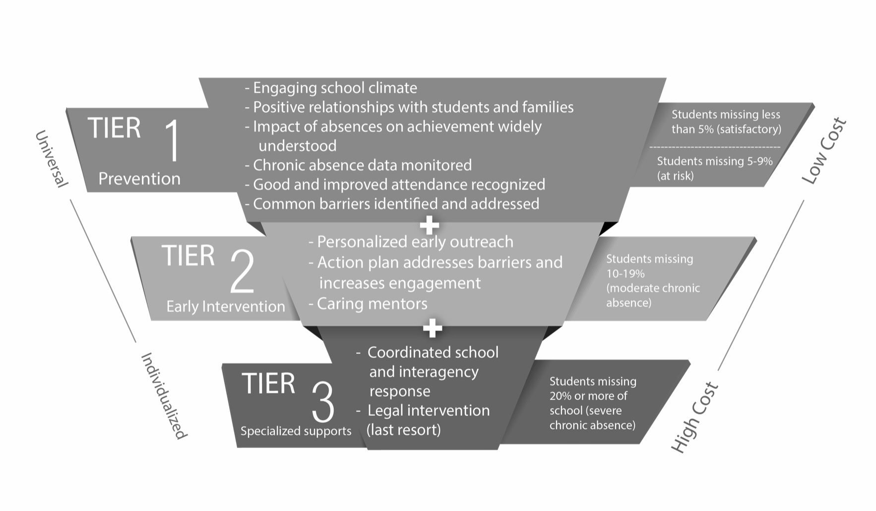
System of Support
District and School Wide Prevention &
Attendance Promotion
Small Group Interventions
Individual Supports
Notes:
Cindy
tier 1: Attendance Promotion
You may have seen something like this floating around, but this image is really going to guide a lot of the discussions that we have over the next few sessions because it is so encompassing of what the system looks like in its entirety.
Draw eyes to the right side and walk you through a couple of things that I want you to tune into. , and acknowledge that Tier I includes both students that are satisfactory attenders & at risk for becoming chronically absent
We need to have a plan for students that are falling into each tier of absenteeism - so if you look on the right, you’ll see that each Tier encompasess a subset of students ….
And we need to ensure that our resources are being utilized as strategically as possible. We know that we can’t create highly individualized plans for each and every students because of the cost, so we need to have universal preventive interventions in place, to ensure that the students who need those specialized services the most, are able to access them.
next slide

Slide 15
Reflect:
Which part of the systemic approach is widely understood at your school/district?
Which part is less understood?
Notes:
Cindy

Slide 16
Setting School Level Expectations
Notes:
Emily

Slide 17
System of Support
District and School Wide Prevention &
Attendance Promotion
Small Group Interventions
Individual Supports
Notes:
Emily
tier 1: Attendance Promotion
You may have seen something like this floating around, but this image is really going to guide a lot of the discussions that we have over the next few sessions because it is so encompassing of what the system looks like in its entirety.
Draw eyes to the right side and walk you through a couple of things that I want you to tune into. , and acknowledge that Tier I includes both students that are satisfactory attenders & at risk for becoming chronically absent
We need to have a plan for students that are falling into each tier of absenteeism - so if you look on the right, you’ll see that each Tier encompasess a subset of students ….
And we need to ensure that our resources are being utilized as strategically as possible. We know that we can’t create highly individualized plans for each and every students because of the cost, so we need to have universal preventive interventions in place, to ensure that the students who need those specialized services the most, are able to access them.
next slide

Slide 18
School Level Expectations
Attendance is a school-wide focus
Focused on chronic absenteeism + truancy
The approach is a multi-tiered system (MTSS or RTI)
Notes:
Emily

Slide 19
In an Ideal World…
Tier 1
Tier 2
Tier 3
Resource-Intensive, Individualized Interventions
Group Interventions
Low Cost, Low Lift Prevention and Early Intervention
Notes:
Emily

Slide 20
What often happens…
Tier 1
Tier 2
Tier 3
Too many students end up needing individualized support
If Tier 1 prevention/early intervention is minimal
Notes:
Emily

Slide 21
School Expectations for Interventions
Interventions/strategies at each tier that are:
  Non-punitive
  Positive
  Solution-based
Interventions address both systemic and individual barriers to attendance
  Systemic: Affect more than 20% of students and/or families
Notes:
Emily

Slide 22
School Expectations for Staff
Attendance team meets at least monthly
  Attendance data analyzed at each meeting and shared out
All school staff understand their role in reducing absenteeism
Notes:
Emily

Slide 23
Jefferson Parish Schools
Sharing their School Level Expectations

Slide 24
Reflection: Review the Rubric
Find the “Prioritization” and the “Multi-Tiered” sections.
Read through each section and think about where you would your school or district would rate.
How can you use this with your school teams?

Slide 25
Utilizing Data Within Your System to Enhance your Attendance Teams
Notes:
Emily

Slide 26
3 Levels of Data
School
Cohort
Student

Slide 27
Data Metrics for Bi-Weekly Meetings
ADA & chronic absenteeism rates
  By grade and/or teacher
Lists of students in the following tiers:
  At Risk students: 5-9% absenteeism
  Moderate Chronic students: 10-19% absenteeism
  Severe/Extreme Chronic students: >20% absenteeism
Individual student level data
Notes:
If you can add grade level metrics as well, that’s amazing!

Slide 28
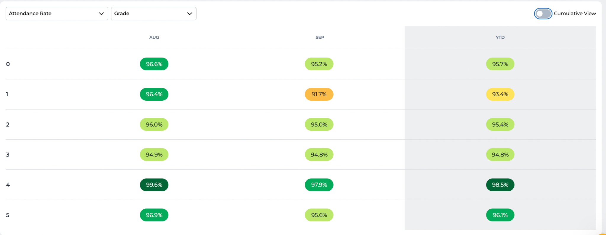
Monthly Attendance Rate by Grade Level

Slide 29
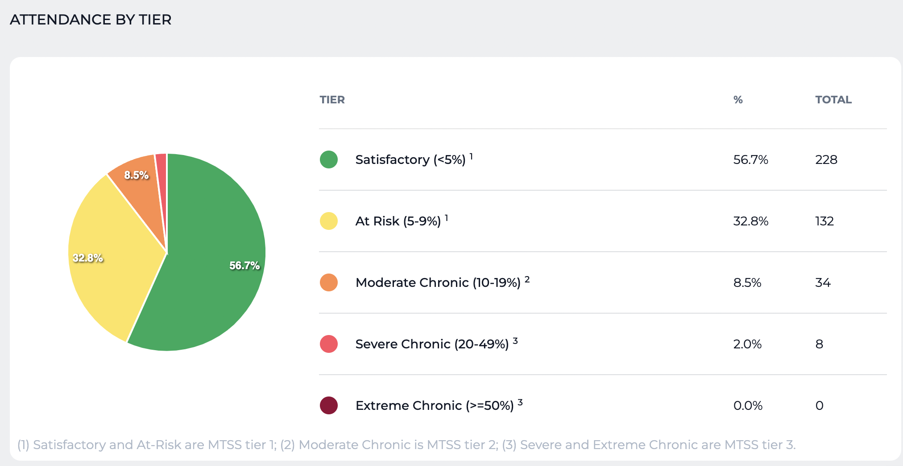

Slide 30
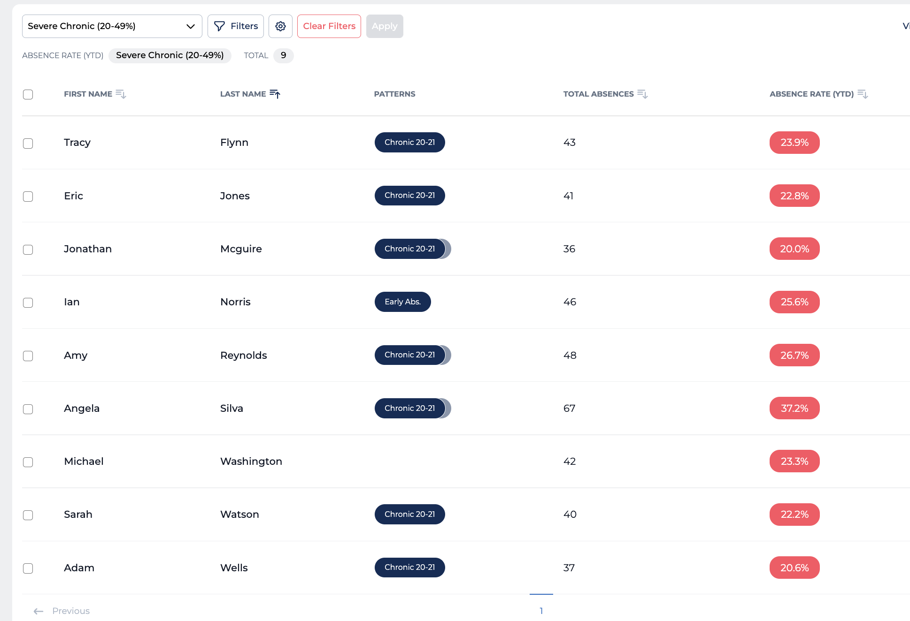
List of Students who are in Tier 3 for Attendance

Slide 31
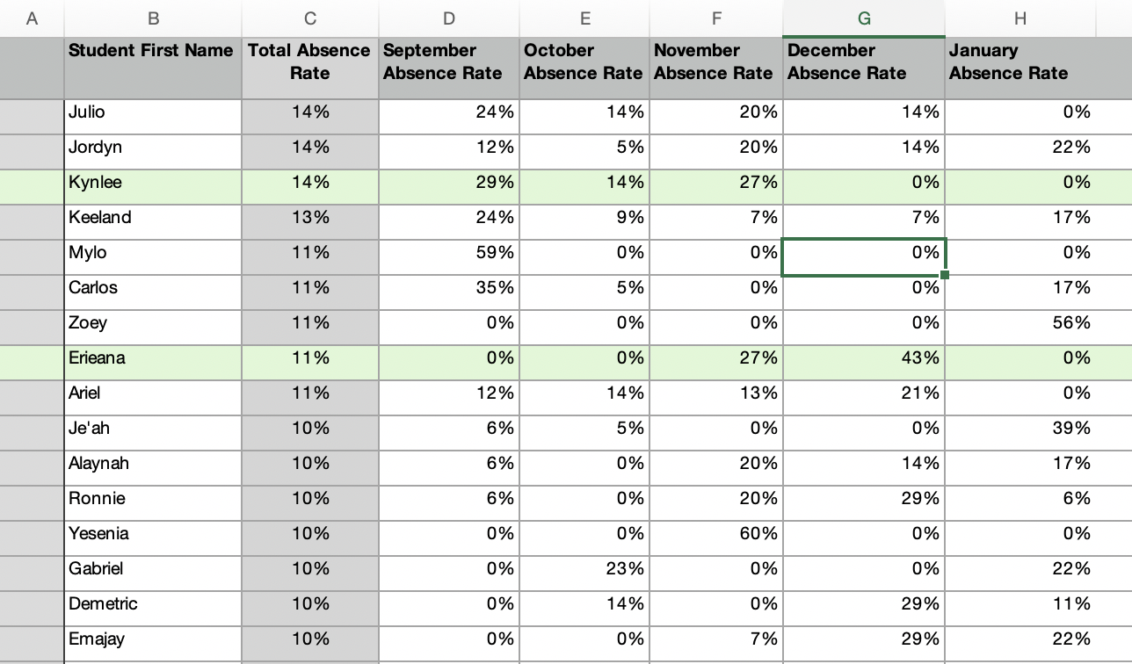
Individual Student Metrics
Notes:
Eriana - VACATIONS

Slide 32
Data Metrics for Quarterly Meetings
Attendance rate by student groups/cohorts
  Race/Ethnicity; Gender; FRPL Status; ELL status; Etc.
Attendance rate for whole school per day
Scores on Attendance Self-Assessment
Notes:
Looking at data through various filters to identify school wide trends & systemic barriers to attendance, which is really going to inform in particular your Tier I Universal Interventions that you put in place. Trends tell us how data is changing over the year and we want to look for are increasing absenteeism & improving attendance.
When you’re looking at your data, think about what you might notice that you could use to inform interventions & policies & procedures.
If you’re noticing that over 20% of your student population is experiencing a particular barrier then that will inform what you’re going to focus on in a long-term way. It’ll help you pivot & think through what you can change for next semester, or next year.
Patterns: Absences that repeat in a recognizable way and may suggest future absences. Some questions to help identify patterns:
Which day or part of the week is most often missed?
How often does the absence border a school holiday?
Are absences usually single day or multiday absences?
Do students in the same household have similar attendance patterns?

Slide 33
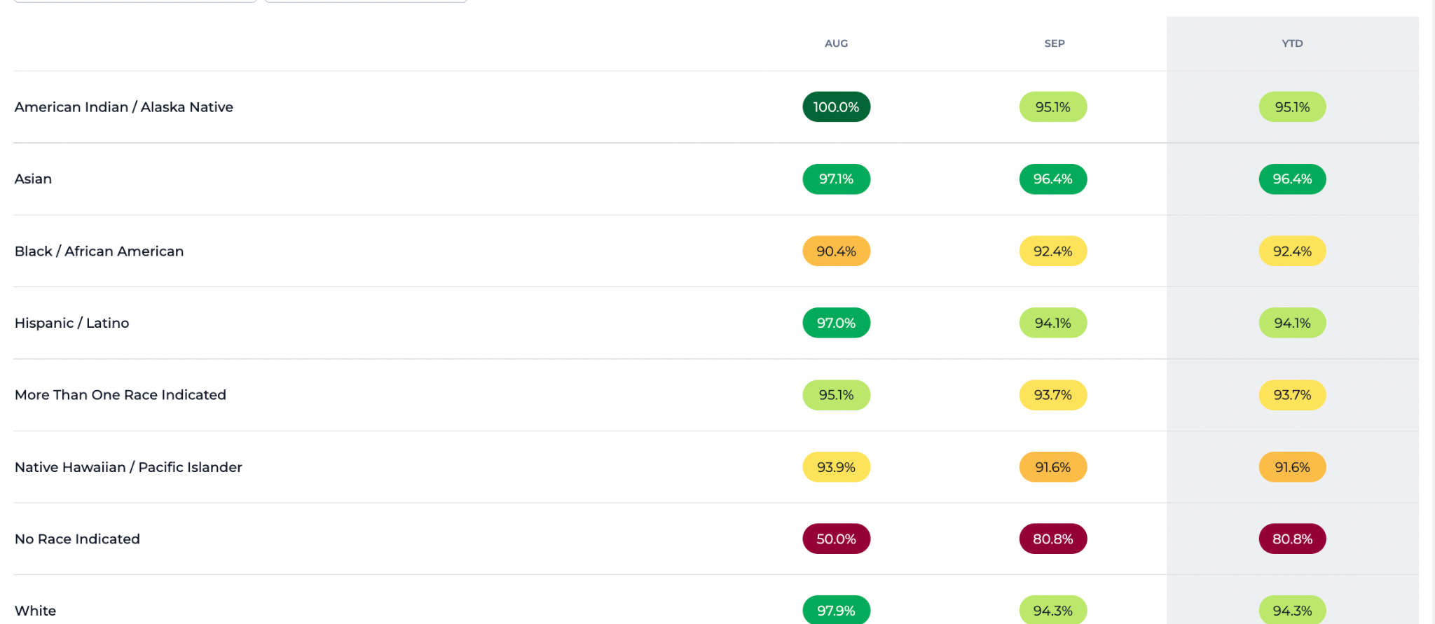
Data by Subgroups

Slide 34
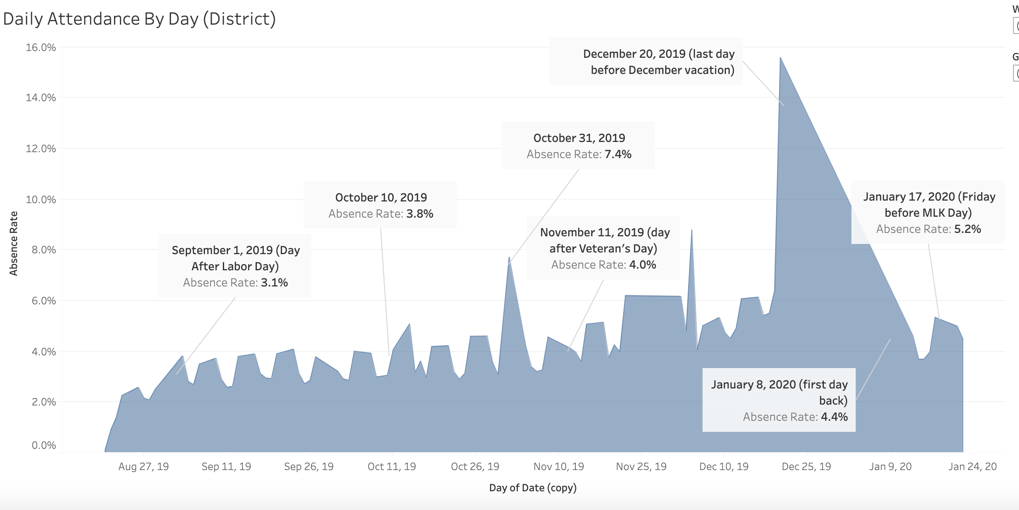
Notes:
Time of Year views allow you to think really critically about your school calendar & how you want to time breaks, etc.

Slide 35
To Consider…
How can you get access to this type of data?
What additional data do you want to see/pull?
Notes:
How can you create access to these data fields?

Slide 36
Final Reflection
Review your rubric and choose two areas that you will work to improve over the next month.
Add to the chat.

Slide 37
Please Share Feedback!
Please take the survey:

Slide 38
For More Information, Contact:
Emily Orngard: emily@everydaylabs.com

