Slide 1
Engineering Design Journal
Student Name:
Project Title:

Slide 2
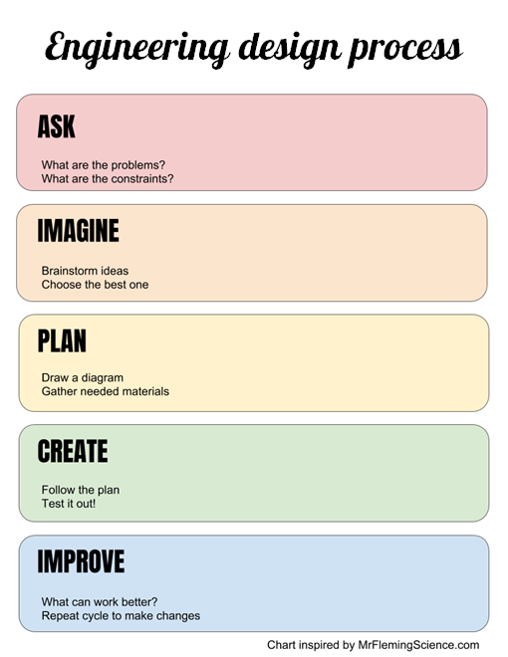
Engineering Design Journal
https://ditchthattextbook.com/powerpoint-templates/
Record your steps through the engineering design process. Add slides as needed to document the process.

Slide 3
ASK
What is the problem?
What do I need to know?
What are the project constraint?
What materials can I use?
How much time do I have?

Slide 4
IMAGINE
Brainstorm possible solutions. (Add brainstorming sketch here)
Choose the BEST solution.

Slide 5
PLAN
Draw a diagram. (Add design sketch here)
Make a list of the materials you will need.

Slide 6
CREATE
Follow your plan. Test it out! (Provide evidence of your design-sketch, photo or video)
What feedback did you receive?

Slide 7
IMPROVE
Modify your design so that it better meets the goal. Test it out!
Was the design functional? Why or why not?
What would you change about the design?
How closely did you follow the planning process?
How did you use ongoing feedback during the “create” phase of the project?

