Slide 1

Operation Spark: Designing an Apprenticeship for High-Wage Careers in Tech

Slide 2



Presenters
Aleen LeBoeuf
CTE Coordinator
St. Bernard Parish Schools
Kelly DiMarco
Director of Workforce Programs
Jefferson Parish Schools
Mayukh Raychaudhuri
Director of High School Programs
Operation Spark

Slide 3
Operation Spark: Designing an Apprenticeship for High-Wage Careers in Tech

Slide 4
Agenda
Operation Spark
Partnership Modalities
Teacher Training + Course Delivery
LDOE Pathways + Apprenticeship
Looking and Planning Ahead

Slide 5
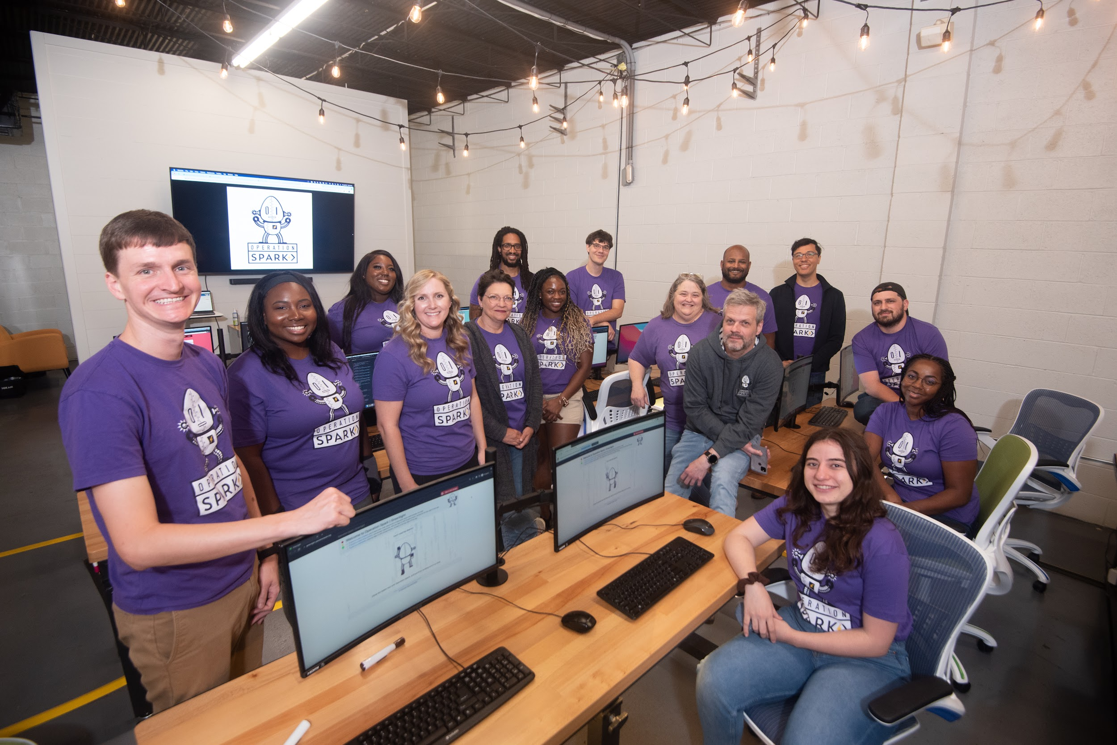
Operation Spark
Nonprofit Coding Bootcamp
SCA Provider Since 2017
Basic and Advanced IBCs
Accreditations and Higher Ed Partnerships
“The quickest path to a high wage career in tech”

Slide 6

Partnership Modalities
Teacher Training → Curriculum Licensing (more on this later)
Jump Start Summers
  3 hours daily, Mon-Fri, full month of June
  Led by Op Spark Staff OR trained teacher
After-school courses
  In person - New Orleans
  Virtual - statewide (students login from home)

Slide 7
Bringing Op Spark In-House: Teacher Training
Two-Week Teacher Trainings in July
  Summer 1 → Basic IBC
  Summer 2 → Advanced IBC
High Quality + High Rigor training
Teachers from any discipline with strong records of success and aptitude for fast-paced technical training

Slide 8
Bringing Op Spark In-house: Course Delivery
Curriculum + Coaching Partnership
  Trained teacher leads course in classroom
  Op Spark provides weekly coaching and ongoing PD
Virtual Courses
  Op Spark Staff leads courses over Zoom
  Trained Teacher acts as Classroom Facilitator and TA

Slide 9
Current District Partners
Ascension
Jefferson
Lafayette
Orleans
Natchitoches
Plaquemines
St. Bernard
St. Charles
St. Tammany
Tangipahoa

Slide 10
LDOE Pathways
Basic and Advanced courses and IBCs align with…
  Fast Forward Apprenticeship Pathway
  Jump Start Pathways
  STEM Pathway
  Coding as a Foreign Language

Slide 11
Fast Forward Apprenticeship Pathways
  Sophomore + Junior Year
    Fundamentals of Software Development (1 credit)
    Advanced Software Development (1 credit)
    Video Game Programming (1 credit)
    Internet of Things Programming (1 credit)
  Senior Year
    Apprenticeship Training (Professional Web Development) (6 credits)
  Post-Graduation
    Complete Apprenticeship Training Hours and Paid Work Experience with Operation Spark

Slide 12
Costs
Costs
  1 credit courses (Fundamentals, Advanced, IoT, Video Game)
    Curriculum and Coaching Model (Led by Trained Teacher): $275 per student, per course
    Zoom led by Op Spark Instructor (Co-taught by Trained Teacher): $575 per student, per course
  6 credit course (Professional Web Development, Senior Year)
    $3,000 per student

Slide 13
Funding Streams
SCA
CDF, CTE Adder, Perkins
Apprenticeship Allocation

Slide 14
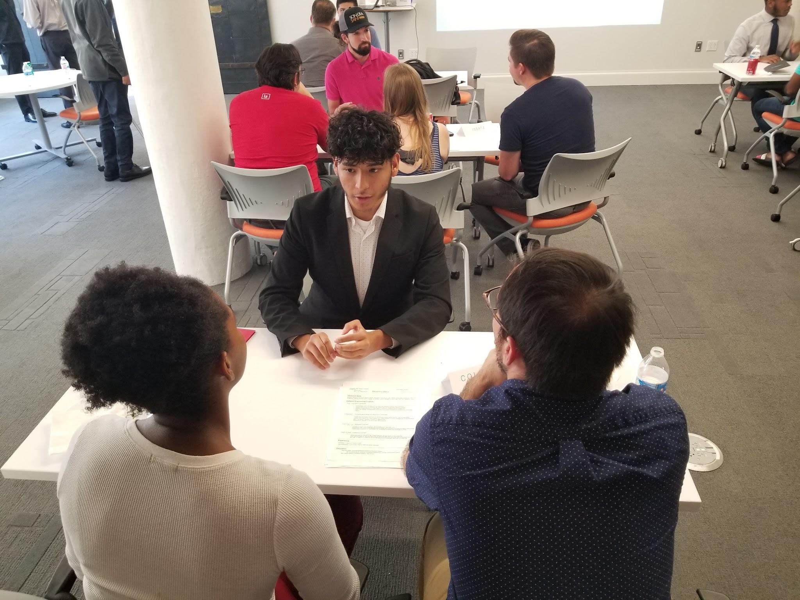
Looking and Planning Ahead
Building a School-Based Foundation
  Teacher Training, Core Courses, Basic and Advanced Credentials
Leveraging Summers
  Jump Start Summers, After-school courses
Fast-Forward Apprenticeship
  Identifying high-interest, high-aptitude students
  Professional-level Career Training and Transition to Workforce
  Grads begin high-wage careers right out of high school

Slide 15
Contact Information
Mayukh Raychaudhuri, mayukh@operationspark.org
Aleen LeBoeuf, Aleen.LeBoeuf@sbpsb.org
Kelly DiMarco, kelly.dimarco@jpschools.org

