Slide 1

Parnerships for the 21st Century
Changing Lives, Creating Futures
www.lctcs.edu
Notes:
Amy Cable
opens the session by welcoming attendees and introduces himself
Each presenter beginning with Board Members introduce themselves followed by staff

Slide 2
A History of Progress
Comprehensive, coordinated system begins teaching academic and workforce training statewide
Granted Authority for adult education: “WorkReady U”
Celebrated 20th anniversary with largest graduating class
1997 -
1998
1999
2007
2010
2013
2018
2020
Our Louisiana 2020
LCTCS Created
New Facilities
New Facilities
Constitutional Amendment Approved
Legislature authorizes state of the art facilities to modernize and equip colleges
Legislature authorizes state of the art facilities to modernize and equip colleges
Successfully completed this public agenda

Slide 3
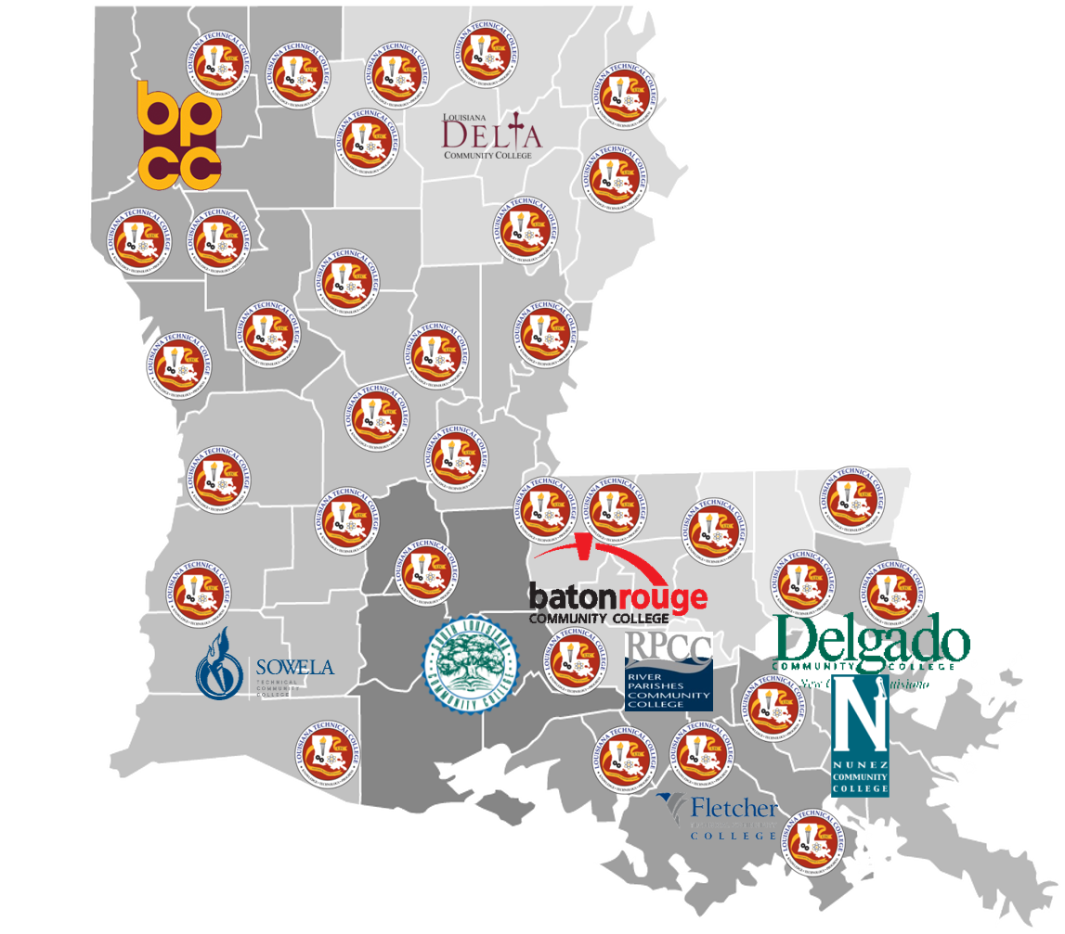
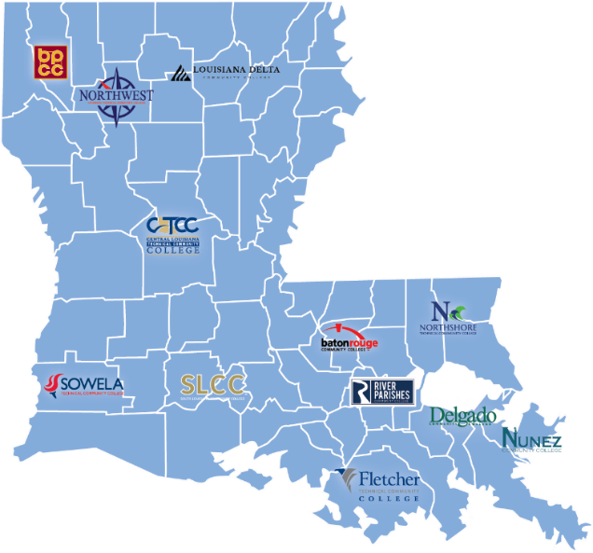
Our Past & Present
1998-1999, Created to put in place the programs and services that would build a vibrant middle-class in Louisiana.
Then:
    49 colleges across our state
    164 programs
    Now:
12 colleges with multiple campuses
1,168+ programs

Slide 4










Bridge to Stability
POVERTY
STABILITY

Slide 5






Defining Stability for Louisianans
Community Stability
Generational Stability
Family Stability
Personal Stability

Slide 6
Education and Middle-Class
“You can choose a future where more Americans have the chance to gain the skills they need to compete, no matter how old they are or how much money they have. Education was the gateway to opportunity for me. It was the gateway for Michelle. And now more than ever, it is the gateway to a middle-class life.”
-Barack Obama
Second Democratic Presidential Nomination Acceptance Speech, delivered 6 September 2012, Charlotte, North Carolina

Slide 7
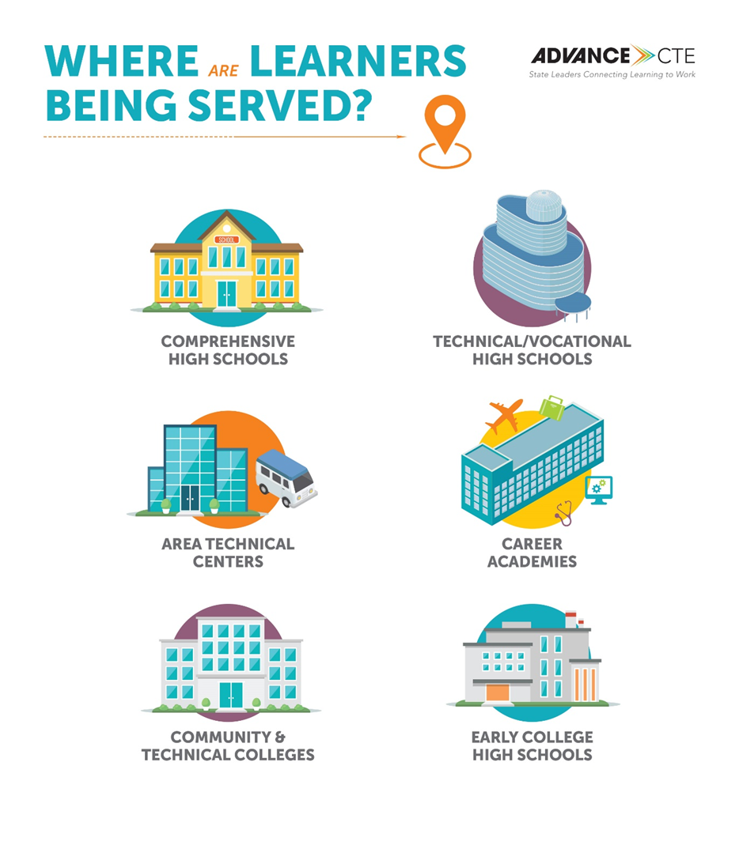

Slide 8
Economic Barriers
More people educated and skilled strengthens Louisiana's Economy
“Middle skills” jobs are requiring more than a high school diploma
250,000 more adults will need to earn credentials beyond high school to fill available jobs in Louisiana by 2026
52.2% of Louisiana’s working-age population have NO certification or degree.
41% of Louisianans are not participating in the workforce

Slide 9




Our Response
Quality Programs
Strategic planning and regional ecosystems
Emphasis on economic impact to people and communities
Funding

Slide 10
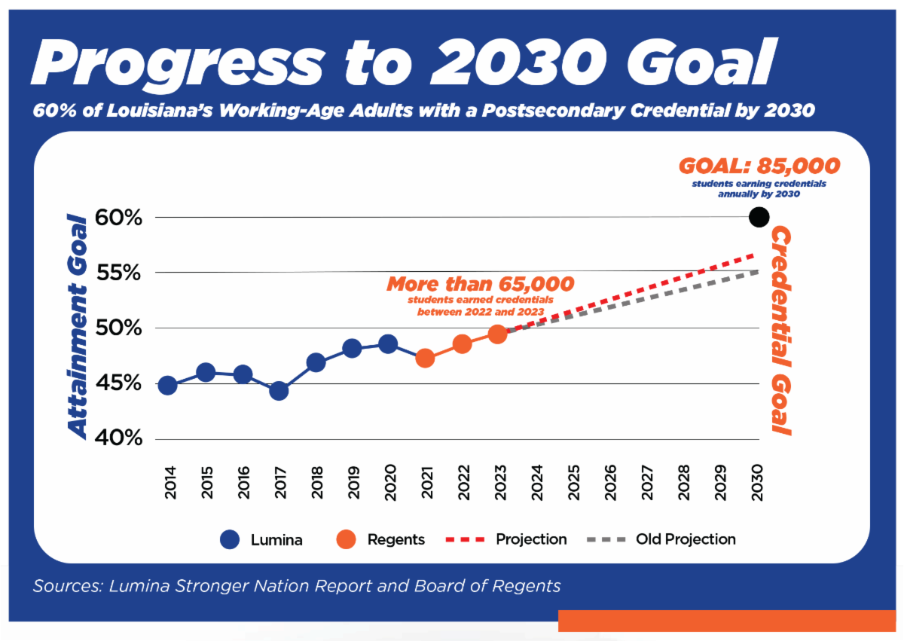
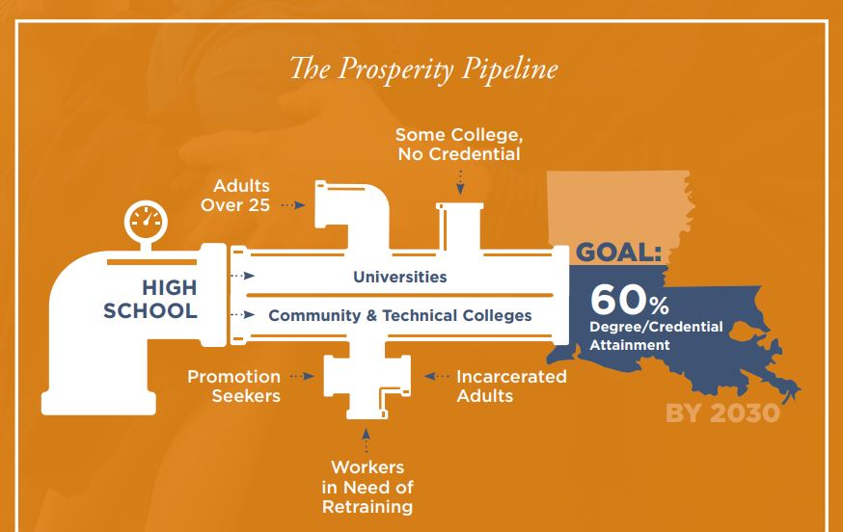
Louisiana Board of Regents Master Plan

Slide 11
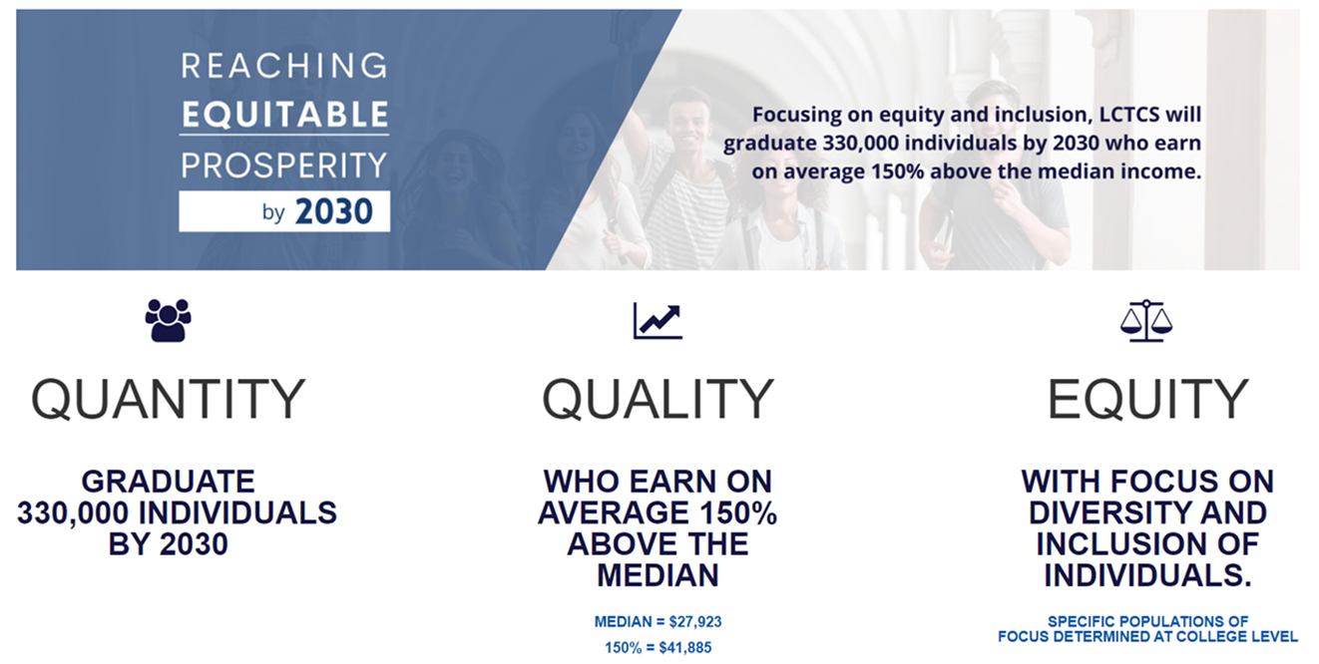
LCTCS Strategic Plan

Slide 12

Partnership Model Strategies
Statewide
Regional Approach
Local Impact

Slide 13
Statewide
Ensure collaboration and alignment of plans
Elevate the command stand
Degree attainment in industry sector/occupational area that will allow for upward mobility of any Louisiana resident

Slide 14
Regional Approach
Leverage regional coalition with multiple stakeholders invested in the work
          Examine regional labor market areas to determine industry needs
          Evaluate educational programs for alignment to industry needs
          Develop and provide CTE programs of value that serve learners and employers
Secondary teachers, staff, and administrators
Postsecondary faculty and administrators
Local workforce development boards
Parents and students
Special populations
Agencies serving out-of-school youth, homeless children and youth, and at-risk youth
Indian tribes and tribal organizations, where applicable
Adult education*
Regional economic development organizations (REDO)*
Local juvenile justice and/or adult corrections education*
Foundation and financial partners*
Community Leaders*
Organizations focused on equity*

Slide 15
Local Impact
Leverage Industry-led Advisory Councils
          Provide connections with regional partners
          Provide learners and college representatives with opportunities
          Recommend program needs (equipment, materials, supplies)
          Support CTE educators
          Advocate for CTE programs
Reports strengths and weakness of graduates
Report on new trends, equipment, and techniques
Review and approve CTE Programs of Value
Recommend industry-based credentials to include program of value
Create work-based learning opportunities
Provide professional development for instructors
Assist in supporting and recruiting of instructors

Slide 16
Dual Enrollment Programs
Partners: Secondary schools and local community colleges
How: High school students can enroll in college-level CTE courses, earning both high school and college credits simultaneously
Value: This partnership provides students with a seamless transition from secondary to post-secondary education
Notes:
Share example

Slide 17
Industry Advisory Boards
Partners: Secondary schools, post-secondary institutions, and local businesses
How: Forming advisory boards with representatives from various industries ensures that CTE programs align with current industry needs
Value: Industry experts can provide input on curriculum development, equipment needs, and emerging trends
Notes:
Share example

Slide 18
Apprenticeship Programs
Partners: Secondary schools, post-secondary institutions, and businesses
How: Establishing apprenticeship programs allow students to gain practical, on-the-job experience while earning academic credits
Value: Businesses benefit by developing a skilled workforce tailored to their specific needs
Notes:
Share example

Slide 19
Work-Based Learning Experiences
Partners: Secondary schools, post-secondary institutions, and local businesses
How: Providing students with internships, job shadowing opportunities, or work placement allows them to apply theoretical knowledge in real-world settings
Value: This partnership enhances students’ skills and fosters connections between education and industry
Notes:
Share example

Slide 20
Technology Partnerships
Partners: Secondary schools, post-secondary institutions, and technology companies
How: Collaborating with technology companies can provide access to cutting-edge equipment, software, and expertise.
Value: This ensures that CTE programs stay current with technological advancements
Notes:
Share example

Slide 21
Career Pathway Partnerships
Partners: Secondary schools, post-secondary institutions, and industry associations
How: Establishing clear career pathways that span from secondary education through post-secondary training and into specific industries
Value: Helps students make informed decisions about their education and career choices
Notes:
Share example

Slide 22
Professional Development Collaborations
Partners: Secondary schools, post-secondary institutions, and industry professionals
How: Joint professional development opportunities for teachers and industry professionals
Value: Ensure that educators are up-to-date with industry standards and practices, enhancing the quality of CTE instruction
Notes:
Share example

Slide 23
Entrepreneurship Programs
Partners: Secondary schools, post-secondary institutions, and local entrepreneurs
How: Collaborating with local entrepreneurs allows students to gain insights into starting and running a business.
Value: Entrepreneurship programs can provide mentorship and real-world experiences.
Notes:
Share example

Slide 24
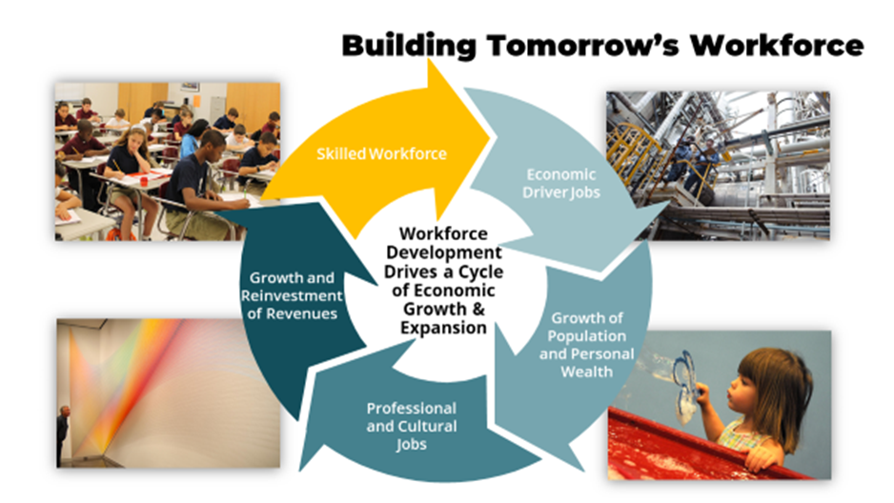
Louisiana's Economy

Slide 25
Thank You!
Questions?

Slide 26
Contact Information
Brittney Baptiste Williams, Ed. D. (She/Her/Hers)
State Director for Career and Technical Education
Office – 225-308-4439
Goggle Voice – 225-317-9231
Bbaptistewilliams@lctcs.edu
Martha Moore
Assistant Director for Career and Technical Education
Office – 225-308-4367
Cell – 318-834-9263
marthamoore2@lctcs.edu
Louisiana Community and Technical College System
265 South Foster Drive
Baton Rouge, Louisiana 70806

