Slide 1
Annual Financial Report (AFR)/LAUGH
August 2023

Slide 2
Outline
Louisiana Accounting & Uniform Governmental Handbook (LAUGH) Defined
Annual Financial Report (AFR) Defined
AFR Uses
AFR Financial Data
AFR Submission Process
AFR Submission Required Data
AFR Submission - FY 2022-2023 Data Collection
Post Submission of AFR
AFR Ratings

Slide 3
Louisiana Accounting & Uniform Governmental Handbook (LAUGH) - Bulletin 1929 Defined

Slide 4
Louisiana Accounting & Uniform Governmental Handbook (LAUGH)
Fund Balance
Serves as the official Chart of Accounts for
financial reporting
Conforms to Generally Accepted Accounting
Principles (GAAP)
Conforms to USDE financial handbook
Provides for full disclosure of financial information
Revenues
Expenditures
LAUGH Guidehttps://www.louisianabelieves.com/docs/default-source/school-choice/guide---laugh-guide.pdf?sfvrsn=ae3e96bd_4

Slide 5
LAUGH Components
LAUGH includes detailed descriptions and guidance for:
Measurement focus and basis of accounting
Fund Accounting (Modified Accrual) vs. Government-Wide (Full Accrual)
Account classification structure
Fund, Source, Object, Function, and Balance Sheet Accounts
Fund classifications
Governmental, Proprietary, Fiduciary
Revenue Account Codes
Local, State, or Federal revenue source

Slide 6
Revenue Account Classification Structure
Revenues:
Fund - A fiscal and accounting entity with a self balancing set of accounts recording cash and other financial resources. (Ex. Governmental, Proprietary & Fiduciary Funds)
Source - Permits segregation of revenues. (Ex. Local, State & Federal Revenues)

Slide 7
Fund Classifications Defined

Slide 8
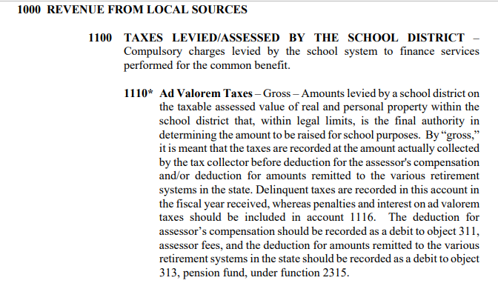
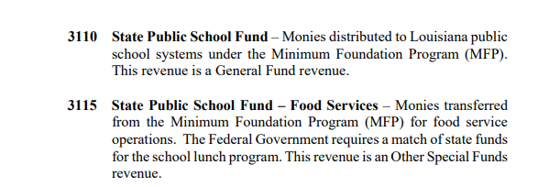
Revenue Sources Examples

Slide 9
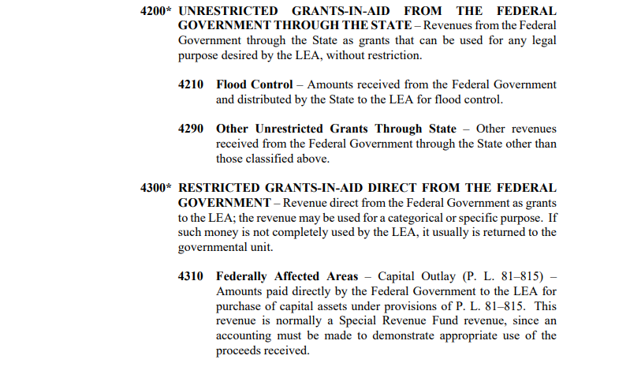
Revenue Sources Examples

Slide 10
Expenditure Account Classification Structure
Expenditures:
Fund - A fiscal and accounting entity with a self balancing set of accounts recording cash and other financial resources. (Ex. Governmental Funds - General Fund, Special Revenue Funds, Capital Projects Funds & Debt Service Funds)
Object - The service or commodity bought. (Ex. 100 - Salaries, 200 - Employee Benefits, 300 - Purchased Professional and Technical Services, 400 - Purchases Property Services, 500 - Other Purchased Services, 600 - Supplies & 700 - Property)
Function - The activity for which a service or material object is acquired. (Ex. 1000 - Instruction, 2000 - Support Services, 3000 - Non Instructional Services, 4000 - Facilities Acquisition & Construction Services & 5000 - Debt Services & Other Uses of Funds)

Slide 11
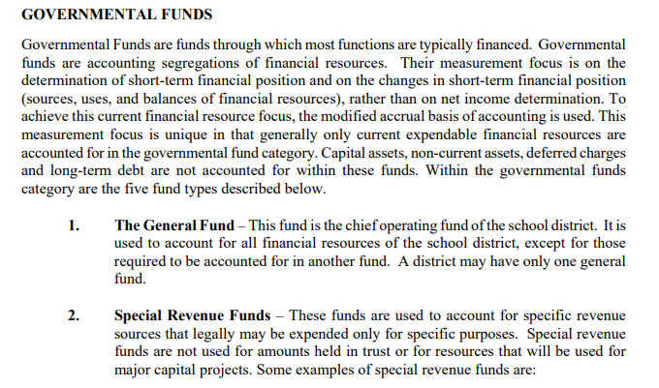
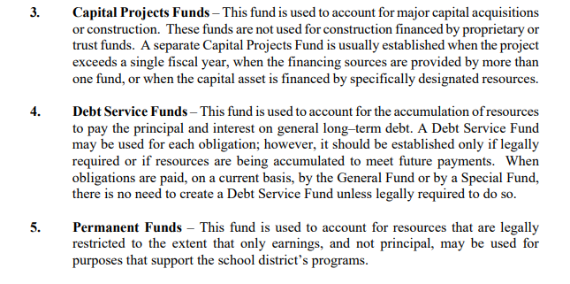
Types of Funds
Fund - A fiscal and accounting entity with a self balancing set of accounts recording cash and other financial resources. (Ex. Governmental Funds - General Fund, Special Revenue Funds, Capital Projects Funds & Debt Service Funds)

Slide 12
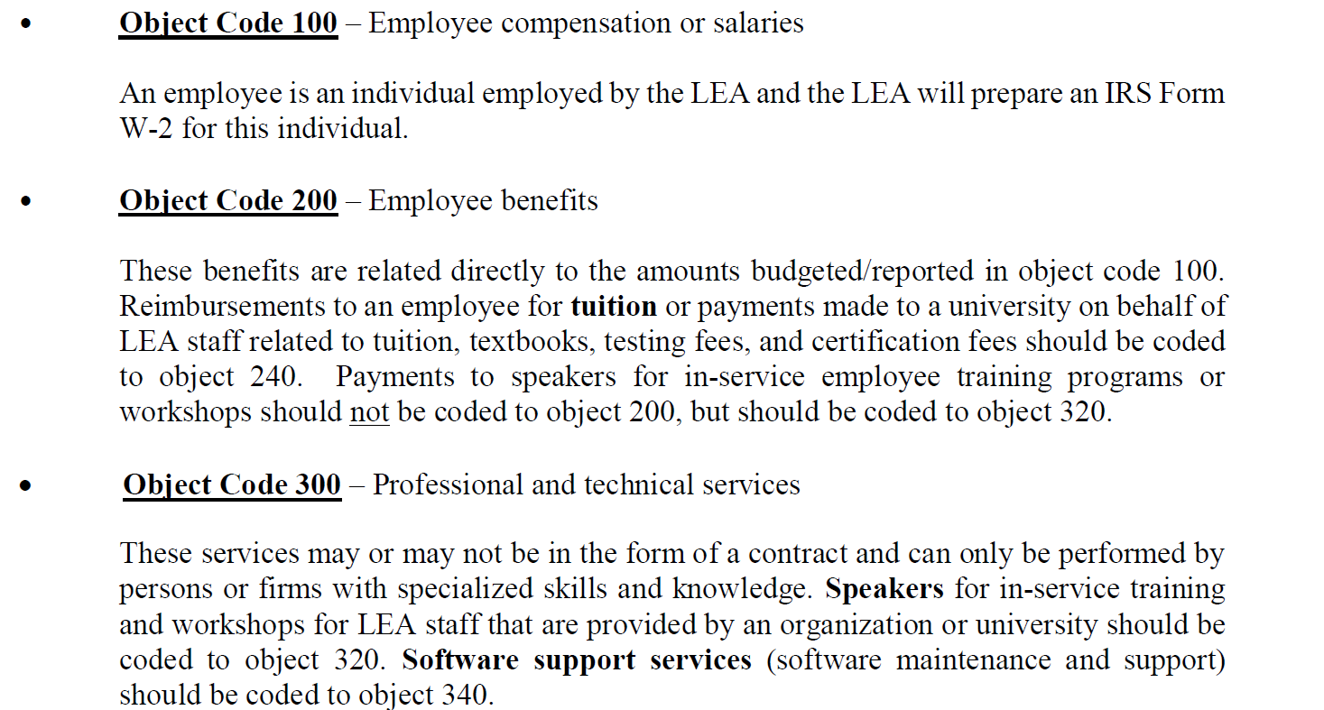
Object Codes
Object - The service or commodity bought. (Ex. 100 - Salaries, 200 - Employee Benefits, 300 - Purchased Professional and Technical Services, 400 - Purchases Property Services, 500 - Other Purchased Services, 600 - Supplies & 700 - Property)

Slide 13
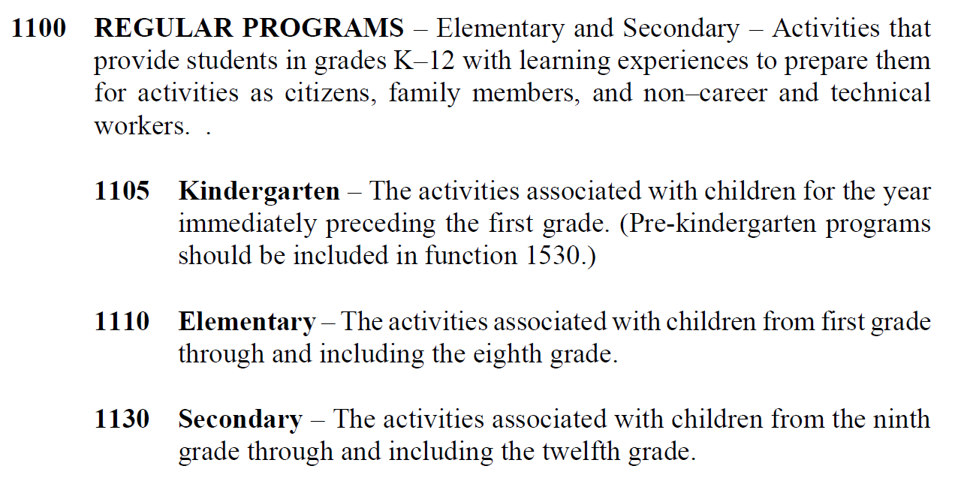
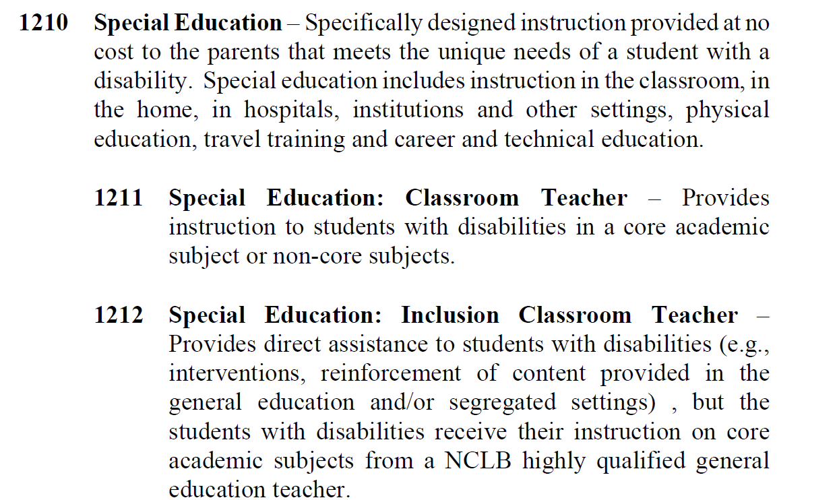
Function Codes
Function - The activity for which a service or material object is acquired. (Ex. 1000 - Instruction, 2000 - Support Services, 3000 - Non Instructional Services, 4000 - Facilities Acquisition & Construction Services & 5000 - Debt Services & Other Uses of Funds)

Slide 14
Coding Transactions
Pay special attention to coding transactions so that data submitted is the most accurate possible.
Extremely important to code transactions as close to the existing categories in LAUGH as possible.

Slide 15
Annual Financial Report (AFR) Defined

Slide 16
What is the AFR?
The AFR provides a summary of all financial activities for the School Systems during the fiscal year being reported (i.e., preceding July 1- June 30), together with the status of selected funds and/or account groupings as of the end of that fiscal year (June 30).
The purpose of the AFR is to collect fiscal data from the School Systems to support state funding allocations and respond to various state and federal financial data reporting requirements at the state level and at the school system level.

Slide 17
What requires the AFR to be submitted?
Louisiana Revised Statute 17:92
Requires School Systems Annual Financial Reports be submitted to the LDOE by September 30th of each year
Compliance with this statute requires submission of a COMPLETE AFR
(all applicable fiscal project codes)

Slide 18
Annual Financial Report (AFR) Uses

Slide 19
Purpose of Reporting Financial Data
Revenues and expenditures reported on the AFR are used to either:
Determine state and federal allocations
Comply with various state and/or federal reporting requirements,
Provide data analysis to make financial and/or other business decisions
MFP Funding
NPEFS
MFP Weighted Funding
Annual Financial Report (AFR)
CMIA
70% Requirement
Indirect Cost Calculation
Financial Risk Assessment
Excess Costs - IDEA
Per Pupil Revenues and Expenditures
Maintenance of Effort

Slide 20
Uses of AFR Data
Revenues and expenditures reported on the AFR are used to either:
determine funding to the school systems and to the State of Louisiana,
determine compliance with various state and/or federal reporting requirements,
provide data to make financial and/or other business decisions
It is important to understand all the ways in which this data is utilized in order to ensure data reporting is the most accurate for every instance.

Slide 21
Uses of AFR Data
Allocations:
Minimum Foundation Program (MFP)
Indirect Costs Calculation
Title I
Compliance:
MFP Weighted Funding Expenditure Requirement
Seventy Percent (70%) Instructional Requirement
Financial Risk Assessment (FRA)
Maintenance of Effort - ESSA and IDEA
Excess Costs - IDEA
Cash Management Investment Act (CMIA)
Data:
Various Data Reports
National Center for Education Statistics (NCES)

Slide 22
Minimum Foundation Program (MFP)
The MFP formula is adopted by the State Board of Elementary and Secondary Education (SBESE) and approved by the Legislature.
MFP determines the cost of a minimum foundation program of education in all public elementary and secondary schools and helps to allocate the funds equitably to parish, city and other local school systems
MFP funds are not earmarked for specific purposes but are intended, in combination with other funds available to the local school systems, to provide the fiscal requirements of operating a school system.

Slide 23
Minimum Foundation Program (MFP)
Local Ad Valorem Tax Revenue
(KPC 200-650)
Local Sales Tax Revenue
(KPC 700-900)
Local Earnings on Investments in Real Property
(KPC 2200 – 2300)
State Revenue in Lieu of Taxes
(KPC 6400 – 7150)
Federal Revenue in Lieu of Taxes
(KPC 12100 – 12400)
Revenues reported in the AFR have a direct effect on the MFP allocation to ALL LEAs

Slide 24
Indirect Cost Calculation
Indirect Cost Rate
The restricted and unrestricted indirect cost rates for each LEA is based on the expenditures reported in its AFR
The indirect cost rate is applied against allowable federal expenditures to determine the maximum indirect costs for each LEA
Indirect Cost Rate Formula = Indirect Costs
Unallowed Costs + Direct Costs

Slide 25
Indirect Cost Rate
The indirect cost calculation includes expenditures from the AFR that are identified as Direct, Indirect, Excluded or Unallowed for the following expenditure functions:
1000 Series
Instruction
2000 Series
Support Services
3000 Series
Non-Instructional Services
4000 Series
Facility Acquisition & Construction Services
5000 Series
Other Uses of Funds

Slide 26
Title I
The AFR populates the National Public Education Financial Survey (NPEFS).
This information is used in the allocation of Title I funds from the USDOE.

Slide 27
MFP Weighted Funding
Economically Disadvantaged (ED)
[Multiple Functions within FPC AB1)
Career & Technical Education (CTE)
[Functions 1300, 2215, & 2235]
Special Education – Other Exceptionalities
[Functions 1210, 2140 - 2170, 2212, 2232 & 2730]
Special Education – Gifted & Talented
[Functions 1220, 2140, 2213, & 2233]
The weighted funding measurement is intended to determine compliance with spending targets set for each category through the weighted allocations included in the MFP budget letter.

Slide 28
Seventy Percent (70%) Instruction Requirement
Instruction
1000 Series Expenditure Functions (Except 1600 – Adult Ed)
Pupil Support Services
2100 Series Expenditure Functions
Instructional Staff Services
2200 Series Expenditure Functions
School Administration
2400 Series Expenditure Functions
At least 70% of General Fund dollars spent must be for instruction at the school building level

Slide 29
Financial Risk Assessment (FRA)
Required by Act 7 of the 2005 Regular Louisiana Legislative Session to define “financially at risk” as a status of any city, parish or other local school board
By law, each city, parish or other local public school board shall be notified on a regular basis by the state Department of Education of its status related to the elements of the definition of financially at risk.
Provides notification to the BESE and the LDOE about the financial standing of LEAs, relying on information being forthcoming from the local school systems.

Slide 30
The Financial Risk Assessment (FRA)
There are four specific areas of reported data within the AFR that are included in the FRA
Local Property and Sales Tax Collections
General Fund Balance
Timely Submission of a complete and error free AFR
General Fund Deficit Spending

Slide 31
Financial Risk Assessment (FRA)
Timely Submission of a complete and clean AFR
This factor is based on when the LEA’s complete and clean AFR is submitted to the LDOE
The ratings are applied as follows:
Excellent – complete & clean AFR submitted to the LDOE on or before October 31
Good – complete & clean AFR is submitted to the LDOE between November 1 - November 30
Needs Improvement – complete & clean AFR is submitted to the LDOE between December 1 - December 30
Unacceptable - complete & clean AFR is submitted to the LDOE after December 31

Slide 32
Maintenance of Effort (MOE)
MOE is calculated for both IDEA Part B and ESSA using the expenditures recorded in each LEA’s AFR
MOE can be met in aggregate of total expenditures or on a per pupil basis using student count data from SIS and/or SER
Failure to meet MOE will result in a reduction in grant allocations for ESSA and repayment of funds from local sources for IDEA Part B

Slide 33
MOE - ESSA
Requires that the most current year of state and local expenditures be equal to or greater than 90% of those same expenditures for the prior year (In aggregate or per pupil)
Expenditures excluded from the calculation are:
Debt Service Expenditures
Facilities and Construction Acquisition Expenditures
Community Service Expenditures
Federal Expenditures

Slide 34
MOE - IDEA
Requires that the most current year state and local or local only special education expenditures be equal to or greater than those same expenditures for a prior year (In aggregate or per pupil)
Verification – uses current year budget
Confirmation – uses most recent actual expenditures
Approximately 240 individual key punch codes are included in this MOE calculation

Slide 35
Excess Costs - IDEA
Excess costs are the educational costs of any elementary or secondary school student with a disability that are in excess of the average per pupil expenditure in an LEA during the preceding fiscal school year
The minimum average per pupil amount for children with disabilities in elementary schools must be computed separately from the minimum average per pupil amount for children with disabilities in secondary school

Slide 36
Excess Costs - IDEA
All expenditures are included in these calculations, so reporting errors will affect the excess costs for each LEA and can impact IDEA funding
Proper coding between elementary and secondary salary expenditures is important to ensure each minimum average amount is accurately calculated

Slide 37
Excess Costs (IDEA) – Minimum Average Amount Calculation
From The Prior Year AFR:
Total Expenditures (local, state, and federal)
Minus: Capital Outlay expenditures
Minus: Debt Service expenditures
Minus: Federal IDEA Part B expenditures
Minus: Federal, State, and local Title I Part A expenditures
Minus: Federal, State, and local Title III Parts A and B expenditures
Calculated Expenditures
Divide the calculated expenditures by the total number of students per SIS

Slide 38
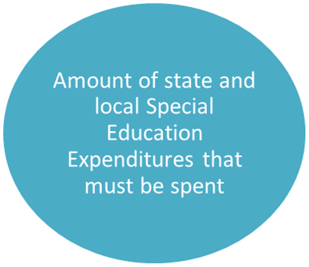
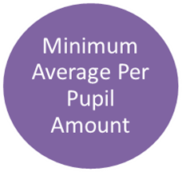
Excess Costs (IDEA) – Minimum Average Amount Calculation cont’d
Excess Costs – Current Year Excess Cost Calculation
Compare the actual state and local Special Education Expenditures spent per the AFR to the calculated required Excess Costs to determine if there was an excess or deficiency

Slide 39
Cash Management Investment Act (CMIA)
CMIA requires that all grantees and sub grantees have, as part of their financial management systems, procedures for minimizing the time between requesting funds and disbursing the funds.
LEAs should only request the amount they have expended and are expected to pay as soon as federal funds arrive.
Other than the cash-neutral request for salary expenditures, reimbursements from federal programs should not be requested or recorded prior to recording the related expenditures.
Federal revenues and expenditures must be recorded for the correct key punch code and the correct fund in the AFR.

Slide 40
Cash Management Investment Act (CMIA)
A positive fund balance indicates that you received more federal money than you spent
This could require refunding the funds to the federal awarding agency along with calculated interest on these excess funds
Upon closing the AFR system, AFRs with a federal fund balance are forwarded to Appropriation Control for collection

Slide 41
Cash Management Investment Act (CMIA)
A negative fund balance is an error because you cannot spend federal monies that you did not receive
“Excess” expenditures should be re-coded to the General Fund
Negative Federal fund balances can result in errors for MOE, Excess Costs, etc.

Slide 42
Various Data Reports
The AFR is utilized to report fiscal data in a variety of different analyses including some reports published on the LDOE website and those reported to other entities including:
School Finder Financial Data - LDOE website
Act 310 School Level Expenditure Data - LDOE website
Total/Per Pupil Revenue and Expenditure Data - LDOE website
National Education Association (NEA) Survey
US Census Bureau School System and School Level Data Surveys
Southern Legislative Survey

Slide 43
National Center for Education Statistics (NCES)
Upon closure of the AFR System, the LDOE is required to report every line item on the AFR to the NCES
The NCES publishes this AFR data for the State of Louisiana and its LEAs on a national level
Various federal agencies, including the USDOE, utilize this data to make financial decisions about grant funding, to perform program evaluation, to perform comparisons among states, and to identify and target areas for improvement for the State of Louisiana

Slide 44
Annual Financial Report (AFR) Data

Slide 45
What data is collected in the AFR?
The AFR collects financial data, revenues and expenditures, at a very detailed level to satisfy reporting requirements.
Every transaction is tracked via the unique Keypunch Codes (KPC).
Individual transactions are identified and reported within the AFR system by funding source and type.
The funding source is designated by the fund designated by the columns on the form.
The type of transaction is identified by the Object and Function which are defined in the Louisiana Accounting and Uniform Governmental Handbook (LAUGH).

Slide 46
Revenue Section
Revenues are reported by type and by fund in three categories on the AFR including:
Local
State
Federal
Specific types of revenues are listed in each category
For some revenue types, the funds column(s) are blocked from reporting to indicate accurate reporting formats.

Slide 47
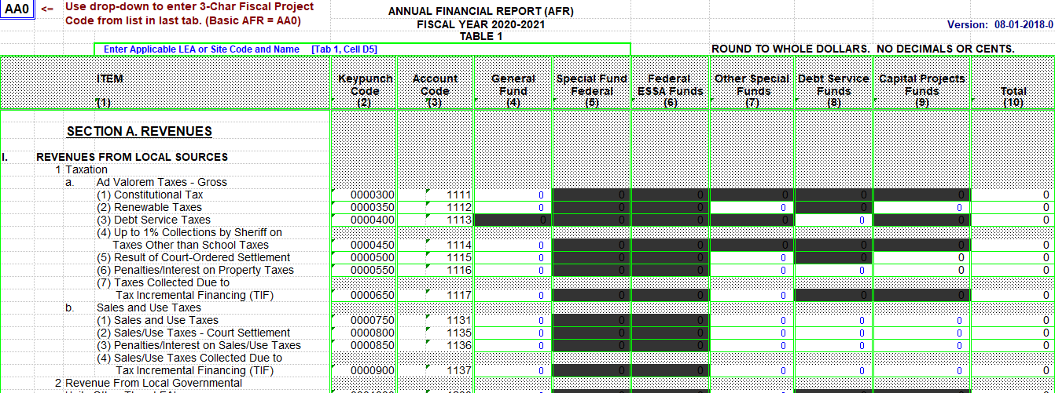
What is the AFR reporting format for Revenues?

Slide 48
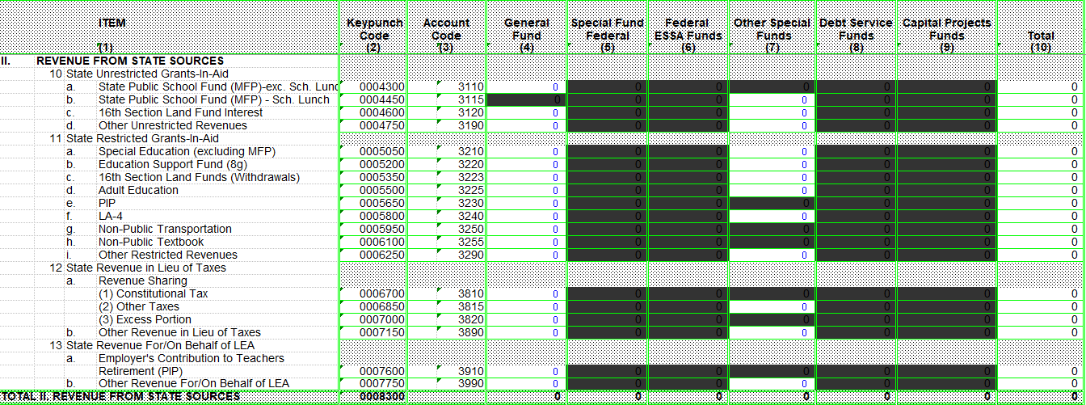
What is the AFR reporting format for Revenues?

Slide 49
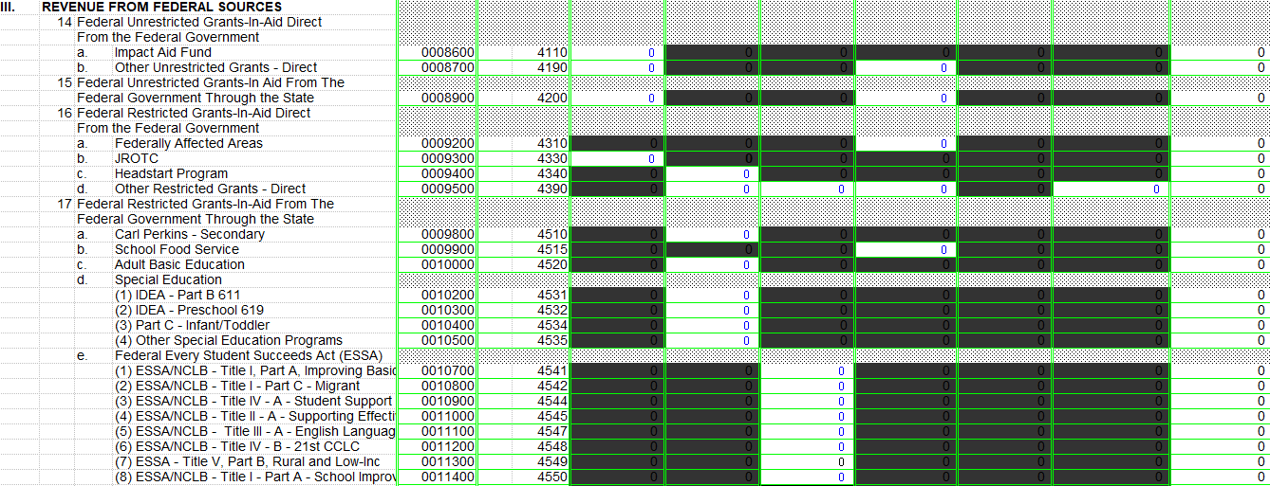
What is the AFR reporting format for Revenues?

Slide 50
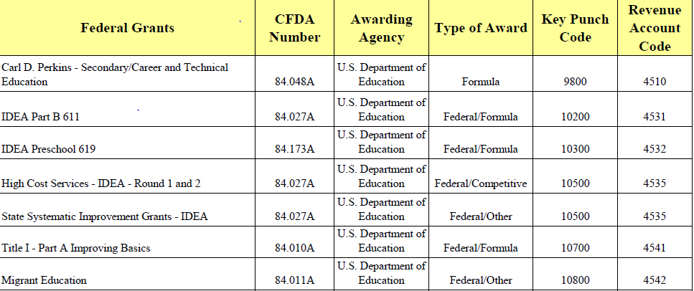
Sample State & Federal Source Coding Guidance

Slide 51
Revenue Coding Sample
State Revenue Coding Sample:
How should I code MFP revenue received?
MFP Funds should be coded to KPC 4300 ; Revenue account code 3110; Column 4 (General Funds)
Federal Revenue Coding Sample:
How should I code Title I, Part A revenue received?
Title I, Part A funds should be coded to KPC 10700; Revenue account code 4541; Column 6 (Federal ESSA Funds)

Slide 52
Expenditure Categories
Expenditure categories are detailed by Function
Specific expenditure categories are provided to ensure the most detailed reporting in compliance with reporting requirements

Slide 53
What is the AFR reporting format for Expenditures?

Slide 54
Expenditure Coding Sample
How should regular programs kindergarten teachers be coded?
Regular programs kindergarten teachers should be coded to Keypunch code 15420; Object code 112; function 1105.
How should I code a regular program employee that is not a teacher?
Teacher aides should be coded to Keypunch code 15450; object code 115; function 1100.
Substitute teachers and substitute teacher aides should be coded to keypunch code 15460; object 123; function 1100.
Other instructional salaries should be coded to keypunch code 15480; object 100; function 1100.

Slide 55
AFR Submission Process

Slide 56
How is AFR data submitted?
All Fiscal Project Codes (FPCs) (primary and secondary) must be separately uploaded or entered to the Web-AFR system via the Louisiana Educational Accountability Data Systems (LEADS) Portal (https://leads5.doe.louisiana.gov/ptl/).
Do not mail/e-mail copies of AFR spreadsheets or text files to LDOE unless they are specifically requested.
AFR user IDs and Total Automated Security (TAS) permissions must be assigned or updated by the school system security administrator in order to access the LEADS Portal.

Slide 57
AFR Submission Methods
School Systems may submit their AFR via two methods:
Online - Update: This method is used by school systems who choose to enter their data directly into the LEADS Portal
Batch Upload - This method is the most commonly used. This will require school systems to upload a formatted text file.

Slide 58
AFR Instructions and Forms
AFR Instructions & Forms: https://leads13.doe.louisiana.gov/lug/AFR/AFR.htm

Slide 59
AFR Submission - Required Data

Slide 60
Required AFR Data
Data in the AFR are collected in Fiscal Project Codes (FPCs)
Each Project Code represents a specific set of data
One Project Code named AAO represents all basic expenditures and must be submitted by all school systems
Other Project Codes are applicable to only some school systems

Slide 61
What Should Be Submitted?
Primary Fiscal Project Code (FPC)
Applicable to all School Systems
AA0 – Basic AFR
Includes all financial transactions for the LEA during the fiscal year being reported (i.e., preceding July 1- June 30), together with the status of selected funds and/or account groupings as of the end of that fiscal year (June 30).
All educational revenues and expenditures regardless of source (MFP, state general fund, federal, local, self-generated hurricane and flood, etc.) must be included in the AFR.
AB1 - Economically Disadvantaged
Includes financial transactions for students that are identified as Economically Disadvantaged (Revenues should be reported in KPC 4300; Column 4)

Slide 62
What Should Be Submitted?
Secondary FPC’s
May not be applicable to all School Systems
CV2 - CARES ESSER I
CV3 - CRRSA ESSER II
CV4 - ARP ESSER III
SA1 - Student Activity Funds
DF1 - Flood Preparation & Recovery
DH1 - Hurricane Flood Recovery
All entries in the secondary FPCs must be included in the primary FPC (AAO).
The column and key punch code (kpc) where amounts are entered in the secondary FPCs should be reported in the same column and kpc in the primary FPC (AAO).

Slide 63
Elementary & Secondary School Emergency Relief (ESSER I) Fund - 84.425D
What is ESSERF I?
Under the ESSER Fund, established in the Coronavirus Aid, Relief & Economic Security Act (CARES Act), the USDOE awarded to State Education Agencies (SEAs) for the purpose of providing local educational agencies (LEAs) with emergency relief funds to address the impact that Novel Coronavirus Disease 2019 (COVID-19) has had, and continue to have, on elementary & secondary schools across the nation.
How do I report ESSERF I in the AFR?
ESSERF I is reported in KPC 12000; Revenue account code 4590; Column 5 (Special Fund Federal)
These funds should be reported in the AA0 as well as the secondary fiscal project code CV2

Slide 64
Elementary & Secondary School Emergency Relief (ESSER II) Fund - 84.425D
What is ESSERF II?
The Coronavirus Response and Relief Supplemental Appropriations Act (CRRSA Act) was enacted December 27, 2020. The USDOE awarded these these grants to State Educational Agencies (SEAs) for the purpose of providing local educational agencies (LEAs) including charter schools with emergency relief funds to address the impact that COVID-19 has had and continues to have on elementary and secondary schools across the Nation.
How do I report ESSERF II in the AFR?
ESSERF II is reported in KPC 12000; Revenue account code 4590; Column 5 (Special Fund Federal)
These funds should be reported in the AA0 as well as the secondary fiscal project code CV3

Slide 65
Elementary & Secondary School Emergency Relief (ESSER III) Fund - 84.425D
What is ESSERF III?
On March 11, 2021, the American Rescue Plan (ARP) Act was signed into law. The USDOE awarded these these grants to State Educational Agencies (SEAs) for the purpose of providing local educational agencies (LEAs) including charter schools to help safely reopen and sustain the same operation of schools and address the impact of the coronavirus pandemic on the Nation’s students.
How do I report ESSERF III in the AFR?
ESSERF III is reported in KPC 12000; Revenue account code 4590; Column 5 (Special Fund Federal)
These funds should be reported in the AA0 as well as the secondary fiscal project code CV4

Slide 66
Student Activity Funds
Student Activity Funds (SA1)
Each school system will be required to report these funds in the most appropriate object codes with the most likely being but not limited to 300 Purchased Professional & Technical Services and 610 Materials
This data was reported for the first time in FY 20-21 in Keypunch code 2560; revenue account code 1760; column 7 (Other Special Funds).
These funds should be reported in the AA0 as well as the secondary fiscal project code SA1.

Slide 67
AFR Submission - FY 2022-23 Data Collection

Slide 68
FY 2022-23 Data Collection
Data collection process will remain the same during the FY 2022-23 collection period beginning late summer 2023.
LEADS Portal will remain active during this collection.

Slide 69
Post Submission of AFR

Slide 70
School System Review Process
Once a school system business manager has pulled and reviewed their PSAR report and notice corrections are needed, a revised AFR should be uploaded via LEADS.
Once all corrections are made, the school system business manager should pull the AFR checklist and response sheet from the AFR webpage and verify that they have reviewed each item.
Once all responses have been complete, the signed forms should be returned to staudit@la.gov

Slide 71
School System Review Process
Instructions for assessing the Post Submission Audit Report (PSAR) in LEADS can be found at https://leads13.doe.louisiana.gov/lug/AFR/AFR.htm (AFR Page in LEADS)

Slide 72
Post Submission Audit Reports
AFR Edit 1: Revenues Violating the Blockout: identifies any revenues that may be reported in a blocked column in AFR. If there is a highlighted item, a correction should be made to reclassify the revenue.
AFR Edit 2: Calculated vs. Reported Excess/Deficiency: The excess or deficiency of revenues and Other Sources of Funds minus the sum of Expenditures and Other Uses of Funds should be compared to the amounts reported in KPC 51190. Total Revenues (KPC 15000) plus Other Sources of Funds (KPC 51000) minus Total Expenditures (KPC 50900) plus Other Uses of Funds (KPC 51180). If there are highlighted areas in this section, a correction should be made.

Slide 73
Post Submission Audit Reports
AFR Edit 3: Calculated vs Reported EOY Fund Balance: if fund balances are reported correctly, zeros will be in each column of the spreadsheet. Where numbers appear in the spreadsheet, it indicates that the district has reported something incorrectly. The beginning fund balance (KPC 51195) should always equal the prior year’s ending balance. If the school system’s reported beginning fund balance (KPC 51195) is not equal to the prior years ending fund balance, LEADS will reject the incorrect beginning fund balance and insert zeros in KPC 51195. Any adjustments should be made in KPC 5195 (Prior Year Adjustment).

Slide 74
Post Submission Audit Reports
AFR Edit 4: Check Internal Math of Reported Fund Balance Records: Compare beginning of year fund balance (KPC 51195) plus reported excess/deficiency (KPC 51190) plus transfer in (KPC 51192) minus transfer out (KPC 51193) plus prior year adjustment (KPC 51195) to reported end of year balance (KPC 51196). ERRORS CAN OCCUR IF BEGINNING FUND BALANCE DOES NOT EQUAL TO PRIOR YEARS ENDING FUND BALANCE.

Slide 75
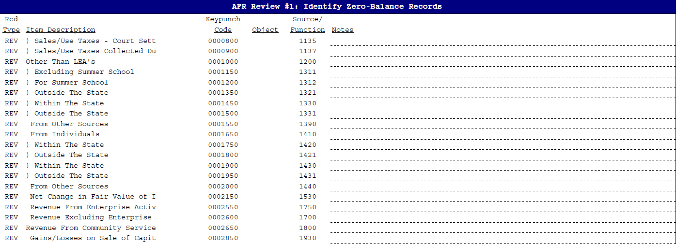
Post Submission Audit Reports
AFR Review #1 - Zero Balance Records: Identify all KPC’s with zero balances. The business manager should review all keypunch codes reported with a zero balance for accuracy.

Slide 76
Post Submission Audit Reports
AFR Review #2 - Negative Balance Records: Identify all KPC’s with zero balances. The business manager should review all keypunch codes reported with a negative balance. If the negative balances are reported correct, an explanation should be provided with responses.

Slide 77
Post Submission Audit Reports
AFR Review #3 - Required Data List: Business Manager should review this report and verify that salary data has been accurately reported. If incorrect data is found during review, a correction should be made to AFR.

Slide 78
Post Submission Audit Reports
AFR Review #4 - Compare Employee Benefits vs Salaries: This report should be reviewed for accuracy. Salaries with no benefits require and explanation and/or corrections if reported incorrectly.

Slide 79
Post Submission Audit Reports
Other AFR Comparisons and Reviews #1: Comparison of Ad Valorem Taxes Revenue to the Amount Reported in Tax Table IIA. The revenue reported in the revenue section of the AFR should agree to the revenue reported in the tax table. If there is a difference, a correction should be made.
This section is not applicable to charter schools.

Slide 80
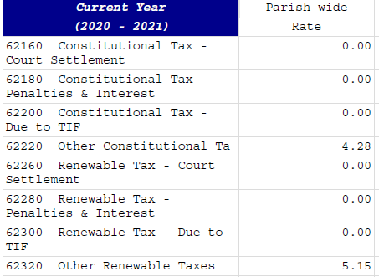
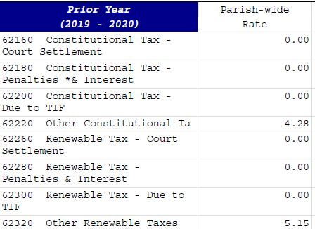
Post Submission Audit Reports
Other AFR Comparisons and Reviews #1: Comparison of Current Year Ad Valorem Tax Data with Prior Year Tax Data. This section should be reviewed for accuracy. If there is a difference (difference will be highlighted in yellow) between current year rate and prior year rate, the business manager should submit a copy of the board minutes supporting the current year rates.
This section is not applicable to charter schools.

Slide 81
Post Submission Audit Reports
Other AFR Comparisons and Reviews #2: Comparison of Sales Taxes Revenue to the Amount Reported in Tax Table IIB. The revenue reported in the revenue section of the AFR should agree to the revenue reported in the tax table. If there is a difference, a correction should be made.
This section is not applicable to charter schools.
This section is not applicable to charter schools.

Slide 82
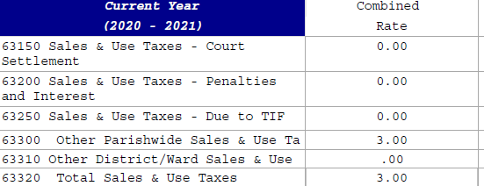
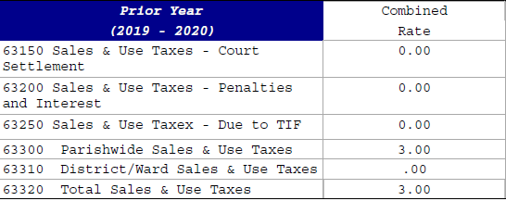
Post Submission Audit Reports
Other AFR Comparisons and Reviews #2: Comparison of Current Year Sales/Use Tax Data with Prior Year. This section should be reviewed for accuracy. If there is a difference (difference will be highlighted in yellow) between current year rate and prior year rate, the business manager should submit a copy of the tax referendum.
This section is not applicable to charter schools.
This section is not applicable to charter schools.

Slide 83
Post Submission Audit Reports
Other AFR Comparisons and Reviews #3: Comparison of Prior Year Ending Balance with Current Year Beginning Balance. The business manager should review and if an area is highlighted in yellow, a correction should be made. If differences are due to rounding, no correction is needed.
This section is not applicable to charter schools.

Slide 84
Post Submission Audit Reports
Other AFR Comparisons and Reviews #4: Comparison of Fund Balance Ending Balance and Balance Sheet Total Fund Balance. The business manager should review and if an area is highlighted in yellow, a correction should be made. If differences are due to rounding, no correction is needed.
This section is not applicable to charter schools.

Slide 85
Post Submission Audit Reports
Other AFR Comparisons and Reviews #5: Comparison of Balance Sheet Total Assets and Balance Sheet Total Liabilities and Fund Balance. The business manager should review and if an area is highlighted in yellow, a correction should be made. If differences are due to rounding, no correction is needed.
This section is not applicable to charter schools.

Slide 86
Post Submission Audit Reports
Other AFR Comparisons and Reviews #6: Comparison of Prior Year Ending Balance and Current Year Beginning Balance. The business manager should review and if an area is highlighted in yellow, a correction should be made. If differences are due to rounding, no correction is needed.
This section is not applicable to charter schools.

Slide 87
Post Submission Audit Reports
Other AFR Comparisons and Reviews #7: Check Internal Math of Reported Fund Balance Records for Current Year. The business manager should review and if an area is highlighted in yellow, a correction should be made. If differences are due to rounding, no correction is needed.
This section is not applicable to charter schools.

Slide 88
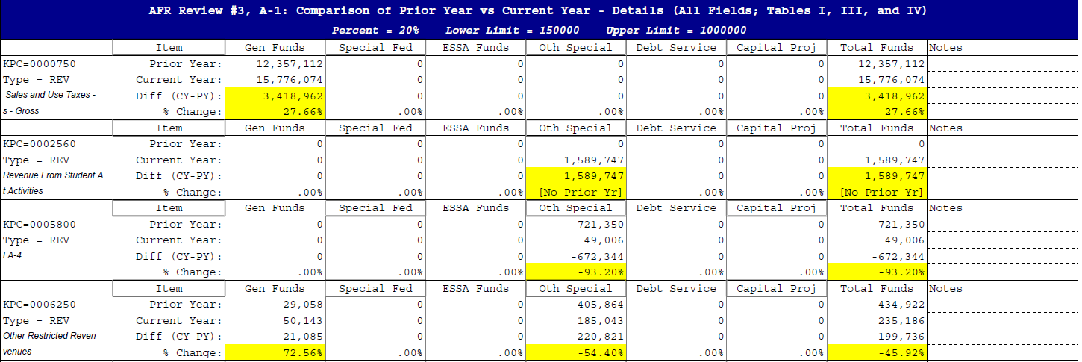
Post Submission Audit Reports
AFR Review #3, A-1: Comparison of Prior Year vs Current Year - Details. Business Managers should review and if there is a difference between Current Year and Prior Year, an explanation should be provided to explain the increase/decrease in revenue/expenditures. This section is not applicable for first year charters as they will not have any prior year data to compare to.
This section is not applicable to charter schools.

Slide 89
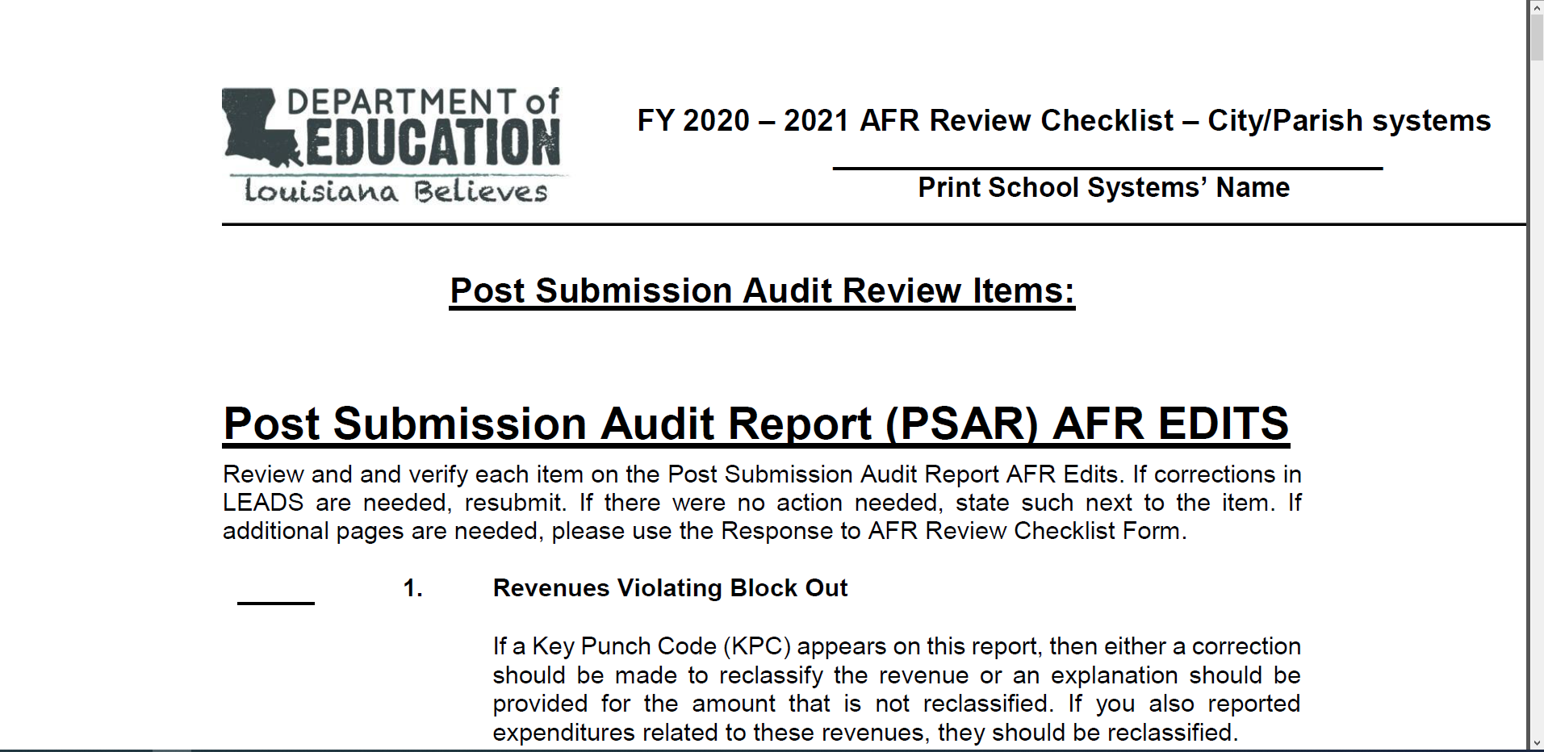
AFR Review Checklist

Slide 90
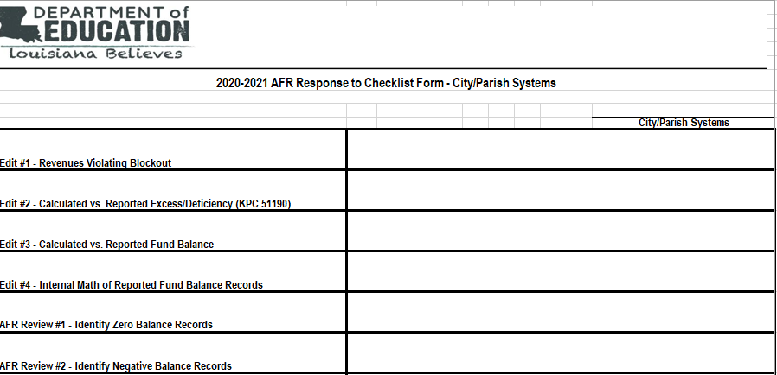
AFR Review Response Sheet

Slide 91
Common AFR Reporting Errors
Financial data reported for salaries of 100 object codes did not have any amounts posted to its corresponding 200 employee benefits codes
Negative amounts were reported in KPC 51310 for Cash and Cash Investments
Transfers of Indirect Cost (KPC 50930) should only be posted for the General Fund column and must equal Indirect Costs (KPC 51120) for the total of Special Fund Federal, Federal ESSA Funds & Other Special Funds Columns
Balance at beginning of Year (KPC 51195) should always equal the Balance at the End of Year (KPC 51196) from the prior year’s AFR for all columns
Total Fund Balance (KPC 55300) should also equal Balance at the End of the Year KPC 51196) for all columns
Total Assets (KPC 51690) should always equal Total Liabilities & Fund Equity (KPC 55300) for all columns

Slide 92
AFR Ratings

Slide 93
AFR Ratings
AFR ratings are based on when the school system have submitted an error free AFR, the school system have submitted ALL required documents to LDOE, and the LDOE audit team have reviewed for accuracy
The ratings are applied as follows:
Excellent - complete & clean AFR submitted to LDOE on or before October 31
Good - complete & clean AFR submitted to LDOE between November 1 - November 29
Needs Improvement - complete & clean AFR submitted to LDOE between November 30 - December 29
Unacceptable - complete & clean AFR submitted to LDOE after December 29

Slide 94
Contact Information
Louisiana Department of Education
1-877-453-2721
Audit Unit
P. O. Box 94064
Baton Rouge, LA 70804-9064
Phone: (225) 342-3617
Toll Free: 1-877-453-2721

Slide 95
Contact Information
State Audit Section
Jameka Henderson, Audit Supervisor
Keya Williams, Auditor
Email: firstname.lastname@la.gov

Slide 96
Technical Support Contact Information
(Technical issues)
systemsupport@la.gov

