Slide 1
Understanding and Using the PARCC Diagnostic Tools
A Webinar for Diagnostics Early Adopter Program Districts
December 2015

Slide 2
Objective
Understand how the
information provided by
PARCC’s Diagnostic tools can support student learning.

Slide 3
Agenda
Overview
Review the design features
  Reading Comprehension
  Vocabulary
  Reading Fluency
  Decoding
  Reader Motivation Survey
  Math Comprehension
  Math Fluency
Using the reports & ADSTeach demo

Slide 4
Overview

Slide 5
Guiding Principles for all Diagnostic Tools:
Ensure items provide evidence of student performance and student progress.
Provide data to inform instruction in real time.
Align all items in both content and cognitive complexity to other tools offered via the PARCC Assessment System.

Slide 6
The ELA Diagnostic Components
ELA Diagnostic Tools
Reading Comprehension
Vocabulary
Literary Text
Reading
Fluency
Literary Text
Decoding
Informational Text
Informational Text
Reader Motivation Survey
Notes:
Use next slide for talking points.

Slide 7
The Mathematics Diagnostic Components
Mathematics Diagnostic Tools
Mathematics Comprehension
(2016+)
Mathematics Fluency
Cluster Tests
(2015-2016)
Progression Tests (2016+)

Slide 8
7 Sub Tests
ELA/Literacy
  Reading Comprehension: Grades 2-9; offers both informational and literary texts;
  focus on reading standards 1-3
  Vocabulary: Grades 2-8; Students demonstrate the ability to use context to determine word meanings in either informational or literary texts (measuring reading standard 4 and parts of language standards 4-6)
  Fluency: by grade level for grades 2-8; with opportunities to measure rate, accuracy, and expression
  Decoding: measures phonemic awareness and phonics
  Reader Motivation Survey: Grades 2-8; elicits information regarding student self-perception as readers and student reading preferences
Mathematics:
  Comprehension: Grades 2-8; 49 different cluster-level subtests that can be chosen by the teacher based on instructional needs
  Fluency: Grades 2-6; measures include time and accuracy for fluency skills for students who are struggling with higher order tasks

Slide 9
The Design Features

Slide 10
Reading Comprehension

Slide 11
Reading Comprehension - Design Features of note:
Questions are designed to measure:
  either student accuracy of comprehension,
  student ability to find and cite evidence from the text to support comprehended ideas, or
  both.
Forms contain approximately 20 items, with authentic passages of varying complexity levels. Each form at a grade level is approximately equal in difficulty with the others.
A small number of vertically-linked items are included (e.g. grade 3 items on the grade 4 test), to allow teachers to see how students perform with the prior grade level material.
Forms measure either informational or literary standards.

Slide 12
Reading Comprehension
Read the passage from Whales. Then answer the questions.
1 Like most whales, the orca has teeth. It eats squid and crabs, turtles and octopus, and even other whales!
2 Some whales do not﻿ have teeth. They have baleen. Baleen is like a stringy curtain. It hangs down in their mouth.
3 Gray whales have baleen. They swim with their mouth open. Water flows in. In the water are tiny shrimp called krill. The krill stick to the baleen.
4 The gray whale closes its mouth. It spits out the water. Spwooooosh! Then it licks off the krill in the baleen. Shluuurp! A hungry whale can eat half a ton of krill a day.
5 Humpbacks have baleen. They eat krill. But they also catch food another way. They can blow a net of bubbles. A school of fish gets trapped in the net. The whale gulps down the fish. A humpback can eat 200 pounds of fish in one gulp!
6 Whales go wherever they can find food. Some spend their whole life in the same place. Some kinds of whales swim all over the ocean.
7 Humpbacks spend the summer in the cold waters around the South or North Pole. They eat tons of krill and squid. In the fall, they swim to warm waters. They have their babies there. They swim back and forth like this every year.
What is an important difference between orcas and gray whales?
a. Orcas eat krill, but gray whales do not.
b. Orcas have teeth, but gray whales do not.
c. Orcas spit out water, but gray whales blow nets of bubbles.
d. Orcas move in the ocean, but gray whales stay in the same place.

Slide 13
Reading Comprehension
Part A
What are paragraphs 3 and 4 mostly about?
A. how much gray whales eat
B. how gray whales use baleen
C. where gray whales find krill
D. why gray whales make noise
Part B
Which evidence from the passage supports the answer to Part A?
A. “Water flows in.” (paragraph 3)
B. “In the water are tiny shrimp called krill.” (paragraph 3)
C. “Then it licks off the krill in the baleen.” (paragraph 4)
D. “A hungry whale can eat half a ton of krill a day.” (paragraph 4)

Slide 14
Vocabulary

Slide 15
Vocabulary - Design Features of note:
Questions are designed to measure either student accuracy of derived vocabulary meanings in passage context, student ability to find and cite evidence from the text to support use of context to define vocabulary or both.
Forms contain approximately 24 items, with passages of varying complexity levels. Each form is approximately equal in difficulty with other forms at that grade level.
Forms measure either RI 4 and language standards or RL 4 and language standards.

Slide 16
Vocabulary
What is the effect of the author’s use of the words spewed and frantic as they are used in paragraph 4 of the passage?
A. by illustrating that Wright could effortlessly produce his work
B. by emphasizing that Wright was rushing to complete his work
C. by suggesting that Wright was sometimes careless with his work
D. by hinting that Wright was anxious about the reaction to his work

Slide 17
Reading Fluency

Slide 18
Reading Fluency - Design Features of note:
At each grade level, there are a large number of passages that were designed to be equivalent in complexity. Half of the passages are informational texts and half are literary texts.
After students have an opportunity to read repeatedly one of the passages, the teacher uses a stop watch and printed copy of the passage to annotate, determining the words read correctly per minute. The teacher also uses a rubric to determine student expressiveness and prosody.
Since fluency is typically monitored no more than quarterly, there are sufficient passages available at each grade level for both progress monitoring and direct fluency instruction.

Slide 19
Reading Fluency
  Oral Reading Fluency- Expressiveness: Smooth, rapid reading evidenced by ease of decoding and appropriate use of phrasing, pausing, and expression to convey meaning.
  Teachers listen to students read, perform a modified running record, and rate expressiveness using a rubric

Slide 20
Reading Fluency – Expression Rubric
4 Reads primarily in larger, meaningful phrase groups. Although some regressions, repetitions, and deviations from text may be present, these do not appear to detract from the overall structure of the story. Preservation of the author’s syntax is consistent. Some or most of the story is read with expressive interpretation.
3 Reads primarily in three- or four-word phrase groups. Some smaller groupings may be present. However, the majority of phrasing seems appropriate and preserves the syntax of the author. Little or no expressive interpretation is present.
2 Reads primarily in two-word phrases with some three-or four-word groupings. Some word-by-word reading may be present. Word groupings may seem awkward and unrelated to larger context of sentence or passage.
1 Reads primarily word-by-word. Occasional two-word or three-word phrases may occur – but these are infrequent and/or they do not preserve meaningful syntax.
0 Silence or irrelevant or completely unintelligible material.

Slide 21
Decoding

Slide 22
Decoding - Design Features of note:
The decoding assessment has been designed to ensure that students have the phonemic awareness and phonics skills called for in the standards.
The test measures skill mastery in six key domains: CVC Words, Blends and Digraphs, Complex Consonants, Complex vowels, Words/Recognition/Inflectional Endings, and Affixes (prefixes, suffixes)/Syllabication.
Within each of the six key domains are items that measure all of the skills relevant to that domain. The skills measured in each domain are provided in the document titled “Diagnostic – Decoding List of Skills by Domain” which can be accessed from the digital library on the PARCC Partnership Resource Center.
The adaptive test allows one to both gauge student strengths and needs in phonemic awareness and phonics, as well as to gauge student progress over time (by comparing student mastery levels from one testing date to another).

Slide 23
Decoding
Directions:
Select the word in which c has the same sound as in the c in city.
sack
patch
fence

Slide 24
Reader Motivation Survey

Slide 25
Reader Motivation Survey
Surveys are separated into grade bands: 2-3, 4-5, and 6-12
Students are given an opportunity to express:
  what they think and feel about reading
  how they view themselves as readers

Slide 26
Reader Motivation Survey
(grades 4-5 sample questions)
Knowing how to read well is _____.
a. very important b. important c. sort of important d. not very important
When you are reading challenging texts, what strategies you do use to help make sense of the text? (You can select more than one.)
a. quit reading b. have someone read it to me c. re-read
d. circle unknown words e. look up words f. talk to a partner
g. outline the text h. ask questions of my teacher or an adult
i. summarize chunks of the text as I read
j. write down my thinking about the text

Slide 27
Math Comprehension

Slide 28
Design Features of note:
Each Cluster-Level test measures the content within that cluster, allowing for use as pre-tests, post-tests, or both.
The Cluster-Level tests follow the CCSS Progressions, allowing teachers to assess off-grade level to focus interventions appropriately.
Each Cluster-Level test has multiple forms, to allow for multiple administrations if desired. Forms contain approximately 22 items, with tasks of varying complexity levels and each form approximately equal in difficulty with others.
A small number of vertically-linked items are included (e.g. grade 3 items on the grade 4 test), to allow teachers to see how students perform with the prior grade level material.
Cluster-Level tests in middle school contain calculator- and non-calculator allowed items.

Slide 29
Mathematics Clusters

Slide 30
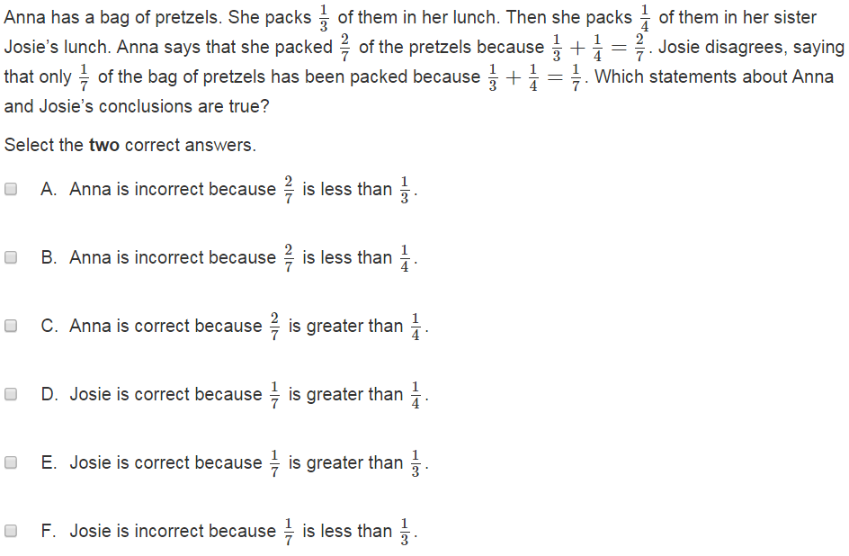
Math Comprehension – Grade 5 Task

Slide 31
Math Fluency

Slide 32
Design Features of note:
Measures each of the fluency skills described in the standards in Grades K-8.
Can be used to measure intervention efficacy using multiple forms.
Forms are built to ensure specific skills can be given the needed focus.
The Fluency test has multiple forms, to allow for multiple administrations if desired. Forms contain approximately 22 items, and each form is approximately equal in difficulty with others.
Both time and accuracy are provided for teachers to address gaps in student learning.

Slide 33
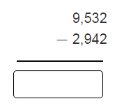
Math Fluency – Grade 4 Tasks
Task 1
Task 2

Slide 34
Reports and Instructional Decision-Making/ADSTeach Demo

Slide 35
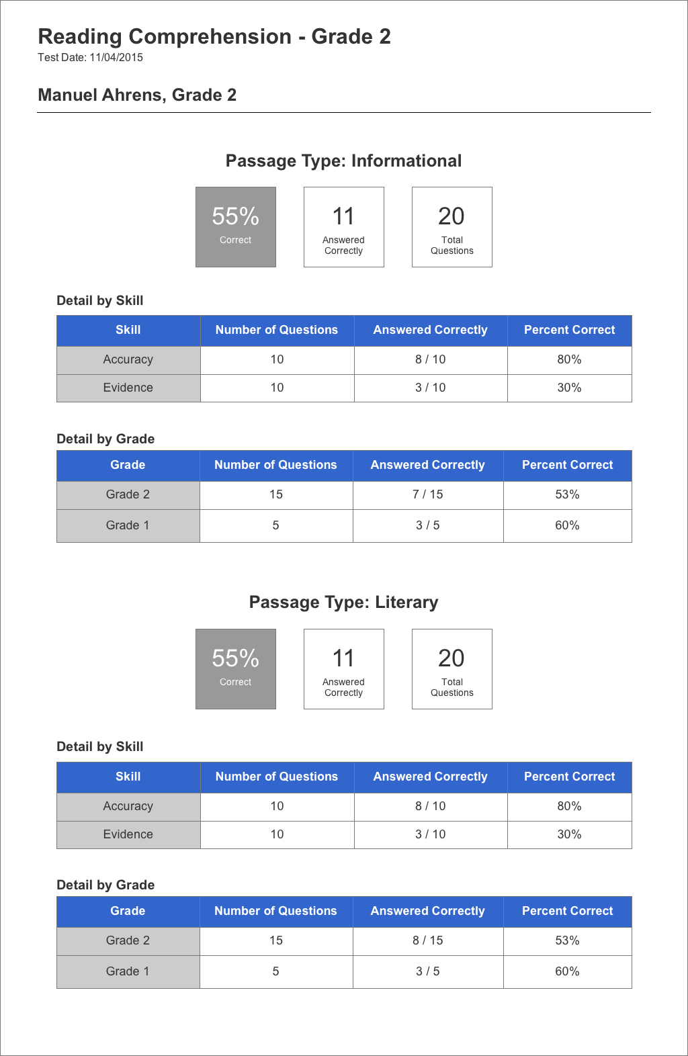
Individual Student Reading Comprehension Report

Slide 36
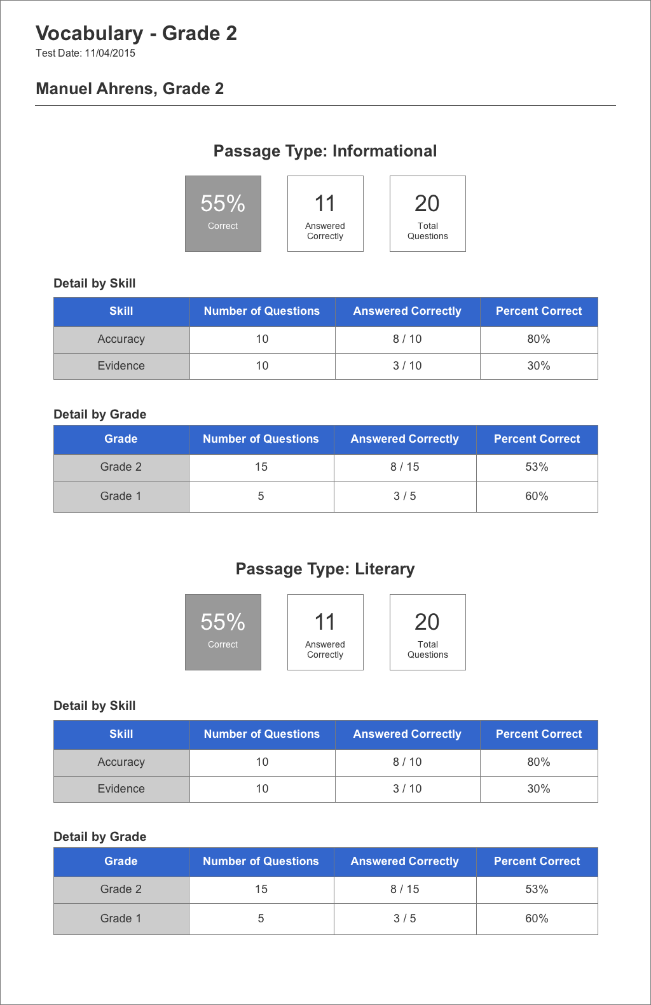
Vocabulary Reports provide similar information to that provided for the reading comprehension assessment.

Slide 37
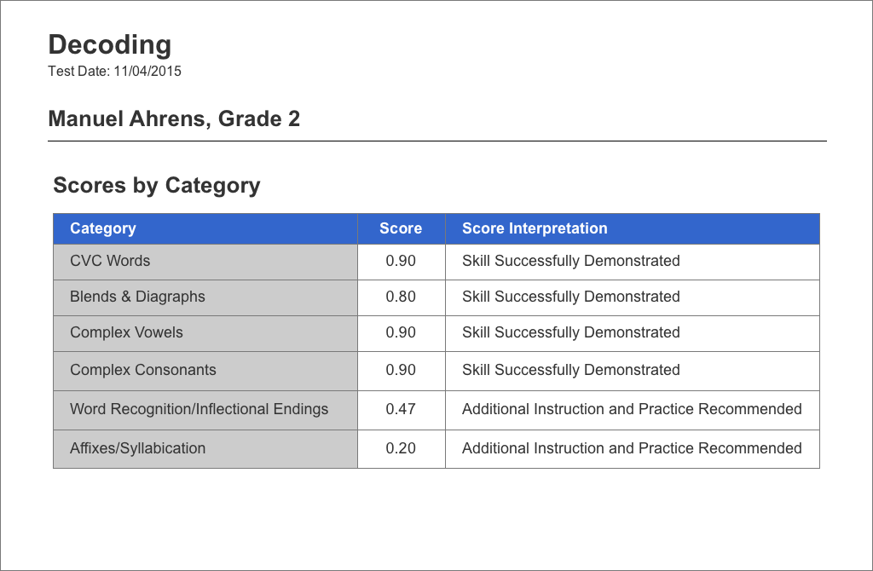

Slide 38

PARCC’s Fluency Assessments, because they are teacher-scored, do not have separate reports. Instead, teachers record their fluency data in their individual grade books.

Slide 39
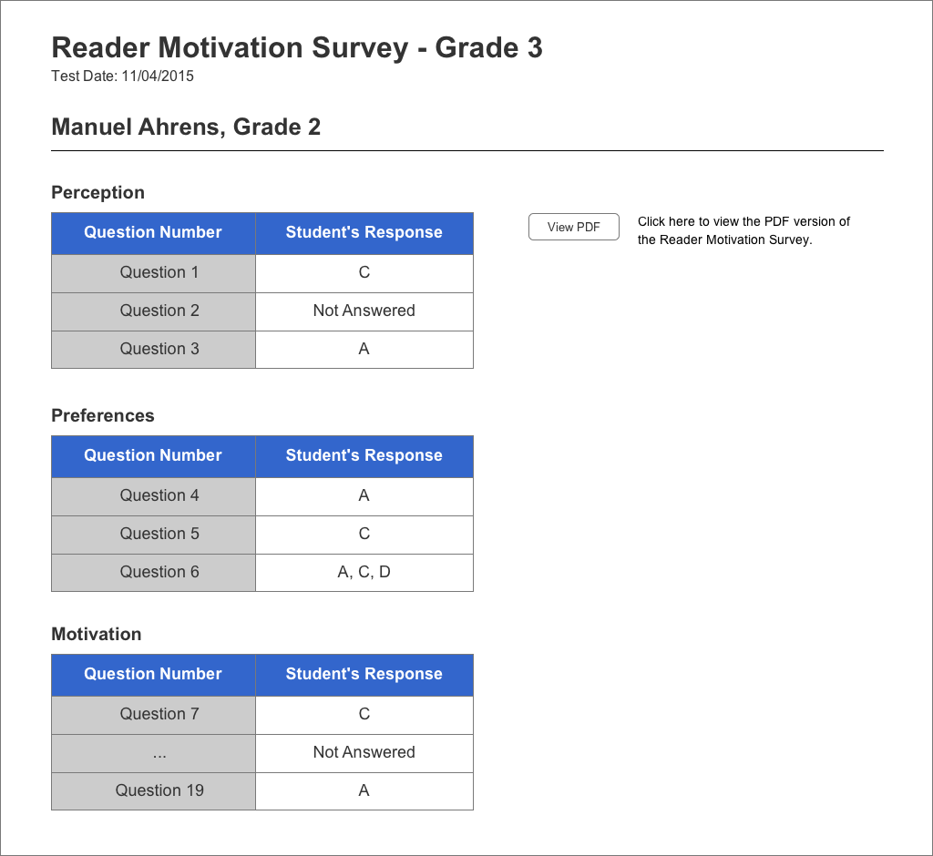
The Reader Motivation Survey provides teachers with an abundance of data on students’ perceptions of reading, their reading preferences, and their motivation to read.

Slide 40
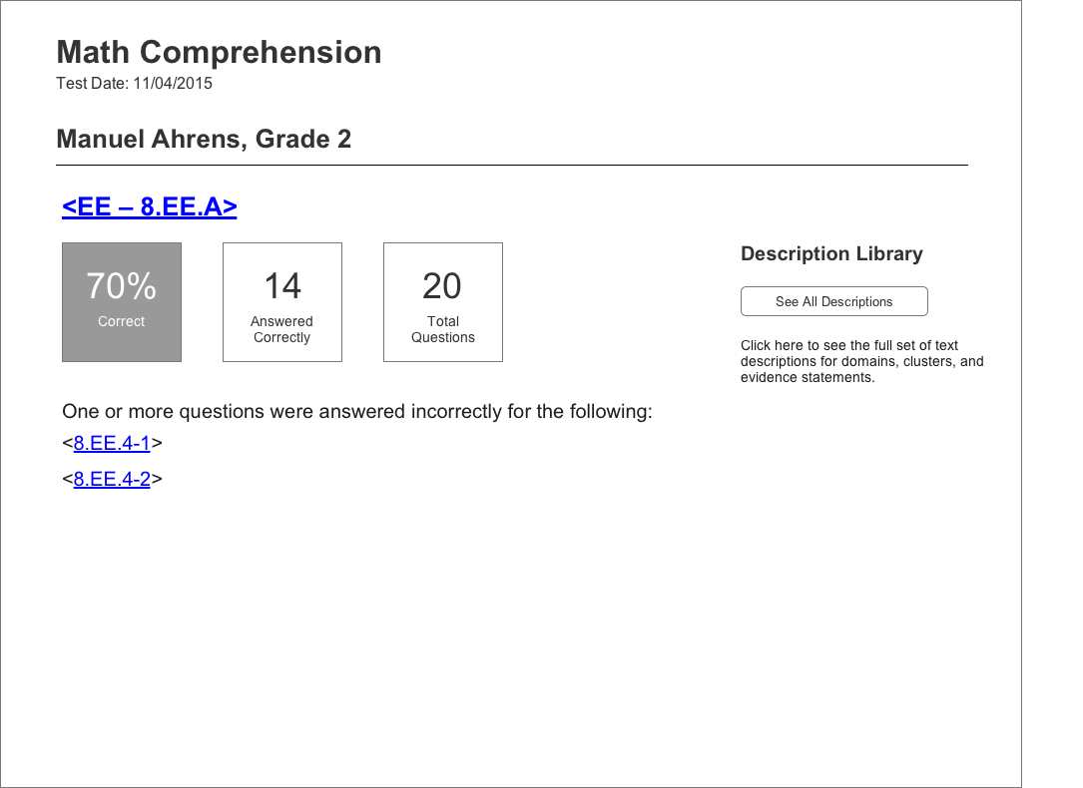
A single student’s cluster-test results.

Slide 41
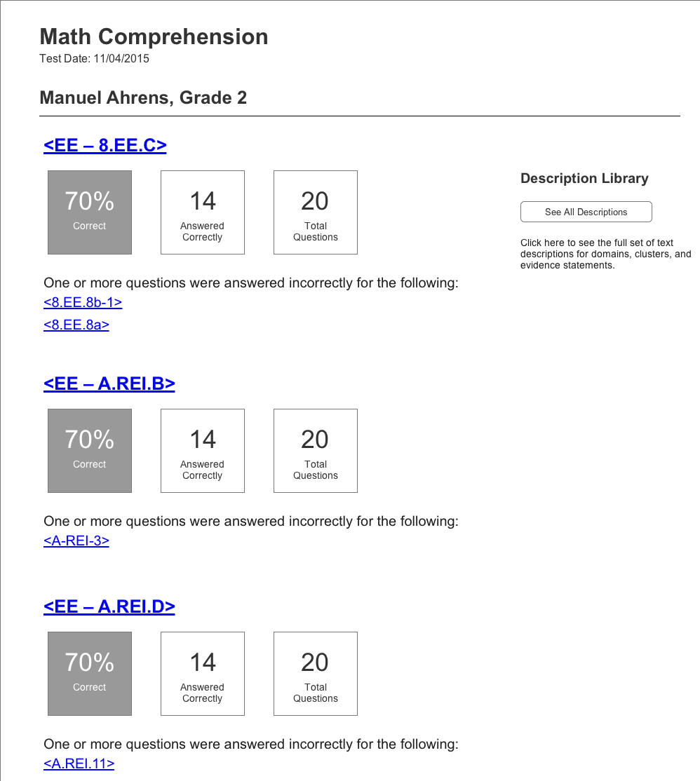
A single student’s results when multiple clusters are given.

Slide 42
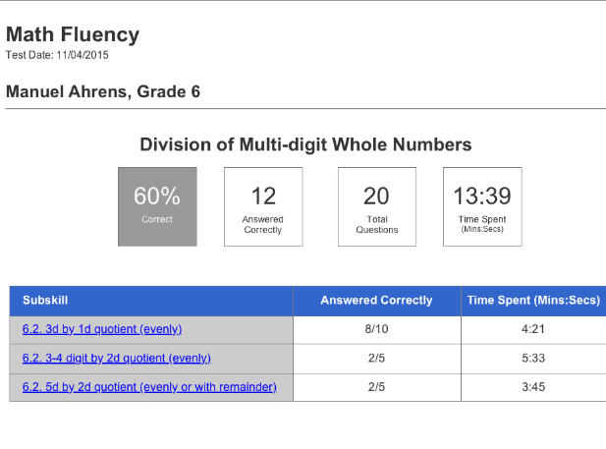

Single Student’s Fluency Test Scores
Sub skill

Slide 43
If you have not yet signed up for the DEAP, go to:
http://www.parcconline.org/instructional-tools/diagnostics/early-adopter-program

Slide 44
Q&A

