Slide 1
Fiscal Monitoring in eGrants Management System (eGMS) July 26, 2018

Slide 2
Agenda
Risk Assessment – LEA Selection
Fiscal Monitoring Scope
eGMS Portal for Fiscal Monitoring
Questions

Slide 3
Subrecipient Fiscal Monitoring Selection
Uniform Grants Guidance (UGG) Part 200, Subpart D, Section 200.331(b) – Requires a Risk-based assessment for selecting Local Educational Agencies (LEAs) for fiscal monitoring
Risk Assessment Factors includes, but is not limited to, data from the following sources:
Comprehensive Annual Financial Report (CAFR)
Federal grant funding and expenditures
Prior year Fiscal Monitoring and Program Monitoring Audits
Last date LDOE Division of Education Finance conducted a review of an LEA
Rating of each LEA is based on the compilation of the above data by:
School Districts
Charter Schools
Other Entities

Slide 4
Scope of Fiscal Monitoring
Consists of three Components:
Review the current year’s internal controls
Substantive testing of expended grant funds for each federal program
Provide technical assistance as needed

Slide 5
Internal Controls
Each LEA selected for monitoring must complete the Fiscal Monitoring Internal Controls Questionnaire
Self Assessment tool – Policies and Procedures
Accounting system, budgeting process, grant reimbursement process, personnel (time and effort) review, purchasing, travel, property control, etc.
LEAs must answer all questions (narrative form)
LEAs may request technical assistance where needed

Slide 6
Substantive Testing of Expended Federal Grant Funds
Random Sample of expenditures from the Reimbursement Requests
Review expenditures in all areas (object codes):
Salaries, benefits, professional services, purchased property services, other purchased services (travel expenses), materials and supplies, property, and other uses of funds
Documentation requirements are outlined in an Audit Instructional
Lists documents that will substantiate federal use of funds
Report on findings (Preliminary/Final Report)

Slide 7
eGMS Portal for Fiscal Monitoring
Old Format
Contact LEA by phone
Confirm audit (email)
Request documentation
LEA submits requested documentation by email
Correspond through email
Mail and/or email Final Report
New Format
Contact LEA by phone
eGMS Notifications
Confirmation details in eGMS
Request documentation in eGMS
LEA upload requested documentation in eGMS by grant
Correspond through eGMS
Access Final Report

Slide 8
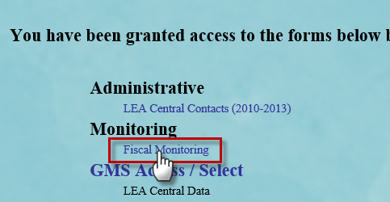
Access Demonstration
Accessible through eGMS for LEAs selected for fiscal monitoring for the current fiscal year as a result of the Fiscal Risk Assessment.

Slide 9
Questions on Fiscal Monitoring in eGMS?

