Slide 1
Family Engagement Coordinator Meeting
July 25, 2018

Slide 2
Agenda
Welcome
Back-to-School Resources
New Family-Focused Legislation
2018-2019 ESSA Consolidated Application Best Practices
Supporting Family Engagement in 2018-2019
Next Steps

Slide 3
Welcome

Slide 4
Using the “Chat” Feature, please enter your name and school system.

Slide 5
Back-to-School Resources

Slide 6
Parent Back-to-School Guides
The Parent Back-to-School Guides provide families with information on
what they should expect to see in their child’s classroom this year,
how to engage with their child’s teacher(s) to ensure they are on the right track, and
what resources are available to support learning at home.
Versions available for parents of students in grades 3-12, English learners and students and students with disabilities. A Prek-2 version will be released in August.
Translated versions will also be available in Spanish, Arabic and Vietnamese.

Slide 7
Back-to-School Night Presentation
The Back-to-School Night Presentation is designed to provide school leaders with a template for back-to-school night conversations with students and families.
Slides are included throughout to provide families with updates on:
2017-2018 student performance,
2018-2019 priorities, and
the state and school’s curriculum, standards, and assessments*.
Schools have the discretion to decide whether or not to use all of these slides or just keep the conversation focused on the school or school system.
* ESSA (Section 1116(c)(4) requires schools to provide parents with a description and explanation of the school’s curriculum and assessments, and the achievement levels of the state academic standards.

Slide 8
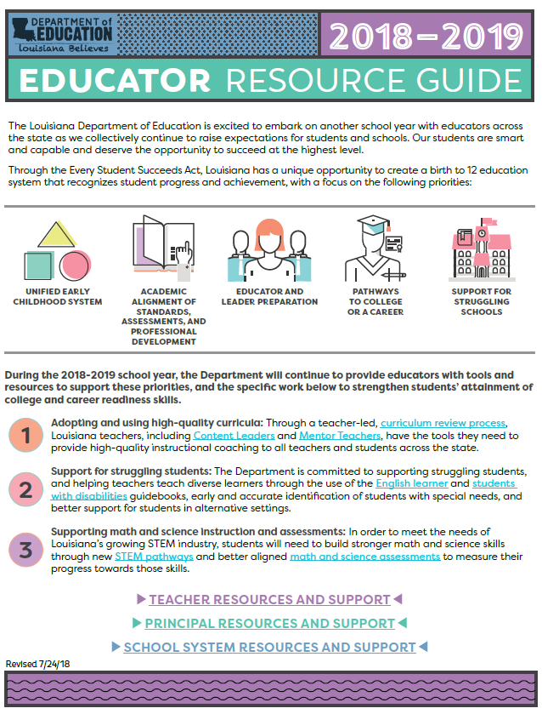
Educator Resource Guide
The Educator Resource Guide provide teachers, principals and school system leaders with the tools they need the most to start the new school year.
The Guide also identifies the state’s priority work for the 2018-2019 school year and the resources to support these initiatives.
The Guide is available in the School System, Principal, and Teacher Toolboxes.

Slide 9
Family Support Toolbox

Slide 10
New Family-Focused Legislation

Slide 11
Louisiana Parents’ Bill of Rights
Act 547 of the 2018 Legislative Session expands the Louisiana Parents’ Bill of Rights for public schools, which affirms parents’ rights in the following new ways:
Parents have the right to:
receive a child’s education records within 10 business days of the parent’s request;
access the final school calendar at least 30 days prior to the beginning of the school year;
view a complete listing of all school fees, the purpose of each fee, and how economic hardships can be addressed;
view any school uniform requirements on the school’s website; and
be informed if their child is at risk of not being promoted to the next grade level.

Slide 12
Additional New Family-Focused Legislation
The 2018 Legislative Session also brought forth several new family-focused pieces of legislation that school systems should be aware of and adhere to.
The 2018 Parent-Focused Legislation Guide provides families and school systems with an overview of new state education laws enacted during this year’s session.
The Guide will be added to the August edition (8/7) of the Educator Resource Guide and school systems are encouraged to share this resource with families and make it available on their websites.

Slide 13
Break: Be Back Soon

Slide 14
2018-2019 ESSA Consolidated Application Best Practices

Slide 15
Involving Families in School Improvement Plans Per ESSA
Section 1114 (b)(2)
Schools operating a schoolwide Title I program shall develop a comprehensive plan with the involvement of parents and other members of the community to be served and individuals who will carry out such plan, including teachers, principals, other school leaders, paraprofessionals present in the school, administrators, the local educational agency, to the extent feasible, tribes and tribal organizations.
Notes:
A written parent and family engagement policy explains how the school system or school supports the important role of parents in the education of their children.
Every school system that receives Title I, Part A funds must have a written parent and family engagement policy.
The same is required for every school that receives Title I, Part A funds.

Slide 16
Developing Parent and Family Engagement Policies Per ESSA
Section 1116 (a)(2)
School systems shall develop a written parent and family engagement policy jointly with families that establish expectations and objectives for meaningful parent and family involvement. The policy shall be incorporated into the local educational agency's plan developed under section 1112, and shared with families.
Section 1116 (a)(1)
A school system may only receive funds if their plan is developed and implemented with the inclusion of ALL families and reaches beyond barriers of culture, language, disabilities, and poverty.
Notes:
A written parent and family engagement policy explains how the school system or school supports the important role of parents in the education of their children.
Every school system that receives Title I, Part A funds must have a written parent and family engagement policy.
The same is required for every school that receives Title I, Part A funds.

Slide 17
Family Engagement Questions in 2018-2019 Application
Enter a description of how the district provided all families with the opportunity to provide input on the development of the district’s family engagement policy.
Enter a description of how the district provided all families with the opportunity to provide input on the development of school improvement plans.
Enter a description of how the district assists and builds capacity in schools in planning and implementing effective parental involvement activities.
Describe how the district will inform families of schools’ curriculum and assessments.
Describe how the district will ensure schools are providing families with materials and training needed to support student learning at home.
Describe how the district will ensure that parental involvement policies and materials reach beyond barriers of culture, language, disabilities, and poverty.
Describe how the district will evaluate its family engagement policy, in coordination with families, in order to ensure its effectiveness in improving the academic quality of all schools.

Slide 18
Consolidated Application Best Practices
Response | Best Practice | Not A Best Practice
Question 1 | The district hosted a half-day parent forum and disseminated a questionnaire for parents to comment on ways to improve our family engagement policy. | The district will post the family engagement policy on its website and have a copy available at the district office.
Question 2 | The district will host two family meetings: one to collect feedback from families on how we can address struggling student performance collectively, and a second to provide an overview of the final plan and our performance objectives. | The district will send a copy of its school improvement plan home with students.
Question 3 | The family engagement director will hold quarterly trainings with school coordinators aligned to key family engagement activities for the quarter. | The district will provide staff with a copy of the district family engagement policy.
Question 4 | Schools will communicate the state and school’s curriculum, standards and assessments as part of back-to-school nights, and other family nights throughout the year | Links to the Department’s standards and assessment pages will be provided on the district’s website.

Slide 19
Consolidated Application Best Practices
Response | Best Practice | Not A Best Practice
Question 5 | At the start of each month, schools will send a parent newsletter home with students providing families with key online resources to support student learning for that month, and inviting them to an upcoming district-hosted training (topics vary). | The district will provide resources and materials on the district’s website.
Question 6 | Hard copies of all parent materials will be available in the family resource room at each school, and will translated in Spanish and Vietnamese. All parent nights hosted by the district or schools will have translators available upon request. All contact to families will be made via paper (student folders/mailings), robo calls and email to compensate for the digital divide. | All parent materials will be made available in an understable language and uniform format.
Question 7 | Each school is required to set a family engagement goal for the year and to have “reflection” meetings at the end of the year for families to weigh in on those goals and family engagement activities and policy. | The district will modify the family engagement policy as needed, and post any updates to its website following Board approval.

Slide 20
Supporting Family Engagement in 2018-2019

Slide 21
How can the Department support you in 2018-2019?
Month | Engagement Topic | Resources | ESSA Parent Engagement Support
July | Back-to-School | Parent Guides to LEAP Results Parent Back-to-School Guides 2018-2019 Educator Resource Guide | Section 1116 (c)(4) Section 1116 (e)(2) Section 1111(b)(2)(B)(x)
September | School Performance Scores Communicating School Redesign Plans and intervention labels | School Finder/School Report Cards School Performance Score videos Parent Night presentation | Section 1116 (c)(4) Section 1111(g)(2)(B)
January | Preparing for spring assessments | Parent Guides to State Tests Practice Tests Sample and Released Test items | Section 1116 (e)(2)
March | 2018-2019 Reflection | Academic Progress Snapshot Family Engagement Policy Evaluation | Section 1116 (d)(2)(D) Section 1116 (a)(2) & (h)
Notes:
Using chat feature, add in resources you would like to have.

Slide 22
Next Steps

Slide 23
Preparing for 2018-2019
Encourage schools to use the Back-to-School Night Presentation as a guide to hosting more meaningful back-to-school night events with families.
Share Back-to-School Parent Guides with schools and encourage their dissemination in hard copies at back-to-school nights or open houses.
Set your Family Engagement Calendar for the year and schedule trainings for school coordinators

