Slide 1
How to Access GANs
Feb. 29, 2016

Slide 2
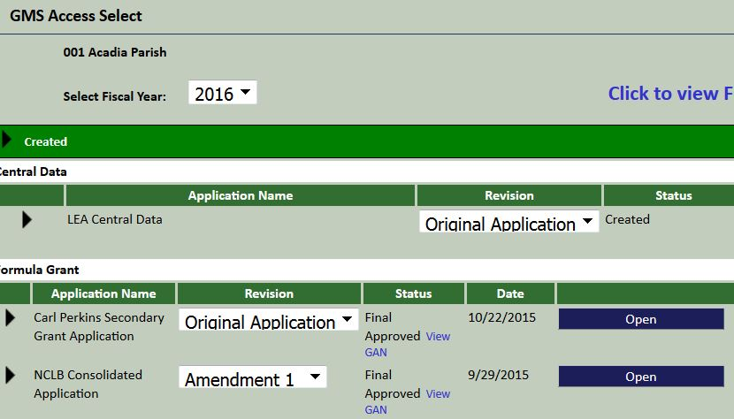
Step 1
From the GMS page, find NCLB Consolidated Grant Application (under Formula Grant) and select Open
1
2

Slide 3
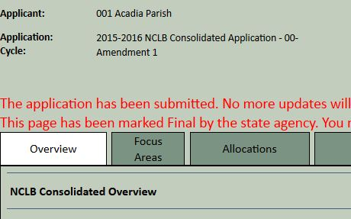
Step 2
When the page opens, select Allocations
3

Slide 4
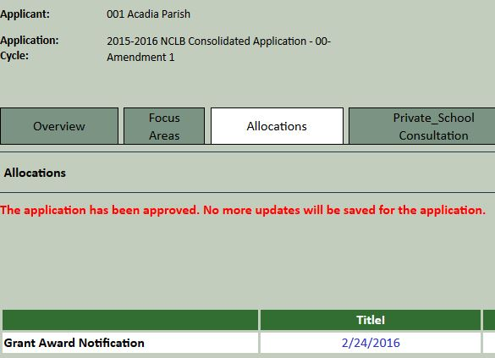
Step 3
When the Allocations page opens, a chart will appear that provides detailed information about these funds. The top row of the chart will show Grant Award Notification for various grants.
4
Click on a date to open the GAN.

Slide 5
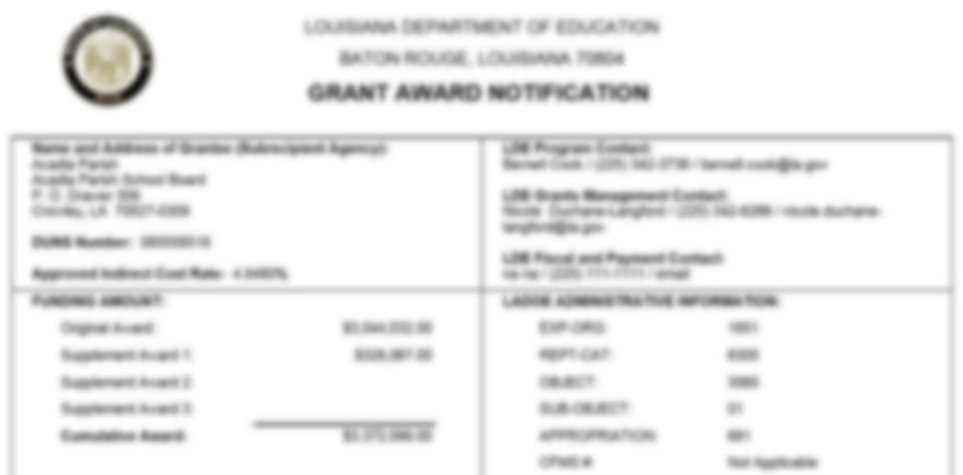
View the GAN

