Slide 1
DTC Contact Call
May 13, 2014

Slide 2
Welcome
Objective: These contact calls bring together LEA coordinators for the purpose of planning for and implementing statewide assessment programs within local education agencies.
Who: District Test Coordinators, District Technology Coordinators, and Accountability Contacts
Topics:
Assessment
Accountability
Technology
Archives: http://www.louisianabelieves.com/resources/library/assessment

Slide 3
14-15 Scope and Sequence
Key Dates | Agenda
May 13, 2014 | LEAP and ACT Series Spring Administration Results Release Accountability Clean-Up End-of-Year Survey
June 3, 2014 | Summer Retest Administration Training Exceptions to the High-Stakes Testing Policy GEE Transition Plan Data Certification
July 1, 2014 | SY 14-15 Planning Planning Meeting Placement Materials Receipt
August 5, 2014 | Summer Administration Results Release Dry Run Preparation
September 2, 2014 | Enrollment Verification School Letter Grades and Related Resources Release Dry Run Administration
October 7, 2014 | Dry Run Waiver Submission
November 11, 2014 | EOC Fall Administration Training Technology Requirements ACT CEA for Retesting Seniors ACT Applications for Accommodations
December 2, 2014 | ACT Match/No Match Distribution

Slide 4
14-15 Scope and Sequence
Key Dates | Agenda
January 6, 2015 | Pretest Workshop (LEAP series, ACT series, EOC): Key Dates, Test Administration, Test Security, Test Accommodations, and Accountability Coding Training Technology Requirements Pre-Grid Roster Distribution Data Certification: Graduation Rate Statewide Assessment Schedule SY 15-16
February 3, 2015 | Placement Test Materials Return
March 3, 2015 | ACT Match/No Match Distribution
April 21, 2015 | LEAP and ACT Series Spring administration Results Release
May 5, 2015 | LEAP Series Spring Administration Results Release Accountability Clean-Up End-of-Year Survey
June 2, 2015 | Exceptions to the High-Stakes Testing Policy Data Certification
July 7, 2015 | SY 14-15 Planning Planning Meeting

Slide 5
Agenda
Assessment
Early Childhood
Grades 3 through 8
High School
Alternate Assessments
Programming
Accountability
Grades 3 through 8
High School
Technology

Slide 6
 | Subject | 13-14 Assessment | 14-15 Assessment
Early Childhood | Developmental skills (PK) | TS GOLD | TS GOLD
 | Developmental skills (PK, K) | DSC | DSC
 | Reading (K-3) | DIBELS Next | DIBELS Next
Grades 3 to 8 | ELA | LEAP and iLEAP | PARCC
 | Math | LEAP and iLEAP | PARCC
 | Science | LEAP and iLEAP | LEAP and iLEAP
 | Social Studies | LEAP and iLEAP | LEAP and iLEAP
High School | All subjects | ACT Advanced Placement | ACT Advanced Placement
 | ELA | English II EOC English III EOC | English II EOC English III EOC
 | Math | Algebra I EOC Geometry EOC | Algebra I EOC Geometry EOC
 | Science | Biology EOC | Biology EOC
 | Social Studies | US History EOC | US History EOC
Alternate Assessments | ELA, Math, Science (varies by grade level) | LAA1 | LAA1
 | ELA, Math, Science, Social Studies (varies by grade level) | LAA2 | LAA2 for eligible re-testers (high school)
 | English Language | ELDA | ELDA

Slide 7
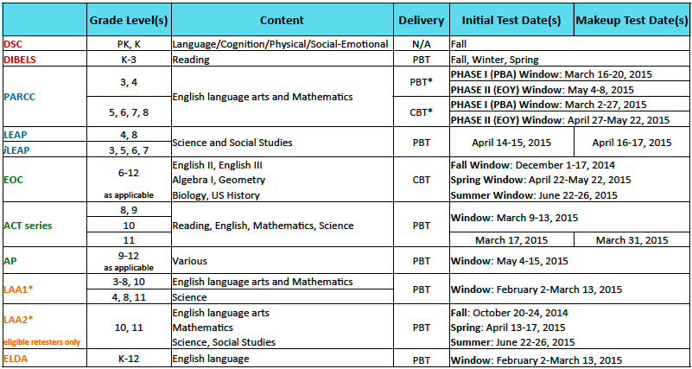
Assessment
Statewide Assessment Schedule SY 14-15

Slide 8
Agenda
Assessment
Early Childhood
Grades 3 through 8
High School
Alternate Assessments
Programming
Accountability
Grades 3 through 8
High School
Technology

Slide 9
Assessment
Early Childhood
DSC SY 14-15 will use the same forms used for SY 13-14
DIBELS Next
SY 14-15 Statement of Assurance due June 30 or waiver application due May 9
Dates for reporting results SY 14-15
Fall: September 30, 2014
Winter: February 20, 2015
Spring: May 29, 2015
For more information, contact assessment@la.gov.
Additional information is available here.

Slide 10
Agenda
Assessment
Early Childhood
Grades 3 through 8
High School
Alternate Assessments
Programming
Accountability
Grades 3 through 8
High School
Technology

Slide 11
Assessment
LEAP series
Release via LEAPweb reporting portal
Student Reports- available April/May 2014
Student Score Report
School Data File (CSV)
School/District Summary Reports- available July 2014
Subgroup/Education Classification Report
Economic Status Subgroup Report
Special Education Exceptionality Report
Test Accommodations Report
Performance Report
Rescore Requests
The DTC may request a rescore from the scoring contractor within 20 working days of receipt of scores for a fee. For more information, see pages 72-75 of the LEAP/iLEAP/LAA2 Test Coordinator’s Manual.
Note: Results released will override existing files in the LEAPweb reporting portal. Please ensure archive of existing records prior to the release of results.

Slide 12
Assessment
LEAPweb Training Manual
www.leapweb.org

Slide 13
Assessment
Types of Merges
Merge Within a Content Area
For a student who responded to portions of a single content area on two different answer documents.
Request for Merging Scores forms (LEAP Phase 2 form or iLEAP and LAA 2 form) should be faxed to DRC at 763-268-2600 when requesting this type of merge.
Student History Merge via LEAPweb
DTC function
The Electronic Merge request in LEAPweb should be used to merge incomplete histories that require LDOE assistance.
LEAP Phase 1/Phase 2 Merge
A manual merge completed by DRC to combine a student’s LEAP Phase 1 and Phase 2 scores so the student has one complete score within a content area

Slide 14
Assessment
LEAP Phase 1/Phase 2 Merge
If a student has records that require a Phase 1/Phase 2 merge:
Print copies of the student’s multiple reports for one content-area test (the unmatched student reports).
Indicate which of the reports will be the primary record by writing “primary” on the top of the student report.
The demographic information on the primary record will override the secondary record’s demographics and be used on the score memo that contains the merged score.
Fax copies of the student reports that require the merge to DRC at 763-268-2600.

Slide 15
Assessment
LEAP Phase 1/Phase 2 Merge Procedures
After review and DRC has performed a Phase 1/Phase 2 merge and the scores are loaded to LEAPweb, the LEA will still see the two records in LEAPweb:
The primary record will contain the student’s complete score.
The secondary record will remain in Web history but will not have scores linked to it.
The LEA will then need to perform a student history merge in LEAPweb to eliminate the secondary student record.
NOTE: When a LEAP Phase 1/Phase 2 merge is complete, the demographic fields cannot be modified.

Slide 16
Assessment
High Stakes Testing Policy
4th Grade Promotion Policy Guidance
8th Grade Promotion and Transitional 9th Grade
Webinar archive available here
Placement test materials will be delivered to LEAs July 2014.
These tests are for students from out-of-district or in-state educational settings, such as approved home study programs or nonpublic schools, who wish to enroll in public schools at grades 5 and 9 and they have not taken and met the requirements for LEAP.

Slide 17
Assessment
PARCC Field Test
Spring 2014 Field Test Report
More than 24,000 students in 60 traditional districts and 16 charter operators successfully complete testing
Survey data is collected from students, test administrators, and test coordinators following administration
EOY Administration
Top 10 Issues and Answers for PARCC EOY Field Test
Support Hotline for District Staff: 1-800-223-2950
Weekly Q and A Sessions for Users: Tuesdays at 1:00pm
click here to enter the conference or call 888-278-0296 Access Code: 1542513

Slide 18
Assessment
PARCC Field Test Focus Group Feedback
In the month between the PBA and EOY windows over 100 district leaders came together to provide feedback on that first window through 4 focus groups.
Successes
Hands on Trainings, call in times, and the LDOE hotline were useful in preparing for and administering the online assessments.
Districts were able to administer the assessments without major technology issues.
Areas to Improve
Real time communication with other districts and LDOE
Better test administrator and coordinator manuals
More opportunities for students to practice on the platform and with the embedded tools
Coming Up
Edmodo group for district test and tech coordinators
September Dry Run

Slide 19
Assessment
EOC
Release via EOC test system
Student score reports- available April/May 2014
Typically available 48 business-hours after test completion
Student Report
Student Item Analysis
Class Report
Student CSV Score File
For information on access, see pages 71-72 of the EOC Test Coordinator’s Manual
School/District Summary Reports- available June/July 2014
School/District CSV File
Subgroup CSV File
District Summary Report
Achievement Level Report
Subgroup Report
Economic Status Report
Special Education Exceptionality Report
Test Accommodations Report
Rescore Requests
The DTC may request a rescore from the scoring contractor by June 2 or June 23 for a fee. For more information, see pages 107-109 of the EOC Test Coordinator’s Manual

Slide 20
Assessment

Slide 21
Assessment
EXPLORE and PLAN
Release via postal mail delivery (password letter, where applicable)
Student and School Level Report- available March 2014
Profile Summary Report by grade includes
Scale scores and the composite range
Shows percentage of students who selected correct/incorrect response to each item
Average percentage of students who responded correctly to the items in each content area.
District Level Reports- available April 2014
Profile Summary Report by grade shows
Percentage of students who selected correct/incorrect response to each item
Average percentage of students who responded correctly to the items in each content area.

Slide 22
Agenda
Assessment
Early Childhood
Grades 3 through 8
High School
Alternate Assessments
Programming
Accountability
Grades 3 through 8
High School
Technology

Slide 23
Assessment
ACT
Release via postal mail delivery (password letter, where applicable)
ACT Student Report- available April/May 2014
Printed paper report containing College Reportable Scores mailed to the student
ACT High School Report and Student Score Labels available April/May 2014
1 paper copy and 2 printed labels mailed to the Director of Counseling
ACT Student College Reports- available April/May 2014
College Reportable scores are reported to colleges selected by the student
ACT State-Allowed Score Notification Letter- available June 2014
Printed letters containing scores achieved using state-allowed accommodations
2 printed copies mailed to the District Test Coordinator
ACT High School Profile Report- available July 2014*
An aggregate report that provides trends and averages of the high school based on the state tested population
1 copy included on CD mailed to the District Test Coordinator
ACT District Profile Report*
An aggregate report that provides trends and averages of the district based on the state tested population
1 copy included on CD mailed to the District Test Coordinator
ACT District Student Level Data File*
A student data file that includes all College-Reportable scores for all students for whom ACT processed and answer document
1 copy included on CD mailed to the District Test Coordinator
*Each district will receive 1 CD which will include all the reports indicated.

Slide 24
Assessment
Placement Test
The LDOE administers the Iowa Test Complete Battery Form C placement test for the students who plan to switch from the Career Diploma to College and Career Diploma.
Materials order via Riverside Publishing
Administration: May 7-May 23, 2014
Final administration
For more information, contact jumpstart@la.gov.
Additional information is available here.

Slide 25
Agenda
Assessment
Early Childhood
Grades 3 through 8
High School
Alternate Assessments
Programming
Accountability
Grades 3 through 8
High School
Technology

Slide 26
Assessment
Alternate Assessments
LEAP Alternate Assessment, Level 2 (LAA 2)
Students with disabilities in grades 4-11, who are functioning significantly below enrolled grade level were previously eligible to participate in LEAP Alternate Assessment, Level 2 (LAA 2) as defined by the LEAP Alternate Assessment Level 2 Participation Criteria.
Starting with the 2014-2015 school year, the LAA 2 assessment will no longer be administered in grades 4-8. Students who entered high school prior to the 14-15 school will continue to have access to the LAA 2 graduation exams.
The Department continues to work with stakeholders to determine the use of the LAA 2 classification in determining promotion and graduation in the future.
For more information, contact Bridget.Devlin@la.gov

Slide 27
Agenda
Assessment
Early Childhood
Grades 3 through 8
High School
Alternate Assessments
Programming
Accountability
Grades 3 through 8
High School
Technology

Slide 28
Assessment
Programming
End-of-Year Survey
As we close out SY 13-14, please provide thoughtful reflection on the implementation of statewide assessment systems to inform future development.
The LDOE Weekly Newsletter continues to serve as the primary method for communication. All District Test and Technology Coordinators have been added to the mailing list for direct receipt of this publication.
Contact Information Updates
LEA shipping address
DTC: phone, fax, email
DTC backup: phone, fax, email
Please send updates to assessment@la.gov

Slide 29
Assessment
Resources
Understanding assessment design, results, and reports:
LEAP series and EOC
Assessment Guidance
Achievement Level Descriptors
Interpretive Guides
Technical Reports
Louisiana PARCC Assessment Guides
ACT series
EXPLORE
PLAN
ACT

Slide 30
Assessment
EAGLE Content Development Plan
ELA/Math | Science and Social Studies
Full coverage of CCSS Items will demonstrate depth and rigor of standards Items will assess multiple standards (not just isolated standards) New item types from Louisiana Guidebook loaded into the system Instructional Tasks Extended Constructed Response Prose Constructed Response Evidence Based Selected Response Grade 9-12 assessment items will be course specific Items will be built to reflect other statewide assessments (i.e., EOCs, PARCC) More technology enabled items added Printable student/teacher resources available | Full coverage of GLEs Items will be moved from PASS* to EAGLE Instructional tasks Multiple choice Constructed Response (Teacher scored) New items will be developed based on gap analysis results *The Louisiana PASS system (all components and services ) will be discontinued on June 30, 2014.

Slide 31
Assessment
EAGLE Calendar SY 14-15
TIMELINE
September | Improved user Interface New item types and teacher resources (printer friendly format) added to item bank New search item bank functionality with filters New test building functionality New split screen design for student testing Training site available for all users
October | New item types and teacher resources added to item bank
November | All items available in printer friendly format Tablet support for student testing*
December | New item types and teacher resources added to item bank
*List of supported devices released in September

Slide 32
Assessment
EAGLE Focus Group
Teachers and school/district administrators are encouraged to provide input on the 2014-15 EAGLE overhaul by joining the EAGLE Focus Group.
Commitment: Educators will participate in 4 webinars, complete an online survey, and participate in one individual phone call with the LDOE team and/or vendor (May-July)
RSVP: Please encourage teachers, school administrators, or district administrators who would like to participate to submit their names/position titles to Dana Maxie at Dana.Maxie@la.gov no later than May 14th (this notice will also be posted in Edmodo for educators)
If you have any questions, please feel free to contact Dana Maxie at Dana.Maxie@la.gov.

Slide 33
Agenda
Assessment
Early Childhood
Grades 3 through 8
High School
Alternate Assessments
Programming
Accountability
Grades 3 through 8
High School
Technology

Slide 34
Accountability
Accountability Codes Reminder
Codes are used when students do not use pre-identified test materials for LEAP, iLEAP, EOC, ACT, LAA 1 (all grades) and LAA 2 (grades 3-8). Please note:
Scores of zero are assigned to unused pre-identified tests unless appropriate accountability codes are applied.
Accountability codes are applied directly to answer documents for LEAP, iLEAP, LAA 1 and LAA 2. For EOC and ACT tests, accountability codes are entered into the EOC test system

Slide 35
Agenda
Assessment
Early Childhood
Grades 3 through 8
High School
Alternate Assessments
Programming
Accountability
Grades 3 through 8
High School
Technology

Slide 36
Accountability
LEAP series
The Online Corrections System (OCS) for iLEAP, LEAP, LAA 1, and LAA 2 test data is used to correct or confirm information provided on answer documents during the Statewide Spring Assessment for these tests.
The cleanup period for these tests will be May 16-22, 2014.
The DTC’s primary responsibilities are to monitor the progress each school is making toward completing their corrections in OCS and to review and approve those corrections once the school has finished updating its reports.

Slide 37
Accountability
www.leapweb.org

Slide 38
Accountability
www.leapweb.org

Slide 39
Accountability
Stages of Correction
STC applies correction to student record
Confirms record by clicking Update
Once all records have been confirmed, the school status is marked Complete and is available for review and approval by the DTC
DTC reviews completed corrections
Highlight for review any additional correction needed by the STC
Approve correction
Once approved, a student record is locked from further changes.
Note: Ensure adequate timing for availability of LEA review and school site response prior to the May 22 deadline. By May 20, if any of your schools have reports with a status of Not Started, the DTC should contact the STC for support.
Louisiana Believes

Slide 40
Accountability
Types of Corrections
Invalid State ID
Invalid Date of Birth
Impending Zeros
No Response Document
Unexcused Absence
Note: Refer to the complete OCS User Manual and Accountability Code Descriptions for detailed guidance on applying corrections to student records in the OCS.

Slide 41
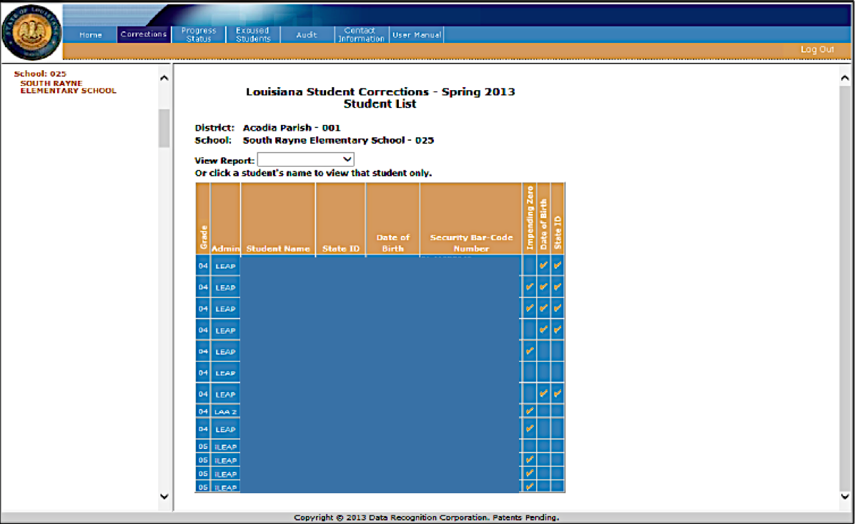
Accountability

Slide 42
Accountability
At anytime during the process of cleaning up data in OCS, the STC can check the progress for all reports by selecting Progress Status from the navigation menu at the top of each screen. Status categories include:
No Report (NR)
Not Started
In Progress
Approved

Slide 43
Agenda
Assessment
Early Childhood
Grades 3 through 8
High School
Alternate Assessments
Programming
Accountability
Grades 3 through 8
High School
Technology

Slide 44
Accountability
EOC
Accountability codes can be assigned during the EOC registration and test administration windows of April 4-May 23, 2014.
This feature allows School Test Coordinators (STCs) to drop students from the class roster when an accountability code is assigned.
To assign an EOC student accountability code, see pages 60-65 in the EOC Test Coordinator’s Manual.
Note: EOC Accountability codes cannot be assigned after the testing window closes. Accountability codes do not apply to EOC retesters.

Slide 45
Accountability
ACT
Accountability codes can be assigned during the EOC registration and test administration windows of April 4-May 23, 2014.
This feature allows School Test Coordinators (STCs) to assign accountability codes to 11th and 12th grade students who did not complete the spring 2014 ACT college readiness assessment.
To assign an ACT student accountability code, see pages 66-70 in the EOC Test Coordinator’s Manual.
NOTE: ACT Accountability codes cannot be assigned after the testing window closes. The CSV file will only be available during the April/May EOC test administration and for approximately two weeks after the testing window closes. Please make sure this file is downloaded for record keeping during this time.

Slide 46
Agenda
Assessment
Early Childhood
Grades 3 through 8
High School
Alternate Assessments
Programming
Accountability
Grades 3 through 8
High School
Technology

Slide 47
Technology
Oracle released a Critical Patch Update for Java 7 on April 15, 2014. TestNav8 will not run until the update is made. All districts and schools running JAVA 7 should apply this updated patch to all devices that will be supporting EOY field testing.
If you need more information or guidance, please contact EdTech@la.gov

Slide 48
Technology
September Dry Run
In September 2014, LEAs will be participating in a Dry Run to test preparedness for the Spring 2015 operational assessments.
Districts are assigned a date for their trial according to internet service provider in order to effectively test both the school’s, LEA’s and ISP’s network.
Results from the Dry Run will inform and be a part of the paper/online assessment waiver process.
Based on the results of the Dry Run as well as related information, LEAs will be able to apply for school-level waivers for:
Grades 3-4 that may be sufficiently tech-ready and wish to test online instead of on paper
Grades 5-8 that are not tech-ready for online assessment to test on paper instead of online
Louisiana Believes

Slide 49
Technology
Technology Readiness Data Submission
The Technology Readiness Tool (TRT) and Network Broadband Survey will reopen May 21 for schools to submit and update their device and network data.
Submission Deadline is July 23.
Districts and schools should update both their device and network data.
Training on the TRT will be held on May 20 and May 21 at 10 am
https://connect4.uc.att.com/stateoflouisiana/meet/?ExEventID=89571670
Dial-in Number: 888-808-6929, Meeting Access Code: 9571670#
The TRT is located at: www.techreadiness.net
The Summer Technology Readiness Footprint will be released In August
Louisiana Believes

Slide 50
Next Steps
For more information, contact assessment@la.gov.
Task | Deadline
Administer Placement Tests *If applicable | May 7-23, 2014
DIBELS Waiver Application *If applicable | May 9, 2014
LEAP Series Online Cleanup | May 16-22, 2014
EOC and ACT Accountability Coding in the EOC Test System | April 4-May 23, 2014
Deadline to Submit Spring DIBELS Data | May 30, 2014
End-of-Year Survey | June 6, 2014
DIBELS Statement of Assurance | June 30, 2014
Louisiana Believes

