Slide 1
System Enhancements
System Enhancements released in November:
Seclusion/Restraint
  Per RS 17:416.21, LEAs shall report to LDOE all instances when students with disabilities are placed in seclusion or physical restraint is used
  LDOE shall maintain a database of all reported incidents of students with disabilities
  To comply with the law, this information had been collected within the Discipline fields in SIS.
  To assist you in following the requirements in Bulletin 1706, Section 543, the reporting of incidents will now be collected through SER.
For assistance, contact Ashley.Augustine@la.gov

Slide 2
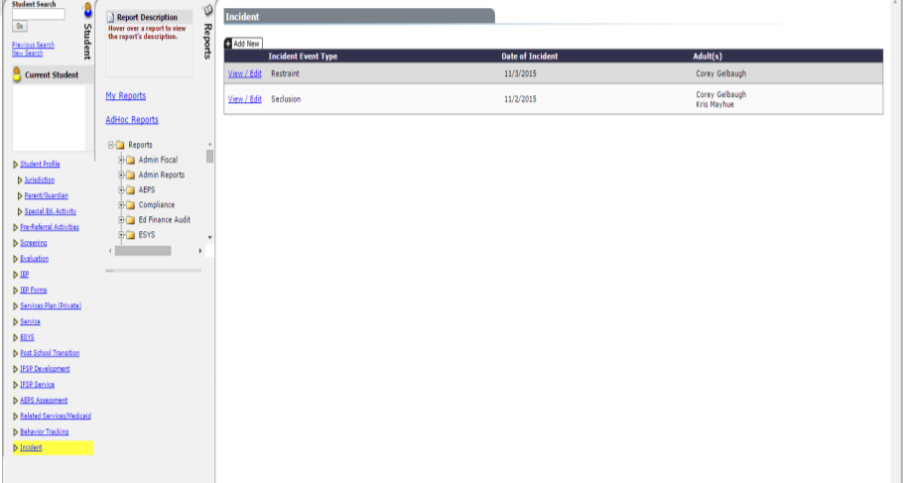
System Enhancements
New Link
For assistance, contact Ashley.Augustine@la.gov

Slide 3
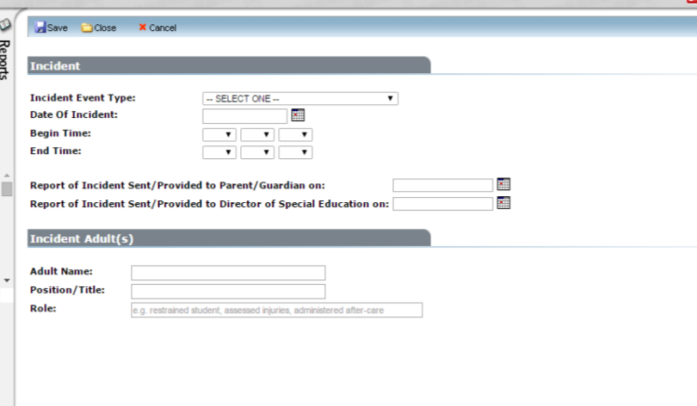
System Enhancements
Incident Adult: Anyone involved in the seclusion or restraint. Additional adults can be added.
For assistance, contact Ashley.Augustine@la.gov
Notes:
Displayed are the required fields to add an Incident record in SER.
Incident Adult can be anyone involved in the seclusion or restraint. You can add as many adults as needed, and you must type in the role of all adults involved.

Slide 4
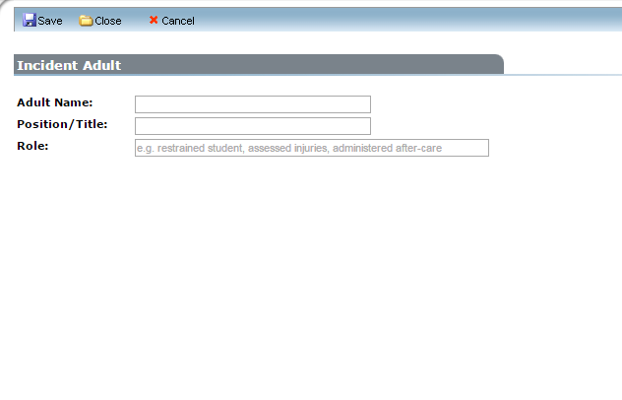
System Enhancements
This information must be typed in. There are no drop down menus for these fields.
For assistance, contact Ashley.Augustine@la.gov

Slide 5
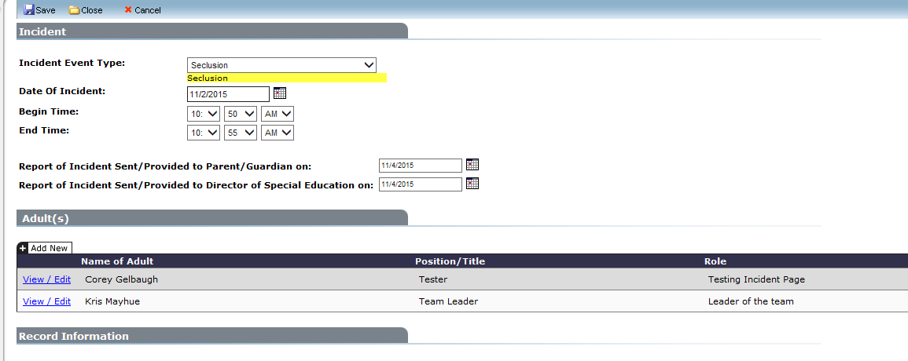
System Enhancements
How information will display once entered and saved.
For assistance, contact Ashley.Augustine@la.gov
Notes:
Once the information is entered and saved.

