Slide 1
Wednesday Bell Ringer
Think about what a
SOCRATIC SEMINAR is.
Jot all your thoughts and anything you
remember about a Socratic Seminar.

Slide 2
Socratic Seminars
During the semester, students have read, analyzed, and discussed many passages of text.
Students have spent time reading, studying, and taking notes over the different sections of text.
Today, students will be randomly divided into pairs.
Questions and quotes will be given to each group to discuss and review before discussion time begins.
One person from each group will be involved in the group discussion. The other group member will be responsible for giving the speaker new ideas.
Roles will be reversed.

Slide 3
Classroom
setup

Slide 4
Socratic Seminars “rules”
Socratic Seminar Rules
Speak so that all can hear
Listen closely
Talk to each other
Ask others for clarification
Speak without raising your hand
Refer to the text
Invite others to speak
Consider all viewpoints
Know that YOU are responsible
for the quality of the seminar
1. Speak so that all can hear
2. Listen closely
3. Talk to each other
4. Ask others for clarification
5. Speak without raising your hand
6. Refer to the text
7. Invite others to speak
8. Consider all viewpoints
9. Don’t repeat information that has already been discussed
10. Know that YOU are responsible
for the quality of the seminar

Slide 5
Socratic Seminars “rules”
Ideas to review
Speak so that all can hear
Listen closely
Talk to each other
Ask others for clarification
Speak without raising your hand
Refer to the text
Invite others to speak
Consider all viewpoints
Know that YOU are responsible
for the quality of the seminar
Was the trouble of war worth it to achieve freedom from England?
Support your opinion with evidence from George vs. George, Liberty!, by Rosalyn Schanzer and If You Lived At the Time of the American Revolution, by Kay Moore.

Slide 6
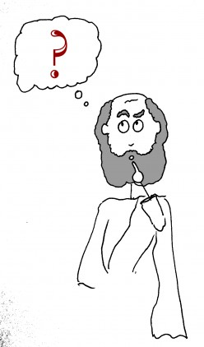
Exit Ticket
On the index card provided, tell one WOW and one WONDER from the Socratic Seminar.

