Slide 1

Student Scholarships for Educational Excellence Program (SSEEP)
Independent Financial Audit Guide
for Participating Schools
September 24, 2015

Slide 2
Overview
Because Scholarship schools receive funds from the Department generated from public tax dollars, these funds come with a high level of responsibility and accountability to the State of Louisiana and Louisiana citizens.
La. R.S. 17:4022(3) requires a financial audit of those schools receiving SSEEP funds
    Must be conducted by a certified public accountant
    Cost of audit to be paid for by LDE
The Department publishes audit guidance regarding the annual independent Scholarship audit so as to ensure compliance with the law.

Slide 3
Audit Requirement
In order to prepare for the audit, school staff must ensure that the following are in order:
  Assurances
    Educational Purpose Assurance – (Due to the Department 10.14.15)
    Individual Enrichment Assurance – (Due to the Department 10.14.15)
  Financial Controls
  Financial Reports
  Segregation of Funds
  Enrollment Records
  Independent Financial Audit Procedures

Slide 4
Educational Purposes Assurance
Each participating school must assure, in writing, that program funds will be spent only for educational purposes in the categories listed below.
  Instructional Programs
  Pupil Support Programs
  Instructional Staff Programs
  School Administration
  General Administration
  Business Services
  Operation and Maintenance of Plant Services
  Transportation
  Food Services Operations
  Facility Acquisition and Construction Services
For greater detail, see the Louisiana Accounting Uniform Guidance Handbook (LAUGH GUIDE) at: http://www.louisianaschools.net/lde/uploads/18078.pdf

Slide 5

Educational Purposes Assurance Form

Slide 6
Individual Enrichment Assurance
  This form must be submitted by key personnel at each participating school.
  This form serves as an assurance that no employee of a participating school may use the authority of his office or position in connection with the school’s participation in the Scholarship Program, directly or indirectly, in a manner intended to compel or coerce any person to provide himself or any other person with anything of economic value.
  Key personnel include:
    School Board Members, School Administrators/Principals, Assistant Principals, Academic Officers/Directors

Slide 7
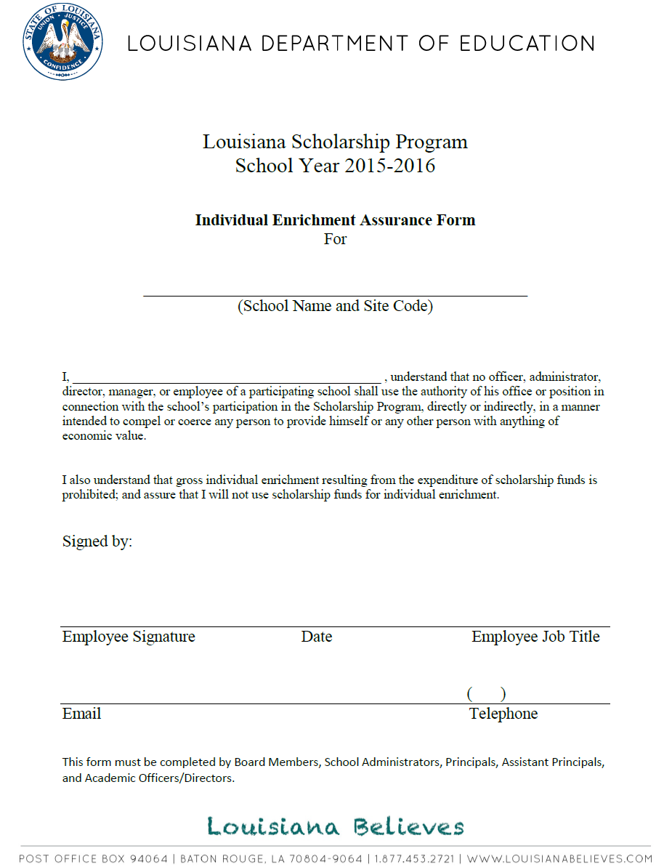
Individual Enrichment Assurance Form

Slide 8
Financial Controls
The financial environment in which SSEEP funds are managed will be audited to determine if adequate internal controls exist to safeguard state funds
In anticipation of this review, existing financial systems should be reviewed to ensure controls are present as follows:
  Up-to-date accounting policies and procedures
  Trained finance and accounting staff
  Ability to report on program funds via system account coding,
  separate fund/account or a substitutionary system such as an
  allocation methodology.

Slide 9
Financial Controls-Cont’d
  Maintenance of supporting documentation for transactions
  Dual signatures on checks required
  Bank statements reconciled and discrepancies resolved
  Limits on access and changes to master payroll files
  Adequate segregation of duties
Refer to the Louisiana Legislative Auditor website for various “Best Practices” tools and additional guidance
*http://www.lla.state.la.us/auditResources/bestPractices/

Slide 10
Financial Reports
Financial records maintained by a participating school and all financial reports must thoroughly document the use of SSEEP funds
As a result, each participating school must complete and submit the following two financial reports:
  Budget briefly detailing the manner in which the total estimated program revenue allocated to the school will be spent
      An annual Budget must be submitted on or before December 11, 2015
      Categories of expenditures may include: Salaries, Benefits, Purchased Services, Supplies and Materials, Property, or Other
      If an allocation methodology is being used to account for SSEEP funds, the allocation spreadsheet must be submitted with the annual budget
      Note: The allocation spreadsheet has been updated to provide greater clarity

Slide 11
Financial Reports
  2) Total expenditures year to date (as of January 31, 2016) by
  budgeted category
      Expenditures must be submitted on or before February 19, 2016
      If an allocation methodology is being used to account for SSEEP funds, the allocation spreadsheet with expenditures through January 31, 2016 must be submitted with the total expenditures to date form
        Schools should ensure that the expenditures reported through January 31, 2016 on the budget to actual agree to the expenditures reported on the allocation spreadsheet

Slide 12
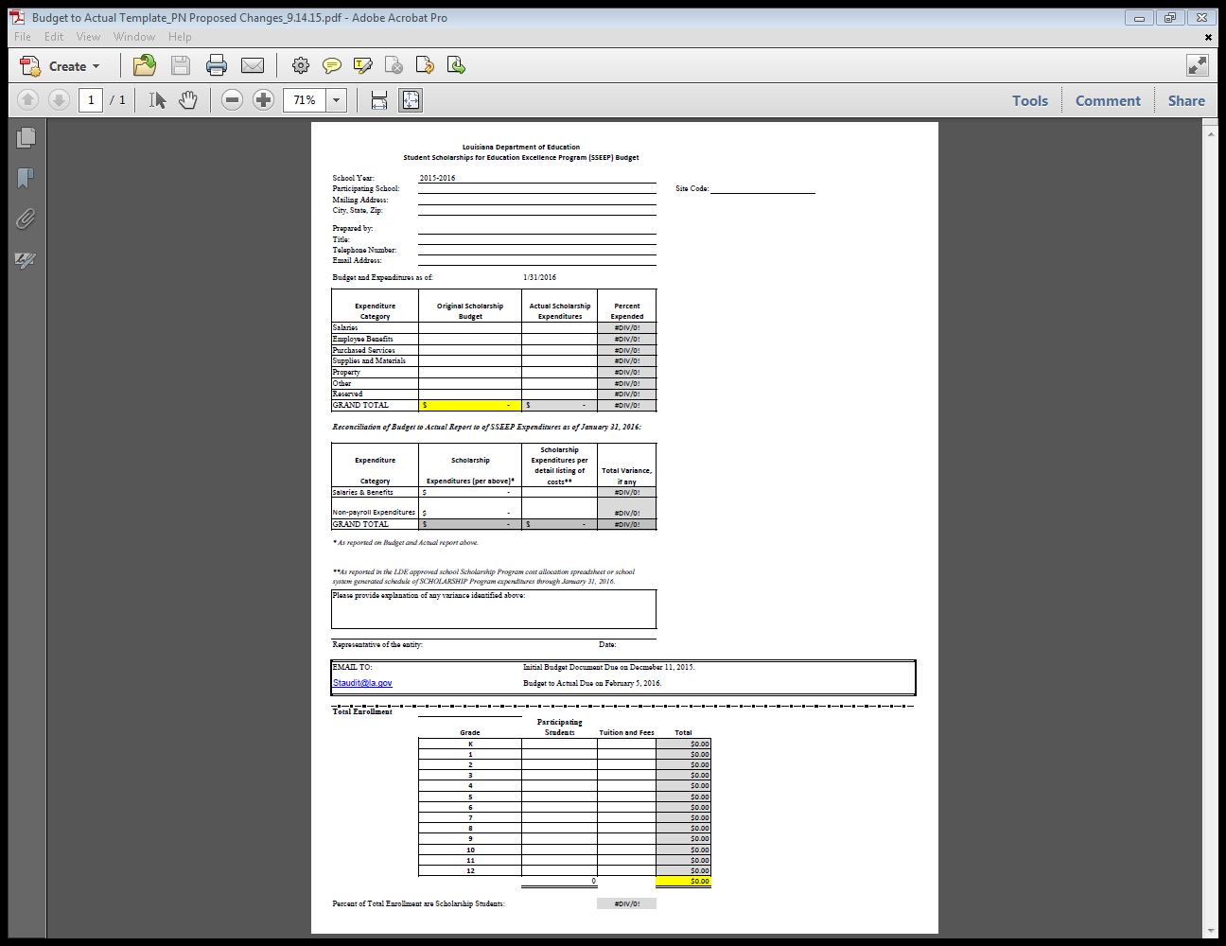
Budget and Expenditure Reports

Slide 13
Segregation of Funds
Schools are required to implement processes and procedures that will allow SSEEP revenue and expenditures to be easily segregated from the non-scholarship revenue and expenditures.
    See this requirement in Act No. 467 of the 2014 Regular Session – R.S. 17:4022(3)
    (http://www.legis.la.gov/legis/ViewDocument.aspx?d=913483&n=SB460 Act)
The use of the accounting controls and processes will readily provide documentation that evidences compliance with SSEEP requirements.
An added benefit of the separate accounting is the protection of the privacy of each participating school’s non-public funds.

Slide 14
Segregation of Funds
To effectively distinguish Scholarship funding and related expenditures from private funding and related expenditures, accounting controls should be implemented through the use of one of the following three methods:
  Separate bank accounts for each fund source
      Tuition and other income from private sources is deposited in the main operating account(s) for the school
      Tuition for SSEEP students is deposited in a separate account upon receipt
      Invoices, payroll, and other obligations are paid as due from the main operating account
      Either on a by disbursement basis or on some regular basis (weekly, bi-weekly, monthly) funds are transferred from the SSEEP account to the main operating account(s) to cover the expenses paid on behalf of the SSEEP students
        Supporting documentation should be on file for each transfer
      The transfer must be based on a reasonable allocation methodology such as the proportion of SSEEP students to the total student population

Slide 15
Segregation of Funds – Unique Coding in the Accounting System
An accounting system with unique revenue codes or account identifiers for tuition and other income from private sources
      Tuition and other income from private sources is recorded with unique revenue coding or identifiers in the accounting system and deposited in the main operating account(s) for the school
      Tuition for SSEEP students is recorded with unique revenue coding and identifiers in the accounting system and deposited in the main operating account(s) for the school
      Invoices, payroll and other obligations are paid as due from the main operating account
      For each expense, the proportionate share allocable to SSEEP students is determined and coded with unique expenditure codes in the accounting system
      A reasonable allocation methodology is used to determine the proportion of each expense that is eligible to be paid from the SSEEP tuition revenue
        Schools should ensure that there is supporting documentation on file to support the allocation methodology used

Slide 16
Segregation of funds – Substitutionary System
Substitutionary System – Allocation Spreadsheet
      A rational methodology for allocating the expenditures must be developed and utilized consistently
      The Department approved allocation spreadsheet may be used as a substitutionary system of demonstrating the segregation of funds through an allocation of expenditures based on the percent of scholarship student population to the total student population by classroom, grade or school.
      The allocation spreadsheet will provide data relative to scholarship expenditures in the areas of salaries, benefits and other charges.
      The allocation spreadsheet must provide enough detail to allow a sample to be pulled for expenditure testing.
      Note: An updated allocation spreadsheet will be provided to provide greater clarity

Slide 17
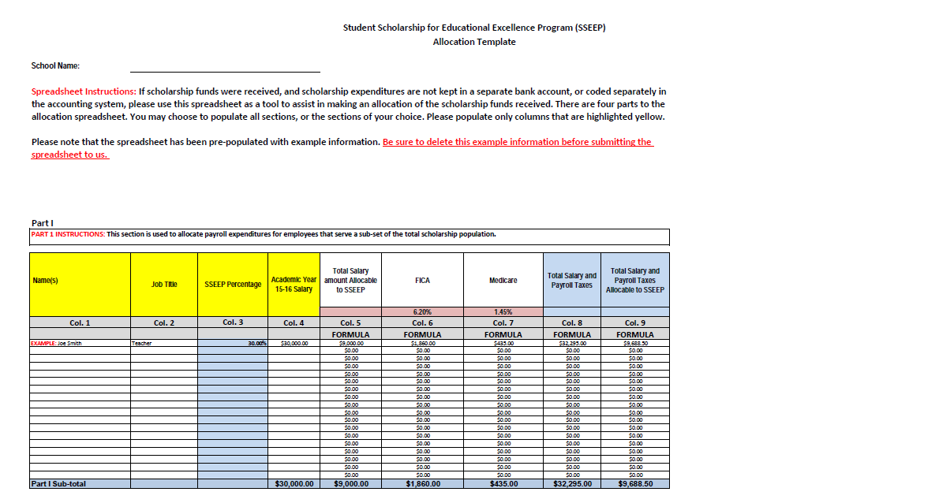
Allocation Spreadsheet – Part I
This section of the spreadsheet allocates expenditures for employee payroll taxes based on the proportion of scholarship to non-scholarship students in the classroom.

Slide 18
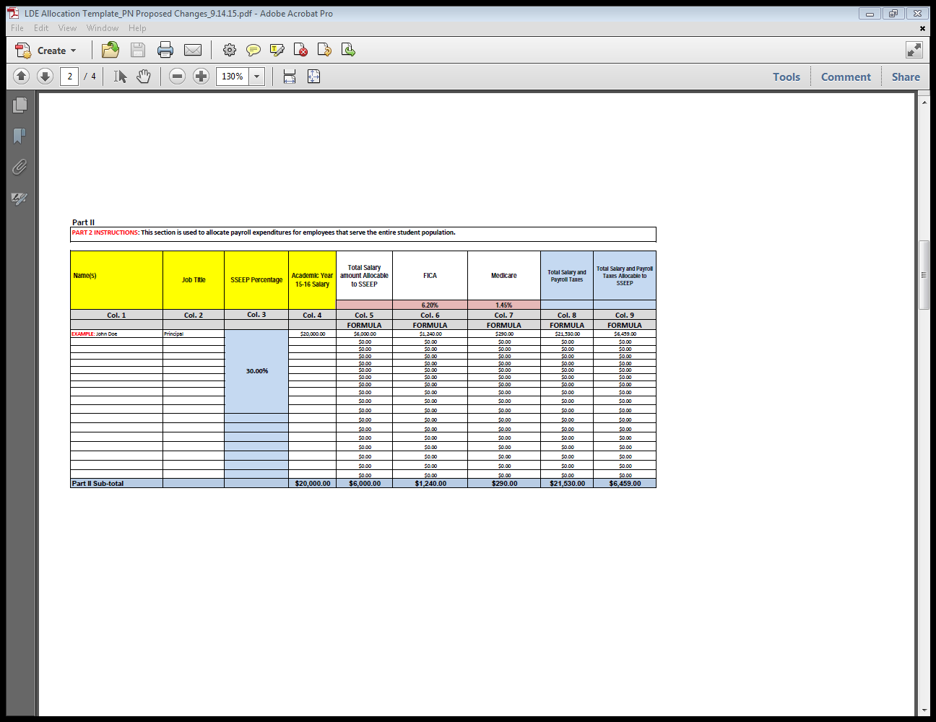
Allocation Spreadsheet – Part II
This section is used to allocate payroll expenditures for employees that serve the entire student population (i.e. – Principal).

Slide 19
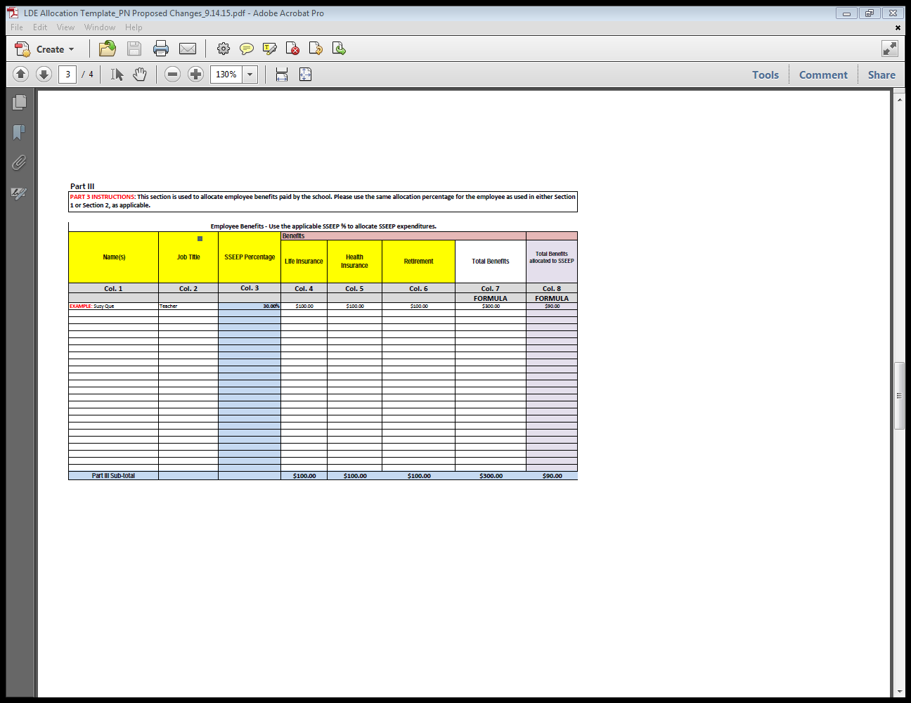
Allocation Spreadsheet – Part III
This section is used to allocate employee benefits paid by the school.

Slide 20
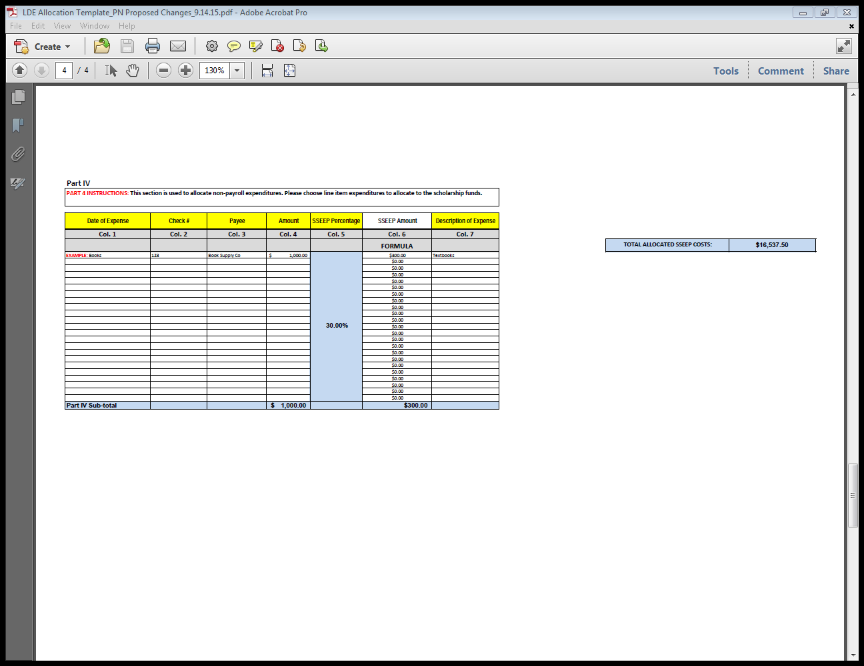
Allocation Spreadsheet – Part IV
This section is used to allocate non-payroll expenditures.

Slide 21
Enrollment Records
Payments of tuition are based on student enrollment
Therefore, schools must maintain records in order to substantiate that the SSEEP students were actually enrolled and present on each of the four count dates
In order to do this, the following documents must be prepared and maintained by the school and available for audit annually:
    Application and enrollment forms for each SSEEP student
    Daily attendance rosters (manual or electronic) inclusive of all SSEEP students.
    Auditors will look for a pattern of attendance for a period of time before and after the count date to verify that each student is accurately included in a count. Attendance data will be requested for the following period for each count date:
      September 9th count date – August 24th through September 25th
      December 2nd count date – November 9th through December 18th
      February 3rd count date – January 18th through February 26th

Slide 22
Independent Financial Audit Procedures
  The audit will include five separate tests:
    Use of funds (BESE Bulletin 133 – Financial Practices) –
      Program funds are managed using adequate accounting controls
      Program funds are spent only on educational purposes
      Funds are not spent in a manner that is grossly irresponsible
      Funds are not used for gross individual enrichment
    Tuition and Fees (BESE Bulletin 133 – Financial Practices)
    Payment verification (Enrollment/Attendance Confirmation) (R.S. 17:4014(B)
    Income Eligibility (R.S. 17: 4013(2)
    Special Education Tuition (BESE Bulletin 133 – Financial Practices)

Slide 23
Test 1 a): Use of Funds – Adequate Accounting Controls
A sample of program expenditures will be tested to verify that program funds were managed using adequate accounting controls.
Documentation Needed:
Program expenditure report (check register or report generated from accounting system)
Supporting documentation to substantiate the expenditure (original invoice, purchase order, contract, payroll documents, cancelled check and/or bank statement)

Slide 24
Test 1 b): Use of Funds – Educational Purposes
A sample of program expenditures will be tested to verify that program funds were spent only for educational purposes.
Documentation needed:
Educational Purposes Assurance Form (Collected & Provided by Department)
Program expenditure report (check register or report generated from accounting system)
Salary schedule for the current school year (list of employees paid with SSEEP funds including title, job description, and salary and benefits)

Slide 25
Test 1 c): Use of Funds – Gross Irresponsibility
Two tests will be performed to identify if program funds were managed in a responsible manner:
    An assessment of the internal controls over program processes based on the internal control questionnaire collected by Department. This item will be handled by Department staff.
    Budget to actual comparison of program expenditures.
Documentation needed:
Program budget and expenditures document (Provided by Department as reported by School)
Initial and final number of enrolled scholarship students by grade (Provided by Department as reported by School)
Approved Tuition and fees charged by grade (Provided by Department)
Explanations for variances where the actual expenditures to budget are greater than 30%

Slide 26
Test 1 d): Use of funds – Individual Enrichment
A review of program expenditures will be performed to identify any expenditures indicative of individual enrichment.
Documentation needed:
Individual Enrichment Assurance Form (Collected and Provided by Department)
Program expenditure report (check register or report generated from accounting system)
Salary schedule for the current school year (list of employees paid with SSEEP funds including title, job description, and salary and benefits)
Explanation for all salaries and benefits where the total expenditures for any key personnel increased by 15%

Slide 27
Test 2: Tuition and Fee Accuracy
The tuition and fees charged for a sample of non-scholarship students will be reviewed to verify that the tuition and fee amount charged to paying students is not less than the amount charged to students participating in the Scholarship Program.
    NOTE: This portion of the audit will take place soon after the 1st quarter
    payment is released in Fall 2015.
Documentation needed:
Tuition and fee schedule for all students (Provided by the Department)
Policies and Procedures if awarding scholarship/financial assistance to non-scholarship students (if applicable)
Discounts should be clearly noted in the school’s policies and procedures
Award letters for paying students awarded a scholarship from the school
Appropriate accounting records to indicate tuition was assessed and appropriate credit was applied upon receipt of a scholarship

Slide 28
Test 3: Payment Accuracy
In order to determine that payments are accurate, enrollment and attendance documentation for a sample of new students identified as participating in the program will be reviewed.
Documentation needed:
Application and enrollment documentation for scholarship students
Daily attendance roster (manual or electronic)
  Attendance data will be requested through the following period for each count date:
    September 9th count date – August 24th through September 25th
    December 2nd count date – November 9th through December 18th
    February 11th count date – January 18th through February 26th

Slide 29
Test 4: Income Eligibility
Income eligibility documentation as collected in the registration process, for a sample of new students identified as participating in the program will be reviewed to:
    Verify that required and acceptable income verification documentation is on file for each new student contained in the sample, and
    That these students meet the income eligibility requirements.
Documentation needed:
Acceptable income verification documentation for each new participating student

Slide 30
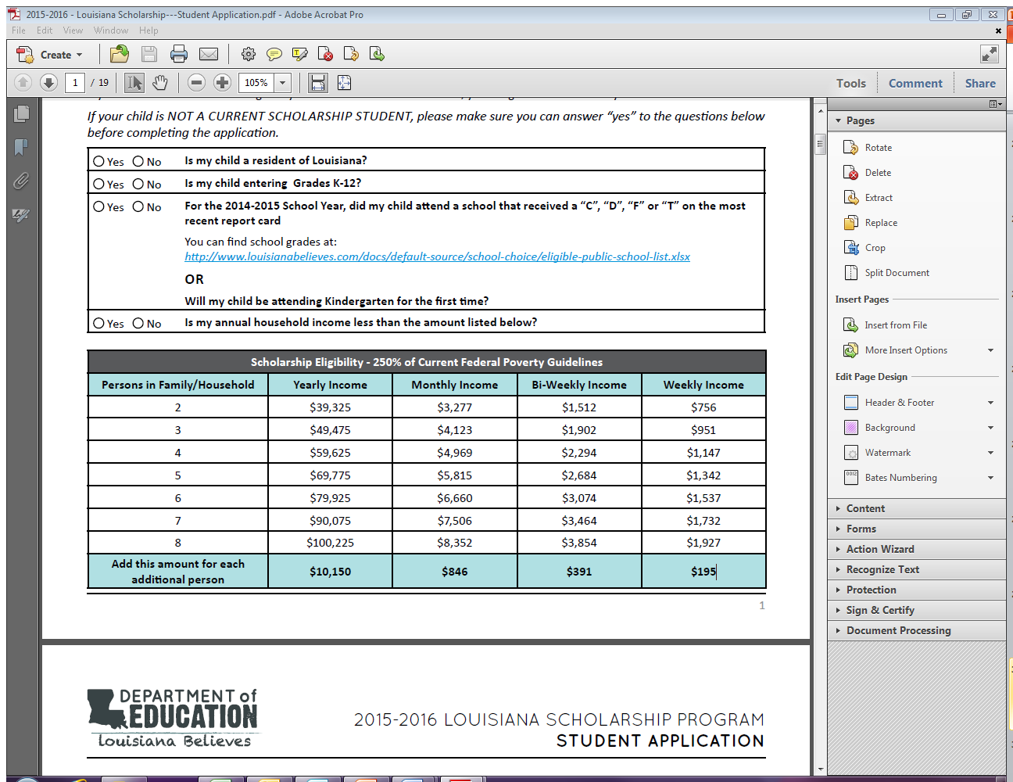
Income Eligibility
Family income cannot be greater than 250% of the current federal poverty guidelines as outlined in the chart below.
If a student participates in any one of these federal assistance programs, income requirement for the scholarship program is met and one of the following forms of documentation is required:
  Louisiana Purchase Card
  SNAP Benefits
  Social Security Benefits

Slide 31
Income Eligibility
If a student does not participate in a federal assistance program, one of the following documents is required:
  Federal Tax Return for the 2014 Calendar Year
  W-2s from All Employers for the Tax Period Ending December 31, 2014
  Unemployment Compensation Statement for the Period Ending on December 31, 2014
  Alimony as shown in Court Decree or Agreement
  Social Security Benefits Statement for the Period Ending on December 31, 2014
  Pension Statement for the Period Ending on December 31, 2014

Slide 32
Test 5: Special Education Tuition
A sample of eligible special education students will be selected to verify that the school is providing services to those students for which tuition was charged.
Documentation needed:
List of students for which special education tuition is being paid
Application and enrollment documentation for each participating student receiving special education services
Daily attendance roster
Service logs for the selected students must include:
  Name of student receiving services
  Date services are rendered
  Services rendered
  Name of service provider

Slide 33
Independent Financial Audit Procedures
In the event that the financial audit identifies a finding, payment adjustments will be made, schools will be required to reimburse the Department for the ineligible student(s), and schools may receive further sanctions.
In addition, ineligible students will lose their Scholarship and be ineligible to receive a new award because they have attended a nonpublic school and therefore, will not meet prior school eligibility requirements.

Slide 34
Consequences of Fiscal Irresponsibility
Schools that demonstrate fiscal irresponsibility by:
Failing to submit required documentation for the audit according to a timeline established and shared by the Department
Failing to comply with the aforementioned audit provisions, and/or
Failing to correct violation(s) of the rules may incur penalties. These penalties include:
  Being placed on probation for one year, during which time the school will not be allowed to enroll additional Scholarship students. Removal from probation will occur upon correction of the violation(s).
  Being declared ineligible to participate in the program

Slide 35
Audit Schedule
Audit Dates
  Tuition and Fees Verification and Income Eligibility - September through November 2015
  Use of Funds and Payment Accuracy Verification – February through March 2016
  Special Education Tuition – February through March 2016

Slide 36
Department Contacts
Louisiana Department of Education
1-877-453-2721
Division of Education Finance
(225) 342-4989
Jameka Henderson
State Audit Supervisor
Jameka.Henderson@la.gov
Office of Portfolio
1-877-453-2721
Corrie Manieri
Louisiana Scholarship Program, Director
Corrie.Manieri@la.gov
Louisiana Scholarship Program:
http://www.louisianabelieves.com/schools/louisiana-scholarship-program

Slide 37
Questions
Please address questions to the following email addresses:
Financial or Audit questions:
Staudit@la.gov
Program questions:
Studentscholarships@la.gov

