Slide 1
Tuition Donation Rebate Program
Enrollment 2016-17

Slide 2
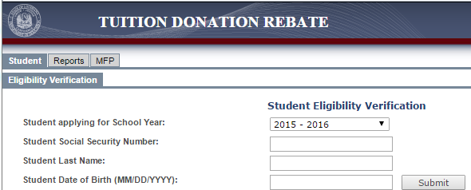
Prior School Eligibility Check
Currently, STOs can verify students’ prior school in the LEADS portal using Social Security #, student last name, and date of birth.
Starting 6/1, the system will require an LDE created Unique ID, last name, and date of birth to verify prior school eligibility.

Slide 3
Updated Prior School Eligibility Check
STO sends the completed TDR Unique ID Check Template to the LDE via the secure FTP site.
LDE researches students and will update the spreadsheet with relevant Unique IDs and return to the STO via the FTP within 1 week.
Applicants entering K for the 1st time will have a Unique ID created for them.
If the LDE is unable to locate a Unique ID:
the student has never been enrolled in a public school, in the LA Scholarship Program or in the Tuition Donation Rebate Program; or;
the parent supplied information does not match our records.
3) STO can now use the Unique ID, last name and DOB to verify prior school eligibility in the LEADS portal.

Slide 4
Preparing the Quarterly Enrollment Report
In order to prepare the quarterly enrollment report, please follow the instructions in the following slides and enter data into the TDR Quarterly Enrollment Template 16-17 STO provided file.
Instructions for the Student Information Section:

Slide 5
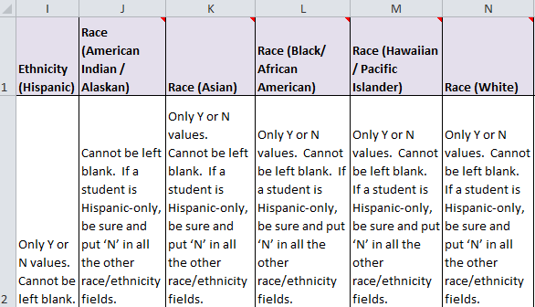
Preparing the Quarterly Enrollment Report
Instructions for the Student Ethnicity Section:

Slide 6
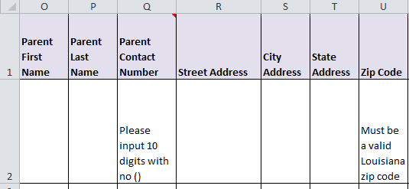
Preparing the Quarterly Enrollment Report
Instructions for the Parent Information Section:

Slide 7
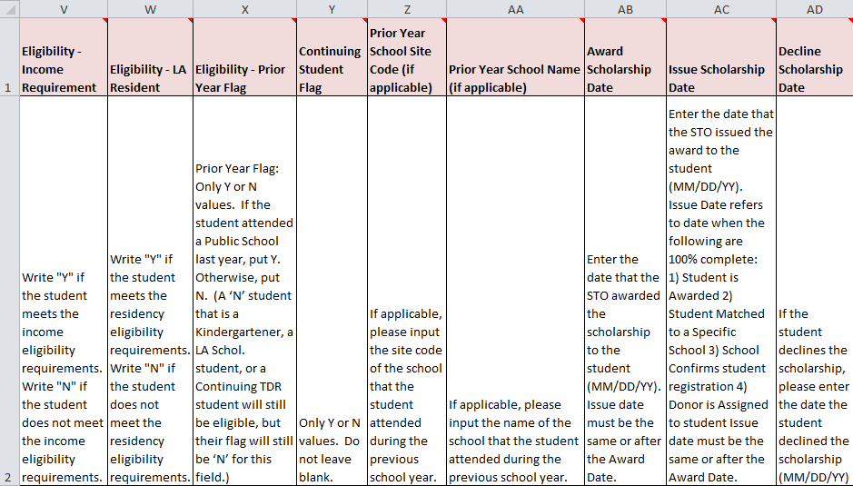
Preparing the Quarterly Enrollment Report
Instructions for the Eligibility Section:

Slide 8
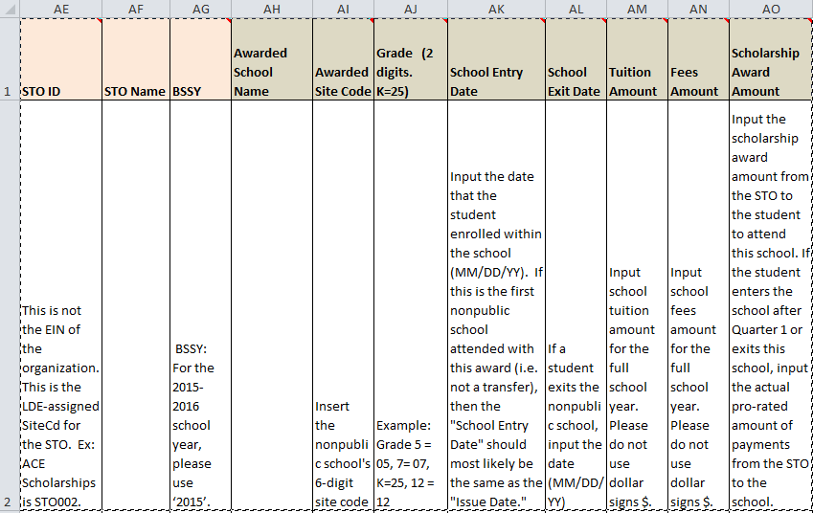
Preparing the Quarterly Enrollment Report
Instructions for the STO and School Information Sections:

Slide 9
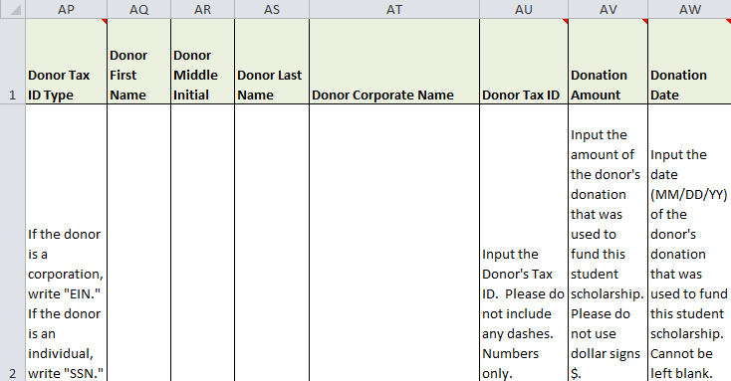
Preparing the Quarterly Enrollment Report
Instructions for the Donor Section:

Slide 10
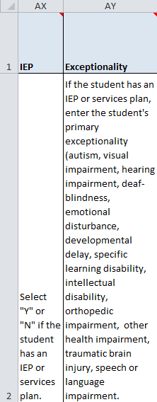
Preparing the Quarterly Enrollment Report
Instructions for the Exceptionality Section:

Slide 11
Accessing the LEADS Portal
STOs are no longer required to upload their enrollment reports to the FTP each month. The FTP is only being used to provide STOs Unique IDs for their applicants.
STOs now upload the quarterly enrollment report to the LEADS portal. Usernames and initial passwords are provided by the LDE.
Accessing the LEADS Portal:

Slide 12
Accessing the LEADS Portal
Please remember to turn off your pop-up blockers before accessing the LEADS portal. See below for instructions on turning off pop-up blockers for the most commonly used browsers.
If you continue to experience issues, please email diana.noble@la.gov.

Slide 13
Uploading the Quarterly Enrollment Report
In order to upload the report in the LEADS portal, the file must be formatted in a specific manner.
Enter all information into the TDR Quarterly Enrollment Template 16-17 STO
Save a copy of this file for your records in Excel format (.xls)
Save a copy of this file for the upload in CSV format (.csv)
a) Go to Save As
b) Under “Save as type” click CSV (Comma delimited) (*.csv)
The saved CSV file should be uploaded to the LEADS portal
Each quarter you should go back to the Excel file you saved for your records in Step 2 to make any updates for the current count date. This saved excel file will have all of the correct formatting features saved for your convenience.

Slide 14
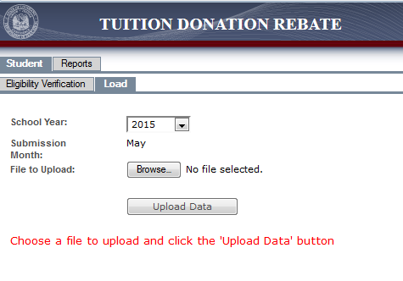
Uploading the Quarterly Enrollment Report
1) Select “Student” from the top row and “Load” from the second row
2) Select “2016” for the School Year
3) The Submission Month will always reflect the current month
4) Click “Browse” and select the CSV file you wish to upload (see slide 17)
5) Click “Upload Data”

Slide 15
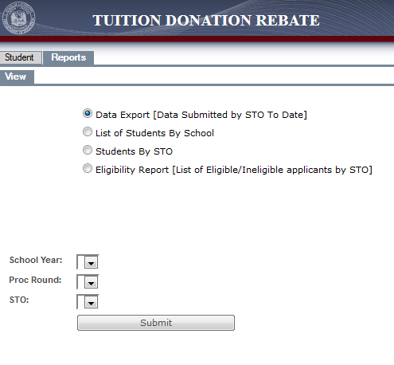
Available Reports in the LEADS Portal
There are 4 reports that STOs will be able to access in the LEADS portal:
Data Submitted by STO to Date
List of Students by School
List of Students by STO
List of eligible/ineligible applicants by STO

Slide 16
Available Resources
FTP Access
Access the FTP server here
Please contact olin.parker@la.gov to be set up with a username and password, if you have not previously received this information from the Department.
LEADS Portal
Link to the LEADS Portal: https://leads3.doe.louisiana.gov/ptl/
Please contact olin.parker@la.gov to be set up with a username and password, if you have not previously received this information from the Department.
Please visit https://password.doe.louisiana.gov/ soon after your first visit to the LEADS portal to create security questions in case you need to reset your password.
Passwords expire frequently and can be reset here: https://password.doe.louisiana.gov/
TDR Unique ID Check Template
To be emailed to all STOs
TDR Quarterly Enrollment Template 16-17 STO (.xls)
To be emailed to all STOs
Please note that all cells have been appropriately formatted for you and formatting should NOT be adjusted.

Slide 17
Questions?
Questions?
Contact: Olin Parker – olin.parker@LA.gov

