Slide 1
K-3 Numeracy Screener: GRADE 1
BOY Remote Administration - Teacher-Led Session
Fall 2026

Slide 2
Prior to reading the remote screening agreement, please ensure video and audio are working and the session is being recorded. To ensure reliability of the K-3 Numeracy Screener remote administration, the following expectations must be read aloud by the test administrator and verbally acknowledged by the parent/guardian and student. If the parent/guardian and/or student refuses to agree or breaks one of the following requirements then remote testing shall not begin or must be stopped immediately and on-site testing will be required. Personnel from school districts and/or the LDOE may monitor this screening session.
Parents/Guardians
May assist with providing a quiet work space with limited distractions.
May ensure the student is following along in the correct section.
May not prompt or solicit a response from the student.
May not disclose screening materials to the student prior to their testing session.
May not show the answer key to the student at any time.
Webcams and audio must stay on the entire testing session with the student in view.
Student
May not ask a parent or guardian for assistance with answering the screening items.
May not review test materials prior to screening.
May not review the answer key at any time prior to screening.
Should follow the directions from the test administrator for each subtest and answer to the best of their ability.
Webcams and audio must stay on the entire testing session with the student in view.

Slide 3
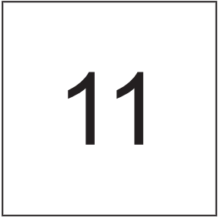
Notes:
Answer Key Item Number : 1
TA Directions
TA says, "What number is this?"
Record Student Response

Slide 4

Notes:
Answer Key Item Number : 2
TA Directions
TA says, "What number is this?"
Record Student Response

Slide 5

Notes:
Answer Key Item Number : 3
TA Directions
TA says, "What number is this?"
Record Student Response

Slide 6
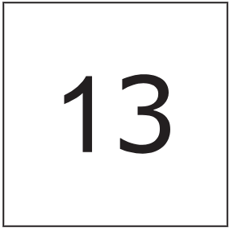
Notes:
Answer Key Item Number : 4
TA Directions
TA says, "What number is this?"
Record Student Response

Slide 7

Notes:
Answer Key Item Number : 5
TA Directions
TA says, “Starting with the number eighty, count forward by ones. I will tell you when to stop. Go!”
TA will start the 30 second timer in Student Portal.
When the red “Time is up!” button appears, TA says, “STOP!”
Record Student Response
Scoring Note: If a student does not respond with a numerical value, enter “0” for both boxes and check “No Response”.

Slide 8

Notes:
Answer Key Item Number : 6
TA Directions
TA says, “Starting with the number twenty, count backward by ones. I will tell you when to stop. Go!”
TA will start the 30 second timer in Student Portal.
When the red “Time is up!” button appears, TA says, “STOP!”
Record Student Response
Scoring Note: If a student does not respond with a numerical value, enter “0” for both boxes and check “No Response”.

Slide 9

Notes:
TA Directions
TA says, “Look at the screen. Dots will appear on the screen. The dots will disappear. I will then ask you, ‘How many dots did you see?’”
TA says, “Are you ready?”
TA says, “Look at the screen.”
Click Next.

Slide 10

Notes:
Answer Key Item Number : 7
TA Directions
At the end of 2 seconds, Click Next to advance this slide.

Slide 11
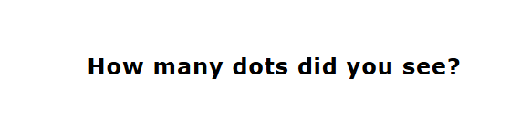
Notes:
TA Directions
After the dots disappear on the screen, TA says, “How many dots did you see?”
Record Student Response

Slide 12
Notes:
TA Directions
TA says, “Dots will appear on the screen. I will ask you the total number of dots.”
TA says, “Are you ready?”
TA says, “Look at the screen.”
Click Next.

Slide 13
Notes:
Answer Key Item Number : 8
TA Directions
At the end of 2 seconds, Click Next to advance this slide.

Slide 14
Notes:
TA Directions
After the dots disappear on the screen, TA says, “How many dots did you see?”
Record Student Response

Slide 15

Notes:
Answer Key Item Number : 9
TA Directions
TA says, “Look at this number. Which group shows this many dots? A or B?”
Record Student Response

Slide 16

Notes:
Answer Key Item Number : 10
TA Directions
TA says, “Which group has more? A or B?”
Record Student Response

Slide 17

Notes:
Answer Key Item Number : 11
TA Directions
TA says, “Which group has more? A or B?”
Record Student Response

Slide 18

Notes:
Answer Key Item Number : 12
TA Directions
TA says, “Starting with the number ten, count forward by tens. I will tell you when to stop. Go!”
TA will start the 30 second timer in Student Portal.
When the red “Time is up!” button appears, TA says, “STOP!”
Record Student Response
Scoring Note: If a student does not respond with a numerical value, enter “0” for both boxes and check “No Response”.

Slide 19
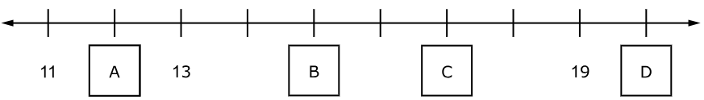
Notes:
Answer Key Item Number : 13
TA Directions
TA says, “Which letter on the number line represents seventeen? A, B, C, or D?”
Record Student Response

Slide 20
Notes:
Answer Key Item Number : 14
TA Directions
TA says, “Count to complete the pattern. Starting with the number zero.”
Record Student Response

Slide 21

Notes:
Answer Key Item Number : 15
TA Directions
TA says, “Solve the equation.”
Record Student Response
Scoring Note: If a student does not respond with a numerical value, enter “0”.

Slide 22

Notes:
Answer Key Item Number : 16
TA Directions
TA says, “Solve the equation.”
Record Student Response
Scoring Note: If a student does not respond with a numerical value, enter “0”.

Slide 23

Notes:
Answer Key Item Number : 17
TA Directions
TA says, “Solve the equation.”
Record Student Response
Scoring Note: If a student does not respond with a numerical value, enter “0”.

Slide 24

Notes:
Answer Key Item Number : 18
TA Directions
TA says, “Solve the equation.”
Record Student Response
Scoring Note: If a student does not respond with a numerical value, enter “0”.

Slide 25

Notes:
Answer Key Item Number : 19
TA Directions
TA says, “Put these numbers in order from smallest to largest. Tell me your answer?”
Record Student Response
Scoring Note: If a student does not respond with a numerical value, enter “0”.

Slide 26

Notes:
Answer Key Item Number : 20
TA Directions
TA says, “Put these numbers in order from smallest to largest.”
Record Student Response
Scoring Note: If a student does not respond with a numerical value, enter “0”.

Slide 27
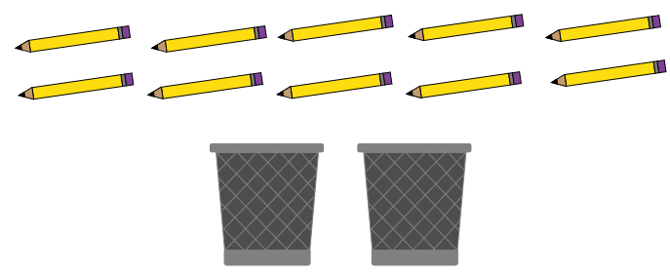
Notes:
Answer Key Item Number : 21
TA Directions
TA says, “Using two numbers, what is one way Lin could put all ten pencil into the two cups?”
Record Student Response
Scoring Note: If a student does not respond with a numerical value, enter “0” for both boxes.

Slide 28
Notes:
Answer Key Item Number : 22
TA Directions
TA says, “Using two different numbers, what is another way Lin could put all ten pencil into the two cups?”
Record Student Response
Scoring Note: If a student does not respond with a numerical value, enter “0” for both boxes.

Slide 29
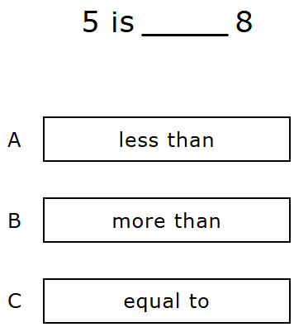
Notes:
Answer Key Item Number : 23
TA Directions
TA says, “Five is [A less than, B more than, C equal to] eight. Which statement makes the comparison true? A, B, or C?”
Record Student Response

Slide 30
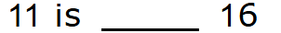
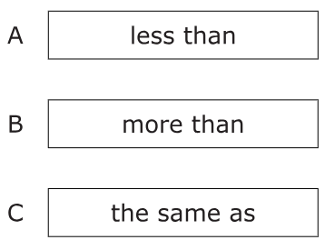
Notes:
Answer Key Item Number : 24
TA Directions
TA says, “Eleven is [A less than, B more than, C the same as] sixteen. Which statement makes the comparison true? A, B, or C?”
Record Student Response

Slide 31

Notes:
Answer Key Item Number : 25
TA Directions
TA says, "How many more are needed to make ten?"
Record Student Response
Scoring Note: If a student does not respond with a numerical value, enter “0”.

Slide 32

Notes:
Answer Key Item Number : 26
TA Directions
TA says, "How many more are needed to make ten?"
Record Student Response
Scoring Note: If a student does not respond with a numerical value, enter “0”.

Slide 33
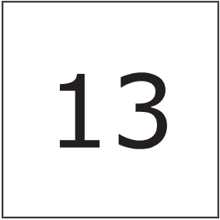
Notes:
Answer Key Item Number : 27
TA Directions
TA says, "What is one less than thirteen?"
Record Student Response
Scoring Note: If a student does not respond with a numerical value, enter “0”.

Slide 34

Notes:
Answer Key Item Number : 28
TA Directions
TA says, “Fill in the blank. Two more than eight is ______ .”
Record Student Response

Slide 35
Notes:
Answer Key Item Number : 29
TA Directions
TA says, “Fill in the blank. Six fewer than ten is ______ .”
Record Student Response

Slide 36
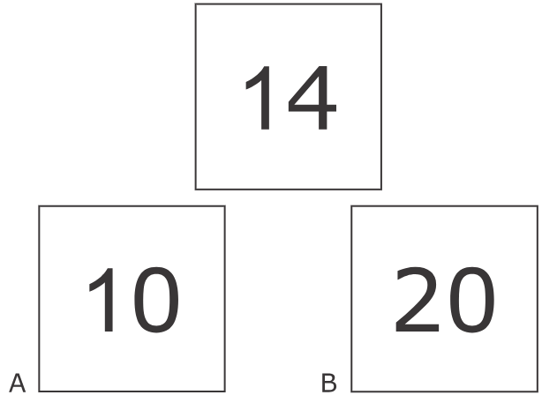
Notes:
Answer Key Item Number : 30
TA Directions
TA says, “This is the number fourteen. Is fourteen closer to A ten or B twenty?”
Record Student Response

Slide 37
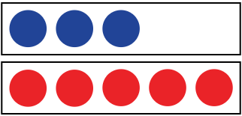
Notes:
Answer Key Item Number : 31
TA Directions
TA says, “How many more blue dots are needed to make the same number of red dots?”
Record Student Response

Slide 38

Notes:
Answer Key Item Number : 32
TA Directions
TA says, “How many more red dots are there than blue dots?”
Record Student Response

Slide 39
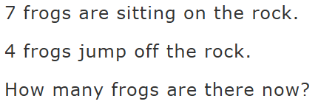
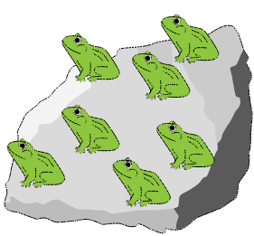
Notes:
Answer Key Item Number : 33
TA Directions
TA says, “Seven frogs are sitting on the rock. Four frogs jump off the rock. How many frogs are there now?”
Record Student Response
Scoring Note: If a student does not respond with a numerical value, enter “0”.

Slide 40
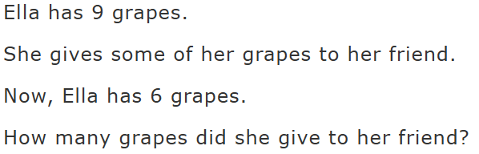
Notes:
Answer Key Item Number : 34
TA Directions
TA says, “Ella has nine grapes. She gives some of her grapes to her friend. Now, Ella has six grapes. How many grapes did she give to her friend?”
Record Student Response
Scoring Note: If a student does not respond with a numerical value, enter “0”.

