Slide 1
K-3 Numeracy Screener: GRADE 2
BOY Remote Administration - Student Led Session
Fall 2026

Slide 2
Prior to reading the remote screening agreement, please ensure video and audio are working and the session is being recorded. To ensure reliability of the K-3 Numeracy Screener remote administration, the following expectations must be read aloud by the test administrator and verbally acknowledged by the parent/guardian and student. If the parent/guardian and/or student refuses to agree or breaks one of the following requirements then remote testing shall not begin or must be stopped immediately and on-site testing will be required. Personnel from school districts and/or the LDOE may monitor this screening session.
Parents/Guardians
May assist with providing a quiet work space with limited distractions.
May ensure the student is following along in the correct section.
May not prompt or solicit a response from the student.
May not disclose screening materials to the student prior to their testing session.
May not show the answer key to the student at any time.
Webcams and audio must stay on the entire testing session with the student in view.
Student
May not ask a parent or guardian for assistance with answering the screening items.
May not review test materials prior to screening.
May not review the answer key at any time prior to screening.
Should follow the directions from the test administrator for each subtest and answer to the best of their ability.
Webcams and audio must stay on the entire testing session with the student in view.

Slide 3
Additional Directions for Administration Grade 2 and Grade 3 Student Sessions
A script has been provided for Test Administrators when administering the Remote Test Student Sessions. These sessions were designed for Grade 2 and Grade 3 students to respond independently. Due to this, Human Reader Directions should only be used for students who receive Human Reader/Text-to-Speech (TTS) accommodations. Otherwise, the script on the next page will give students the directions for this portion of the screener. Record the student’s response for each question in the student portal and then flip to the next slide.
Test Administrators must have the Student Portal Student Session screen open while administering the student session to record student responses.
Human Reader Directions
The Human Reader Directions should ONLY be provided to students who receive Human Reader/Text-to-Speech (TTS) Accommodations.
The Human Reader Directions are provided in the note section below each powerpoint slide.

Slide 4
Directions
Read each question carefully.
To answer test questions, you may have to click on an answer or type in a response box. Some response boxes require you to use the virtual keyboard that will appear when clicking in the short answer box.
There are online tools available as you move through the test session. For example, you can use the Flag button to mark any question you want to return to, the Next and Back buttons to move from question to question, and the Review/End Test button to review your answers. If you have questions about any of the online tools, ask your test administrator for assistance.
When you have completed the test session, follow the directions on the screen to submit the test session. Keep in mind that once you submit the test session, you cannot go back into the test session.
Do not begin the test session until you are instructed to do so by the Test Administrator. Please raise your hand if you have any questions about these directions.
Notes:
TA Directions: TA reads these directions to the student prior to beginning the Student-led Session.

Slide 5
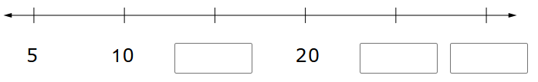
Notes:
Human Reader Directions
TA says, "Complete the pattern. Enter your answers in each box.”
Record Student Response

Slide 6


Notes:
Human Reader Directions
TA says, "Put the numbers in order from least to greatest.”
Record Student Response

Slide 7
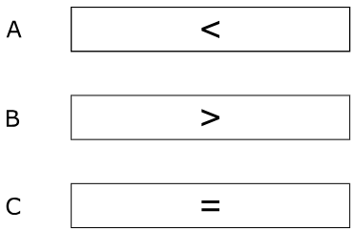
Notes:
Human Reader Directions
TA says, "Which symbol makes the comparison true? A, B, C.”
Record Student Response

Slide 8
Notes:
Human Reader Directions
TA says, "Which symbol makes the comparison true? A, B, C.”
Record Student Response

Slide 9
Notes:
Human Reader Directions
TA says, "Which symbol makes the comparison true? A, B, C.”
Record Student Response

Slide 10
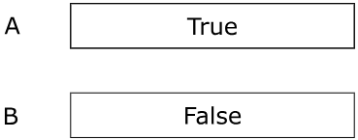
Notes:
Human Reader Directions
TA says, "Is the equation True or False? A True, B False.”
Record Student Response

Slide 11

Notes:
Human Reader Directions
TA says, "Place a point on the number line to represent 58. From left to right the number line is labeled fifty, sixty.”
Record Student Response

Slide 12


Notes:
Human Reader Directions
TA says, "What is the value of the underlined digit? Enter your answer in the box.”
Record Student Response

Slide 13

Notes:
Human Reader Directions
TA says, "How many groups of ten are in the number sixty-eight? Enter your answer in the box.”
Record Student Response

Slide 14

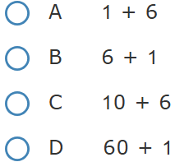
Notes:
Human Reader Directions
TA says, "Which expression represents the number below? A, B, C, D”
Record Student Response

Slide 15

Notes:
Human Reader Directions
TA says, "Solve the equation. Enter your answer in the box.”
Record Student Response

Slide 16

Notes:
Human Reader Directions
TA says, "Solve the equation. Enter your answer in the box.”
Record Student Response

Slide 17

Notes:
Human Reader Directions
TA says, "Solve the equation. Enter your answer in the box.”
Record Student Response

Slide 18


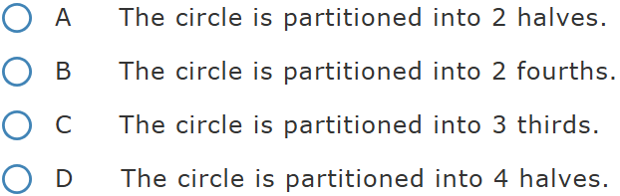
Notes:
Human Reader Directions
TA says, "The circle is partitioned into equal parts.”
TA says, “Part A. Which statement about the circle is true? A The circle is partitioned into two halves. B The circle is partitioned into two fourths. C The circle is partitioned into three thirds. D The circle is partitioned into four halves.”
Record Student Response

Slide 19
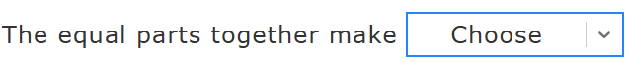
one whole.
two wholes.
one half.
Notes:
Human Reader Directions
TA says, "The circle is partitioned into equal parts.
TA says, “Part B. There is one drop down menu to complete a sentence. The equal parts together make [one whole, two wholes, one half.]”
Record Student Response

Slide 20
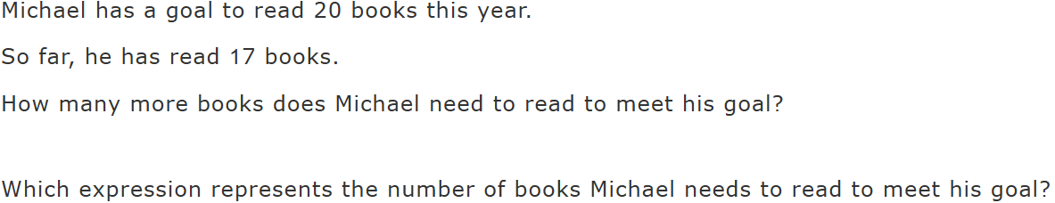
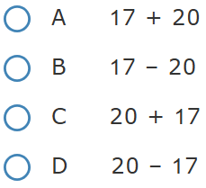
Notes:
Human Reader Directions
TA says, "Michael has a goal to read twenty books this year. So far, he has read seventeen books. How many more books does Michael need to read to meet his goal? Which expression represents the number of books Michael needs to read to meet his goal? A, B, C, D.”
Record Student Response

Slide 21
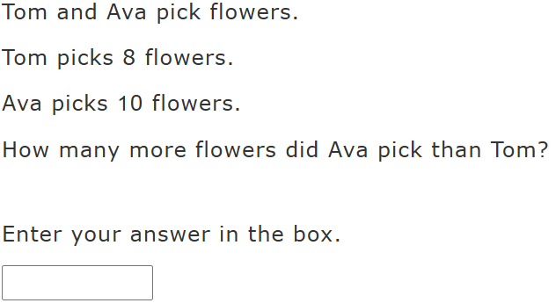
Notes:
Human Reader Directions
TA says, "Tom and Ava pick flowers. Tom picks eight flower. Ava picks ten flowers. How many more flowers did Ava pick than Tom? Enter your answer in the box.”
Record Student Response

