Slide 1
K-3 Numeracy Screener: GRADE 3
BOY Remote Administration - Student-Led Session
Fall 2026

Slide 2
Prior to reading the remote screening agreement, please ensure video and audio are working and the session is being recorded. To ensure reliability of the K-3 Numeracy Screener remote administration, the following expectations must be read aloud by the test administrator and verbally acknowledged by the parent/guardian and student. If the parent/guardian and/or student refuses to agree or breaks one of the following requirements then remote testing shall not begin or must be stopped immediately and on-site testing will be required. Personnel from school districts and/or the LDOE may monitor this screening session.
Parents/Guardians
May assist with providing a quiet work space with limited distractions.
May ensure the student is following along in the correct section.
May not prompt or solicit a response from the student.
May not disclose screening materials to the student prior to their testing session.
May not show the answer key to the student at any time.
Webcams and audio must stay on the entire testing session with the student in view.
Student
May not ask a parent or guardian for assistance with answering the screening items.
May not review test materials prior to screening.
May not review the answer key at any time prior to screening.
Should follow the directions from the test administrator for each subtest and answer to the best of their ability.
Webcams and audio must stay on the entire testing session with the student in view.

Slide 3
Additional Directions for Administration Grade 2 and Grade 3 Student Sessions
A script has been provided for Test Administrators when administering the Remote Test Student Sessions. These sessions were designed for Grade 2 and Grade 3 students to respond independently. Due to this, Human Reader Directions should only be used for students who receive Human Reader/Text-to-Speech (TTS) accommodations. Otherwise, the script on the next page will give students the directions for this portion of the screener. Record the student’s response for each question in the student portal and then flip to the next slide.
Test Administrators must have the Student Portal Student Session screen open while administering the student session to record student responses.
Human Reader Directions
The Human Reader Directions should ONLY be provided to students who receive Human Reader/Text-to-Speech (TTS) Accommodations.
The Human Reader Directions are provided in the note section below each powerpoint slide.

Slide 4
Directions
Read each question carefully.
To answer test questions, you may have to click on an answer or type in a response box. Some response boxes require you to use the virtual keyboard that will appear when clicking in the short answer box.
There are online tools available as you move through the test session. For example, you can use the Flag button to mark any question you want to return to, the Next and Back buttons to move from question to question, and the Review/End Test button to review your answers. If you have questions about any of the online tools, ask your test administrator for assistance.
When you have completed the test session, follow the directions on the screen to submit the test session. Keep in mind that once you submit the test session, you cannot go back into the test session.
Do not begin the test session until you are instructed to do so by the Test Administrator. Please raise your hand if you have any questions about these directions.
Notes:
TA Directions: TA reads these directions to the student prior to beginning the Student-led Session.

Slide 5


Notes:
Answer Key Item Number : 1
Human Reader Directions
TA says, "What is the value of the underlined digit? Enter your answer in the box.”
Record Student Response

Slide 6

Notes:
Answer Key Item Number : 2
Human Reader Directions
TA says, "Show the number below in expanded form. Enter your answer in the box.”
Record Student Response

Slide 7
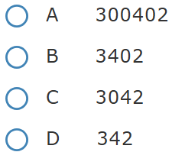
Notes:
Answer Key Item Number : 3
Human Reader Directions
TA says, "Which number is equivalent to three hundred plus forty plus two? A, B, C, D.”
Record Student Response

Slide 8
Notes:
Answer Key Item Number : 4
Human Reader Directions
TA says, "Plot a point at thirty-seven and fifty-four on the number line. The number line ranges from thirty-five to fifty-five in increments of one.”
Record Student Response

Slide 9

Notes:
Answer Key Item Number : 5
Human Reader Directions
TA says, "Place a point on the number line to show the number that is twenty-three more than forty-two. The number line ranges from twenty to seventy in increments of ten. A point is shown on the number line. ”
Record Student Response

Slide 10
Notes:
Answer Key Item Number : 6
Human Reader Directions
TA says, "Two points are shown on the number line. What is the distance between the two points? The number line ranges from one to twenty in increments of one. Two points are shown on the number line. Enter your answer in the box.”
Record Student Response

Slide 11
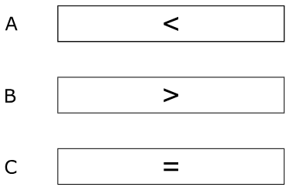
Notes:
Answer Key Item Number : 7
Human Reader Directions
TA says, "Which symbol makes the comparison true? A, B, C.”
Record Student Response

Slide 12

Notes:
Answer Key Item Number : 8
Human Reader Directions
TA says, "Solve the equation. Enter your answer in the box.”
Record Student Response

Slide 13

Notes:
Answer Key Item Number : 9
Human Reader Directions
TA says, "Solve the equation. Enter your answer in the box.”
Record Student Response

Slide 14
Notes:
Answer Key Item Number : 10
Human Reader Directions
TA says, "Solve the equation. Enter your answer in the box.”
Record Student Response

Slide 15

Notes:
Answer Key Item Number : 11
Human Reader Directions
TA says, "Solve the equation. Enter your answer in the box.”
Record Student Response

Slide 16
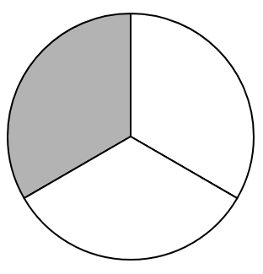
One-half
One-third
Two-thirds
Three-thirds
Notes:
Answer Key Item Number : 12
Human Reader Directions
TA says, "There is one drop down menu to complete a sentence. [one-half, one-third, two-thirds, three-thirds] of the circle is shaded.]”
Record Student Response

Slide 17



Notes:
Answer Key Item Number : 13
Human Reader Directions
TA says, "Use the array below to answer parts A through D. Enter your answers in each box.”
TA says, “Part A. What is the total number of dots in the array?”
Record Student Response

Slide 18
even
odd
Notes:
Answer Key Item Number : 14
Human Reader Directions
TA says, "Use the array below to answer parts A through D. Enter your answers in each box.”
TA says, “Part B. There is one drop down menu to complete a sentence. The total number of dots in the array is even, odd?”
Record Student Response

Slide 19
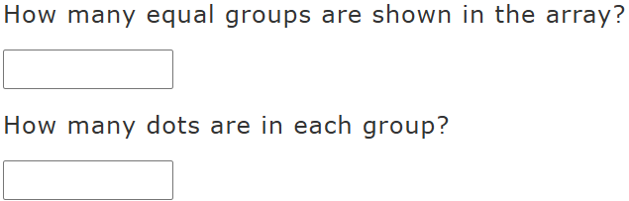
Notes:
Answer Key Item Number : 15
Human Reader Directions
TA says, "Use the array below to answer parts A through D. Enter your answers in each box.”
TA says, “Part C. How many equal groups are shown in the array? How many dots are in each group?”
Record Student Response

Slide 20
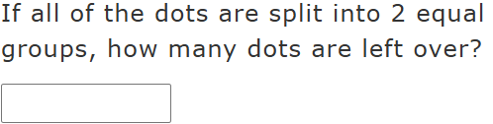
Notes:
Answer Key Item Number : 16
Human Reader Directions
TA says, "Use the array below to answer parts a through d. Enter your answers in each box.”
TA says, “Part D. If all of the dots are split into two equal groups, how many dots are left over?”
Record Student Response

Slide 21

Notes:
Answer Key Item Number : 17
Human Reader Directions
TA says, "The array shows four groups of six dots. Write an expression that represents the array. Enter your answer in the box.”
Record Student Response

Slide 22
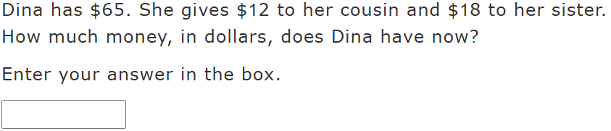
Notes:
Answer Key Item Number : 18
Human Reader Directions
TA says, "Dina has sixty-five dollars. She gives twelve dollars to her cousin and eighteen dollars to her sister. How much money, in dollars, does Dina have now? Enter your answer in the box.”
Record Student Response

Slide 23
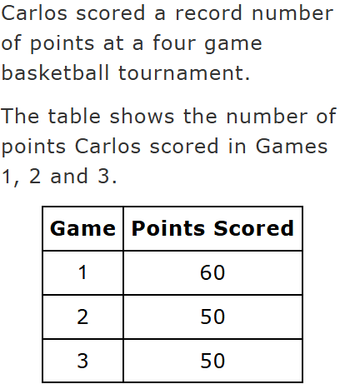
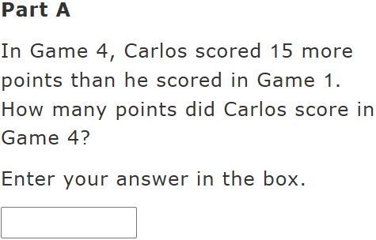
Notes:
Answer Key Item Number : 19
Human Reader Directions
TA says, "Carlos scored a record number of points at a four game basketball tournament. The table shows the number of points Carlos scored in Games one, two, and three. There are two columns and three rows. Moving top to bottom, left to right, game, points scored, game one, sixty points, game two, fifty points, game three, fifty points.”
TA says, “Part A. In Game four, Carlos scored fifteen more points than he scored in game one. How many points did carlos score in game four? Enter your answer in the box.”
Record Student Response

Slide 24
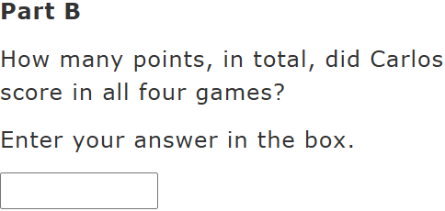
Notes:
Answer Key Item Number : 20
Human Reader Directions
TA says, "Carlos scored a record number of points at a four game basketball tournament. The table shows the number of points Carlos scored in Games one, two, and three. There are two columns and three rows. Moving top to bottom, left to right, game, points scored, game one, sixty points, game two, fifty points, game three, fifty points.”
TA says, “Part B. How many points, in total, did Carlos score in all four games? Enter your answer in the box.”
Record Student Response

