Slide 1
K-3 Numeracy Screener: GRADE 3
BOY Remote Administration - Teacher-Led Session
Fall 2026

Slide 2
Prior to reading the remote screening agreement, please ensure video and audio are working and the session is being recorded. To ensure reliability of the K-3 Numeracy Screener remote administration, the following expectations must be read aloud by the test administrator and verbally acknowledged by the parent/guardian and student. If the parent/guardian and/or student refuses to agree or breaks one of the following requirements then remote testing shall not begin or must be stopped immediately and on-site testing will be required. Personnel from school districts and/or the LDOE may monitor this screening session.
Parents/Guardians
May assist with providing a quiet work space with limited distractions.
May ensure the student is following along in the correct section.
May not prompt or solicit a response from the student.
May not disclose screening materials to the student prior to their testing session.
May not show the answer key to the student at any time.
Webcams and audio must stay on the entire testing session with the student in view.
Student
May not ask a parent or guardian for assistance with answering the screening items.
May not review test materials prior to screening.
May not review the answer key at any time prior to screening.
Should follow the directions from the test administrator for each subtest and answer to the best of their ability.
Webcams and audio must stay on the entire testing session with the student in view.

Slide 3

Notes:
Answer Key Item Number : 1
TA Directions
TA says, “What is ten more than this number?”
Record Student Response

Slide 4

Notes:
Answer Key Item Number : 2
TA Directions
TA says, “What is ten less than this number?”
Record Student Response

Slide 5

Notes:
Answer Key Item Number : 3
TA Directions
TA says, "What is one hundred more than this number?"
Record Student Response

Slide 6

Notes:
Answer Key Item Number : 4
TA Directions
TA says, "What is one hundred less than this number?"
Record Student Response

Slide 7
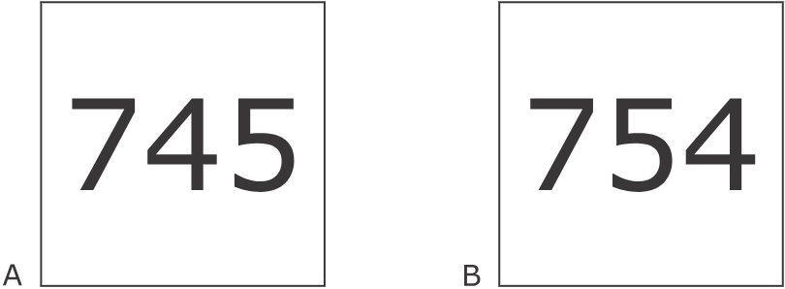
Notes:
Answer Key Item Number : 5
TA Directions
TA says, “Which group is greater? A or B?”
Record Student Response

Slide 8
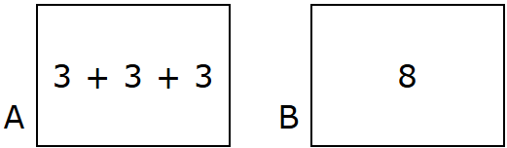
Notes:
Answer Key Item Number : 6
TA Directions
TA says, "Which group is greater? A or B?"
Record Student Response

Slide 9
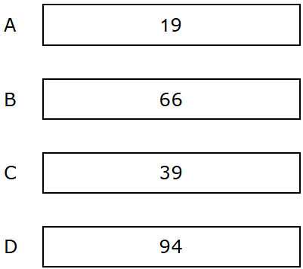
Notes:
Answer Key Item Number : 7
TA Directions
TA says, "Which two numbers are odd? A, B, C, or D?"
Record Student Response
Scoring Note: If a student provides only one answer choice, mark the answer choice that matches the student response. Only select “No Response/Inaccurate Response” if the student does not provide A, B, C, or D.

Slide 10
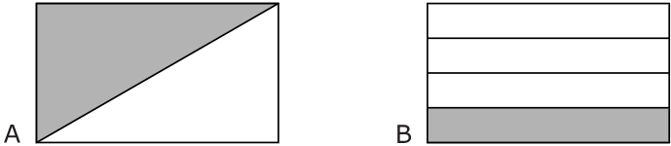
Notes:
Answer Key Item Number : 8
TA Directions
TA says, “Which shape shows one-half shaded? A or B?”
Record Student Response

Slide 11
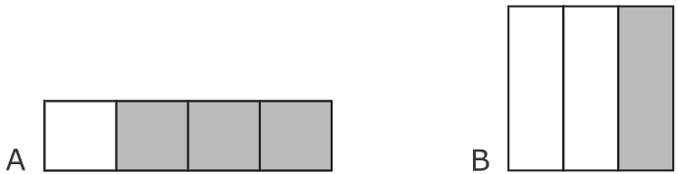
Notes:
Answer Key Item Number : 9
TA Directions
TA says, “Which shape shows one-third shaded? A or B?”
Record Student Response

Slide 12

Notes:
Answer Key Item Number : 10
TA Directions
TA says, “Solve the equation.”
Record Student Response
Scoring Note: If a student does not respond with a numerical value, enter “0”.

Slide 13

Notes:
Answer Key Item Number : 11
TA Directions
TA says, “Solve the equation.”
Record Student Response
Scoring Note: If a student does not respond with a numerical value, enter “0”.

Slide 14

Notes:
Answer Key Item Number : 12
TA Directions
TA says, “Solve the equation.”
Record Student Response
Scoring Note: If a student does not respond with a numerical value, enter “0”.

Slide 15

Notes:
Answer Key Item Number : 13
TA Directions
TA says, “Solve the equation.”
Record Student Response
Scoring Note: If a student does not respond with a numerical value, enter “0”.

Slide 16

Notes:
Answer Key Item Number : 14
TA Directions
TA says, “Solve the equation.”
Record Student Response
Scoring Note: If a student does not respond with a numerical value, enter “0”.

