Slide 1
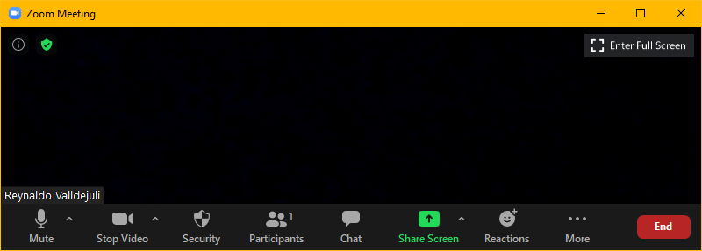
Zoom Meeting Preparation
Please make sure your phone or computer is muted to minimize background noise.
  To do this, hover over the bottom left-hand side of your screen and click “Mute.”
Please make sure you have turned off your camera to save bandwidth and prevent any connectivity issues.
  To do this, hover over the bottom left-hand side of your screen and click “Stop Video.”
Please submit questions during the presentation in the “Chat” function located on the bottom of your screen.
NOTICE: In accordance with the Americans with Disabilities Act, if you need special assistance at this meeting please contact ldoecommunications@la.gov.

Slide 2
AAA: K-Literacy Screening
Fall DIBELS 8th Edition
Test Security
August 2, 2023

Slide 3
Purpose of This PowerPoint
This PowerPoint is provided to support the test security training that is required for the DIBELS 8th Edition that was selected as the statewide screener for the fall of 2023. The test coordinator manual (TCM) was designed to be used for test administration and test security training, and this PowerPoint should not replace the training on the TCM.
Use of this PPT is not required if the TCM is being used for training.

Slide 4
Overview

Slide 5
K-3 Literacy Screening Requirement
Louisiana law requires that all students in grades K through 3 participate in the administration of a single, statewide literacy screener. Until the department is permitted to enter into a contract with one of three vendors who submitted proposals, the DIBELS 8th Edition has been selected as the single, statewide screener for all students, including all students with disabilities and English learners. School systems who use mCLASS online may do so for the fall since the screener is completely aligned to the DIBELS 8th.
To have valid and reliable results, all administrative directions, as provided in the Dibels 8th Edition Administration and_Scoring_Guide_2023 prepared by the University of Oregon, must be followed.

Slide 6
DIBELS 8th Edition
The DIBELS 8th Edition is a free literacy screening developed by the University of Oregon.
The screening consists of a series of short subtests that provide information about reading fluency. Three uses listed in the administration guide include:
  Identifying students who may be at risk of reading difficulties by screening up to three times per year
  Documenting students’ progress of reading skills as a consequence of special intervention programs through progress monitoring, and to
  Providing minimum levels of performance for all students to be considered on track for becoming a reader through benchmark goals and timelines.
By combining the performance on the short subtests, teachers can calculate a composite score that can be used to monitor progress over time.

Slide 7
Document Security

Slide 8
DIBELS 8th Document Security
The DIBELS 8th literacy screener being used in the fall is not a secure document. It is widely available and used across the nation. The Louisiana Department of Education does not require it to be stored and kept secure throughout screening as is required during LEAP administrations.
However, the department does require that students not be provided access to screener contents in advance of the screening administration. If the screener is being administered remotely, parents may not share the screener in advance.

Slide 9
Spring Secure Document
In the spring, the department plans to administer a secure Louisiana-specific screener that will be considered a secure document.

Slide 10
Completed Screening Results
As with other documents that include the results for a student who is identified by name on the document, schools should be cautious about how results are shared. Results for students with less than 10 in a group should not be shared publicly.

Slide 11
Secure Administrations

Slide 12
DIBELS 8th Test Administration Security
The DIBELS screening requires uniform administration protocols in order to ensure valid and reliable measures that can be compared across groups and over years.
Subtests are timed and no student should have additional time except for a small group of students who qualify for extended time (defined as double time for the Louisiana administration.)
Administration requires training, and there are a number of modules available on the website: https://dibels.uoregon.edu/materials/dibels
As with all valid and reliable assessments, test administrator assistance is limited to what is allowed in the administration guide.
Test administration should not be changed to offer any student an unfair advantage over other students.

Slide 13
Test Security
It shall be a violation of test security for any person to do any of the following:
administer tests in a manner that is inconsistent with the administrative instructions provided by the LDE that would give examinees an unfair advantage or disadvantage
give examinees access to test questions prior to testing
coach examinees in any manner during testing or alter or interfere with examinees' responses in any manner
provide answers to students in any manner during the test, including provision of cues, clues, hints, and/or actual answers in any form: written, printed, verbal or nonverbal
fail to report irregularities

Slide 14
Allowable Testing Processes
Unlike LEAP, the free DIBELS 8th can and will need to be copied.
Teachers can review the items on the screener.

Slide 15
Extended Time
For the administration of the DIBELS 8th free version, extended time is defined as double the time that is prescribed. For example, if all students must complete the subtest in 1 minute, extended time allows for 2 minutes. The screener sections should be strictly timed. Extended time is only available for the following students:
English learners as identified in EdLink 360 enrollment
Students with fluency-based speech disorders documented on IEPs
Students assessed with alternative rubrics (significant cognitive disabilities)
Students with limited verbal language skills, as documented on the IEP, that are not participating in an alternate assessment
Students who require braille
PLEASE REFER ALL ACCOMMODATIONS QUESTIONS TO THE SPECIAL EDUCATION OFFICE.

Slide 16
Oaths of Security
The test coordinator manual includes oaths for the school test coordinator and the test administrators. Oaths must be signed before and after administrations. All oaths should be kept on file and available for review in the event of an audit or investigation.

Slide 17
Testing Irregularities
Testing irregularities should be reported to the department: assessment@la.gov.
Screening was interrupted and required an extended pause.
Screening had to be restarted or redelivered.
Screening was not administered according to the administrative directions provided in the test coordinator manual and/or the Dibels 8th Edition Administration and_Scoring_Guide_2023.

Slide 18
Remote Administration
For fall, the department is allowing remote administration. Prior to screening, the test administrator MUST review the requirements on the following slides. If the parent or student does not agree or fails to comply, then remote administration must be stopped and in-person screening will be required.

Slide 19
Remote Administration: Parent Requirements
Parents/Guardians
May assist with providing a quiet work space with limited distractions.
May ensure the student is following along in the correct section.
May not prompt or solicit a response from the student.
May not disclose screening materials to the student prior to their testing session.
May not show the answer key to the student at any time.
Webcams and audio must stay on the entire testing session with the student in view.

Slide 20
Remote Administration: Student Requirements
Student
May not ask a parent or guardian for assistance with answering the screening items.
May not review test materials prior to screening.
May not review the answer key at any time prior to screening.
Should follow the directions from the test administrator for each subtest and answer to the best of their ability.
Webcams and audio must stay on the entire testing session with the student in view.

