Slide 1
DIBELS 8th Edition: Grade 1
MOY Remote Administration

Slide 2
Prior to reading the remote screening agreement, please ensure video and audio are working and the session is being recorded. To ensure reliability of the K-3 Literacy Screener remote administration, the following expectations must be read aloud by the test administrator and verbally acknowledged by the parent/guardian and student. If the parent/guardian and/or student refuses to agree or breaks one of the following requirements then remote testing should not begin or should be stopped immediately and on-site testing will be required. Personnel from school districts and/or the LDOE may monitor this screening session.
Parents/Guardians
May assist with providing a quiet work space with limited distractions.
May ensure the student is following along in the correct section.
May not prompt or solicit a response from the student.
May not disclose screening materials to the student prior to their testing session.
May not show the answer key to the student at any time.
Webcams and audio must stay on the entire testing session with the student in view.
Student
May not ask a parent or guardian for assistance with answering the screening items.
May not review test materials prior to screening.
May not review the answer key at any time prior to screening.
Should follow the directions from the test administrator for each subtest and answer to the best of their ability.
Webcams and audio must stay on the entire testing session with the student in view.

Slide 3
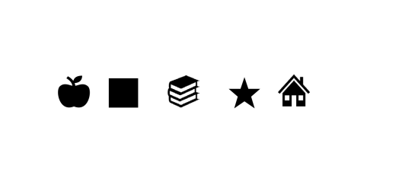
Notes:
Say to the student: “First I want to make sure that you can see what’s on the screen. Tell me the name of each of these letters/shapes.” Have student name each letter/shape, prompting the student to “Keep going” if needed.

Slide 4
Letter Naming Fluency (LNF)
Objective: Tell me the names of as many letters as you can within 60 seconds.

Slide 5
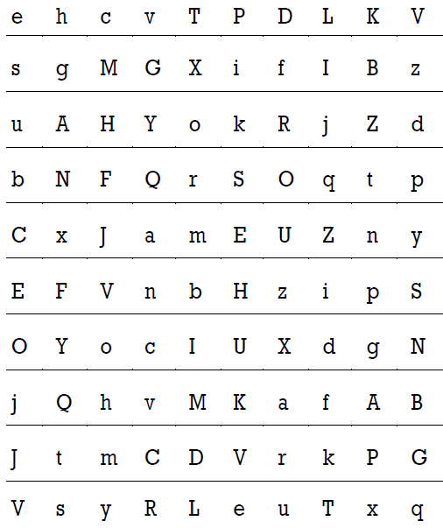
Notes:
Say these specific directions: Here are some letters (point to the student form). Tell me the names of as many letters as you can. When I say “Begin,” start here, (point to the first letter with the cursor) and go across the page (point). Point to each letter and tell me the name of that letter. If you come to a letter you don’t know, I’ll tell it to you. Put your finger on the first letter. Ready? Begin. 4. Start the timer after saying “Begin.” 5. Follow along in the Scoring Booklet. Put a slash (/) through each letter name read incorrectly. See Acceptable Prompts and Scoring Rules for more details. 6. At the end of 60 seconds, place a bracket (]) after the last letter named and say, “Stop.”

Slide 6
Phonemic Segmentation Fluency (PSF)
Objective: Student breaks words into phonemes for 60 seconds.
The test administrator will say a word. The student will verbalize all the sounds in that word.
Administrator: Tell me all the sounds in the word ‘it’.
Student responds /i/ /t/.

Slide 7
Nonsense Word Fluency (NWF)
Objective: Student reads or sounds out make-believe words for 60 seconds.

Slide 8
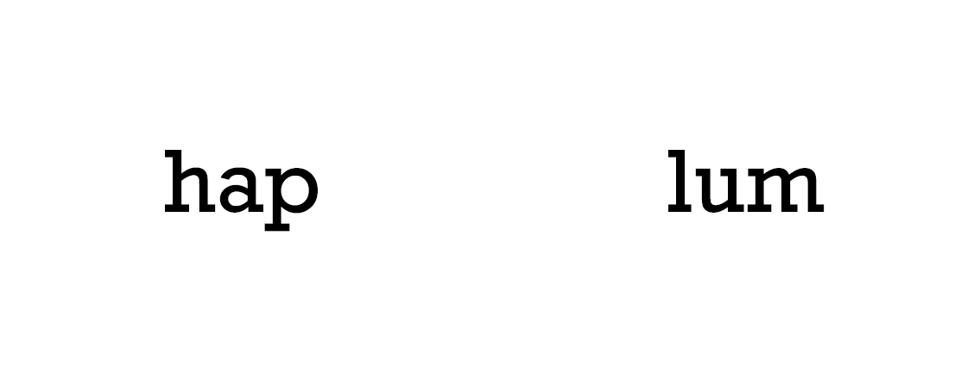
Example:
Notes:
Examiner: pg. 4 of the scoring guidance

Slide 9
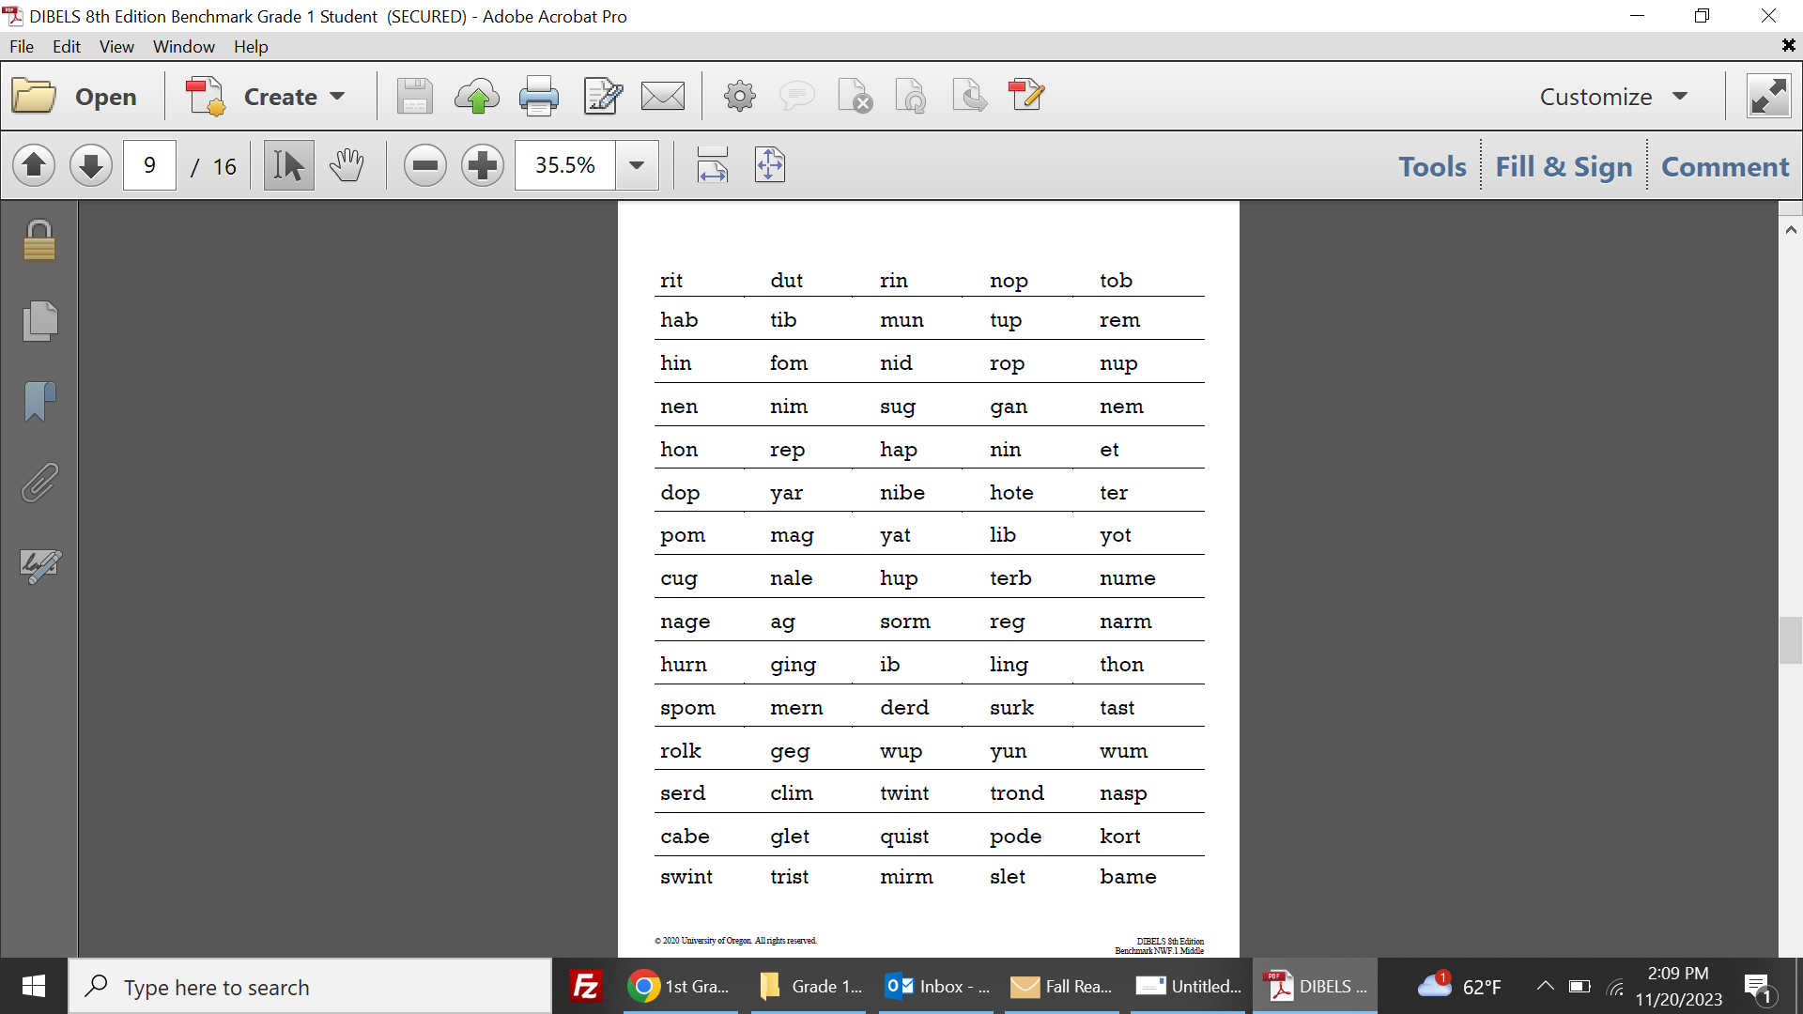

Slide 10
Word Reading Fluency (WRF)
Objective: Student reads sight words for 60 seconds.

Slide 11
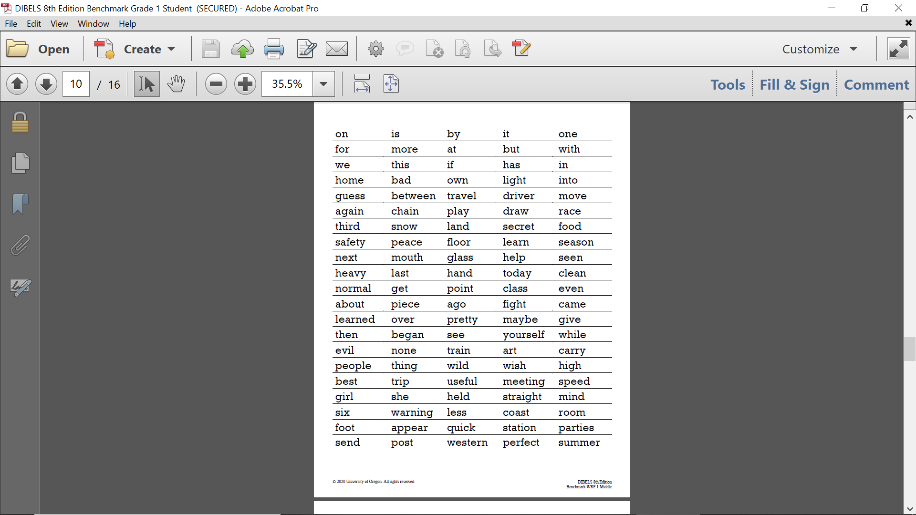

Slide 12
Oral Reading Fluency (ORF)
Objective: Student reads a passage aloud for 60 seconds.

Slide 13
