Slide 1
DIBELS 8th Edition: Grade 3
EOY Remote Administration
Notes:
The Test Administrator is to use this deck in conjunction with the Grade 3 EOY Remote Administration Scoring Booklet (Secure).

Slide 2
Prior to reading the remote screening agreement, please ensure video and audio are working and the session is being recorded. To ensure reliability of the K-3 Literacy Screener remote administration, the following expectations must be read aloud by the test administrator and verbally acknowledged by the parent/guardian and student. If the parent/guardian and/or student refuses to agree or breaks one of the following requirements then remote testing should not begin or should be stopped immediately and on-site testing will be required. Personnel from school districts and/or the LDOE may monitor this screening session.
Parents/Guardians
May assist with providing a quiet work space with limited distractions.
May ensure the student is following along in the correct section.
May not prompt or solicit a response from the student.
May not disclose screening materials to the student prior to their testing session.
May not show the answer key to the student at any time.
Webcams and audio must stay on the entire testing session with the student in view.
Student
May not ask a parent or guardian for assistance with answering the screening items.
May not review test materials prior to screening.
May not review the answer key at any time prior to screening.
Should follow the directions from the test administrator for each subtest and answer to the best of their ability.
Webcams and audio must stay on the entire testing session with the student in view.

Slide 3
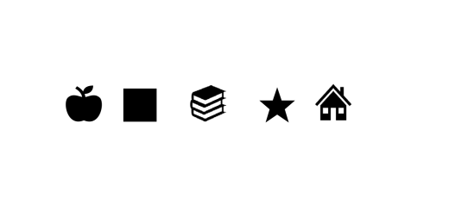
Notes:
Say to the student: “First I want to make sure that you can see what’s on the screen. Tell me the name of each of these shapes.” Have student name each shape, prompting the student to “Keep going” if needed.

Slide 4
Nonsense Word Fluency (NWF)
Objective: Student reads or sounds out make-believe words for 60 seconds.

Slide 5
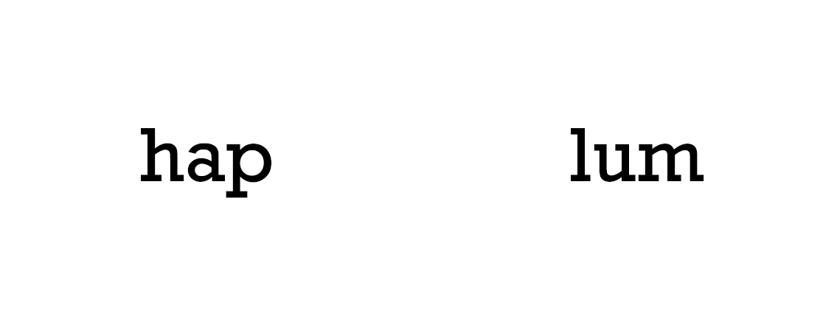
Practice:

Slide 6
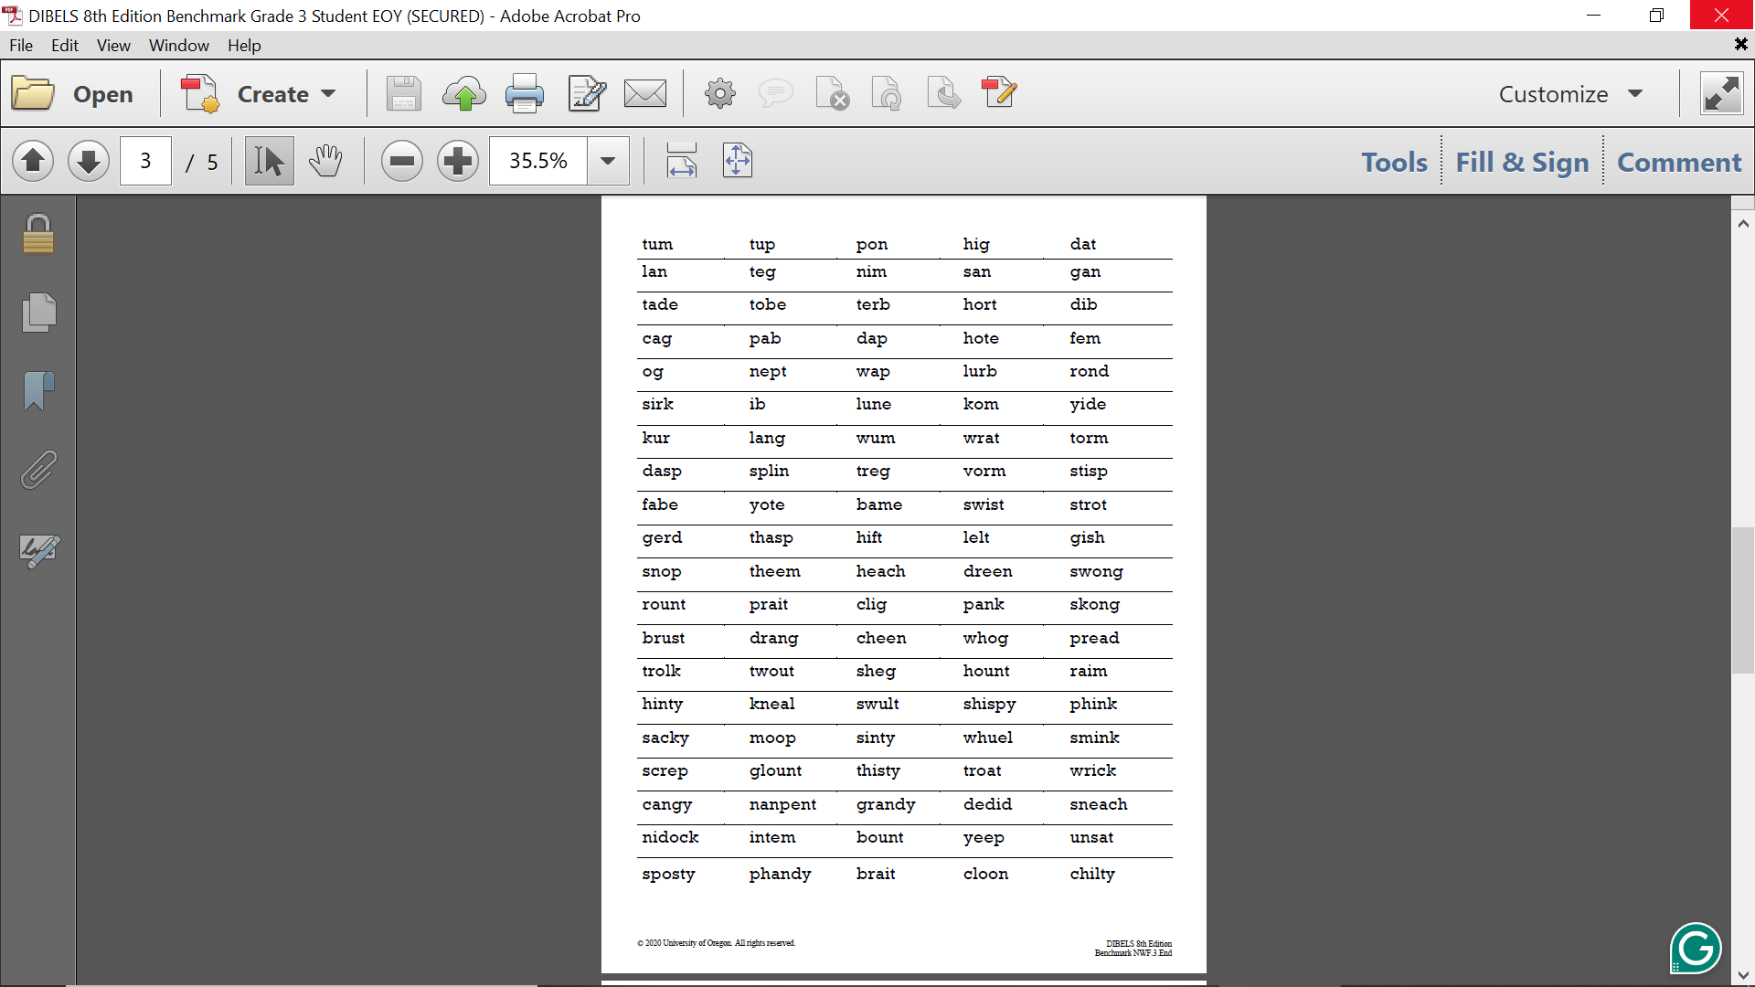

Slide 7
Word Reading Fluency (WRF)
Objective: Student reads sight words for 60 seconds.

Slide 8
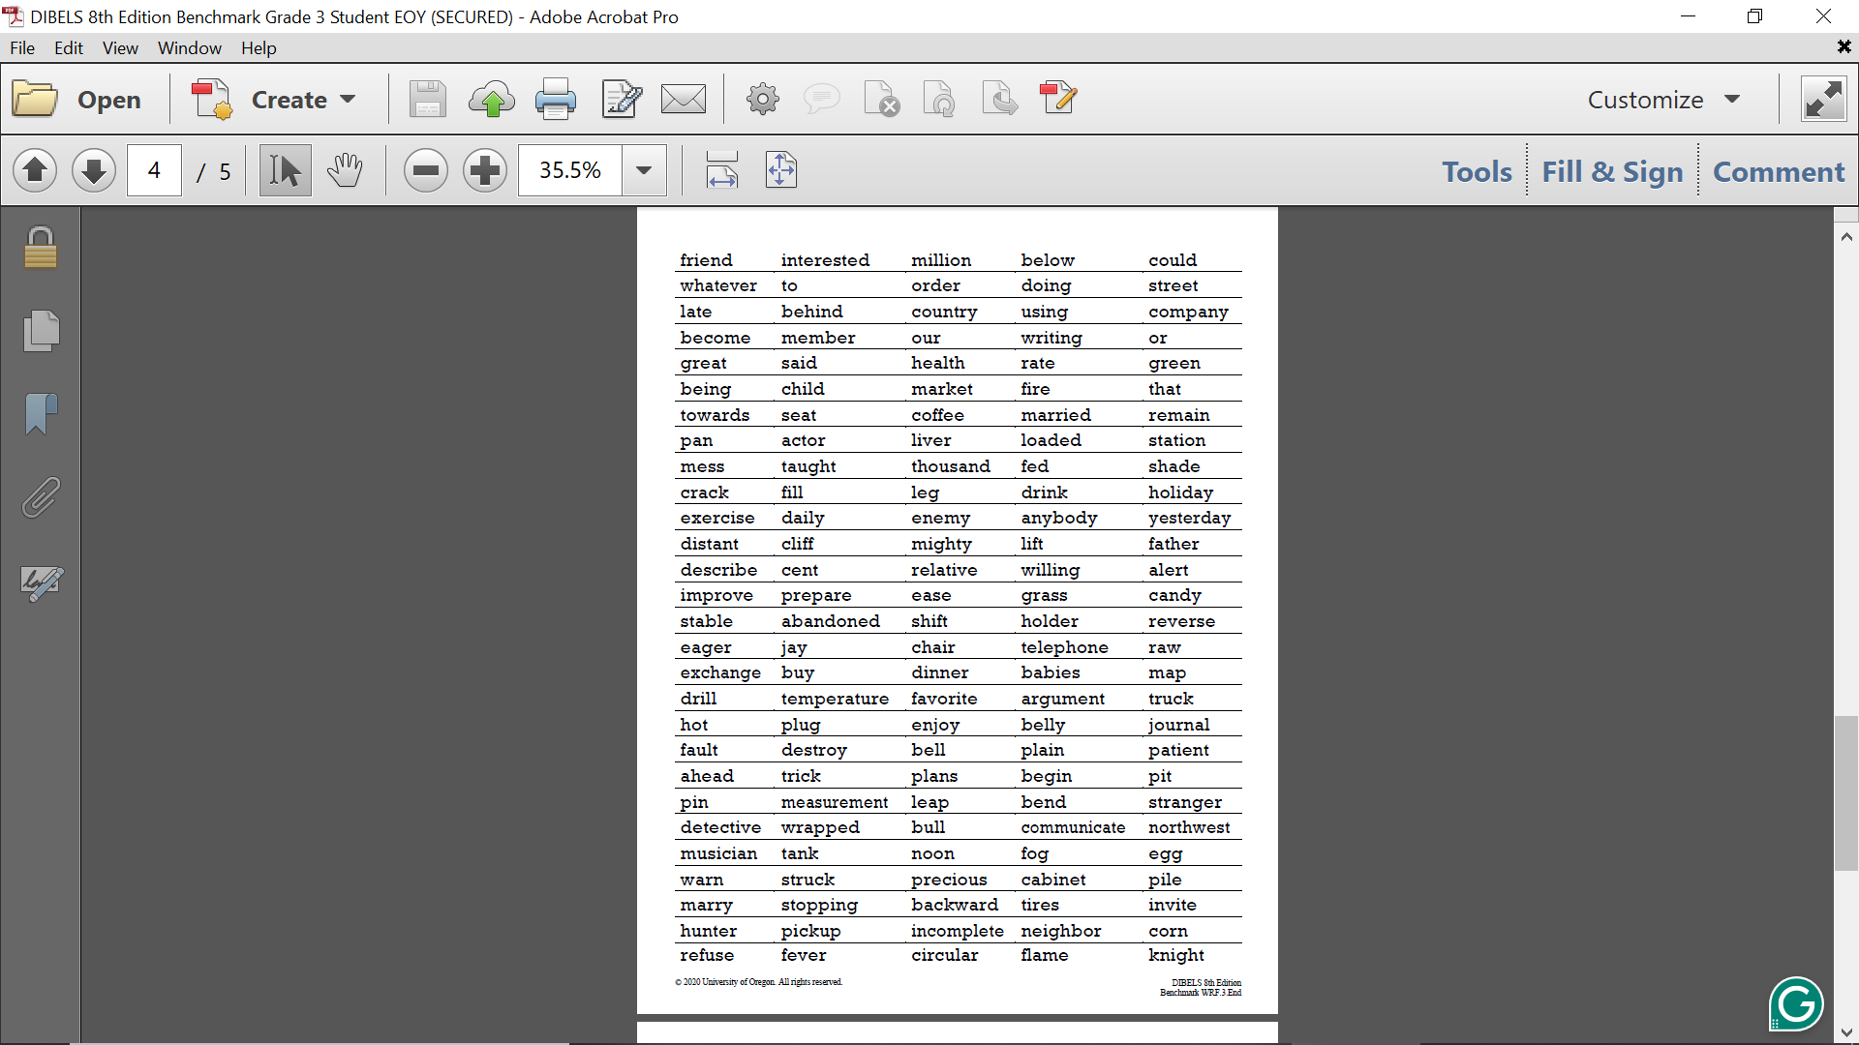

Slide 9
Oral Reading Fluency (ORF)
Objective: Student reads a passage aloud for 60 seconds.

Slide 10
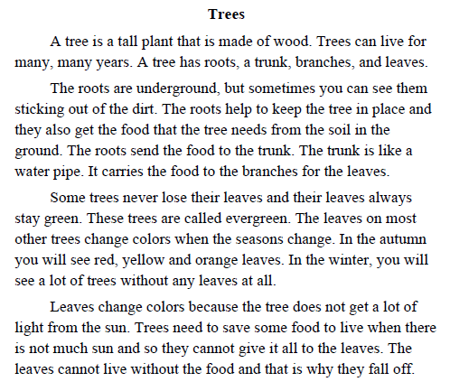

Slide 11
MAZE
Objective: Student silently reads a passage for 180 seconds, verbally choosing the best multiple-choice answer for missing words.

Slide 12
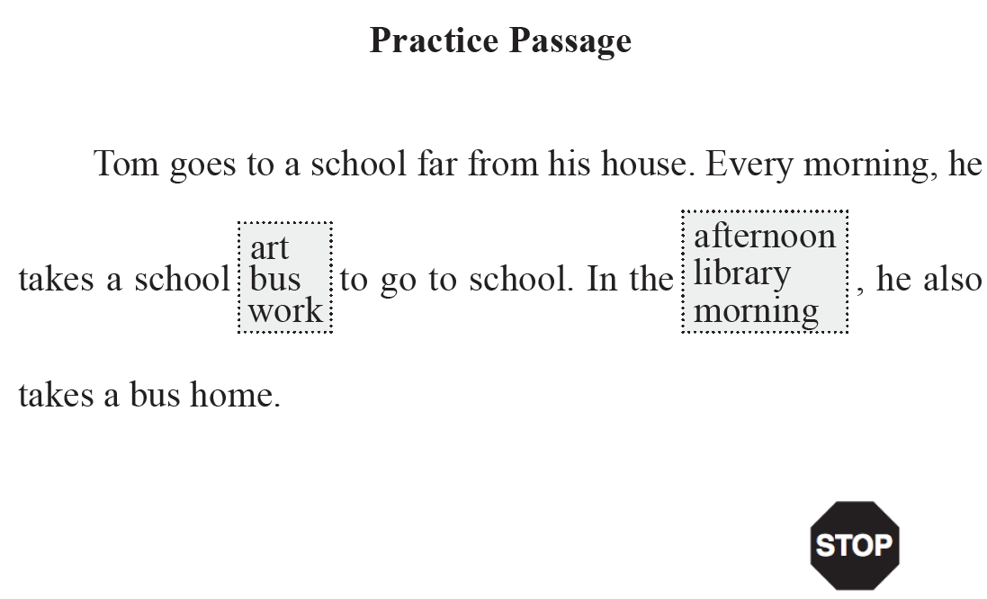

Slide 13
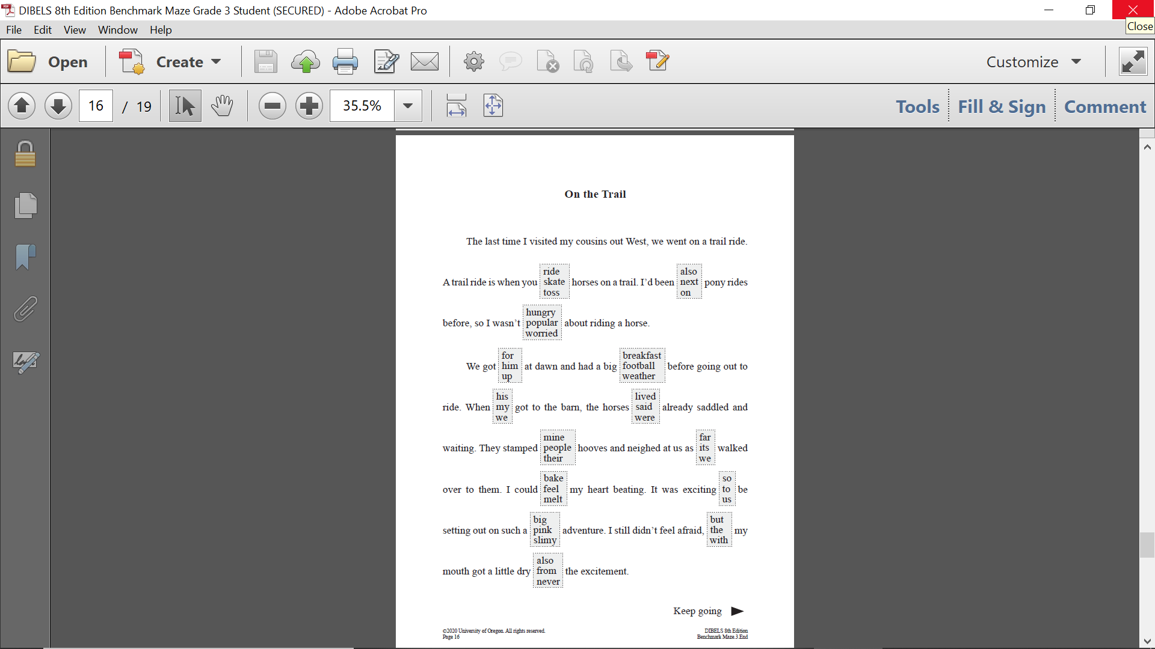

Slide 14
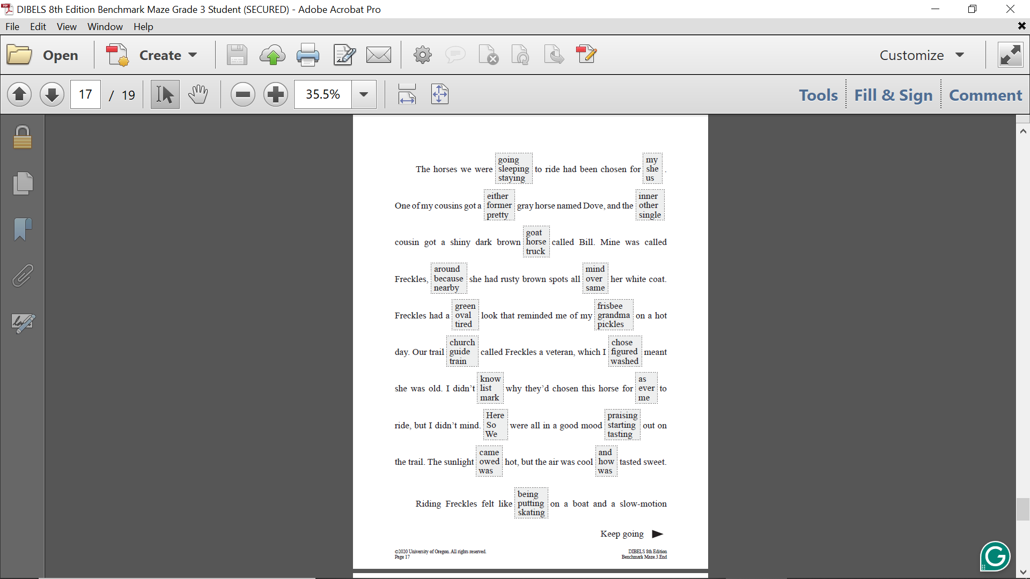

Slide 15
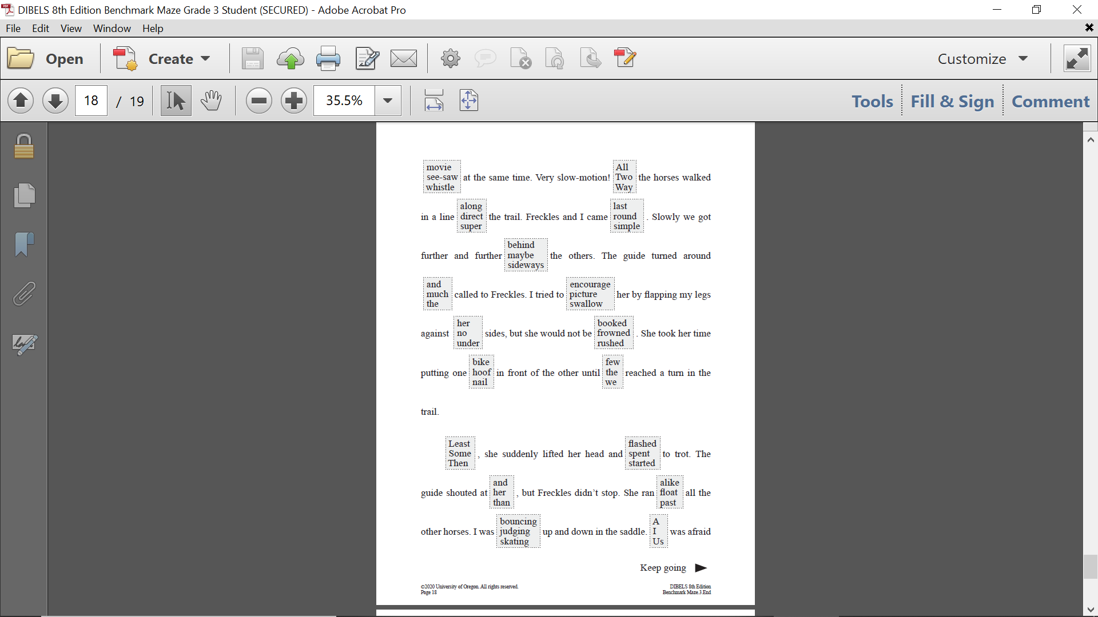

Slide 16
