Slide 1
End-of-Year (MOY) State Administered K-3 Literacy Screening
March 2025

Slide 2
Agenda
Assessment Window
Roles and Responsibilities
Training for Test Administration
Screening Setup
Invalidations
Special Populations
Remote Administration
Test Security
Accountability Timeline
Contact Information

Slide 3
K-3 Literacy Assessment Windows
The system will open on March 18 for administrative functions. Student records reflects data submitted to EdLink for enrollment through February 25. Any grade level changes requested for MOY that were not also recorded in EdLink have now been replaced by the grade level in EdLink.
Screening cannot begin prior to April 1. When the window closes on April 30, there will be no additional opportunity to submit scores for both regular screening and screening for alternate assessment using the LAAR. There is no submission to EdLink in 2024-2025.
Screening support from Amplify and department staff may be limited during the holiday week, especially on April 18 or 21.
Academic Year | Window 1 (BOY) | Window 2 (MOY) | Window 3 (EOY)
2024-2025 | First 30 school days | December 1-31 | April 1-30

Slide 4
Screener Content
Students must complete all measures for a composite score to be calculated and reported to the department by the vendor. The content of the screener varies by grade. Gating, discontinuing, or exemptions for sections of the screener may not be used as part of the Louisiana K-3 screening system.

Slide 5
Roles and Responsibilities

Slide 6
Assigning School Test Coordinators
DTCs should review school test coordinator accounts for any changes in staffing that may have occurred between administrations. Permissions should be removed for any staff who no longer participate in screening.
All staff accounts must be connected to a genuine email inbox for the staff to set their own passwords. If you intend to manage all enrollment and rostering for your district, you can skip this step and review the School Test Coordinator Rostering Guide.
In the Admin Portal, navigate to the Staff List.
Follow the instructions to create a single staff member or many staff members: https://my.amplify.com/help/en/articles/8482846-ldoe-admin-portal-create-staff-accounts

Slide 7
Assigning Test Administrators
Staff accounts should be reviewed and new accounts should be created for all newly-added individuals who serve as Test Administrators. Permissions should be removed for staff who no longer participate in screening.
Note: All staff accounts must be connected to a genuine email inbox for the staff to set their own passwords.
In the Admin Portal, navigate to the Staff List.
Follow the instructions to create a single staff member or many staff members: https://my.amplify.com/help/en/articles/8482846-ldoe-admin-portal-create-staff-accounts

Slide 8
Role of the Test Administrator
For New TAs: Complete required training and earn at least an 80% on the test (not required for TAs who completed training in 2023-2024 unless otherwise directed by the STC/DTC.
Make sure the mCLASS Teacher Administered Assessment, mCLASS Assessment Forms, mCLASS Student Assessment are installed on testing devices and the TA computers have a microphone with the volume set to a level that is audible.
Administer all required grade level measures to all assigned students
Follow all test security protocols in the Test Administrator Manual (TAM)
Implement accommodations provided by the STC
Report any testing irregularities to the STC

Slide 9
Training for Test Administrators

Slide 10
Test Administrator Required Training
Prior to administration of the screener, all test administrators must have completed the training found at this link and score at least 80%. The date on which the training was completed must be entered into the test administrator oath signed by the test administrator. If the TA was trained in 2023-2024, the department does not require that they complete this training again.
Online Course(s) for Leaders:
An outline of the course as-is for leaders.
A link to self-enroll in the Administration and reporting training for leaders online course: https://elearning.easygenerator.com/b2975530-9e54-42ff-a31d-1137869d6ff2/
Online Course(s) for Teachers:
An outline of the course as-is for teachers.
A link to self-enroll in the Administration and instruction essentials for teachers online course: https://elearning.easygenerator.com/6ae65f32-8c1c-4e77-bd04-5f86d95a73fe/

Slide 11
Test Security and Administration Training
All TAs shall participate in a general administration and test security training annually to review school and district protocols, technology checks/needs, instructions on keeping microphone on with sufficient volume, and test security requirements that are in place that include:
Review all requirements of the test security oaths, which must be signed by all TAs for every window of screening
Follow all directions in TAM
No cues, clues or hints to students
Maintain the security of the K, 1 and 2 secure Louisiana forms
Report to the department all testing irregularities that include reasons for invalidations.

Slide 12
Screening Setup and Secure Browser

Slide 13
Technology
Prior to testing District Technology Coordinators should ensure the following sites are open on the district’s network.
https://amplify.com/allowlist/
DTCs, STCs, District Technology Coordinators and TAs can use the tool below prior to testing to ensure the device and network are working appropriately.
https://my.amplify.com/allowlist/

Slide 14
Louisiana Amplify Portal
All schools will administer the statewide screener using the Louisiana portal. Statewide screeners cannot be administered with any other option.
In a supported web browser, navigate to my.amplify.com/login/louisiana and login through the State Administered K-3 Literacy Screener.

Slide 15
Secure Browser
The Tech User Guide includes directions for:
Installing the SEB for Windows and Mac devices
Installing mCLASS Apps for Chromebooks screening in kiosk mode
Grades K, 1 and 2 must use the secure browser or kiosk mode to administer the screening.
Grade 3 does not use this process.
Step-by-step instructions with screen shots are included in the guide.

Slide 16
Accessing Testing Manuals
All manuals are housed on the Louisiana mCLASS page.
Test Coordinator Manual (TCM)
Test Administrator Manual (TAM)
Accesssibility and Accommodations Manual
Tech User Guide
The Louisiana Specific Instructions and Oaths Guide will be sent by email to DTCs by Friday, March 14 and will be posted to the K-3 Literacy webpage.

Slide 17
Louisiana Specific Instructions and Oaths Guide
The Louisiana Specific Instructions and Oaths Guide has been updated for EOY and will include:
Oaths of security to be completed by STCs and all test administrators
Directions for disabling the timer for the Maze online
Links to guides posted on the Louisiana mclass page; includes link to Tech Guide for secure browser and Kiosk mode instructions
Details about applying accommodations for Louisiana
A list of appropriate accountability codes
Directions for capturing LAAR scores in the system
Test security reminders

Slide 18
Transferring Students
DTCs can transfer students into their district from a different district within the state using Amplify’s Admin Portal. Transferring a student removes them from all classes in the originating district, and deletes them from the originating district’s roster. All of their data will be migrated to the new district, so they can be added to classes in their new organization.
Step by step guidance is available in the mClass Test Coordinator Manual.

Slide 19
Transferring Student from Other Districts
To transfer a student to the district:
Navigate to the Students list page.
Select the district the student will be enrolled in. It is only possible to transfer students into a district the DTC has access to.
Click New Students and select + Students into school from the menu.

Slide 20
Confirmation of Transfer
If the system finds a student matching the ID entered in the selected district, a confirmation message displays. The student’s first initial and first three characters of their last name display, along with their state ID and the school they are transferring from. The student’s full name will be available after the transfer.
The department received reports of districts claiming the same student. When this occurs, please contact jennifer.baird@la.gov as soon as possible so that the information in EdLink can be reviewed.

Slide 21
Changing Student Grade Level
Requests to change a student’s grade level must continue to be sent to Jennifer.Baird@la.gov. The request will be forwarded to Amplify upon confirmation of grade level in EdLink. Please include the following in the request:
Student Name: Partial PII (format J Bai)
Student LASID: 10-digit state ID
Name of school:
Site code of school: 6-digit ID
Current Grade Level as shown in Amplify:
Requested New Grade Level:

Slide 22
Grade Change Requests
For 5 or less students, the DTC can submit a list of students in the body of the email with required formatting.
For more than 5 students, the DTC should provide the list of students in an Excel file with required formatting.
Amplify will not accept a pdf or Word form.

Slide 23
Request for Name Change
A name change requires confirmation in EdLink. Please follow the steps below:
Submit a request to jennifer.baird@la.gov in required format with partial PII only (first letter of first name, first three letters of last name, day of birth.)
Jennifer will review record in EdLink and send approval or rejection of request via email to DTC
DTC sends request with FULL PII along with Jennifer’s message of approval to Amplify Insight Support <help@amplify.com>

Slide 24
Required Name Change Format
Student Name in Amplify: First letter of first name, first three letters of last name
Requested Name Change: First letter of first name, first three letters of last name
LASID: All 10 digits
Day of Birth (day only, for example if Jen’s birthday is August 9, 2000, then provide the number 9.
School Site code: All six digits

Slide 25
Invalidations

Slide 26
Invalidation
For EOY testing, district test coordinators are responsible for all invalidations. Test administrators will no longer have this ability. A testing irregularity report must be submitted to assessment@la.gov for all invalidations. Directions are on page 10 of the TCM.
If there has been a change in the DTC or backup DTC, the superintendent must submit the DTC and Accountability Contact Update Form form to assessment@la.gov. DTCs are responsible for all administrations, and the department will not accept multiple DTCs for different assessments.

Slide 27
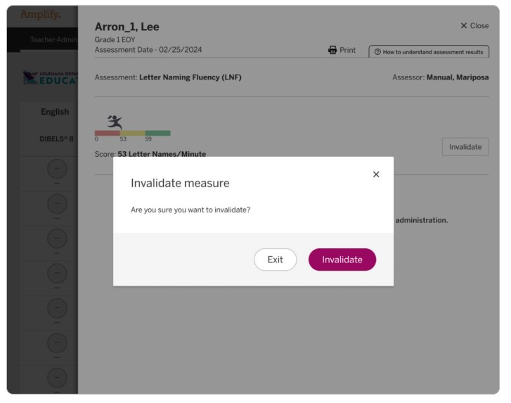
Invalidation Changes
Navigate to the classroom reporting page, click the End of Year tab, and scroll down to the Results table.
Locate the student to invalidate the results for, and click the score icon for the assessment to be invalidated. The Details panel for the selected measure opens.
The DTC clicks Invalidate on the Details panel.

Slide 28
Summer Invalidation
The invalidation process described in the TCM also includes instructions for “resetting” the first summer attempt to allow for a second summer attempt for students in grade 3 who must rescreen.
The system is essentially invalidating the first summer attempt to allow users to rescreen in the same G3 summer window.
It is very important that the first summer attempt report is saved, as it will no longer appear in the classroom reporting section. It will be saved by Amplify. Directions begin on page 11 of the TCM.
Testing irregularity reports do not need to be submitted when resetting the screener for a final second summer attempt.

Slide 29
Avoid Testing Invalidations
Test administrators should check the following before they begin screening to avoid unnecessary invalidations. All invalidations are reported to the Louisiana Department of Education and require a testing irregularity report. A screening may not be invalidated because the test administrator believes that the student should have performed better.
Is the student being screened under the correct student name in mCLASS?
Is the student being tested on the correct portion of the screener?
Does the TA have all of the accommodations allowed for the student prior to beginning the screening?
Are both screening devices set up correctly prior to beginning the screening? (secure browser not used for BOY)
Is the screening environment free of distractions and interruptions?
Has the TA had sufficient practice on administration to be able to manage speed of student responses, provide direction to student for speaking loudly enough to be heard,
practice on scrolling the page when needed?

Slide 30
Voiding Student Assessments
Student tests must be voided if there is an instance of cheating, misconduct, or administrative error—whether by a student or by anyone else. A testing irregularity form must be submitted to assessment@la.gov by the district test coordinator.

Slide 31
Reasons for Invalidations/Incompletions
The measure may be marked as invalid. | The measure may be marked as incomplete. | The measure may NOT be marked as invalid/incomplete.
The test administrator tested the student under the wrong name. | The test administrator tested the student under the wrong name. | Student behavior disrupted the testing environment, including the student being screened.
The test administrator tested the wrong section of the test. | The test administrator tested the wrong section of the screener. | Student skipped a line or a word on the measure.
The test administrator did not provide the correct accommodations. | The test administrator or the student had technology issues. | The screening environment allowed for frequent interruptions and/or disturbances.
The test administrator did not have the correct materials available for the student or themselves. | Student became ill. | The test administrator could not keep up with the student while administering the screener.
 | Despite a secure environment, carefully selected to minimize interruptions or disturbances, an unavoidable interruption occurred (fire drill, for example) where student had to exit. | The test administrator thought the student could score better. (Includes student missing points on previous material, student lost their place, student forgot how to work the technology, TA did not feel they scored the assessment appropriately, etc.)
 |  | Test administration ran out of time in the class period or the student had to switch classes.

Slide 32
Accountability Codes
School systems must apply accountability codes for students who do not test. The code field is added as an additional demographic field for each student. The list of codes is in Appendix A of the Louisiana K-3 Literacy Screening: Specific Instructions and Oaths-Test Coordinator Manual.
Codes 01-44 and 97: Use only for students who have been exited from enrollment in EdLink with a matching exit code.
Code 80: Use for students who have a letter from a doctor that does not use a disability as the sole reason for excluding students from testing.
Code 81: Not applicable for 2024 since the screening results will not be used for accountability until 2025-2026.
Code 94: Use for students that are alternately assessed and scored using the LAAR. The score must be entered into the new LAAR field in mCLASS.

Slide 33
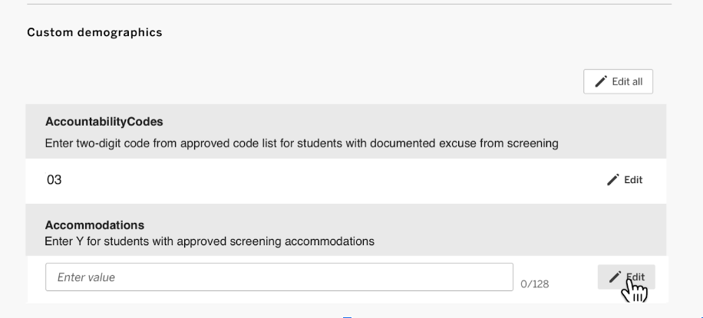
Accountability Codes in mCLASS
From the student’s profile page, you can view their demographics, and if you are an educator with system or enrollment access, you can also add or edit the student’s custom demographics.

Slide 34
Special Populations

Slide 35
Accommodations
Some accommodations may be applied during the screener if they are documented on an IEP, IAP or EL Checklist and they are used routinely during regular class instruction.
Breaks in between sections
Hearing aids, assistive listening devices, glasses, Smartwatches if used for medical reasons (Smartwatches and or phones that are used for medical reasons must be carefully monitored)
Enlarged student materials (magnification)
Covered overlays, filters or lighting adjustments
Marker or ruler for tracking
Whisper phones

Slide 36
Preparation for Accommodations
As with all statewide assessments, test administrators must have a list of students with their accommodations prior to administration of the screener. The test administrator should be trained in the proper administration of the accommodation.
If a screener is invalidated due to improper application of accommodations, the district test coordinator must submit a testing irregularity report to assessment@la.gov.
For details on allowable accommodations, please see the Louisiana Specific Instructions and Oaths Test Coordinator Manual.

Slide 37
Accommodations in mCLASS
There is no place to list accommodations in mCLASS for students. A custom demographic field for each student captures a Y for students who are being given accommodations.
Accountability codes and LAAR scores will now be restricted to options in a dropdown list. The accommodations field will continue to allow endless options to be entered incorrectly.

Slide 38
Accommodation Flag in mCLASS
One of the three custom demographics added to the student profile is a field for identifying students who will receive Louisiana-approved accommodations. The only acceptable value for this field is Y (if student is receiving an accommodation.)

Slide 39
Demographic Field for LAAR scores
A designated demographic field allows administrators to enter the composite score from the LAAR. This should only be completed if the student is also accountability coded as 94 and the IEP clearly indicates the student’s eligibility for alternate assessment. There will be no collection for alternate assessment scores through EdLink. As with scores from DIBELS, all scores must be entered in mCLASS no later than the last day of the school system’s custom administration window.

Slide 40
LAAR Score Reporting
Test administrators will choose a score from 1-25 in the field labeled laarScore for students who qualified for alternate assessment no later than November 1 as recorded in the current IEP in eSER.
Students cannot have both a LAAR score and a regular screening score. The regular score will be used if both are included in the file.

Slide 41
Extended Time
For the administration of the state K-3 Literacy Screener, extended time is defined as double the time that is prescribed. For example, if all students must complete the subtest in 1 minute, extended time allows for 2 minutes. The screener sections should be strictly timed. Extended time is only available for the following students:
English learners as identified in EdLink 360 enrollment
Students with fluency-based speech disorders documented on IEPs
Students assessed with LAAR alternative rubric
Students with limited verbal language skills, as documented on the IEP, that are not participating in an alternate assessment
Students who require braille

Slide 42
Extended Time: Maze

Slide 43
Additional Timing Device
An additional timing device will be needed for all extended time, including the grade 2 and grade 3 Maze online. The timer for Maze can be disabled for both grade 2 and grade 3. This can only be done by a test administrator.

Slide 44
Braille
Braille material requests are past due. If braille materials have not been requested for EOY, it may not be feasible to have them delivered on-time.
It was not necessary to order braille for EOY if materials were ordered for a student in BOY/MOY.
If braille is no longer needed, then please notify the department at assessment@la.gov
Braille materials for grades K, 1 and 2 are secure forms. These materials must be kept secure at all times.

Slide 45
Testing Accommodations Not Permitted
The following test accommodations are not permitted on the K-3 Literacy Screener.
Test read aloud (all forms)
Word prediction
Communication assistance
Any other accommodation that subverts the measure

Slide 46
Remote Administration

Slide 47
Remote Administration
Remote testing is not an option for grades K, 1 or 2. Remote administration is allowed for grade 3 end of year until a secure form is developed. Please remember that:
BOY or MOY PowerPoints cannot be used for end of year. The appropriate PPT deck is posted to the K-3 Literacy page.
The TA will need to log into two devices and enable a microphone as if they are screening the student in person, even for remote administration
The grade 3 Remote Administration PPT must be used with agreements from the student and the parent. The virtual meeting must be recorded in the meeting application.
All student responses will have to be added to mCLASS individually upon completion of the screening.

Slide 48
Test Security

Slide 49
Oaths of Security
All STCs and TAs must have a signed oath of security prior to the BOY administration window opening. Oaths should be maintained at the school for three years.

Slide 50
Prohibited Materials
Prohibited materials can compromise test security and violate the construct being measured by the assessment, thus producing invalid results. Prohibited materials must be covered or removed from the testing room. This includes any document or display that provides content from the screener or content related to the items on the screener.
A secure environment is required for all grade levels. Interruptions from intercoms, persons entering or exiting from the testing area, or disruption from other students must be minimized as much as possible.

Slide 51
Accountability Timeline

Slide 52
Inclusion in School Accountability
Student performance measured by the K-3 literacy end of year screener will be included in the 2025-2026 school year (2026 SPS).
The data from the end of year screener for grades K-2 in 2024-2025 will set the baseline for growth in 2026.
It is very important that test administrators are aware of the impact that invalidations, test security violations, and failure to screen all students can have on the 2026 SPS.

Slide 53
Contact Information
For issues related to administration: assessment@la.gov
For grade changes or name changes: jennifer.baird@la.gov
For literacy and promotion/retention policy: LouisianaLiteracy@la.gov
For Amplify customer service:
Email: help@amplify.com
Call: 1.800.802.2584
For resources and “how to”:
https://amplify.com/louisiana-mclass/

