Slide 1
End-of-Year State Administered
K-3 Literacy Screening
March 20, 2024

Slide 2
Agenda
Assessment Window
Roles and Responsibilities
Training for Test Administration
Screening Setup
Screening Administration
Special Populations
Remote Administration
Test Security
Accountability, Intervention and Gifted Referrals
Contact Information

Slide 3
K-3 Literacy EOY Assessment Window
Per state law, there can be no extensions into May.
LAAR scores are due in EdLink no later than May 1 to be included in the May 2 snapshot
Academic Year | Window 1 (BOY) | Window 2 (MOY) | Window 3 (EOY)
2023-2024 | First 30 school days | December 12-January 25 | April 1-30
2024-2025 | First 30 school days | December 2-22 | April 1-30

Slide 4
Screener Content
Students must complete all measures for a composite score to be calculated and reported to the department by the vendor. The content of the screener varies by grade. Gating, discontinuing, or exemptions for sections of the screener may not be used as part of the Louisiana K-3 screening system.

Slide 5
Literacy Measures Required by Grade Level
Measure | Kindergarten | Grade 1 | Grade 2 | Grade 3
Letter Naming Fluency | ✔ | ✔
Phonemic Segmentation | ✔ | ✔
Nonsense Word Fluency | ✔ | ✔ | ✔ | ✔
Word Reading Fluency | ✔ | ✔ | ✔ | ✔
Oral Reading Fluency |  | ✔ | ✔ | ✔
Maze (Basic Comprehension) |  |  | ✔ | ✔

Slide 6
Roles and Responsibilities

Slide 7
Role of the District Test Coordinator
District test coordinators are responsible for:
Redelivering portions of this webinar to STCs/other staff
Assigning school test coordinators in the system
Activating the EOY secure assessment so that STCs can schedule.
Providing training in administration and test security for school test coordinators
Providing specific testing schedules for all schools to the department
Reporting any irregularities to the department
Establishing forms of communication with STCs for questions, technology support, reporting to and from the department
Maintain records that include but are not limited to:
  Doctor’s letters for students who cannot test due to extreme medical illness
  Testing irregularities and breaches

Slide 8
Assigning School Test Coordinators
DTCs should review school test coordinator accounts for any changes in staffing that may have occurred between administrations.
All staff accounts must be connected to a genuine email inbox for the staff to set their own passwords. If you intend to manage all enrollment and rostering for your district, you can skip this step and review the School Test Coordinator Rostering Guide.
In the Admin Portal, navigate to the Staff List.
Follow the instructions to create a single staff member or many staff members: https://my.amplify.com/help/en/articles/8482846-ldoe-admin-portal-create-staff-accounts

Slide 9
Role of the School Test Coordinator
School test coordinators are responsible for:
Ensure all test administrator and student divides have the Secure Exam Browser (Kiosk for Chromebook), mCLASS Teacher Administered Assessment, mCLASS Assessment Forms, mCLASS Student Assessment are installed on testing devices and the TA’s computers have a microphone.
Must schedule the EOY secure assessment for your school(s) before administration can begin.
Assigning logins for new test administrators
Ensure that all test administrator are provided with accommodations for students that are being screened, if applicable
Confirm required administration training and provide test security for test administrators
Reporting any irregularities to the District Test Coordinator
Establishing forms of communication with TAs for questions, technology, support within the school

Slide 10
Assigning Test Administrators
Staff accounts should be reviewed and new accounts should be created for all newly-added individuals who serve as Test Administrators.
Note: All staff accounts must be connected to a genuine email inbox for the staff to set their own passwords.
In the Admin Portal, navigate to the Staff List.
Follow the instructions to create a single staff member or many staff members: https://my.amplify.com/help/en/articles/8482846-ldoe-admin-portal-create-staff-accounts

Slide 11
Role of the Test Administrator
Complete required training and earn at least an 80% on the test.
Make sure the Secure Exam Browser (Kiosk for Chromebook), mCLASS Teacher Administered Assessment, mCLASS Assessment Forms, mCLASS Student Assessment are installed on testing devices and the TA’s computers have a microphone.
Administer all required grade level measures to all assigned students
Follow all test security protocols in the Test Administrator Manual (TAM)
Implement accommodations provided by the STC
Report any testing irregularities to the STC
The department does not require that teachers be TAs. The role of the TA is determined by the school system.

Slide 12
Training for Test Administrators

Slide 13
Test Administrator Required Training
Prior to administration of the screener, all test administrators must have complete the training found at this link and score at least 80%. The date on which the training was completed must be entered into the test administrator oath signed by the test administrator. If the TA was trained for MOY they do not need to complete this training again.
Online Course(s) for Leaders:
An outline of the course as-is for leaders.
A link to self-enroll in the Administration and reporting training for leaders online course: https://elearning.easygenerator.com/b2975530-9e54-42ff-a31d-1137869d6ff2/
Online Course(s) for Teachers:
An outline of the course as-is for teachers.
A link to self-enroll in the Administration and instruction essentials for teachers online course: https://elearning.easygenerator.com/6ae65f32-8c1c-4e77-bd04-5f86d95a73fe/

Slide 14
Screening Setup

Slide 15
Technology
Prior to testing District Technology Coordinators should ensure the following sites are open on the district’s network.
https://amplify.com/allowlist/
DTCs, STCs, District Technology Coordinators and TAs can use to tool below prior to testing to ensure the device and network are working appropriately.
https://my.amplify.com/allowlist/

Slide 16
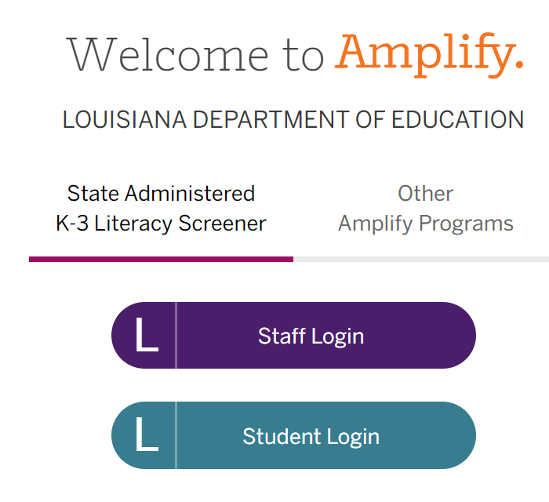
Louisiana Amplify Portal
All schools will administer the statewide screener using the Louisiana portal. Statewide screeners cannot be administered with any other option.
In a supported web browser, navigate to my.amplify.com/login/louisiana and login through the State Administered K-3 Literacy Screener.

Slide 17
Secure Browser
K-2 end-of-year (EOY) screeners must be administered in a secure browser. To install the browser, see the instructions provided in the Louisiana Specific Instructions and Oaths of Security document or Tech User Guide on the Louisiana mCLASS page.
Instructions vary based on the device that is being used to access the screener.
NOTE: The grade 3 screener is not accessed in the secure browser.

Slide 18
Accessing Testing Manuals
All manuals are housed on the Louisiana mCLASS page.
Test Coordinator Manual (TCM)
Test Administrator Manual (TAM): Secure K-2 End of Year Literacy Assessment
Test Administrator Manual (TAM): Grade 3 End of Year Literacy Assessment
Accessibility and Accommodations Manual
Tech User Guide
The Louisiana Specific Instructions and Oaths Guide was sent by email to DTCs on March 15 and will be posted to the K-3 Literacy webpage.

Slide 19
Louisiana Specific Instructions and Oaths Guide
The Louisiana Specific Instructions and Oaths Guide has been updated for EOY and will include:
Oaths of security to be completed by STCs and all test administrators
Directions for downloading the secure browser that must be installed to access the K-2 secure screeners
Directions for disabling the timer for the grade 2 Maze online
Details about applying accommodations for Louisiana
Test security reminders.

Slide 20
Secure K-2 Screening
Test administrators will follow the step-by-step guidance provided in the Test Administrator Manual.
The microphone on the TA’s device must be turned on to start the assessment.
The TA will login to their mCLASS. Click Assessment. Enable Safe Exam Browser. Click Teacher-Administered Assessment. Scroll down to the Student List, and find the student to assess.
The TA will then login to the student’s device with the SAME login credentials used on the TA’s device. Click Programs & Apps. Click mCLASS Assessment Forms. Once the two devices are prepared with the same measure, begin the assessment.

Slide 21
Transferring Students
DTCs can transfer students into their district from a different district within the state using Amplify’s Admin Portal. Transferring a student removes them from all classes in the originating district, and deletes them from the originating district’s roster. All of their data will be migrated to the new district, so they can be added to classes in their new organization.
Step by step guidance is available in the mClass Test Coordinator Manual.

Slide 22
Transferring Student from Other Districts
To transfer a student to the district:
Navigate to the Students list page.
Select the district the student will be enrolled in. It is only possible to transfer students into a district the DTC has access to.
Click New Students and select + Students into school from the menu.

Slide 23
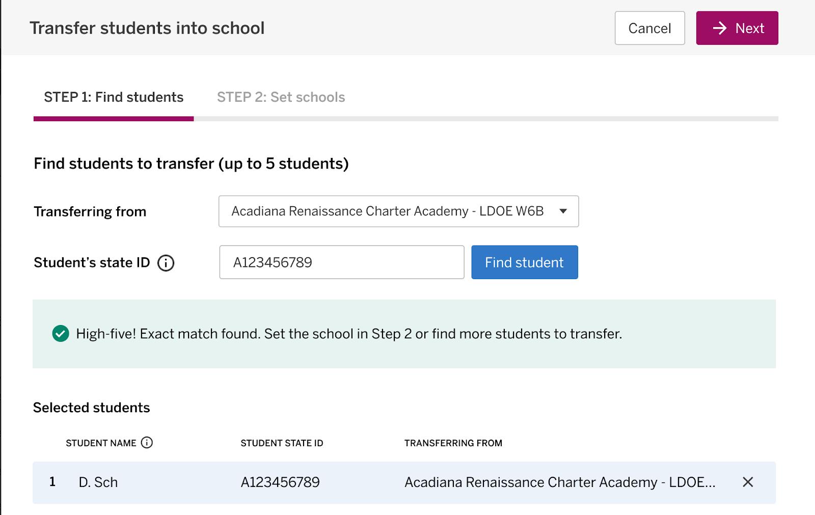
Finding and Transferring Students
Up to 5 students at one time can be transferred. If the student cannot be found with the LASID, they should be added as a new student.

Slide 24
Confirmation of Transfer
If the system finds a student matching the ID entered in the selected district, a confirmation message displays. The student’s first initial and first three characters of their last name display, along with their state ID and the school they are transferring from. The student’s full name will be available after the transfer.

Slide 25
Changing Student Grade Level
Requests to change a student’s grade level must continue to be sent to Jennifer.Baird@la.gov or assessment@la.gov. The request will be forwarded to Amplify upon confirmation of grade level in EdLink. Please include the following in the request:
Student Name: Partial PII (format J Bai)
Student LASID: 10-digit state ID
Name of school
Site code of school: 6-digit ID
Current Grade Level: as shown in Amplify
Requested New Grade Level:

Slide 26
Screening Administration

Slide 27
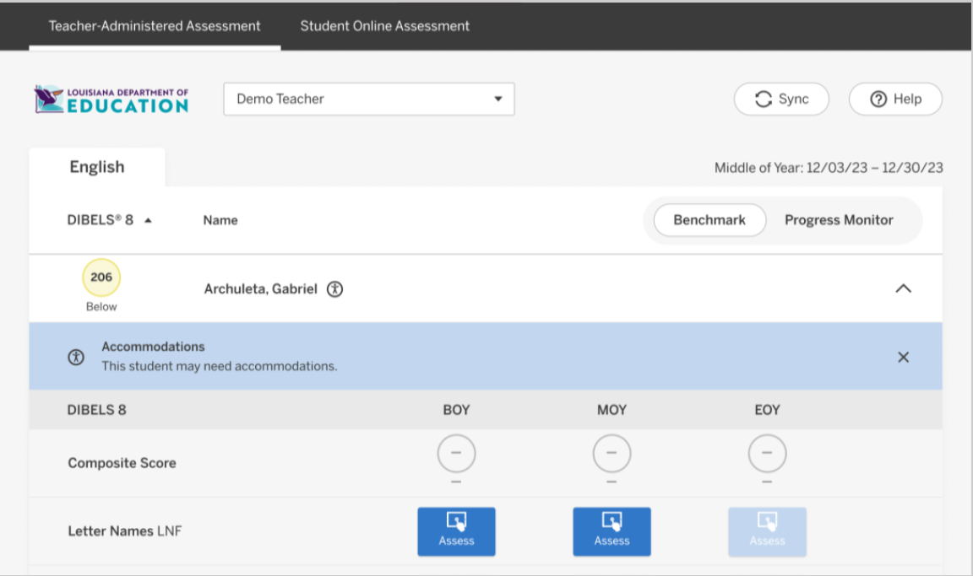
Conducting the Assessment
On the TA’s device, click Assess in the Student File for the measure being administering.

Slide 28
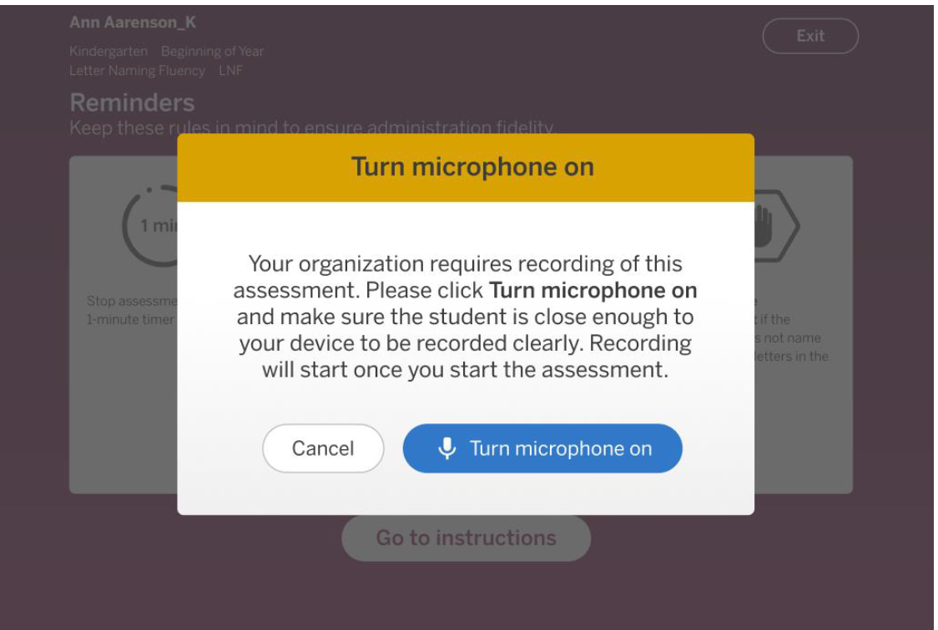
Conducting the Assessment
Click Turn microphone on. Test administrators should ensure the name in the upper left hand corner of the screen matches the student they are testing.

Slide 29
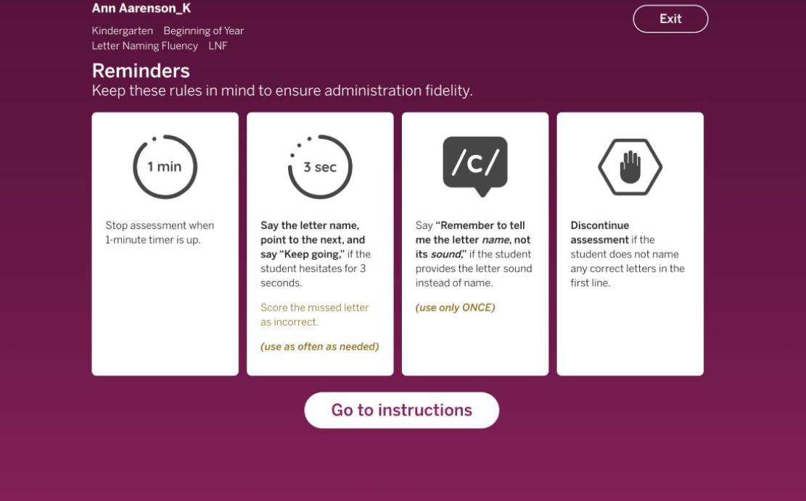
Conducting the Assessment
Test administrators will read the Reminders silently and click Go to instructions. Test administrators should ensure the name in the upper left hand corner of the screen matches the student they are testing. Example screenshot.

Slide 30
Conducting the Assessment
The student device displays either a sample form or a form with all but the first word blurred (depending on the measure) so the student can participate in the instructions and practice items.

Slide 31
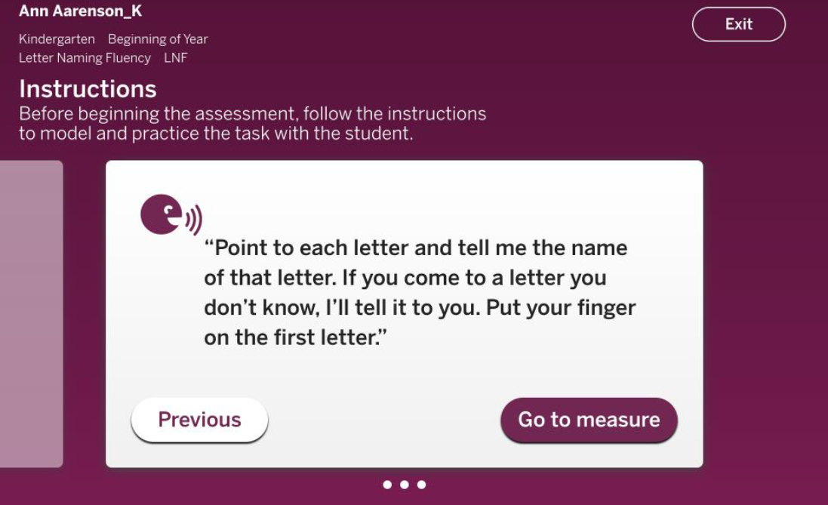
Conducting the Assessment
Go through the Instructions screens with the student and then click Go to measure.

Slide 32
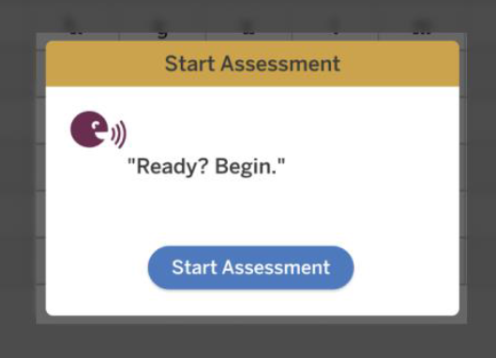
Conducting the Assessment
The assessment screen displays on the TA’s device with the content blurred until the assessment begins. The student device displays the sample or blurred content until the assessment begins.
Click Start Assessment, or select Correct or Incorrect (depending on the measure).

Slide 33
Conducting the Assessment
Administer the assessment. See the detailed administration instructions for each measure in the How To Guides linked in Support Materials. Refer to the steps in the [Measure] Administration section, after the measure begins.
After the one-minute timer is finished and scoring the measure is complete (make sure to insert the bracket in LNF, WRF, and ORF), click Done.
The TA’s device returns to the TA Assessment page and the student’s device returns to the Assessment Forms waiting page.

Slide 34
Avoid Testing Invalidations
Test administrators should check the following before they begin screening to avoid unnecessary invalidations. All invalidations are reported to the Louisiana Department of Education and require a testing irregularity report. A screening may not be invalidated because the test administrator believes that the student should have performed better.
Is the student being screened under the correct Student Name in mCLASS?
Is the student being tested on the correct portion of the screener?
Does the TA have all of the accommodations allowed for the student prior to beginning the screening?
Are screening devices set up correctly prior to beginning the screening?
Is the screening environment free of distractions and interruptions?
Has the TA had sufficient practice on administration to be able to manage speed of student responses, provide direction to student for speaking loudly enough to be heard, practice on scrolling the page when needed?

Slide 35
Voiding Student Assessments
Student tests must be voided if there is an instance of cheating, misconduct, or administrative error—whether by a student or by anyone else. A testing irregularity form should be submitted to assessment@la.gov by the district test coordinator.
See page 11 in the Louisiana K-3 Literacy Screening: Specific Instructions and Oaths - Test Coordinator Manual for a list of valid reasons for voiding.

Slide 36
Reasons for Invalidations/Incompletions
The measure may be marked as invalid. | The measure may be marked as incomplete. | The measure may NOT be marked as invalid/incomplete.
The test administrator tested the student under the wrong name. | The test administrator tested the student under the wrong name. | Student behavior disrupted the testing environment, including the student being screened.
The test administrator tested the wrong section of the test. | The test administrator tested the wrong section of the screener. | Student skipped a line or a word on the measure.
The test administrator did not provide the correct accommodations. | The test administrator or the student had technology issues. | The screening environment allowed for frequent interruptions and/or disturbances.
The test administrator did not have the correct materials available for the student or themselves. | Student became ill. | The test administrator could not keep up with the student while administering the screener.
 | Despite a secure environment, carefully selected to minimize interruptions or disturbances, an unavoidable interruption occurred (fire drill, for example) where student had to exit. | The test administrator thought the student could score better. (Includes student missing points on previous material, student lost their place, student forgot how to work the technology, TA did not feel they scored the assessment appropriately, etc.)
 |  | Test administration ran out of time in the class period or the student had to switch classes.

Slide 37
Accountability Codes
For end-of-year screening, school systems must apply accountability codes for students who do not test. The code field is added as an additional demographic field for each student. The list of codes is in Appendix A of the Louisiana K-3 Literacy Screening: Specific Instructions and Oaths-Test Coordinator Manual.
Codes 01-44 and 97: Use only for students who have been exited from enrollmnet in EdLink with a matching exit code.
Code 80: Use for students who have a letter from a doctor that does not use a disability as the sole reason for excluding students from testing.
Code 81: Not applicable for 2024 since the screening results will not be used for accountability until 2025-2026.
Code 94: Use for students that are alternately assessed and scored using the LAAR. The score must be reported to EdLink no later than May 1.

Slide 38
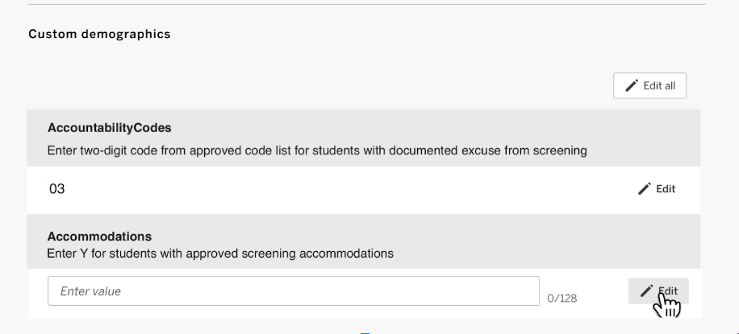
Accountability Codes in mCLASS
From the student’s profile page, you can view their demographics, and if you are an educator with system or enrollment access, you can also add or edit the student’s custom demographics.

Slide 39
Special Populations

Slide 40
Accommodations
Some accommodations may be applied during the screener if they are documented on an IEP, IAP or EL Checklist and they are used routinely during regular class instruction.
Breaks in between sections
Hearing aids, assistive listening devices, glasses, Smartwatches if used for medical reasons (Smartwatches and or phones that are used for medical reasons must be carefully monitored)
Enlarged student materials (magnification)
Covered overlays, filters or lighting adjustments
Marker or ruler for tracking
Whisper phones

Slide 41
Preparation for Accommodations
As with all statewide assessments, test administrators must have a list of students with their accommodations prior to administration of the screener. The test administrator should be trained in the proper administration of the accommodation.
If a screener is invalidated due to improper application of accommodations, the district test coordinator must submit a testing irregularity report to assessment@la.gov.
For details on allowable accommodations, please see the Louisiana Specific Instructions and Oaths Test Coordinator Manual.

Slide 42
Accommodations in mCLASS
There is no place to list accommodations in mCLASS for students. A custom demographic field for each student captures a Y for students who are being given accommodations.
DTCs and STCs should be aware that the two new demographic fields: accountability codes and accommodations will allow endless options to be entered incorrectly. Descriptions for both fields are included to explain what is expected to be entered.

Slide 43
Accommodation Flag in mCLASS
One of the two custom demographics added to the student profile is a field for identifying students who will receive Louisiana-approved accommodations.

Slide 44
Extended Time
For the administration of the state K-3 Literacy Screener, extended time is defined as double the time that is prescribed. For example, if all students must complete the subtest in 1 minute, extended time allows for 2 minutes. The screener sections should be strictly timed. Extended time is only available for the following students:
English learners as identified in EdLink 360 enrollment
Students with fluency-based speech disorders documented on IEPs
Students assessed with LAAR alternative rubric
Students with limited verbal language skills, as documented on the IEP, that are not participating in an alternate assessment
Students who require braille

Slide 45
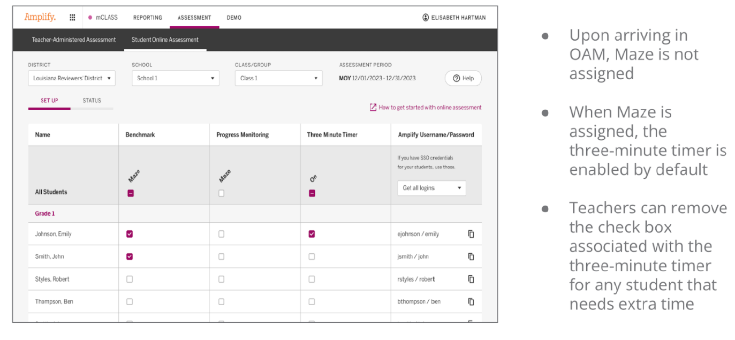
Extended Time: Maze

Slide 46
Additional Timing Device
An additional timing device will be needed for all extended time, including the grade 2 and grade 3 Maze online. If paper is used for grade 3 Maze, scores must be entered into mCLASS as students are screened. The upload of a multiple student file will not be possible for EOY.
The timer for Maze can be disabled for both grade 2 and grade 3. This can only be done by a test administrator.

Slide 47
Braille
Braille materials need to be ordered. Amplify will be responsible for shipping the materials. Only secure EOY K-2 forms will need to be returned at the completion of testing.
Braille Styles offered by Amplify:
Grade 3: Contracted
Grade 2: Uncontracted and Contracted
Grades K-1: Uncontracted

Slide 48
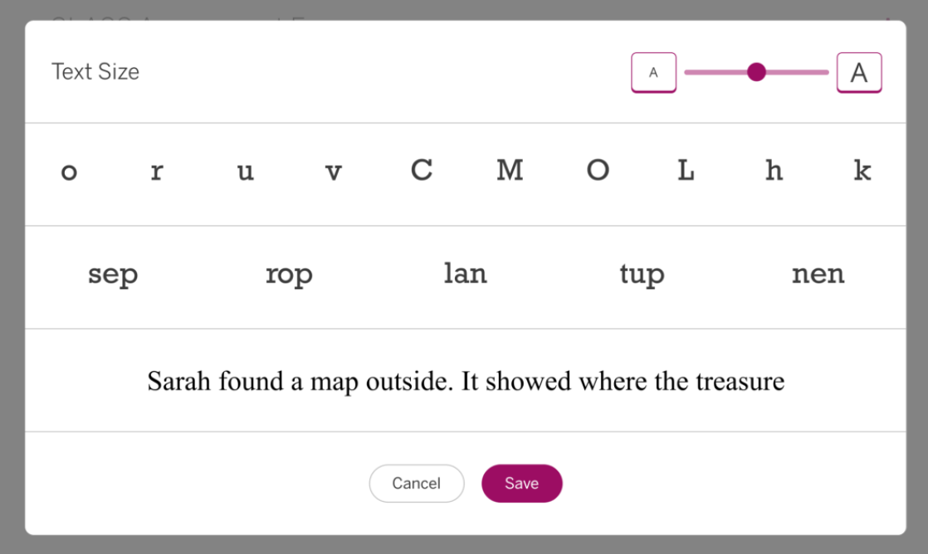
Large Print
Test administrators will use the magnification tool in the Louisiana mClass platform. Use the slider at the upper right of the Text Size dialog box to Adjust the text size to the needs of the student. When finished, click Save. The student form will reflect your selection, and the selected size displays in the Assessment Forms page.

Slide 49
Testing Accommodations Not Permitted
The following test accommodations are not permitted on the K-3 Literacy Screener.
Test read aloud (all forms)
Word prediction
Communication assistance
Any other accommodation that subverts the measure

Slide 50
Qualifying for Alternate Assessment
The IEP in place by the deadline should reflect that the student qualified for alternate assessment based on qualification guidelines for their official enrolled grade. Links for criteria are provided below. The IEP should also reflect the current grade.
K-2 Alternate Assessment Participation Decision-making Tool
Grades 3-8 Alternate Assessment Criteria

Slide 51
Remote Administration

Slide 52
Grade 3 Remote Administration
Test administrators must use the grade 3 EOY remote administration deck and grade 3 remote administration scoring booklet are found on the Literacy Screener website.
Grade 3 remote administration is available under certain conditions that are agreed upon by the test administrator and the parent. If a parent and/or student refuses to agree to the conditions or violates any remote testing requirements, then the remote administration must be terminated without scoring, and the student will be required to screen in person.
There is no remote administration option for the secure K-2 forms. When a secure form is added to grade 3 in future years, grade 3 will no longer be a remote option.

Slide 53
Test Security

Slide 54
Test Security
The K-2 literacy screening instrument used for the end-of-year is a secure document that was created specifically for Louisiana. All test security applies to this screening.
The contents of the screener must be kept secure. Individuals who are not serving as TAs should not have access to it.
The screener contents cannot be copied, photographed, memorized or duplicated in any way. There can be no paper version of the screener.
The contents of the screener should not be discussed outside of the administration of the screener to a student.

Slide 55
Oaths of Security
Anyone who may come into contact with secure materials should have a signed oath of security prior to the EOY administration window opening. Access should be limited to test administrators.
Oaths should be maintained at the school for three years.

Slide 56
Prohibited Materials
Prohibited materials can compromise test security and violate the construct being measured by the assessment, thus producing invalid results. Prohibited materials must be covered or removed from the testing room. This includes any document or display that provides content from the screener or content related to the items on the screener.
A secure environment is required for all grade levels, including grade 3 screening.

Slide 57
Accountability, Intervention and Gifted Referrals

Slide 58
Inclusion in School Accountability
Beginning with the 2025-2026 school year (2026 SPS), the kindergarten through eighth grade assessment index will also include a measure of K-2 literacy and growth on student literacy. The data that will be used to develop a model for inclusion will come from the secure DIBELS 8th Louisiana end-of-year screeners administered statewide in mCLASS. The 2024 data will be used with data collected in 2025 to develop final K-2 student literacy measures recommended to BESE for inclusion in the 2026 SPS.

Slide 59
Summer Intervention and Retention
For questions regarding Grade 3 and 4 Summer Intervention and Retention please contact LouisianaLiteracy@la.gov

Slide 60
EOY Gifted Referral
Gifted Referral reporting is due Friday, May 10. Each district is required to submit one report.
The following data sets will be collected for each grade level:
The number of gifted students scoring in the above-average range on the literacy screener.
The number of non-gifted students referred for additional screening.
The number of non-gifted students referred for gifted evaluation.
https://form.jotform.com/LDOE/eoy-k-3-literacy-screening-gifted

Slide 61
Contact Information
For issues related to administration: assessment@la.gov
For literacy policy: LouisianaLiteracy@la.gov
For Amplify customer service:
Email: help@amplify.com
Call: 1.800.802.2584
For resources and “how to”:
https://amplify.com/louisiana-mclass/

