Slide 1
New Orleans, Louisiana
June 11, 2025
Design of Instruction
High-Leverage Practices that Promote Learning
Polishing Practices in 2025 and Beyond

Slide 2

Anita L. Archer, PHD
Author, Consultant, Teacher archerteach@aol.com
Archer, A., & Hughes, C. (2011). Explicit Instruction: Effective and Efficient Teaching. NY: Guilford Publications.
Videos that illustrate explicit instruction can be found on this website:
www.explicitinstruction.org

Slide 3
Session Description: Design of Explicit Instruction: High Leverage Practices that Promote Learning
Anita L. Archer, PhD
Explicit instruction is an evidence-based, systematic methodology for teaching academic skills to students across grade levels. While the Science of Reading informs us on what to teach, 50 years of research on Explicit Instruction guides us on how to teach.
In this session, Dr. Archer will review, illustrate, and model high-leverage practices concerning the Design of Explicit Instruction lessons in which the teacher would 1) convey the purpose of the lesson, 2) establish a firm foundation for new learning by reviewing necessary prerequisite skills and knowledge, 3) clearly explain or demonstrate what is to be learned, 4) provide scaffolding to optimize student success, and 5) provide adequate guided and independent practice to ensure learning.
Note: Dr. Archer is presenting two sessions on Explicit Instruction. This session focuses on the Design of Explicit Instruction Lessons and the second on the Delivery of Explicit Instruction. Participants may attend one or both sessions.
Audience: All Educators

Slide 4
Active Participation during Session
Short Choral Responses
Structured Partners (1 and 2)
Choral Reading
Cloze Reading
Make a response sheet.

Slide 5
Purposes of Session
Affirm
Remind
Polish Good Practices
Expand
Apply

Slide 6
Learning Intentions
Objectives stated as Questions
What are the high-leverage practices critical in the design of explicit instruction lessons?
What instructional practices can be polished to enhance learning in your classroom/school?

Slide 7
Universal Outcome
Learning
Learning
Learning
Learning
Learning
Learning

Slide 8
Universal Outcome
Teaching ➡️Learning
Teaching ➡️Learning
Teaching ➡️Learning
Teaching ➡️Learning
Teaching➡️Learning
Teaching➡️Learning

Slide 9
How can we make a difference for all students?
A relentless focus on learning.
A relentless focus on teaching.
A relentless focus on teaching and learning.

Slide 10
Elements of Explicit Instruction
Explicit Instruction is unambiguous and direct approach to teaching that incorporates instruction design and delivery.
Archer & Hughes, 2011

Slide 11
What is Explicit Instruction?
“a way of teaching where the teacher selects an important objective, specifies the learning outcome, designs structured instructional experiences, explains directly, models the skills being taught, and provides scaffolded practice to help a student achieve mastery”
(Devin Kearns, 2018).

Slide 12
Guiding Principles
Remember this:
Good Instruction is Good Instruction
Remember this:
What they think about is what they learn
Remember this:
Success + Value ➡️ Motivation
Partners

Slide 13
Clarity - Effect Size .85
Clarity – Goals
Clarity – Expectations
Clarity - Explanations
Clarity – Demonstrations
Clarity - Practice Activities
  Fendick & Titsworth

Slide 14
Elements of Explicit Instruction
Content

Slide 15
Elements of Explicit Instruction
Content
Focus on critical content.

Slide 16
Polish Practice Critical Content
Critical Content
Select evidence-based content.
Select critical content that is:
Useful in the Moment
  Useful in the Future
  Archerism:
Teach the Stuff and Cut the Fluff

Slide 17
Focus on critical content.
Word-Level Reading (Decoding) What are the 5 pillars?
Phonemic Awareness
Decoding - Phonics and Morphology
Encoding (Spelling)
Morphology
Sight Vocabulary (Instant Recognition)
Fluent Reading (Accuracy, Rate, Expression)
Language Comprehension
Vocabulary
Background Knowledge
Strategies to focus Attention on Critical Content

Slide 18
IES Practice Guides
Guides to Evidence-Based Practices
Foundational Skills to Support Reading for Understanding in Kindergarten Through 3rd Grade (2016)
Teach students to decode words, analyze word parts, and write and recognize words.
Teach students academic language skills, including the use of inferential and narrative language, and vocabulary knowledge.

Slide 19
IES Practice Guides
Teaching Academic Content and Literacy to English Learners in Elementary and Middle School (2014)
Teach a set of academic vocabulary words intensively across several days using a variety of instructional activities.
Teaching Elementary School Students to Be Effective Writers (2012)
Teach students to use the writing process for a variety of purposes. (Plan, Draft, Revise, Edit)
Teach students to become fluent with handwriting, spelling, sentence construction, typing, and word processing.

Slide 20
IES Practice Guides
Improving Reading Comprehension in Kindergarten Through 3rd Grade (2010)
Teach students how to use reading comprehension strategies.
Teach students to identify and use the text’s organizational structure to comprehend, learn, and remember content.
Providing Reading Interventions for Students in Grades 4 – 9 (2022)
  Build students’ decoding skills so they can read complex multisyllabic words.
  Provide purposeful fluency-building activities to help students read effortlessly.
  Routinely use a set of comprehension-building practices to help students make sense of the text.

Slide 21
Elements of Explicit Instruction
Content
Break down new material into smaller
instructional steps (obtainable chunks).

Slide 22
Polish Practice Break-down Content into Obtainable Chunks
Break-down Content
Set students up for learning and success
Break- down content to avoid cognitive overload
Strategies – into steps
Knowledge – into short amounts followed by rehearsal or retrieval of content
Vocabulary – Teach limited number of terms in depth in one session

Slide 23
Strategy – Break it down
Writing Process – Short Summary
  Plan and outline Plan
  Create a draft Draft
  Revise the draft Revise
  Edit the draft Edit
The Writing Revolution 2.0
Judith C. Hochman and Natalie Wexler

Slide 24
Break down new material into smaller instructional steps (obtainable chunks).
Topic _______________
Topic Sentence ____________________________________
_________________________________________________
Details - Notes
1. _______________________________________________
________________________________________________
2. _______________________________________________
_________________________________________________
3. _______________________________________________
_________________________________________________

Slide 25
Break down new material into smaller instructional steps (obtainable chunks).
Plan: Can determine and record the topic and three critical details of a section of informative text.
Plan: Can determine and record the topic, three important details, and a topic sentence for a section of informative text.
Draft: Using a plan, can write a draft summary containing a topic sentence and related detail sentences.
Revise: Can revise by expanding sentences and adding transitions.
Edit: Can check for errors in spelling, punctuation, and capitalization.

Slide 26
Break down new material into smaller steps
(obtainable chunks).
Topic - Three Branches of the Federal Government
I can name the three branches of government.
I can describe the primary functions of each branch of government.
I can compare and contrast each of the functions.
I can describe the limitations of each branch of government.
I can apply these limitations to the balance of power.

Slide 27
Vocabulary – Break it down
Teach a limited number of terms in depth in one session.
Text: American Journey Chapter 11, Section 1 Publisher: Glencoe Jacksonian Democracy
favorite son | majority | plurality | mudslinging
landslide | nominating convention | tariff | suffrage
nullify | secede

Slide 28
Elements of Explicit Instruction
Design and teach organized and focused lessons.

Slide 29
Polish Practice Design and teach organized and focused lessons.
Organized and
Focused Lessons
Teach organized and focused lessons on critical content every day in every class.
Archerism
How well you teach =
How well they learn

Slide 30
3. Design and teach organized and focused lessons.
Organized and focused lessons
Explicit Instruction
Teacher-led instruction
Tell (Don’t Ask)
Clear explanations (Clarity)
Clear models (Clarity)

Slide 31
Design and teach organized and focused l Lessons.
                1. Opening
                2. Body
                3. Closing
Which lesson segment is most often deleted? Show Fingers - 1, 2, or 3.

Slide 32
Design and teach organized and focused lessons.
Opening
      Attention
      Review
      Preview
Body
Closing
      Review
      Preview
      Independent Work

Slide 33
Elements of Explicit Instruction
Opening of Lesson
Begin lessons with a clear statement of the lesson goals. Hattie Effect Size .68

Slide 34
By many names Purpose
          goals
          objectives
          learning objectives
          learning aims
          I can statements
          targets
          learning Intentions

Slide 35
Polish Practice Opening of Lesson
Clear statement of lesson goal
Lesson Goal
Lesson Purpose
Clarity –
  Student-friendly
  Terminology known
Student Involvement
  Students and Teacher read
  Students respond to questions on goal
Revisited during lesson
Known by students

Slide 36
Elements of Explicit Instruction
Opening of Lesson
Review prior skills and knowledge before
beginning instruction.

Slide 37
Polish Practice Review prior skills and knowledge
Review
essential preskills
steps previously taught
essential vocabulary
essential facts
- Consistent instructional
practice
Actively involve students in review
Utilize retrieval practice
When students retrieve and bring information to mind, this mental challenge produces durable long-term learning.

Slide 38
Design and teach organized and focused lessons.
Body of Lesson
Instructional Procedures differ for:
Skills and Strategies – How to do something
Information (facts) – What we need to know
Vocabulary – What something means

Slide 39
Design and teach organized and focused lessons. Body of Lesson
Utilizing explicit instruction procedures to teach strategies. How to do something
  Demonstration I do it.
  Guided Practice We do it.
  Checking understanding You do it.

Slide 40
Polish Practice I do – Demonstration - Skills/Strategies
I Do
Demonstrations
Show and Tell
Broken down into small steps
Steps exaggerated
Clarity Clarity Clarity
Dynamic demonstrations followed by WE DO IT

Slide 41
Polish Practice We do – Guided Practice
We Do
Optimizing student success
Guiding steps in strategy application
Step – Do – Step – Do
Clarity Clarity Clarity
Using gradual release of responsibility
Continuing until majority have accuracy
Check understanding

Slide 42
Polish Practice You do – Checking Understanding
You do it.
  Students perform a task.
  Teacher monitors performance.
  Have students mastered the skill.
  If successful, students practice
  the skill independently.
Differentiation
  Focused monitoring
  Peer Assistance
  Small group instruction

Slide 43
Design and teach organized and focused lessons. Body of Lesson
Utilizing explicit instruction procedures to teach facts and knowledge.
(What we know.)

Slide 44
Polish Facts and Knowledge
Attend
Intend
Rehearse
Retrieve
Three different sets of complete knowledge
Graham Nuthall, 2007

Slide 45
Teaching Facts and Knowledge
Elementary Example - Emperor Penguins
Emperor Penguins
Habitat – Natural Environment
When we study a natural environment, a habitat, what should we examine?
  land
  climate
  vegetation (plants)
  animals

Slide 46

Land – Antarctica
Twice the size of Australia
South Pole in Antarctica
20

Slide 47

Land – Antarctica
ice covers all but 2.4% of land
90% of ice found on the earth is in Antarctica
21

Slide 48
Land – Antarctica
Retell to partner.
“Here’s some things you you need to know about the land of Antarctica.”
Use words and gestures to retell.
22

Slide 49
Design and teach organized and focused lessons. Body of Lesson
Utilizing explicit instruction procedures to teach vocabulary and concepts.
What something is

Slide 50
Vocabulary Instructional Routine
Step 1: Introduce the word’s pronunciation.
Step 2: Introduce the word’s meaning.
Step 3: Illustrate the word with examples. (and non-examples when helpful)
Step 4: Check students’ understanding.

Slide 51
Lesson Design — Vocabulary
Step 1. Introduce the word’s pronunciation.
  Write word on board or display on screen.
  Read word and have students repeat word.
  If word is difficult to pronounce or unfamiliar have students repeat word several times OR have students tap out the oral syllables of the word.
  Orally spell the word. (and write the word)
“ This word is compulsory. What word?” compulsory
“Tap and say the syllables in compulsory.” com pul sor y
“What word?” compulsory
“Spell the word with me. c-o-m-p-u-l-s-o-r-y

Slide 52
Lesson Design — Vocabulary (continued)
Step 2. Introduce the word’s meaning.
Present a student-friendly explanation
  Tell students the explanation OR
  Have them read the explanation with you
Present the definition with me.
  “When something is compulsory, it is required and
  you must do it. So, if it is required and you must do it,
  it is _______________.”

Slide 53
Lesson Design — Vocabulary (continued)
Step 3. Illustrate the word with examples
Present the examples with me.
“Stopping at a stop sign when driving is compulsory.”
“Paying taxes is compulsory.”

Slide 54
Lesson Design — Vocabulary (continued)
Step 4. Check students’ understanding
Option #1. Have students discern between
examples and non-examples
Check students’ understanding with me.
Tell me, compulsory or not compulsory
Attending school at age 15 in Louisiana? compulsory
How do you know it is compulsory? It is required to attend
Going to college when you are 25 years old? not compulsory
Why is it not compulsory? It is not required. You choose to go to college.

Slide 55
Lesson Design — Vocabulary (continued)
Step 4. Check students’ understanding
Option #2. Have students generate examples
Check students’ understanding with me.
There are many things at this school that are
compulsory. Think of things that are compulsory.
Sentence Starter: One thing that is compulsory is…

Slide 56
Lesson Design — Vocabulary (Continued)
Step 4. Check students’ understanding
Option #3. Ask deep processing questions
Check students’ understanding with me.
Many things become compulsory. Why do
you think something becomes compulsory?
Sentence Starter: Something becomes compulsory because …

Slide 57
Lesson Design — Vocabulary (Continued)
Step 4. Check students’ understanding
Option #4. Compare/Contrast
Check students’ understanding with me.
Compare and contrast these vocabulary terms:
compulsory and essential.
Ones: How are these words similar?
Twos: How are they different?

Slide 58
Elements of Explicit Instruction
Practice

Slide 59
Judicious Practice
Three Important Types of Practice
Deliberate Practice (Goal-Oriented Practice)
Spaced Practice (Distributed Over Time)
Retrieval Practice (Retrieved from Memory)

Slide 60
Deliberate Practice
Deliberate practice is goal-oriented practice consciously devoted to improvement of a skill.

Slide 61
Mass vs Spaced Practice
Mass Practice vs Spaced Practice –
Effect size d = 0.60 Hattie, 2017
Gains achieved in massed practice are transitory and melt away quickly. Brown, Roediger, McDaniel, 2014

Slide 62
Retrieval Practice
“Retrieval practice” is a learning strategy where we focus on getting information out. Through the act of retrieval, or calling information to mind, our memory for that information is strengthened and forgetting is less likely to occur.
Agarwal, Roediger, McDaniel, & McDermott (2018)
Retrieval Practice makes learning STICK far better than re-exposure to the original material.

Slide 63
Design of Explicit Instruction
1. Focus on Critical Content.
2. Break down new material into smaller steps (obtainable chunks).
3. Design and teach organized and focused lessons.
4. Begin lessons with a clear statement of the lesson goals.
5.Review prior skills and knowledge before beginning instruction.
6. Provide step-by-step demonstrations. I do.
7. Provide guided practice. We do.
8. Check students’ understanding. You do.
9. Provide judicious practice.

Slide 64
Learning Intentions - Revisited
Objectives stated as Questions
What are the high-leverage practices critical in the design of explicit instruction lessons?
What instructional practices can be polished to enhance learning in your classroom/school?

Slide 67
Thank you for attending this conference.
Thank you for your service to children.
Remember This:
How well you teach = How well they Learn
Teach with Passion
Manage with Compassion

Slide 68

Explicit Instruction: Effective and Efficient Teaching
Anita L. Archer and Charles A. Hughes

Slide 69

Just Tell Them: The Power of Explanations and Explicit Instruction
Zach Groshell

Slide 70
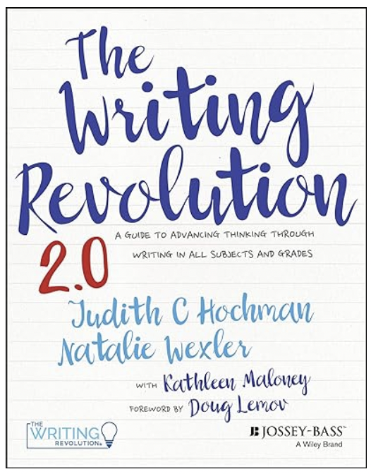
The Writing Revolution 2.0
Judith C. Hochman
Natalie Wexler

Slide 71

Harnessing the Science of Learning
Harnessing the Science of Learning
Nathaniel Swain

Slide 72
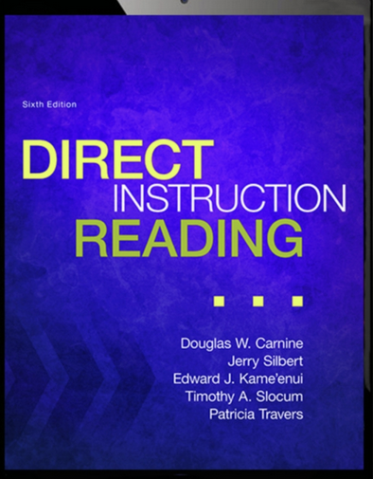
Direct Instruction Reading 6th Edition

