Slide 1

Using PARCC
Assessment Resources

Slide 2
Objectives
By the end of this presentation, participants will:
Understand key PARCC documents and how they are being used to inform assessment decisions
Discuss ways to prepare to use the PARCC documents to inform their work

Slide 3
Overview
1. Introduce some essential PARCC documents
  Evidence statements
  Assessment Design
  Performance Level Descriptors
  Resources
2. Discuss how the documents are being used and could be used to inform assessment decisions

Slide 4
PARCC’s Core Commitments to Assessment Quality
Focus (Math): where the Standards focus, more time to master concepts at a deeper level
Problems Worth Doing (Math): multi-step problems, conceptual questions, applications, and substantial procedures
Texts Worth Reading (ELA): authentic texts worthy of study , not artificially produced or commissioned passages
Questions Worth Answering (ELA): sequences of questions that draw students into deeper encounters with texts, not sets of random questions of varying quality
Notes:
Focus—should look to the CCSS, but also the MCF and Evidence Statements
Problems worth doing—does not mean they all have context, for example fluency problems—clarifications in evidence tables can help

Slide 5
Evidence Statements
This section includes:
Evidence-Centered Design
Model Content Frameworks
Mathematics Evidence Statements
Reading ELA Evidence Tables
Instructional Uses and Discussion

Slide 6
Evidence-Centered Design (ECD) for the PARCC Assessments
Claims
Design begins with the inferences (claims) we want to make about students
Evidence
In order to support claims, we must gather evidence
Tasks
Tasks are designed to elicit specific evidence from students in support of claims
Notes:
PARCC is using Evidence-Centered Design to drive the development of its summative assessments
In the ECD framework, assessment is considered a process of reasoning from imperfect evidence, and as such, is a part of a practical argument using claims and evidence to support the inferences we are making about student proficiency. In other words, an argument is made from what we observe students say, do, or produce (the evidence) in a few particular circumstances (the tasks or items) to support our inferences (or claims) about what they know, can do, or have accomplished more generally. Using ECD for design and development helps one clearly articulate assessment arguments. The ECD process includes identifying potential claims about what constitutes student proficiency; identifying evidence (what students might say, do or produce that will constitute evidence for the claims), and identifying the kinds of situations – the tasks or items -- that give students the optimal opportunity to produce the desired evidence.

Slide 7
Claims Driving Design: Mathematics
Master Claim: Students are on-track or ready for college and careers
Sub-claim A:
Students solve problems involving the major content for their grade level with connections to practices
Sub-Claim E:
Students demonstrate fluency in areas set forth in the Standards for Content in grades 3-6
Sub-Claim B:
Students solve problems involving the additional and supporting content for their grade level with connections to practices
Sub-claim C:
Students express mathematical reasoning by constructing mathematical arguments and critiques
Sub-Claim D:
Students solve real world problems engaging particularly in the modeling practice
Notes:
Evidence statements from sub-claims A, B, and E are reflective of direct standard language.
Sub-claim C statements expect students to demonstrate their reasoning ability as applied to the CCSS. These statements are not derived from the language of the standards.
Sub-claim D statements expect students to demonstrate their modeling ability as applied to the CCSS. These statements are not derived from the language of the standards.
Sub-claims C and D are based on the standards for Mathematical Practices 3 and 4.

Slide 8
Claims for ELA/Literacy
Master Claim/Reporting Category:
Students are “on track” to college and career readiness in ELA/Literacy.
Major Claim: Reading Complex Text
Subclaim (SC):
Vocabulary Interpretation
SC: Reading
Informational Text
Major Claim: Writing
SC: Conventions and Knowledge of Language
SC: Written Expression
SC: Reading
Literature
SC: Research
Notes:
We have to start with the claims because that is what drives the evidence tables and will determine reporting categories. Each of the subclaims is attached to a specific set of standards.

Slide 9
Model Content Frameworks
PARCC designed the MCF to inform evidence statement development and test design.
It is encouraged that teachers, instructional strategists, curriculum coordinators, et al. use the MCF in conjunction with the CCSS to inform instructional and assessment decisions for grades 3-8.
ELA Model Content Frameworks
Mathematics Model Content Frameworks

Slide 10
Model Content Frameworks for Mathematics
Instructional resources include (per grade level):
    Advances from the previous grade level
    Fluency expectations or culminating standards
    Within-grade dependencies
    Connections among standards, clusters, and domains
    In-depth focus
    Connecting content and mathematical practices
    Content emphases by cluster
    Linking supporting work to major work
Implications for assessment
    Provides additional guidance on integrative evidence statements
    Emphases by cluster inform test blueprints: major, supporting, additional
Notes:
Implications
Integrative statements—some come from previous grade level with a clarification that tasks are to be grade level appropriate, the MCF can help to illuminate the grade level differences in “advances” and other sections.
PARCC MCF is clear that supporting and additional work is not to be skipped and will be assessed in sub-claim B. My observation is that many additional/supporting standards are included in sub-claim C and D evidence statements and integrative statements. Meaning: additional/supporting standards are less frequently individually assessed, but more likely appear as part of a type 2 or 3 task which is more involved and combines standards.

Slide 11
Model Content Frameworks ELA/Literacy
Purpose of the ELA Model Content Frameworks:
To provide a frame for the PARCC assessments
To provide a resource to help guide educators and those developing curricula and instructional materials
  Includes a narrative summary of the ELA standards
  Includes a visual model of how the standards could be organized in a number of ways over the course of the school year
  Explains key terminology when working with the CCSS (close reading, text complexity, etc.)
Notes:
Serve as a useful bridge for teachers and others who want to create curriculum that reflects the key shifts within the CCSS while simultaneously preparing their students for the PARCC Assessment System.
This is not a curriculum; it is what may be used to guide curriculum decisions. It was a place to start for many states in better understanding PARCC and how to use it to think about curriculum. We now have curriculum guides at grades 3-12, which are much more specific and comprehensive.

Slide 12
What are Evidence Statements?
Contain the evidences to be measured on the PARCC Summative Assessment to support the Claims
  Describe what students might say or do to demonstrate mastery of the standards
  Describe the knowledge and skills an assessment item or a task elicits from students
Notes:
For ELA, the Reading and Vocabulary and Writing evidence tables include the claim or sub-claim, the standards that are eligible for assessment, and the evidences to be measured on the summative assessments. The evidence statements essentially break down the standards into smaller parts to illustrate how each standard will be assessed.

Slide 13
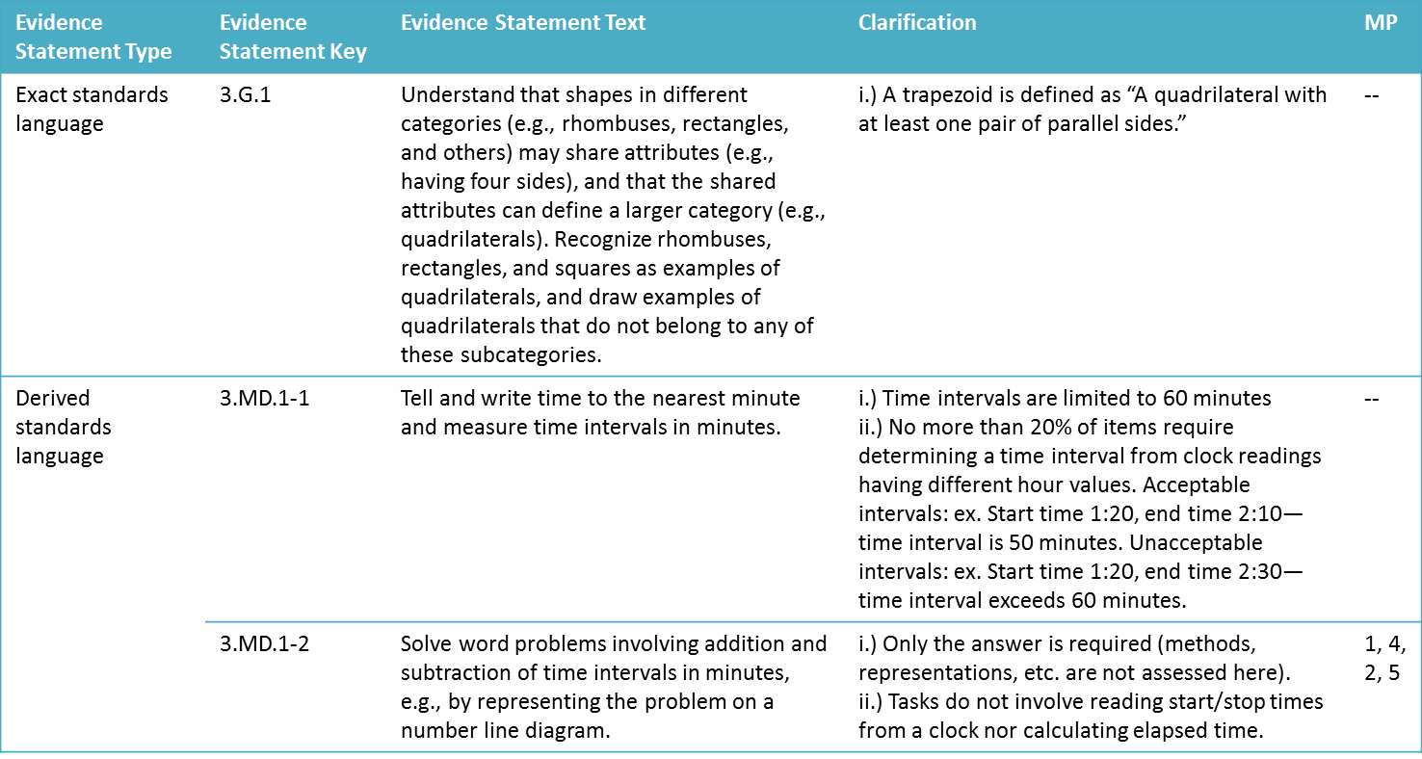
Evidence Statements for Mathematics
Notes:
For the spring 2014 transitional LEAP/iLEAP assessments, the CCSS were assessed similar to these types of statements. These statements use standards exactly as written or divide dense standards in separate skills. In the first example, the statement and standard are exactly the same. While the CCSS leaves the definition of trapezoid open, PARCC clarifies this evidence statement by defining how they plan to assess trapezoids. PARCC has split 3.MD.1 into two assessed parts. The first part is the first sentence of the standard dealing with telling, writing, and measuring time; the second part is the other sentence in the standard dealing with problem-solving involving time intervals. For dense standards of this type, the LEAP/iLEAP assessments also had to limit items to only assessing a portion of the standard. PARCC offers clarifications on time interval limitations, item variety, expected and unexpected student responses. What implications should these evidence statements and clarifications have toward instruction and/or assessment?

Slide 14
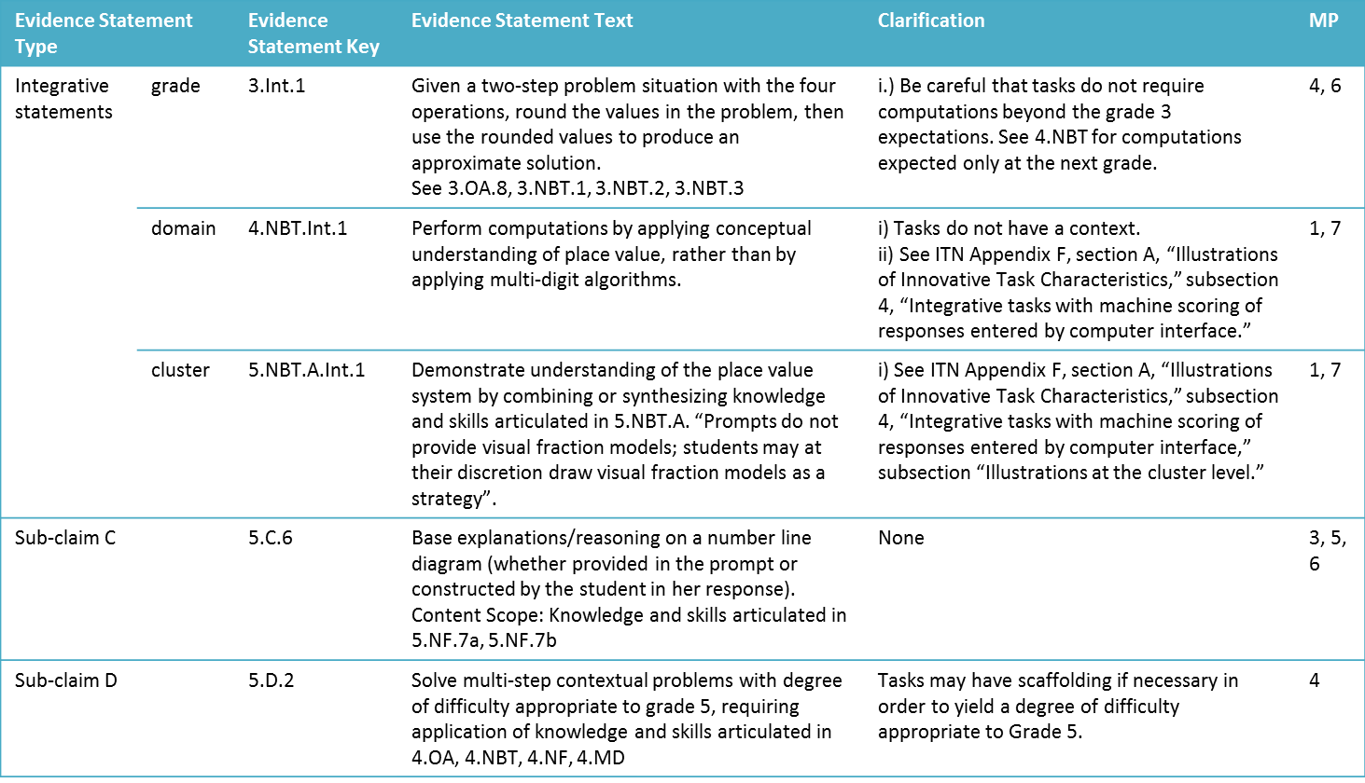
Evidence Statements for Mathematics
Notes:
Evidence statements for integrative statements and sub-claims C and D are very different from the transitional LEAP/iLEAP assessment. On the transitional assessments, standards were either assessed independently or in part, but not in combination.
Integrative statements combine standards in three ways: across content within the grade, across one domain within the grade, or across one cluster within one domain within the grade. Evidence statements that are integrated by grade will indicate which standards are being combined in the assessment task.
Evidence statements for sub-claim C assess certain identified standards based on MP 3: Construct viable arguments and critique the reasoning of others and MP 6: Attend to precision. In this example, MP 5: Use appropriate tools strategically is also incorporated by identifying the use of a number line.
Evidence statements for sub-claim D assess certain identified standards/clusters/domains based on MP 4: Model with mathematics. Notice that the identified domains are grade 4. What would a teacher need to know to determine “a degree of difficulty appropriate to Grade 5”?
While spring transitional assessments attempted to incorporate the MPs where appropriate, this was not a consistent/mandated feature of test design. What instructional and assessment implications do these types of evidence statements have for stakeholders?

Slide 15
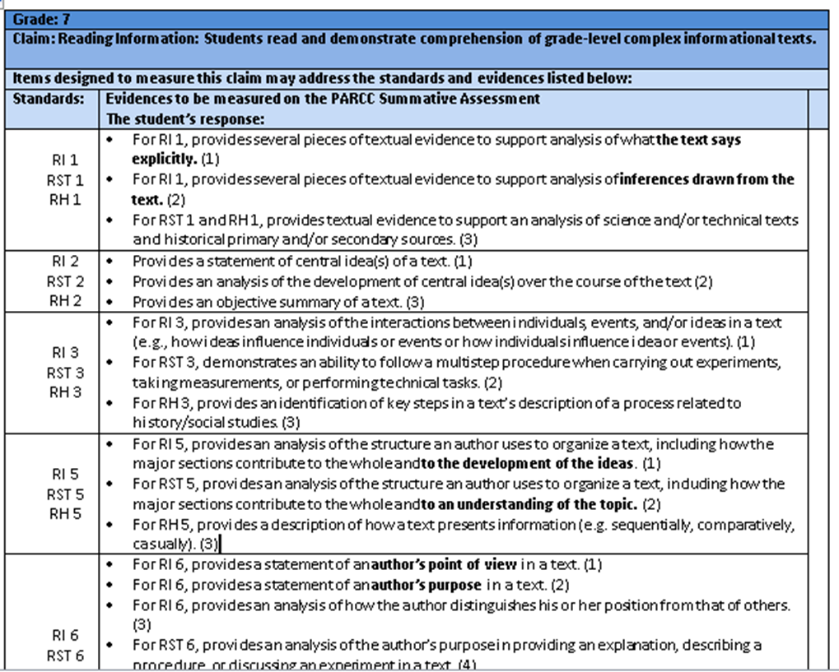
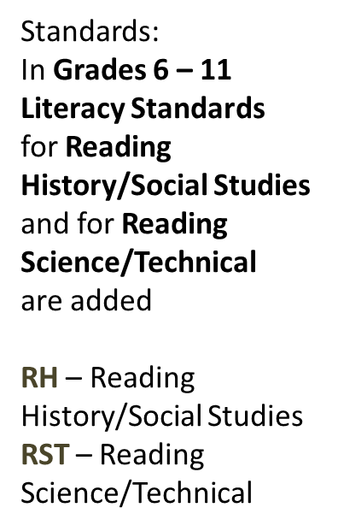


Reading an ELA Evidence Table: Reading
Notes:
In this slide, one learns how to read an evidence table. On each evidence chart the first line indicates the grade. This is followed by the second line which lists the claim for reading literature or reading informational text or vocabulary. Next is a statement that the standards and evidences listed below may be reflected in the items designed to measure the claim.
This example shows a partial table for the reading informational standards at grade 7. Notice the first column on the table also lists the literacy standards for science using RST to identify the standard and the literacy standards for history using RH to identify the standard. These are circled in yellow on the chart and are separated out for grades 6-11 but integrated for grades 3-5.
In the first column on the left is a list of the standards. If it is a reading literature standard it be identified with the letters RL and if it is an reading informational text standard it will be identified with the letters RI.
In the next column are the evidences to be measured on the PARCC Summative Assessment. The evidences can serve as a basis for guiding classroom instruction when teaching reading.
Evidences are attached to the Reading, Writing, and Vocabulary claims presented by PARCC.

Slide 16

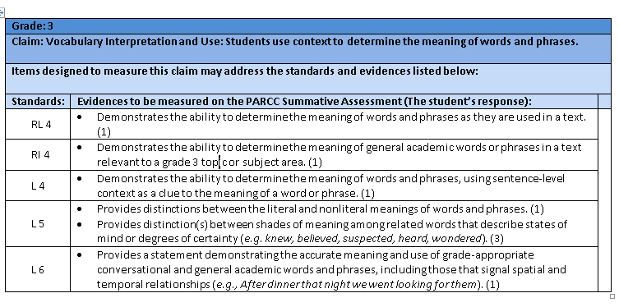


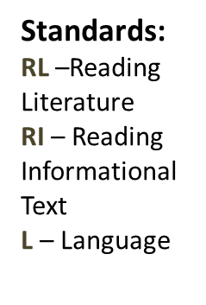

Reading an ELA Evidence Table: Vocabulary
Notes:
Notice that there is more than one sub-claim covered in the vocabulary evidence table since both types of text (informational and literary) include vocabulary, and the Language domain also has its own vocabulary standards that are slightly different from the reading vocabulary standards.

Slide 17

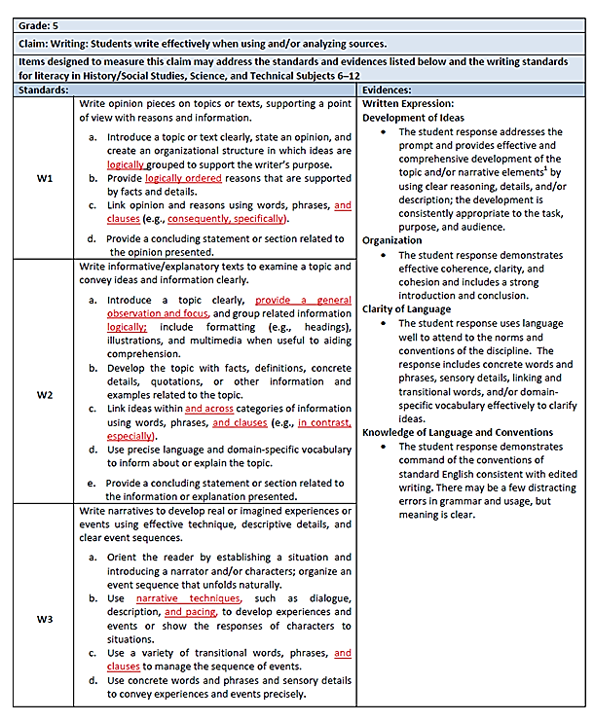


Reading the Writing Evidence Tables
Notes:
On each evidence chart the first line indicates the grade. This is followed by the second line which lists the claim for writing. Next is a statement that the standards and evidences listed below may be reflected in the items designed to measure the claim.
In the first column on the left is a list of the standards.
In the next column are the evidences to be measured on the PARCC Summative Assessment. The evidences can serve as a basis for guiding classroom instruction when teaching reading.
The last column has to do with how the writing is scored: Written Expression and Conventions, both Writing standards.
Information in red shows what is new to this grade level.

Slide 18
Instructional Uses of the Evidence Statements for Teachers
To see ways to combine standards naturally when designing instructional tasks
To develop the stem for questions/tasks for instruction aligned with the standards
To develop rubrics and scoring tools for classroom use
To determine and create instructional scaffolding (to think through which individual, simpler skills can be taught first to build to more complex skills)
To help determine alignment of a complex text with standards for instructional passage selection
To provide guidance on how content should be connected to the standards for mathematical practices
Notes:
First few are general; others are specific to ELA or Math

Slide 19
Discussion of Evidence Statements
Do you have any questions about the evidence statements?
How will you best use the evidence statements based on your role in the school or district?
Notes:
Stop and discuss any questions participants may have about Evidence Statements.
Different places to use evidence statements: instruction, assessment, resources, etc.

Slide 20
PARCC Assessment Design
This section includes:
Summative Assessment Design (Math/ELA)
Mathematics Task Types
Mathematics Blueprints
ELA Tasks and Task Models
ELA Form Specifications (PBA and EOY)
Discussion of Design

Slide 21
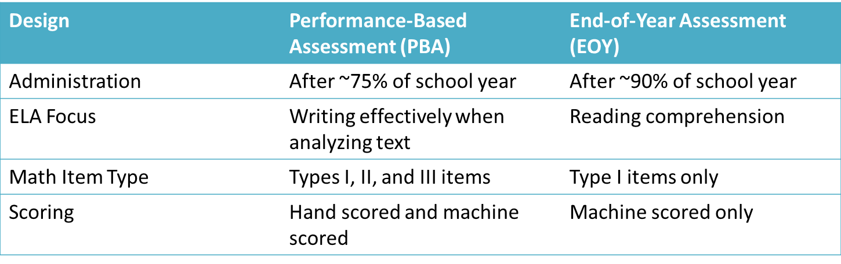
PARCC Summative Assessment Design

Slide 22
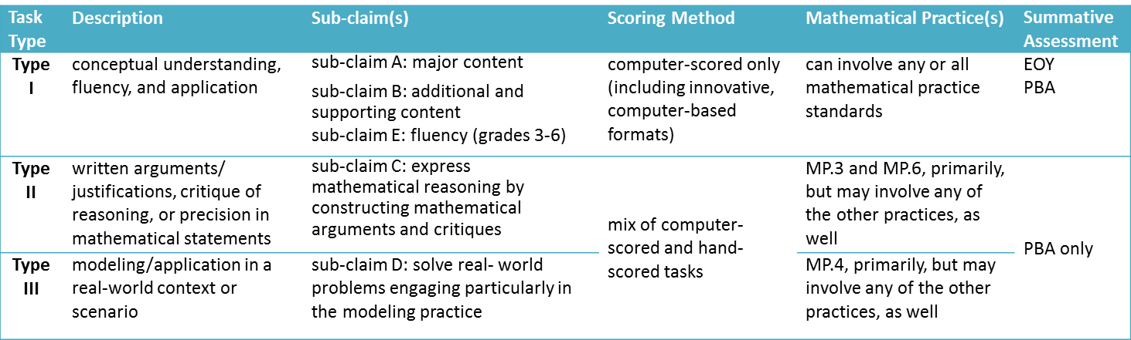
Overview of PARCC Mathematics Task Types

Slide 23
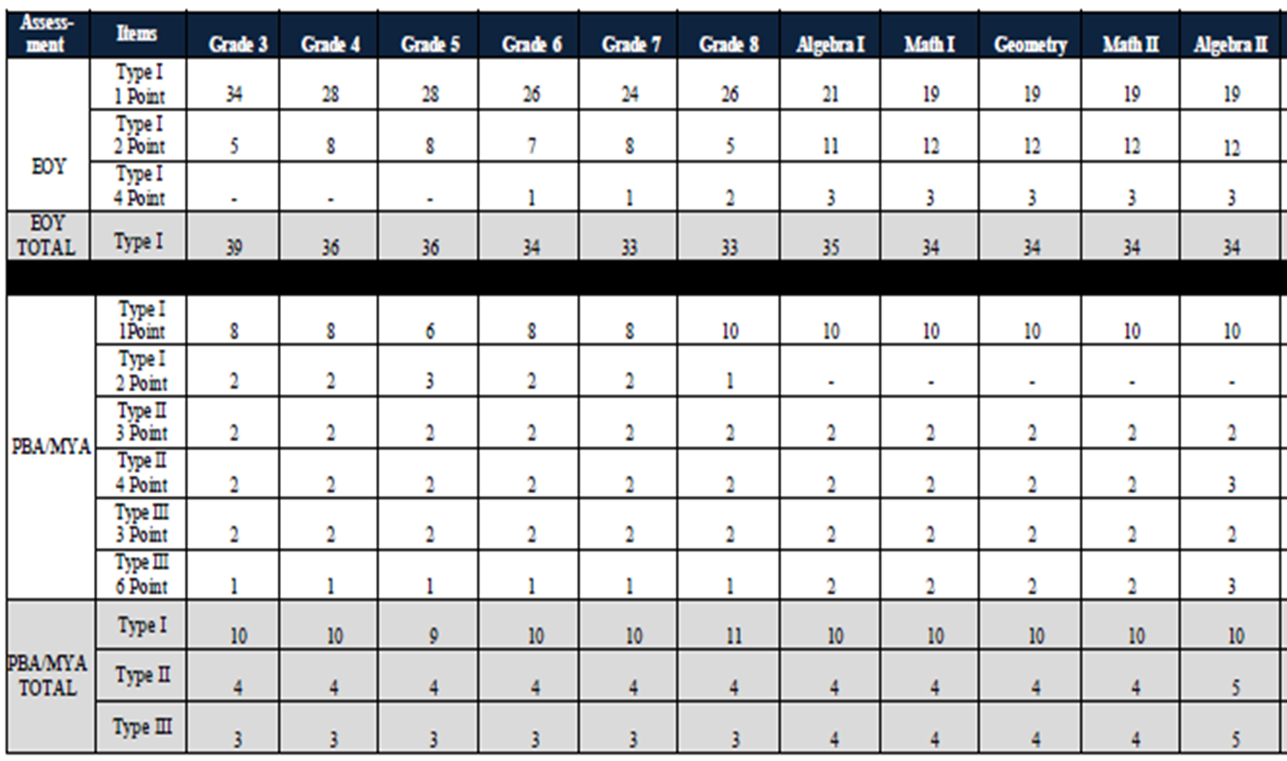
High-level Math Blueprints
Notes:
Details the number of each type of item by grade level to be expected on the EOY and PBA. What guidance can this table provide?
To note:
Fewer items, but increase in items worth more than 1 point.
Impact classroom assessment design

Slide 24
Performance Based Assessment:
ELA Tasks
  Literary Analysis Task (LAT): two literary texts
  Students answer selected-response questions to show comprehension of texts and then write an extended literary analysis of the texts using evidence from both texts
  Research Simulation Task (RST): three related sources (one may be multimedia)
  Students read/watch sources, answer selected-response items, and write an analytic essay using textual evidence from the sources.
  Narrative Task (NT): one or two short texts
  Students answer selected-response questions to show comprehension of text and write a narrative based on the provided text.
Notes:
Different Item Types include
Selected Response:
Evidence-Based Selected Response (EBSR): two-part items where first part measures a specific standard and second part asks for evidence for part 1
Technology Enhanced Constructed Response (TECR)
Prose Constructed Response (PCR)

Slide 25
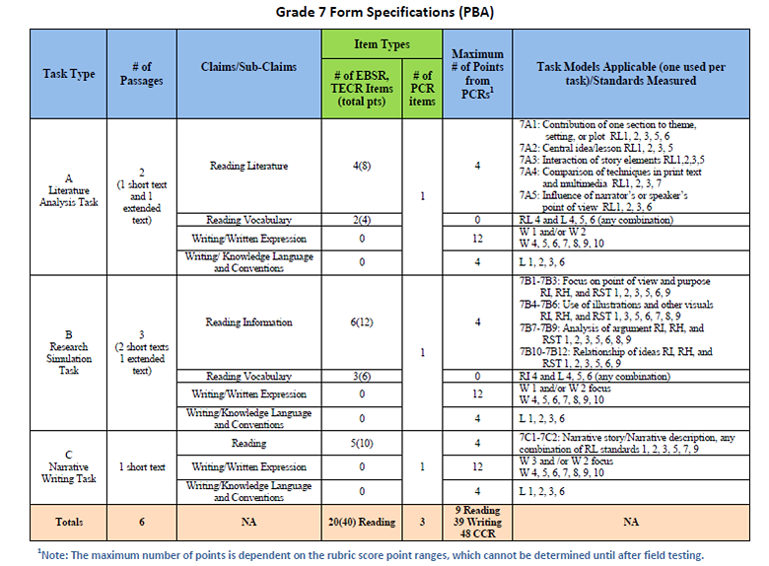
Performance Based Assessment Specifications: ELA
Notes:
See slide 19 for link to actual specifications.
Treat as a draft. There will be changes that come from recent PARCC rangefinding, especially with points and distribution of items.
Only one task model is used per form, per task. The specs list all possible task models.
Shows what is required for each task: types of text(s), what each task is measuring, item types, points, task models
Different task models for each kind of task. All tasks include EBSR/TECR items as well as PCRs, which are the written responses.
Uses:
Understand what we mean by tasks (texts, different kinds of items, culminating task/PCR), similar to what the curriculum guide asks for but with cold read tasks
Shows what is emphasized as far as task models and the range of standards that is covered with each (grade specific)
Supports the idea of scaffolding assessment items within a task to build up the written response item

Slide 26
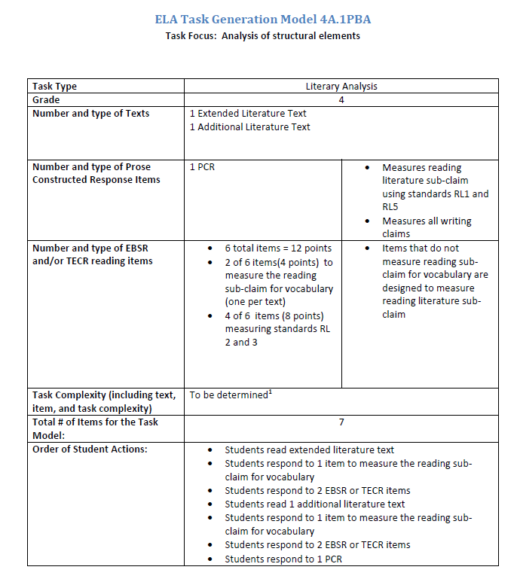
ELA/Literacy Task Models
Notes:
See slide 19 for link to actual task models.
Grade 4 example: Structural elements/Standard 5 is emphasis of PCR, which is the culminating task or synthesis of texts
Parts:
Task Type (LAT, Research Simulation, Narrative), Grade, Texts, item types and points, order of items
Uses:
Understand what we mean by tasks (texts, different kinds of items, culminating task/PCR), similar to what the curriculum guide asks for but with cold read tasks
Shows what is emphasized with each model and shows the range of standards that is assessed with each task model (grade specific)
Determine which tasks models might best serve the focus of their own units
Supports the idea of scaffolding assessment items within a task to build up the written response item

Slide 27
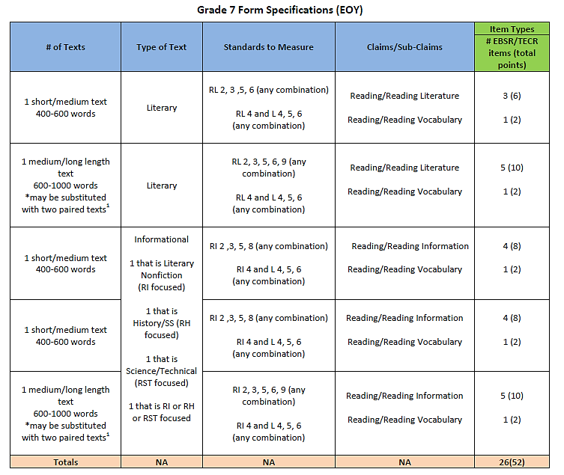
ELA End-of-Year Form Specifications
Notes:
See slide 19 for link to actual specifications documents.
This is a screen shot of Grade 7 End Of Year Form Specifications. Still considered a draft.
Focuses on reading comprehension
Completely machine-scored
Includes several texts, both literary and informational (some single texts, some paired)
The EOY specifications could help guide the creation of text-dependent questions attached to a particular text or set of texts.

Slide 28
Discussion of Design
Do you have any questions about the design of the PARCC tests?
How will you use the design information based on your role in the school or district?
More information about test design can be found at https://www.parcconline.org/assessment-blueprints-test-specs
Notes:
Discuss with group to check for understanding and to encourage discussion of how to use based on role (teacher, principal, district personnel, etc.)

Slide 29
Performance Level Descriptors (PLDs)
This section includes:
PLD Development Information
PLD Samples for Mathematics and ELA
Discussion

Slide 30
What are Performance Level Descriptors?
Performance Level Descriptors or PLDs describe what students at each performance level know and can do relative to grade-level or course content standards assessed.
capture how all students perform
show understandings and skill development across the spectrum of standards and complexity levels assessed
PARCC PLDs are in DRAFT form only and will most certainly be altered/amended after field-testing data has been analyzed
PARCC PLDs do NOT correlate to LEAP/iLEAP ALDs
Notes:
Performance levels, sometimes referred to as “achievement levels,” are the broad, categorical levels used to report student performance on an assessment.
Why no level 1 on the actual documents?
Each performance level on the PARCC assessments will encompass a wide range of student performance. For the lowest level, Level 1, the performances can include those from students who chose not to answer a majority of the questions, those who answered all but a few questions incorrectly, and those who just missed the cut score for Level 2. Consequently, the most accurate means to describe the performance of a student achieving at Level 1 is to say that this student is one who has not demonstrated the knowledge and skills necessary to achieve Level 2.

Slide 31
Building on Work to Date
In October 2012 PARCC established 5 performance levels
  Level 5: Students performing at this level demonstrate a distinguished command of the knowledge, skills, and practices embodied by the Common Core State Standards assessed at their grade level.
  Level 4: Students performing at this level demonstrate a strong command…
  Level 3: Students performing at this level demonstrate a moderate command…
  Level 2: Students performing at this level demonstrate a partial command…
  Level 1: Students performing at this level demonstrate a minimal command…
Notes:
ELA language is slightly different but same terminology:
A student who achieves a Level 5 demonstrates distinguished command of the grade-level standards, etc.

Slide 32
Purpose of the PLDs
Communicate expectations to educators about what will be necessary in grades 3-8 for students to demonstrate that they are academically prepared to engage successfully in further studies in each content area
Provide information to local educators for use in developing curricular and instructional materials
Serve as the basis for PARCC standard setting in summer 2015
Inform item and rubric development for the PARCC assessments
https://www.parcconline.org/plds
Notes:
Later, when teachers receive data from the assessment on individual students, the teacher can better understand what level of instructional supports students might require:
all students who score at Level 3 may need to increase achievement in the given content
For students whose PLD indicates they are not academically well prepared to engage successfully in further studies in a content area may need instructional interventions while students whose PLD indicates they have strong content skills may need instructional enrichment.

Slide 33
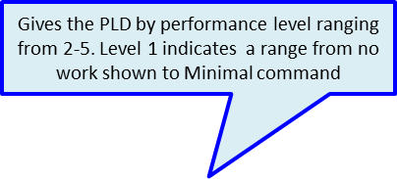

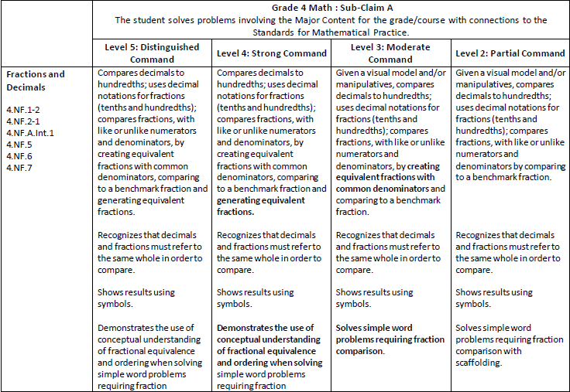
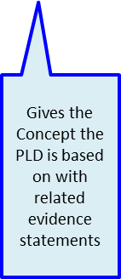

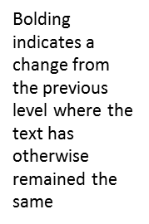
Sample Math PLDs
Notes:
To see a better image of the examples that follow, go to the link on slide 32.

Slide 34
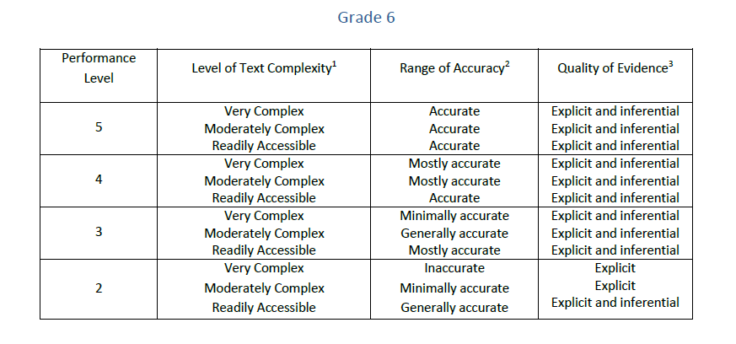
ELA Level Development
Three factors that determined the levels. (text complexity; range of accuracy; quality of evidence)
Notes:
https://www.parcconline.org/plds (see slide 32 for link)
This is a sample of Grade 6 Chart that accompanies the draft PLDs.
These charts are at the beginning of each grade level in the PLD documents, along with explanations of each factor linked to reading performance-level descriptors.
To determine a student’s performance level, it is critical to identify the pattern of responses when students respond to items with varied text complexities.
To determine text complexity, PARCC uses two components:
1. The first component is composed of three quantitative text complexity measures (Reading Maturity Metric, SourceRater, and Lexiles). These programs are ones that are able to determine a text’s recommended grade level analytically or through a computerized program. This provides a starting point and an initial recommendation for grade level.
2. The second component is a set of Complexity Analysis Worksheets, one for informational text and one for literary text, to determine the qualitative complexity of the texts. These measures rely largely on educator professional judgment and expertise. To determine whether a text is readily accessible, moderately complex, or highly complex, teams of trained reviewers use the data from the quantitative measures, in combination with the data from the qualitative measures.
To determine range of accuracy, PARCC has developed a reading rubric to measure comprehension of key idea and details for prose constructed response (PCR) items.
There is one generic scoring rubric for grade 3, one for grades 4 and 5, and one for grades 6 – 11.
The PARCC assessments will have four levels of accuracy at grades 3 - 5 and five levels of accuracy at grades 6 -11 that are measured using the reading data collected through the PCR, EBSR, and TECR items.
Accurate means that a student is able to accurately state both the general ideas expressed in the text(s) and the key and supporting details. The response is complete and the student demonstrates full understanding.
Mostly accurate means that a student is able to accurately state most of the general ideas expressed in the text(s) and the key and supporting details, but the response is incomplete or contains minor inaccuracies. The student demonstrates extensive understanding.
Generally accurate means that a student is able to accurately state the gist of the text(s), but fails to accurately state the key and supporting details in the text or to connect such details to the overarching meaning of the text(s). The student demonstrates basic understanding. This level of accuracy is used only in grades 6 -11.
Minimally accurate means that a student is unable to accurately state the gist of the text(s), but is able to minimally state some of the key or supporting details with accuracy. The student does not connect the specific details of the text to the overarching meaning(s) of the text. The student demonstrates minimal understanding.
Inaccurate means that a student is unable to accurately state either the gist of the text or the key and supporting details evident in the text.
PARCC’s reading rubrics measure comprehension for written responses and provide statements about the quality of evidence students use to support their statements of comprehension of texts. Scores on the written response items therefore help to determine student performance levels, as the levels reflect this factor.
Written responses require students to elicit inferential and explicit evidence from the text/s in their written responses. (Except in grade 3 – this grade requires only explicit evidence.)
As a reminder, there will be a range of complex texts for any given grade level.
Inferential evidence means that students show how inferences drawn from the text support statements made about the meaning of the text
Explicit evidence means that students show how the explicit words and phrases (details) from the text support statements made about the meaning of the text.
A student who shows that he or she can both identify explicit and inferential evidence in a range of complex texts will most likely achieve a higher level on the assessment.
All of this information is provided at the beginning of each grade level PLD.

Slide 35
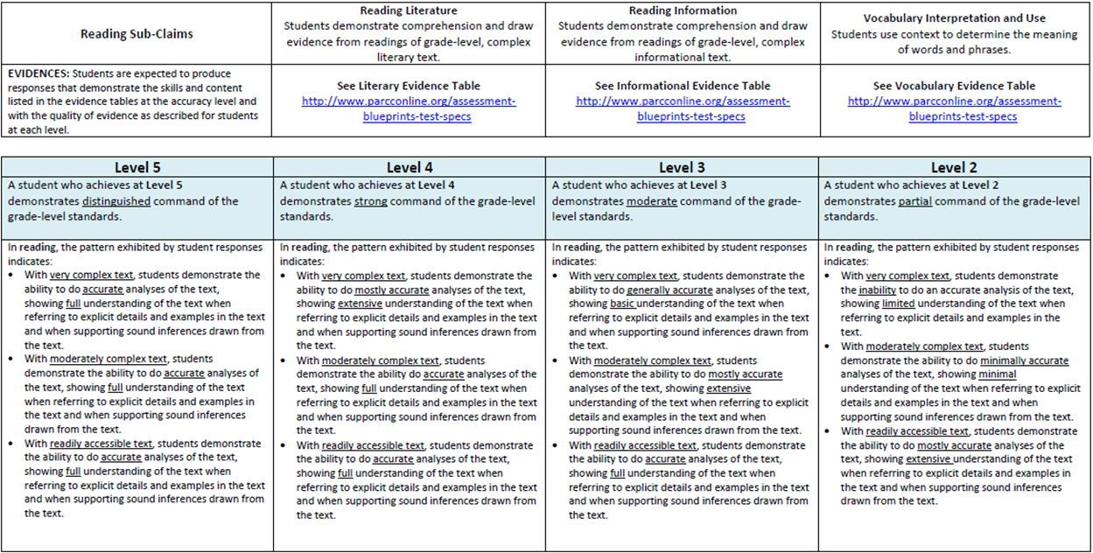

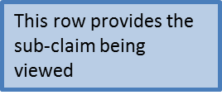

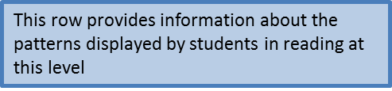
Looking at the PLDs: Reading
Notes:
All PLDs are linked to the evidence tables.
This is where text complexity, accuracy and quality of evidence is addressed. (The three factors that determine the levels as previously described)
Next we will review the PLDs for the writing sub-claim for written expression.

Slide 36
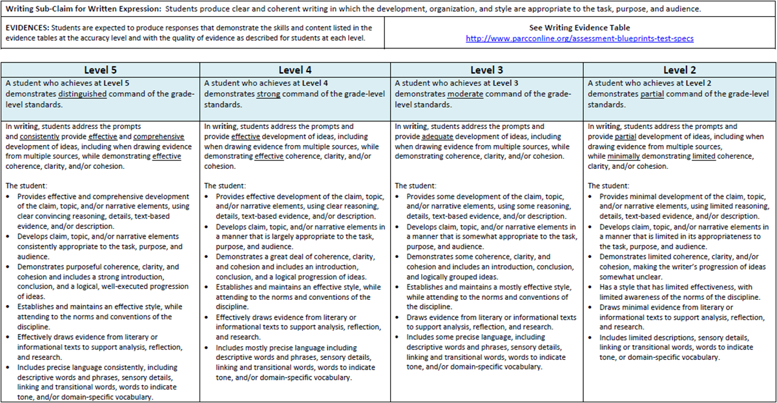


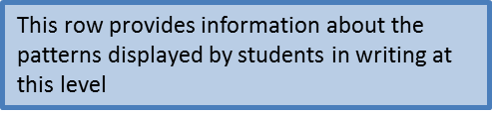

Looking at the PLDs: Written Expression
Notes:
This slide shows the Written Expression grade specific PLDS.
This row states what students are expected to demonstrate at each level. Please view the evidence statements linked to the CCSS for each grade level as well.
Next we will review the PLDs for the writing sub-claim for knowledge of language and conventions.

Slide 37
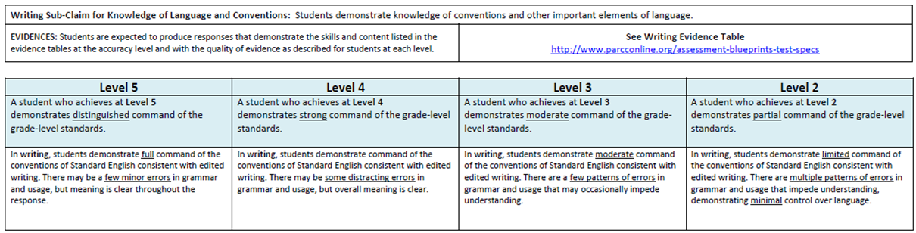


Looking at the PLDs: Knowledge of Language and Conventions
Notes:
This slide shows the knowledge of language and conventions grade specific PLDS.
This row states what students are expected to demonstrate at each level. Please view the evidence statements linked to the CCSS for each grade level as well.

Slide 38
Discussion of PLDs
Do you have any questions about the Performance Level Descriptors?
How will you use the PLDs based on your role in the school or district?
Notes:
For ELA, they show the importance of text complexity in determining readiness.
The separate reading, writing, and language charts describe the levels and help teachers better understand what it might look like in the classroom.
Keep in mind that these are still drafts, though, and should be used with caution.

Slide 39
Other PARCC Resources
This section includes:
How to Access the Assessment Guides
Practice Test Links
Sample Items Information

Slide 40
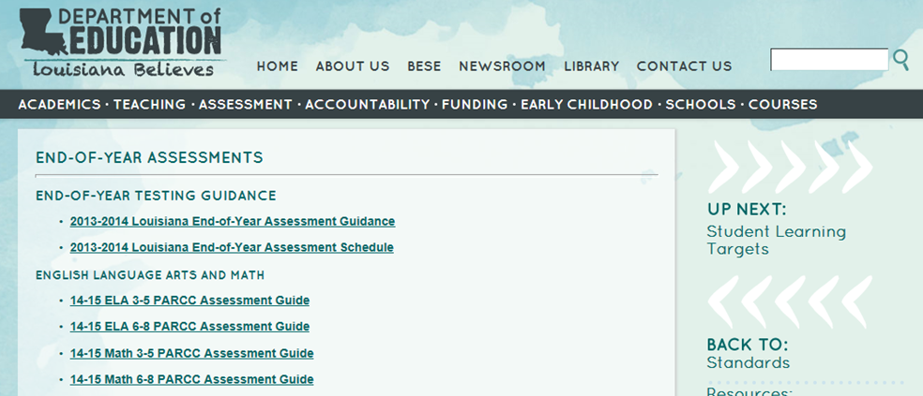

PARCC Assessment Guide
    Can be found at
    http://www.louisianabelieves.com/resources/classroom-support-toolbox/teacher-support-toolbox/end-of-year-assessments
    Grouped by subject, ELA or mathematics, and grade span, 3-5 or 6-8
    Includes information about evidence statements, test design, tasks types and functionalities, item types, sample items, and administration policies
Notes:
Provided by LDOE

Slide 41
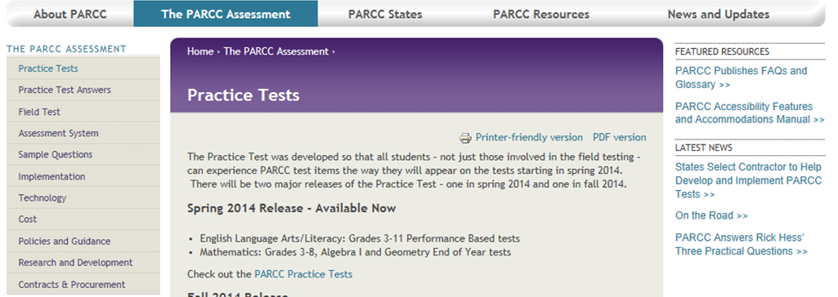

PARCC Practice Test
Can be found in the Toolbox and at https://www.parcconline.org/practice-tests
Components
PBA only (ELA)
EOY, only Type I (mathematics)
EOY ELA and PBA: anticipated release in fall 2014
Purpose
Gain familiarity with assessment components and system functionalities
See sample items for math and ELA
Includes
Variety of technology enhanced items
Answer key with evidence statement alignment
Notes:
Newer release, do not contain annotations, but provide practice with the testing environment and show complete tasks for ELA.

Slide 42
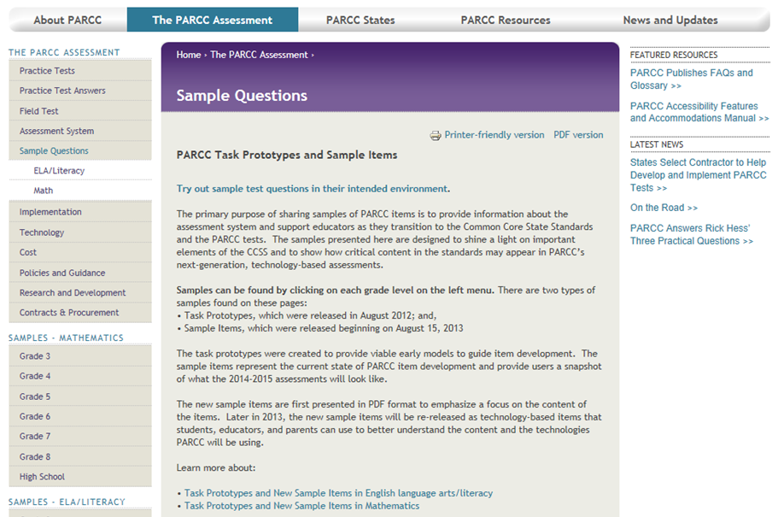

PARCC Task Prototypes and Sample Items
Can be found in the Toolbox or at https://www.parcconline.org/samples/item-task-prototypes
Purpose
To provide guidance on PARCC assessment item development
For math, to gain clearer understanding of the difference between type 1, type 2, and type 3 tasks
For ELA, to present annotated samples of different item types and tasks
Notes:
The prototypes provide a lot more information about the items than the practice tests. They should help teachers understand how standards are assessed, the different parts of the assessments, the item types, etc.

Slide 43
Discussion of Other Resources
What questions do you have concerning these other resources?
How will you use these resources in your role in the district/school?
Notes:
Discussion about these resources.

Slide 44
Continue the conversation…
Which of the PARCC documents is most relevant to what you do and how can you use it to help teachers/students?
Post your ideas and discuss with other teachers on our group space at www.edmodo.com.
Notes:
Tell them to ask Whitney or Mandy about how to join.

Slide 45
Contact Information
Kathy Judy,
ELA Assessment Coordinator
kathleen.judy@la.gov
225-219-4514
Michelle McAdams,
Mathematics Assessment Coordinator
michelle.mcadams@la.gov
225-342-6811

