Slide 1
PARCC Evidence Statements for Mathematics Part II:
Evaluating Tasks
Adapted from PARCC Materials

Slide 2
Agenda
PARCC’s Item Review Process
Evaluating Sample Tasks Using PARCC’s Criteria
Matching Tasks with Evidence Statements
Creating Tasks based on PARCC Evidence Statements (time permitting)

Slide 3
Agenda
PARCC’s Item Review Process
Evaluating Sample Tasks Using PARCC’s Criteria
Matching Tasks with Evidence Statements
Creating Tasks based on PARCC Evidence Statements (time permitting)

Slide 4
Who are PARCC’s Item Reviewers?
K-16 educators, state department of education staff, and external experts from PARCC states
Experience with students from various backgrounds
Many have participated in item reviews for their own states
Experience in various geographic and educational settings

Slide 5
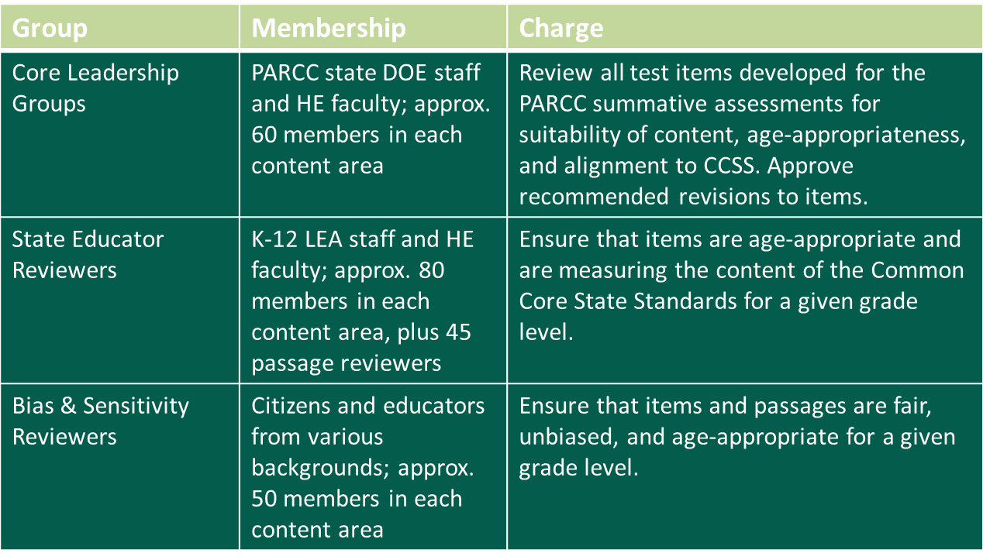
PARCC Item Review Committees
Various review teams meet, both in person and virtually, to evaluate the items over an extended period of time. Only items that are approved by these teams of reviewers will appear on the PARCC summative assessments.

Slide 6
Operational Working Groups
Content experts from state departments of education
ELA/Literacy
Mathematics
Accessibility, Accommodations, and Fairness (AAF)
Role in Item Reconciliation
Advise on conflicting opinions/issues after each item review
Includes members from content OWG and AAF OWG if there are item concerns after bias and sensitivity reviews

Slide 7
PARCC Item Review Meetings
Bias & Sensitivity teams are organized by grade band
Core Leadership* groups have 4-5 reviewers per team
State Educator* and Bias & Sensitivity* teams have 6-8 reviewers per team
Conducted both in-person and virtually, and last 3 – 5 days
Consist of independent review of items followed by group discussion
* Led by an OWG member and facilitated by contractor staff

Slide 8
Summary of PARCC Item Review Process
Items Developed
Core Leadership Review
State Educator Review
Bias & Sensitivity Review
Field Test Item Bank

Slide 9
Mathematics Review Considerations/Criteria
Does the task measure the intended evidence statement(s)?
Does the task measure the intended mathematical practice(s)?
Is the task mathematically correct and free from errors?
Is the wording of the task clear, concise, and grade-level appropriate?
Are the graphics/stimuli in the task clear, accurate, appropriate for the task, and appropriate for the grade?
Do each of the prompts and all associated graphics/stimuli contribute to the quality of the task?
Is the scoring guide/rubric clear, correct and aligned with the expectations for performance that are expressed in the task?

Slide 10
Bias & Sensitivity Considerations/Criteria
Does the item disadvantage any population (gender, race, ethnicity, language, religion, socioeconomic status, disability or geographic region) for non-educationally relevant reasons?
Does the item contain controversial or emotionally charged subject matter that is not supported by the Common Core State Standards?
Is the item potentially offensive, demeaning, insensitive, or negative toward any population?
Does the item depict any population in a stereotypical manner?

Slide 11
Compare PARCC’s Item Review Process with Louisiana’s Process

Slide 12
Agenda
PARCC’s Item Review Process
Evaluating Sample Tasks Using PARCC’s Criteria
Matching Tasks with Evidence Statements
Creating Tasks based on PARCC Evidence Statements (time permitting)

Slide 13
General Steps for Item Reviews
Step 1 - Read and work each task independently.
Step 2 - Verify that the task aligns to the intended evidence
statement.
Step 3 - Determine if there are any mathematical flaws in the task;
i.e., anything that makes the task unusable as written. (See
next slide.)
Step 4 - Review answer keys and rubrics for accuracy.
Step 5 - Advise to accept, accept with revision, or reject the task.
Step 6 - Discuss with group. Come to consensus on acceptance and
provide a rationale for the decision. (See Step 5.)

Slide 14
Mathematics Review Considerations/Criteria
Does the task measure the intended evidence statement(s)?
Does the task measure the intended mathematical practice(s)?
Is the task mathematically correct and free from errors?
Is the wording of the task clear, concise, and grade-level appropriate?
Are the graphics/stimuli in the task clear, accurate, appropriate for the task, and appropriate for the grade?
Do each of the prompts and all associated graphics/stimuli contribute to the quality of the task?
Is the scoring guide/rubric clear, correct and aligned with the expectations for performance that are expressed in the task?

Slide 15
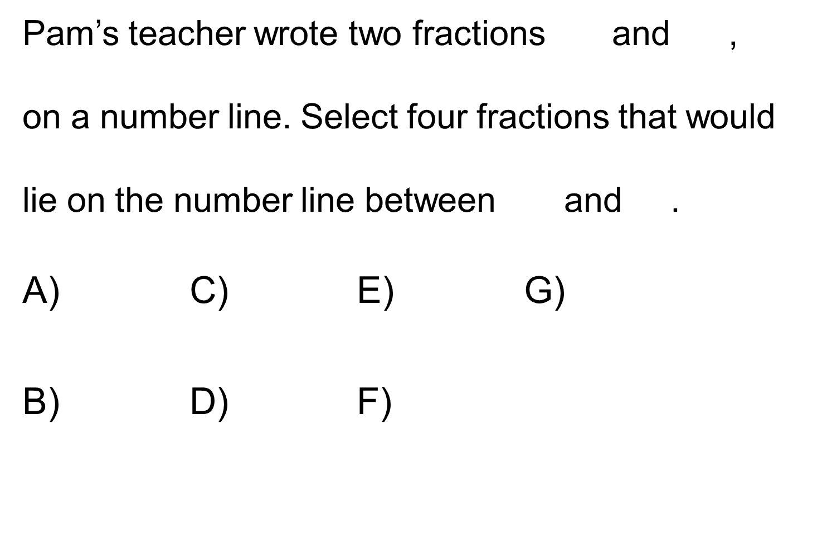
Sample 1 Task Type: I Points: 1 Evidence Statement: 3.NF.2
This sample item was created for training purposes only. It is not an actual PARCC item.

Slide 16
Evidence Statement Text, Clarifications, Limits, Emphases and Other Information for 3.NF.2
Evidence Statement Text | Clarifications, limits, emphases, and other information intended to ensure appropriate variety in tasks
Understand a fraction as a number on the number line; represent fractions on a number line diagram. a. Represent a fraction 1/b on a number line diagram by defining the interval from 0 to 1 as the whole and partitioning it into b equal parts. Recognize that each part has size 1/b and that the endpoint of the part based at 0 locates the number 1/b on the number line. b. Represent a fraction a/b on a number line diagram by marking off a lengths 1/b from 0. Recognize that the resulting interval has size a/b and that its endpoint locates the number a/b on the number line. | i) Fractions may include values greater than 1. ii) Fractions equal whole numbers in 20% of these tasks. iii) Tasks have “thin context”⁹ or no context. iv) Tasks are limited to fractions with denominators 2, 3, 4, 6, and 8. (See footnote CCSSM, p 24) .
Louisiana Believes

Slide 17
Sample 3 Task Type: I Points: 1 Evidence Statement: 8.EE.2
Which values represent solutions to the equation 2x² = 64? Select all that apply.
A) x = -16 D) x = 4
B) x = - E) x =
C) x = - 4 F) x = 16
This sample item was created for training purposes only. It is not an actual PARCC item.

Slide 18
Evidence Statement Text, Clarifications, Limits, Emphases and Other Information for 8.EE.2
Evidence Statement Text | Clarifications, limits, emphases, and other information intended to ensure appropriate variety in tasks
Use square root and cube root symbols to represent solutions to equations of the form x² = p and x³ = p, where p is a positive rational number. Evaluate square roots of small perfect squares and cube roots of small perfect cubes. Know that 2 is irrational. | Pool should contain tasks with and without contexts. ii) Tasks might for example take the form of algebraic word problems leading to equations x² = p or x³ = p, or geometric problems such as finding the edge length of a cubical object with a given volume. iii) In problems where p and – p are both relevant as solutions to x² = p, both of these solutions should be given. Note that p is nonnegative by definition. Solutions to equations x² = p or x³ = p are represented as p or ³ p , respectively. iv) Manipulations such as 8 = 2 2 are beyond the scope of grade 8. Students need not simplify a solution such as 8 . But students should ultimately express the following cases in the form of whole numbers: (a) the square roots of 1, 4, 9, 16, 25, 36, 49, 64, 81 and 100; (b) the cube roots of 1, 8, 27, and 64.
Louisiana Believes

Slide 19
Sample 3 Task Type: I Points: 1 Evidence Statement: 7.NS.2b-2
Which situation can be represented by the expression $3\frac{3}{4}÷\frac{1}{3}$ ?
A) The width of a nightstand is the width of a dresser. If the width of
the dresser is feet, what is the width of the nightstand?
B) There are cups of flour in a container. How much flour is left in the container after a baker takes cup of flour from it?
C) A relay race is miles long. This distance is divided into equal parts that are mile each. How many parts are there in the race?
D) A puppy’s weight increased by pound. What is the puppy’s new weight if its original weight was pounds?
This sample item was created for training purposes only. It is not an actual PARCC item.
Louisiana Believes

Slide 20
Evidence Statement Text, Clarifications, Limits, Emphases and Other Information for 7.NS.2b-2
Evidence Statement Text | Clarifications, limits, emphases, and other information intended to ensure appropriate variety in tasks
Apply and extend previous understandings of multiplication and division and of fractions to multiply and divide rational numbers. c. Interpret quotients of rational numbers by describing real-world contexts. | –
Louisiana Believes

Slide 21
Sample 4 Task Type: I Points: 1 Evidence Statement: 6.G.1
10 in.
5 in.
4 in.
14 in.
This sample item was created for training purposes only. It is not an actual PARCC item.

Slide 22
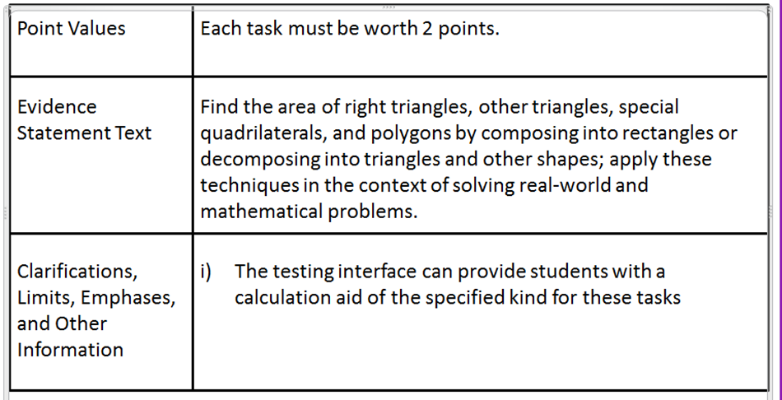
Evidence Statement Text, Clarifications, Limits, Emphases and Other Information for 6.G.1

Slide 23
Sample 5 Task Type: II Points: 4 Evidence Statement: 5.C.6/5.MD.5c
Rosa needs to calculate the volume of a right prism. This diagram shows the dimensions of the prism. All angles in the base of the prism are right angles.
7 in.
7 in.
4 in.
5 in.
6 in.
12 in.
11 in.
Show how Rosa can calculate the volume of the right prism. Be sure to explain why you chose the operations you use in your calculation, and include the volume of the prism.
This sample item was created for training purposes only. It is not an actual PARCC item.
Louisiana Believes

Slide 24
Evidence Statement Text, Clarifications, Limits, Emphases, Other Information for 5.C.6 and 5.MD.5c
Evidence Statement Key | Evidence Statement Text | Clarifications, Limits, Emphases, and Other Information
5.C.6 | Base explanations/reasoning on concrete referents such as diagrams (whether provided in the prompt or constructed by the student in her response). Content Scope: Knowledge and skills articulated in 5.MD.C | –
5.MD.5c | Relate the operations of multiplication and addition and solve real world and mathematical problems involving volume. c. Recognize volume as additive. Find volumes of solid figures composed of two non-overlapping right rectangular prisms by adding the volumes of the non-overlapping parts, applying this technique to solve real world problems. | i) Tasks require students to solve a contextual problem by applying the indicated concepts and skills.
Louisiana Believes

Slide 25
Scoring Rubric for Sample #5
Scoring Rubric
The task is worth 4 points; 1 point for computation and 3 points for reasoning.
Computation component: 582 cubic inches
Reasoning component:
1 point is awarded for a correct process in which the student shows or explains how to divide the prism into two (or more) right rectangular prisms
1 point is awarded for showing or explaining the correct calculations for determining the volume of each rectangular prism
1 point is awarded for showing or explaining that the volumes need to be added together to determine the volume of the entire prism.
Louisiana Believes

Slide 26
Agenda
PARCC’s Item Review Process
Evaluating Sample Tasks Using PARCC’s Criteria
Matching Tasks with Evidence Statements
Creating Tasks based on PARCC Evidence Statements (time permitting)

Slide 27
Instructions for Matching Activity
Form groups of 3-4.
Open your envelopes and remove the set of tasks.
Use the appropriate EOY Evidence Statement table to match each task to an Evidence Statement.
Record the Evidence Statement Key on the Group Recording Sheet.
Please do not mark on the tasks. They will be used multiple times during the conference.
Louisiana Believes

Slide 28
Agenda
PARCC’s Item Review Process
Evaluating Sample Tasks Using PARCC’s Criteria
Matching Tasks with Evidence Statements
Creating Tasks based on PARCC Evidence Statements (time permitting)

Slide 29
Developing the Stem
3.MD.1-1
Tell and write time to the nearest minute and measure time intervals in minutes.
Assessment task clarifications:
Time intervals are limited to 60 minutes.
No more than 20% of the items require determining a time interval from clock readings having different hour values.
Acceptable intervals: ex. Start time 1:20, end time 2:10 – time interval is 50 minutes.
Unacceptable intervals: ex. Start time 1:20, end time 2:30 – time interval exceeds 60 minutes.
3.MD.1-2
Solve word problems involving addition and subtraction of time intervals in minutes, e.g., by representing the problem on a number line diagram.
Assessment task clarifications:
Only the answer is required (methods, representations, etc. are not assessed here).
Tasks do not involve reading start/stop times from a clock nor calculating elapsed time.

Slide 30
Determine and Create Scaffolding
3.C.6-2
Base explanations/reasoning on a number line diagram (whether provided in the prompt or constructed by the student in her response).
Content Scope: Knowledge and skills articulated in 3.MD.1
Tell and write time to the nearest minute and measure time intervals in minutes. Solve word problems involving addition and subtraction of time intervals in minutes, e.g., by representing the problem on a number line diagram.
Mathematical Practices associated with this content: MP.3, MP.5, and MP.6

Slide 31
Key Takeaways
The PARCC evidence statement tables are valuable tools that can and should be used in the classroom to inform instruction.
The PARCC sample items act as great instructional tasks to embedded in instruction.
Creating one’s own instructional tasks or lessons aligned to the PARCC evidence statement tables with not only prepare students for the PARCC Assessment, but, will prepare students to be College and Career Ready, as intended through the CCSS.

Slide 32
Learn More About PARCC
Partnership for Assessment of Readiness for College and Careers
www.parcconline.org
On Twitter:
@PARCCPlace
#askPARCC

