Slide 1
Taking a Look at PARCC
Deb Bellinger
Elementary Curriculum Consultant
Calcasieu Parish

Slide 2
Goals
Teachers will be able to describe the structure of the PARCC assessment, including the three performance tasks and the item types.
Teachers will be able to describe the three unit assessments and how they will prepare students for the PARCC assessment.

Slide 3
Goals for Students in ELA
Comprehend (access) meaningful, on level texts
Speak and write in response to meaningful texts
Notes:
As we work today, let’s remember our focus for students.

Slide 4
Agenda
PARCC Performance Assessment Tasks
Item Types and Structure of the Assessment
Unit Assessments in the Guidebook

Slide 5
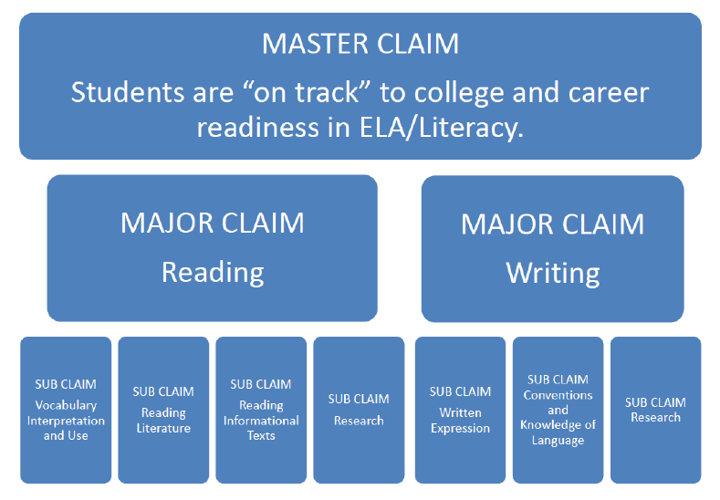
Notes:
The PARCC assessment is designed to measure students
Master Claim: measures the overall goal—students must demonstrate that they are “on track” for college and career readiness.
Major Claims: identify the extent to which students are “on track” by measuring
Reading –close, analytic reading and the comparison and synthesis of ideas that are at the heart of understanding complex literary works and informational texts, and
Writing –the ability to write effectively when using and/or analyzing sources.
Sub-Claims: additional skills and understandings included in the major claims (The sub-claims integrate all of the specific standards.)

Slide 6
3 Performance Tasks
Literary Analysis
Narrative
Research Simulation
Notes:
The basic test design is the same for all grade levels. Students will have consistency from year to year and will know what to expect.

Slide 7
Jigsaw
Form a group of three
Number yourselves 1-3
PARCC Performance Based Component
1s read Literary Analysis
2s read Narrative Writing
3s read Research Simulation
Choose 3 key points to share with your team
I will signal when to begin (1 min each)
Notes:
Have teachers form groups of three.
Number off. 1’s – literary analysis, 2’s – narrative task, 3’s research simulation.
Read the description (1 minutes)
Decide on 3 key points that should be shared with their team. (2 min)
Use timer to regulate sharing time for each member. (1 minute each)
Record key details on your recording sheet.
10 minutes

Slide 8
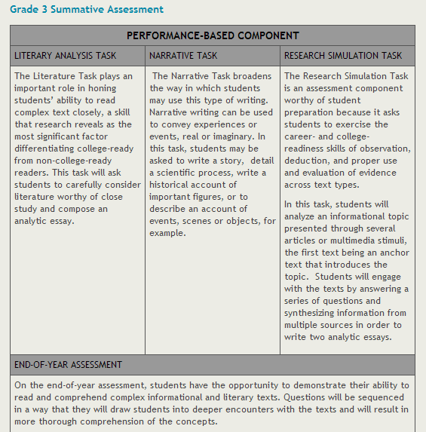
Notes:
Share out by placing sticky notes on chart paper. Each person record 1 key point on a sticky note. Place on the appropriate chart paper. 1’s will share about Lit Analysis, 2’s will share about Nar. Task, 3’s will share about Research Sim.
ALT PLAN – Have audience share out ideas and record on chart paper. (use if there isn’t enough room to move around)
Go to chart and read key points. Make sure to elaborate or correct ideas.
Science/SS teachers – How can you support your students in your classrooms? Which tasks can you prepare students for?
10-15 minutes

Slide 9
Agenda
PARCC Performance Assessment Tasks
Item Types and Structure of the Assessment
Unit Assessments in the Guidebook

Slide 10
Item Types
Performance Based Assessment

Slide 11
Three Innovative Item Types That Showcase Students’ Command of Evidence with Complex Texts
From “Advances in the PARCC/ELA Literacy Assessment,” Aug 2012
Evidence-Based Selected Response (EBSR)—Combines a traditional selected-response question with a second selected-response question that asks students to show evidence from the text that supports the answer they provided to the first question. Underscores the importance of Reading Anchor Standard 1 for implementation of the CCSS.
Technology-Enhanced Constructed Response (TECR)—Uses technology to capture student comprehension of texts in authentic ways that have been difficult to score by machine for large scale assessments (e.g., drag and drop, cut and paste, shade text, move items to show relationships).
Range of Prose Constructed Responses (PCR)—Elicits evidence that students have understood a text or texts they have read and can communicate that understanding well both in terms of written expression and knowledge of language and conventions. There are four of these items of varying types on each annual performance-based assessment.
Notes:
EBSR – most like multiple choice except there is always a “Part B” that asks for details from the text to support the answer in “Part A” Part B is assessing Standard 1. Standard 1 will only be assessed as evidence in the EBSR or in the Writing.
TECR – can be graphic organizer that is filled in.
PCR is the essay for each task.
5 min

Slide 12
Try It
Read the text “Life in the Limbs” by Heather Kaufman-Peters
Answer the EBSR and TECR items.
Discuss your answers at your table.
Notes:
Print copy of text to keep on table.
2 minutes to read
10 minutes to answer and come to a consensus.
5 minutes to discuss

Slide 13
Evidence Based Selected Response
Part A: What is the purpose of the braces described in paragraph 6 of the article?
a. They fix broken tree limbs, so a tree house will not fall down.
b. They lock several trees together, so almost any kind of tree can be used.
c. They join two trees into one unit, so a tree house looks secure.
d. They help trees hold up a tree house, so the trees will not break.*
Part B: Which two details from the article help support the answer to Part A?
a. “Designing unique tree houses may sound tough, but Jonathan says it's no sweat.”
b. “’Hardwoods such as oak, maple, or hickory make the best trees for houses—but I did once build a wonderful tree house in a crabapple tree.’”
c. “’My tree house is in two trees—an oak and a fir—and has three posts to support the weight.’”*
d. “As a certified arborist, Jonathan tries to never harm the trees.”*
e. "The tree's center of gravity is at the top and the ends of its branches, so I build a house down at the center of the tree. . . ”
f. "The tree grows over the artificial limbs, and they become part of the tree, . . .”
Notes:
Handout to write on.
5th Grade, EOY
Packets on table of passages to read then answer question.
2 pts for all correct answers
1 pts for part A and one detail from part B
0 pts if part A is incorrect

Slide 14
Technology Enhanced Constructed Response
Choose the two main ideas and drag them to the empty box labeled “Main Ideas.” Then choose one detail that best supports each main idea. Drag each detail into the empty box labeled “Supporting Details.”
Possible Main Ideas | Possible Supporting Details
Jonathan has his own 1000-yard zipline. | "In fact, as a tree house architect, Jonathan has built more than 380 custom tree houses across the United States."*
Jonathan is an experienced tree house builder.* | “Jonathan’s love of tree-house living began when he was a kid.”
Jonathan works carefully so that tree houses do not hurt the trees.* | "It was the most fun I ever had."
Jonathan lived in a tree house when he was in college. | "'I build a tree house so it helps the tree,' he says."*
Jonathan advises readers to learn the names of trees. | "'Walk in the woods and learn the different trees. Spend time climbing and learn how to do it safely.'"
Jonathan once built a house in a crab apple tree. | “One of his favorite names is ‘Ups and Downs.’”
Main Ideas | Supporting Details
Notes:
Handout to write on.
Scoring Points:
• 2 points are awarded when the student chooses the correct main ideas and corresponding details.
• 1 point is awarded if the student correctly chooses one correct main idea and a corresponding detail or if the student chooses two correct main ideas
without any correct corresponding details.
• 0 points are awarded if the student fails to demonstrate partial mastery of the standard

Slide 15
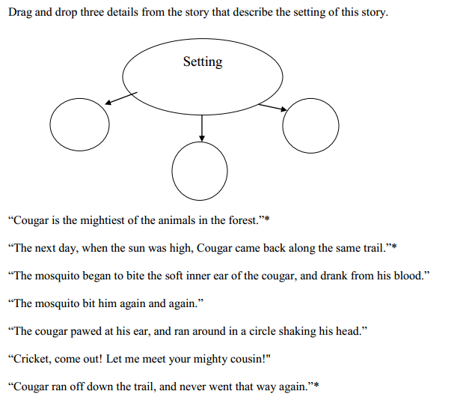
Technology Enhanced Constructed Response
Notes:
Sample from PARCC Assessment Guide. 4th grade PBA, Literary Analysis Task
• 2 points are awarded when the student correctly chooses all three correct details.
• 1 point is awarded when students choose two correct details.
• 0 points are awarded if the student selects fewer than two correct details.

Slide 16
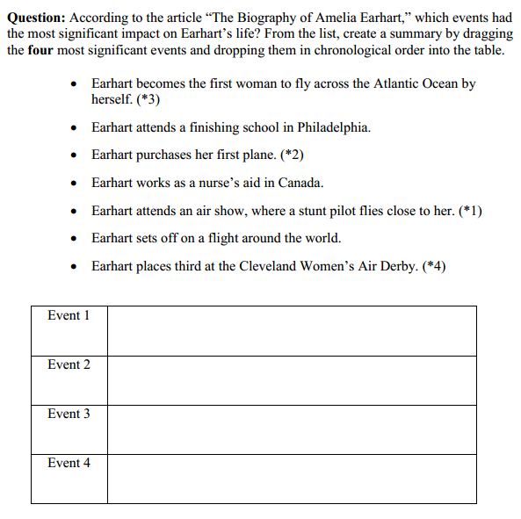
Technology Enhanced Constructed Response
Notes:
Sample from PARCC Assessment Guide. 7th grade PBA, Research Simulation
1 point for 3 correct in order
2 points for all correct

Slide 17
Prose Constructed Response
Notes:
Sample from PARCC Assessment Guide. 3rd Grade Research Simulation

Slide 18
Item Types
Evidence Based Constructed Response
Technology Enhanced Constructed Response
Prose Constructed Response
Notes:
Key points to add to notes.

Slide 19
Structure of the Tasks
Performance Based Assessment

Slide 20
Literary Analysis
How is this different from the way our
students have been assessed?
Read 1 extended literature text
Respond to 1 vocab question
Respond to 2 EBSR or TECR
Read 1 additional literature text
Respond to 1 vocab question
Respond to 2 EBSR or TECR
Respond to 1 PCR - essay
Notes:
An extended text should be closer to the end of the grade band range. The additional text is expected to be a shorter text, closer to the beginning of the grade band range. The range for 3-5 is 200-800 words.
Another important point about these items is that they are designed to build understanding. The questions are posed to engage the reader and prepare him/her for the PCR item.
How is this different from the testing that our students have typically experienced. (Talk to group or partner.)
How can you use this information in your instruction.
10 min

Slide 21
Research Simulation
Session 1
Read 1 anchor text
Respond to 1 vocab question
Respond to 2 EBSR or TECR
Session 2
Read additional text (may be multi-media with transcript)
Respond to 1 vocab question
Respond to 2 EBSR or TECR
Read additional text (may be multi-media with transcript)
Respond to 1 vocab question
Respond to 2 EBSR or TECR
Write a PCR - information
Grade 3 will have only 2 texts
Notes:
The Research Simulation follows the same pattern but involves possible multi-media text and has an additional text for grades 4&5.
Information Text standards require students to synthesize information.
5 min

Slide 22
Narrative Task
Read 1 short text
(either literary or information)
Respond to 5 EBSR or TECR
Respond to 1 PCR - essay
Notes:
Narrative Task – can be either information or literary
Need examples.
2 min

Slide 23
Agenda
PARCC Performance Assessment Tasks
Item Types and Structure of the Assessment
Unit Assessments in the Guidebook

Slide 24
Each Unit Will Have 3 Assessments
Culminating Writing Task
Cold Read Assessment
Extension Task
Notes:
Let’s look at how these summative unit assessments

Slide 25
Work with a neighbor to answer:
For which task(s) will this assessment prepare students?
How will this task address the goals for students?

Slide 26
Goals for Students in ELA
Comprehend (access) meaningful, on level texts
Speak and write in response to meaningful texts

Slide 27
Goals
Teachers will be able to describe the structure of the PARCC assessment, including the three performance tasks and the item types.
Teachers will be able to describe the three unit assessments and how they will prepare students for the PARCC assessment.
Notes:
Review goals – what did we do to accomplish them?

Slide 28
Feedback
Deb Bellinger
deborah.bellinger @cpsb.org

Slide 29
Materials List
Note taking pages
Performance task descriptions
“Life in the Limbs”
Sample items for “Life in the Limbs”
Unit One from guidebook – Summative Unit Assessment Tasks

Slide 30
Evidence Based Selected Response
Part A: What is the purpose of the braces described in paragraph 6 of the article?
a. They fix broken tree limbs, so a tree house will not fall down.
b. They lock several trees together, so almost any kind of tree can be used.
c. They join two trees into one unit, so a tree house looks secure.
d. They help trees hold up a tree house, so the trees will not break.
Part B: Which two details from the article help support the answer to Part A?
a. “Designing unique tree houses may sound tough, but Jonathan says it's no sweat.”
b. “’Hardwoods such as oak, maple, or hickory make the best trees for houses—but I did once build a wonderful tree house in a crabapple tree.’”
c. “’My tree house is in two trees—an oak and a fir—and has three posts to support the weight.’”
d. “As a certified arborist, Jonathan tries to never harm the trees.”
e. "The tree's center of gravity is at the top and the ends of its branches, so I build a house down at the center of the tree. . . ”
f. "The tree grows over the artificial limbs, and they become part of the tree, . . .”
Notes:
Handout to write on.
5th Grade, EOY
Packets on table of passages to read then answer question.
2 pts for all correct answers
1 pts for part A and one detail from part B
0 pts if part A is incorrect

Slide 31
Technology Enhanced Constructed Response
For our purposes, you may simply circle your answers in the chart on the right.
Choose the two main ideas and drag them to the empty box labeled “Main Ideas.” Then choose one detail that best supports each main idea. Drag each detail into the empty box labeled “Supporting Details.”
Possible Main Ideas | Possible Supporting Details
Jonathan has his own 1000-yard zipline. | "In fact, as a tree house architect, Jonathan has built more than 380 custom tree houses across the United States."
Jonathan is an experienced tree house builder. | “Jonathan’s love of tree-house living began when he was a kid.”
Jonathan works carefully so that tree houses do not hurt the trees. | "It was the most fun I ever had."
Jonathan lived in a tree house when he was in college. | "'I build a tree house so it helps the tree,' he says.”
Jonathan advises readers to learn the names of trees. | "'Walk in the woods and learn the different trees. Spend time climbing and learn how to do it safely.'"
Jonathan once built a house in a crab apple tree. | “One of his favorite names is ‘Ups and Downs.’”
Main Ideas | Supporting Details
Notes:
Handout to write on.

