Slide 1
Rigor in the ELA Classroom
Presenter
Amy Gobert
Jefferson Davis Parish

Slide 2
Instructional Vision
To meet these raised expectations, we must clarify our focus on what our students need. Specifically, we must ensure this year that our students…
English language arts
Comprehend (access) meaningful, on level texts
Speak and write in response to meaningful texts
Math students
Master math concepts of priority, on level content and practice standards (not just procedures)
Master targeted remedial content that allows practice faster focus of on level content

Slide 3
Teacher Leader Summit: Day 1 Ready
This Summit will prepare teachers to make these shifts beginning the first day of the 14-15 school year. This will include focused training on:
Student Learning Targets
Assessment
Standards, curricula, and instructional strategies

Slide 4
Objectives
By the end of this presentation, participants will
Understand the definition of rigorous instruction
Select rigorous questions and tasks in response to meaningful texts
Demonstrate rigor using Louisiana EAGLE

Slide 5
Overview
What is rigorous instruction?
How do I incorporate rigor into my classroom assessments and tasks?
How can Louisiana EAGLE support rigorous instruction?

Slide 6

Framework for Instruction

Slide 7
What is rigorous instruction?
Working independently, develop your personal definition of rigorous instruction.
Now share with your shoulder partner. How are your definitions similar or different?
Please be prepared to share out in approximately five minutes.

Slide 8
What is the definition according to the Common Core State Standards and Compass?

Slide 9
What is rigorous instruction?
Rigor
Asking students to demonstrate deep conceptual understanding through application of content knowledge and skills and to new situations
(from Math Standards Introduction)

Slide 10
What are the key words in this definition?
Rigor
Asking students to demonstrate deep conceptual understanding through application of content knowledge and skills and to new situations
(from Math Standards Introduction)
Notes:
Discuss important words that the audience may highlight such as deep conceptual, application

Slide 11
What are the key words in this definition?
Rigor
Asking students to demonstrate deep conceptual understanding through application of content knowledge and skills and to new situations
(from Math Standards Introduction)
Notes:
Discuss conceptual understanding… what does it look like in the ELA classroom even though this is taken from the math standards.

Slide 12
What are the key words in this definition?
Rigor
Asking students to demonstrate deep conceptual understanding through application of content knowledge and skills and to new situations
(from Math Standards Introduction)
Notes:
Discuss conceptual understanding… what does it look like in the ELA classroom even though this is taken from the math standards.

Slide 13
What are the key words in this definition?
Rigor
Asking students to demonstrate deep conceptual understanding through application of content knowledge and skills and to new situations
(from Math Standards Introduction)
Notes:
Discuss important words that the audience may highlight such as deep conceptual, application

Slide 14
What is rigorous instruction?
Review the descriptors/indicators on the Compass rubric. After reviewing the definition of rigor, where do you see similar or overlapping ideas on the Compass rubric.
Please discuss with your shoulder partner.
Be prepared to share out in about five minutes.

Slide 15
What is rigorous instruction?
Is this demonstrating rigorous instructing?
1. Students complete a grammar worksheet.
2. Students learn the definition of several poetry terms. Then they read poems that may or may not contain them.
3. Students read a text about Mardi Gras. They then create their own mask and parade in the hallway.
4. Students read various texts that are connected thematically; they are asked to perform certain tasks over time and then read a new text to demonstrate independent understanding.

Slide 16
How do I plan for rigorous, text-based whole-class instruction?
Read “The Country that Stopped Reading” by David Toscana. Then with a partner, consider the following:
First, select meaningful texts and an instructional focus:
What begs to be taught in this piece? Why?
Look at the evidence tables for grades 9-10. Does this text suit this grade level?
Second, design rigorous instruction:
What tasks and/or questions would you engage students in with this text in one class period?
What text and/or tasks could come before this piece? What texts and/or tasks could come after?

Slide 17
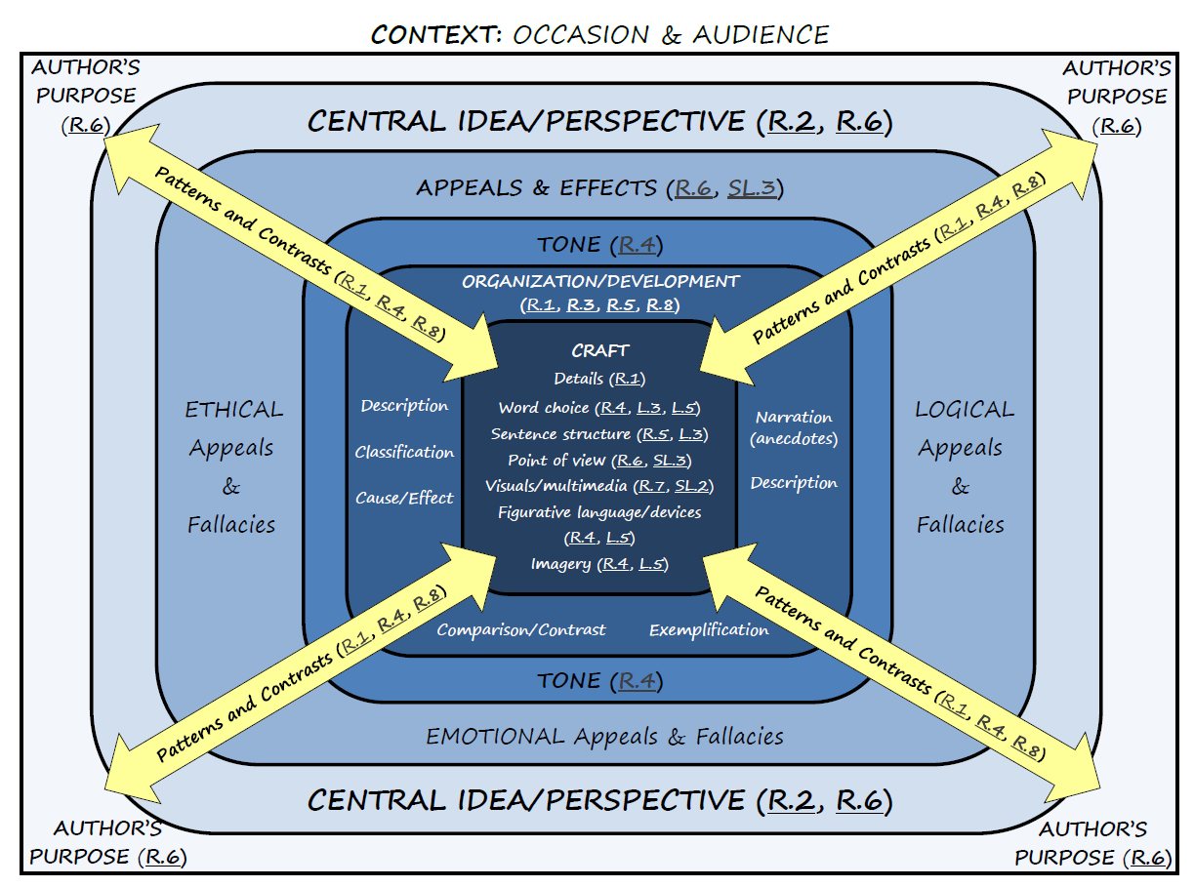

Slide 18
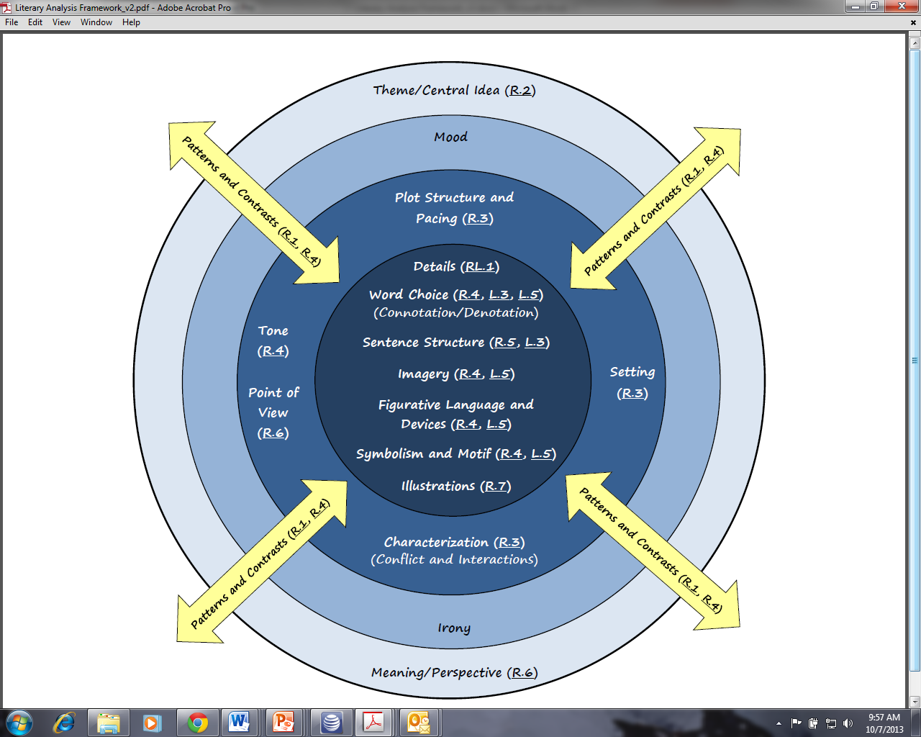

Slide 19
How do I plan for rigorous, text-based whole-class instruction?
Reflect:
What are the steps of this process that are new to you?
Why is this thinking and selection process important for students to meet higher expectations?
What tools did you use?
What new tools supports this process?
  Analysis circles

Slide 20
EAGLE
Think about these questions:
How have you used EAGLE in the past?
How are you using EAGLE now?

Slide 21
EAGLE’s Place in a CCSS Unit Plan
UNIT FOCUS
The “big ideas” of the unit
UNIT ASSESSMENT
Culminating Writing Activity
DAILY
PERF.
TASKS
Daily instruction and tasks aligned to the CCSS to prepare students to meet the expectations of the unit assessments
Extension Task
Cold-Read Assessment
Where does EAGLE fit in?

Slide 22
Ways to use EAGLE
To help set goals when used in formative assessment
Inform instruction
Guide and assist with assessment

Slide 23

TODAY’S FOCUS….
How can EAGLE demonstrate rigorous, text-based whole-class instruction?

Slide 24
CCSS Criteria for Determining Item Quality
Does the question have Value, and is it worthy of students’ time?
Is the question Text Dependent, requiring deep understanding of the text and the use of textual evidence?
Is the question Aligned to and reflective of the rigor of the CCSS?
(applies to all grade levels)

Slide 25
EAGLE Contents
TEXT (single text or set of texts)
Items aligned to CCSS
  Multiple-choice items
  4-point extended constructed response
  PARCC-like prose constructed response (PCR)
Rubrics
  4-pt (general and item-specific)
  PARCC
Student work (exemplary responses)
Metadata
  Alignment (primary and secondary)
  Difficulty levels
  Answer keys

Slide 26
EAGLE Item Types: Multiple Choice
    Stand-alone (4 answer options)
    Two-part/Evidence-based selected response (EBSR):
Part A
What is one main idea of “How Animals Live?”
a. There are many types of animals on the planet.
b. Animals need water to live.
c. There are many ways to sort different animals.*
d. Animals begin their life cycles in different forms.
Part B
Which detail from the article best supports the answer to Part A?
a. “Animals get oxygen from air or water."
b. "Animals can be grouped by their traits."
c. "Worms are invertebrates."
d. "All animals grow and change over time.“
Example taken from PARCC Prototypes

Slide 27
EAGLE Item Types: Constructed Response
Extended Response—a 4-point essay question that asks students to analyze text (no conventions)
Write an extended response that analyzes how Julius’s feelings about moving are revealed through his impressions of the house and his interactions with the other characters. Be sure your response includes
*well-chosen descriptions of Julius’s impressions of the house,
*well-chosen examples of Julius’s interactions with the other characters,
and
*an analysis of how those details show Julius’s feelings about moving.
Make sure your response includes specific details from the passage to support your response.

Slide 28
EAGLE Item Types: Constructed Response (cont’d)
PARCC Prose Constructed Responses (PCR)—Elicit evidence that students have understood a text(s)and can communicate that understanding well both in terms of written expression and knowledge of language and conventions.
Use what you have learned from reading “Daedulus and Icarus,” by Ovid and “To a Friend Whose Work Has Come to Triumph,” by Anne Sexton to write an essay that analyzes how Icarus’s experience of flying is portrayed differently in the two texts.
As a starting point, you may want to consider what is emphasized, absent, or different in the two texts, but feel free to develop your own focus for analysis.
Develop your essay by providing textual evidence from both texts. Be sure to follow the conventions of standard English.

Slide 29
PARCC Tasks that Include Written Responses (PCR
  Literary Analysis Task (LAT): two literary texts
  Answer selected-response questions to show comprehension of texts
  Write a literary analysis of the texts
  Research Simulation Task (RST): an anchor text , plus additional sources
  Answer a few selected-response items
  Write an analytic essay using textual evidence from the sources
  Narrative Task (NT): one or two short texts
  Answer selected-response questions to show comprehension of texts(s)
  Write either a narrative story or a narrative description
                *This is for 9-12 ELA.

Slide 30
CCSS Criteria for Determining Item Quality
Does the question have Value, and is it worthy of students’ time?
Is the question Text Dependent, requiring deep understanding of the text and the use of textual evidence?
Is the question Aligned to and reflective of the rigor of the CCSS?
How does this criteria reflect the desired rigor in the classroom?

Slide 31
Practice
Take a couple of minutes to read the Grade 5 passage:
“Mary Henrietta Kingsley: Explorer and Author”
Using the CCSS criteria, decide whether the following questions meet all requirements.

Slide 32
DOES THIS QUESTION MEET THE CCSS CRITERIA?
Which sentence from the article is an opinion?
Her bachelor brother expected her to keep house for him, but Mary had other ideas.
During Mary’s second trip to Africa in 1894, she traveled to more places than she had the first time.
She explored the Ogowe River in Gabon by steamboat and by canoe, which she rowed herself.
Though her life was cut short, Mary’s bravery and intelligence earned her respect and admiration.*

Slide 33
EAGLE
Review the following 5th grade CCSS Standard:
RI5.4
Does this question meet the criteria?

Slide 34
EAGLE
Review the standards for grade 5.
Is this questions a reflection of the standards?
Why or why not?
The author most likely wrote this article in order to
persuade people to visit Africa.
give information about Mary Kingsley’s life.*
describe what life was like in Victorian England.
explain where Mary Kingsley got the ideas for her books.

Slide 35
EAGLE
Review the following 5th grade CCSS Standard:
RI5.4
Does this question meet the criteria?

Slide 36
Using “Questions that Meet the Standards” Handout

Slide 37
A Helpful Tool
From 5th Grade Evidence Tables
The student’s response:
RI 3: Explain the relationships or
interactions between two or more
individuals, events, ideas, or concepts
in a historical, scientific, or technical
text based on specific information in
the text.
Provides an explanation of the relationships or interactions between two or more individuals, in a historical, scientific or technical text. (1)
Does this question meet the standard on the left?
RL.5.3(1) How are the characters ______ and ______ alike (or different)?
(see Questions that Meet the Standards Document)

Slide 38
Review Objectives
By the end of this presentation, participants will
Understand the definition of rigorous instruction
Select rigorous questions and tasks in response to meaningful texts
Demonstrate rigor using Louisiana EAGLE

Slide 39
Amy Gobert
Elton High School
Jefferson Davis Parish amy.gobert@jdpsbk12.org

