Slide 1
3rd Grade Math Flipcharts, bridging the gap to 4th Grade
Lea Banister
EBR Parish

Slide 2
Session Overview : Teachers will be provided a flipchart lesson from Module 4 Lesson 13. Creation and use of the flipchart will be discussed.

Slide 3
Students’ Achievement

Slide 4
Bridging the GAP Bell ringer activity
Date
Number of the day
Odd/even
Number Sentence
Array
Compare numbers
Add 1000 to the number
Fact Family
9. Place Value
10.Show number with money
11. Collecting Data
Monday – Collect Data
Tuesday – Tally Chart
Wednesday – Bar Graph
Thursday – Analyze Data
Friday – Write 2 questions from the data

Slide 5
Bridging the gap Bell ringer activity
Date
Number of the day
Write the number in words
Place Value
Add the previous number
Subtract the previous number
Array
Number Sentence
Write a problem
Solve the problem using number bond or tape diagram.

Slide 11
Mathematical Practices
Make sense of problems and persevere in solving them.
Reasons abstractly and quantitatively.
Construct viable arguments and critique the reasons of others.
Model with mathematics.
Use appropriate tools strategically.
Attend to precision.
Look for and make use of structure.
Look for and express regularity in repeated reasoning.

Slide 21
How do I make flipcharts easily?

Slide 22
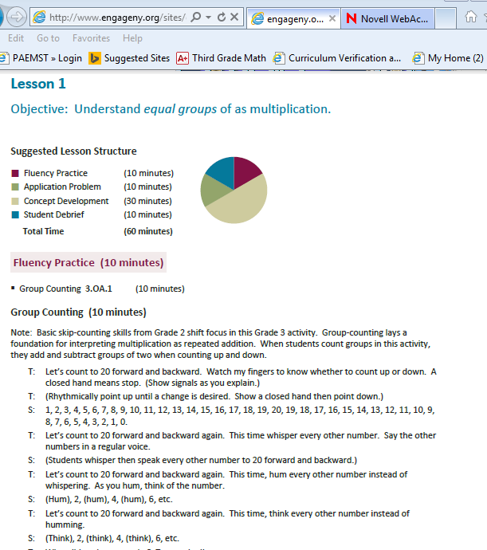
Open ActivInspire and Eureka/EngageNY

Slide 23
Open the website you would like to copy.
Use the tools
- camera
- choose the snapshot you like
3. Adjust the size of the object you copied to fit the chart.

Slide 24
What’s in the flipcharts?
Objective
Fluency
Review of Previous Lesson
Application Problem
Concept Development
Problem Set
Student Debrief
Exit Ticket

Slide 25
Let’s Look at a Flipchart!

