Slide 1
Conceptually Understanding
Fractions: Grades 3-5
New Orleans Teacher/Leader Conference
June 3-4, 2014
Judith Vail
Common Core Coordinator
Calcasieu Parish Schools
E-mail: Judy.vail@cpsb.org
Twitter: @vailjuju #Calcachat
Pre-Read
Constructive Struggling– Cathy Seeley
  http://education.illinois.edu/smallurban/chancellorsacademy/documents/FasterIsntSmarter_CathySeeley.pdf

Slide 2
Session Objectives
Audience will explore fraction bars, area model, and egg cartons as tools to develop conceptual understanding;
Assessment tasks will offer audience opportunity to struggle with the model and the concept;
Fraction modeling will be view through exemplar video of teaching strategies.

Slide 3
Setting the Stage
Constructive Struggling Reading– Cathy Seeley
  http://education.illinois.edu/smallurban/chancellorsacademy/documents/FasterIsntSmarter_CathySeeley.pdf
Constructive Struggling Video– Cathy Seeley
  http://www.mathsolutions.com/nl44/

Slide 4
Informational Resources
Constructive Struggling– Cathy Seeley
  http://education.illinois.edu/smallurban/chancellorsacademy/documents/FasterIsntSmarter_CathySeeley.pdf
Parent Roadmaps for Common Core State Standards – Council of the Great City Schools
  http://www.cgcs.org/domain/36
3-5 Fractions Progressions –
  http://ime.math.arizona.edu/progressions
Five Key Strategies for Effective Formative Assessment–
  http://www.nctm.org/news/content.aspx?id=11474

Slide 5
Video Resources
Dialogue and Constructive Struggle – Cathy Seeley
  http://www.mathsolutions.com/nl44/
4th Grade Modeling with Equivalent Fractions – Education Nation
  https://www.teachingchannel.org/videos/understanding-modeling-and-creating-equivalent-fractions-core-challenge-
4th Grade Learn Zillion Multiplying Fractions by Whole Numbers
  www.learnzillion.com/lessonsets/478-understand-multiplication-of-fractions-by-whole-numbers
5th Grade Teaching Channel Multiplying Fractions
  https://www.teachingchannel.org/videos/multiplying-fractions-lesson

Slide 6
Assessment Task Resources
Grades 3-5 Math Guidebooks – LDOE
  http://www.louisianabelieves.com/docs/default-source/teacher-toolbox-resources/2014-math-3-5-curriculum-guidebook.pdf?sfvrsn=4
Engage NY – Common Core 3-5 Mathematics Tests
  http://www.engageny.org/resource/new-york-state-common-core-sample-questions
Grades 3-5 PARCC Fraction Released Items
  http://www.parcconline.org/samples/item-task-prototype
PARCC Mathematics Practice Test
  http://practice.parcc.testnav.com/#
Illustrative Mathematics
  https://www.illustrativemathematics.org
Delaware Mathematics Assessment Tools
  http://www.doe.k12.de.us/aab/Mathematics/assessment_tools.shtml

Slide 7
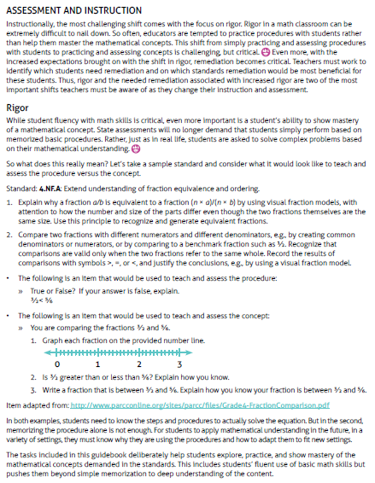

Slide 8
Formative Assessment Practices- What We Do | CCSS for Mathematical Practice- What Students Do
Create effective classroom discussions, questions, activities, and tasks that offer the right type of evidence of how students are progressing to the espoused learning intentions. Clarify, share, and understand learning targets and criteria for success. Provide feedback that moves learning forward Encourage students to take ownership of their own learning Use students as learning resources for one another. | Make sense of problems and persevere in solving them. Reason abstractly and quantitatively. Construct viable arguments and critique the reasoning of others. Model with mathematics. Use appropriate tools strategically. Attend to precision. Look for and make use of structure. Look for and express regularity in repeated reasoning.

Slide 9
CCSS Mathematics Practices http://katm.org/wp/wp-content/uploads/flipbooks/
1. Make sense of problems and persevere in solving them. Interpret and make meaning of the problem to find a starting point. Analyze what is given in order to explain to themselves the meaning of the problem. Plan a solution pathway instead of jumping to a solution. Monitor their progress and change the approach if necessary. See relationships between various representations. Relate current situations to concepts or skills previously learned and connect mathematical ideas to one another. Continually ask themselves “Does this make sense?” Can I understand various approaches to solutions. | How can you describe the problem in your own words? How would you describe what you are trying to find? What do you notice about...? What information is given in the problem? Describe the relationship between the quantities. Describe what you have already tried What might you change? Talk me through the steps you’ve used to this point. What steps in the process are you most confident about? What are some other strategies you might try? What are some other problems that are similar to this one? How might you use one of your previous problems to help you begin? How else might you organized your response?
2. Reason abstractly and quantitatively. Make sense of quantities and their relationships. Decontextualize (represent a situation symbolically and manipulate the symbols) and contextualize (make meaning of the symbols in a problem) quantitative relationships. Understand the meaning of quantities and are flexible in the use of operations and their properties. Create a logical representation of the problem. Attends to the meaning of quantities, not just the answer. | What do the numbers used in the problem represent? What is the relationship of the quantities? How is _______ related to ________? What is the relationship between ______ and ______? What does_______mean to you? (e.g. symbol, quantity, diagram) What properties might we use to find a solution? How did you decide in this task that you needed to use...? Could we have used another operation or property to solve this task? Why or why not? USD 259 Learning Services 2011

Slide 10
CCSS Mathematics Practices http://katm.org/wp/wp-content/uploads/flipbooks/
3. Construct viable arguments and critique the reasoning of others. Analyze problems and use stated mathematical assumptions, definitions, and established results in constructing arguments. Justify conclusions with mathematical ideas. Listen to the arguments of others and ask useful questions to determine if an argument makes sense. Ask clarifying questions or suggest ideas to improve/revise the argument. Compare two arguments and determine correct or flawed logic | What mathematical evidence would support your solution? How can we be sure that…? How could you prove that...? Will it still work if …? What were you considering when...? How did you decide to try that strategy? How did you test whether your approach worked? How did you decide what the problem was asking you to find? (What was unknown?) Did you try a method that did not work? Why didn’t it work? Would it ever work? Why or why not? What is the same and what is different about...? How could you demonstrate a counter example?
4. Model with mathematics. Understand this is a way to reason quantitatively and abstractly (able to decontextualize and contextualize). Apply the mathematics they know to solve everyday problems. Are able to simplify a complex problem and identify important quantities to look at relationships. Represent mathematics to describe a situation either with an equation or a diagram and interpret the results of a mathematical situation. Reflect on whether the results make sense, possibly improving/revising the model. Ask themselves, “How can I represent this mathematically? | What number model could you construct to represent the problem? What are some ways to represent the quantities? What is an equation or expression that matches the diagram, number line, chart, table? Where did you see one of the quantities in the task in your equation or expression? How would it help to create a diagram, graph, table...? What are some ways to visually represent...? What formula might apply in this situation USD 259 Learning Services 2011
Mathematics Learning, Teaching, & Leading Collaborative

Slide 11
CCSS Mathematics Practices http://katm.org/wp/wp-content/uploads/flipbooks/
5. Use Appropriate Tools Strategically Use available tools recognizing the strengths and limitations of each. Use estimation and other mathematical knowledge to detect possible errors. Identify relevant external mathematical resources to pose and solve problems. Use technological tools to deepen their understanding of mathematics. | What mathematical tools could we use to visualize and represent the situation? What information do you have? What do you know that is not stated in the problem? What approach are you considering trying first? What estimate did you make for the solution? In this situation would it be helpful to use a graph, number line, ruler, diagram, calculator, manipulative? Why was it helpful to use...? What can using a______ show us? In what situations might it be more informative or helpful to use?
6. Attend to precision. Communicate precisely with others and try to use clear mathematical language when discussing their reasoning. Understand the meanings of symbols used in mathematics and can label quantities appropriately. Express numerical answers with a degree of precision appropriate for the problem context. Calculate efficiently and accurately. | What mathematical terms apply in this situation? How did you know your solution was reasonable? Explain how you might show that your solution answers the problem. What would be a more efficient strategy? How are you showing the meaning of the quantities? What symbols or mathematical notations are important in this problem? What mathematical language, definitions, properties can you use to explain...? How could you test your solution to see if it answers the problem? USD 259 Learning Services 2011
Mathematics Learning, Teaching, & Leading Collaborative

Slide 12
Ideas For Formative Assessment Questioning
During Small Group Work or Large Group Discussions
Idea No. 1
In terms of student behavior, strategic questioning encourages students to:
listen actively
speak
take turns
be actively involved with learning.
If the classroom culture does not encourage 'hands up', but rather emphases that everyone is expected to think and be ready to answer any question, students are more likely to be involved with the lesson. Likewise, if the classroom culture encourages the asking of questions and makes it okay to give a wrong answer, then students will be more likely to offer answers.
Idea No. 2
The asking of questions is a deliberate, planned activity.
Identify the Learning Target and plan related questions to target knowledge, understanding or the teaching and learning strategies.
Plan for more open questions than closed questions, understanding that open questions provide more opportunities for the teacher to understand the thinking behind a response and more opportunities for the students to demonstrate their understanding.
Plan for questions that pose appropriate cognitive demands, not only in respect of the age and development of the student but also in terms of where the questions occur in the unit or lesson. This means asking knowledge and comprehension questions about new material prior to questions of analysis and evaluation.
Idea No. 3
Provide students with time to think after asking a question.
This means accepting a pause or silence as an integral part of questioning during class. More demanding, open-ended questions pose cognitive challenges. Students need time to reason and consider their answers. Research (Rowe 1972) strongly suggests that, where there is a lapse of time between question and answer, answers dramatically increase in quality. Where teachers wait for student responses, more students participate in answering, responses are longer and more confident, and students comment, respond to and thus build upon each other's answers.

Slide 13
Formative Assessment Questioning
Idea No. 4
A critical factor in enhancing the strategic effectiveness of questions is teacher receptiveness. The teacher's positive response to both good and wrong answers is essential.
A receptive, listening attitude on the part of the teacher is conveyed through:
  facial expression
  body language
  verbal responses.
Responses to wrong answers can include:
the teacher rephrasing the original question
  'Let me put it another way…'
a request for clarification
'What do you mean when you say …?'
a request for specific examples
'How would this work?’
'Can you give me an example of this?'
a request for rephrasing
'Can you put it another way?’
Idea No. 5
During a Whole Group Discussion:
The strategic effectiveness of questioning is further enhanced by
moving around the room to make sure questions are more likely to be evenly distributed.
allowing students to talk to each other about a question
asking everyone to write down an answer and then reading out a selected few
giving students a choice of possible answers and having a vote on the correct option.
All of these tactics increase student participation.
providing prompt questions such as
'Why do you think that?', 'Can you tell me more about …?' or 'Is it possible that ...?'
posing fewer, well chosen questions is more strategic as an assessment for learning strategy.
ACCOUNTABLE TALK, NEXT PAGE

Slide 14
Accountable Talk SM: Classroom Conversation that Works, University of Pittsburg
FORMATIVE ASSESSMENT TEACHER MOVES IN GROUP DISCUSSIONS
Marking
  Wow! That’s interesting. Did everyone hear what LeShaun said? She said that…..
  That’s an important point
  Re-voice student’s important mathematical statements
Challenging
But what about Daman’[s point that….
Can anyone come up with another relevant contrast?
What do YOU think?
Press students with a counter example
Connecting
OK. Let’s sum up.
What have we discovered?
Keeping the channels open
Did everyone hear what Mattie just said?
Say that again, so everyone can hear
What did she just say?
Moves that Support Accountability to the Learning Community
Keeping everyone together
Who can repeat in their own words what Juan just said?
Can you explain that in your own words?
Linking Contributions
Do you agree with what Keisha just said?
Can someone add on to Sean’s idea?
Who wants to add one?
Verifying and Clarifying
Oscar, what am I asking you?
So are you saying?
Moves that Support Accountability to Accurate Knowledge
Pressing for Accurate and Sufficient Information
So, how did you know 50 is the solution?
How can we check to make sure?
What do we know? What’s our evidence?
Do you agree of disagree?
Building on Prior Knowledge
Who remembers what we learned about that yesterday?
How does this connect with what we have previously learned?
Moves that Support Accountability to Rigorous Thinking
Pressing for Reasoning
Why do you think that?
How did you arrive at that solution?
Making room for expanded reasoning
Hmmm….say more about that
Take your time, we’ll wait
Allow Private Think Time, time for processing
Notes:
NEW, specific examples of questions.

Slide 15
Learning Targets and Success Criteria
Learning Targets
‘What’ and ‘Why’
Success Criteria
‘How to recognise success’
A Learning Target describes what pupils should know, understand or be able to do by the end of the lesson or series of lessons.’ Learning
Targets can be found in the CCSS for Mathematics.
Success Criteria
are linked to the learning targets;
are specific to an activity;
are discussed with pupils prior to undertaking the activity;
provide a scaffold and focus for pupils while engaged in the activity; and
are used as the basis for feedback and peer-/self-assessment.
Learning Targets and Success Criteria
Success Criteria allows students to take more responsibility for their own learning and what they need to know. It lets them know:
what they are going to learn;
how they will recognize it when they have succeeded.
Mathematics Learning, Teaching, & Leading Collaborative
6
Notes:
The next element in the Assessment for Learning process is the development of success criteria.
If learning intentions spell out what the students will learn and why, the success criteria show pupils how to recognise success.

Slide 16
Learning Targets: What You Want Students to Learn
The design of Learning Targets starts with the answers to these questions.
What do I want students to know?
What do I want students to understand?
What do I want students to be able to do?
A certain challenge exists for teachers in translating the knowledge, understanding and skills from CCSS into learning targets as language that is accessible to your students, but time spent on this preliminary step is in itself excellent professional learning.
Thinking about the different kinds of knowledge, and being specific about the kind of knowledge that is required in a particular situation, will help you design learning targets.
Usually the teacher knows why the students are engaged in a particular activity, but the students are not always able to differentiate between the activity and the learning that it is meant to promote. A carefully framed learning intention will direct students' attention to the learning. The learning intention emphasis what the students will learn, rather than what they will do.
Teachers Questions
Are the success criteria in language the students are likely to understand?
Do some of the success criteria need to be explained by showing students exemplars or work samples?
Do the success criteria refer to the specific skills, knowledge and understanding that you wanted the students to learn? (Do they refer to all of these? Do they contain reference to extra skills, knowledge and understanding that were not the focus of the learning intention?)
Student Questions
Did I:
provide a written summary of the problem in my own words?
use an appropriate strategy?
explain my thinking with words, pictures or symbols
have an accurate answer, which uses correct terminology?
provide evidence of having checked the answer?
Success Criteria: What Students Will Do in Order to meet the Learning Target

Slide 17
CCSS “I Can” Statements
3rd Grade Fractions
3rd Grade: Number and Operations – Fractions
3.NF.1 | I can define fractions as parts of a whole. I can determine the individual parts within a fraction. (numerator) I can determine the number of equal parts within a fraction. (denominator)
3.NF.2 | I can partition and identify fractions on a number line that starts at 0 I can represent a fraction on a number line when 1 is the numerator. (Ex. Use a number line from 0-1 to show that each partition represents one part of b or 1/b with b representing the denominator and 1 representing the numerator) I can represent a fraction on a number line when the numerator is more than 1. (Ex. 1/b + 1/b + 1/b =3/b.)
3.NF.3 | I can recognize when two fractions are equivalent when they are the same size or the same point on a number line I can recognize simple equivalent fractions and use a visual fraction model to explain why they are equivalent (Ex. 1/2 = 2/4 or 4/6 = 2/3 I can express whole numbers as fractions such as 3/3 = 1 and locate both on a number line I can compare two fractions with the same numerator or the same denominator by reasoning about their size I can recognize that to correctly compare two fractions they must have the same whole I can compare fractions using >, <, or = and explain why I am correct by using a visual fraction model

Slide 18
CCSS “I Can” Statements
4th Grade Fractions
4th Grade: Number and Operations - Fractions
4NF.1 | I can use models to explain why multiplying a fractions numerator and denominator by the same number does not change the value of the fraction I can recognize and create equivalent fractions
4NF.2 | I can compare two fractions with different numerators and different denominators by creating common denominators or numerators or by comparing them to a benchmark fractions like one-half I can recognize that comparisons of fractions are valid only when the two fractions refer to the same whole I can record the results of my fractions comparisons using symbols (< = >) and justify my answer by using models
4NF.3 | I can add and subtract fractions by joining and separating parts referring to the same whole I can break apart a fraction into into a sum of fractions with the same denominator in more than one way I can record each sum of fractions using an equation I can prove my equations are correct by using a visual fraction model I can add and subtract mixed numbers with like denominators I can use fractions models and equations to solve word problems using addition and subtraction of fractions with the same denominator
4NF.4 | I can connect what I know about multiplying and dividing whole numbers to multiplying and dividing fractions I can use a fraction model or equation to multiply a fraction by a whole number I can use fraction models and equations to solve word problems involving multiplication of a fraction by a whole number I can understand that the addition of unit fractions such as 1/b + 1/b + 1/b can be represented by 3 x 1/b
4NF.5 | I can express a fraction with denominator 10 as equivalent to a fraction with a denominator of 100 I can add a fraction with denominator 10 with a fraction of denominator 100
4NF.6 | I can use decimal notation to represent fractions with denominators of 10 or 100
4NF.7 | I can recognize that the comparison of two decimals must always refer to the same whole I can use a visual model to record my decimal comparisons and record the result using < = or >

Slide 19
CCSS “I Can” Statements
5th Grade Fractions
5th Grade: Number and Operations - Fractions
5.NF.1 | I can use equivalent fractions to add and subtract fractions with unlike denominators, including mixed numbers
5.NF.2 | I can solve word problems involving addition and subtraction of fractions with the same whole, including fractions with unlike denominators I can use visual fraction models or equations to represent the problem I can use benchmark fractions and number sense to estimate and assess the reasonableness of my answer
5.NF.3 | I can explain a fraction as divisions of the numerator by the denominator, for example: 3/4 means dividing 3 by 4 as when 3 wholes are shared equally among 4 people, each person receives a share size of 3/4 I can solve word problems involving division of whole numbers leading to quotients with fractions or mixed numbers I can use visual fraction models or equations to explain my answer
5.NF.4 | I can explain the product of a whole number and a fraction by using a visual fraction model I can explain the product of two fractions using a visual fraction model I can create a story to describe my fraction models I can find the area of a rectangle with fractional sides by tiling I can show the area is the same as would be found through multiplication I can multiply fractional side lengths to find the area of rectangles I can represent fraction products as rectangular areas
5.NF.5 | I can compare the size of a product to the size of one factor based on the size of the other factor without multiplying I can explain why multiplying a number by a fraction greater than 1 results in a product greater than the number I can explain why multiplying a number for a fraction less that 1 results in a product smaller than the number
5.NF.6 | I can solve real-world problems involving multiplication of fraction and mixed numbers using visual fraction models or equations
5.NF.7 | I can use what I know about the division of whole numbers to explain and find the quotient of the division of a unit fraction by a whole number by using visual fraction models and equations to represent the problem I can use what I know about the division of whole numbers to explain and find the quotient of the division of a whole number by a unit fraction by using visual fraction models and equations to represent the problem I can solve word problems AND create a story context involving division of unit fractions by whole numbers and whole numbers by unit fractions by using visual fraction models and equations to represent the problem

Slide 20
Rectangle to Shade
Shade 4/6 of the rectangle below. Explain how you know your answer is correct.
Notes:
3.NF 3.a,b,d; 4.NF.3.a,b,d; 5NF.2

Slide 21
Student Ages in 4th Grade Classroom
A) The following are 7 student’s ages on September 30 in a 4th grade classroom. Build a line plot to display the data.
Nicole 9 1/4 years old
Joseph 9 1/5 years old
Hanna 9 1/3 years old
Brandon 9 years old
Tiffany 9 1/6 years old
Jasmine 9 1/8 years old
Tyler 9 1/2 years old
Brandon
9 9 1/2
B) Write down the difference between Tyler’s age and Nicole’s age, include numbers, words or sketches.
c) Write down at least 2 fraction word problems that use the data in your number line.
Notes:
4.MD.4

Slide 22
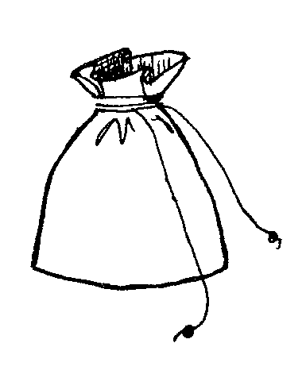
James and Benito’s Pencils
James and Benito each have a bag of pencils. Some pencils are sharpened and some are not. James’ bag of pencils has a total of 5 pencils and 2 of the 5 are sharpened.
Benito’s bag of pencils has a total of 10 pencils, we do not know how many are sharpened. We do know that Benito has the same fraction of sharpened pencils in his bag as James has.
Exactly how many of Benito’s pencils are sharpened?
2) Draw pictures of the pencils in James bag and the pencils in Benito’s bag. Use numbers to show the fractions of sharpened and unsharpened pencils in each bag.
James’ Bag
Fraction Sharpened:
Fraction Unsharpened:
Benito’s ’ Bag
Fraction Sharpened:
Fraction Unsharpened:
Benito’s bag has a total of 10 pencils inside, and James’ bag has a total of 5 pencils inside. How can the fraction of sharpened pencils in James’ bag be the same as the fraction of sharpened pencils in Benito’s bag, even though they have a different number of pencils?
Explain your answer using both numbers and words.
Notes:
4.NF.1,2

Slide 23
Model Z is shaped to represent a value that is less than 1 whole.
Write down 4 equivalent fractions or decimals that represent the shaded part. Explain why you are correct for each answer.
1)
2)
3)
4)
Notes:
4.NF.5, 6, & 7

Slide 24
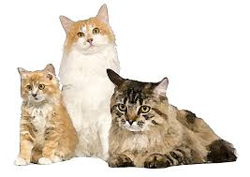
Ralph’s Cats
Ralph has 3 cats. Mojo, Kahn and Suki.
Ralph feeds them Cat Crunches every day. Each day Mojo eats 1/4
box of Cat Crunches, Kahn eats 1/3 box and Suki eats 1/6 of a box. How much of a box do the cats eat each day?
Write down how you decided.
2) Mojo and Kahn spend much of their day sleeping. Mojo sleeps 2/3 of the day and Kahn sleeps 3/5 of the day. Which cat sleep longer?
Use symbols, words, and or pictures to help you write down your thinking.
3) The cats shared a carton of milk today. Mojo drank 1/3 of the carton, Kahn drank 5/12 of the carton and Suki drank 1/6 of the carton. What fraction of the carton was left over?
Write down you figured this out.
Notes:
5.NF. 1, 2 & 6

Slide 25
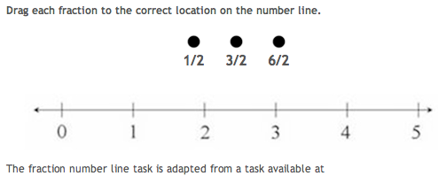
PARCC 3rd Grade
Fractions on a Number Line

Slide 26
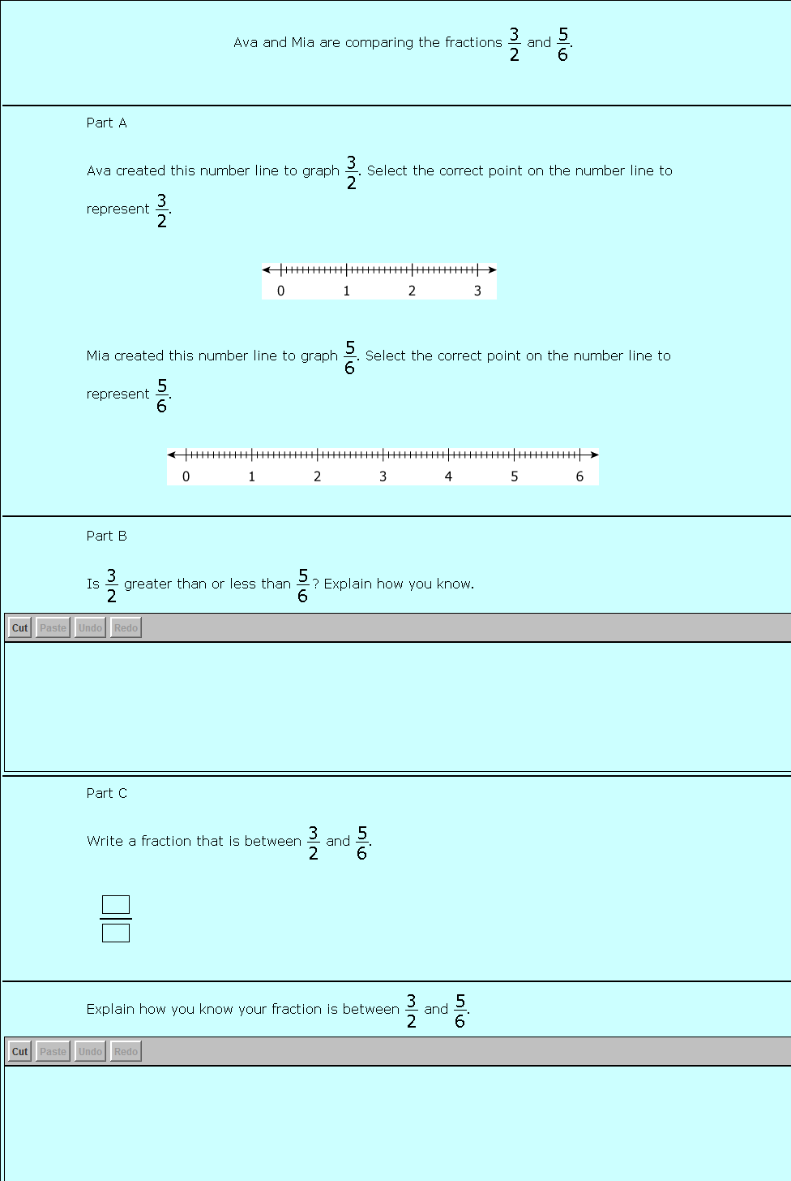
PARCC 4th Grade
Fractions on a Number Line

Slide 27
5th Grade
Fractions on a Number Line

Slide 28
Engage NY Sample Item: Pete’s Rectangle
4.NF.3d – Build fractions from unit fractions by applying and extending previous understandings of operations on whole numbers.

Slide 32
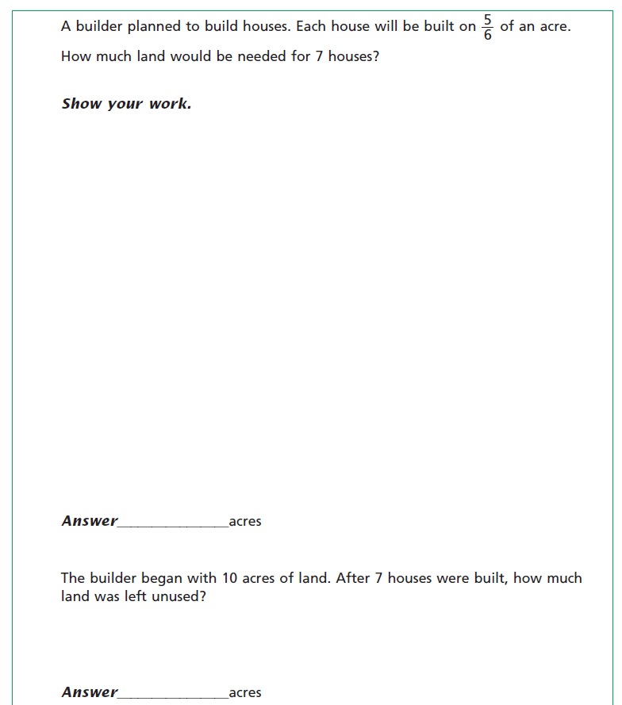
Engage NY Sample Item: The Builder
4.NF.4c & 4.NF.3d – Students need many opportunities to work with problems in context to understand the connections between models and corresponding equations. Contexts involving a whole number x a fraction lend themselves to modeling and examining patterns.
Explain with pictures or words how you know how much land was left unused.

Slide 33
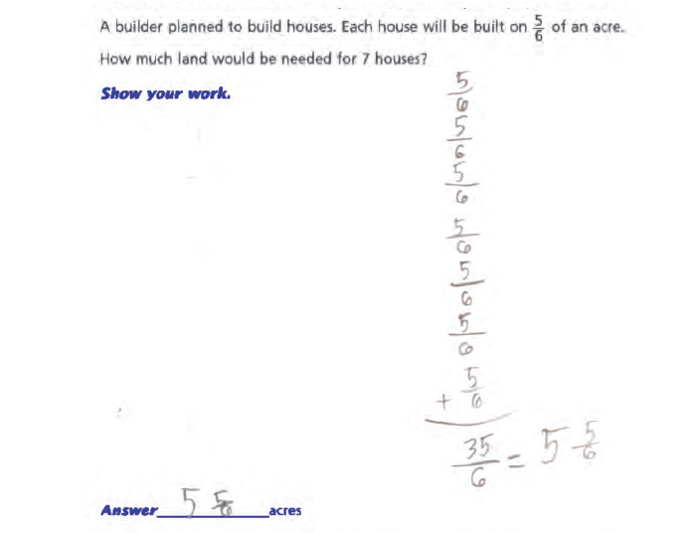

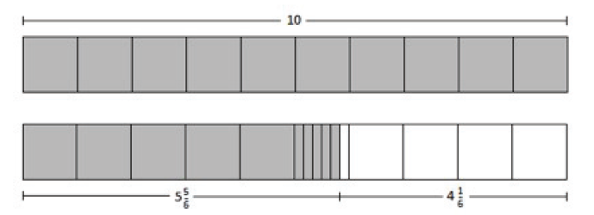
Explain with pictures or words how you know how much land was left unused.

Slide 34
The Mathematical Task Analysis Guide Where are we situated?
Lower-Level Demands Memorization Tasks Involves either producing previously learned facts, rules, formulae, or definitions OR committing facts, rules, formulae, or definitions to memory. Cannot be solved using procedures because a procedure does not exist or because the time frame in which the task is being completed is too short to use a procedure. Are not ambiguous – such tasks involve exact reproduction of previously seen material and what is to be reproduced is clearly and directly stated. Have no connection to the concepts or meaning that underlie the facts, rules, formulae, or definitions being learned or reproduced. Procedures Without Connections Tasks Are algorithmic. Use of the procedure is either specifically called for or its use is evident based on prior instruction, experience, or placement of the task. Require limited cognitive demand for successful completion. There is little ambiguity about what needs to be done and how to do it. Have no connection to the concepts or meaning that underlie the procedure being used. Are focused on producing correct answers rather than developing mathematical understanding. Require no explanations, or explanations that focus solely on describing the procedure that was used. Stein and Smith, 1998 Learning, Research and Development Center, Uiniversity of Pittsburgh | Higher-Level Demands Procedures With Connections Tasks Focus students’ attention on the use of procedures for the purpose of developing deeper levels of understanding of mathematical concepts and ideas. Suggest pathways to follow (explicitly or implicitly) that are broad general procedures that have close connections to underlying conceptual ideas as opposed to narrow algorithms that are opaque with respect to underlying concepts. Usually are represented in multiple ways (e.g., visual diagrams, manipulatives, symbols, problem situations). Making connections among multiple representations helps to develop meaning. Require some degree of cognitive effort. Although general procedures may be followed, they cannot be followed mindlessly. Students need to engage with the conceptual ideas that underlie the procedures in order to successfully complete the task and develop understanding. Doing Mathematics Tasks Requires complex and non-algorithmic thinking (i.e., there is not a predictable, well-rehearsed approach or pathway explicitly suggested by the task, task instructions, or a worked-out example). Requires students to explore and to understand the nature of mathematical concepts, processes, or relationships. Demands self-monitoring or self-regulation of one’s own cognitive processes. Requires students to access relevant knowledge and experiences and make appropriate use of them in working through the task. Requires students to analyze the task and actively examine task constraints that may limit possible solution strategies and solutions. Requires considerable cognitive effort and may involve some level of anxiety for the student due to the unpredictable nature of the solution process required.
Stein and Smith, 1998

