Slide 1
Eureka: If we knew then…
Math Needs a Makeover

Slide 2
Implementation of
Eureka Math
Session Overview
Process used to choose the EngageNY/Eureka Math material
Training for district and teacher leaders
Professional development for administrators
Professional development and support for teachers
Lessons Learned
Support for Parents

Slide 3
Implementation of
Eureka Math
LPSS Teacher Leader Cadre selected Eureka Math as the Curriculum for grades Kindergarten to Algebra I.
Training attended by district coaches and teacher leaders in Yuma, Arizona
Direct contact with writers of the curriculum and the Cain Center
Reading the modules and working all problems to provide training for teachers
Notes:
In spring of 2013 a five member team of LPSS teachers were brought together study closer common core and to decide on curricular material. Professional Development was conducted by Mary Lou Jumonville as well as District Coaches
-Grade Level PD specific to each module or parts of a particular module.
-Content Knowledge training for teachers with some of the new topics to their grade level (in advance of teaching the topic! I guess here, I think we need to say “Don’t assume they know” and “Don’t necessarily wait for them to ask”)
Material is scripted but teachers still need to make it their own
It is a resource but also a professional development tool for teachers

Slide 4
Implementation of
Eureka Math
Professional Development began Summer 2013
5th grade on Fractions
3 day study of Statistics grades 6-12
3rd and 4th grade MSP project
Job Embedded and throughout the school year
2 job embedded days before school, 1 at the end of September or October
½ day job embedded or Saturday Training before each module
Bill Davidson Fluency and Grade band provided by LDOE
Eureka webinars beginning in January
Notes:
In spring of 2013 a five member team of LPSS teachers were brought together study closer common core and to decide on curricular material. Professional Development was conducted by Mary Lou Jumonville as well as District Coaches
-Grade Level PD specific to each module or parts of a particular module.
-Content Knowledge training for teachers with some of the new topics to their grade level (in advance of teaching the topic! I guess here, I think we need to say “Don’t assume they know” and “Don’t necessarily wait for them to ask”)
Material is scripted but teachers still need to make it their own
Eureka is a curricular resource as well as a professional development tool for teachers

Slide 5
Implementation of
Eureka Math
Administrators PLC sessions
Explanation of rational for selecting and creating of Eureka Math
Motivation to change
Completed a scavenger hunt to understand the lesson structure or components of lesson
Instructional Practice Guide for administrator
Rigor Presentation provided by the LDOE-Edmodo
Use only EUREKA Math
Role of the Administrator in implementation
Teacher Professional Development
Lesson Structure
Content study
Study, prepare and deliver professional development modules by grade level
Engage teachers in study of standards in each grade band
Show how strategies are used at each grade level
Notes:
Change in practice, content and strategies.
Begin Now to study and plan for extensive support for teachers and leaders
Teacher and Principal will speak about implementation

Slide 6
Lessons Learned
Resources delivered in a timely manner
Print a copy of teacher materials for each module for every teacher
Print a copy of every module for every student
Have a plan!
Notes:
We printed each student a book for each module and a teacher copy for each teacher for each module.

Slide 7
Lessons Learned
K-5 Lesson Structure
Fluency
Concept Development
Application Problem
Activity /Problem Set
Student Debrief
Exit Tickets
Homework
Notes:
Lesson structure should be discussed throughout the whole year
One lesson a day should be the goal
Carefully select problems
Always maintain lesson structure
Fluency
Activities for each lesson is intentionally organized
Revisit previously learned material to develop automaticity
Anticipate future concepts
Statically preview or build skills for the day’s concept development
Concept Development
Major portion of instruction and generally comprises at least 20 min
a deliberate progression of material, from concrete to pictorial to abstract
Our goal is always to strengthen students’ understanding of numbers rather than to teach manipulatives.
Application Problem
Single-step word problems help children to understand the meaning of new ideas
Multi-step word problems support and develop instructional concept
Activity /Problem Set
Student Debrief
Exit Tickets
Homework

Slide 8
Lessons Learned
6-High School Lesson Design
Identifiable Lesson Type
Introduction or lesson notes
Examples and exercises
Exit Tickets
Problem Set
Notes:
6-High School Lesson Design
Identifiable Lesson Type
Socratic
Problem Set
Exploratory
Modeling
Introduction or lesson notes
Examples and exercises
Teacher guided vs student driven
Exit Tickets
always a part of the lesson
Problem Set
always a part of the lesson

Slide 9
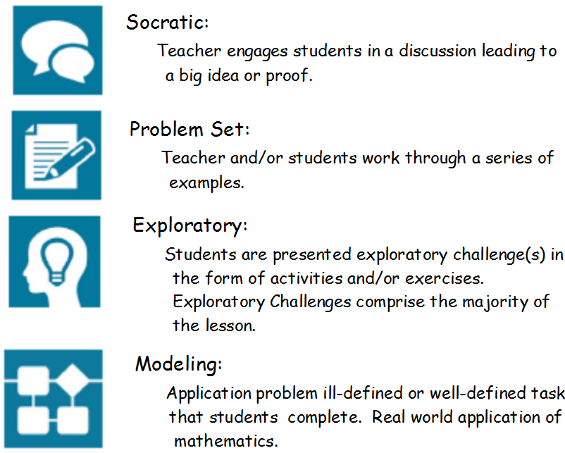
Notes:
Each Lesson in Middle & High School Begins with an Icon to describe the type of lesson

Slide 10
Notes:
When looking at a lesson, begin by looking at the type of lesson
Then the student outcomes
Then the Exit ticket; every lesson ends with an Exit Ticket

Slide 11
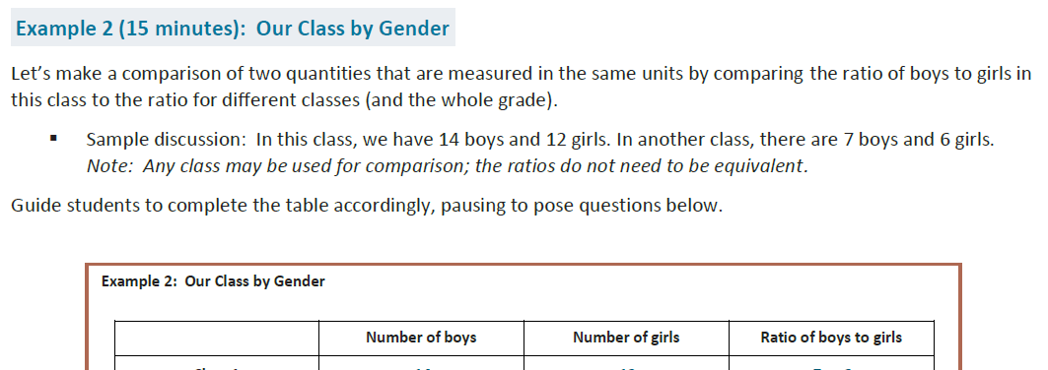
Notes:
Middle and High School Lessons do not all follow a set structure
Many lessons contain examples and exercises
Anything in the box is usually also in the located in the Student sheets

Slide 12
Notes:
Many times the Math Practices are highlighted in the teacher notes

Slide 13
Notes:
Every lesson concludes with a closing
This could be presented to the class and then students should share out…
Most have a lesson summary

Slide 14
Ready
Set
Action:
Teacher Engage in Study
Module:
Module overview
Topic overviews
Lessons
lesson structure
Mid and end of module assessment
How to engage in lesson notes?
How to engage teachers in learning new content?
What do you use for weekly assessments?
Notes:
Module is the same as a unit. Each module contains multiple topics and multiple lessons within each topic. Every module contains mid-module and end of module assessment. The content covered in the first half of the module is covered on the mid-module assessment and the end of module assesses the second half of the content.
How to engage in lesson notes? Have teachers read to determine the Big Ideas and Potential Gaps. They certainly needed to keep the lesson type and the student outcomes in mind as they read through the progression of the lesson. Teachers should always be looking for coherence and connections to previous lessons.
How to engage teachers in learning new content? Teacher should keep in mind that the teacher notes are written to develop or tap into the teacher’s content knowledge. We did find it necessary at times to provide PD by module at first to assist teachers in the content.
What do you use for weekly assessments? As teachers read through the modules & work problems, they were encouraged to write similar problems to use for assessments. We were told by the writers to avoid grading Exit Tickets since they were written to be formative assessments.

Slide 15
Notes:
Used in Middle School for Module Training

Slide 16
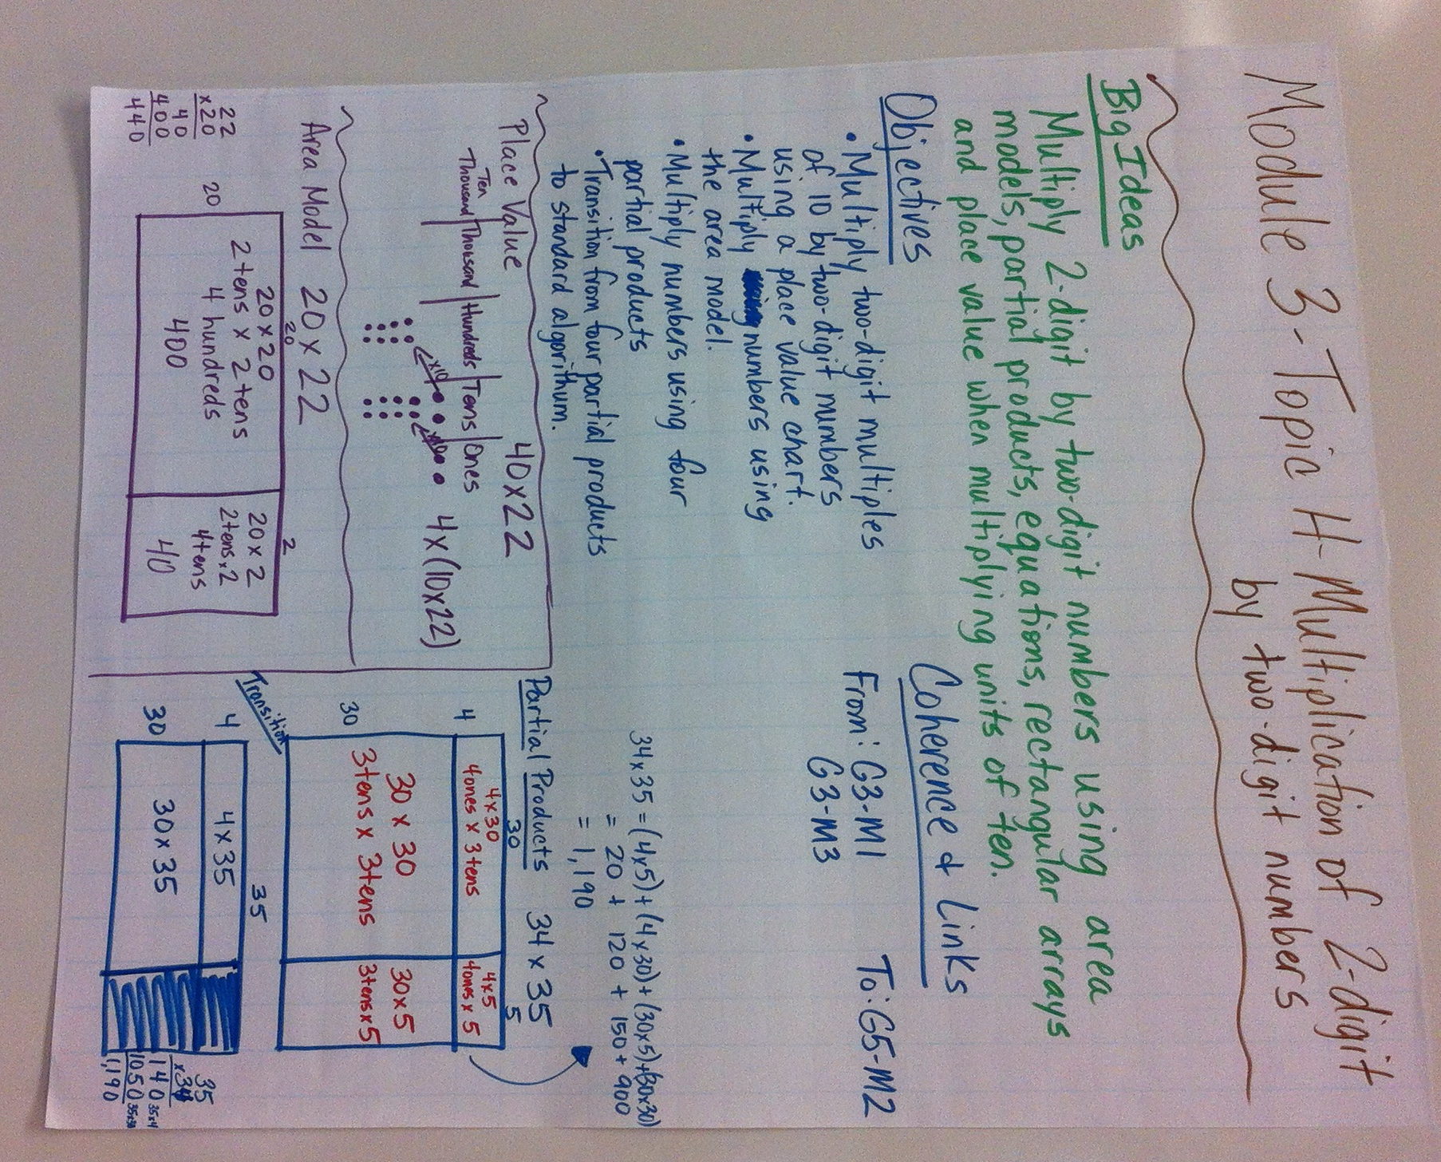
Notes:
4th grade Module 3 topic investigation during a LPSS PD

Slide 17
Lessons Learned
Ways to support teachers in the learning process
Change is hard and it requires
Patience
Positive feedback
Listening
No Blame Game
New Strategies are used across grade level
Requires school leadership support and expectation
Failing grades are a teacher issue not a curricular issue
Creation of Support Material
teacher flip charts
topic assessments
answer key for homework and exit tickets for K-5
Work toward a lesson a day focusing on the objective of the day
Minimize extra teacher responsibility
Maximize instructional minutes
Notes:
Instructional minutes for k-3 was 75 minutes per day
Instructional minutes for Grades 4 and 5 was 70 minutes
Most middle schools have 90 minute math blocks
High School 52 minutes during a 7 period of day and 90 minutes in a 4x4 block schedule

Slide 18
Parent and School Support
Teacher resources and Parent Newsletters
Representation at Open House
Math Nights
District Academic Super bowl, We are in it to win it
Notes:
Parent Roadmap
Module descriptions K-5
What will students learn?
Vocabulary
Home Activities
Video
Videos for Parents-Vermillion Parish
Parent Newsletters
Math Nights at Schools
Academic Super Bowl: We are in it to win it

Slide 19
Other Resources
Other Resources:
Required tools or manipulatives (Technology, compass, protractors, patty paper, Rekenrek etc)
www.louisianabelieves.com
Parent and Student resources
EAGLE
Louisiana Believes Teacher Leader Edmodo
Learning modules
Collaboration
What’s Next
Planning guides –LDOE guidebook, Learn Zillion, MDC
Parent newsletters
Additional videos
Study PARCC
Notes:
Technology of links to videos
Manipulatives such as scales, Rekenrek, compass, protractor, ten frames, place value disk, place value cards, clock, snap cubes, patty paper, personal white board, dry erase markers..etc. Look at the material list and read closely for additional materials

Slide 20
What’s at the Core of Common Core Math?
Understanding the Shift in Mathematics
Notes:
This presentation was created to help parents, teachers, and other stake holders in education to better understand the shifts happening in math education today.

Slide 21
Why Shift?
 Louisiana ranks 49th out of 50 states in education according to National Assessment of Educational Progress (NAEP 2013).
 Only 72.3% of Louisiana’s students complete high school in 4 years. Louisiana believes.com
 The Council for a Better Louisiana 2013 report card gave our state a grade of “F” for K-12 Achievement.
 U.S. students score significantly lower in mathematics when compared to other countries. Louisiana believes.com
 Nationwide, colleges are overwhelmed with the number of incoming freshman who need math remediation. Almost 1/3 of Louisiana college students need remediation in math.

Slide 22
What does it look like in the classroom?
Researched based strategies
(Concrete-pictorial-abstract – Jerome Bruner, Relational Understanding – Richard Skemp, Multiple models, Zoltan Dienes)
tape diagrams
number bonds
number lines
unit form and place value
alternatives to the standard algorithm
various other strategies rooted in conceptual understanding

Slide 23
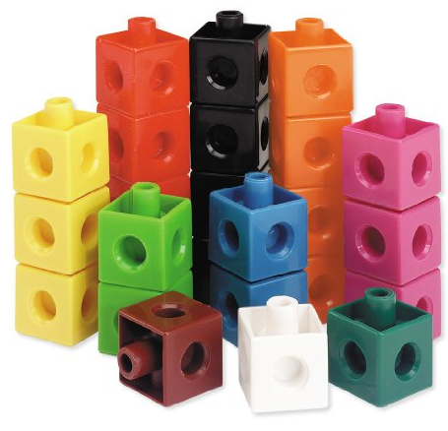
Tape Diagrams
Grade 1
Emi made a train with 6 yellow snap cubes and some green snap cubes. The train was made of 9 snap cubes. How many green cubes did she use?
6
3
9 snap cubes
Notes:
A tape diagrams is essentially a rectangle that helps students analyze and dissect word problems.
It helps students see the part to whole relationships in the word problem.
In this example, we know our whole is 9 snap cubes.
We also know that part of that whole is made up of 6 yellow snap cubes.
Some parents have suggested that students do not need tape diagrams because they just know they need to subtract.
We see students all the time who would add 6 and 9 together.

Slide 24
Tape Diagrams
Grade 3
The baker packs 36 bran muffins in boxes of 4. Draw and label a tape diagram to find the number of boxes he packs.
4
4 4 4 4 4 4 4 4
36 muffins
Notes:
This is an example of a problem where knowing key words would be of no use to students.
If drawing a tape diagram becomes a “go to” strategy instead of key words, students will be more successful.
Tape diagrams can become a powerful tool to have in the students tool belt.

Slide 25
Tape Diagrams
Jerome, Kevin, and Seth shared a submarine sandwich. Jerome ate ½ of the sandwich, Kevin ate$\frac{1}{3}$ of the sandwich, and Seth ate the rest. What is the ratio of Jerome’s share to Kevin’s share to Seth’s share?
3
Jerome
Kevin
2
Seth
1
Practice ACT Question
Notes:
This is an ACT practice problem
A visual representation is one method to solving this problem
Click – This box represents the entire sandwich
Click – it is broken into two equal parts since Jerome ate ½ of the sandwich
Click,, - The same size box is depicted for Kevin, but broken into three equal part
Click… - in order to represent what Kevin and Jerome both ate on the same sandwich, it would need to be broken into 6 equal parts
… When looking at the shading for each person, Jerome ate 3 sixths, Kevin 2 sixths, and Seth one sixth. Thus the ratio is 3 to 2 to 1

Slide 26
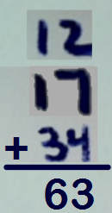
Tape Diagrams
Jaden is 5 years older than Harold and Sammy is twice as old as Jaden. If Harold is 12, what is the sum of their ages?
Notes:
Let’s work a problem using tape diagrams.
These will be used during this presentation but not expected to be used with Parents.
See attachment

Slide 27
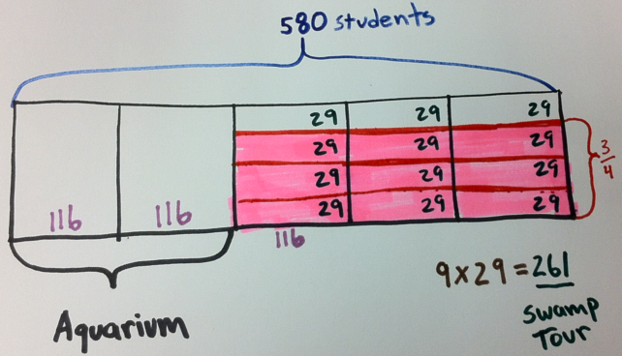
Your Turn Using Tape Diagrams
If $\frac{1}{4}$ of Caleb’s money is equal to $\frac{1}{5}$ of Hannah’s money and their total funds equal $180.00, find out how much they each have.
Of all the students at L. J. West Elementary School, $\frac{2}{5}$ went on a field trip to the aquarium, $\frac{3}{4}$ of the remainder went on a swamp tour field trip and the rest stayed at school. If there are 580 students at L. J. West Elementary School, how many went to the swamp tour?
Notes:
This slide is only for this presentation and not intended for parents

Slide 28
Number Bonds
Grades K, 1, & 2
17
- 9
17
8
10
7
8
10 – 9 =
1
Notes:
Like tape diagrams, number bonds model a part, part, whole relationship as well.
The larger circle being the whole and the smaller ones being the parts. Take 17 for example.
We can think of 17 as being made up of 2 parts, 10 and 7.
This can be very useful when subtracting 17 – 9.
I was taught to put 9 in my head and count up to 17 or put 17 in my head and count down 9.
But if I culd see 17 as 10 and 7, then I could subtract the 9 from the ten and put the 1 and 7 together to make 8.

Slide 29
Subtraction Algorithm
Number Bond
2
1
34
- 9
34
2
5
20
4
10
10-9=1
Notes:
Let’s think about how we subtract 9 from 34 using the standard algorithm.
Cross out 3 make it a 2
make the 4 a 14
Put 9 in head count up to 14 getting 5
2 minus nothing is 2
Answer is 25
There is nothing wrong with this procedure. We want students to be able to master this algorithm but they need to understand why it works.
Number bonds can help students understand why the algorithms work.
Think of 34 as 20, 10, and 4.
Take the 9 from the 10.
Put the 20, 1, and 4 back together to make 25.
Imagine you have 34 dollars in your wallet.
The clerk at the counter says your total is 9 dollars.
Will you give him any of your ones?
No you will give him a 10 because you have internalized the meaning of the ten dollar bill. You have conceptual understanding of ones, tens, and hundreds when dealing with money. We want our students (your children) to have that same conceptual understanding when they work with any numbers.

Slide 30
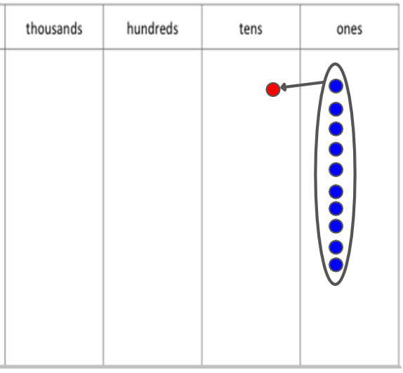
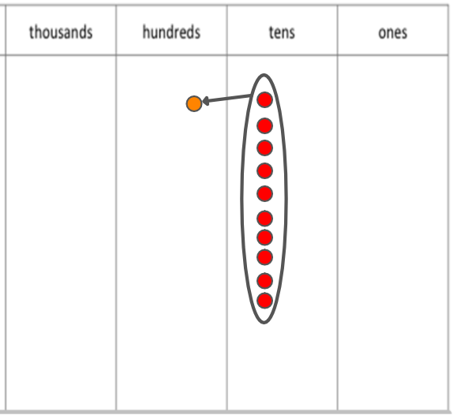
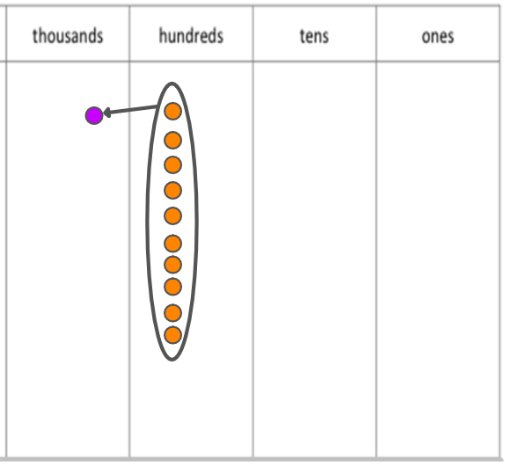
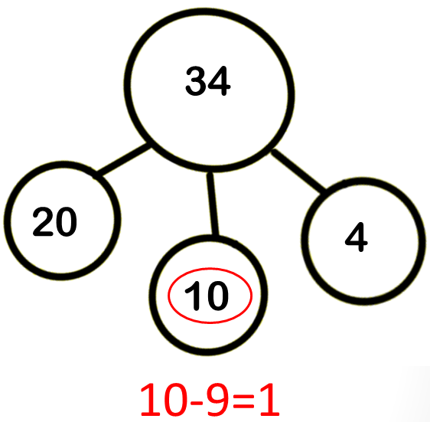
Base Ten Understanding
450
$450
Notes:
We want our students to master the base ten system. Let’s look at 450. When asked how many tens are in 450, many students would answer 5 because 5 is in the tens place. Let’s say your boss owed you 450 dollars and he was going to pay you in ten dollar bills. Would you be ok with 5 tens? No, So how many ten dollar bills should he give you? Yes, 45 tens make 450. We know this because that’s how our base ten system works. We group 10 ones together and exchange them for 1 ten. This process works for each of the places in the base ten system. Number bonds are an excellent way to help students build that conceptual understanding of base ten.

Slide 31
Number Bonds
Grade 6 & 7
2
-7 + 9 = ___
7
2
Makes 0
Notes:
Middle school students can use this thinking to better understand negative numbers. They can see 9 as a bond of 7 and 2. Negative 7 and positive 7 make 0. So the negative 7 plus 9 equals 2.

Slide 32
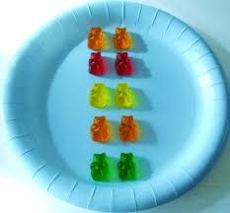
Multiplication as an Array
Kindergarten – arrange items into array
Notes:
In kindergarten, students arrange items into arrays.

Slide 33
Multiplication as an array
Kindergarten – arrange items into array
2 in each row
5 rows

Slide 34
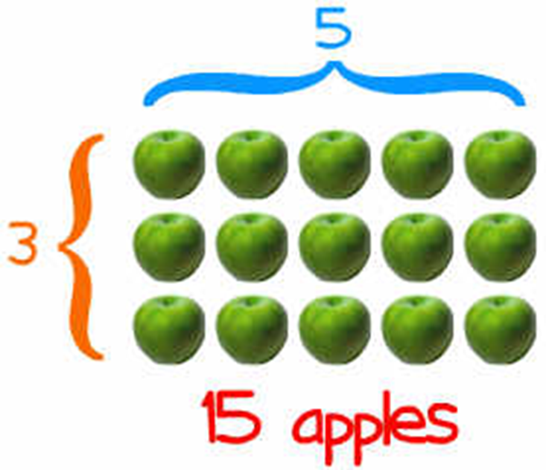
Multiplication as an array
3rd grade – recognize array as multiplication
3 rows
5 in each row
Notes:
These arrays become the foundation of multiplication. 3x5=15 apples

Slide 35
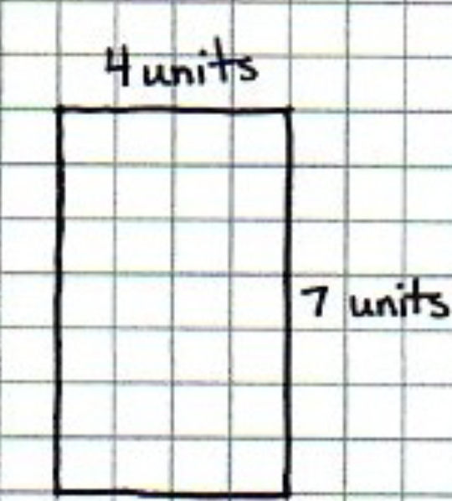
Multiplication as an array
4th & 5th grade – multiply using area model
7 rows
4 in each row
4 units
7 units
Notes:
The arrays transition easily into area. We still have 7 rows with 4 in each row. That’s 7 x 4. Even when the rows are not visible, students use multiplication (7x4) to find the area.

Slide 36
Multiplication Algorithm
2
25
X 14
0
10
5
2
___
0
350
Notes:
Let’s walk through the multiplication algorithm.
First we multiply 4 times 5 - that’s 20.
We put the zero here and the s above the other 2.
Then we multiply 4 times 2 – That’s 8… plus 2 makes 10. and we write that here.
Now I put a zero here. Why? Because my 3rd grade teacher Mrs. Murphy told me to.
Then we multiply 1 times 5 and put the 5 here.
Now we multiply 1 times 2 (is that a 2) that makes 2
Now add to get 350

Slide 37
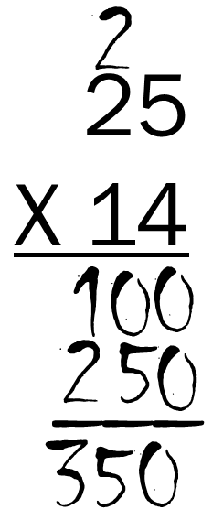
Multiplication - Area Model
25
X 14
20
5
4
80
20
10
200
50
Notes:
Now let’s multiply using the area model. We learned from number bonds that we can break numbers apart to make our operations easier. I can break 25 into 20 and 5. I can also break 14 into 10 and 4. Remember with area, we thought of how many rows and how many were in each row.
In this first area we have 4 rows with 20 in each row. So that would be 20, 40, 60, 80 or 4 times 20 which is 80. We will continue on and multiply for each area. 5 x4 = 20. 10 x 20 = 200. 10 x 5 = 50. now we can combine 80 and 20 and get 100. There’s the zero; it has a real mathematical reason to be there.
Add 200 and 50 to get 250. Now add 100 and 250 to get 350.

Slide 38
Area model – multiply polynomials
$x^{2}$+ 5𝑥 + 6
$(x+2)(x+3$) = ________________
𝑥
$$+ 2$$
𝑥
$$x^{2}$$
2𝑥
$$+$$
$$3$$
3𝑥
6
Notes:
Now into Algebra I
Students can use this same area model to multiply binomials
What’s great is that this area model can be used for any polynomial multiplication
As students do these models, they will connect the visual with the algorithm and have a better conceptual understanding

Slide 39
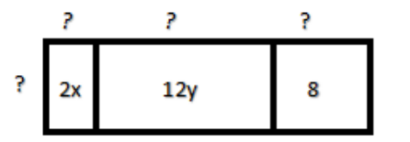
Area Model – 7th Grade – Introduction to Factoring
x
6y
4
2
2x + 12y + 8 =
2(x + 6y + 4)
Notes:
This area model allows students to directly relate the distributive property to factoring.
If the area of each section is show, what are the possible measures of the length and width of each rectangle….(pause)
Students will likely notice the common factor of 2 to become the width
In order to have an area of 2x, with one side measuring 2 – the other must be x.. 6y…4
Students can write equivalent expressions in grade 7… 2x + 12y + 8 = 2(x + 6y + 4)
These students have factored 2x + 12y + 8

Slide 40
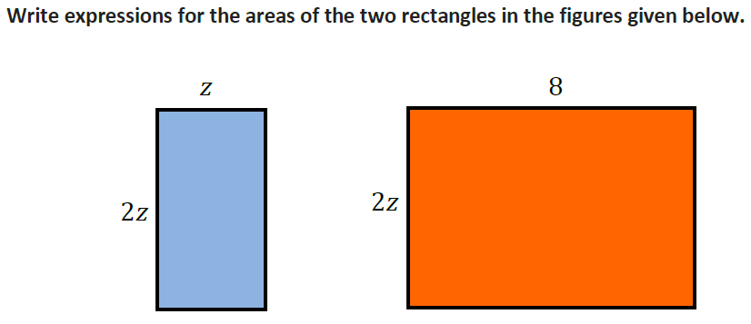
Algebra I
Notes:
What is the are of the blue rectangle?
What is the area of the orange rectangle?
Do you notice anything in common about the two rectangles?

Slide 41
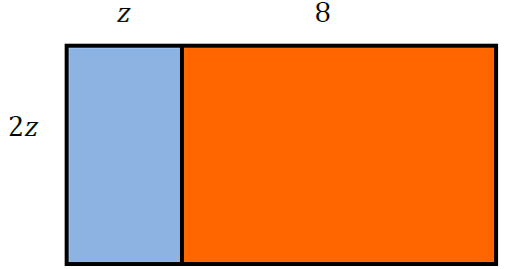
Write the expanded(factored) form:
2z² + 16z = 2z(z + 8)
Notes:
What is the area of our new picture/rectangle?
Some students may answer 2z² + 16; where as other students will start with 2z(z + 8)
Students will begin to easily toggle between the expanded (factored) form and the condensed form

Slide 42
Contact Information:
Penny Gennuso, Math and Science Specialist
pcgennuso@lpssonline.com
337-288-2855
Melanie Heintz, 6-12 Math Coach Pat Gilbert, K-5 Math Coach
mpheintz@lpssonline.com ptgilbert@lpssonline.com
Bridget Soumeillan 6-12 Math Coach Jada Singleton K-5 Math Coach
btsoumeillan@lpssonline.com jcsingleton@lpssonline.com
Sandra Lebouef 6-12 Math Coach Miko McDaniel K-5 Math Coach
sllebouef@lpssonline.com tamcdaniel@lpssonline.com
Candy Kelly , Principal Scott Middle
ctkelly@lpssonline.com
Lisa Thomas, Principal Westside Elementary
lgthomas@lpssonline.com

