Slide 1
Classroom Discussions for Elementary Math
Presented by Kelly Lenox
2nd Grade Teacher, NBCT
Riser Elementary School
Ouachita Parish Schools
lenox@opsb.net

Slide 2
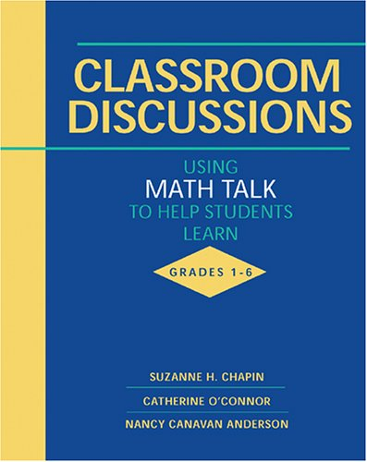
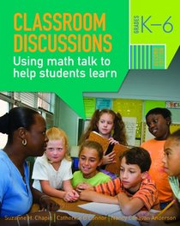
Classroom Discussions: Using MATH TALK to Help Students Learn
By Suzanne H. Chapin, Catherine O’Connor, and Nancy Canavan Anderson

Slide 3
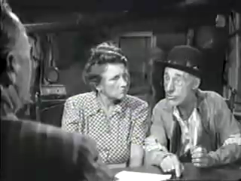
Notes:
Ice Breaker - Use this funny video to open up a discussion about how listening to students explain their reasoning can be quite enlightening for both the teacher and the class.

Slide 4
Talk in the Mathematics Class
The mathematical thinking of many students is aided by hearing what their peers are thinking.
Putting thoughts into words pushes students to clarify their thinking.
Teachers can spot student misunderstanding much more easily when they are revealed by a discussion instead of remaining unspoken.

Slide 5
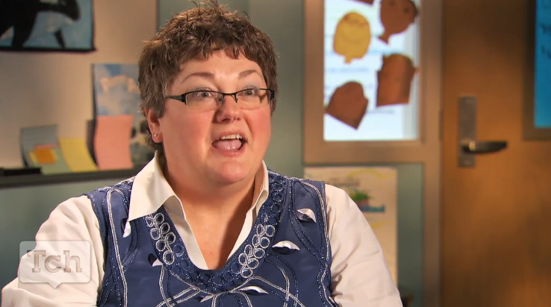
Talk in the Mathematics Class
Notes:
Click on this photo for a 2 minute Teaching Channel video on the benefits of Classroom Discussions in the mathematics classroom.

Slide 6
Five Productive Talk Moves
Revoicing.
“So what you’re saying is that it’s an odd number?”
Asking students to restate someone else’s reasoning.
“Can you repeat what he just said in your own words?”
Asking students to apply their own reasoning to someone else’s reasoning.
“Do you agree or disagree and why?”
Prompting students for further participation.
“Would you like to add on?”
Using wait time.
“Take you time….we’ll wait…”

Slide 7
Three Productive Talk Formats
1. Whole-Class Discussion
The teacher is not delivering information, but rather attempting to get students to share their thinking, explain the steps in their reasoning, and build on another’s contributions.
The teacher refrains from providing the correct answer and does not reject incorrect reasoning, but instead attempts to get students to explore the steps in their reasoning with the aim that they will gain practice in discovering where their thinking falls short.
Students learn by processing information, applying reasoning, hearing ideas from others, and connecting new thinking to what they already know, all for the goal of making sense for themselves of new concepts and skills.

Slide 8
Three Productive Talk Formats
2. Small-Group Discussion
The teacher gives students a question to discuss in groups of 3 to 6.
The teacher circulates as groups discuss and doesn’t control the discussions, but observes and interjects.
3. Partner Talk
The teacher asks a question and gives students one or two minutes to put their thoughts into words with their nearest neighbor.
The students who are hesitant about voicing their thoughts to a whole class will have a chance to practice their contribution with just on person.
Students who have not understood completely can bring up their questions with their partner.

Slide 9
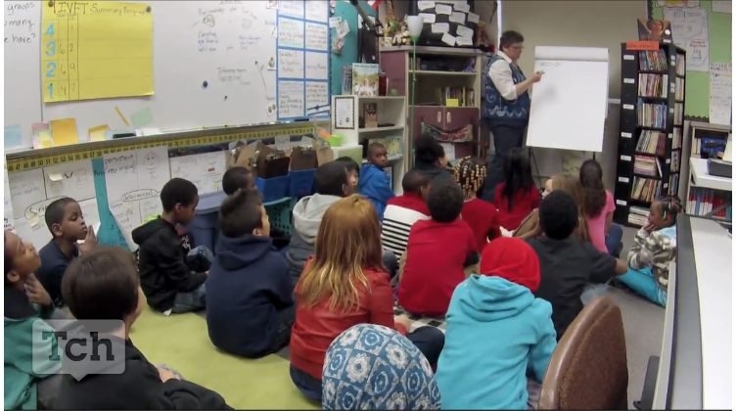
What Talk Moves and Talk Formats Can You Spot?
Notes:
Click Picture to watch a 7 minute Teaching Channel video of a class using Talk Moves.

Slide 10
Ground Rules for Respectful Talk and Equitable Participation
Every student is listening to what other say
Every student can hear what others say
Every student may participate by speaking out at some point
Set ground rules for your class! Respect and courtesy are mandatory. If students are fearful that they will be mocked, they will not speak.

Slide 11
Principles of Productive Talk
Establish and maintain a respectful, supportive environment.
Focus talk on mathematics.
Provide for equitable participation in classroom talk.
Explain your expectations about new forms of talk.
Try one challenging new thing at a time.

Slide 12
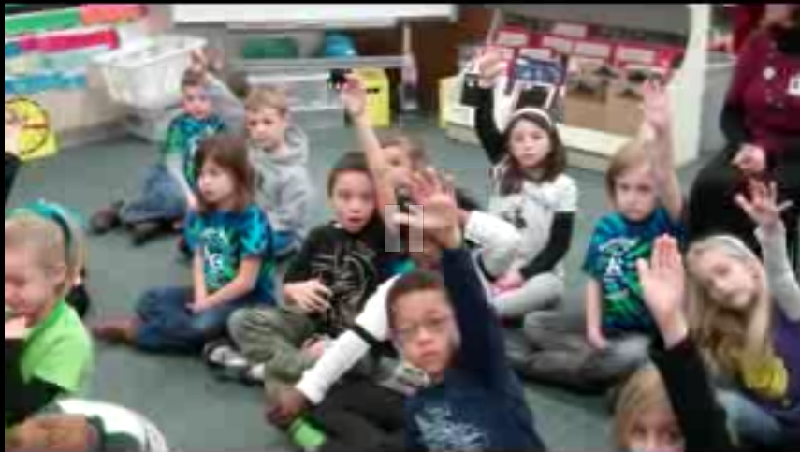
What Does Productive Talk Look Like?
Pay attention to how many times you hear the teacher speak in this video.
Notes:
(Click picture to link to YouTube video.) The teacher only says 1 word in this video. The entire process is student led. These are 1st graders!

Slide 13
What Do We Talk About?
Mathematical Concepts
Computational Procedures
Problem-Solving Strategies
Mathematical Reasoning
Mathematical Terminology, Symbols, and Definitions
Forms of Representation

Slide 14
First Steps
Practicing two talk moves on your own.
Introducing students to talk-centered instruction.
Beginning with a whole-class discussion.
Revoicing in small-group discussion.
Using partner talk.
Building and supporting an argument.

Slide 15
Evaluating Your Progress
Did you establish and maintain a respectful, supportive environment?
Did you focus the talk on mathematics?
Did you provide for equitable participation in classroom talk?
Did you explain your expectations about new forms of talk?
Did you try one challenging new thing at a time?

Slide 16
Planning Lessons
Identifying the mathematical goals.
Anticipating confusion.
Asking questions.
Managing classroom talk.
Planning the implementation.

Slide 17
Troubleshooting
My students won’t talk!
The same few students do all the talking!
Should I call on students who do not volunteer?
My students will talk, but they won’t listen!
Huh? Responding to incomprehensible contributions.
Brilliant, but did anyone understand?
I have students at different levels.
What should I do when they’re wrong?
This discussion is not going anywhere.
Their answers are so superficial!
What if the first speaker gives the right answer?
What should I do for English language learners?

Slide 18
Your turn!
Choose one person at your table to be the “teacher”.
Using the assignment on your handout, the “teacher” should use the five talk moves we’ve learned about to facilitate a classroom discussion .
If time allows, choose a new teacher and repeat the exercise.

Slide 19
3-2-1…..
Turn and discuss with your nearest neighbor:
3 things you learned today……
2 things you are excited to learn more about…..
1 thing you still have a question about…..

