Slide 1
Inquiring Minds : Making Literacy Connections Through Science
Leslie A. Birdon, Curriculum Coordinator
East Feliciana Parish School Board
LDOE Teacher Leader Summit
New Orleans, LA
June 3-4, 2014

Slide 2
Instructional Vision
To meet these raised expectations, we must clarify our focus on what our students need. Specifically, we must ensure this year that our students…
English language arts
Comprehend (access) meaningful, on level texts
Speak and write in response to meaningful texts
Math students
Master math concepts of priority, on level content and practice standards (not just procedures)
Master targeted remedial content that allows practice faster focus of on level content

Slide 3
Teacher Leader Summit: Day 1 Ready!
This Summit will prepare teachers to make these shifts beginning the first day of the 14-15 school year.
This will include focused training on:
Student Learning Targets
Assessment
Standards, curricula, and instructional strategies

Slide 4
Objectives
Explain how thinking strategies could be embedded at particular sections of a lesson or/and unit.
Articulate a brief overview on TABA models, SCAMPER, and Reciprocal Teaching are applied in science context.
Review examples using the above thinking techniques for literacy connections.
Apply and Reflect for future classroom use in various disciplines.

Slide 5
HO
#1

Slide 6
How does the SCAMPER impact thinking skills in literacy?
Students must cultivate a strong curiosity, creativity, objectivity, and openness to new ideas to a given concept.
S- Substitute
C- Combine
A- Adapt
M- Modify, Magnify
P- Put in Other Uses
E- Eliminate
R- Reverse, Rearrange
Looking at the idea page for SCAMPER, discuss the following questions using TIMED PAIR SHARE:
How is reflection and curiosity are developed for students?
Why are the letters important in communicating expectations?
HO
#2

Slide 7
Focus Model-SCAMPER
Students will look at a symbol such as question mark. Students will write as many expressions that this symbol may represent. Students will debate how many expressions are concrete or abstract based on definition using a T- chart.
How is a question mark interpreted?
How is a question mark an example of a symbol?
How many expressions, meanings, uses, or feelings does a question mark communicate?
Using the definition of abstract and concrete, classify the items within your group as abstract or concrete.

Slide 8
SCAMPER APPLICATION
In groups of 4, practice using the SCAMPER on either safety or numbers on the blank page in your packet for 5 minutes.
Time of Reflection- 5 minutes
How would you structure this logic puzzle for student engagement?
Why were these key concepts developed for SCAMPER?
HO
#3/4

Slide 9
Strategy Connection to CCSS
Use precise words and phrases, telling details, and sensory language to convey a vivid picture of the experiences, events, setting, and/or characters. (W.9-10 3d)
Determine the meaning of words and phrases as they are used in a text, including figurative, connotative, and technical meanings; analyze the cumulative impact of specific word choices on meaning and tone (e.g., how the language of a court opinion differs from that of a newspaper).
(RI.9-10.4)

Slide 10
How does the TABA Model impact thinking skills?
Students give the opportunity to practice:
Problem- solving
Efficient reasoning
Critical thinking
Method is highly structured, open-ended, and supported with reasoning which enables students to :
Process Information
Develop Concepts
Formulate Generalizations
HO
#5

Slide 11
Analyzing the TABA Model
Concept Development
Interpretation of Data
Application of Generalizations
Interpretation of Feelings, Attitudes, and Values
Looking at the different types of models and examples, which models are better suited for science and justify your reasoning.
HO
#5

Slide 12
Concept Development
Students develop new connections with a proposed key concept through making inferences and creating generalization.
Focus Objective: You will analyze and evaluate the movement of molecules in a cell.
Essential Question: Looking at the definitions for active and passive transport, in what ways does it relate to your grouping of items and the plasma membrane?
HO
#6

Slide 13
Concept Development
List all information/concepts about a topic.
List five things that move in nature and our society.
Combine these items with your group to produce a list.
Place your list on the board for the class.
Reduce all group lists to a class list.
Group and given reasons why information is grouped that way.
Using the textbook and dictionary, we as a class will define the words, active and passive.
Using these responses, you classify your objects’ movements as active or passive.
HO
#6

Slide 14
Concept Development
Label with at least 3 different labels. Give reasons.
What are some factors that contribute to the grouping of these items?
Infer, Generalize, Synthesize
Looking at the definitions for active transport, in what ways does it relate to your grouping of items?
State the Concept/Generalization
Scientists have classified the plasma membrane as using active transport. Looking at its function, is this a valid perception? State at least three reasons for your position.
HO
#6

Slide 15
Wisdom for the Sages
Common Barriers for Developing Thinking
How would you address the following roadblocks for implementation?
Keep purposes of the discussion in mind by using the questions.
Arrange input prior to discussion using reading selections.
Decide on appropriate strategy.
Design all questions to be open-ended.
Select certain responses for lesson focus and direction.
Wait for students to formulate answers- Give them time to think and response.

Slide 16
Strategy Connection to CCSS
Cite strong and thorough textual evidence to support analysis of what the text says explicitly as well as inferences drawn from the text.
(RI 9-10.1)
Determine a central idea of a text and analyze its development over the course of the text, including how it emerges and is shaped and refined by specific details; provide an objective summary of the text.
(RI 9-10.2)

Slide 17
Picking the Best Fit
What topic(s) are being showcased in the novel?
In what ways is topic explored throughout the text?
What is the author’s background concerning the given concept or topic?
How can the novel be presented to students?
HO
#7

Slide 18
Qualitative Measures
Measures such as:
Levels of meaning
Levels of purpose
Structure
Organization
Language conventionality
Language clarity
Prior knowledge demands
HO
#8

Slide 19
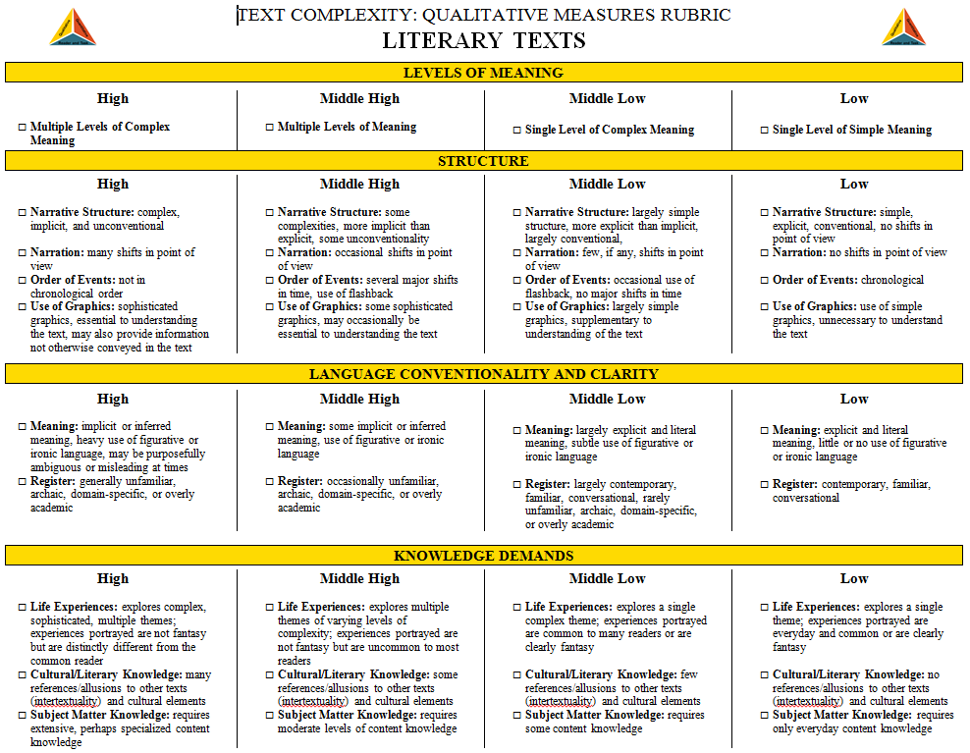
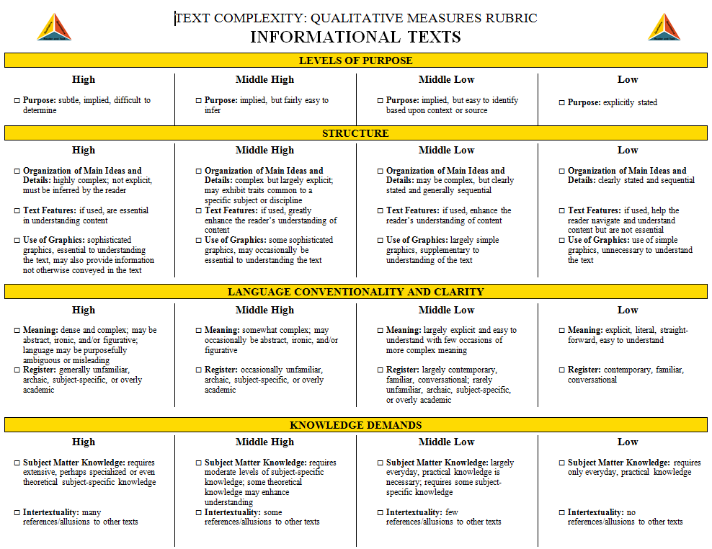
Step 2: Qualitative Measures
The Qualitative Measures Rubrics
for Literary and Informational Text: http://www.ksde.org/Default.aspx?tabid=4605
The rubric for literary text and the rubric for informational text allow educators to evaluate the important elements of text that are often missed by computer software that tends to focus on more easily measured factors.
HO
#8

Slide 20
Focus Model using Brave New World- Chapter 4
They aren’t important enough, somehow. I feel I could do something much more important. Yes, and more important, more violent. But what? What is there more important to say? And how can one be violent about the sort of things one’s expected to write about? Words can be like X- rays, if you use them properly-they’ll go through anything. You read and you’re pierced. That’s one of the things I try to teach my students- how to write piercingly

Slide 21
Group Reflection using 1984
The new doctrines arose partly because of the accumulation of historical knowledge, and the growth of the historical knowledge, which had hardly existed before the nineteenth century. The cyclical movement of history was now intelligible, or appeared to be so; and if it was intelligible, then it was alterable.

Slide 22
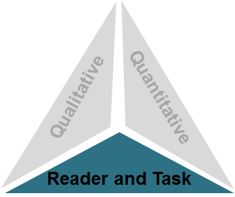
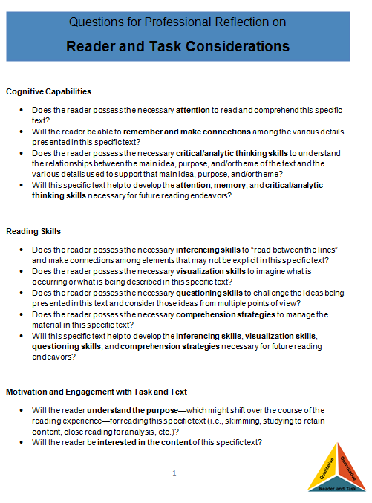
Step 3:Reader and Task Considerations
Questions for Professional Reflection on Reader and Task Considerations:
http://www.ksde.org/Default.aspx?tabid=4605
The questions provided in this resource are meant to spur teacher thought and reflection upon the text, students, and any tasks associated with the text.
HO
#9

Slide 23
Focus Model using Brave New World- Chapter 4
They aren’t important enough, somehow. I feel I could do something much more important. Yes, and more important, more violent. But what? What is there more important to say? And how can one be violent about the sort of things one’s expected to write about? Words can be like X- rays, if you use them properly-they’ll go through anything. You read and you’re pierced. That’s one of the things I try to teach my students- how to write piercingly

Slide 24
Group Reflection using 1984
The new doctrines arose partly because of the accumulation of historical knowledge, and the growth of the historical knowledge, which had hardly existed before the nineteenth century. The cyclical movement of history was now intelligible, or appeared to be so; and if it was intelligible, then it was alterable.

Slide 25
Reciprocal Teaching and Literature Circles
Goals of Reciprocal Teaching
To deepen comprehension using a highly cooperative setting
To provide opportunities for students to practice the four reciprocal teaching strategies in a variety of texts
To release more responsibility for strategy use to the students
HO
#10/11

Slide 26
Predict
Before reading aloud from the text, tell the students you are going to show them how to predict.
Preview the title, book cover, and a few illustrations or headings from inside the reading.
Sentence Stems
I think this is about …. because
I think … will happen because …
HO
#10/11

Slide 27
Predict Model- I DO
Preview the title, book cover, and a few illustrations or headings from inside the reading.
Sentence Stems
I think this is about …. because
I think … will happen because …

Slide 28
Predict Model- We Do
Preview the title, book cover, and a few illustrations or headings from inside the reading.
Sentence Stems
I think this is about …. because
I think … will happen because …

Slide 29
Question
Model how to ask a question about a text you’ve read so far. Tell students you are asking using the following prompts.
Ask a wonder question starting with “I wonder…?
Ask a quiz question: who, what, when, where, why, or how.
Ask a thinking question that starts with “Why do you think…?
HO
#10/11

Slide 30
Focus Model using Brave New World- Chapter 4
They aren’t important enough, somehow. I feel I could do something much more important. Yes, and more important, more violent. But what? What is there more important to say? And how can one be violent about the sort of things one’s expected to write about? Words can be like X- rays, if you use them properly-they’ll go through anything. You read and you’re pierced. That’s one of the things I try to teach my students- how to write piercingly

Slide 31
Group Reflection using 1984
The new doctrines arose partly because of the accumulation of historical knowledge, and the growth of the historical knowledge, which had hardly existed before the nineteenth century. The cyclical movement of history was now intelligible, or appeared to be so; and if it was intelligible, then it was alterable.

Slide 32
Clarify
Identify a difficult word, sentence, or part. Use a context clue to find the meaning.
Identify a place where you had to read twice to get a picture in your head.
Is there a metaphor or figure of speech that you need to clarify?
HO
#10/11

Slide 33
Focus Model using Brave New World- Chapter 4
They aren’t important enough, somehow. I feel I could do something much more important. Yes, and more important, more violent. But what? What is there more important to say? And how can one be violent about the sort of things one’s expected to write about? Words can be like X- rays, if you use them properly-they’ll go through anything. You read and you’re pierced. That’s one of the things I try to teach my students- how to write piercingly

Slide 34
Group Reflection using 1984
The new doctrines arose partly because of the accumulation of historical knowledge, and the growth of the historical knowledge, which had hardly existed before the nineteenth century. The cyclical movement of history was now intelligible, or appeared to be so; and if it was intelligible, then it was alterable.

Slide 35
Summarize
Summarize this [paragraph, page, chapter].
What is this mainly about?
Is there a problem to be solved? If so, what?
Tell me the main idea. Use the topic sentence or heading to help you.
HO
#10/11

Slide 36
Focus Model using Brave New World- Chapter 4
They aren’t important enough, somehow. I feel I could do something much more important. Yes, and more important, more violent. But what? What is there more important to say? And how can one be violent about the sort of things one’s expected to write about? Words can be like X- rays, if you use them properly-they’ll go through anything. You read and you’re pierced. That’s one of the things I try to teach my students- how to write piercingly

Slide 37
Group Reflection using 1984
The new doctrines arose partly because of the accumulation of historical knowledge, and the growth of the historical knowledge, which had hardly existed before the nineteenth century. The cyclical movement of history was now intelligible, or appeared to be so; and if it was intelligible, then it was alterable.

Slide 38
Closing Reflection
Did you use text clues and background knowledge to make logical predictions?
Did you ask questions that can be answered in the text or inferred?
Were there examples of clarifying words and ideas?
How did you summarize for important points and academic vocabulary?

Slide 39
Contact Information
Leslie A Birdon
East Feliciana Parish School Board
225-683-8277 ext. 218
lbirdon@efpsb.k12.la.us

Slide 40
