Slide 1
Instructional Vision
To meet these raised expectations, we must clarify our focus on what our students need. Specifically, we must ensure this year that our students…
English language arts
Comprehend (access) meaningful, on level texts
Speak and write in response to meaningful texts
Math students
Master math concepts of priority, on level content and practice standards (not just procedures)
Master targeted remedial content that allows practice faster focus of on level content

Slide 2
Teacher Leader Summit: Day 1 Ready!
This Summit will prepare teachers to make these shifts beginning the first day of the 14-15 school year. This will include focused training on:
Student Learning Targets
Assessment
Standards, curricula, and instructional strategies

Slide 3
Learning Centers in Middle/High School Classrooms
Dr. Lisa Juneau
Notes:
Welcome. Session title. Name.
I have worked 7 years at a middle school in Jefferson Davis Parish.
Currently, I teach high school (English I, English II, and Senior Applications in English).
I work at a public school. I teach all students. Class sizes from 16 to 31. I am a teacher like you who found a method that works really well.

Slide 4
Session Overview
Teachers will learn to put their energy and efforts into the planning phase of teaching as opposed to the direct instruction component of lessons/class time in order to create student-centered classrooms. Learning centers increase student engagement as collaboration allows students to be in charge of their own learning.
Notes:
First time I heard of centers, I thought that it would not work. But, I tried it out, and it was a success. So I have a few questions for you to think about…

Slide 5
Session Overview
Are you tired of the same routine?
Do you wish students would be in charge of their learning?
Are you a planner? Do you like to plan ahead?
Wish students would be more engaged in class?
Wish students would put as much effort into the lesson as you do?

Slide 6
Instructional Framework
Notes:
Centers fit the framework perfectly!

Slide 7
Learning Centers Increase engagement Increase learning
Notes:
If you answered yes, this is the right session for you!

Slide 8
Previous Knowledge Lesson Objectives Future Application
Notes:
Just as we explain our lessons to our students, I will introduce this session to you.
I believe that teacher PD should reflect how teachers should teach students.
We have all had PD which have been lectures on what we should do. (Sit and Get.)
Instead of that, this PD will be interactive with you participating in centers, and I will share with you images of my students engaged in centers.

Slide 9
Previous Knowledge
Most people have knowledge of learning centers from elementary school.
Some people might have heard of learning stations or performance stations instead of learning centers.

Slide 10
Lesson Objectives
Participants will recognize the benefits of learning centers as an instructional strategy allowing students to direct their own learning.
Participants will learn how to implement learning centers in their own classrooms to increase student engagement.
Notes:
Discuss key words:
“direct their own learning” Students are more likely to learn if they have some choice. It also makes class more “fun.”
“student engagement” Students are more likely to actively engage in small groups where their voice can be heard.

Slide 11
Future Knowledge
At the end of this session, participants should be able to implement learning centers in their own classrooms.
Participants should be able to share the benefits of using learning centers with other educators.
Notes:
There are different degrees of centers. You can use centers anywhere from a few times a year up to every single day.

Slide 12
Have you seen this?
Notes:
We are lead teachers at our school. Our classrooms might not look like these, but I am sure you have seen classrooms like these before.

Slide 13
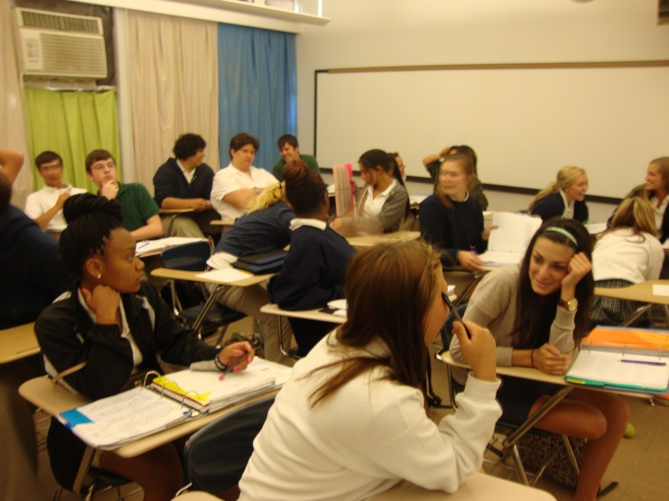
Disengaged Students

Slide 14
Bored/Sleepy Students

Slide 15
Shy Students

Slide 16
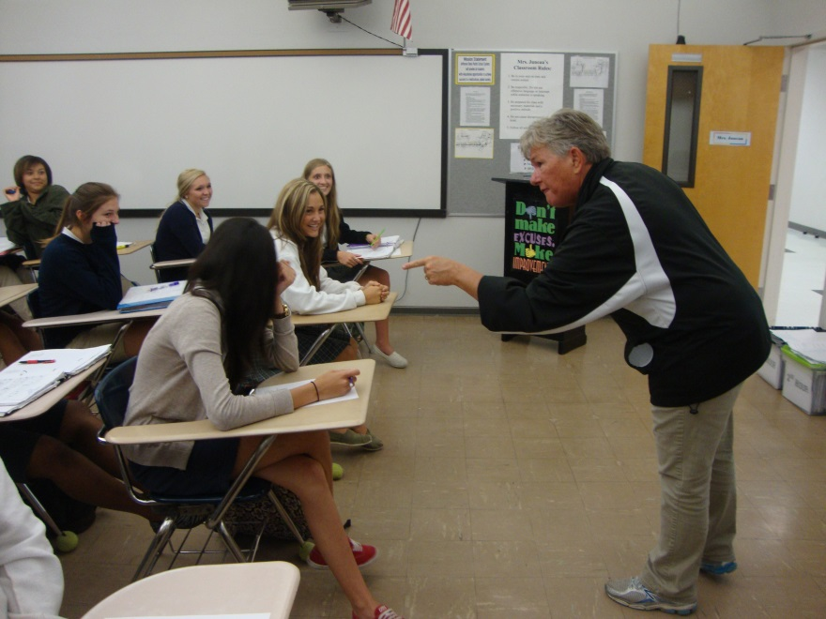
Yelling Teachers

Slide 17
Teachers Giving Answers
Notes:
teachers doing all the work by giving the answer

Slide 18
2-3 Students Answering

Slide 19
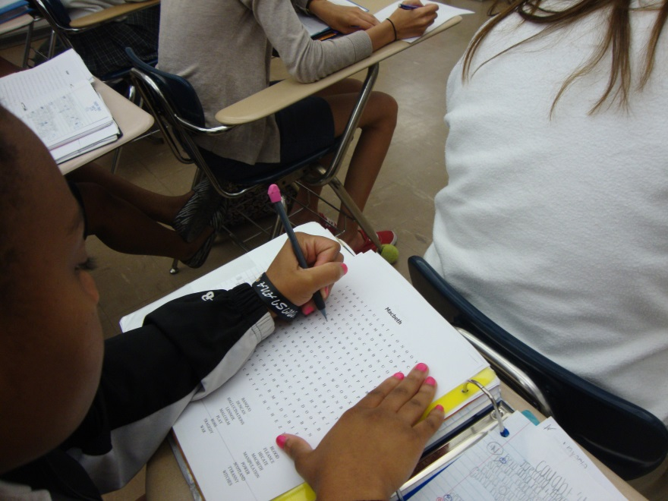
Busy Work

Slide 20
Lack of Collaboration

Slide 21
Questions
Notes:
Raise left or right arm to answer.

Slide 22
Who is more engaged?
Notes:
Having to discuss and work with others is more engaging than working alone.

Slide 23
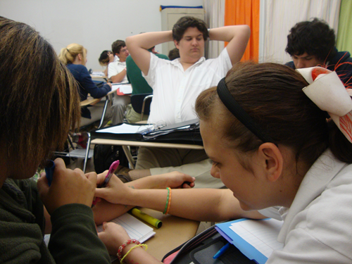
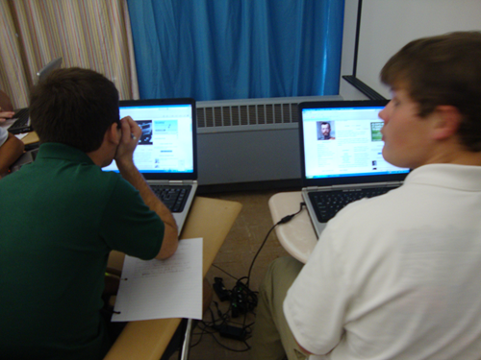
Who is actively learning?
Notes:
To the left is a group working on a worksheet. To the right is a group researching key figures in the Russian Revolution.
Teachers are thinking for the students. Teachers are getting more knowledgeable about the subject than the students are.

Slide 24
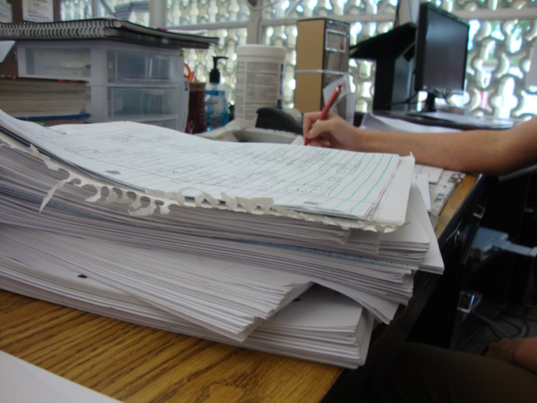
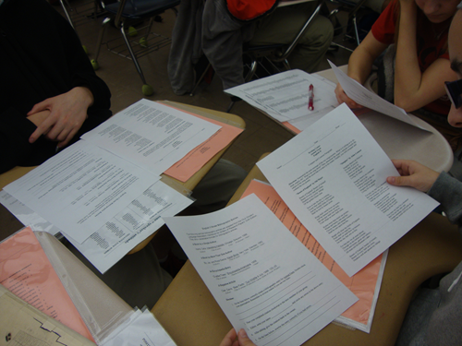
Who is assessing?
Notes:
Teachers are doing more assessing than the students are. What is really more important: grades or learning?

Slide 25
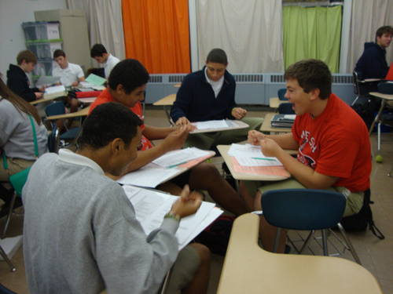
Who is having more fun?

Slide 26
Who is burned-out?
Notes:
Teachers are burned-out by the end of the day because teachers are working harder than the students are during class time.

Slide 27
Learning Centers Increase engagement Increase learning

Slide 28
Try out centers!
Notes:
Learn by doing
If I want you to use centers in your classrooms, I will use centers to teach you about centers.
A good educational strategy is good for all ages.

Slide 29
Center 1
Directions:
1.) Go to http://www.ehow.com/how_6607771_set- centers-middle-school-classroom.html
2.) Read each of the six steps.
3.) Decide which is the easiest and hardest step.
4.) Record why you believe that step is easy or hard.
5.) Share with your group and why you believe the step recorded is the easiest or hardest.
6.) Record which steps the group found easiest and hardest.
Notes:
In center one, you will learn about learning centers on your own and make connections to your own classrooms.
This is what we want our students to be able to do: discover/learn for themselves and apply what they have learned.
Step one has been done for you on the handout. Your group will be the people around you.

Slide 30
Setting Up Learning Centers

Slide 31
Grouping Students
How many students would you like in a group?
Groups can vary from 2-6 students.
A four student group is ideal.
If students are absent, a group of two or three could become a group of only one student.
When five or six students are in a group, side conversations are more likely to occur.
More students in a group increases the space they will need in your room.

Slide 32
Grouping Students
Group according to behavior, ability, and effort.
Behavior: Some students will not work well with others. Consider any altercations students have had such as fighting.
Ability: You might wish to have strong students grouped with weaker students. You might wish to have strong students grouped together and weaker students grouped together to ensure strong students do not do all the work for the weaker students.
Effort: Look at the effort students put into their work. Some will take their time to do their best work while other will rush to finish.
Groups can and should be modified.
Notes:
If you are using centers daily for weeks, change your groups. I make adjustments after I see how students work together.
You may decide to allow students to select their own groups.

Slide 33
Group Leader
Each group needs a leader and sub-leader.
If the leader of the group is absent, the sub-leader becomes the leader.
The leader can be selected by the group or by the teacher.
Leaders are in charge of the group. They pass out the supplies for the center and gather absent students’ work.
Students can take turns being the leader.

Slide 34
Number of Centers
The number of centers depends on the amount of content you are teaching.
First, decide on what you want you students to learn.
Then, decide what the students need to do to learn what you want them to learn.
Finally, decide how you can divide that into different activities and each activity can become a center.
Center can also come from CCSS and general teaching practices.
ELA: literature, non-fiction, vocabulary, writing, literary elements
Math: learn, practice, check your work, apply
Notes:
Planning centers is similar to planning for a normal classes. The difference is that will have two to five class days of work going on at the same time. You have to be prepared.

Slide 35
Center Locations
A common complaint is that classrooms do not have enough space to use centers.
To maximize classroom space, have groups face corners or walls and have one group in the middle of the room.
To solve lack of space issues, consider using outdoor spaces and hallways.
Think outside the box and be creative: it can work.
Hang signs on the wall where each center is located.
Have a method to inform students what center they are working at that day. A chart is very efficient.
Notes:
Use floor tiles to space out students.
Use outdoor lunch benches.
Use baseball or football stadium seating.

Slide 36
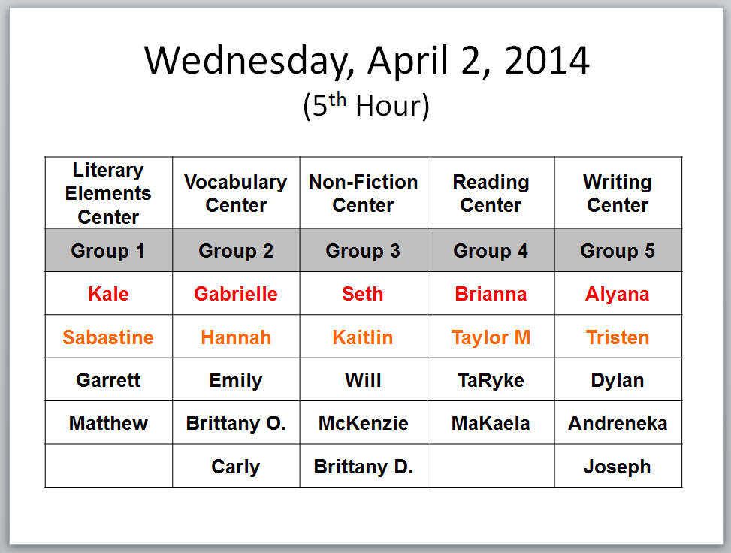
Example Location Chart
Notes:
The only changes I have to make each day is to change the date and move the center titles. It takes 15 seconds to prepare for the next day.

Slide 37
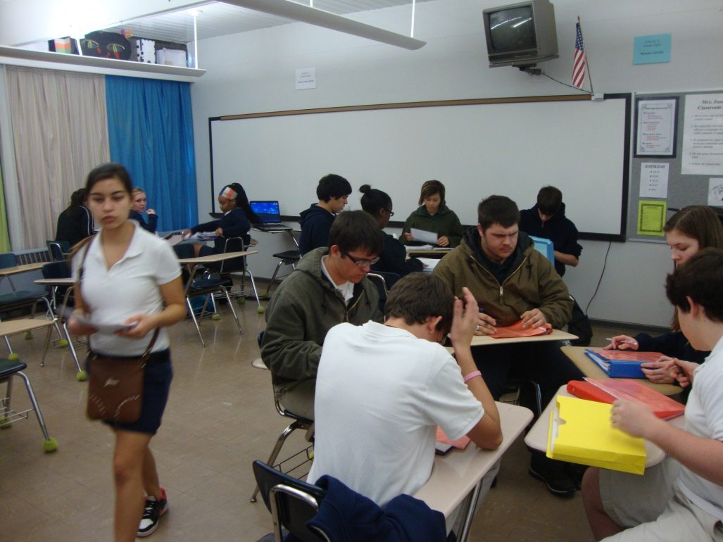
Center Locations and Signs

Slide 38
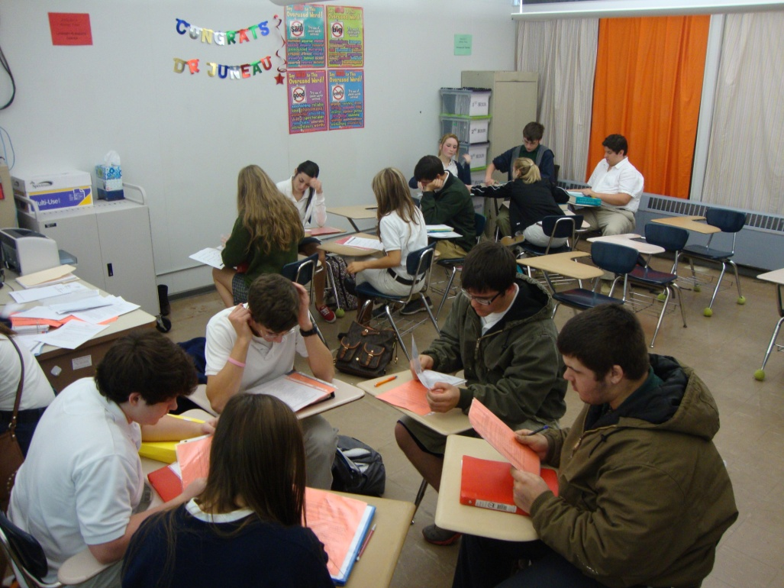
Center Locations and Signs

Slide 39
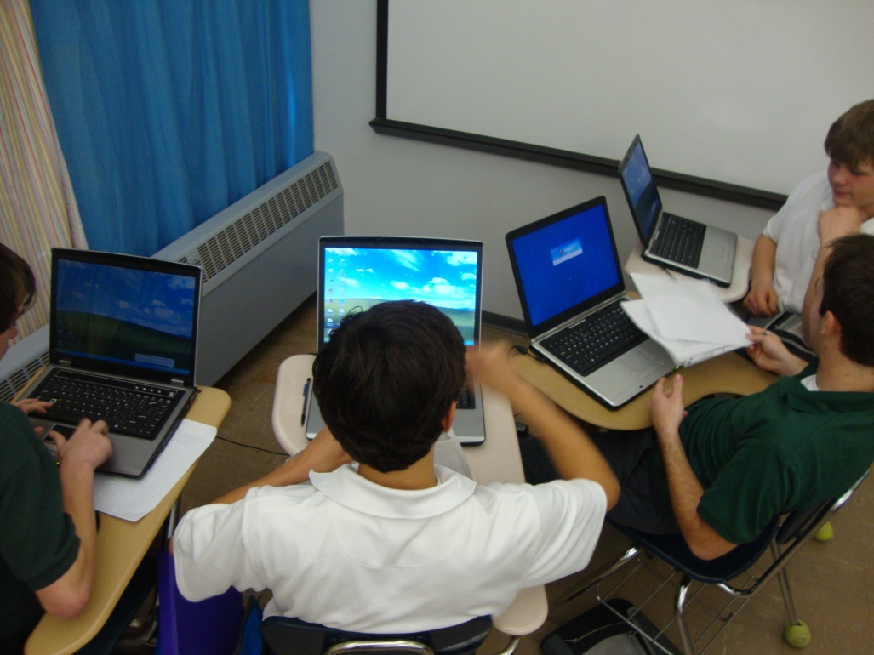
Locate Centers in Corners
Notes:
More space. Less distractions.

Slide 40
Create the Learning Centers

Slide 41
Center Materials
Use folders, binders, or storage container tubs to hold the materials students need to complete the work at each centers.
All material must be located in the tub before class begins.
The container must have a detailed direction sheet that tells students what to do.
Create the direction sheet on bright colored paper. Using clear plastic sleeves or card stock paper will increase the durability of the direction sheet.

Slide 42
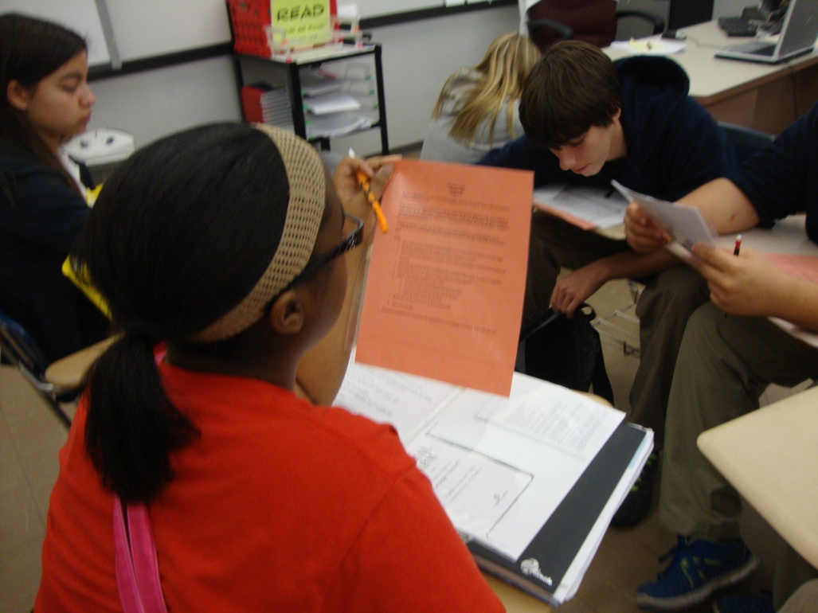
Center Direction Sheet

Slide 43
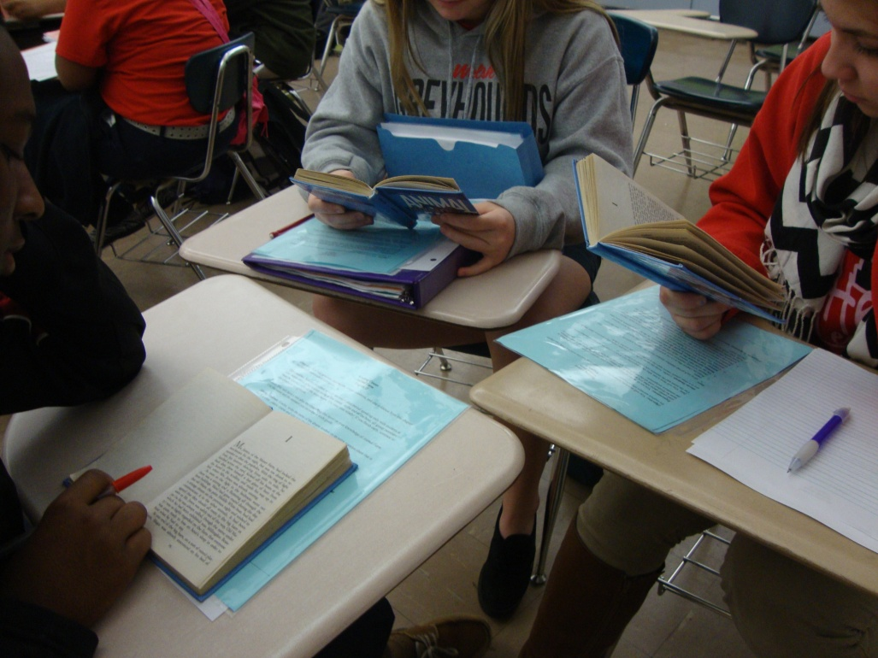
Center Direction Sheet
Notes:
Different color direction sheet for each center.

Slide 44
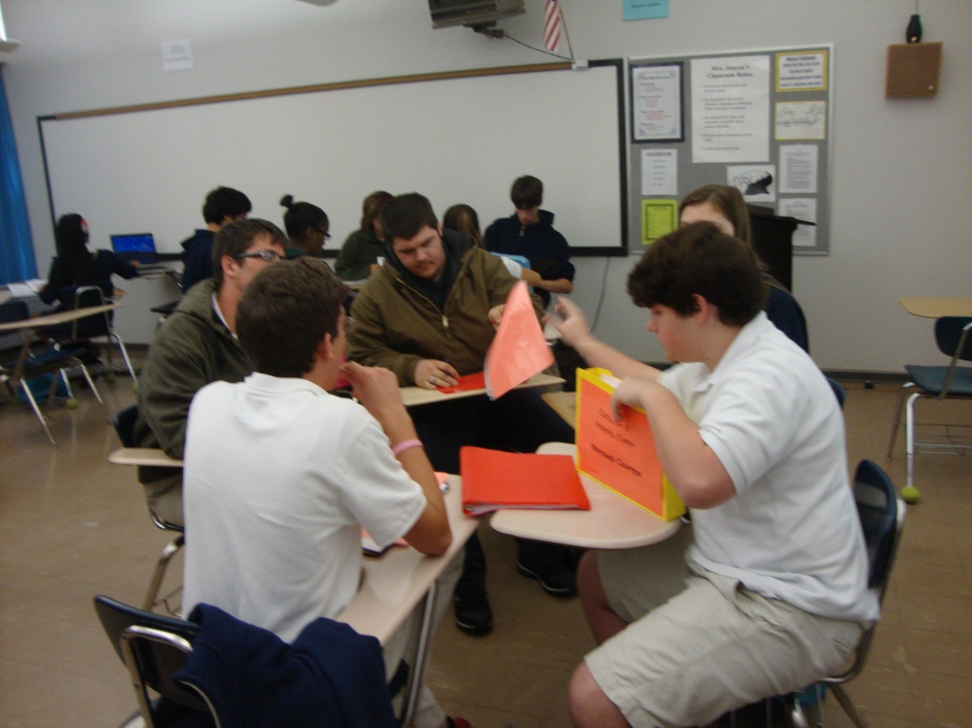
Center Direction Sheet
Notes:
Student leader gets the center folder and passes out direction sheet.

Slide 45
Center Direction Sheet
Notes:
Student leader gathers absent student’s work.

Slide 46
Center Direction Sheet
This is the most important item in the container.
Include on the direction sheet
Lesson objectives
Student expectations
What the leader should gather for absent students
Directions
What to turn in and how to turn it in
Extension activities

Slide 47
Scheduling Learning Centers

Slide 48
Frequency
You can use centers every day for the entire class period.
You can use centers for part of the class period.
You can use centers a few times a week.
You can use centers once a week.
You can use centers the day before a holiday.
You can use centers on club day, picture day, awards day, or any day a school event changes the schedule.
You can use centers as often or as seldom as you wish.

Slide 49
Frequency
You can use centers everyday for the entire class period.
Guide Book Units
Novel
Plays
You can use centers for part of the class period.
Anchor Activities
Skill Focus
Multiplication Facts/Division Facts
Comma Rules/Capitalization Rules
Notes:
My class used centers for 10 weeks. We did bell work together for five minutes. The rest of the class time was for centers.
Give specific example of comma rules skill focus centers: each group works on different rules and after 10 minutes rotate to next center.

Slide 50
Rotations
Rotate centers weekly
If you are using centers once a week
Rotate centers daily
If you are using centers daily
Rotate centers after 10-15 minutes
If you want students to visit each center during one class period
Notes:
My class rotated centers daily.

Slide 51
Developing the Lessons for Learning Centers

Slide 52
Keys to Successful Centers
Centers should be student-centered by using discovery learning.
Have students look up what key terms mean.
Have students research important events or people.
Teachers are the facilitator. He or she should visit each center to monitor progress.
Students are teaching themselves.
Centers should include opportunities for student choice.
Provide a variety of extension choices.
Have different extension activities for multiple learning styles.

Slide 53
English Learning Center
Centers based on CCSS
Writing Center
Reading Center
Non-Fiction Center
Vocabulary Center
Literary Elements Center

Slide 54
English Learning Center
Writing Center
Argumentative Essay
Expository Essay
Narrative Essay
NOTE: Have as many prompts as you will have students in a group.
Break Down
Rotation 1
Rubric Creation
Outline
Rotation 2
Rough Draft
Rotation 3
Edit
Final Draft
Turn in
Notes:
Week 1: Compare and contrast paragraph
Weeks 2-4: Write narrative essay
Weeks 5-7: Write argumentative essay
Weeks 8-10: Write expository essay

Slide 55
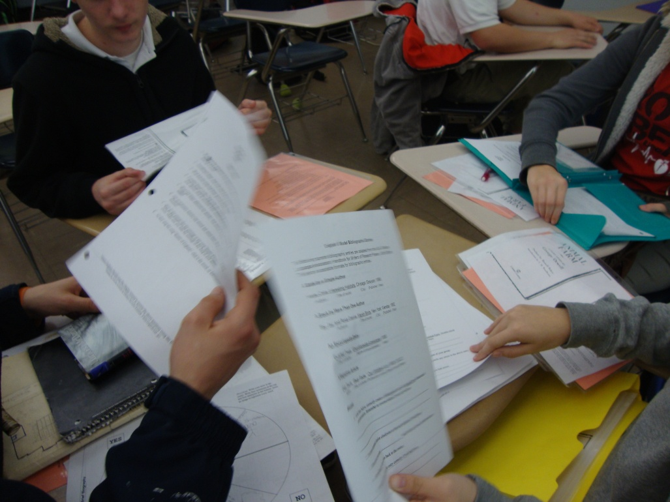
Writing Center

Slide 56
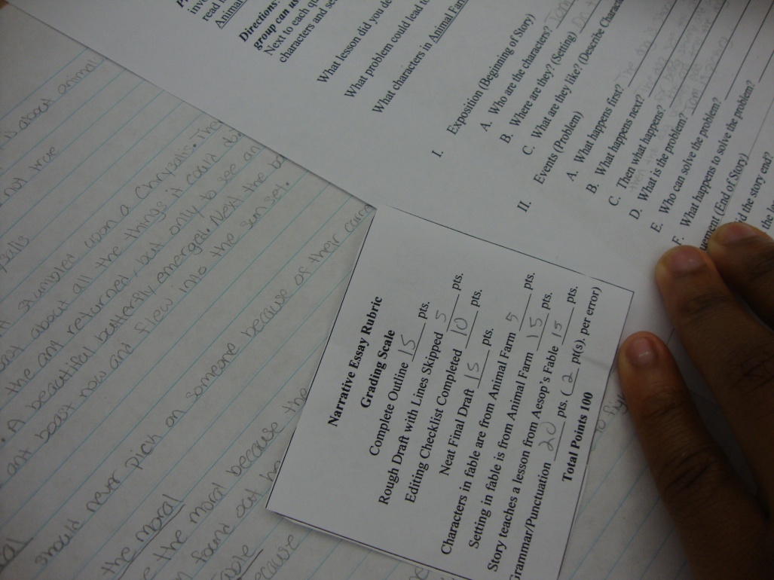
Writing Center
Notes:
Student created rubric!!!

Slide 57
English Learning Center
Reading Center
Novels
Short Stories
Plays
NOTE: Have students take turns reading aloud to members of their group
Break Down
Rotation 1
Read a chapter
Read a short story
Read part of a long short story
Read an act
Read a scene
Notes:
Read one chapter, write a question you have about the chapter, have a peer answer the question, and answer guided reading questions

Slide 58
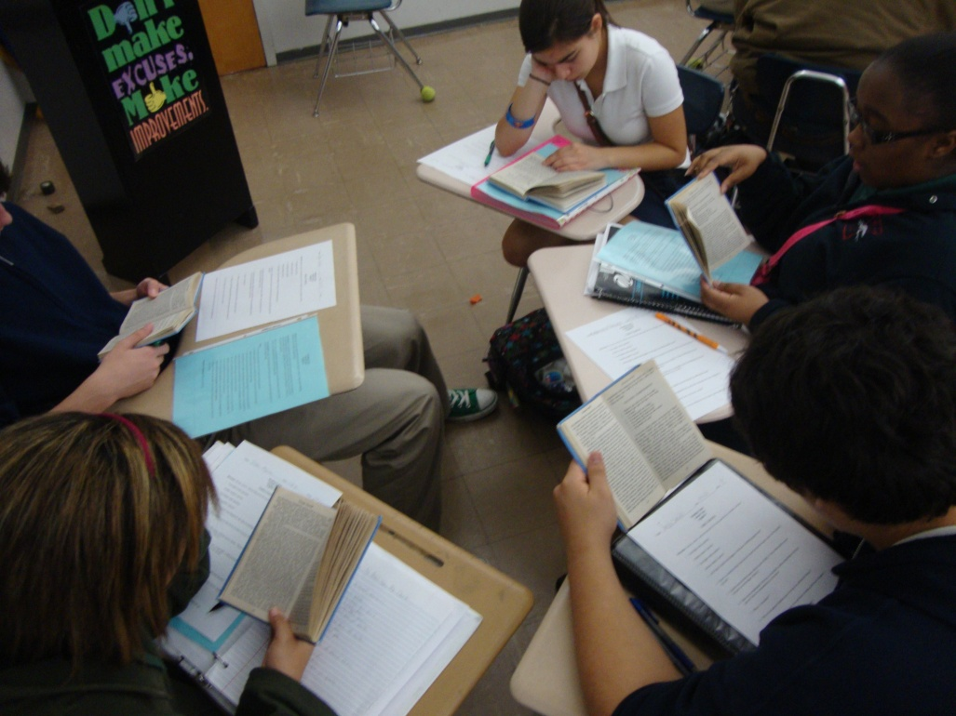
Reading Center

Slide 59
English Learning Center
Non-Fiction Center
Research people, places, history
Read non-fiction related to reading center
NOTE: Have as many research topics as you will have students in a group.
Break Down
Rotation 1
Research Notes
Rotation 2
Create presentation
Rotation 3
Present to group
Notes:
Weeks 1: Research the author
Weeks 2-5: Research, create, and present presentation of historical figure of the Russian Revolution
Weeks 6-9: Research, create, and present presentation of historical events/battles of the Russian Revolution
Week 10: Read Bill of Rights and relate each amendment to the novel Animal Farm

Slide 60
Non-Fiction Center

Slide 61
English Learning Center
Vocabulary Center
Read passage that includes the word and use context clues to determine word meaning
Confirm meaning with dictionary
Use the word (varies)
Use the word
Draw images
Compare/contrast
Real life examples
Use in a sentence
Write a RAFT about the word
Act out the word
Create a 3D object
Determine prefix, suffix, and root
Notes:
Unit words, Story words, Key words, Literary terms
Each week students learned five vocabulary words out of the same chapter as the reading center.

Slide 62
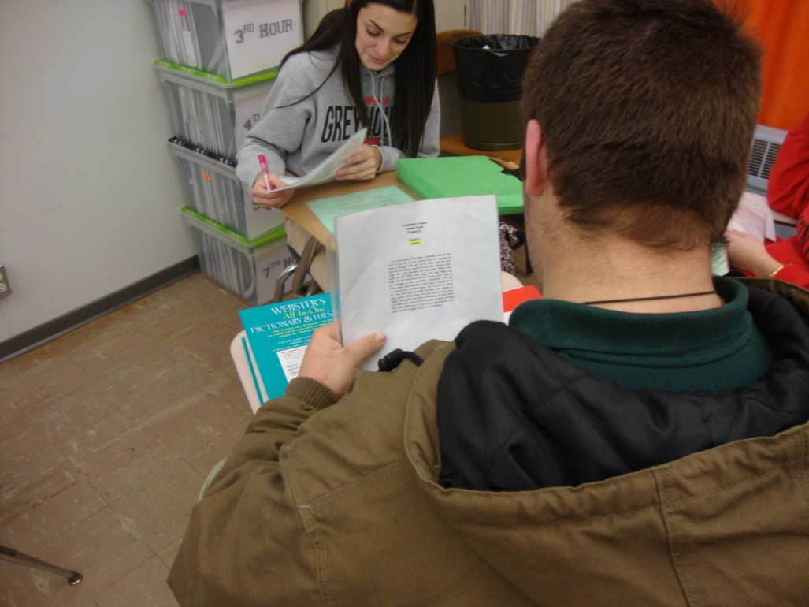
Vocabulary Center

Slide 63
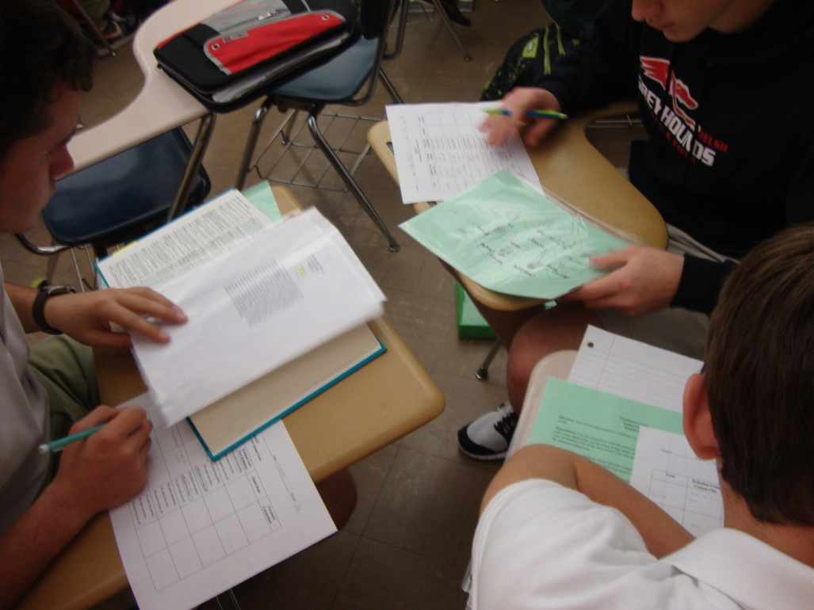
Vocabulary Center

Slide 64
English Learning Center
Literary Elements Center Examples
Propaganda
Match advertisements to the correct propaganda technique
Create an advertisement with four propaganda techniques
Notes:
Week 1: Fable Week 2: Characters of main characters Week 3-5:Propaganda
Week 6: Foreshadowing/Satire Week 7: Allegorical Parallels Week 8: Theme
Week 9: Irony and Satire Week 10: Plot Chart
You need to include the page(s) in the chapter that the students should refer to for the literary elements center.

Slide 65
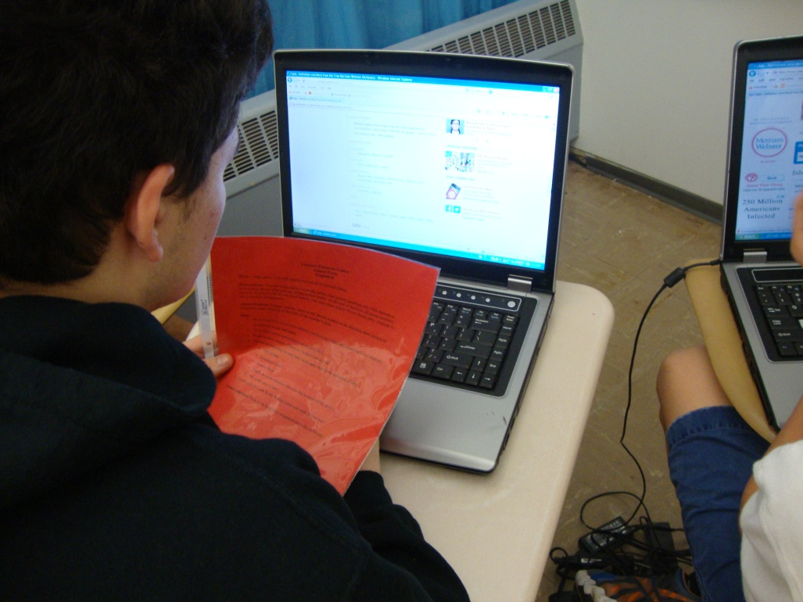
Literary Elements Center
Notes:
How will students learn if I don’t teach them? They learn for themselves.
How would students know that Animal Farm was a fable. They found the definition for fable, read examples fables, and determined why stories were fables.

Slide 66
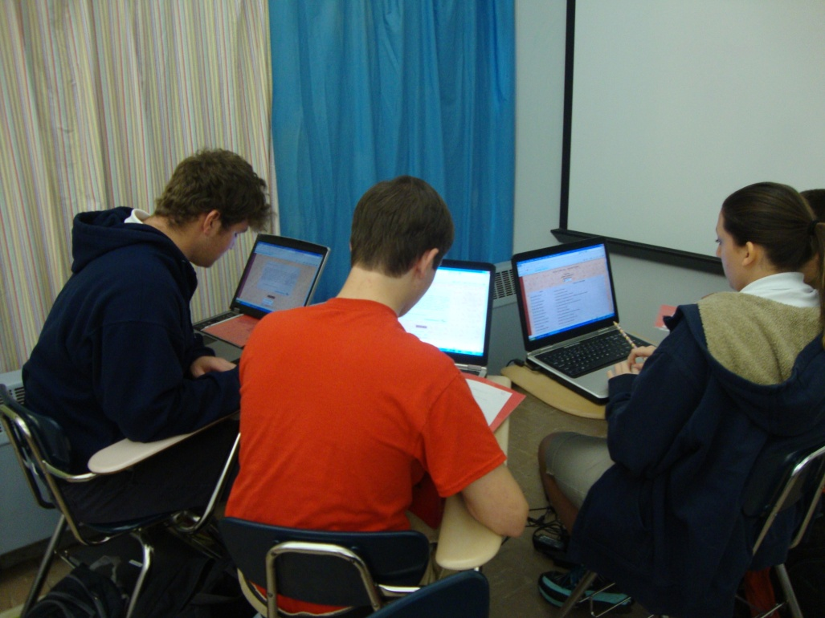
Literary Elements Center

Slide 67
Literary Elements Center

Slide 68
English Learning Center
Centers based on guide books
One center would be the extension activity
The other centers would be different lessons
Some lessons will take longer than others and will need to be divided into two centers
The amount of lessons will depend on how many centers you wish to have

Slide 69
English Learning Center
Centers based on Guide Book Unit 1 for English II
Whole group (lesson 1/Introduction to unit)
Center 1 (lesson 7/extension research task)
Center 2 (lesson 2/ethos and pathos)
Center 3 (lesson 3/logos and ethos)
Center 4 (lesson 4/pathos)
Center 5 (lesson 6/persuasion or propaganda)
Whole group (present extension task)
Whole group (summative task culminating writing task)
Whole group (lesson 8/cold-read task)
Notes:
Whole group lesson 1 introduction for 3 days.
Centers for four weeks because each center lesson takes about four classes to complete. (NOT all lessons are four days: some will have to be divided)
Whole group cold-read task for 2 days. Whole group presentations for 2 days.
Whole group culminating writing task 3 days. Total unit time six weeks.

Slide 70
Math Learning Center
Centers based on guide books
Monday: Whole class is taught a key concept.
Tuesday-Friday: Centers
Practice Problems Center
Word Problems/Real World Center
Create Word Problems Center
Write the Steps Center

Slide 71
Math Learning Center
Practice Problems Center
Group solves one problem together
Complete a couple practice problems individually
Exchange with group members to peer assess
Group talks through the practice problems to check that they are solved correctly
Students make corrections on peer’s paper
Papers are passed back to the owner to self-evaluate their understanding of the key concept

Slide 72
Math Learning Center
Word Problems Center
Group solves one word problem together
Complete a word problem individually
Exchange with group members to peer assess
Group talks through the practice problems to check that they are solved correctly
Students make corrections on peer’s paper
Papers are passed back to the owner to self-evaluate their understanding of the key concept

Slide 73
Math Learning Center
Create Word Problems Center
Each student creates one word problem that would relate to a real world situation (They may view an example word problem.)
Group members exchange word problems
Students solve peer’s word problem making notes or corrections in word problem as needed
Members give answered word problem back to creator to check the answer
Group discusses each problem and answer

Slide 74
Math Learning Center
Write the Steps Center
Students are given two problems
Students write out the steps, in sentences, to solve one of the problems
Students read their directions to the group, so the group can peer assess
Using the other problem, students use those directions to solve the problem to make sure the directions are correct

Slide 75
Math Learning Center
Centers based on Solving Right Triangles Unit in Geometry
Monday: Whole class is taught how to solve right triangles.
Tuesday-Friday: Centers
Student Extended Constructed Response (p 135-136)
Real-World Preparation/Research (p 133-134)
Create a constructed response word problem and solve it
Write the steps to solve right triangles

Slide 76
Helpful Center Tips
Your direction sheets might need to be revised after you see what students did not understand in your directions.
Evaluate your centers and make changes.

Slide 77
Dispel Negative Thoughts
Centers are ONLY for elementary students who want to do their work! This is just a fad ☹
I DO NOT have time to make five different lessons each day!
Students are SOOOOO going to copy off of each other!!!
How are students going to do their work if I don’t tell them what to do?!
I can’t grade all of their work; it will be too much.

Slide 78
Try out centers!

Slide 79
Center 2
Directions:
1.) Complete the handout steps to begin developing centers for your class.
2.) Talk with people around you. You can get ideas from each other.
3.) Bring back this idea to your school and spread the word about learning centers.

Slide 80
Learning Centers Increase engagement Increase learning

