Slide 1
Observations to Support
English Language Arts Instruction

Slide 2
Objectives
By the end of the session, participants will be able to:
Understand the 2014-2015 focus areas for ELA classrooms and identify how they are supported by the Compass Rubric.
Understand how student actions and teacher actions should change to support the focus areas.
Identify the tools available to support observation and feedback and understand their appropriate use.

Slide 3
Agenda
What are the focus areas for ELA in 2014-2015?
How does the Compass rubric help educators implement the necessary shifts in teacher practice?
- What do we expect to see students doing as a result? - When we observe, what shift in teacher practice do we expect to see?
What resources are available?
What are our next steps?

Slide 4
Student Focus Areas 2014-15
What should students be doing in ELA classrooms?
English Language Arts
Comprehend (access) meaningful, on grade level texts
Speak and write in response to meaningful texts

Slide 5
Agenda
What are the focus areas for ELA in 2014-2015?
How does the Compass rubric help educators implement the necessary shifts in teacher practice?
- What do we expect to see students doing as a result? - When we observe, what shift in teacher practice do we expect to see?
What resources are available?
What are our next steps?

Slide 6
What should teachers be doing differently?
ELA teachers plan, instruct and assess using:
on-level texts daily with ALL students
Increasingly challenging questions that help students comprehend text
Increasingly complex task that require students to write and speak about text
Louisiana Believes

Slide 7
ELA: Connecting Student & Teacher Actions
Pair Activity
ELA Student Focus in 2014-15
If we want students to do this in ELA/Math: | Then educators should plan, instruct, & assess using:
Comprehend (access) meaningful, on grade level texts | on-level texts daily with ALL students Increasingly challenging questions that help students comprehend text Increasingly complex tasks that require students write and speak about text
Speak and write in response to meaningful texts
Notes:
Now that we have reflected on what teachers should be doing in ELA and math classrooms, let’s take a look at the Teacher priorities for next school year and how they are reflected in the Compass rubric

Slide 8
Observing these Shifts
1c. Setting instructional outcomes
2c. Managing classroom procedures
3b. Using questioning/prompts and discussion
3c. Engaging student in learning
3d. Using assessment in instruction
Louisiana Believes
Notes:
Components of the compass rubric aligned to the shifts

Slide 9
Observing Instructional Outcomes
1c. Setting instructional outcomes
Teacher Focus
Teacher Focus
Louisiana Believes

Slide 10
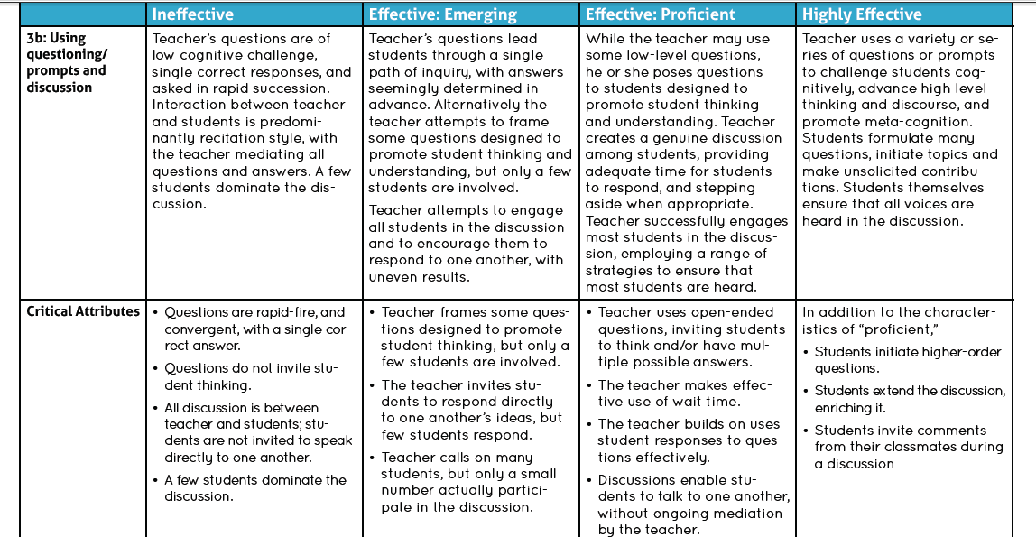
Observing Questioning
3b. Using questioning/prompts and discussion
Student Focus
Teacher Focus
Teacher Focus
Louisiana Believes

Slide 11
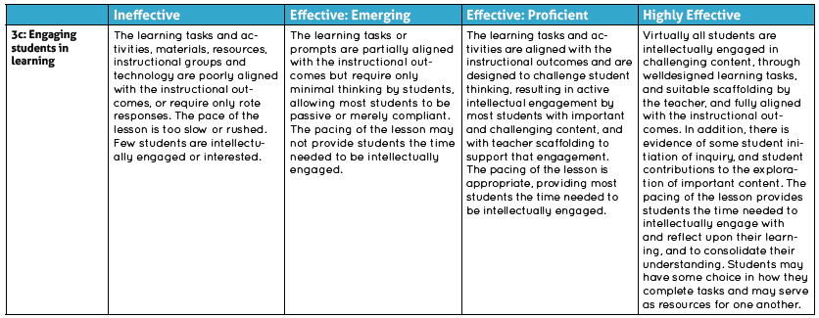
Observing Engagement (1/2)
Teacher & Student Focus
3c. Engaging students in learning
Teacher Focus
Louisiana Believes

Slide 12
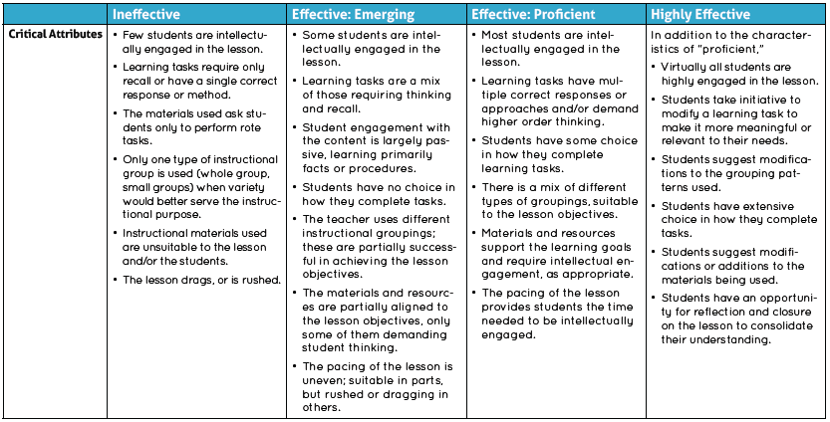
Observing Engagement (2/2)
3c. Engaging students in learning
Teacher Focus
Student Focus
Teacher Focus
Louisiana Believes

Slide 13
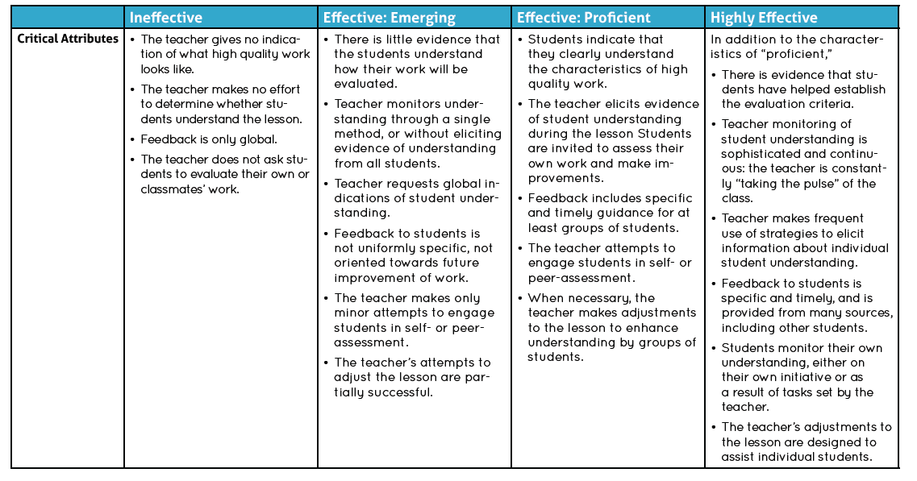
Observing Assessment
3d. Using assessment in instruction
Teacher & Student Focus
Teacher Focus
Teacher Focus
Teacher Focus
Louisiana Believes

Slide 14
What does this look like?
PAIR-SQUARE-SHARE Activity
Read Lesson 3 from the Grade 6 Unit: Steve Jobs’ Commencement Address and identify the elements and indicators that could be present in this lesson if you were to observe it. Cite supporting evidence from the lesson .
focus areas | Teacher Actions | Student Actions
Comprehend (access) meaningful, on grade level texts
Speak and write in response to meaningful texts

Slide 15
What does this look like?
PAIR-SQUARE-SHARE Activity
Focus Areas | Teacher Actions | Student Actions
Comprehend (access) meaningful, on grade level texts | Outcomes of a challenging cognitive level (1c) Lesson permits assessment of student attainment (1c) Questions of high cognitive challenge (3b) | Actively working to analyze text (3c) Thinking, problem-solving (3c)
Speak and write in response to meaningful texts | Outcomes of a challenging cognitive level (1c) Questions of high cognitive challenge (3b) Questions with multiple correct answers (3b) Effective use of student responses and ideas (3b) Discussion with teacher stepping out of central, mediating role (3b) Activities aligned with goals of lesson (3c) Tasks require high level student thinking (3c) Specially created questions to elicit evidence of student understanding (3d) | Participation in discussion (3b, 3c) Extending discussion (3b) Analysis of text claims (3d)

Slide 16
What does this look like?
Watch the video from the LDOE Video Library.
Collect evidence on Components 1c, 3b, and 3c by taking notes while watching the video.
Focus on evidence related to the student focus areas.
Collect Evidence
10th grade ELA lesson

Slide 17
Reflection
What student focus areas did you see in action in this video?
Review the video notes for the 10th grade ELA lesson you just watched.
How does observing for the student focus areas help you to rate each component?
Reflect

Slide 18
Agenda
What are the focus areas for ELA in 2014-2015?
How does the Compass rubric help educators implement the necessary shifts in teacher practice?
- What do we expect to see students doing as a result? - When we observe, what shift in teacher practice do we expect to see?
What resources are available?
What are our next steps?

Slide 19
Available Resources
Resource | Possible Uses | Rubric
CCSS Appendix B: Text Exemplars | Locating texts for building units and lessons Understanding grade-level text complexity | 1c.
CCSS Appendix C: Student Writing Samples | Understanding what grade-level writing in response to text should look like Norming teachers’ scoring of student writing | 1c., 3c.
Classroom Support Toolbox: ELA Curriculum Guidebooks | Building a curriculum that appropriately integrates ELA standards and uses appropriately complex texts Understanding how to frame questions and tasks Identifying instructional strategies that support the focus areas Understanding what an exemplar ELA lesson should contain | 1c., 3b.
Student Achievement Partners Instructional Practice Guide | Planning an ELA lesson that focuses on the focus areas Providing guidance to teachers on their lesson design | 1c.

Slide 20
Agenda
What are the focus areas for ELA in 2014-2015?
How does the Compass rubric help educators implement the necessary shifts in teacher practice?
- What do we expect to see students doing as a result? - When we observe, what shift in teacher practice do we expect to see?
What resources are available?
What are our next steps?

Slide 21
Next Steps
Making a Plan
What two things should you be able to observe in ELA classes in 2014-2015?
How does the Compass rubric support these two focus areas?
How can you use the observation and feedback cycle to help teachers make these shifts?

Slide 22
Questions?
Contact:
Compass@la.gov
or visit
http://www.louisianabelieves.com/teaching/compass

