Slide 1
Observations to Support Mathematics Instruction

Slide 2
Objectives
By the end of the session, participants will be able to:
Understand 2014-2015 focus areas for mathematics classrooms and identify how they are supported by the Compass Rubric.
Understand how student actions and teacher actions should change to support the focus areas.
Identify the tools available to support observation and feedback and understand their appropriate use.

Slide 3
Agenda
What are the focus areas for mathematics in 2014-2015?
How does the Compass rubric help educators implement the necessary shifts in teacher practice?
- What do we expect to see students doing as a result? - When we observe, what shift in teacher practice do we expect to see?
What resources are available?
What are our next steps?

Slide 4
Student Focus Areas 2014-15
What should students be doing in math classrooms?
Mathematics
Master priority concepts and practice standards (not just procedures)
Master targeted remedial content that allows faster on grade level practice

Slide 5
What should teachers be doing differently?
Math teachers plan, instruct and assess using:
Tasks that build conceptual understanding of priority standards
Tasks that require fluency and use of math practices to master concepts
Just enough remediation to help students practice on grade level content as quickly as possible

Slide 6
Math: Connecting Student & Teacher Actions
Pair Activity
If we want students to do this in ELA/Math: | Then educators should plan, instruct, & assess using:
Master priority concepts and practice standards (not just procedures) | Tasks that build conceptual understanding of priority standards Tasks that require fluency and use of math practices to master concepts Just enough remediation to help students practice on level content as quickly as possible
Master targeted remedial content that allows faster on grade level practice

Slide 7
Observing these Shifts
1c. Setting instructional outcomes
2c. Managing classroom procedures
3b. Using questioning/prompts and discussion
3c. Engaging student in learning
3d. Using assessment in instruction

Slide 8
Student Focus 2014-15
Mathematics
Master priority concepts and practice standards (not just procedures).
Master targeted remedial content that allows faster on grade level practice

Slide 9
Priority Content
How do I know what content to prioritize?
Where do I find the priority content?

Slide 10
Priority Content: K - 2
Grade | Content Focus
K | Representing and comparing whole numbers, initially with sets of objects Describing shapes and space
1 | Developing understanding of addition, subtraction, and strategies for addition and subtraction within 20 Developing understanding of whole number relationships and place value, including grouping in tens and ones Developing understanding of linear measurement and measuring lengths as iterating length units Reasoning about attributes of, and composing and decomposing geometric shapes
2 | Extending understanding of base-ten notation Building fluency with addition and subtraction Using standard units of measure Describing and analyzing shapes

Slide 11
Priority Content: 3 – 5
Grade | Content Focus
3 | Developing understanding of multiplication and division and strategies for multiplication and division within 100 Developing understanding of fractions, especially unit fractions (fractions with numerator Developing understanding of the structure of rectangular arrays and of area describing and analyzing two-dimensional shapes
4 | Developing understanding and fluency with multi-digit multiplication, and developing understanding of dividing to find quotients involving multi-digit dividends Developing an understanding of fraction equivalence, addition and subtraction of fractions with like denominators, and multiplication of fractions by whole numbers Understanding that geometric figures can be analyzed and classified based on their properties, such as having parallel sides, perpendicular sides, particular angle measures, and symmetry
5 | Developing fluency with addition and subtraction of fractions, and developing understanding of the multiplication of fractions and of division of fractions in limited cases (unit fractions divided by whole numbers and whole numbers divided by unit fractions) Extending division to 2-digit divisors, integrating decimal fractions into the place value system and developing understanding of operations with decimals to hundredths, and developing fluency with whole number and decimal operations; and (3) developing understanding of volume.

Slide 12
Priority Content: 6 – 8
Grade | Content Focus
6 | Connecting ratio and rate to whole number multiplication and division and using concepts of ratio and rate to solve problems Completing understanding of division of fractions and extending the notion of number to the system of rational numbers, which includes negative numbers Writing, interpreting, and using expressions and equations; and (4) developing understanding of statistical thinking
7 | Developing understanding of and applying proportional relationships Developing understanding of operations with rational numbers and working with expressions and linear equations Solving problems involving scale drawings and informal geometric constructions, and working with two- and three-dimensional shapes to solve problems involving area, surface area, and volume; and (4) drawing inferences about populations based on samples
8 | Formulating and reasoning about expressions and equations, including modeling an association in bivariate data with a linear equation, and solving linear equations and systems of linear equations Grasping the concept of a function and using functions to describe quantitative relationships Analyzing two- and three-dimensional space and figures using distance, angle, similarity, and congruence, and understanding and applying the Pythagorean Theorem.

Slide 13
Priority Content: High School
Grade | Content Focus
Algebra I | Analytic geometry of lines; adding, subtracting, and multiplying polynomials Transforming expressions and chunking (seeing parts of an expression as a single object)
Geometry | Transformational geometry; proofs Triangle congruence and similarity criteria Coordinate geometry (for use in proofs) Geometric constructions Modeling with geometric concepts
Algebra II | Complex numbers Rational expressions Equations, and functions Sequences and series (recursive and explicit formulas)

Slide 14
Priority Content – Grade Level Fluencies
Grade | Required Fluency by Grade
K | Add and subtract within 5
1 | Add and subtract within 10
2 | Add and subtract within 20 ; Add and subtract within 100 (paper and pencil)
3 | Multiply / divide within 100; Add/subtract within 1,000
4 | Add / subtract within 1,000,000
5 | Multi-digit multiplication
6 | Multi – digit division; Multi – digit decimal operations
7 | Solve px+q=r, p(x+q)=r
8 | Solve simple 2x2 systems by inspection

Slide 15
Focus: Priority Content
Activity
THINK – PAIR – SHARE
How will teachers know what to prioritize?
How is this teacher action observed?

Slide 16
Observation - Priority Content
Teacher Focus
Teacher Focus
Teacher Focus

Slide 17
Student Focus 2014-15
Mathematics
Master priority concepts and practice standards (not just procedures)
Master targeted remedial content that allows faster on grade level practice
Notes:
Melissa

Slide 18
Mastery of Remedial Content
What does “just enough” remediation look like in terms of student actions?
Activity
Read pages 11-12 from the Math Guidebook. Discuss with a partner:
How is this a change in practice?
What teacher/student actions are described?
Notes:
Melissa
This will introduce the shift that teachers need to make in order to respond to the 2nd focus area.

Slide 19
Agenda
What are the focus areas for mathematics in 2014-2015?
How does the Compass rubric help educators implement the necessary shifts in teacher practice?
- What do we expect to see students doing as a result? - When we observe, what shift in teacher practice do we expect to see?
What resources are available?
What are our next steps?
Notes:
Melissa

Slide 20
What should students be doing?
CCSS MATH PRACTICES
Make sense of problems and persevere in solving them
Reason abstractly and quantitatively
Construct viable arguments and critique the reasoning of others
Model with mathematics
Use appropriate tools strategically
Attend to precision
Look for and make use of structure
Look for and express regularity in repeated reasoning

Slide 21
What should teachers be doing?
Math teachers plan, instruct and assess using:
Tasks that build conceptual understanding of priority standards
Tasks that require fluency and use of math practices to master concepts
Just enough remediation to help students practice on grade level content as quickly as possible

Slide 22
Observation - Building Conceptual Understanding
Teacher Focus

Slide 23
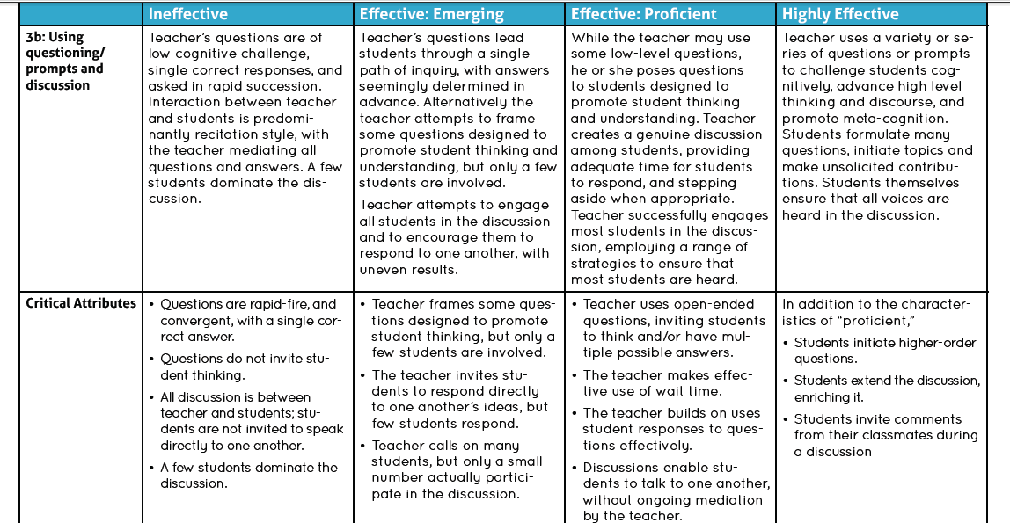
Observation – Building Conceptual Understanding
Teacher Focus
Student Focus
Teacher Focus

Slide 24
Teacher & Student Actions – Building Conceptual Understanding
What does it look like for students to engage in math practices?
Activity
Watch the video from the LDOE Video Library.
Collect evidence of student and teacher actions throughout.
Note evidence of students engaging in math practices.

Slide 25
What should teachers be doing?
Plan, instruct and assess using:
Tasks that build conceptual understanding of priority standards
Tasks that require fluency and use of math practices to master concepts
Just enough remediation to help students practice on grade level content as quickly as possible

Slide 26
Teacher Actions - Use of Math Practices
What teacher actions support this shift?
What

Slide 27
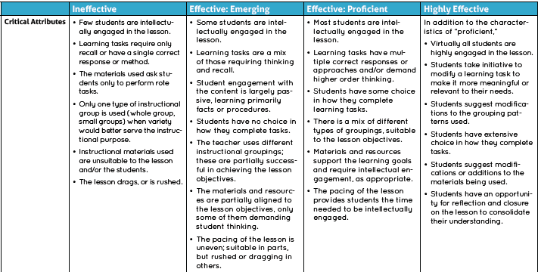
Observation – Fluency & Math Practices
Teacher Focus
Student Focus

Slide 28
Student Actions –Math Practices
What teacher actions support reflect this shift?
Activity
Watch the video from the LDOE Video Library.
Collect evidence of teacher and student actions throughout.
Note evidence of the teacher actions that build conceptual understanding.

Slide 29
What should teachers be doing?
Plan, instruct and assess using:
Tasks that build conceptual understanding of priority standards
Tasks that require fluency and use of math practices to master concepts
Just enough remediation to help students practice on grade level content as quickly as possible

Slide 30
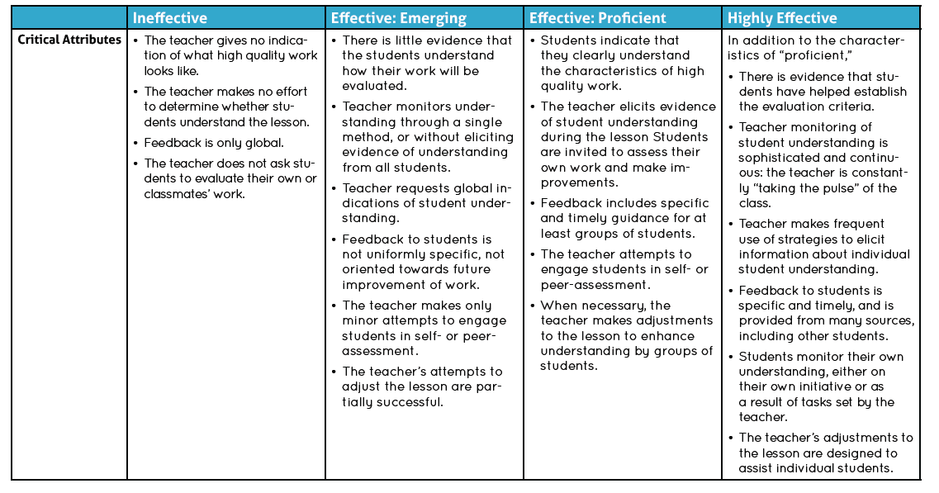
Observing – Mastery of Remedial Content
Teacher & Student Focus
Teacher Focus
Teacher Focus
Teacher Focus

Slide 31
Teacher Actions - Providing Remediation
What teacher actions reflect this shift?
Activity
THINK – PAIR – SHARE
In the area/perimeter video (slide 23) what evidence of this type of remediation did you see?
2) What student actions did you see?

Slide 32
Agenda
What are the focus areas for mathematics in 2014-2015?
How does the Compass rubric help educators implement the necessary shifts in teacher practice?
- What do we expect to see students doing as a result? - When we observe, what shift in teacher practice do we expect to see?
What resources are available?
What are our next steps?

Slide 33
Aligned Resources
Teacher Actions | Compass Rubric Alignment | Teacher Resources
Priority Content | 1c. | Common Core State Standards Assessment Guides Module 2: Focus and Coherence – The First Two CCSSM Shifts PARCC Model Content Frameworks
Conceptual Understanding | 1c., 3b. | Module 3: Rigor – The Third CCSSM Shift K-12 Math Tasks
Fluency | 3c. | Module 3: Rigor – The Third CCSSM Shift
Math Practices | 3c. | Standard for Mathematical Practice Teacher Toolbox
Remediation | 3d. | Math Guidebooks K-12 Math Remediation Recommendations
Other Resources |  | Video Library School Achievement Partners

Slide 34
Agenda
What are the focus areas for mathematics in 2014-2015?
How does the Compass rubric help educators implement the necessary shifts in teacher practice?
- What do we expect to see students doing as a result? - When we observe, what shift in teacher practice do we expect to see?
What resources are available?
What are our next steps?

Slide 35
Next Steps
Making a Plan
Identify key teacher actions you should be able to observe in mathematics classes in 2014-2015.
What actions should we observe in math classrooms in 2014-2015?
How does the Compass rubric support these shifts?
How can you use the observation and feedback cycle to help teachers make these shifts?

Slide 36
Questions?
Contact:
Compass@la.gov
or visit
http://www.louisianabelieves.com/teaching/compass

