Slide 1
ELA Instructional Framework and Student Work
Louisiana Teacher Leader Summit
June 3 -4, 2014

Slide 2
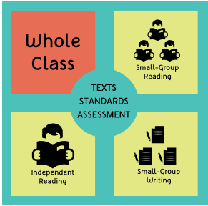
ELA Instructional Framework
To support students in developing independence with reading and communicating about complex texts, teachers should incorporate the interconnected components of the ELA Instructional Framework into their instruction.
Handout 1
Notes:
After introducing the document, have participants:
Take a minute to review handout 1 and consider the following questions:
What does this framework say about ELA Instruction?
How does this fit with what you value in the classroom?
Handout 1- the ELA Instructional Framework with definitions

Slide 3
Session Outcomes
By the end of today’s session, participants will be able to:
    Analyze an ELA Unit Plan to identify opportunities to integrate additional components of the ELA Instructional Framework effectively.
    Improve their abilities to utilize student work to inform instructional decisions within the ELA Instructional Framework.
Notes:
Review

Slide 4
Central to the Framework
Notes:
Texts, standards, and assessment permeate the rest of the framework.
These pieces are central to the effectiveness of an ELA classroom.

Slide 5
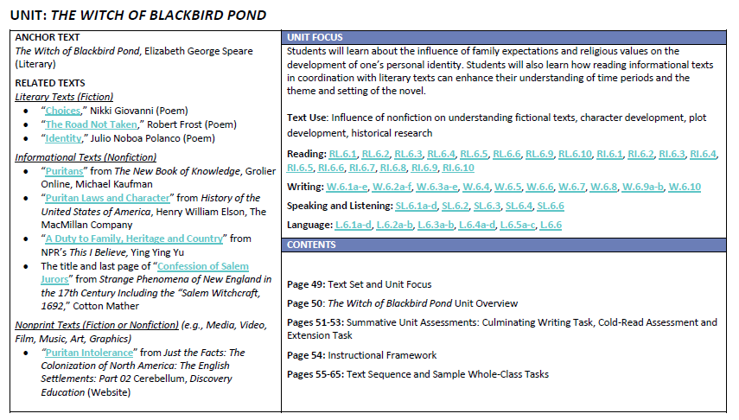
Texts, Standards, and Assessment
Handout 2, pg. 1
Notes:
Handout 2- Sample Unit Plan: Grade 6, The Witch of Blackbird Pond
Quality texts are critical for English language arts instruction. All students, even the most struggling readers, must regularly have access to texts that are at or above grade level. Texts should be varied and include fiction or literary texts, nonfiction or informational texts, and nonprint texts (e.g., art, film, songs, etc.).

Slide 6
Texts, Standards, and Assessment
Handout 2, pg. 1
Notes:
Handout 2- Sample Unit Plan: Grade 6, The Witch of Blackbird Pond
Louisiana’s ELA standards help students make meaning of text and communicate about text. They are the skills that help students process the content of text.

Slide 7
Texts, Standards, and Assessment
Handout 2, pg. 1
Notes:
Handout 2- Sample Unit Plan: Grade 6, The Witch of Blackbird Pond
Strong ELA assessments measure a students’ ability to comprehend meaningful text and effectively express their understanding of that text.

Slide 8

and Reflect…
Handout 3
Review Component 3d: Using Assessment in Instruction from the Louisiana Teacher Performance Evaluation Rubric.
Based upon your reading,
What might be some components of an effective assessment plan?
What might an effective assessment plan look and sound like in a classroom?
Notes:
Group discussion should last 3-5 minutes. Adjust time based upon participant feedback during the activity.
Share select responses whole group.

Slide 9
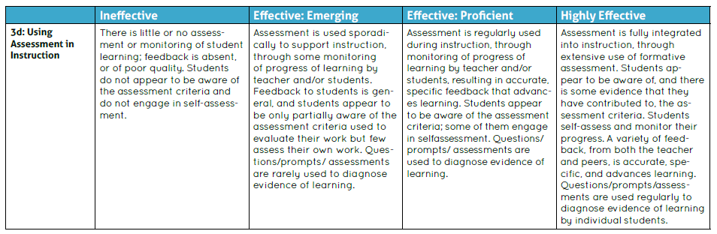
Assessment
from the Louisiana Teacher Performance Evaluation Rubric
Handout 3

Slide 10
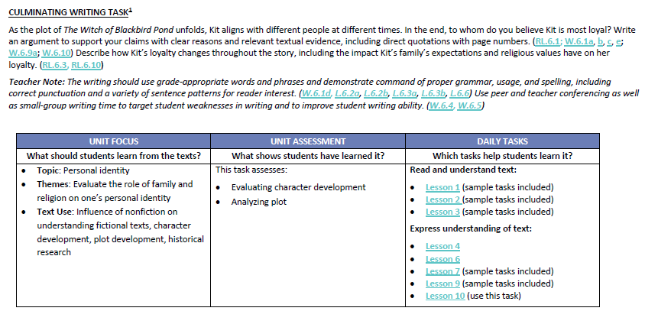
Culminating Writing Task
Handout 2, pg. 3
Notes:
The unit plans contain 3 sample summative assessments:
This is a culminating writing task that students would (usually) write at the end of unit.
It typically focuses on the anchor text and it should allow students to show they understand the anchor text.

Slide 11
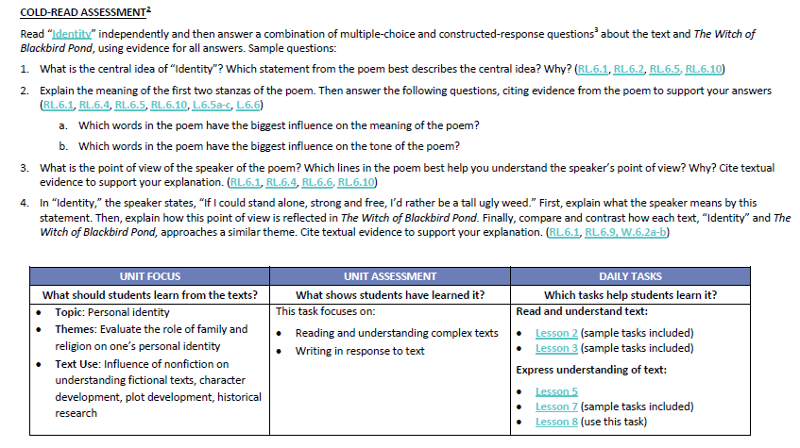
Cold-Read Assessment
Handout 2, pg. 4
Notes:
The cold-read assessment provides sample questions that students would respond to using a new text that hasn’t been read before but still connects to the anchor text or unit focus in some way.

Slide 12
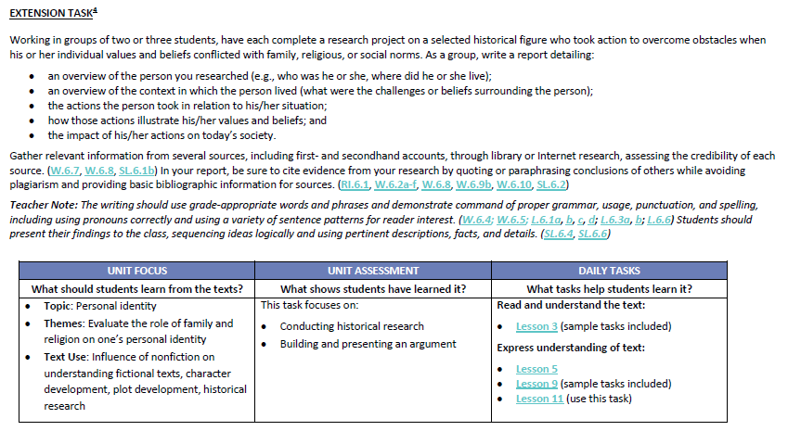
Extension Task
Handout 2, pg. 5
Notes:
This is either a research task or a writing task .
For the research task, it can (in groups or independently) extend the concepts studied in the set.
For the writing task, the writing assignment will be about the unit focus and connect several of the texts together OR is some kind of personal narrative that is related to the anchor and focus but not necessarily about the actual texts in the unit.
**Extension tasks are for ALL students, not just “advanced” students.

Slide 13
Assessment
from the Louisiana Teacher Performance Evaluation Rubric
Handout 3

Slide 14
Assessment Uses
Summative Assessment: to gather evidence of mastery or proficiency at the end of a cycle of instruction
Formative Assessment: feedback from students that is used to guide and inform future instruction
Handout 4

Slide 15
“From judging performance to guiding students to shaping instruction to informing learning, coming to grips with informative assessment is one insightful journey.”
-Carol Ann Tomlinson
Notes:
Summative assessment judge student performance. They are opportunities for students to show that they have reached or exceeded important learning targets.
However, within a Unit Plan, opportunities for informative (formative) assessment can guide, shape, and inform student learning so that a teacher can better ensure that each individual student will be equipped with the knowledge and skills needed to reach or exceed learning targets at the end of a unit.

Slide 16
Texts, Standards, and Assessment
Handout 2, pg. 1
Notes:
Handout 2- Sample Unit Plan: Grade 6, The Witch of Blackbird Pond
Going back to the unit plan, you’ll see that summative assessments are clearly labeled while opportunities for formative assessments are not.
A teacher must analyze the unit plan in order to determine opportunities to gather evidence of mastery of objectives along the way.
Let’s look at a small piece.

Slide 17
Culminating Writing Task
Handout 2, pg. 3
Notes:
I’ll just focus on preparing students for the culminating writing task for the purposes of today’s session
Read through the task,
Think aloud:
I see that
It’s a literary analysis task (PARCC PBA Session 1)
Students need to understand the “moderately complex” text, The Witch of Blackbird Pond, specifically the character, Kit, and her relationships with other characters as impacted by the events in the novel. RL.6.3
They need to be able to support claims with clear reasons and textual evidence including direct quotations
Use appropriate language conventions
But what are my expectations for what student success will actually look like? What criteria will I use to evaluate student responses?

Slide 18
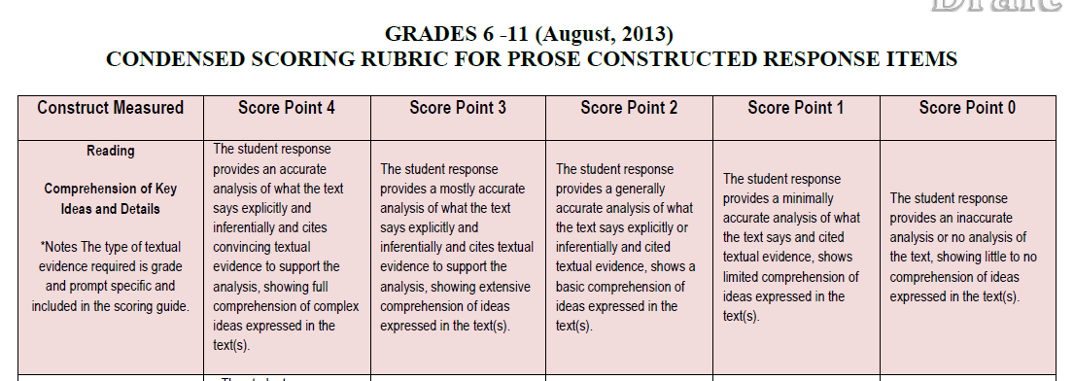
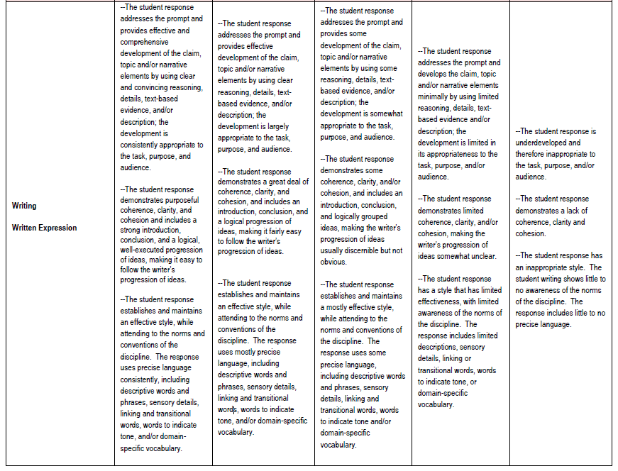
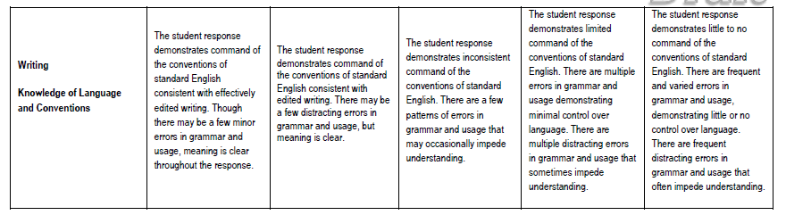
PARCC Draft Scoring Rubric
Handout 5

Slide 19
Assessment Plan Development
In order for students to be successful on the Culminating Writing Task, we must use formative assessment opportunities to shape instruction and inform learning for each individual student throughout the unit.
Handout 6

Slide 20
Framework Connections
Progress within the assessment plan will determine individual student needs for small-group reading and small-group writing.

Slide 21

and Analyze…
AllWrite Round Robin Structure Notes:
In a clockwise manner, take turns sharing responses to the question.
All participants should record agreed upon answers on their own papers.
Continue to share until time expires.
Handout 6
Notes:
Group discussion should last 3-5 minutes. Adjust time based upon participant feedback during the activity.
Share select responses whole group.

Slide 22
and Analyze…
Review standard RL.6.3 and the summative assessment task.
Based upon your reading,
What are some sub skills that students must master before they can be successful with RL.6.3?
Handout 6
Notes:
Group discussion should last 3-5 minutes. Adjust time based upon participant feedback during the activity.
Share select responses whole group.

Slide 23
Sample Sub Skills for RL.6.3
Identify traits of major characters as they change throughout a text
Identify character traits of major characters
Describe the plot of the story
RL.5.3: compare and contrast two or more characters, settings, or events
Define terms such as character, trait, events, plot
Handout 6

Slide 24
Culminating Writing Task
Handout 2, pg. 3
Notes:
Analyze the daily tasks to determine student need, gather evidence of progress towards mastery, and determine needs for small group instruction
Today we’ll just focus on RL.6.3

Slide 25
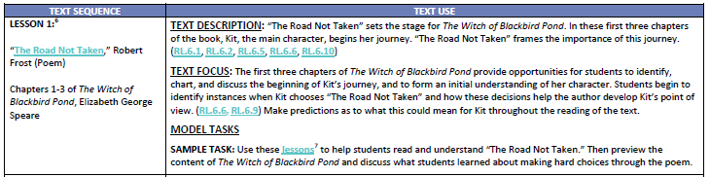
Unit Plan Lesson 1
What potential formative assessment opportunities do we see here?
Handout 2, pg. 7
Notes:
Model and explain; question

Slide 26
Student Work Analysis
Look
Listen
Speak
Notes:
Model and explain; question

Slide 27
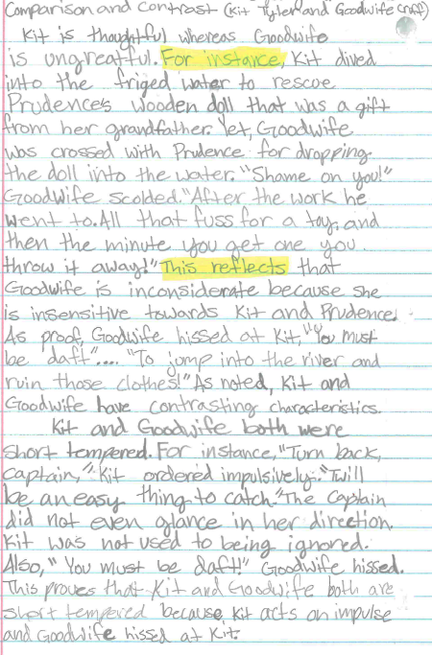
SW Analysis
Look at the Assignment:
Is the assignment a match for what students need to know, understand, and be able to do?
What skill or subskill does it assess?
Handout 7
Notes:
Criteria, standards, text, rigor
Model and explain; question

Slide 28
SW Analysis
Listen to
the Work:
How does the assignment show student understanding of the thinking behind the assignment?
Handout 7
Notes:
Criteria, standards, text, rigor
Model and explain; question

Slide 29
SW Analysis
Listen to
the Work:
How accurate is the student in selecting the best answers and utilizing the most specific evidence?
Handout 7
Notes:
Criteria, standards, text, rigor
Model and explain; question

Slide 30
SW Analysis
Speak Instructional Decisions
What (if any) additional support will the student require through small group instruction?
Handout 7-8
Notes:
Criteria, standards, text, rigor
Model and explain; question

Slide 31
SW Analysis
Speak Instructional Decisions
What (if any) extension opportunities will the student require through small group instruction?
Handout 7-8
Notes:
Criteria, standards, text, rigor
Model and explain; question

Slide 32
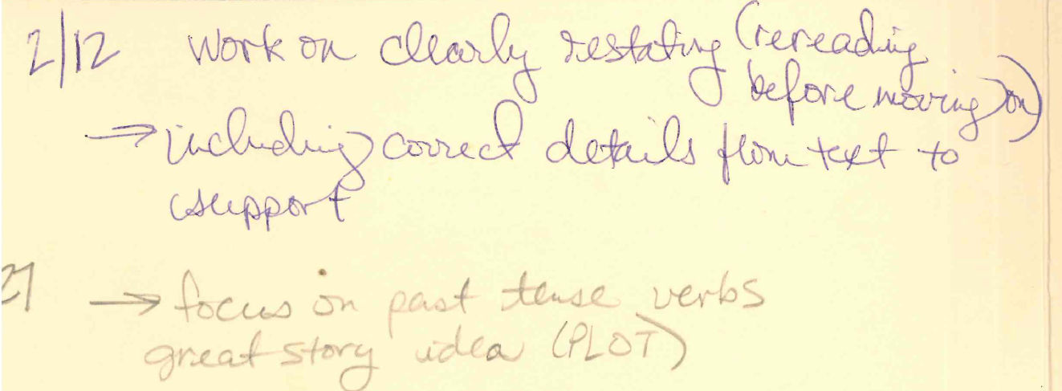
Small-Group Writing
Reilly’s Writer’s Conference:
Handout 8
Notes:
Model and explain; question

Slide 33
Framework Connections
How does student work analysis contribute to the implementation of all aspects of the ELA Instructional Framework?

Slide 34

and Try It Out…
AllWrite Consensus Structure Notes:
In a clockwise manner, take turns sharing responses to the question.
After reaching consensus, participants record each answer on their own paper.
Repeat for each question.
Handout 9
Notes:
Share select responses whole group as needed/as time allows

Slide 35
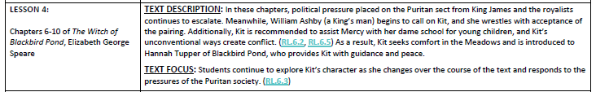
Unit Plan Lesson 4
What potential formative assessment opportunities do we see here?
Handout 2, pg. 12

Slide 36
Student Work Analysis
Look
Listen
Speak

Slide 37
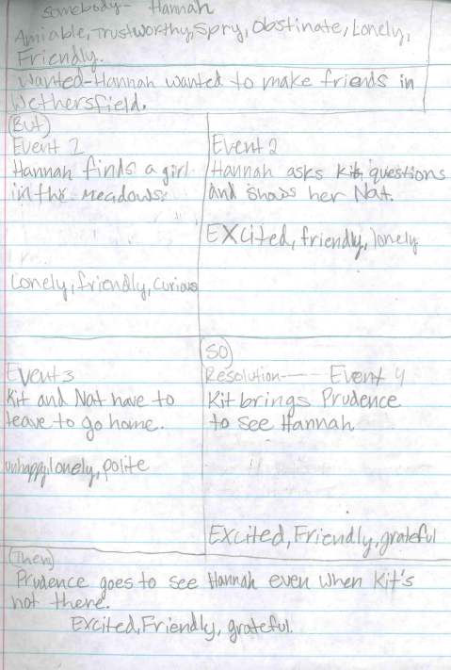
SW Analysis
Look at the Assignment:
Is the assignment a match for what students need to know, understand, and be able to do?
Handout 10
Notes:
Criteria, standards, text, rigor

Slide 38
SW Analysis
Listen to
the Work:
How does the assignment show student understanding of the thinking behind the assignment?
Handout 10
Notes:
Criteria, standards, text, rigor

Slide 39
SW Analysis
Listen to
the Work:
How accurate is the student in selecting the best answers and utilizing the most specific evidence?
Handout 10
Notes:
Criteria, standards, text, rigor

Slide 40
SW Analysis
Speak Instructional Decisions
What (if any) additional support will the student require through small group instruction?
Handout 10
Notes:
Criteria, standards, text, rigor

Slide 41
SW Analysis
Speak Instructional Decisions
What (if any) extension opportunities will the student require through small group instruction?
Handout 10
Notes:
Criteria, standards, text, rigor

Slide 42
and Reflect…
How does student work analysis help you determine next steps for small-group reading and small-group writing instruction?

Slide 43
and Reflect…
How does student work analysis help ensure effective use of text, standards, and assessment?

Slide 44
Session Outcomes
By the end of today’s session, participants will be able to:
    Analyze an ELA Unit Plan to identify opportunities to integrate additional components of the ELA Instructional Framework effectively.
    Improve their abilities to utilize student work to inform instructional decisions within the ELA Instructional Framework.
Notes:
Review

Slide 45
and Reflect…
Based upon today’s learning,
Create a statement that summarizes your learning.
Identify next steps for your classroom or school.
Handout 11
Notes:
Group discussion should last 3-5 minutes. Adjust time based upon participant feedback during the activity.
Share select responses whole group.

Slide 46

and Reflect…
Share:
Your summary statement.
At least one next step you identified.
Handout 11
Notes:
Group discussion should last 3-5 minutes. Adjust time based upon participant feedback during the activity.
Share select responses whole group.

Slide 47
Essentially,
We use the unit plans to determine formative assessment opportunities in order to drive small-group reading and small-group writing instruction to meet the needs of all learners.

