Slide 1
LDC in
St. Bernard
A Teacher’s Perspective
Justin Burkhardt, Nicole Bower
Notes:
5 min

Slide 2
LDC in St. Bernard
http://www.stbernard.k12.la.us/LDC_Showcase.asp
In the 2013-2014 Academic School year, we continued to train all Secondary ELA, Science, and Social Studies teachers in the LDC framework with our in-house trainers.
www.stbernard.k12.la.usa
Notes:
Film – 10-15 mins

Slide 3
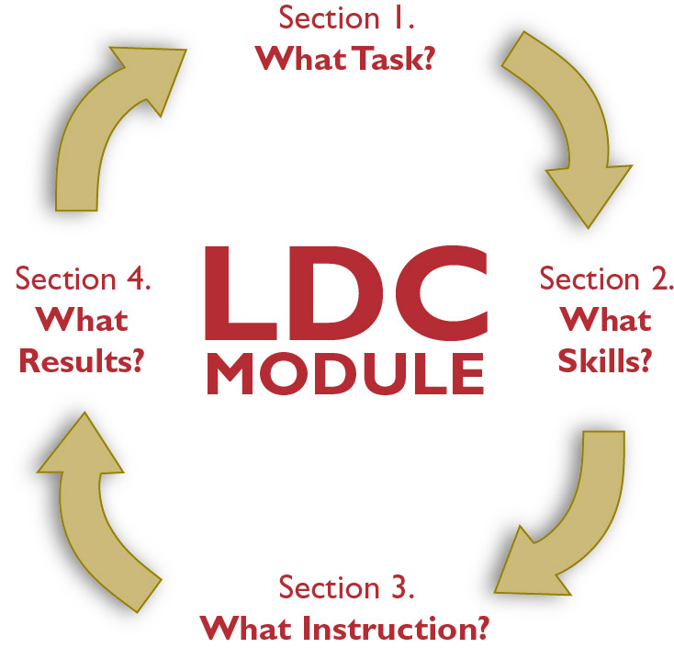
The LDC Framework
www.stbernard.k12.la.usa
Notes:
Framework underlies everything we do in curriculum
Fluidity of curriculum/instruction
5 min

Slide 4
LDC in English
What Task – Templates and CCSS
What Skills – Close Reading, CSR
What Instruction – Discussion, Socratic Seminars
What Results – Essays, AEC, Portfolios
www.stbernard.k12.la.usa
Notes:
Talk about how we develops tasks – essential questions, CCSS standards, template tasks.
Focus on two mini tasks: AEC strategy, Close reading (Student Interviews embedded within)
Reflection on handouts that fit with each mini- task (20-25 min)
Circular nature of the process
Tie-in to PARCC

Slide 5
LDC in Social Studies
What Task – Templates and CCSS, GLEs
What Skills – Bag and Tag
What Instruction – Discussion, Socratic Seminars
What Results – Essays, AEC,
www.stbernard.k12.la.usa
Notes:
How you set up a task – Literacy CCSS, 8th specific content standards GLES, template tasks
Mini tasks: bag & tag, Socratic seminars (student interviews embedded within, handouts embedded within)
Tie-in to writing tasks for the LEAP test (20-25)

Slide 6
Take-Aways
What We Learned:
Goal setting and organization
Student engagement in task
Importance of scaffolding a task and modeling
Helpful Resources
CoreTools http://ldc.org/coretools
www.stbernard.k12.la.usa
Notes:
10 min

Slide 7
Guidebooks
LDC Framework as a tool for curriculum and instruction
Connections to the state-released guidebooks
www.stbernard.k12.la.usa
Notes:
10 min

Slide 8
Questions
www.stbernard.k12.la.usa

