Slide 1
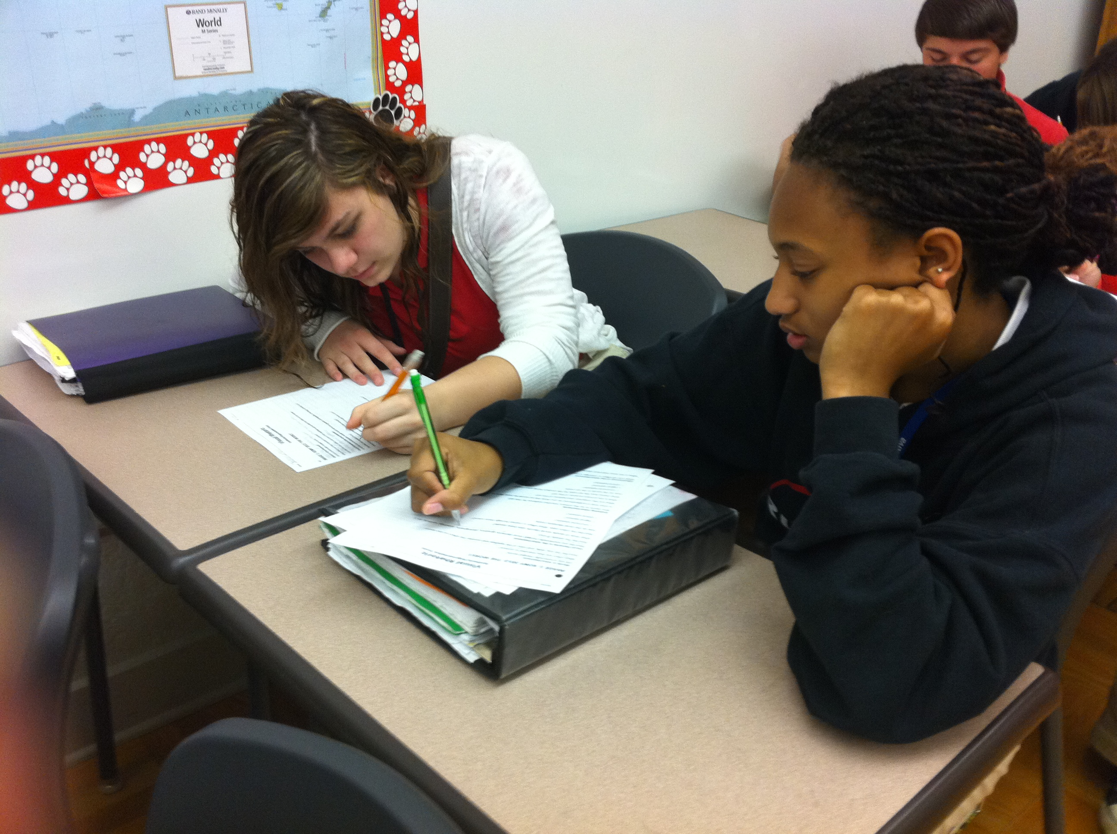
MAKING THE SHIFTS IN AN ELA CLASSROOM
2014 SUMMIT

Slide 2
Introductions
Emily Howell—2012 HS TOY
9th and 11th Grade English
Ruston High School/Lincoln Parish

Slide 3
Some Logistics…
Username– guest
Password– Welcome
Limited bandwidth—please do not access any sites except the ones for this session.

Slide 4
Instructional Vision
To meet these raised expectations, we must clarify our focus on what our students need. Specifically, we must ensure this year that our students…
Comprehend (access) meaningful, on level texts
Speak and write in response to meaningful texts

Slide 5
Day One: Ready!
This Summit will prepare teachers to make these shifts beginning the first day of the 14-15 school year. This will include focused training on…
Student Learning Targets
Assessment
Standards, curricula, and instructional strategies

Slide 6
Making the Shifts in an ELA Classroom
Romeo and Juliet
Unit for 9th Grade

Slide 7
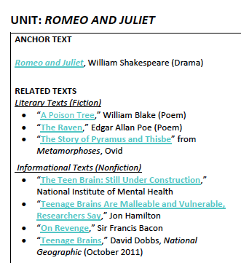
Goal for Today: A Unit in a Nutshell
Teachers will understand how to use LA DOE Resources to shift to teaching Common Core State Standards.

Slide 8
Some Shifts and Our Objectives
Notes:
Connect these to the CC shifts explicitly.

Slide 9
Essential Questions
Thematic Approach
Some Tips…
To what extent do our reactions to conflict and opposition dictate our outcomes?
How can we take healthy risks?
Begin with the end in mind.
Choose universal questions.
Everything should circle back to these questions.

Slide 10
Beginning the Unit
Teaching Annotation Skills

Slide 11
Cold Read: The Prologue
1 Class Period
Box words that you don’t know.
Replace with synonyms and re-read the text.
Take notes in the margins about details.
After class discussion, introduce annotation guide. Have students fill in the gaps.

Slide 12
During the Unit
Reading Texts Independently
Making Predictions
Student-Led Discussion

Slide 13
Some Tips…
Do…
Don’t…
Strategically pull excerpts to copy for students to annotate.
Let them read independently for some scenes (try No Fear Shakespeare).
Choose strategic film scenes to reinforce understanding.
Daily circle back to essential questions.
Ditch the original text for summaries.
Watch the movie instead of reading the text.
Make the students read every line out loud.

Slide 14
Cold Read: Act III, Scene i
2 Class Periods
See Sample Lesson Plan

Slide 15
“…analyze how complex characters (e.g. those with multiple or conflicting motivations) develop over the course of a text, interact with other characters, and advance the plot or develop the theme”
The Standards…
RL.9-10.3
“Initiate and participate effectively in a range of collaborative discussions…with diverse partners on grades 9–10 topics, texts, and issues, building on others’ ideas and expressing their own clearly and persuasively”
SL.9-10.1

Slide 16
Student Samples
Level Three Thematic Question:
How does having a peace keeper help solve a conflict?
Keep in mind that this discussion occurs mid-unit. Students are making predictions about what will happen in the play.

Slide 17
A Student-Led Discussion
How does having a peace-keeper help solve a conflict?

Slide 18
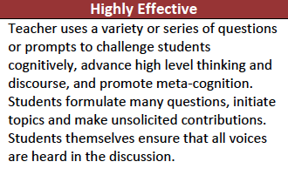
COMPASS Connection
3b: Using Questioning/Prompts and Discussion

Slide 19
Some Tips…
Do…
Don’t…
Let students prep for the discussion.
Preview their questions and give them feedback.
Award them with points for discussion.
Model good discussion techniques.
Jump in to save the day when there is awkward silence.
Control the discussion.
Let students sit out.
Let students randomly change the subject.

Slide 20
Some Templates for Discussion…
I agree with ___ when she said ___.
I would like to add to ___’s point that ___.
Although I appreciate ___’s comment, I saw it this way: ___.
___, have you ever considered the following perspective: ___?

Slide 21
At the End of the Unit…
Creating a Text-Based Response
Using Informational Texts

Slide 22
“Delineate and evaluate the argument and specific claims in a text, assessing whether the reasoning is valid and the evidence is relevant and sufficient; identify false statements and fallacious reasoning.”
The Standards…
RI.9-10.8
“Write arguments to support claims in an analysis of substantive topics or texts, using valid reasoning and relevant and sufficient evidence.”
W.9-10.1

Slide 23
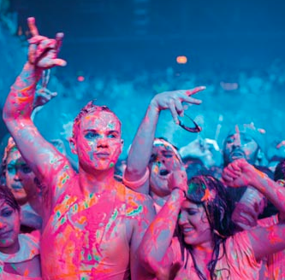
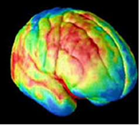
National Geographic
“Moody. Impulsive. Maddening. Why do teenagers act the way they do? Viewed through the eyes of evolution, their most exasperating traits may be the key to success as adults” (David Dobbs)
“Teenage Brains”

Slide 24
The Article
David Dobbs; National Geographic
In his article in National Geographic, David Dobbs argues that “Teens take more risks not because they don't understand the dangers but because they weigh risk versus reward differently: In situations where risk can get them something they want, they value the reward more heavily than adults do” and further asserts that “Studies show that when parents engage and guide their teens with a light but steady hand, staying connected but allowing independence, their kids generally do much better in life.”

Slide 25
The Prompt
Argumentative; Synthesis
With this in mind and using textual evidence from both the article “Teenage Brains” and Romeo and Juliet as your primary sources, answer the following questions: How could have the teens in Romeo and Juliet taken healthy risks? What responsibility should the parents, the friar, and the nurse take (if any)?

Slide 26
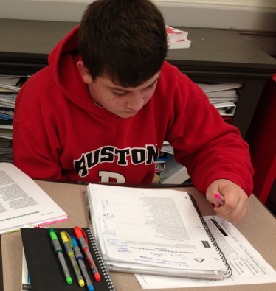
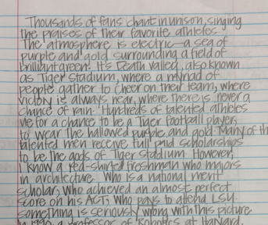
STUDENT WORK
Ruston High School/Lincoln Parish

